Slide 1
ANATOMY RESPIRATORY SYSTEM
Henry Katua

Slide 2
.
.
RESPIRATORY SYSTEM CONSISTS OF :
>UPPER RESPIRATORY TRACT(NOSE TO LARYNX)
>LOWER RESPIRATORY TRACT(TRACHEA ONWARDS)

Slide 3
ANATOMY OF THE RESPIRATORY SYSTEM.
Respiratory system includes:- - Nose and Nasal cavity.
- Pharynx.
- Larynx.
- Trachea.
- Bronchi and their smaller branches.
- Lungs.

Slide 4
.
The system consists of two zones:
The Respiratory zone, actual site of gas exchange, composed of:-
- Respiratory bronchioles,
- Alveolar ducts,
- Alveoli,
- All microscopic structure serminal air sacs, or alveoli .

Slide 5
.
The conducting zone includes all other respiratory passageways,
which provide fairly rigid conduits for air to reach the gas exchange
sites.
The conducting zone organs also cleanse, humidify, and warm
incoming air.
Thus, air reaching the lungs has fewer irritants (dust, bacteria, etc.)
than when it entered the system, and it is warm and damp.

Slide 6
.

Slide 7
.

Slide 8
THE NOSE.
(1) Provides an airway for respiration,
(2) Moistens and warms entering air,
(3) Filters and cleans inspired air,
(4) Serves as a resonating chamber for speech,
(5) Houses the olfactory (smell) receptors.

Slide 9
EXTENAL NOSE
Its upper one third is bony and lower two third are cartilaginous.
- Bony part consists of two nasal bones which meet in midline.

Slide 10
Cartilaginous part consists of
- Upper lateral cartilage: Extends from under surface of nasal bones above to alar cartilages below.
- Lower lateral cartilage(alar cartilage):it s u shaped.
- Lesser alar cartilage ( sesamoid ): lie above and lateral to alar cartilages.
- Septal cartilage

Slide 11
Muscles of nose:
ANTERIOR
- Procerus
- Nasalis
- Levator labii superioris,
- Alaque nasi.
POSTERIOR
- Dilator nares,
- Depressor septi.
These muscles help in movement of nose.

Slide 12
.
- The structures of the nose are divided into the external nose and the
internal nasal cavity.
- The surface features of the external nose include the root (area
between the eyebrows), bridge, and dorsum nasi (anterior margin).
- Just inferior to the apex is a shallow vertical groove called the
philtrum.
- The external openings of the nose, the nostrils or nares , are bounded
laterally by the flared alae.

Slide 13
.
- The skeletal framework of the external nose is fashioned by the nasal
and frontal bones superiorly.
- The maxillary bones laterally, and flexible plates of hyaline cartilage
(the lateral, septal, and alar cartilages) inferiorly.
- Noses vary a great deal in size and shape, largely because of
differences in the nasal cartilages.
- The skin covering the nose’s dorsal and lateral aspects is thin and
contains many sebaceous glands.

Slide 14
.

Slide 15
.
- The internal nasal cavity lies in and posterior to the external nose.
- During breathing, air enters the cavity by passing through the nostrils,
or nares.
- The nasal cavity is divided by a midline nasal septum, formed
anteriorly by the septal cartilage and posteriorly by the vomer bone
and perpendicular plate of the ethmoid bone.
- The nasal cavity is continuous posteriorly with the nasal portion of
the pharynx through the posterior nasal apertures, also called the
choanae.

Slide 16
.

Slide 17
.
- The roof of the nasal cavity is formed by the ethmoid and sphenoid
bones of the skull.
- The floor is formed by the palate, which separates the nasal cavity
from the oral cavity below.
- Anteriorly, where the palate is supported by the maxillary processes
and palatine bones, it is called the hard palate.
- The unsupported posterior portion is the muscular soft palate.

Slide 18
.
- The part of the nasal cavity just superior to the nostrils, called the
nasal vestibule, is lined with skin containing sebaceous and sweat
glands and numerous hair follicles.
- The hairs, filter coarse particles (dust, pollen) from inspired air.
- The rest of the nasal cavity is lined with two types of mucous
membrane.

Slide 19
.
- The olfactory mucosa, lining the superior region of the nasal cavity,
contains smell receptors.
- The respiratory mucosa, is a pseudostratified ciliated columnar
epithelium, containing scattered goblet cells, that rests on a lamina
propria richly supplied with mucous and serous glands.
- (Mucous cells secrete mucus, and serous cells secrete a watery fluid
containing enzymes.)

Slide 20
.
- These glands secrete mucus containing lysozyme, an antibacterial
enzyme.
- The sticky mucus traps inspired dust, bacteria, and other debris,
while lysozyme attacks and destroys bacteria chemically.
- The epithelial cells of the respiratory mucosa also secrete defensins,
natural antibiotics that help get rid of invading microbes.
- Additionally, the high water content of the mucus film acts to
humidify the inhaled air.

Slide 21
.
- The nasal mucosa is richly supplied with sensory nerve endings, and
contact with irritating particles (dust, pollen, and the like) triggers a
sneeze reflex.
- The sneeze forces air outward in a violent burst—a somewhat crude
way of expelling irritants from the nose.

Slide 22
.
NERVE SUPPLY:
- Olfactory nerves.
- Nerves of common sensation- ant. Ethmoidal
nerve, sphenopalatine nerve, infra orbital nerve.
- Autonomic nerves.
BLOOD SUPPLY: - Both the internal and external carotid system supply nose.

Slide 23
THE PHARYNX.
- The funnel-shaped pharynx connects the nasal cavity and mouth
superiorly to the larynx and oesophagus inferiorly.
- Commonly called the throat, the pharynx extends for about 13 cm (5
inches) from the base of the skull to the level of the sixth cervical
vertebra.

Slide 24
.
- The pharynx is divided into three regions:-
- Nasopharynx,
- Oropharynx,
- Laryngopharynx.
The muscular pharynx wall is composed of skeletal muscle throughout its length.
But the cellular composition of its mucosa varies from one pharyngeal region to
another.

Slide 25
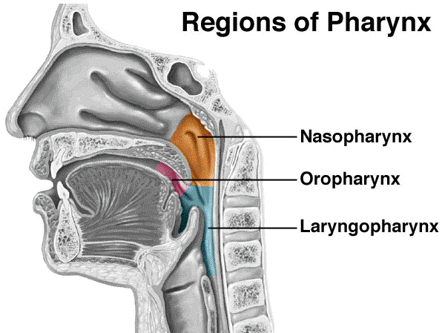
.
.

Slide 26
NASOPHARYNX.
- The nasopharynx is posterior to the nasal cavity.
- Inferior to the sphenoid bone.
- Superior to the level of the soft palate.

Slide 27
.
- It serves only as an air passageway.
- During swallowing, the soft palate and uvula move superiorly.
- An action that closes off the nasopharynx and prevents food from
entering the nasal cavity.

Slide 28
.
- The nasopharynx is continuous with the nasal cavity through the posterior nasal
apertures.
- And its pseudostratified ciliated epithelium takes over the job of propelling
mucus where the nasal mucosa leaves off.
- On its posterior wall is the pharyngeal tonsil (or adenoids), which
traps and destroys pathogens entering the nasopharynx in air.

Slide 29
THE OROPHARYNX.
- The oropharynx lies posterior to the oral cavity.
- And is continuous with it through an archway called the isthmus of the fauces.
- Because the oropharynx extends inferiorly from the level of the soft
palate to the epiglottis, both swallowed food and inhaled air pass
through it.

Slide 30
.
- As the nasopharynx blends into the oropharynx, the epithelium
changes from pseudostratified columnar to a more protective
stratified squamous epithelium.
- Two kinds of tonsils lie embedded in the oropharyngeal mucosa.
- The paired palatine tonsils lie in the lateral walls of the fauces.
- The lingual tonsil covers the base of the tongue.

Slide 31
THE LARYNGOPHARYNX.
- The laryngopharynx serves as a passageway for food and air.
- It is lined with a stratified squamous epithelium.
- It lies directly posterior to the upright epiglottis.
- And extends to the larynx, where the respiratory and digestive pathways diverge.

Slide 32
.
At that point the laryngopharynx is continuous with the oesophagus
posteriorly.
- The oesophagus conducts food and fluids to the stomach; air enters
the larynx anteriorly.
- During swallowing, food has the “right of way,” and air passage
temporarily stops.

Slide 33
THE LARYNX.
The larynx , or voice box, extends for about 5 cm (2 inches) from the
level of the third to the sixth cervical vertebra.
- Superiorly it attaches to the hyoid bone and opens into the
laryngopharynx.
- Inferiorly it is continuous with the trachea .

Slide 34
.
- The larynx has three functions:-
- To provide (open) airway
- To switching mechanism
- To route air and food into the proper channels.
- Because it houses the vocal cords, the third function of the larynx is
voice production.

Slide 35
.
- The framework of the larynx is in arrangement of nine cartilages
connected by membranes and ligaments.
- Except for the epiglottis, all laryngeal cartilages are hyaline cartilages.
- The large, thyroid cartilage is formed by the fusion of two cartilage
plates.

Slide 36
.
- The midline laryngeal prominence , which marks the fusion point, is
obvious externally as the Adam’s apple.
- The thyroid cartilage is typically larger in males than in females
because male sex hormones stimulate its growth during puberty.
- Inferior to the thyroid cartilage is the cricoid cartilage , perched atop
and anchored to the trachea inferiorly.

Slide 37
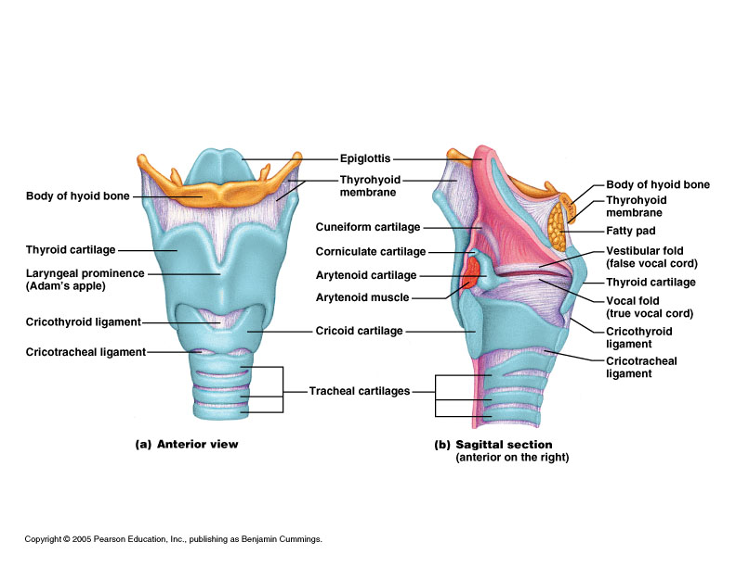

Slide 38
Muscles of larynx
Intrinsic muscles of larynx: Muscle Function 1. Posterior cricoarytenoid 1. Abductor of vocal cords 2. Lateral cricoarytenoid 2. Adducts arytenoids closing glottis 3. Transeverse arytenoid 3. Adducts arytenoids 4. Oblique arytenoid 4. Closes glottis 5. Aryepiglottic 5. Closes glottis 6. Vocalis 6. Relaxes the cords 7. Thyroarytenoid 7. Relaxes tension cords 8. Cricothyroid 8. Tensor of the cords

Slide 39
Extrinsic muscles of larynx:
Muscle Function 1. Sternohyoid 1. Indirect depressor of the larynx 2. Sternothyroid 2. Depresses the larynx 3. Thyrohyoid 3. Depresses the larynx 4. Thyroepiglottic 4. Inversion of aryepiglottic fold 5. Stylopharyngeus 5. Assists folding of thyroid cartilage 6. Inferior pharyngeal constrictor 6. Assists in swallowing

Slide 40
nerve supply of larynx
- SENSORY – Above the vocal cord – Superior laryngeal nerve.
Below the vocal cord - Recurrent laryngeal nerve.
- MOTOR – All intrinsic muscle of the larynx are supplied by RLN except
cricothyroid which is supplied by external laryngeal nerve which is a
branch of SLN.
Both SLN & RLN are branches of vagus nerve.

Slide 41
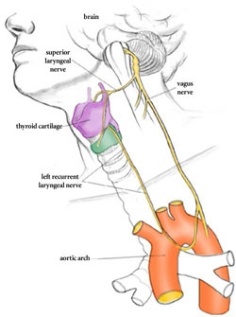
.

Slide 42
Arterial supply & venous drainage
ABOVE THE VC - Superior laryngeal artery, a branch of superior thyroid
artery.
Superior laryngeal vein, drains into superior thyroid vein
BELOW THE VC – Inferior laryngeal artery, a branch of inferior thyroid artery.
Inferior laryngeal vein, drains into Inferior thyroid vein.
lymphatic drainage
ABOVE THE VC - Pre laryngeal & Jugular – Digastric LN.
BELOW THE VC – Pre tracheal & Para tracheal LN.

Slide 43
THE TRACHEA.
- The trachea , or windpipe, descends from the larynx through the
neck and into the mediastinum.
- It ends by dividing into the two main bronchi at mid thorax.
- In humans, it is 10–12 cm (about 4 inches) long and 2 cm (3/4 inch) in
diameter, and very flexible and mobile.

Slide 44
.
- The tracheal wall consists of several layers that are common to many
tubular body organs—the mucosa, submucosa, and adventitia.
- The mucosa contains pseudostratified epithelium.
- Its cilia continually propel debris-laden mucus toward the pharynx.
- This epithelium rests on a thick lamina propria that has a rich supply
of elastic fibers.

Slide 45
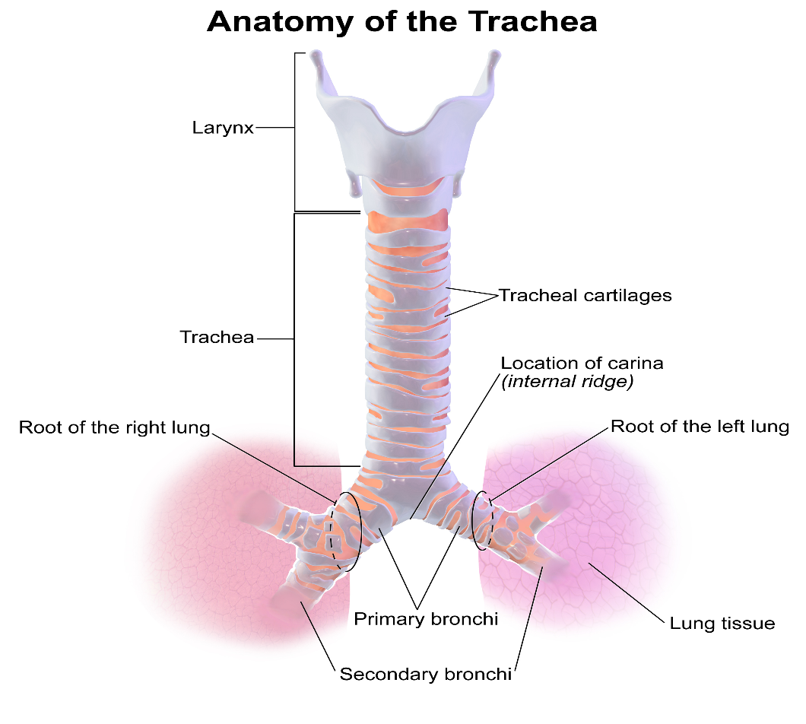
.
.

Slide 46
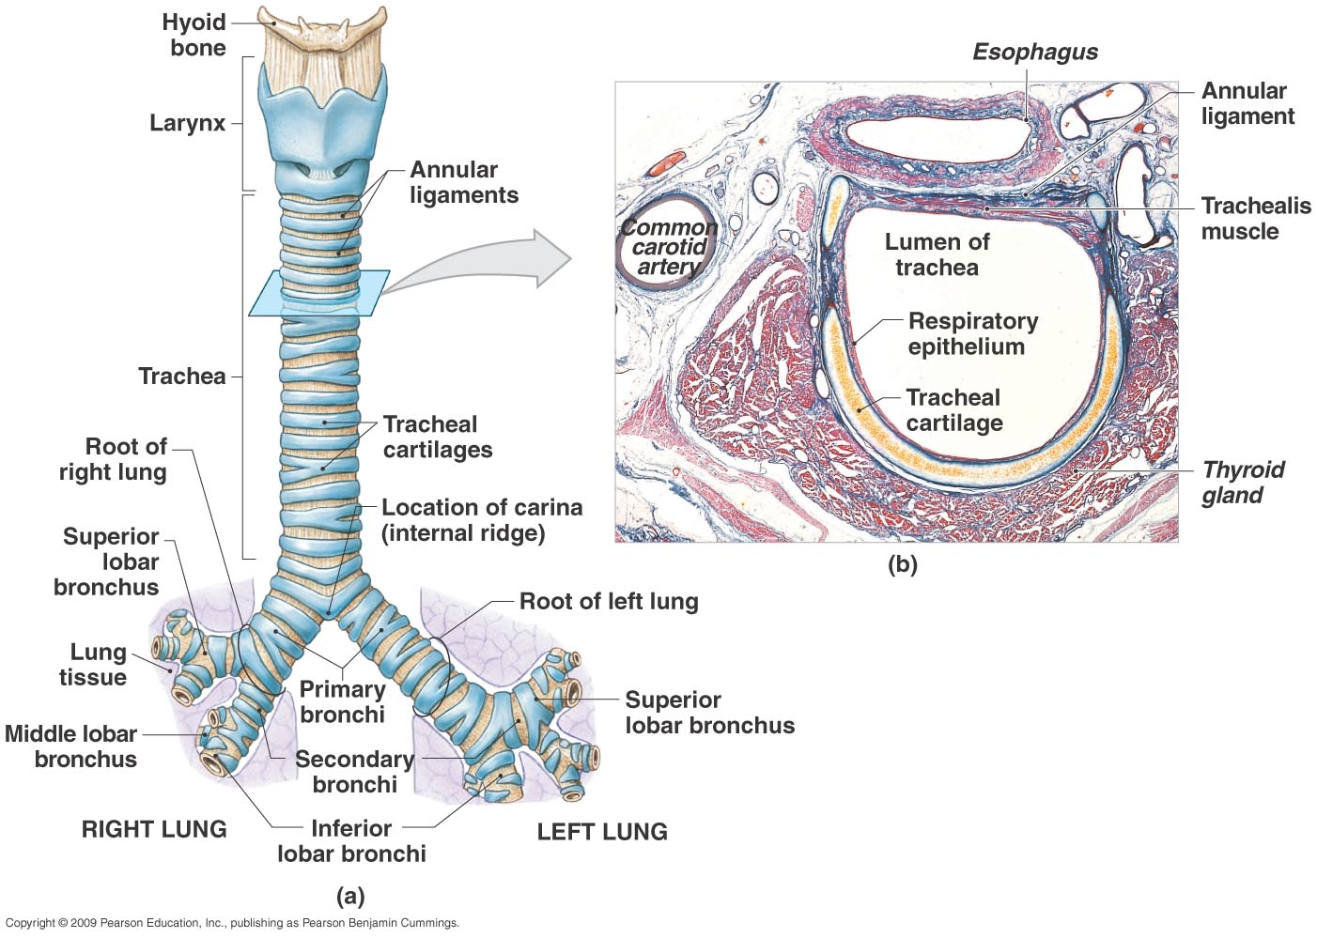
.
.

Slide 47
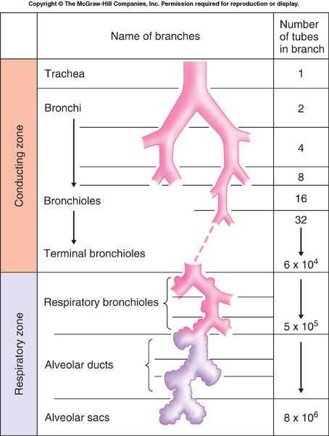
Dichotomous division starting with trachea and ending in alveolar sac.
.

Slide 48
.

Slide 49
THE BRONCHI AND SUB-DIVISIONS:
The Bronchial Tree:- - The bronchial tree is the site where conducting zone structures give
way to respiratory zone structures.

Slide 50
CONDUCTING ZONE STRUCTURES.
- The right and left main (primary) bronchi are formed by the division
of the trachea approximately at the level of T₇ in an erect (standing)
person.
- Each bronchus runs obliquely in the mediastinum before plunging
into the medial depression (hilum) of the lung on its own side.

Slide 51
.
The right main bronchus is wider, shorter, and more vertical than the
left.
- And is the more common site for an inhaled foreign object to become lodged.
- By the time incoming air reaches the bronchi, it is warm, cleansed of
most impurities, and saturated with water vapour.

Slide 52
.
Once inside the lungs, each main bronchus subdivides:-
- Into lobar(secondary) bronchi.
- Three on the right and two on the left.
- Each supplying one lung lobe.

Slide 53
.
The lobar bronchi branch into third-order segmental (tertiary)bronchi,
which divide repeatedly into smaller and smaller bronchi
(fourth-order, fifth-order, etc.).
- Overall, there are about 23 orders of branching air passageways in
the lungs.

Slide 54
.
- Passages smaller than 1 mm in diameter are called bronchioles(“little bronchi”),
- And the tiniest of these, the terminal bronchioles, are less than 0.5 mm in
diameter.
- Because of this branching pattern, the conducting network within the
lungs is often called the bronchial or respiratory tree.

Slide 55
.
1. Support structures change: The cartilage rings are replaced by
irregular plates of cartilage.
2. Epithelium type changes: The mucosal epithelium thins as it
changes from pseudostratified columnar to columnar and then to
cuboidal in the terminal bronchioles.
3. Amount of smooth muscle increase: The relative amount of
smooth muscle in the tube walls increases as the passageways
become smaller.

Slide 56
RESPIRATORY ZONE STRUCTURES.
- Defined by the presence alveoli ,it begins as the terminal bronchioles
feed into respiratory bronchioles within the lung.
- Protruding from these smallest bronchioles are scattered alveoli.
- The respiratory bronchioles lead into winding alveolar ducts, whose
walls consist of diffusely arranged rings of smooth muscle cells,
connective tissue fibers, and out pocketing alveoli.

Slide 57
.
- The alveolar ducts lead into terminal clusters of alveoli called alveolar
sacs.
- The 300 million or so gas-filled alveoli in the lungs account for most
of the lung volume and provide a tremendous surface area for gas
exchange.

Slide 58
Artery supply, Nerve supply of bronchial tree:
- Up to terminal bronchioles – Bronchial artery.
- Beyond the terminal bronchioles- Pulmonary artery.
- Parasympathetic by – vagus (bronchoconstriction).
- Sympathetic - (T2-T5) (Broncho dilatation)

Slide 59
MUSCLES OF RESPIRATION:
*During quite inspiration: *During forced inspiration:
- Diaphragm(main) - Sternocleidomastoid - External intercostal - Serratus anterior - Inter chondral portion of - Scalene the internal intercostals - Erector spinae - Alaque nas - Pectoralis major and minor

Slide 60
.
*During quite expiration: *During forced expiration: - Elastic recoil of alveoli and - Abdominal muscles thoracic wall - Latissimus dorsi - Internal intercostal - Transverse thoracic

Slide 61
THE LUNGS AND PLEURAE.
- The lungs occupy all of the thoracic cavity.
- Each lung is suspended in its own pleural cavity.
- And connected to the mediastinum by vascular and bronchial attachments,
called the lung root.
- The anterior, lateral, and posterior lung surfaces lie in close contact
with the ribs

Slide 62
.
- Just deep to the clavicle is the apex, the narrow superior tip of the
lung.
- The concave, inferior surface that rests on the diaphragm is the base.
- On the mediastinal surface of each lung is the hilum, through which
pulmonary and systemic blood vessels enter and leave the lungs.

Slide 63
.
- The left lung is smaller than the right.
- The left lung is subdivided into superior and inferior lobes by the oblique fissure.
- The right lung is partitioned into superior, middle, and inferior lobes by the
oblique and horizontal fissures.

Slide 64
.
- Each lobe contains bronchopulmonary segments separated from one
another by connective tissue septa.
- Each segment is served by its own artery and vein and receives air
from an individual bronchus.

Slide 65
Root of lung:
- It connects the medial surface of the lung to the mediastinum.
- Roots of the lungs lies opposite the bodies of T5-T7.
>Contents:-
1. Principal bronchus on the left side and eparterial,hyparterial bronchi on the right side.
2. One pulmonary artery.
3. Two pulmonary veins.

Slide 66
.
4. Bronchial arteries, - One on the rt side. - Two on left side.
5. Bronchial vein.
6. Lymphatic of lung.
7. Broncho pulmonary lymph nodes.
8. Areolar tissue

Slide 67
Differences between right and left lung
Right lung Left lung 1. It has 2 fissures and 3 lobes. 1. It has one fissure and 2 lobes. 2. Anterior border is straight. 2. Anterior border is interrupted by the cardiac notch. 3. Larger and heavier. 3. Smaller and lighter. 4. Shorter and broader. 4. Longer and narrower.

Slide 68
THE PLEURAE.
- The pleurae form a thin, double-layered serosa called the parietal
pleura.
- It covers the thoracic wall and superior face of the diaphragm.

Slide 69
.
- It continues around the heart and between the lungs, forming the
lateral walls of the mediastinal enclosure and enclosing the lung root.
- From here, the pleura extends as the layer called the visceral pleura
to cover the external lung surface, dipping into and lining its fissures.

Slide 70
.
- The pleurae produce pleural fluid, which fills the pleural cavity
between them.
- This lubricating secretion allows the lungs to glide easily over the
thorax wall during our breathing movements.

Slide 71
PLEURA
- Two types of pleura found in lung : - Visceral pleura.
- Parietal pleura.
*Visceral pleura: - It covers the surfaces and fissures of lung except at hilum.
- Along the attachment of pulmonary ligament it is continuous with parietal pleura.
- It is firmly adherent to lung and cannot be separated from it.
- It is pain insensitive.

Slide 72
.
*Parietal pleura: - It is thicker than visceral pleura.
- Subdivided in to four parts:
1.Costal.
2.Diaphragmatic.
3.Mediastinal.
4.Cervical

Slide 73
.
*Nerve supply: Parietal pleura- Somatic nerve(intercostal and phrenic nerve) Visceral pleura- Autonomic nerves
*Blood supply:
1. Parietal pleura- - Arterial supply : Intercostal, internal thoracic, musculophrenic arteries - Vein drainage: Azygos,internal thoracic vein 2. Visceral pleura- - Arterial supply: Bronchial arteries - Vein drainage: Bronchial veins

Slide 74
.
.

Slide 75
.

Slide 76
.

Slide 77
.

Slide 78
.

Slide 79
.

Slide 80
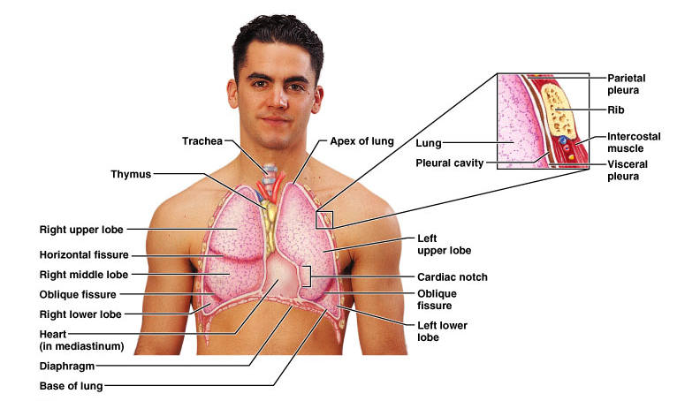

Slide 81
BLOOD AND NERVOUS SUPPLY OF LUNGS.
- The lungs are perfused by two circulations, the pulmonary and the
bronchial, which differ in size, origin, and function.
- Systemic venous blood that is to be oxygenated in the lungs is
delivered by the pulmonary arteries.
- The pulmonary arteries branch with the bronchi and feed into the
pulmonary capillaries surrounding the alveoli.

Slide 82
.
- Oxygenated blood is conveyed from the respiratory zones to the
heart by the pulmonary veins.
- Whose tributaries course back to the hilum both with the
corresponding bronchi.
- The connective tissue septa separating the bronchopulmonary
segments.

Slide 83
.
- The bronchial arteries,
- Which provide systemic blood to lung tissue,
- Arise from the aorta,
- Enter the lungs at the hilum,
- And then run along the branching bronchi,
- Supplying all lung tissues except the alveoli (these are supplied by the
pulmonary circulation).

Slide 84
.
- Although some systemic venous blood is drained from the lungs by
the tiny bronchial veins,
- There are multiple anastomoses between the two circulations,
- And most venous blood returns to the heart via the pulmonary veins.

Slide 85
.
- The lungs are innervated by parasympathetic and sympathetic motor
fibers, and visceral sensory fibers.
- These nerve fibers enter each lung through the pulmonary plexus on
the lung root.
- And run along the bronchial tubes and blood vessels in the lungs.
- Parasympathetic fibers constrict the air tubes, whereas the
sympathetic nervous system dilates them.

Slide 86
.
- Although the pleurae slide easily across each other, their separation
is strongly resisted by the surface tension of the pleural fluid.
- The lungs cling tightly to the thorax wall and are forced to expand
and recoil passively as the volume of the thoracic cavity alternately
increases and decreases during breathing.

