Slide 1
Renal system Anatomy
Wayeta

Slide 2
Composed of
2 kidneys
2 ureters
1 urinary bladder
1 urethra

Slide 3
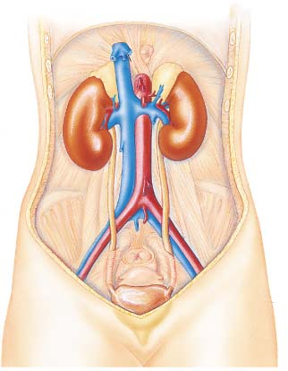
Urinary System-organs
Renal artery
Renal Vein
Kidney
Ureter
Urinary Bladder
sphincters.

Slide 4
Kidney anatomy
Lie on posterior and wall
Extend from 12th thoracic vertebra to 3rd lumber vertebra
Rt kidney is lower than left

Slide 5
FUNCTIONS OF THE URINARY SYSTEM{ kidney functions }
Filtration of the blood.
Re-absorption of vital nutrients, ions and water
Secretion of excess materials
Activation of Vitamin D
Release of Erythropoietin
Release of Renin
Release of Prostaglandins
Ph balance.
Notes:
Filtration of the blood
Occurs in the glomerulus of the kidney nephron
Contributes to homeostasis by removing toxins or waste
Reabsorption of vital nutrients, ions and water
Occurs in most parts of the kidney nephron
Contributes to homeostasis by conserving important materials
Secretion of excess materials
Assists filtration in removing material from the blood
Contributes to homeostasis by preventing a build-up of certain materials in the body such as drugs, waste,etc.
Activation of Vitamin D
Vitamin D made in the skin is converted to Vitamin D3 by the kidney
Active Vitamin D (D3) assists homeostasis by increasing calcium absorption from the digestive tract
Release of Erythropoietin by the kidney
Erythropoietin stimulates new RBC production
New RBC’s assist homeostasis by insuring adequate Oxygen and Carbon Dioxide transport
Release of Renin by the kidney
Renin stimulates the formation of a powerful vasoconstrictor called Angiotensin II
Angiotensin II assists homeostasis by causing vasoconstriction which increases blood pressure
Release of Prostaglandins
Prostaglandins dilate kidney blood vessels
Dilated blood vessels contribute to homeostasis by maintaining blood flow in the kidneys

Slide 6
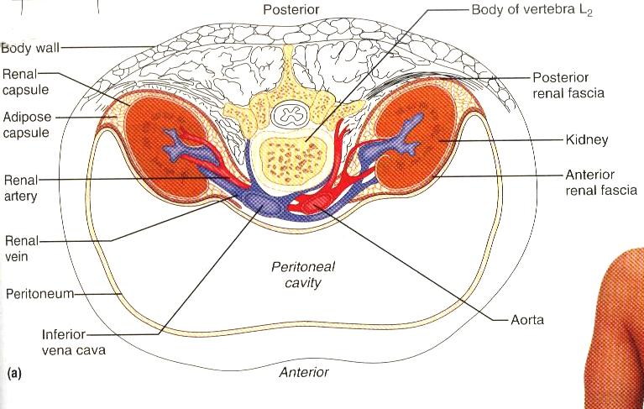
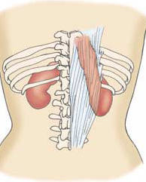
KIDNEY ANATOMY- LOCATION.
Kidneys receive some protection from the lower ribs.
Spans from T₁₂- L₃
Notes:
The bean shaped kidney is retroperitoneal.
Extends from T12-L3. Right kidney is crowded by the liver, it lies a little lower.
Weighs about 150g, and average dimensions are 12 *6*3 cm thick. The lateral surface is convex, and the medial surface is concave with a vertical cleft called HILUS where renal structures enter the kidney.
The kidney is supported by renal capsule, renal fat and renal fascia.
6

Slide 7
Urinary System
HILUS
Renal artery
Renal Vein
Kidney
Ureter
For sphincters, see next slide
Urinary Bladder
Notes:
Show the renal hilus.

Slide 8
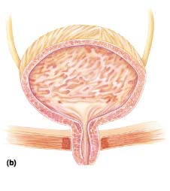
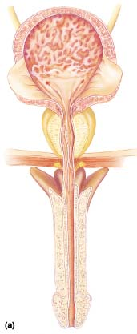
Urinary System
Male Sphincters
Female Sphincters
Internal urethral sphincter
External Urethral Sphincter

Slide 9
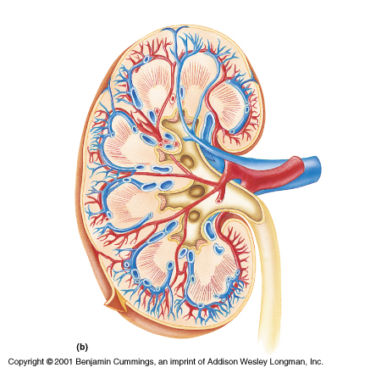
Kidney internal anatomy.
Medulla
Papilla
Calyx
Pyramid
Renal Vein
Cortex
Renal Artery
Nephron
Pelvis
Column
Capsule
Ureter
Notes:
A frontal section shows three areas, CORTEX, MEDULLA, PELVIS- the medulla has medullary pyramids, that open into minor calyses.
The pelvis splits into 2-3 major calyses that then further divide into minor calyses.
Blood supply is from the renal arteries and drainage is by renal veins. The ANS supplies the kidney with sympathetic increasing renbal perfusion.

Slide 10
kidneys
Bean shaped
About 10 cm long, 5 cm wide and 3 cm thick
Weighs 150g
Embedded and held in position by a mass of fat and areola tissues
Lie retroperitoneally in the posterior abdominal wall at the level of T12-L3

Slide 11
CONT...
Right kidney is 2.5 cm lower than the left
Both have adrenal gland superiorly
They have hilum where renal vein is anterior to the renal artery which is anterior the pelvis
Lateral margin is convex while medial margin is concave
Renal pelvis is funnel shaped and for the ureter distally

Slide 12
Continuation.......
Outer fibrous capsule, surrounding the kidney the cortex
The renal parenchyma is divided into the cortex and the medulla.
Cortex
A reddish-brown layer of tissue immediately below the capsule and outside the pyramids and the medulla

Slide 13
Cont………………..
contains the glomeruli, proximal and distal tubules, and cortical collecting ducts and their adjacent peritubular capillaries.
Medulla
Innermost layer, consisting of pale conical-shaped striations, the renal pyramids.

Slide 14
Continuation.....
The hilum is the concave medial border of the kidney where the renal blood and lymph vessels, the ureter and nerves enter.
The renal pelvis is the funnel-shaped structure that collects urine formed by the kidney
Urine formed in the kidney passes through a renal papilla at the apex of a pyramid into a minor calyx.
Then into a major calyx before passing through the renal pelvis into the ureter.

Slide 15
Cont…………
The walls of the pelvis contain smooth muscle and are lined with transitional epithelium.
Peristalsis of the smooth muscle originating in pacemaker cells in the walls of the calyces propels urine through the renal pelvis and ureters to the bladder.
This is an intrinsic property of the smooth muscle, and is not under nerve control.

Slide 16
Other parts of the kidney
Major calices
Minor calices
Renal papilla
Pyramid and associated cortex form the lobes
The renal cortex is covered by fibrous capsule

Slide 17
Organs associated with kidney
Lt kidney
Superiorly rt adrenal gland
Anteriorly =spleen, stomach, pancreas, jejunum, colon
Posteriorly – diaphragm & post abdominal wall
Rt kidney
Superiorly- adrenal gland
Anteriorly –rt lobe of liver duodenum, colon
Posteriorly- diaphragm, posterior abdominal wall

Slide 18
THE NEPHRON
The physiological unit of the kidney used for filtration of blood and reabsorption and secretion of materials.
Each consists of a glomerulus & renal tubule.
Two types: cortical nephrons and Justamedullary nephrones.

Slide 19
The Nephron
Tubule closed at one end, the other end opening into a collecting tubule.
Closed/blind end is indented to form Bowman's capsule
It almost completely encloses a network of arterial capillaries, the glomerulus.

Slide 20
Continuing from the glomerular capsule, remainder of the nephron is about 3 cm long & has 3 parts:
proximal convoluted tubule
medullary loop (loop of Henle)
distal convoluted tubule, leading into a collecting duct.
Collecting ducts unite, forming larger ducts that empty into the minor calyces.

Slide 21
After entering the kidney at the hilum, renal artery divides into smaller arteries & arterioles.
In the cortex an afferent arteriole, enters each glomerular capsule then subdivides into a cluster of capillaries, forming the glomerulus.
Between the capillary loops there are connective tissue phagocytic mesangial cells; part of the reticuloendothelial system.
Blood vessel leading away from the glomerulus; efferent arteriole, breaks up into a 2nd capillary network to supply oxygen & nutrients to the remainder of the nephron.then empties into renal vein and inferior venacava

Slide 22
Bp in the glomerulus is higher than in other capillaries because…
The diameter of the afferent arteriole is greater than that of the efferent arteriole.
Blood flow from the aorta flows under high pressure
Walls of the glomerulus & glomerular capsule consist of a single layer of flattened epithelial cells.

Slide 23
Nerve supply to the blood vessels of the kidney consists of sympathetic & parasympathetic nerves
This permits control of renal blood vessel diameter & renal blood flow independently of autoregulation.

Slide 24
Nephron & associated vessels

Slide 25
Structure of a nephron.
Notes:
Each nephron is associated with capillaries 3- afferent, efferent and pericapilary.
Through the length of each nephron the cellular composition varies.

Slide 26
Blood vessels series

Slide 28
The Juxtaglomerular Apparatus
Description
Consists of specialized macula densa cells that develop in the DCT and
specialized granular JG cells that develop mainly in the afferent arteriole.
See following diagram.
Notes:
Each nephron has region called JGA. Where the initial portion of its coiling distal tubule lies against the afferent ( and sometimes) the efferent arteriole.

Slide 29
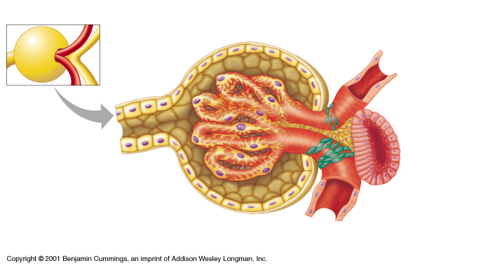
The Juxtaglomerular Apparatus
Bowman’s Capsule
Efferent Arteriole
DCT
PCT
Macula Densa Cells
Granular Juxtaglomerular (JG) Cells
Afferent Arteriole

Slide 30
The Juxtaglomerular Apparatus
Used in maintaining blood pressure
if the blood pressure drops, the granular JG cells release renin .
the macula densa cells monitor the salt content of the blood
if the blood salt content gets too high, the macula densa cells begin to inhibit the granular cells and suppress renin release

Slide 31
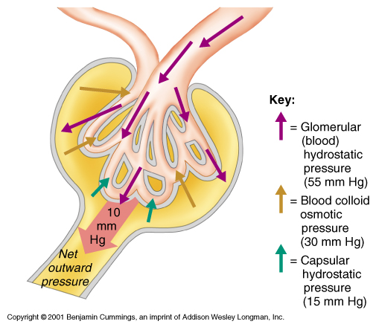
Location of the Glomerulus
Efferent Arteriole
Afferent Arteriole
Bowman’s Capsule
Glomerulus
Proximal Convoluted Tubule

Slide 32
BASIC RENAL PROCESSES
Efferent Arteriole
Afferent
Arteriole
Glomerulus
GF
Kidney
Tubule
TR
Peritubular Capillary
TS
Urine Excreted
10/21/2021

Slide 33
Functions of Nephron Structures
Efferent Arteriole
Transports filtered blood from the glomerulus , through the peritubular capillaries and the vasa recta, and to the kidney venous system

Slide 34
Functions of Nephron Structures
Glomerulus
The site for blood filtration
operates as a nonspecific filter; in that, it will remove both useful and non-useful material
the product of the glomerulus is called filtrate

Slide 35
Functions of Nephron Structures
Bowman’s Capsule
A sac that encloses glomerulus and transfers filtrate from the glomerulus to the Proximal Convoluted Tubule (PCT)

Slide 36
Absorptive capabilities of different segments of nephron.
Proximal Convoluted Tubule (PCT)
A thick, constantly actively segment of the nephron that reabsorbs most of the useful substances of the filtrate: sodium (65%), water (65%), bicarbonate (90%), chloride (50%), glucose (nearly 100%!), etc.
The primary site for secretion (elimination) of drugs, waste and hydrogen ions

Slide 37
Functions of Nephron Structures
Decending Limb of the Loop of Henle
A part of the counter current multiplier
freely permeable to water and relatively impermeable to solutes (salt particles)
receives filtrate from the PCT, allows water to be absorbed and sends “salty”filtrate on the the next segment. “Saves water and passes the salt”

Slide 38
Functions of Nephron Structures
Ascending Limb of the Loop of Henle
a part of the counter current multiplier
impermeable to water and actively transports (reabsorbs) salt (NaCl) to the interstitial fluid of the pyramids in the medulla. “Saves salt and passes the water.”

Slide 39
Functions of Nephron Structures
Distal Convoluted Tubule (DCT)
receives dilute fluid from the ascending limb of the Loop of Henle
Variably active portion of the nephron
When aldosterone hormone is present, sodium is reabsorbed and potassium is secreted. Water and chloride follow the sodium.

Slide 40
Functions of Nephron Structures
Collecting Duct
receives fluid from the DCT
variably active portion of the Nephron
when antidiuretic hormone (ADH) is present, this duct will become porous to water. Water from the collecting duct fluid then moves by osmosis into the “salty” (hyperosmotic) interstitium of the medulla.
The last segment to save water for the body

Slide 41
Functions of Nephron Structures
Peritubular Capillaries
transport reabsorbed materials from the PCT and DCT into kidney veins and eventually back into the general circulation
help complete the conservation process (reabsorption) that takes place in the kidney

Slide 42
FUNCTIONS OF THE KIDNEY
Urine formation
Has 3 stages….filtration
selective reabsorption
secretion

Slide 43
URINE FORMATION
i) Simple filtration
Takes place through the semi-permeable walls of the glomerulus & glomerular capsule.
Water & a large number of small molecules pass through.
Blood cells, plasma proteins & other large molecules are unable to filter through & remain in the capillaries.

Slide 44
Filtration is assisted by the difference between the blood pressure in the glomerulus & the pressure of the filtrate in the glomerular capsule.
Because the diameter of the efferent arteriole is less than that of the afferent arteriole, a capillary hydrostatic pressure of about 55 mmHg builds up in the glomerulus.
.

Slide 45
Glomerular filtration rate (GFR): Volume of filtrate formed by both kidneys each minute.
Healthy adult; GFR is about 125 ml/min; Autoregulation of filtration.
Autoregulation: protective mechanism whereby renal blood flow is maintained at a constant pressure across a wide range of systolic blood pressures (from 80 to 200 mmHg).

Slide 46
Operates independently of nervous control.
An inherent property in renal blood vessels; it may be stimulated by changes in blood pressure in the renal arteries or by fluctuating levels of certain metabolites, e.g. prostaglandins.
ii) Selective re-absorption
Def: Process by which the composition & volume of the glomerular filtrate are altered during its passage through the convoluted tubules, the medullary loop and collecting tubule.
General purpose: To reabsorb into the blood those filtrate constituents needed by the body to maintain fluid & electrolyte balance & the pH of the blood.

Slide 47
Reabsorption and secretion in the tubule frequently involve passive and active transport and may require the use of energy.
Filtrate becomes concentrated in the distal tubule and collecting ducts under the inﬂuence of antidiuretic hormone (ADH)and becomes urine, which then enters the renal pelvis.

Slide 48
Other substances reabsorbed by active transport include amino acids & sodium, calcium, potassium, phosphate & chloride.
In some cases re-absorption is regulated by hormones.
Parathyroid hormone & calcitonin; together regulate re-absorption of calcium & phosphate.
ADH; increases the permeability of the distal convoluted tubules & collecting tubules, increasing water re-absorption.
Aldosterone; increases the re-absorption of sodium & excretion of potassium
Nitrogenous waste products,e.g urea & uric acid, are reabsorbed only to a slight extent.

Slide 49
iii) Secretion
Substance moves from the peritubular capillaries or vasa recta into tubular ﬁltrate by filtration because of the short time they remain in the glomerulus.
Such substances are excreted from the body in the urine.
Tubular secretion of hydrogen (H+) ions is important in maintaining homeostasis of blood pH.

Slide 50
Composition of urine
Water 96%
Urea 2%
Uric acid
Creatinine
Ammonia
Sodium
Potassium 2%
Chlorides
Phosphates
Sulphates
Oxalates

Slide 51
Fluid balance
Osmoreceptors detect changes in the osmotic pressure of the blood.
Nerve impulses from the osmoreceptors stimulate the posterior lobe of the pituitary gland to release ADH.
When the osmotic pressure is raised, ADH output is increased & as a result, water re-absorption by the cells in distal convoluted tubules and collecting ducts is increased, reducing the blood osmotic pressure & ADH output.

Slide 52
Excretion of Waste Products
The kidney functions as the body’s main excretory organ
The major waste product of protein metabolism is urea.
Other waste products excreted are creatinine, phosphates, and sulfates

Slide 53
Autoregulation of Blood Pressure
Autoregulation of Blood Pressure
Specialized vessels of the kidney called the vasa recta constantly monitor blood pressure as blood begins its passage into the kidney.
When the vasa recta detect a decrease in blood pressure, specialized juxtaglomerular cells near the afferent arteriole, distal tubule, and efferent arteriole secrete the hormone renin.

Slide 54
Renin converts angiotensinogen to angiotensin I
This is then converted to angiotensin II by the Angiotensin Converting Enzyme, the most powerful vasoconstrictor known.
The vaso- constriction causes the blood pressure to increase.

Slide 55
ct
The adrenal cortex secretes aldosterone in response to stimulation by the pituitary gland.
This in turn is in response to poor perfusion or increasing serum osmolality. The result is an increase in blood pressure.
When the vasa recta recognize the increase in blood pressure, renin secretion stops.
Failure of this feedback mechanism is one of the primary causes of hypertension.

Slide 56
Regulation of Red Blood Cell Production
When the kidneys sense a decrease in the oxygen tension in renal blood ﬂow, they release erythropoietin.
Erythropoietin stimulates the bone marrow to produce red blood cells (RBCs), thereby in- creasing the amount of hemoglobin available to carry oxygen
Vitamin D Synthesis
The kidneys are also responsible for the ﬁnal conversion of in- active vitamin D to its active form, calcitriol.
This is necessary for maintaining normal calcium balance in the body.

Slide 57
Electrolyte balance
Changes in the concentration of electrolytes in the body fluids may be due to changes in:
body water content, or
electrolyte levels.
Sodium & potassium concentration
Sodium is excreted mainly in urine & sweat.
Sodium is a normal constituent of urine & amount excreted is regulated by the hormone aldosterone.
Cells in the afferent arteriole of the nephron are stimulated to produce the hormone renin by sympathetic stimulation, low blood volume or by low arterial blood pressure.
Renin converts the plasma protein angiotensinogen, produced by the liver, to angiotensin I.
ACE converts angiotensin I into angiotensin II; a very potent vasoconstrictor & increases Bp.

Slide 58
Water is reabsorbed with sodium & together they increase blood volume, leading to reduced renin secretion.
When sodium re-absorption is increased, potassium excretion is increased, indirectly reducing intracellular potassium.
POTASSIUM
Potassium is the most abundant intracellular ion, with about 98%. To maintain a normal potassium balance in the body, the kidneys are responsible for excreting more than 90% of the total daily potassium intake.
Aldosterone causes the kidney to excrete potassium.

Slide 59
Regulation of Acid Excretion
The catabolism, or breakdown, of proteins results in the phosphoric and sulfuric acid.
They are nonvolatile and cannot be eliminated by the lungs.
Accumulation of these acids in the blood would lower its pH (making the blood more acidic) and inhibit cell function.
The kidney is able to excrete some of this acid directly into the urine until the urine pH reaches 4.5 excess acids are bound to chemical buffers so they can be excreted in the urine.

Slide 60
Two important chemical buffers are phosphate ions and ammonia (NH3).
When buffered with acid, ammonia becomes ammonium (NH4).
Synthesis of prostaglandin which has vasodilatory effect

Slide 61
To maintain the normal pH of the blood, the cells of the proximal convoluted tubules secrete H⁺ ions.
In the filtrate they combine with buffers:
bicarbonate, forming carbonic acid
(H⁺ + HCO- -> H2C03)
ammonia, forming ammonium ions
(H⁺ + NH3 --» NH⁺4)
hydrogen phosphate, forming dihydrogen phosphate
(H⁺ + HPO² ₃->> H2PO3-).

Slide 62
Carbonic acid is converted to CO2 & H2O), & the CO2 is reabsorbed maintaining the buffering capacity of the blood.
H⁺ ions are excreted in the urine as ammonium salts & hydrogen phosphate.
Normal pH of urine varies from 4.5 to 7.8 depending on
diet, large amount of animal proteins tend to produce more acidic urine than vegetarians.
time of day etc.

Slide 63
URETERS
Def: Tubes that convey urine from the kidneys to the urinary bladder.
About 25 to 30 cm long
a diameter of about 3 mm.
Continuous with the funnel-shaped renal pelvis.
Passes downwards through the abdominal cavity, behind the peritoneum in front of the psoas muscle into the pelvic cavity & passes obliquely through the posterior wall of the bladder.

Slide 64
When urine accumulates & the pressure in the bladder rises, the ureters are compressed & the openings occluded.
Prevents reflux of urine into the ureters as the bladder fills & during micturition, when pressure increases as the muscular bladder wall contracts.

Slide 65
Structure of ureters
3 layers of tissue:
an outer covering of fibrous tissue, continuous with the fibrous capsule of the kidney
a middle muscular layer consisting of interlacing smooth muscle fibres that form a syncytium spiralling round the ureter, some in clockwise and some in anticlockwise directions and an additional outer longitudinal layer in the lower third
an inner layer, the mucosa, lined with transitional epithelium.

Slide 67
Function of Ureters
Propel urine from the kidneys into the bladder by peristaltic contraction of the smooth muscle layer.
An intrinsic property of the smooth muscle.
Waves of contraction originate in a pacemaker in the minor calyces.

Slide 68
Urinary bladder
Reservoir for urine
Lies in the pelvic cavity posterior to pubic symphysis
When distended rises to abdominal cavity
Size varies with amount of urine
It is pear shaped
Becomes more oval as it gets full

Slide 69
structure
Peritoneum covers the bladder
Three layers of bladder wall
Outer layer – loose connective tissue has blood and lymphatic vessels and nerves
Middle layer – interlacing smooth muscle fibres loosely arranged in three layers (detrusor muscle) longitudinal and circular fibres, contracts to empty bladder
Lining is transitional epithelium

Slide 71
Organs associated with the bladder
In male
Ant- symphysis pubis
Superiorly- small intestines
Post- rectum and seminal vesicles
Inferiorly- urethra and prostate gland
Females
Ant- symphysis pubis
Superiorly- small intestines
Posteriorly -uterus and upper part of vagina
Infer – urethra and muscles of pelvic floor

Slide 73
When the bladder is empty the inner lining is arranged in folds/rugae, & these gradually disappear as the bladder fills.
Bladder is distensible but when it contains 300 to 400 ml, the awareness of the desire to urinate is initiated.
Total capacity is about 600 ml but can stretch upto 1000 mls

Slide 74
3 orifices in the bladder wall form a triangle/trigone
Upper 2 orifices on the posterior wall are the openings of the ureters.
Lower orifice is the point of origin of the urethra.
Where the urethra commences is a thickening of the smooth muscle layer forming the internal urethral sphincter; not under voluntary control.

Slide 75
The trigone

Slide 76
urethra
Canal from neck of the bladder to the exterior
In females it is 4 cm
In males 19- 20 cm long
In females opens between the clitoris and the vagina
The external urethral meatus has the external urethral sphincter under voluntary control

Slide 77
In males several glands and other structures deliver their secretion to urethra
In males it is divided into

Slide 78
Structure of urethra
1. Muscle layer
At the origin from bladder has the internal urethral sphincter under ANS
At the middle is striated muscles forming the external urethral meatus under voluntary control
2. Submucous spongy layer containing blood vessels and nerves

Slide 79
3. Mucous membrane lining
Continuous with that of the bladder
In the lower part has Stratified Squamous Epithelium

Slide 80
MICTURITION
When 300 to 400 ml of urine have accumulated, afferent autonomic nerve fibres in the bladder wall sensitive to stretch are stimulated.
In the infant this initiates a spinal reflex action & micturition occurs.
Micturition occurs when autonomic efferent fibres convey impulses to the bladder causing contraction of the detrusor muscle & relaxation of the internal urethral sphincter.
When the nervous system is fully developed the micturition reflex is stimulated but sensory impulses pass upwards to the brain & there is an awareness of the desire to pass urine.
By conscious effort, reflex contraction of the bladder wall and relaxation of the internal sphincter can be inhibited for a limited period of time.

Slide 81
In adults, micturition occurs when the detrusor muscle contracts, & there is reflex relaxation of the internal sphincter & voluntary relaxation of the external sphincter.
It can be assisted by increasing the pressure within the pelvic cavity,Valsalva's manoeuvre.

Slide 82
Simple reflex control of micturition where conscious effort can’t override reflex action

Slide 83
Control of micturition where conscious effort overrides reflex action

