Slide 1
Research 1.
Clinical medicine March 2020
Continuation.

Slide 2
LITERATURE REVIEW
Review of liteerature is one of the most important steps in research process.
Its an account of what is already known about a particular phenomenon
The main purpose of a literature review is to convey to the readers about the work already done and the knowledge and ideas that have been already established on a particular topic of research.
LR is a labourous task, but it is essential if the research process is to be successful.

Slide 3
Def.
A RV is an evaluative report of information found in the literature related to selected area of study

Slide 4
Importance of LR
rv12

Slide 6
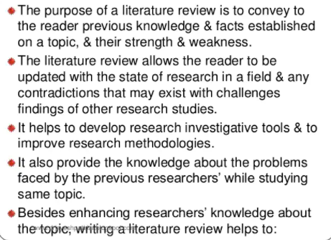
PURPOSES OF RV
RV 3,4

Slide 8
SOURCES OF LR

Slide 11
The main sources from where literature can be searched

Slide 17
STEPS OF RV

Slide 21
STAGE 3- MORE READI NG

Slide 22
STAGE 4- SECTIONS

Slide 25
PREPAIRING WRITTEN LITERATURE

Slide 30
POINTS TO BE CONSIDERED

Slide 35
END
NEXT
REFERENCING AND CITATION

