Slide 1
Research 1 continuation.
Kmtc clinical medicine.
March 2020

Slide 2
Discussion
What are some of the types/designs/methods of research
What are the protocols
Literature review
How do we formulate research objectives
Research Methodology

Slide 3
Last lecture
Basic steps
Identifying and prioritizing topics for research
Topic identification
Analysis and statement of the problem
Statement of the problem

Slide 4
Criteria for selecting a research
Interest
Relevance
Avoidance of duplication
Feasibility
Political acceptability
Applicability
Cost-effectiveness
Ethical consideration

Slide 5
Research Process- recarp
Identification of the research problem
Literature review
Formulation of the objectives of the study
Protocol preparation
Data analysis
Preparation of Report

Slide 6
Research process

Slide 11
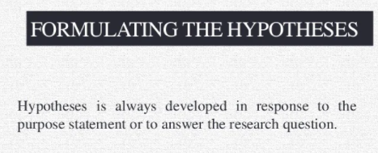

Slide 19
1. STATEMENT OF THE PROBLEM
This id the first major section in research proposal
It’s the foun dation of research, it facilitates information search and justifies why the research should be conducted.
Contents;
A concise description of nature of the problem, what is the magnetude, distribution and severity
Systematic elucidation of why the proposed research will solve the problem

Slide 20
Cont.
A brief description of any attempts to solve the problem in the past-success, failure and challenges
A brief description of the significance of the proposed study- how are the results useful.

Slide 21
2. Literature Review
A systematic analysis and interpretation of available information about a topic of study
Its an opportunity to develop professional confidence in the field of study
WHY?
We want to know more about the problem
Avoid duplication
Learn the gaps in the sudy arena
Learn various methods
Forecast the challenges that might be faced in the conduct of study

Slide 22
WHAT?
We review literature to look at the sources.
Library, internent,Gray literature
HOW?
How do we write a review of literature?
3 steps;
Consider analysis of the problem
Organize notes based on the factors
Decide the order(broader to specific/global or local, then from past to present

Slide 23
Tips
Search widely
Evaluate relevance of information to your study
Include information directly relevant to your study
Mention sources of all bold statements
Write a coherent discussion in your own words

Slide 24
In General
Literature review should be
Adequate
Relevant
Critical
IT MUST ANSWER
How much is known about the topic
What is not known about the topic
What should be done on what is lacking

Slide 25
3.Formulation of research objectives
Types of objectives
Estimation Objective-estimates magnetude of an event
Association objectives-analyses factors associated with an event
Evaluation objectives-evaluates associations

Slide 26
Categories of objectives
General objective;
Summarizes what is to be achieved by the study
Should be clearly related to the statement of the problem
Specific objectives;
Logically connected parts of the general objectives
Focus on the study essentials
Direct design of investigation
Orientation collection, analysis and interpretation of Data

Slide 27
Why should research objectives be developed?
It focuses on the study
Avoids unnecessary information
Facilitates organizing of the study
How should we state objectives?
3 possible ways
As a positive statement
As research questions
As a hypothesis( a prediction of relationship btn one or more factors and the problem under study can be tested.

Slide 29
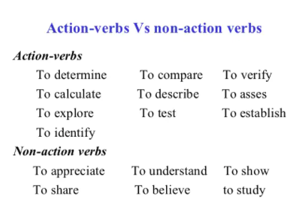

Slide 30
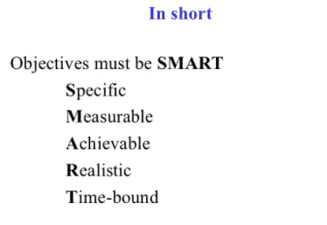

Slide 31
The END……………………………….
Q/A
Research Methodology
https://www.who.int/groups/research-ethics-review-committee/recommended-format-for-a-research-protocol/

