Slide 1
RESEARCH
BY
MR. VINCENT EJAKAIT

Slide 2
DEFINITION
SCIENTIFIC RESEARCH
According to Burns and Grove (1999: 3) the word ‘research’ means ‘to search again’ or ‘to examine carefully’.
Research is diligent, systematic inquiry or study to validate and refine existing knowledge and develop new knowledge.

Slide 3
DEFINITION
NURSING RESEARCH
Nursing research is defined as research into those aspects of professional activity, which are predominantly and appropriately the concern and responsibility of nurses.
In order to define a research as nursing research; your study must be geared towards improving certain aspects of the nursing practice, education and administration.

Slide 4
CONCEPTS IN RESEARCH

Slide 5
PURPOSE OF RESEARCH
Developing scientific, evidence based reasons for nursing activities.
Finding ways of increasing the cost-effectiveness of nursing activities.
Providing a basis for standards setting and quality assurance.
Providing evidence in support of demands for resources in nursing.
Barring and defending a professional status for nursing.
Focusing on priority problems that affect the nursing profession.

Slide 6
CHARACTERISTICS OF A GOOD RESEARCH
Makes a comprehensive statement of the problem and justification of the research problem
Has clearly stated objectives and research questions
Measures what it sought to from the onset.
Has a clearly stated and relevant purpose.
Utilizes an intensive and extensive review of relevant literature to broaden the perspective of the research project
Clearly and systematically explains the methodology utilized

Slide 7
CONT…
Offers plausible interpretations and explanations of the results
Draws valid evidence-based conclusions deduced from the research results
Generates plausible evidence based on the scientific methods applied
Examines the implications of the evidence adduced with other relevant important areas of the target community, such as social, economic, health, policy and other aspects

Slide 8
CLASSIFICATION OF RESEARCH
Research can be classified according to:
  Categories, i.e., what the study is to be used for.
  Methodological approaches
  Aims of the study
  The time dimension
In broad terms, research can be classified into Qualitative and Quantitative research approaches.

Slide 9
TYPES OF RESEARCH
Qualitative research
Quantitative research
Cross-sectional research
Longitudinal research

Slide 10
1. Qualitative research
Is a type of research where the data collected is in the form of words rather than numbers.
Data collected is then grouped into categories, themes and patterns

Slide 11
Cont..
Data from qualitative research is usually collected through:
  Observation: participant observer or non participant observer.
  Focus group discussions.
  Face to face interviews.
  Posted or self administered questionnaires.

Slide 12
Cont.…
Qualitative research can further be sub divided into several categories:
Historical research
Case study
Rapid Rural Appraisal

Slide 13
Cont.…
A) Historical research:
It is a qualitative research that attempts to describe and learn from the past
Example:
A nurse may investigate the historical development of nursing in Kenya

Slide 14
Cont.…
B) Case studies:
Is an in-depth investigation of an individual, group, institution or phenomena.
However case studies have certain limitations
  Results cannot be statistically validated because no sampling strategy is involved.
  Case studies can be time consuming,
  They are more susceptible to the ‘Hawthorne effect’, where the research process influences the study outcome.

Slide 15
Cont.…
Rapid Rural Appraisal
This approach emphasizes the need for the researcher to acknowledge and appreciate that local research respondents have the knowledge and skills to be partners in the research process.
In RRA, both the researcher and the respondents collaborate and learn from each other, getting possible solutions for the research questions

Slide 16
2. Quantitative research
Is a ‘formal, objective, rigorous, systematic process for generating information about the world’, with respect to populations’ dynamics, characteristics and phenomenon
Analyses numeric information through statistical procedures.

Slide 17
Cont.…
Quantitative research is also subdivided into several types:
  Descriptive research
  Experimental research
  Quasi experimental research

Slide 18
Cont.…
A) Descriptive research
It is the exploration and description of a phenomenon in real-life situations
The main focus is the investigation of existing practices, beliefs and attitudes held by people
A good example of descriptive study is a survey

Slide 19
Cont.…
B) Experimental Research
One of the most complex and important research types.
It is commonly used in clinical settings because of its accuracy and reliability.
It has 3 major characteristics of:
  control,
  manipulation
  randomisation.

Slide 20
Cont.….
A major difference between experimental and non experimental research types is:
In experimental research, the researcher is the active agent rather than remaining a passive observer

Slide 21
Descriptive vs Experimental
Describes something
Cannot predict
No control over study subjects
Tests a hypothesis
Can predict
Full control over study subjects
Researcher controls the variables
Researcher cannot control the variables
Notes:
Descriptive research merely describes something, whereas experimental research tests a hypothesis.
Researchers can control variables in experimental research but cannot do this with descriptive research.
Descriptive research may not have control of the study subjects but experimental research has full control of the subjects under study.
Experimental research can lead to predictions but descriptive research may not.

Slide 22
Cont.…
C) Quasi-experimental Research
Research whose purpose is to examine causal relationships or to determine the effects of one variable on another
Involve implementing a specific treatment and then later examining the effects of this treatment using selected methods of measurement

Slide 23
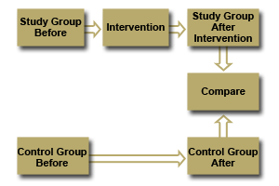
Quasi-experimental research

Slide 24
Cross-sectional studies
Studies that are conducted over a short duration of time.
Initiated where results are required as a matter of urgency.
Unlike the longitudinal studies they tend to be relatively cheaper.

Slide 25
Longitudinal studies
Studies that are conducted over a long duration of time.
A good example is the cohort study where individuals having a characteristic of interest (exposure) are followed over a duration of time.
During the time of study the subjects are observed to see if they develop an outcome of interest.

Slide 26
RESEARCH PROCESS

Slide 27
PHASES
Has 5 phases;
  The conceptual phase/ thinking phase.
  Design and planning phase
  The empirical phase/ the doing phase.
  The interpretive phase (analytic
  The communication phase or the phase of writing and disseminating the research report
  The 5 phases have been expanded to 10 steps

Slide 28
Planning phase
Emperical phase
Interpretive phase
Communication phase
Conceptual process

Slide 29
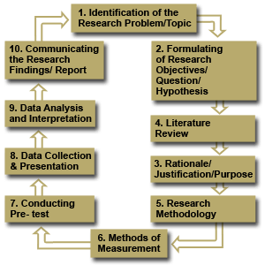
Research process (STEPS)

Slide 30
STEPS
Identify the research topic
Problem statement
Rationale/ justification/purpose of the study
Formulate research objectives, questions & hypothesis
CHAPTER 1

Slide 31
STEPS cont.….
5. Literature review
CHAPTER 2

Slide 32
STEPS cont.….
6. Research methodology
7. Describe the methods of measurement
8. Data collection and presentation
9. Data analysis & interpretation
CHAPTER 3

Slide 33
STEPS cont.….
10. Communicating research findings, conclusion, recommendations, limitations & appendices
Chapter 4 & Chapter 5

Slide 34
ALL STEPS
1. Identify the research topic
2. Problem statement
3. Rationale/ justification/purpose of the study
4. Formulate research objectives, questions & hypothesis
5. Literature review
6. Research methodology
7. Describe the methods of measurement
8. Data collection and presentation
9. Data analysis & interpretation
10. Communicating research findings, conclusion, recommendations, limitations & appendices

Slide 35
1. Identify Research Topic

Slide 36
IDENTIFICATION OF RESEARCH PROBLEM
A research problem is an issue that needs investigation or solution.
Once the problem has been selected, it is then used to make the study topic.
Sources of Research Problems:
Existing theories and literature
Media – News papers, Radios, TVs etc.
Previous research studies/reports
Personal experiences – Clinical etc.
Discussions with experts
Replication – Carrying out research projects that had been done before

Slide 37
Note: The researcher should have the necessary knowledge and skills and the necessary resources e.g. money, manpower, materials etc.
Characteristics of a Good Nursing Research Topic
Improve nursing services by contributing to more knowledge and better skills.
Enhance existing knowledge by filling in gaps that exist.
Encourage more research on already existing nursing theories.
Address current concerns or priority areas in nursing.
Pay more attention to ethical issues

Slide 38
A Good Research Title Should:
Describe contents clearly and precisely so that the readers can decide whether to read the report or not.
Provide clear key words.
Not include terms like ‛an investigation of….’ or “a research on……..”
Not have abbreviations or jargon.
Not use “cute language”

Slide 39
Example:
FACTORS INFLUENCING IMPLEMENTATION OFTHE HIV/AIDS EDUCATION CURRICULUM IN PRIMARY SCHOOLS: A CASE STUDY OF NYERI COUNTY.
UPTAKE OF VOLUNTARY MEDICAL MALE CIRCUMCISION AMONG ADULT MEN: A CASE STUDY OF TESO SOUTH CONSTITUENCY

Slide 40
2. Problem statement

Slide 41
Criteria for Formulating a Research Problem
a) Workability
Is the research within the range of resources and time constraints?
Is the necessary data accessible?
Can you come up with an answer to the problem?
Is the required methodology manageable and understandable?
b) Critical Mass
Is the problem of sufficient magnitude to fulfill the motivation of the study?
Are there enough variables?

Slide 42
c) Interest
Are you interested in the problem area?
Does it relate to your background and career?
Will you learn useful skills from pursuing it?
d) Theoretical Value
Does the problem fill the gap in literature?
Does it challenge previously held opinions?
Will others recognize its importance?
Will it contribute to advancement of knowledge?
Is it publishable?

Slide 43
d) Practical Value
Will the solutions to the problem improve available knowledge?
Are other researchers likely to be interested in the results?
Will your own research skills be improved as a result of your study?

Slide 44
Characteristics of a Good Research Problem
Should be written clearly in a way that captures the reader’s interest
The specific problem identified is objectively researchable
The scope of specific research problem is indicated
Importance of the study in adding new knowledge is clearly indicated
The problem statement must give the purpose of the study

Slide 45
Step 3: Rationale/ Justification/Purpose of the Study

Slide 46
PURPOSE OF THE STUDY
This is the focus/ goal or ultimate aim of the study.
It should be accurately expressed for the research process to be carried out with ease.
The criteria for formulating a purpose of the study:
Must be clearly indicated, unambiguous and in a declarative manner
Should indicate the concepts or variable in the study
Where possible, the relationship among the variables should be indicated
Should state the target population
Variables and target population in the purpose should be consistent with the variables and target population operationalized in the methods of the study

Slide 47
RATIONALE/ JUSTIFICATION
The words ‘rationale’ and ‘justification’ are commonly used interchangeably.
This is the section of the study that outlines reasons for carrying out the study.
Justifications of the study should address some of the following questions:
What gaps in knowledge will the study address?
Why is the study important?
What will the study contribute to the society?

Slide 48
Meanwhile, the significance of the study addresses questions like:
How will the results be used?
Who will benefit from the results?
Is the study worth it?
It is important to state the justification convincingly so as to rationalize the utilization of resources such as time, money materials and manpower.
The rationale of the study should describe the utility and importance of the problem in health care services in general and the nursing profession in particular

Slide 49
Step 4: FORMULATION OF RESEARCH OBJECTIVES, HYPOTHESIS & QUESTIONS

Slide 50
FORMULATION OF RESEARCH OBJECTIVES, HYPOTHESIS AND QUESTIONS
RESEARCH OBJECTIVES
They are clear, concise, declarative, statements expressed to direct a study.
They focus on identification and description of variables and/or determination of the relationships among variables.

Slide 51
Importance of Research Objectives
Research objectives help to:
Bridge the gap between the research purpose and the study design.
Guide on planning for data collection and analysis.
Summarize what is to be achieved by the study.
Build a close link with the statement of the problem.
Keep the researcher within the scope of study by defining the area of focus.

Slide 52
TYPES OF OBJECTIVES
General/Broad Objectives
Is the aim/ goal of the study
It is what will be achieved at the end of the study
Linked to the research topic/ title
Specific Objectives
They are measurable tasks that will assist achieve the general/broad objectives
They are what the researchers hope to achieve

Slide 53
When Formulating:
State them clearly in a way that they can be evaluated.
List them in approximate order of importance.
Ensure they are ‛‛SMART”
Use neutral action verbs e.g. To Determine, Evaluate, Explore, Analyze, Examine, Assess, Establish, Find Out……
Avoid biased action verbs e.g. To Check, Confirm, Prove, Validate, Show………

Slide 54
S - Specific; clearly identifies the item at hand for investigation.
M - Measurable; being quantifiable
A - Achievable; acquire the set objectives
R - Realistic
T - Time bound; in form of human, financial and material resources
Example of a SMART Objective
To establish the number of children born at home within the last two years in Ganga village
Example of a Non SMART Objective
To find out the level of home deliveries.

Slide 55
RESEARCH QUESTIONS:
They pose a relationship between two or more variables but phrases the relationship as a question
They are specific objectives in question form
When answered the research objectives will be addressed
Good research questions should be “FINER”
F - Feasible, allowing one to appreciate the practical limitations.
I - Interesting, sustaining the research process.

Slide 56
N - Novel, able to provide new findings.
E - Ethical
R - Relevant, advancing science or influencing clinical care, health care policy among others.
Example of a FINER Research Question
Do nurses in Kalala hospital practice the hand washing procedure as stipulated by the hospital infection control handbook?
Example of a Non – FINER Research Question
Are nurses washing hands?

Slide 57
Research question assists the researcher to:
Focus on the study by narrowing it down to the essentials
Avoid collection of data that are not necessary
Organize the study in clearly defined parts or phases

Slide 58
HYPOTHESIS OF THE STUDY:
A tentative prediction or explanation of the relationship between two or more variables.
A prediction of the answer to the research question.
Example
Persons with Type II diabetes mellitus who have greater knowledge of their diseases will have a higher rate of adherence to treatment regimen than those with less knowledge.

Slide 59
Types of Hypothesis
There are three types:
1. Simple Vs. Complex Hypotheses
Simple: Predicts the relationship (associative or casual) btw 2 variables i.e. 1 independent and 1 dependent.
Complex: Predicts a relationship(associative or casual) among 3 or more variables e.g. x ,y & z {>1 independent → >1 dependent}
Example: Good leadership → Peace, Love and Unity.

Slide 60
2. Non – Directional Vs. Directional Hypotheses.
Non – Directional: States the existence of a relationship but does not predict the nature of the relationship whether +ve or-ve.
Directional: States the nature/direction of the relationship between 2 or more variables.
It uses terms like less, more, little, decreased, increased, small, large etc.
It can be associative, casual, simple or complex.
Note: All casual hypotheses are directional

Slide 61
3. Null/ Statistical (H0) Vs. Research/ Alternative (H1 or Ha) Hypotheses.
Null: Used for statistical testing and interpretation of statistical outcomes.
Can be simple or complex; associative or casual.
States that there is no real relationship or difference existing between variables and any relationship or difference existing is due to chance or error.
Research(H1 or Ha): States that there is a relationship or difference between two or more variables.
It can be simple or complex; directional or non-directional; associative or casual.

Slide 62
Step 5. Literature review

Slide 63
LITERATURE REVIEW
It is a summary of theoretical and empirical sources to generate a picture of what is known and not known about a particular problem.
It entails the systematic identification, location and analysis of documents containing information related to the research problem being investigated.

Slide 64
Characteristics of A Good Literature Review
Thorough and complete
Logical
Recent (not more than 10 years old unless very necessary)
Original
Primary sources
Critical appraisal
Building a case for new study

Slide 65
Purposes of Literature Review
Determine what has been done already as regards the research problem under investigation.
Identify strategies, procedures and measuring instruments that have been found useful in the investigation of the research problem.
Help make the researcher familiar with previous studies and thus facilitate the interpretation of the study.
Help the researcher to narrow the research topic.
Help determine new approaches and stimulate new ideas

Slide 66
When reviewing any literature, the researcher needs to:
Assess the strengths and weaknesses of past work on the subject
Report any inconsistent findings
Identify gaps in the knowledge
Determine the contribution of proposed study
Consider the possibility of unintentional duplication

Slide 67
Sources of Literature
Primary Sources
This is the work written by the person who is actually involved in, or is responsible for, the generation of the
idea published.
It can also be information from a person who actually observed or witnessed the occurrence
under investigation.
The person who conducts empirical research and publishes it in a journal is usually regarded as the primary source of information

Slide 68
Secondary Sources
Involves summaries or quoted content from a primary source.
This type of work is usually a paraphrase of the primary source. Often, it does not give the correct interpretation of the primary sources.
It is usually information given by someone who was not a direct observer or participant of the events described.

Slide 69
Sources of Secondary Information
Scholarly Journals
Theses and Dissertations: research projects written by Masters and PhD students.
Govt. Documents; i.e. policy papers, research reports owned by the govt., annual reports of hospitals and government ministries
Papers Presented at Conferences
Books
Computers: Computers also have databases prepared for literature search. Examples of such databases are MEDLINE or INDEX MEDICUS, Pub Med

Slide 70
Challenges faced in Formulation of Literature Review
Failure to connect the reviewed studies with current studies
Poor presentation – Too many disjointed paragraphs; Repetition in referencing e.g. starting each article with the name of the author
Lack of or poor referencing
Lack of critique
Failure to review current studies – Make attempts to analyze studies carried out less than 5 years ago

Slide 71
6. Research Methodology

Slide 72
RESEARCH METHODOLOGY
Every researcher has to identify an appropriate research design for use in the study. Identification of a specific study design will depend on :
Available information (state of knowledge) about the problem.
The nature of the problem and its environment.
The availability of resources for the study.
The skills and creativity of the researchers.

Slide 73
RESEARCH DESIGN
The overall plan for obtaining an answer to the research question or for testing the research hypothesis.
Some of the terminologies used to describe study designs include:
Qualitative/quantitative
Intervention /observational
Cross-sectional/longitudinal
Prospective/retrospective
True experimental /quasi experimental etc.

Slide 74
The Design Must:
Be consistent with objectives/hypothesis
Be justifiable
Be appropriate to answer questions
Lack of biasness-valid
Be precise
Be Feasible
Be Ethical

Slide 75
STUDY POPULATION (SUBJECTS)
This is the entire group of individuals, cases or events having a common observable characteristic.
To achieve this, ask yourself the following questions:
Who will be studied? (Eligible Subjects)
How will they be recruited? (Sampling)
How will they be allocated to study groups?

Slide 76
Q. Who will be studied?
Specify Eligible Subjects:
Target population: - Refers to the number or subjects or the total environment of interest to the researcher.
Accessible population:-This is part of the target population that the researcher can actually reach.
Sample population:-This is part of the target or accessible that has been procedurally chosen to represent it.
Note: Out line the inclusion/exclusion criteria

Slide 77
Q. How to select?
This is known as Sampling which is the process of selecting a portion of the population to represent the entire subjects since it is almost impossible for a researcher to study the all subjects.
The type of sampling method a researcher uses will depend mainly on
The type of research one intends to undertake,
The methodology to be applied and
The time available for the tasks

Slide 78
Advantages of Sampling
Cheaper to administer compared to census
Saves time and cost
Has a possibility of better testing and more thorough investigation
Provides results faster than census
In some instances, it would be dangerous to use the entire population e.g. testing vaccines or medication
Most appropriate is experiments where destruction is involved

Slide 79
Steps in Sampling Procedures
1. Define the population
2. Determine the sampling frame
3. Determine the sampling procedure i.e. probability or non – probability techniques
4. Determine the appropriate sample size. The larger the sample size, the more accurate the conclusions drawn are more likely to be
5. Finally, select the specific study objects to be included in the sample

Slide 80
SAMPLING TECHNIQUES
They are in two categories:
A) Probability
Each element in the population has an equal independent chance of being selected. They include:
Simple random sampling
Stratified sampling
Cluster sampling
Systematic/interval sampling

Slide 81
B) Non – Probability
There is no equal opportunity given to all subjects. They include:
Convenience/ accidental sampling
Purposive/ judgmental sampling
Snow ball sampling
Quota sampling.

Slide 82
Assignment
Group Presentations:
Prepare for class presentation on sampling techniques with emphasis on the procedure, advantages and disadvantages.
Group 1: Probability Techniques
Group 2: Non – Probability Techniques and the differences between the two techniques

Slide 83
1. PROBABILITY SAMPLING
Every unit in the population has a chance (greater than zero) of being selected in the sample, and this probability can be accurately determined.
Allows for a much more a representative sample of the population and enables the estimation of sampling error.
It also enables the calculation of differential statistics and allows the study to be generalized to other areas.
All units of the study population have an equal or at least a known chance of being included in the sample from list provided

Slide 84
Advantages
Ideal for statistical purposes
Disadvantages
Difficult to achieve a representative sample
Requires an accurate list from the whole population
May prove expensive to conduct as those sampled may be scattered over a wide range

Slide 85
Probability Sampling Techniques
a) Simple Random Sampling:
One of the commonest and the simplest methods of sampling.
Each unit (subject) has the chance to be selected.
Used when the group is homogenous
It involves one stage selection. It also allows the researcher access to the study population
There are several ways of selecting a random sample using this technique. These include, the lottery method, use of random tables, or tossing a coin to help you decide where and how to start.

Slide 86
b) Systematic or Interval Sampling:
It is a statistical method involving the selection of elements from an ordered sampling frame.
Each element in the population has a known and equal probability of selection.
The most common form of systematic sampling is an equal-probability method. In this approach, progression through the list is treated circularly, with a return to the top once the end of the list is passed.

Slide 87
The sampling starts by selecting an element from the list at random and then every k^{th} element in the frame is selected, where k, is the sampling interval (sometimes known as the skip).
This k is calculated as: k = N/n; where n is the sample size, and N is the population size.
It is much more efficient and much less expensive to do than simple random sampling.

Slide 88
c) Stratified Random Sampling:
The researcher divides the entire target population into different subgroups, or strata, and then randomly selects the final subjects proportionally from the different strata.
Used when the group is heterogeneous to ensure all categories participate in the study
This type of sampling is used when the researcher wants to highlight specific subgroups within the population.
When sub-populations vary considerably, it is advantageous to sample each subpopulation (stratum) independently.

Slide 89
Stratification is the process of grouping members of the population into relatively homogeneous subgroups, e.g., by education level, before sampling.
The strata should be mutually exclusive i.e. every element in the population must be assigned to only one stratum.
The strata should also be collectively exhaustive, that is, no population element can be excluded.
Random sampling is then applied within each stratum. This often improves the representativeness of the sample by reducing sampling error.

Slide 90
Advantages
Achieves greater precision provided the strata have been chosen so that members of a stratum are similar as possible
It is often administratively convenient to stratify as the results from each stratum may be of intrinsic interest and can be analyzed differently
Ensures better coverage of the population than simple random
Disadvantages
Difficulty in identifying appropriate strata
More complex to organize and analyze results

Slide 91
d) Cluster Sampling:
Is a sampling technique used when 'natural' groupings are evident in the population.
The total population is divided into these groups (or clusters), and a sample of the groups is selected.
The required information is then collected from the elements within each selected group.
This may be done for every element in these groups, or a subsample of elements may be selected within each of these groups.

Slide 92
Elements within a cluster should ideally be as homogeneous as possible. However, there should be heterogeneity between clusters.
Each cluster should be a small scale version of the total population. The clusters should be mutually exclusive and collectively exhaustive.
A random sampling technique is then used on any relevant clusters to choose which clusters to include in the study.

Slide 93
Advantages
Saves travelling time and consequent reduction in cost
Useful in surveying employees in a particular industry, where individual companies can form clusters
Disadvantages
Units close to each other may be very similar and so less likely to represent the whole population
Large sampling error

Slide 94
2. NON – PPROBABILITY SAMPLING
The sample is not based on chance. It is determined by a person
Random selection not used. Respondents are selected at the researcher’s discretion – these individuals that the researcher feels they will offer vital information

Slide 95
Non – Probability Sampling Techniques
a) Purposive or Judgmental Sampling:
It is where the researcher selects a particular group or groups based on certain criteria.
In this method the researcher determines who should be included in the study.
It is, in fact, the researcher’s opinion that the sample is representative of the target population. Commonly used in qualitative studies.

Slide 96
Advantages
It gives the researcher a free hand to respond according to their judgment.
Disadvantages:
Sampling biases
the possibility of unrepresentative samples
lack of generalizations of the study findings

Slide 97
b) Quota Sampling:
The population is first segmented into mutually exclusive sub-groups, just as in stratified sampling.
Then judgment is used to select the subjects or units from each segment based on a specified proportion.

Slide 98
c) Convenience or Accidental/Availability Sampling
The study units that happen to be available at the time of data collection are selected and used as a sample.
This type of sampling allows the utilization of any available target population.
The researcher is unable to control bias at all.
Example: If you need to assess the blood pressure of females using DMPA who are above 40 years of age, you will need to check the blood pressure of any female available, who is above this age on DMPA irrespective of her parity or other characteristics.

Slide 99
d) Snow Ball Sampling:
It is a technique for developing a research sample where existing study subjects recruit future subjects from among their acquaintances. Thus, the sample group appears to grow like a rolling snowball.
This sampling technique is often used in hidden populations which are difficult for researchers to access e.g. drug users and commercial sex workers.
Sample members are not selected from a sampling frame, therefore, snowball samples are subject to numerous biases.

Slide 100
Differences between Probability and Non – Probability Sampling Techniques
Probability Sampling | Non – Probability Sampling
Involves random selection | Does not involve random selection
Samples can depend on the rationale of the probability theory | Samples can not depend on the rationale of probability theory
Represents the population well | May not represent the population well

Slide 101
Keys to Successful Research
Make a clear description of the study population
Indicate appropriate eligibility criteria(inclusion and exclusion)
Justify the population and sampling methods.
Describe the sampling methods clearly.

Slide 102
SAMPLE SIZE DETERMINATION
Factors to consider:
The purpose of the study
The population size
The risk of selecting a ‘bad sample’
The sampling error allowed

Slide 103
CRITERIA FOR SAMPLE SIZE DETERMINATION
Three criteria needed to determine the appropriate sample size:
The level of precision
The level of confidence or risk
The degree of variability in the attributes being measured.
1. Level of Precision {Statistical Significance/ Sampling Error}
Is the range in which the true value of the population is estimated to be.
How sure one is that the statistic is reliable, is there a difference or relationship? Expressed in percentage

Slide 104
2. The Confidence Level {Standard Error/Risk Level}
The range of values in which the population mean is likely to be contained within a given level of probability defined by the standard errors of the sampling distribution.
In a normal distribution curve, some samples have higher values while others have lower values in relation to the average population mean.

Slide 105
3. The Degree of Variability
Represents the distribution of the attributes in the population.
Expressed in percentage between 1 and 100%.
50% indicate the maximum variability in a population.
50% is therefore used most often in determining a more conservative sample size especially where the population with the attribute are not known.

Slide 106
Strategies Used
Using a Census for Small Populations. Good for small population of 200 or less
Using a Sample Size of a Similar Study
Using Published Tables
Using Formulas e.g. Fishers formula
Redundancy levels – data saturation

Slide 107
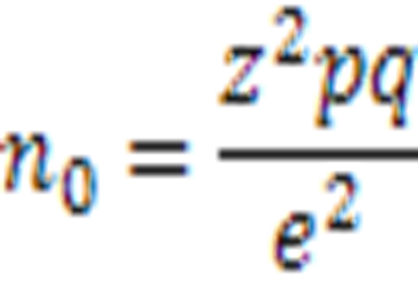
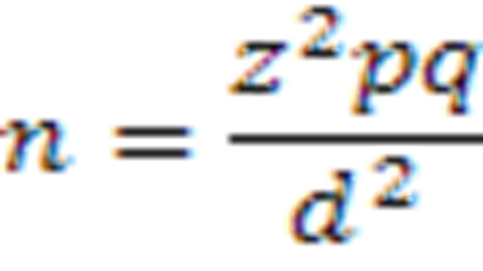
Formula Methods
Cochran Formula
Fishers Formula

Slide 108
Where in both techniques:
n0/n : - Desired sample size{if the target population is greater than 10,000)
z : - Desired confidence level e.g.95%
p : - Degree of variability (the proportion in the target population estimated to have characteristics being measured; {50% max})
q : - 1-p
e/d: - Desired level of precision e.g. ±5%
Note: If there is no estimate available of the proportion in the target population assumed to have the characteristics of interest, 50% should be used as recommended by Fischer’s et al.

Slide 109
Example:
If the proportion of a target population with a certain characteristic is 0.50, the Z statistic is 1.96, and we desire accuracy at the 0.05 level, then the sample size is:
n = (1.96)² (0.50) (0.50) = 384
(0.05) ²

Slide 110
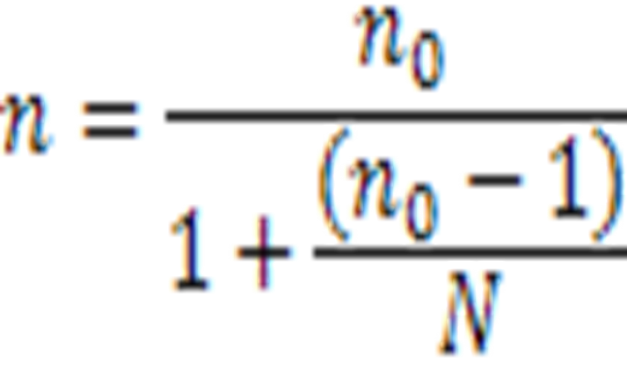
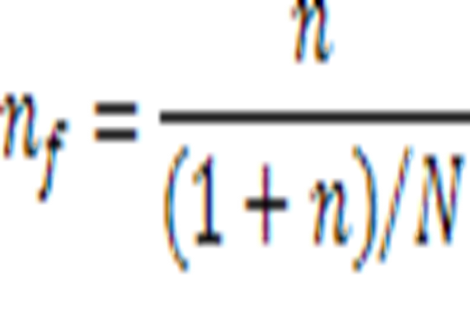
When population is less than 10000, the required sample size will be smaller. In such cases, calculate a final sample estimate using the following formula:
Cochran Formula
Fishers Formula
n = Sample size
n₀ = Sample in pop>10,000
N = Target/Estimated population
n_{f} = Sample size
n = Sample in >10,000
N = Target/ Estimated population

Slide 111
7. Describe methods of measurement

Slide 112
METHODS OF MEASUREMENT
Methods
Review of existing records
In-depth interviews(face to face or telephone)
Participatory or non-participatory observations
Focused group discussions

Slide 113
Tools/Instruments
Structured/semi structured interview schedules.
Focused discussion guides.
Observational checklists.
Structured or standardized questionnaires.
Existing records.

Slide 114
1. RELIABILITY:
It is the degree to which research instruments yield consistent results (Mugenda & Mugenda, 2003)
Without the agreement of independent observers able to replicate research procedures, researchers would be unable to satisfactorily draw conclusions, formulate theories, or make claims about the generalizability of their research.

Slide 115
2. VALIDITY:
It is the degree to which results obtained from the analysis of the data actually represents the phenomenon under the study (Robinson, 2002)
While reliability is concerned with the accuracy of the actual measuring instrument or procedure, validity is concerned with the study's success at measuring what the researchers set out to measure.

Slide 116
Factors Influencing Selection of the Research Method/ Tool
Objectives of the study
Target population
Geographical scope
Security
Infrastructure

Slide 117
Types of Research Questions
Closed ended questions
Open ended questions

Slide 118
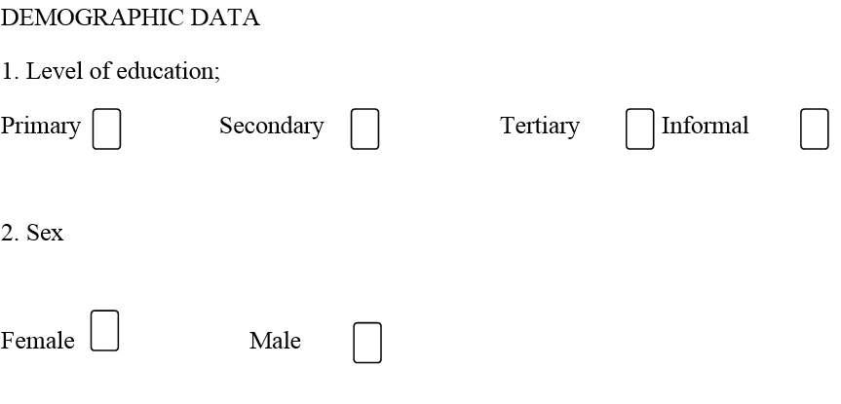
Close ended question (structured)

Slide 119
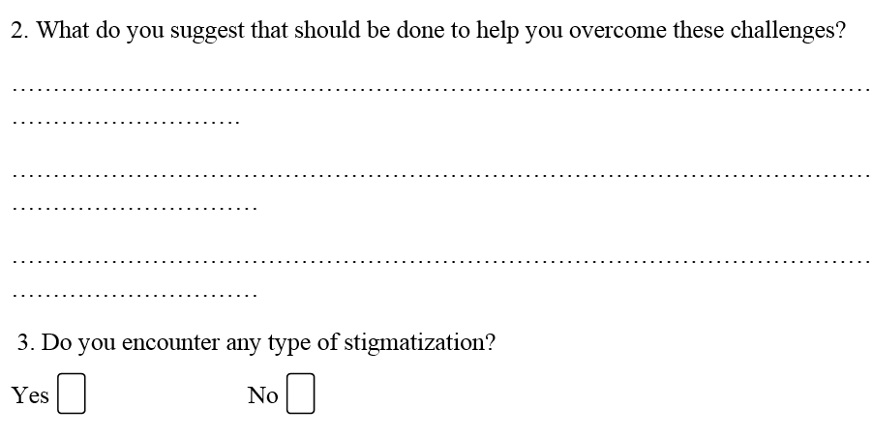
Open ended (unstructured)

Slide 120
Data collection tools

Slide 121
1. REVIEW OF EXISTING RECORDS
Advantages
Saves time and money
Limits respondent bias.
They cover a long period of time,
Saves the researcher from the worries and concerns of seeking the cooperation of the respondents.

Slide 122
Disadvantages
Since the researcher is not responsible for the collection and recording of the data, limiting biases and even ascertaining the authenticity of the data would be difficult. This can often result in doubts about the validity of the data.

Slide 123
2. STRUCTURED INTERVIEW SCHEDULE
It is a formal and written document where questions are asked orally in either face-to-face or telephone interviews.
The responses are then recorded by the researcher

Slide 124
3. FOCUS GROUP DISCUSSIONS (FGDs)
They are interviews with groups of 5-15 people whose opinions and experiences are solicited simultaneously.
The composition of the group is usually limited to those with similar characteristics, such as socio- economic status, so that the members feel free in contributing to the issue at hand.
The instrument allows the members to share their views, experiences and opinions.

Slide 125
4. INTERVIEWS
This is oral administration of questions.
Types of Interviews
Structured interviews
Unstructured Interviews
Face to face Interviews
Telephone interviews
In – Depth Interviews

Slide 126
5. OBSERVATION
This is a research tool that deals with analyzing things the way they are
It involves systemic watching, recording, analyzing and interpreting situations/ issues/ people’s behavior
Two Types:
Participatory observation
Non – Participatory observation

Slide 127
Participatory Observation
The observer becomes a part of or an active participant in the study
The researcher attempts to participate fully in the lives and activities of the subjects e.g. phenomenal studies

Slide 128
b) Non – Participant Observation
It is observing a given situation from the outside.
As the activities to be observed progress, the observer remains in the background, keenly observing and noting down events without comment.

Slide 129
6. QUESTIONNAIRES
These are research instruments where the researcher is expected to note down their views
Each person is asked to respond to similar questions

Slide 130
7. Key informant
Def: a person (or group of persons) who has unique skills or professional background related to the issue/intervention being evaluated,
Is knowledgeable about the project participants, or has access to other information of interest to the evaluator.

Slide 131
CONDUCTING A PRE- TEST OR PILOT STUDY
A pilot study may be defined as ‘a small version of a proposed study conducted to refine the methodology.
It is developed and conducted in a manner similar to the proposed study, using similar research respondents and the same setting.
A pre-test usually refers to a small scale trial of a particular research component.

Slide 132
Purpose of a Pre – Test or Pilot Study
1. To determine whether the proposed study is feasible
2. Identify any problems with the research design
3. To ensure that items in the data collection instrument are stated clearly and have the same meaning to all research respondents
4. To assess the time taken to administer the research instrument
5. To determine the effectiveness of the sampling technique used

Slide 133
7. Give the researcher the real experience in the field
8. Determine the effectiveness of the training given to research assistants where necessary
10. Evaluate the procedure for data processing and analysis

Slide 134
Ethical consideration

Slide 135
ETHICS IN RESEARCH
Ethics: is defined as that branch of philosophy which deals with one’s conduct and serves as a guide to one’s behaviour’.
Plooy (2003:118) describes ethics in research as ‘that which is morally justifiable’.
Research ethics fundamentally consist of collecting, analyzing and interpreting data in a way that respects the rights of your participants and respondents.

Slide 136
Principle of Respect for Persons
It involves two main convictions:
Individuals are autonomous, that is, they have the right to self-determination and this right should be respected. This means the research respondents have the right to:
a) Accept or decline to participate in the study without punishment or prejudice
b) Withdraw from the study at any stage
c) Withhold information
d) Seek clarification concerning the purpose of the study

Slide 137
b) Individuals with diminished autonomy require protection. This group includes children, the mentally impaired, unconscious patients and institutionalized persons.
For this group of persons, you will need to seek the consent of their legal guardian.

Slide 138
2. Principle of Justice
This includes the subjects’ right to fair selection and treatment and their right to privacy:
Right to Privacy: This is the freedom of an individual to determine the time, extent and the circumstances under which private information will be shared with or withheld from others.

Slide 139
Right to Anonymity :
Complete anonymity exists when the respondents’ identity is not revealed and the information collected is not linked to the respondent.
Right to Confidentiality
Confidentiality refers to the researcher’s responsibility to protect all data gathered within the scope of the project from being divulged or made available to any other person, which means the research data should never be shared with outsiders.

Slide 140
3. Principle of Beneficence
This principle involves an effort to secure the well being of persons.
It is the right to protect respondents from discomfort and harm.
This principle states that one should do what is good and above all should do no harm.

Slide 141
The Major Content of an Informed Consent
Informed consent revolves around the following three major elements:
  The type of information you need to obtain from the research subjects.
  The degree of understanding required of the subject in order to give consent.
  The fact that the subject has a free choice in giving consent.
Informed consent should be based on the following factors:
  The purpose of the research study
  Foreseen risks
  A guarantee of anonymity and confidentiality
  Identification of the researcher
  Number of subjects involved
  Benefits and compensation or lack of them

Slide 142
Access to Research Population
Prior to commencing the study, a formal application to the government of Kenya for permission to conduct the research must be written.
This should include two or more copies of the research proposal, accompanied by a recommendation letter from the supervisor(s) as required by the Kenyan authorities.
If your institution is authorized to conduct research, there may be a ‘Research and Ethics Committee’. Such a committee is usually vested with the authority of granting research permits, which you could use.
As a requirement, each research respondent should be requested to accept in writing and sign or affix a thumb print.

Slide 143
In cases where a respondent can neither read nor write, a consent form should be completed and duly signed after you have clearly explained the purpose of the research.
You should inform the respondents that their participation is absolutely voluntary and they may pull out of the study whenever they so wish.
As part of the contract, you should guarantee the respondents absolute confidentiality during and after the study.

Slide 144
8. Data collection & Presentation

Slide 145
DATA COLLECTION AND PRESENTATION
This is the precise, systematic gathering of information relevant to the research purpose or the specific objectives, questions or hypotheses of a study.
There are three main stages in the data collection process:
Stage One - Permission to Proceed(seeking consent)
Stage Two - Data Collection: Listing tasks, training assistants, available data, time
Stage Three - Data Handling

Slide 146
Sources Of Data Bias
The subject being studied changes their behavior as a consequence of the research.
The researcher may use non-standard measuring scales, imprecise or no guidelines for interviewing.
Researchers themselves vary in what they observe or measure, that is, observer variability. E.g., researchers may be selective in their observations, that is, observer bias

Slide 147
Data Handling guidelines
Check that the data gathered is complete and accurate.
At some stage questionnaires will have to be numbered.
Identify the person responsible for storing data and the place where it will be stored.
Decide how data should be stored. Record forms should be kept in the sequence in which they have been numbered.

Slide 148
Data Entry
Decide on a format, that is, the way you will organize the data in a file.
Next, design a code,
Then do the actual coding,
Data entry is the next step, which is keying the data into the computer so that you can process it.
Finally, data cleaning is the final check you make on the data file for accuracy, completeness, and consistency prior to the onset of analysis.

Slide 149
9. Data analysis & Interpretation

Slide 150
DATA ANALYSIS AND INTERPRETATION
Data Presentation: is the way in which data is displayed for viewing, interpreting & understanding
Methods of data presentation
Tables
Charts
Graphs
Frequency distribution tables
Histograms
Narrative method

Slide 151
The data presentation and analysis of qualitative research is quite different from that of presenting data collected when using the quantitative research method
This is because qualitative research uses words while quantitative uses numbers (numerical).
However, the principles are the same for both types.

Slide 152
Principles of Data Presentation and Analysis
a) Describe the sample population by providing a description of the respondents, for instance, key informants or focus group members: Age; Sex; Occupation; Educational background etc.
b) Order, reduce and/or code the data (data processing).
c) Display the summaries of data for interpretation.
d) Draw conclusions.
e) Develop strategies for testing or confirming the findings to prove their validity.

Slide 153
Measures of Central Tendency
Referred to as 'average' measures. They describe how closely related the data is.
Mode:
Median:
Mean:
Measures of Dispersion
Range
Variance
Standard Deviation

Slide 154
MEASUREMENT SCALES
Nominal Scale:
Ordinal Scale:
Interval Scale:
Ratio Scale:

Slide 155
QUALITATIVE DATA PRESENTATION AND ANALYSIS
1. Organizing the Data:
Involves putting all the information in a simple format that can be understood.
This is known as ‘cleaning’ the data.
2. Creating Categories, Themes and Patterns:
The researcher needs to be very familiar with the data so as to establish relationships among these categories.
One may use the research questions or discussion topics.

Slide 156
3. Analyzing and Interpreting the Data:
It involves evaluating the data to determine its usefulness and accuracy.
4. Writing the Report:
Unlike the quantitative research where the report writing is done after analyzing the data, in qualitative research techniques, the writing and the analysis go hand in hand.

Slide 157
QUANTITATIVE DATA PRESENTATION AND ANALYSIS
1. Tabular Method
Simple Table:
Usually a single line of characters explaining a few columns of information.
Compound Table:
A single line of characters has been described by two or more components of information.

Slide 158
2. Graphic Method
Graphs are used to organize and describe data.
This enables the reader to see at a glance the trend of distribution of the data. Graphs have two axes: vertical and horizontal.

Slide 159
There are three common graphic methods that you may use for presenting data, i.e. Bar Charts, histograms, frequency polygons
a) Bar Charts
Used when the data being presented is discrete or when the scale is nominal.
Bar charts are quite similar to histograms with the exception that there are spaces in bar charts.

Slide 160
b) Histograms
Unlike the bar chart, in the histogram there are no spaces between the bars.
A histogram in many cases is used to represent continuous variables.
c) Frequency Polygons
Frequency polygons are drawn based on the frequencies of the observations along the vertical axis against the group or class midpoints.
They form a polygon shape hence the name.

Slide 161
3. Charts Method:
They include; pie charts, doughnut charts, and scatter charts.
One of the commonest types of charts used is the pie chart.
Pie charts are relatively easy to interpret.
Each portion represents a variable.

Slide 162
Tables
No. | Weight | Frequency | Percentage (%)

Slide 163
Charts
Pie chart

Slide 164
Graphs
Simple bar graph

Slide 165
Graph Cont.…
Clustered bar graph

Slide 166
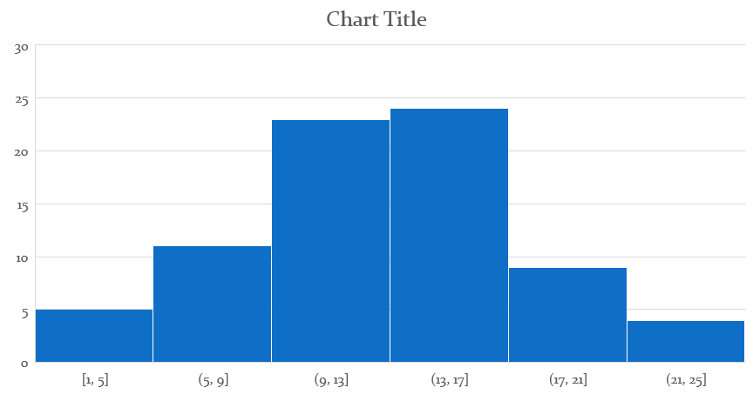
Graphs cont.…..
Histogram

Slide 167
Graphs cont.….
Line graphs

Slide 168
10. Communicating research findings, conclusion, recommendations, limitations & appendices

Slide 169
Communicating the Research Findings
Ways of Communicating the Research Findings include:
A written report for academic purposes, e.g. a dissertation or a thesis, which are a requirement in the obtaining of a certain academic level.
A written report prepared for managers and policy implementers.
A written report sent as an article for publication in refereed journals.
Presentations of the research findings in workshops, seminars and conferences.

Slide 170
STUDY LIMITATIONS
Limitations may include:
Inherent weakness in the sampling method, faulty designs and controls, data collection methods.
Time factor due to pressure of work.
Expenses involved if grant is not secured.
Possibility that some of the respondents may not agree to participate in the study.
Diverse spread of the target population, which may hinder easy access to respondents.

Slide 171
References and Bibliography
Cited References refer to a list of references which the researcher actually read and cited in the text.
Bibliography refers to the list of materials that were read whether they are cited or not.
Harvard referencing style is the mostly used. Examples
1. Journal article- one author: Moon, M. (1990) Consumer issues and the elderly. Journal of Consumer affairs, 24, 235 – 244
2. Journal Article – 2 authors: Hira, K. Tahira & Mugenda, OM (1987) Families’ perception of the bankruptcy process. Family Perspectives, 21, No. 1, May, 1987.

Slide 172
3. Journal article – more than 2 authors: Palmore, F.B., Fillennbaum, S. S. & George, L.K. (1984). Consequences of retirement. Journal of Gerontology, 39.
109 – 116
4. Papers presented at a conference
Mugenda, O. (1999) Redefining and Actualizing the Research Mission in African Universities. Paper presented at the BOLESWA Educational Research Symposium, Maseru, Lesotho, July, (1999).
5. Newspaper article: Ngw’eno, H.B. (1993, September). Multiply and fill the earth. The Weekly Review, pp 15 – 17.
6. A book: Haris, H.I. (1970) Why family Estate Planning? San Francisco, CA Bancroft-Whitney Co.

Slide 173
Referencing Within Text
Method 1:
The author’s last name and the year of documents publication are put after a paraphrased statement in a text; the name and the year are put in brackets.
Examples:
Among ……….with quality of life (Berry and William, 1987)or
Berry and William (1987) found………..with quality of life

Slide 174
Method 2:
The numbers representing names of authors are used.
Example:
Communication………to realize goals (1, 1987).
1 refers to the number against the particular reference as listed in the cited references.

Slide 175
BIAS
Systematic, non-random deviation of results and inferences from the truth, or processes leading to such deviation. Any trend in the collection, analysis, interpretation, publication or review of data that can lead to conclusions which are systematically different from the truth. (Dictionary of Epidemiology, 3rd Edition)
Can either be conscious or unconscious. In epidemiology, bias does not imply, as in common usage, prejudice or deliberate deviation from the truth.

Slide 176
TYPES OF BIAS
There are many types of biases, some studies being particularly prone to one type or another.
Two Main Types:
Selection
Information
1. Selection Bias:
This occurs when the subjects studied are not representative of the target population about which conclusions are to be drawn.

Slide 177
Types of Selection Bias
Migration Bias: results from migration of diseased subjects from an exposed status to an unexposed status during the course of a study.
Response Bias: Those who agree to be in a study may be in some way different with those who refuse to participate.
Volunteers may be different from those who are enlisted.
Membership bias (health worker effect)
Prevalence-incidence bias

Slide 178
Information Bias:
Results from the different quality of information and errors in obtaining and classifying information.
Types of Information Bias
Interviewer Bias: An interviewer’s knowledge may influence the structure of questions and the manner of presentation, which may influence responses.
Recall Bias: Those with a particular outcome or exposure may remember events more clearly or amplify their recollections.

Slide 179
Diagnostic Suspicion Bias: When potentially exposed subjects are subjected to more and in-depth diagnostic procedures and tests (cohort studies?).
Loss to Follow-up: Those that are lost to follow-up or who withdraw from the study may be different from those who are followed for the entire study.
Surveillance Bias: The group with the known exposure or outcome may be followed more closely or longer than the comparison group.
Observer Bias:
Misclassification Bias

Slide 180
ALL STEPS
1. Identify the research topic
2. Problem statement
3. Rationale/ justification/purpose of the study
4. Formulate research objectives, questions & hypothesis
5. Literature review
6. Research methodology
7. Describe the methods of measurement
8. Data collection and presentation
9. Data analysis & interpretation
10. Communicating research findings, conclusion, recommendations, limitations & appendices

