Slide 1
Respiratory Physiology
SAMUEL NGIGI K.
Copyright © The McGraw-Hill Companies, Inc. Permission required for reproduction or display.

Slide 2
Course Content
What is respiration
Purposes of respiration
Upper respiratory tract
Structure and Function of lungs
Mechanics of Breathing [pressure changes/ compliance/Pneumothorax/The work of breathing/Surfactants]

Slide 3
Course Content
3. Ventilation [pulmonary and Alveolar ventilation]
4. Anatomical and physiological dead spaces.
5. Composition of inspired, alveolar and expired air.

Slide 4
Course Content
6. Pulmonary circulation [Ventilation-perfusion ratio].
7. Lung Volumes and Pulmonary Function Tests
8. Review of Gas Laws
9. Diffusion of gases across alveolar walls [Gas exchange in the lungs]
10. The exchange of gasses in the tissues

Slide 5
Course Content
11. Gas Transport to the Periphery [The carriage of oxygen and Carbondioxide]
12. Acid-Base Regulation [The role of respiration in maintenance of blood pH]
13. Regulation & Control of Breathing [Neural, chemical and non-chemical control ]

Slide 6
Discovery Is To See What Everybody Has Seen And Think What Nobody Has Thought.
- Albert Szent - Gyorgyi
“No one, unless he is grossly ignorant of what science has done for mankind, can entertain any doubt of the incalculable benefits which will hereafter be derived from physiology.” — Charles Darwin

Slide 7
Introduction
Definition
Respiration is the processes resulting in exchange of gas between environment and cells
Respiratory System is divided into:
  Respiratory zone: site of gas exchange
  Conduction zone: gets air to the respiratory zone

Slide 8
Processes
ventilation
this represents the mechanics of breathing, i.e. moving gases into and from the airways
gas exchange
exchange of gas between air and blood (external respiration)
exchange of gas between blood and tissues (internal respiration)
oxygen utilization by tissues (internal respiration)

Slide 9
Respiration
Includes:
  Ventilation (breathing)
  Gas exchange between blood and lungs and between blood and tissues
  Oxygen utilization by tissues to make ATP
Ventilation and gas exchange in lungs = external respiration
Oxygen utilization and gas exchange in tissues = internal respiration

Slide 10
The Respiratory System
functions
  provide oxygen to tissues and remove carbon dioxide
  maintain tissue pH
general mechanics
  gas transporting system (blood)
Notes:
the pump for the gas transporting system is a positive pressure pump
- gas exchanging system (lungs)
the pump for the gas exchanging system is a negative pressure pump.

Slide 11
The Respiratory System
Includes respiratory airways leading into (& out of) lungs plus the lungs themselves
Pathway of air: nasal cavities (or oral cavity) > pharynx > trachea > primary bronchi (right & left) > secondary bronchi > tertiary bronchi > bronchioles > alveoli (site of gas exchange)

Slide 12
Gas Exchange in Lungs
Occurs via diffusion
O₂ concentration is higher in the lungs than in the blood, so O₂ diffuses into blood.
CO₂ concentration in the blood is higher than in the lungs, so CO₂ diffuses out of blood.

Slide 13
Alveoli
Air sacs in the lungs where gas exchange occurs
300 million of them
  Provide large surface area (760 square feet) to increase diffusion rate

Slide 14
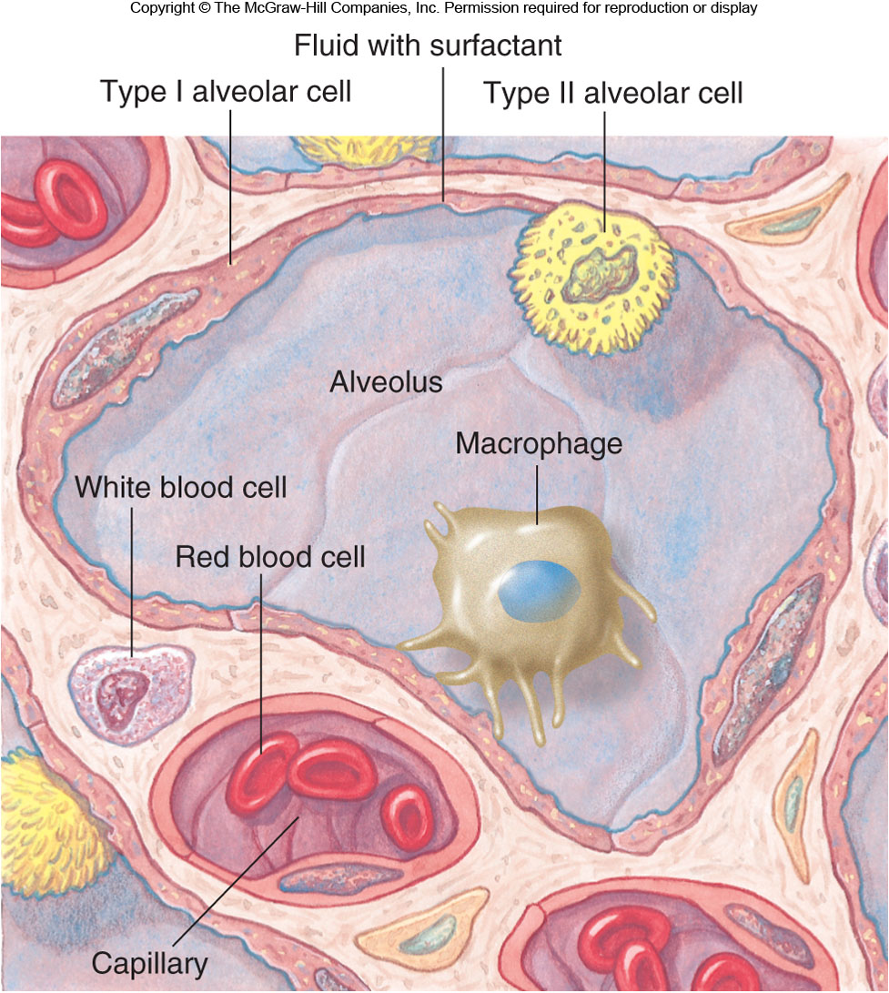
Alveoli

Slide 15
Alveolar Cells
Type I: 95−97% total surface area where gas exchange occurs
Type II: secrete pulmonary surfactant and reabsorb sodium and water, preventing fluid buildup

Slide 16
Conducting Zone
Air travels down the nasal cavity →
Pharynx →
Larynx →
Trachea →
Right and left primary bronchi →
Secondary bronchi →
Tertiary bronchi → (more branching) →
Terminal bronchioles →
Respiratory zone (respiratory bronchioles →
Terminal alveolar sacs

Slide 17
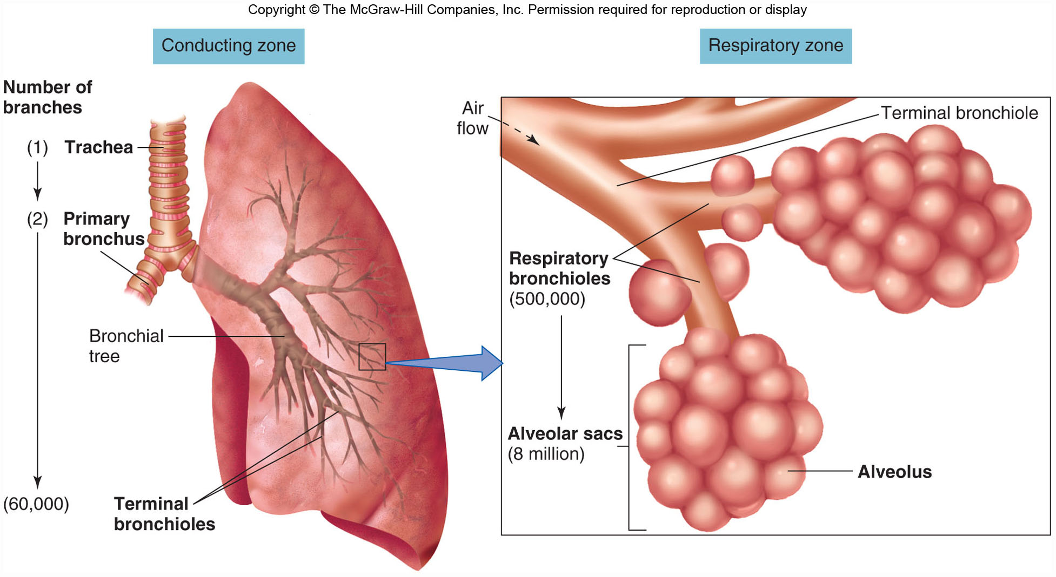
Respiratory Structures

Slide 18
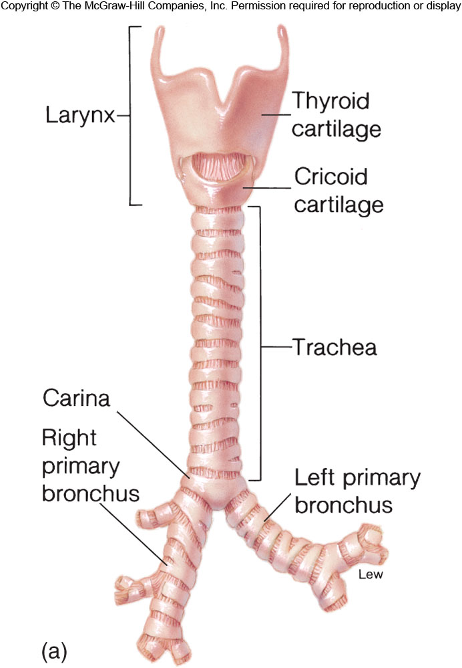
Trachea and Respiratory Bronchi

Slide 19
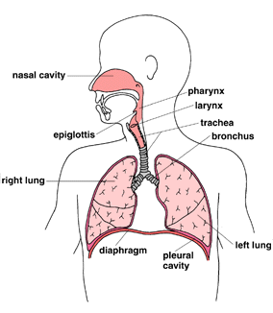

Slide 20
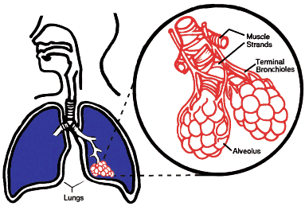

Slide 21
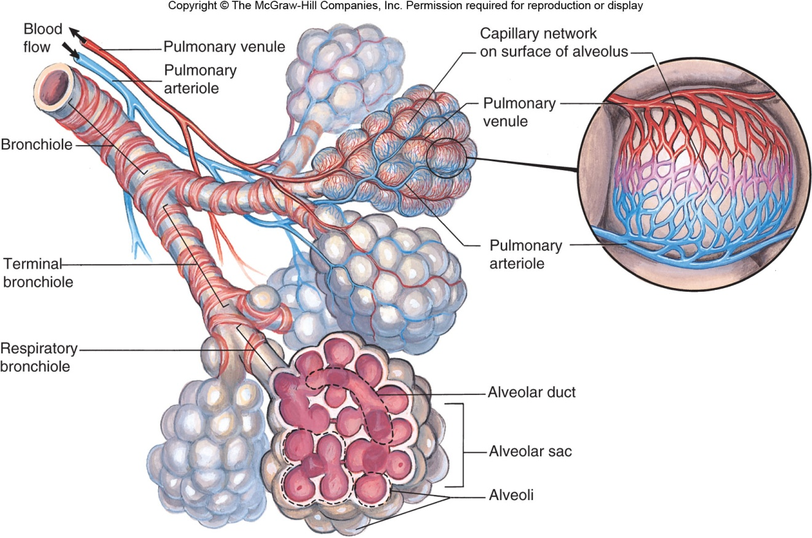
The Respiratory System

Slide 22
The respiratory tract, where external respiration occurs, starts at the nose and mouth.
There is a brief complication where the air stream crosses the path taken by food and drink in the pharynx:
  air flows on down the trachea while food normally passes down the esophagus to the stomach.
The trachea (windpipe) extends from the neck into the thorax, where it divides into right and left main bronchi, which enter the right and left lungs, breaking up as they do so into smaller bronchi and bronchioles and ending in small air sacs or alveoli, where gaseous exchange occurs.

Slide 23
The lungs are divided first into right and left, the left being smaller to accommodate the heart, then into lobes (three on the right, two on the left) supplied by lobar bronchi.
Bronchi, pulmonary arteries and veins (which supply deoxygenated blood and remove oxygenated blood), bronchial arteries and veins (which supply oxygenated blood to the substance of the lung itself) and lymphatics all enter and leave the lung by its root (or hilum).

Slide 24
Lymph nodes blackened by soot particles can often be seen here and the substance of the lung itself may be blackened by soot in city dwellers or heavy smokers.
Gaseous exchange relies on simple diffusion.
In order to provide sufficient oxygen and to get rid of sufficient carbon dioxide there must be:

Slide 25
A large surface area for gaseous exchange
a very short diffusion path between alveolar air and blood
concentration gradients for oxygen and carbon dioxide between alveolar air and blood.

Slide 26
The surface available in an adult is around 140m² in an adult, around the area of a singles tennis court.
The blood in the alveolar capillaries is separated from alveolar air by 0.6* in many places (1* = one thousandth of a mm) .
Diffusion gradients are maintained by

Slide 27
ventilation (breathing) which renews alveolar air, maintaining oxygen concentration near that of atmospheric air and preventing the accumulation of carbon dioxide
the flow of blood in alveolar capillaries which continually brings blood with low oxygen concentration and high carbon dioxide concentration
Haemoglobin in blood continually take dissolved oxygen from the blood and binds with it.

Slide 28
Outside air:
varies in temperature.
At the alveolar surface it must be at body temperature
varies from very dry to very humid.
At the alveolar surface it must be saturated with water vapor

Slide 29
contains dust and debris.
These must not reach the alveolar wall.
contains micro-organisms, which must be filtered out of the inspired air and disposed of before they reach the alveoli, enter the blood and cause possible problems.

Slide 30
The exchange of gases (O₂ & CO₂) between the alveoli & the blood occurs by simple diffusion:
O₂ diffusing from the alveoli into the blood & CO₂ from the blood into the alveoli.
Diffusion requires a concentration gradient.

Slide 31
So, the concentration (or pressure) of O₂ in the alveoli must be kept at a higher level than in the blood & the concentration (or pressure) of CO₂ in the alveoli must be kept at a lower lever than in the blood.
We do this, of course, by breathing - continuously bringing fresh air (with lots of O₂ & little CO₂) into the lungs & the alveoli.

Slide 32
Functions of Conducting Zone
Transports air to the lungs
Warms, humidifies, filters, and cleans the air
  Mucus traps small particles, and cilia move it away from the lungs.
Voice production in the larynx as air passes over the vocal folds

Slide 33
Conducting Zone of respiratory System

Slide 34
Thoracic Cavity
Contains the heart, trachea, esophagus, and thymus within the central mediastinum
The lungs fill the rest of the cavity.
  The parietal pleura lines the thoracic wall.
  The visceral pleura covers the lungs.
  The parietal and visceral pleura are normally pushed together, with a potential space between called the intrapleural space [pleural cavity].

Slide 35
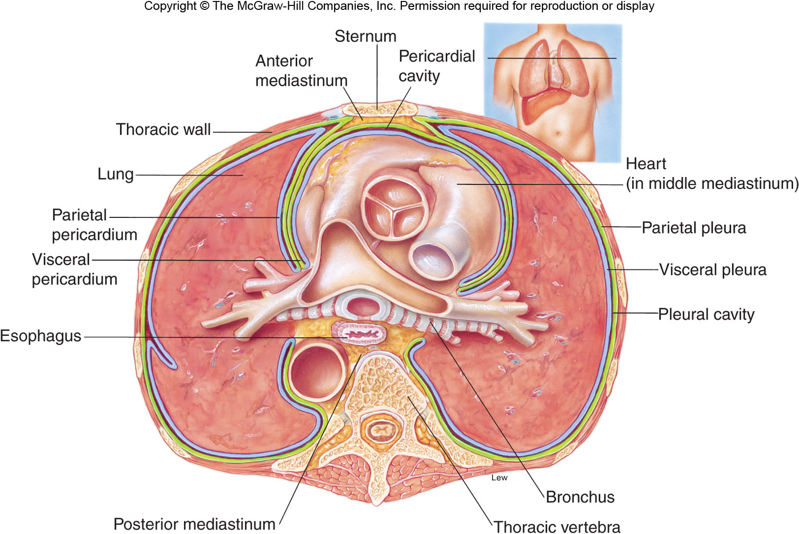
Thoracic Cavity Cross Section

Slide 36
COUPLING OF THE LUNGS AND THE CHEST WALL
The lungs are not directly attached to the chest wall but they change their volume and shape according to the changes in shape and volume of the thoracic cavity.
Pleura covering the surfaces of the lungs (visceral) or the thoracic cavity (parietal) together with a thin (20 μm) layer of liquid (pleural fluid) between them create a liquid coupling.
The pleural fluid lubricates the movement of the lungs within the cavity.

Slide 37
Mechanics of Breathing

Slide 38
Breathing
Also called pulmonary ventilation
  Inspiration: breathe in
  Expiration: breathe out
Accomplished by changing thoracic cavity/ lung volume
Breathing is an active process - requiring the contraction of skeletal muscles.

Slide 39
Muscles Involved in Breathing
The primary muscles of respiration include the external intercostal muscles (located between the ribs) and the diaphragm (a sheet of muscle located between the thoracic & abdominal cavities).
accessory muscles of inspiration
  sternomastoids-from behind ear to sternum
  Anterior serrati,scaleni

Slide 40
Muscles Involved in Breathing
muscles of expiration
  transversus abdominis
  rectus abdominis
  internal oblique
  external oblique, internal intercostals

Slide 41
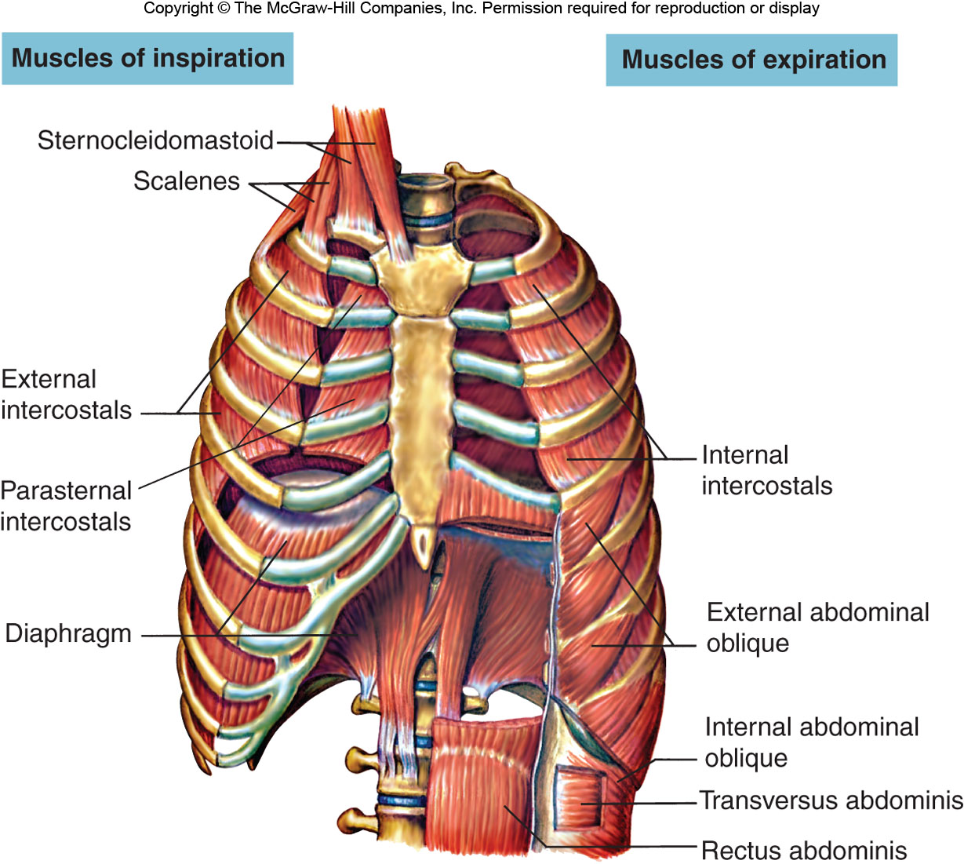
Muscles Involved in Breathing

Slide 42
Mechanics of breathing
Contraction of external intercostal muscles > elevation of ribs & sternum > increased front- to-back dimension of thoracic cavity > lowers air pressure in lungs > air moves into lungs
Contraction of diaphragm > diaphragm moves downward > increases vertical dimension of thoracic cavity > lowers air pressure in lungs > air moves into lungs:

Slide 43
Mechanics of breathing
Expiration is usually passive, and normally occurs by recoil of stretched tissue of
lungs and thorax.
At high rates of ventilation or with airway obstruction the muscles of expiration actively contract.
They lower the ribs and increase
intra-abdominal pressure which forces the diaphragm upward.

Slide 44
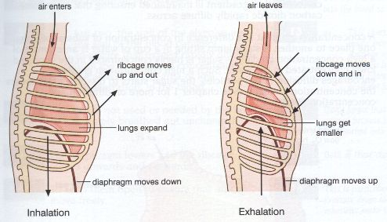
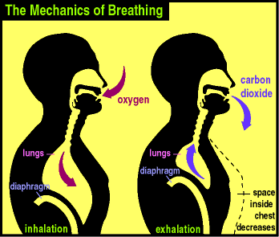
Mechanics of breathing

Slide 45
Mechanics of breathing
To exhale:
relaxation of external intercostal muscles & diaphragm > return of diaphragm, ribs, & sternum to resting position > restores thoracic cavity to pre inspiratory volume > increases pressure in lungs > air is exhaled

Slide 46
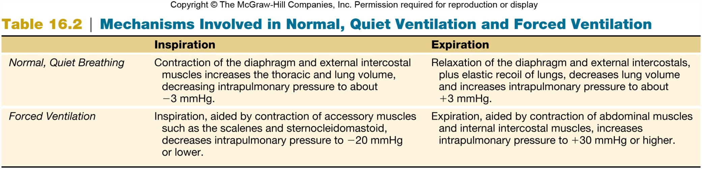
Normal vs. Forced Breathing

Slide 47
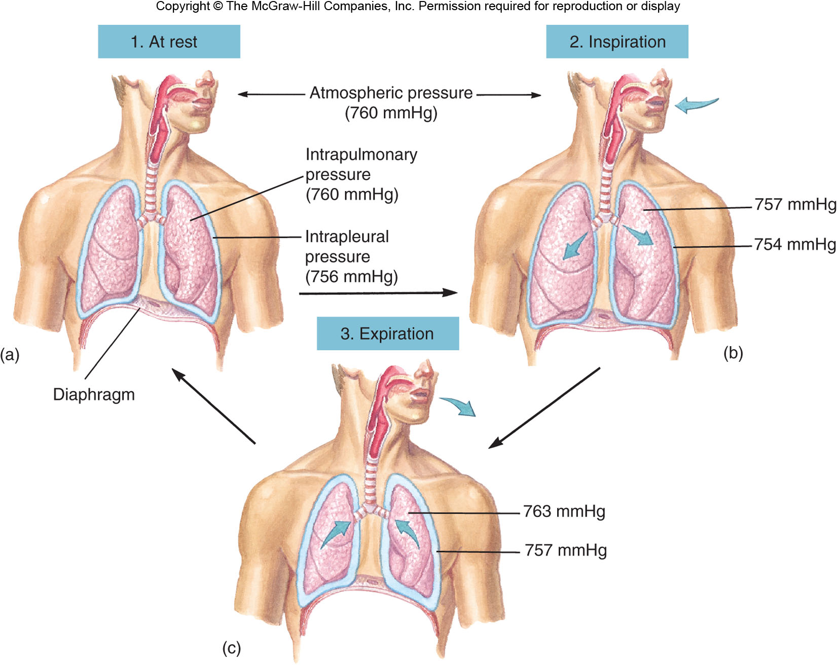
Mechanisms of Breathing

Slide 48
Pressure
Atmospheric pressure [barometric pressure]: pressure of air outside the body
Intrapulmonary pressure [alveolar pressure]: pressure in the lungs
Intrapleural pressure: pressure within the intrapleural space (between parietal and visceral pleura)

Slide 49
Pressure cnt’d…
-ve force always required on the outside to keep the lungs expanded
Provided by –ve pressure in the pleural space
-ve pressure provided by continuous pumping of fluid from this space by the lymphatics
Normal collapse pressure of lungs about -4mmHg, pleural pressure must be at least -4mmHg to keep lungs expanded

Slide 50
Pressure cnt’d…
Usual pressure about -7mmHg
Thus negativity of pleural fluid keeps normal lungs pulled against the parietal pleural of the chest cavity except for an extremely thin layer of mucoid fluid that acts as a lubricant

Slide 51
Pressure Changes during inspiration & expiration
lungs are housed in a hermetically sealed compartment known as the pleural space
As the external intercostals & diaphragm contract, the lungs expand.
The expansion of the lungs causes the pressure in the lungs (and alveoli) to become slightly negative relative to atmospheric pressure.
Notes:
Hermetically: in a way that is completely airtight.

Slide 52
Pressure Changes during inspiration & expiration
As a result, air moves from an area of higher pressure (the air) to an area of lower pressure (lungs & alveoli).
During expiration, the respiration muscles relax & lung volume decreases.
This causes pressure in the lungs (and alveoli) to become slight positive relative to atmospheric pressure. As a result, air leaves the lungs.
Animation\Ventilation Animation.ppsx

Slide 53
by changing the dimensions of the thorax one can increase or decrease intrapleural pressure, which in turn will influence transpulmonary pressure.
the muscles of respiration regulate the size of the thorax.
they act as a negative pressure pump to enlarge the thorax, and lower the pressure in the alveoli to below atmospheric pressure.

Slide 54
Pressure Differences When Breathing
Inspiration: Intrapulmonary pressure is lower than atmospheric pressure.
  Pressure below that of the atmosphere is called subatmospheric or negative pressure
Expiration: Intrapulmonary pressure is greater than atmospheric pressure.

Slide 55
Ventilation
Air moves from higher to lower pressure.
  Pressure differences between the two ends of the conducting zone occur due to changing lung volumes.
  Compliance, elasticity, and surface tension are important physical properties of the lungs.

Slide 56
Boyle’s Law
States that the pressure of a gas is inversely proportional to its volume
  An increase in lung volume during inspiration decreases intrapulmonary pressure to sub-atmospheric levels.
    Air goes in.
  A decrease in lung volume during exhalation increases intrapulmonary pressure above atmospheric levels.
    Air goes out.

Slide 57
Compliance of the Lungs
The extent to which the lungs expands for each unit increase in transpulmonary pressure is called compliance [ΔV/ΔP]
The compliance of the human lung is 0.15 L/cm H₂O.
However, it gets stiffer (compliance smaller) as it is expanded above the normal range.

Slide 58
Compliance is reduced when:
The pulmonary venous pressure is increased and the lung becomes engorged with blood
There is alveolar oedema due to insufficiency of alveolar inflation
The lung remains unventilated for a while and
Because of diseases causing fibrosis of the lung e.g. chronic restrictive lung disease.
Notes:
Oedema, also known as dropsy, is the medical term for fluid retention in the body. The build-up of fluid causes affected tissue to become swollen. The swelling can occur in one particular part of the body.
Fibrosis, also known as fibrotic scarring, is a pathological wound healing in which connective tissue replaces normal parenchymal tissue to the extent that it goes unchecked, leading to considerable tissue remodelling and the formation of permanent scar tissue.

Slide 59
On the contrary in chronic obstructive pulmonary disease (COPD, e.g. emphysema) the alveolar walls progressively degenerate, which increases the compliance.
The lung compliance is changed according to the lung size
At birth the lung compliance is the smallest and increased with age (until adulthood) due to increase in the size of the lungs.
Notes:
Emphysema is a lung condition that causes shortness of breath. In people with emphysema, the air sacs in the lungs (alveoli) are damaged.

Slide 60
CHEST WALL COMPLIANCE
Changes in chest wall compliance are less common than changes in the lung compliance:
pathologic situations preventing the normal movement of the rib cage, such as, distortion of the spinal column,
pathologic (cancer) or physiologic (pregnancy) reasons increasing the intra abdominal pressure,
stiff chest, such as broken ribs.

Slide 61
Elasticity
Lungs return to initial size after being stretched.
  Lungs have lots of elastin fibers.
  Because the lungs are stuck to the thoracic wall, they are always under elastic tension.

Slide 62
Surface Tension
Resists distension
Exerted by fluid secreted in the alveoli
Raises the pressure of the alveolar air as it acts to collapse the alveolus

Slide 63
SURFACE TENSION
A thin film of liquid lines the alveoli and the surface tension of this film is another important factor in the pressure-volume relationship of the lung.
The surface tension arises because the attractive forces between adjacent molecules of water are much stronger than those of between the liquid and the gas.
As a result of that, the liquid surface is always attempting to contract.

Slide 64
SURFACE TENSION
At the interface between the liquid and the alveolar gas, intermolecular forces in the liquid tend to cause the area of the lining to shrink (the alveoli tend to get smaller).
the attraction of the liquid molecules creates a force called surface tension.
This surface tension increases as water molecules come closer together, which is what happens when we exhale & our alveoli become smaller (like air leaving a balloon).

Slide 65
SURFACE TENSION
Potentially, surface tension could cause alveoli to collapse and, in addition, would make it more difficult to 're-expand' the alveoli (when you inhaled).
Both of these would represent serious problems: if alveoli collapsed they'd contain no air & no oxygen to diffuse into the blood &, if 're-expansion' was more difficult, inhalation would be very, very difficult if not impossible.
Fortunately, our alveoli do not collapse & inhalation is relatively easy because the lungs produce a substance called surfactant that reduces surface tension.

Slide 66
Law of Laplace
Pressure is directly proportional to surface tension and inversely proportional to radius of alveolus.
  Small alveoli would be at greater risk of collapse without surfactant.

Slide 67
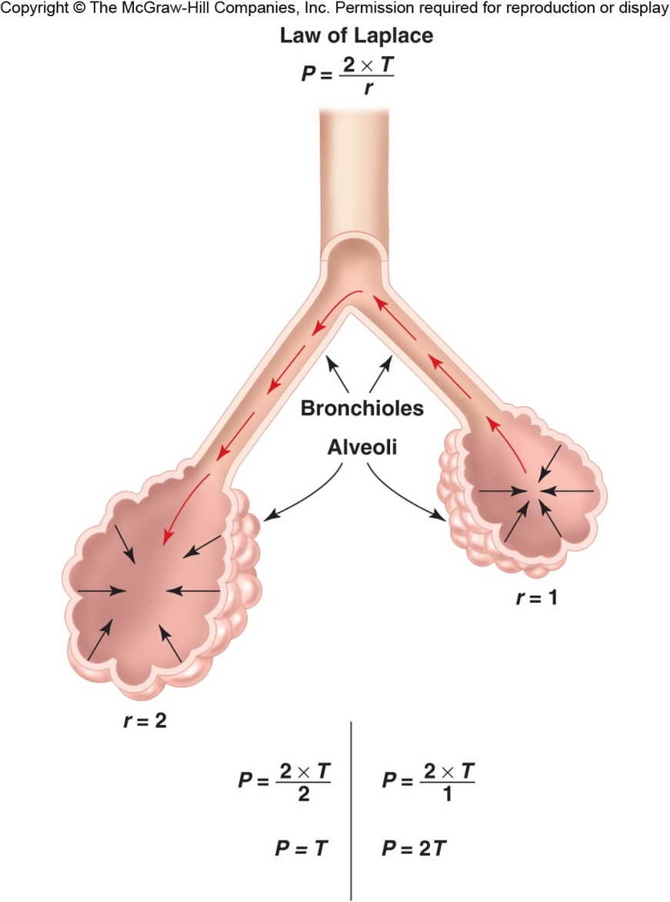
Law of Laplace

Slide 68
SURFACE TENSION
Surfactant is produced by type 2 alveolar epithelial cells and its major constituent is dipalmitoyl phosphotidylcholine (DPPC), a phospholipid with detergent properties.
Other important components include surfactant apoproteins and calcium.
The phospholipid DPPC is synthesized in the lung from fatty acids that are either extracted from the blood or are themselves synthesized in the lung.
DPPC along with other phospholipids is responsible for reducing the surface tension.
They do not dissolve in the fluid but spread over its surface

Slide 69
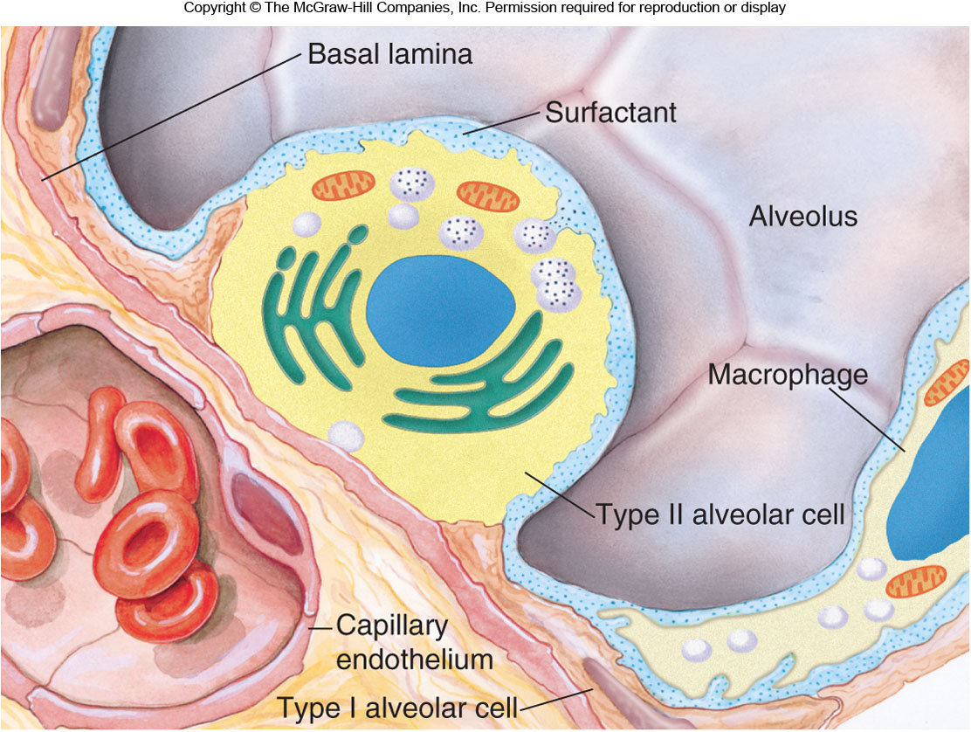
Surfactant

Slide 70
SURFACE TENSION
Synthesis is fast and there is a rapid turnover of surfactant.
If the blood flow to a region of lung is restricted due to an embolus the surfactant may be depleted in the effected area.
Surfactant synthesis starts relatively late in foetal life [from 7th month] and premature babies without adequate amount of surfactant develop respiratory distress syndrome [RDS] of the new born which could be life threatening.

Slide 71
SURFACE TENSION
What are the advantages of having surfactant and the low surface tension?
It increases the compliance of the lung
It reduces the work of expanding the lung with each breath
It stabilizes the alveoli (thus the smaller alveoli do not collapse at the end-expiration)
It keeps the alveoli dry (as the surface tension tends to collapse alveoli, it also tends to suck fluid into the alveolar space from capillaries).

Slide 72
Work of breathing
The respiratory muscles perform work to cause inspiration and not to cause expiration.
The work performed by the muscles during inspiration can be divided into 3 fractions
  Work required to expand the lungs against the lung and chest elastic forces-compliance work or elastic work.
  Work required to overcome the viscosity of the lungs and chest wall structures-tissue resistance work.
  Work required to overcome airway resistance during movement of air into the lungs-airway resistance work.

Slide 73
Work of breathing
Most of the work performed by the respiratory muscle is used to expand the lungs.
Only a small percentage of the total work is used to overcome tissue resistance [tissue viscosity] and more to overcome airway resistance.
In pulmonary disease all 3 type of work are frequently vastly increased.

Slide 74
Lung Volumes & Capacities
The total volume contained in the lung at the end of a maximal inspiration is subdivided into volumes and subdivided into capacities.
There are four volume subdivisions which:
  do not overlap.
  can not be further divided.
when added together equal total lung capacity.
Lung capacities are subdivisions of total volume that include two or more of the 4 basic lung volumes.

Slide 75
Lung Volumes & Capacities
Basic lung volumes
Tidal Volume (TV). The amount of gas inspired or expired with each breath (500 ml)
Inspiratory Reserve Volume (IRV). Maximum amount of additional air that can be inspired from the end of a normal inspiration [3000 ml].

Slide 76
Lung Volumes & Capacities
Expiratory Reserve Volume (ERV). The maximum volume of additional air that can be expired from the end of a normal expiration [1100].
Residual Volume (RV). The volume of air remaining in the lung after a maximal expiration [1200].

Slide 77
Lung Volumes & Capacities
Basic lung capacities
Total Lung Capacity (TLC). The volume of air contained in the lungs at the end of a maximal inspiration.
  Called a capacity because it is the sum of the 4 basic lung volumes. TLC=RV+IRV+TV+ERV

Slide 78
Lung Volumes & Capacities
Vital Capacity (VC). The maximum volume of air that can be forcefully expelled from the lungs following a maximal inspiration.
  Called a capacity because it is the sum of inspiratory reserve volume, tidal volume, and expiratory reserve volume. VC=IRV+TV+ERV=TLC-RV

Slide 79
Lung Volumes & Capacities
Functional Residual Capacity (FRC). The volume of air remaining in the lung at the end of a normal expiration.
  Called a capacity because it equals residual volume plus expiratory reserve volume. FRC=RV+ERV
Inspiratory Capacity (IC). Maximum volume of air that can be inspired from end expiratory position.
  Called a capacity because it is the sum of tidal volume and inspiratory reserve volume. IC=TV+IRV

Slide 80
Minute Respiratory volume (Total Minute Vol)
This is the total amount of new air moved into the respiratory passage each minute.
  This is equal to TV x Respiratory rate
    TV = 500 ml
    Respiratory rate = 15/min
MRV = ?L/min

Slide 81
Lung Volumes & Capacities
A simple method of measuring lung volumes [a measure of pulmonary function] is by the use of a spirometer [a process called spirometry]
The subject breathes into a closed system in which air is trapped (bell).
As the subject breathes air movement into or out of the mouthpiece causes the bell to rise (inspiration) or fall (expiration).
Corresponding movements of an attached pen register the change in volume on a rotating drum recorder.
From such a recording we could measure lung volumes.

Slide 82
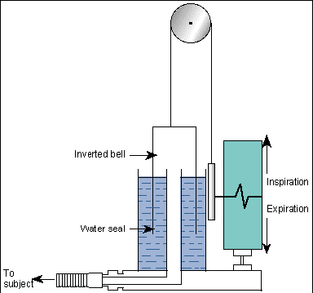

Slide 83
Can diagnose restrictive and disruptive lung disorders

Slide 84
Functional Residual Capacity (FRC) and Residual Volume (RV) cannot be measured with a spirometer.

Slide 85
Functional Residual Capacity (FRC) and Residual Volume (RV) cannot be measured with a spirometer.
WHY?

Slide 86
Residual Volume (RV). The volume of air remaining in the lung after a maximal expiration [1200].
Functional Residual Capacity (FRC). The volume of air remaining in the lung at the end of a normal expiration.
  Called a capacity because it equals residual volume plus expiratory reserve volume. FRC=RV+ERV

Slide 87
Residual Volume is determined by one of 3 techniques.
  Gas [[Nitrogen or Helium] dilution techniques.
  Body Plethysmography
  Radiographic Determination.
Notes:
1. Gas [[Nitrogen or Helium] dilution techniques.
In this technique a subject is connected to a spirometer filled with a gas [Nitrogen or Helium] which is virtually insoluble in the blood
2. Body Plethysmography.
A plethysmograph is an instrument for measuring changes in volume within an organ or whole body (usually resulting from fluctuations in the amount of blood or air it contains).

Slide 88
PULMONARY FUNCTION TESTS
Pulmonary function tests are very useful tests to diagnose several lung diseases.
The simplest but one of the most informative tests of lung function is a forced expiration.

Slide 89
Forced Expiratory Volume (FEV): It is the volume of gas exhaled in one second by a forced expiration following a full inspiration (FEV₁).
The total volume of the gas exhaled after a full inspiration represents the vital capacity.
However, this value could be slightly smaller than the vital capacity measured with a slow (normal speed) expiration.
Therefore, this value is called forced vital capacity (FVC).
The normal ratio of the FEV1 is 80 % of FVC.

Slide 90
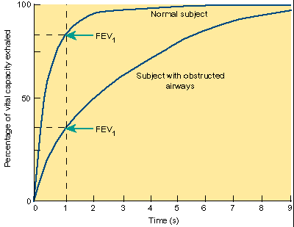

Slide 91
On the basis of the knowledge obtained from these functional tests, lung diseases can be classified as restrictive or obstructive

Slide 92
LUNG CAPACITIES AND RESPIRATORY DISEASES
A. Restrictive Disease.
Respiratory disease which make it more difficult to get air in to the lungs.
Lung tissue is damaged.
They “restrict” inspiration.
  Includes fibrosis, muscular diseases, pulmonary fibrosis, emphysema and chestwall deformities.
Decreased VC,TLC, RV, FRC but Forced expiration is normal

Slide 93
LUNG CAPACITIES AND RESPIRATORY DISEASES
Obstructive Disease.
Respiratory disease which make it more difficult to get air out of the lungs.
Lung tissue is normal
Includes chronic bronchitis and asthma.
VC is decreased or normal; increased TLC, RV, FRC but forced expiration is reduced.

Slide 94
Asthma
Symptoms: dyspnea (shortness of breath) and wheezing
Caused by inflammation, increased mucus secretion, and constriction of bronchioles
Often called airway hyperresponsiveness

Slide 95
Asthma
Allergic asthma: triggered by allergens stimulating T-lymphocytes to secrete cytokines and recruit eosinophils and mast cells, which contribute to inflammation
Can also be triggered by cold or dry air
Reversible with bronchodilators and glucocorticoids

Slide 96
Chronic Obstructive Pulmonary Disease (COPD)
COPD is characterized by chronic inflammation with narrowing of the airways, and alveolar destruction
  Includes emphysema and chronic obstructive bronchiolitis
Accelerated decline in FEV
Inflammation involves macrophages, neutrophils, and cytotoxic T cells

Slide 97
Chronic Obstructive Pulmonary Disease (COPD)
  Although asthma is also classified as chronic inflammatory disorder, its distinguish from COPD in that the obstruction in asthma is largely reversible with inhalation of a bronchodilator.
  The inflammatory cells in COPD are macrophages, neutrophils, and cytotoxic T lymphocytes, whereas in asthma they are helper T lymphocytes, eosinophils, and mast cells.

Slide 98
Chronic Obstructive Pulmonary Disease (COPD)
Excessive mucus production and inflammation triggered by smoking
Most people with COPD smoke.
  Smoking also promotes the infiltration of obstructing fibrous tissue and muscle in the airways and remodeling of blood vessels in the lungs, leading to pulmonary hypertension.
There is no cure. Cessation of smoking once COPD has begun does not seem to stop its progression
5th leading cause of death

Slide 99
Emphysema
Destruction of alveoli
Reduces surface area for gas exchange
With fewer alveoli to put pressure on bronchioles, they collapse during expiration.
Smoking is the most common cause. It triggers inflammation and destruction of alveoli by immune cells [cytokines]

Slide 100
Pulmonary Fibrosis
Some people accumulate fibrous tissues in the lungs when alveoli are damaged.
  May be due to inhalation of small particles
  Example: black lung in miners

Slide 101
Interpretation of Vital Capacity Measurements
Most lung disease reduces vital capacity.
When interpreting pulmonary function tests;
  Note that ventilation is not necessarily affected since we don’t use our entire vital capacity to breath even during maximal exercise.
  Note also that vital capacity shows tremendous variation in normal individuals even when corrected for age, sex, height, and weight.

Slide 102
Interpretation of Vital Capacity Measurements
  Values may not be considered abnormal unless they are 20% greater or less than predicted values.
  Body position. Vital capacity decreases when lying down because pulmonary blood volume increases and the diaphragm is pushed toward thorax.
Vital capacity is most useful when followed over the clinical course of a disease since normal values of VC can be found in diseased patients who have high values of VC under normal conditions.

Slide 103
Interpretation of Vital Capacity Measurements
Pulmonary factors that can reduce vital capacity;
Absolute reduction in distensible lung tissue.
Increased stiffness of lungs can’t get enough air in, e.g. alveolar edema, respiratory distress syndrome (surfactant abnormality), or infiltrative interstitial lung diseases.
Increased residual volume. Can’t get enough air out, e.g. emphysema or asthma

Slide 104
Interpretation of Vital Capacity Measurements
Extrapulmonary factors that can reduce vital capacity
Limited thoracic expansion. Examples include thoracic deformities and pleural fibrosis.
Limitations on diaphragmatic descent. Examples include ascites and pregnancy.
Nerve or muscle dysfunction. Examples include pain from surgery or rib fracture and primary neuromuscular disease (e.g. Guillain-Barré Syndrome).
Notes:
Guillain-Barre (gee-YAH-buh-RAY) syndrome is a rare disorder in which your body's immune system attacks your nerves. Weakness and tingling in your extremities are usually the first symptoms. These sensations can quickly spread, eventually paralyzing your whole body.

Slide 105
Check point
Describe the actions of the diaphragm and external intercostal muscles during inspiration.
How is quiet inspiration produced
Explain how the total minute volume is calculated and how the value is affected by exercise
How are the vital capacity and the forced expiratory volume measurements affected by asthma and pulmonary fibrosis? Give reasons for these effects

Slide 106
Alveolar ventilation
The rate at which new air reaches the gas exchange areas [alveoli, alveolar sacs, alveolar ducts, and respiratory bronchioles] per minute.
It is equal to:
Respiratory rate X amount of new air entering the lungs [Tidal Vol – Dead space volume]
Alveolar ventilation is one of the major factors determining the conc of O₂ and CO₂ in the alveoli

Slide 107
Dead Space
During normal quiet respiration, the vol of air in the tidal air is only enough to fill the respiratory passages down to the terminal bronchioles.
Only a small fraction of the inspired air actually flow into the alveoli from the terminal bronchioles into the alveoli by diffusion.
The air that fills the respiratory passages where there is no gas exchange [nose, pharynx, and trachea] is called dead space air because it is not useful for gas exchange process.
The respiratory passages where there is no gas exchange is called dead space.

Slide 108
2 type of dead space:
Anatomic dead space: dead space vol in all the respiratory passages besides the alveoli and related gas exchange areas [i.e. conducting zone of the respiratory system].
Physiologic dead space: air that reaches non functional alveoli due to absent or poor blood flow through adjacent pulmonary capillaries.
Dead space is measured by continuous measurement of N₂ concentration in expired air after a previous inspiration of pure O₂.

Slide 109
The air in the DS reaches the alveoli first, so the amount of fresh air reaching the alveoli with each breath is less than the TV.
For example, if the anatomical DS is 150ml and TV is 500ml, the % of fresh air reaching the alveoli is 350/500 X 100% = 70%
If the TV is increased to 2000ml, the amount of fresh air reaching the alveoli is increased to 93%
An increased TV can thus be a factor in the respiratory adaptations to exercise and high altitude

Slide 110
Pulmonary Circulation

Slide 111
Pulmonary Circulation
Lung is the only organ to receive entire cardiac output i.e. the quantity of blood flowing through the lungs is equal to that flowing through the systemic circulation (5.5 L/minute cardiac output).
As a result, factors that control CO [peripheral factors] also control pulmonary blood flow.
Pulmonary vessels act as passive, distensible tubes that enlarge with increasing pressure and narrows with decreasing pressure.
Pulmonary artery branches run parallel to airways to the level of the terminal bronchioles where they break off to form the capillaries in the alveolar walls.

Slide 112


Slide 113
Pulmonary Circulation
The arteries are thin but have larger diameter than their counterparts in the systemic circulation.
Thus pulmonary arteries have large compliance which allow them to accommodate about 2/3 of the stroke volume output of the right ventricle
The pulmonary veins are short but their compliance is similar to those in the veins in the systemic circulation.
Pulmonary capillaries are so dense within the alveolar walls that capillary blood flow in the alveolar wall can be thought of as sheet rather than individual vessels

Slide 114
Functions of pulmonary circulation
Filter: The pulmonary capillaries trap thrombi and other sources of emboli and prevent them from entering the systemic circulation.
Blood Reservoir: A portion of the 900 ml of pulmonary blood volume (contained mostly in the veins) can be used to sustain left ventricle output transient during decreases in right heart output (blood reservoir for left ventricle).
Pulmonary circulation supplies nutrients for the alveolar ducts and alveoli.
Bronchial vessels from the systemic circulation supply nutrition to the rest of the lung (<3% cardiac output).

Slide 115
Pulmonary Circulation
Pressures in the pulmonary circulation are much lower than pressures in the systemic circulation.
The pressure difference between the left atrium and the pulmonary artery is only 10 mmHg.
Vascular resistance must be very low.
  Low pressure/low resistance pathway
  Reduces possibility of pulmonary edema

Slide 116
Pulmonary Circulation
Mean capillary hydrostatic pressure is about 7‑10 mmHg.
  Major pressure drop in pulmonary circulation occurs across the capillaries.
  Major pressure drop in systemic circulation occurs across the arterioles.
Notes:
The pulmonary circulation is a relatively low pressure system compared to the systemic circulation because the pulmonary arteries are not as muscularized as their systemic counterparts.
Arterioles have the most increase in resistance and cause the largest decrease in blood pressure. The constriction of arterioles increases resistance, which causes a decrease in blood flow to downstream capillaries and a larger decrease in blood pressure.

Slide 117
A unique property of the pulmonary circulation is its ability to decrease resistance as cardiac output increases.
Two mechanisms are responsible for this function.
  Capillary recruitment: opening of initially closed capillaries when cardiac output increases.
  Capillary distension: increase in caliber of vessels

Slide 118
What is the significance of the decrease in Pulmonary pressure with increasing Cardiac output?

Slide 119
The decrease in pulmonary pressure with increased cardiac output has several beneficial effects
  minimize the load on the right heart,
  prevents pulmonary oedema,
  maintains the adequate flow rate of the blood in the capillary and

Slide 120
Hypoxic vasoconstriction
If alveolar PO₂ falls to a region of the lung, the pulmonary arterioles in that region constrict.
Vasoconstriction begins when PAO₂ falls below about 70 mmHg.
Blood flow will stop almost completely at very low PAO₂ .
Mechanism is unknown but may involve the release of chemical mediators.
It does not involve nerves since it occurs in isolated lungs.
Hypoxic vasoconstriction is beneficial in that blood flow goes to ventilated areas where gas exchange can occur.

Slide 121
  Opposite of systemic arterioles that constrict when partial pressure O₂ in tissues is high. This ensures that only tissues that need oxygen are sent blood.
  Other substances known to increase pulmonary vascular resistance include
      serotonin,
      histamine and
      norepinephrine.
Substances known to relax pulmonary vascular smooth muscle include
    isoproterenol and
    acetylcholine.

Slide 122
Zones of the lung.
The lung can be divided into 3 zones depending on the relationship between pulmonary artery pressure (PPA), alveolar pressure (PALV), and pulmonary venous pressure (PPV).
    Zone 1. P_{ALV} > P_{PA} > P_{PV}.
    Zone 2. P_{PA} > P_{ALV} > P_{PV}.
    Zone 3. P_{PA} > P_{PV} > P_{ALV}.
Due to hydrostatic effects, arterial and venous pressures fall as we move from the bottom to the top of the lung.
Since the density of air is small, alveolar pressure is the same everywhere

Slide 123
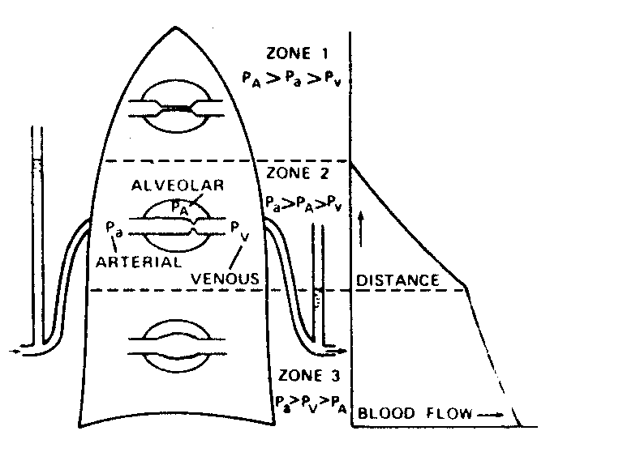

Slide 124
VENOUS ADMIXTURE (PULMONARY SHUNT)
There is usually no separate venous system draining bronchial vessels.
Deoxygenated bronchial venous blood mixes with oxygenated pulmonary venous blood in pulmonary veins and enters the left atrium rather passing back to the right atrium .
Right to left shunt. Said to occur when deoxygenated blood (systemic veins, pulmonary artery) contaminates normally oxygenated blood (pulmonary veins, aorta).
  Deoxygenated blood draining from the bronchial circulation.
  Coronary thebesian drainage directly into the left atrium and ventricle.
  Blood passing through non‑ ventilated areas of the lung.
Notes:
The smallest cardiac veins, also known as the Thebesian veins, are small valveless veins in the walls of all four heart chambers.

Slide 125
Two factors determine the effect of right to left shunt.
  Amount of deoxygenated blood that is added.
  Saturation and thus the O₂ content of the shunted blood.

Slide 126
Gas Exchange in the Lungs

Slide 127
Introduction to Exchange of Gases
External respiration - exchange of O₂ & CO₂ between external environment & the cells of the body
  efficient because alveoli and capillaries have very thin walls & are very abundant (the lungs have about 300 million alveoli with a total surface area of about 75 square meters)
Internal respiration - intracellular use of O₂ to make ATP occurs by simple diffusion along partial pressure gradients

Slide 128
Factors affecting diffusion of gases
1. Diffusion distance
The shorter the diffusion distance, the higher the diffusion.
In lungs alveolar is one cell thick and the capillary membrane is also one cell thick.
This leads to rapid diffusion of the gases between the two sides
Blood in the alveolar capillaries is separated from alveolar air by 0.6* in many places (1* = one thousandth of a mm) .

Slide 129
The surfactant also keeps the alveolar surface dry hence a thinner membrane
Low pressure in pulmonary circulation also aids to avoid edema which could lead to increase in this diffusion distance
In pneumonia where there is edema in the alveoli, there is inadequate diffusion of O2
In heart failure also, there is accumulation of blood in the lungs thus affecting gaseous exchange

Slide 130
2. Surface area of gaseous exchange area
This is mitigated by presence of many alveoli ( about 30 million alveoli). There is extensive blood supply to the alveoli via the alveolar capillaries such that the supply appears like a continuous sheet of blood seperated by the capillary membrane
The surface available in an adult is around 140m² , around the area of a singles tennis court

Slide 131
3.Concentration gradients.
This gradient is maintained by
ventilation (breathing) which renews alveolar air, maintaining oxygen concentration near that of atmospheric air and preventing the accumulation of carbon dioxide
the flow of blood in alveolar capillaries which continually brings blood with low oxygen concentration and high carbon dioxide concentration
Haemoglobin in blood continually removes dissolved oxygen from the blood and binds with it.

Slide 132
Others
1. Temperature but since temperature is the body temp, then this is not a variable
2. Solubility: Both gases are highly lipid soluble hence this does not affect

Slide 133
Introduction to Exchange of Gases
Simple Diffusion _from an area of high to low partial pressure, as simple as water runs downhill.
It is a passive process which means requires no energy
Fick’s law of diffusion determines the amount of gas moves across the tissue is proportional to the area of the tissue but inversely proportional to its thickness.
Because the blood-gas barrier in the lung is extremely thin and has a very large area (50-100 m²), it is well suited to its function.

Slide 134
Introduction to Exchange of Gases
How does the lung achieve such a large surface area of blood-gas barrier inside the limited thoracic cavity?
This is achieved by wrapping the pulmonary capillaries around an enormous number of small air sacs, alveoli, and each about 1/3 mm in diameter.
There are about 300 million alveoli in the human lung, creating 75 m² surface area but having a volume of only 4 L.

Slide 135
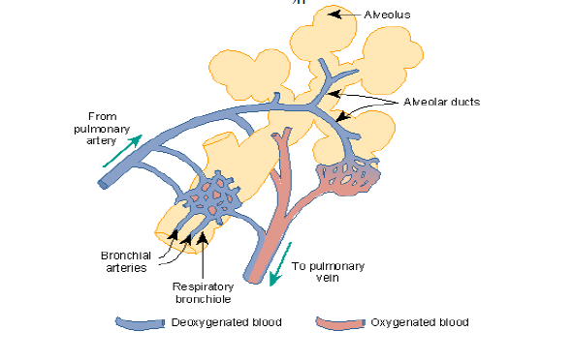

Slide 136
Atmospheric Pressure
The atmosphere is an ocean of gases that exert pressure on all objects within it.
This pressure can be measured using a barometer
At sea level, the atmospheric pressure is 760 mmHg.

Slide 137
Dalton’s Law
The total pressure of a gas mixture is equal to the sum of the pressures of each gas in it (partial pressure of each gas).
Partial pressure: it's the individual pressure exerted independently by a particular gas within a mixture of gases.
Partial pressure can be measured by multiplying the % of that gas by the total pressure
  O₂ makes up 21% of the atmosphere, so partial pressure of O₂ = 760 x 21% = 160 mmHg.
P_{dry atmosphere} = PN₂ + PO₂ + PCO₂ = 760 mmHg

Slide 138
Total Pressure
Because the temperature in the lungs does not change significantly, water vapour of the alveolar air could be considered constant (47 mm Hg)
When air gets to the lungs, it is humid, so the calculation changes to:
P_{wet} = P_{N2} + P_{O2} + P_{CO2} + P_{H2O}= 760 mmHg

Slide 139
Partial Pressure
Addition of water vapor also takes away from the total atmospheric pressure when calculating partial pressure O₂.
  Pressure of water is a constant 47 mmHg because the temperature of the respiratory zone remains at 37ºC.
  Partial pressure O₂ at sea level:
    0.21(760 − 47) = 150 mmHg

Slide 140
Role of Gas Exchange
In the alveoli, the percentage of oxygen decreases and CO₂ increases, changing the partial pressure of each.

Slide 141
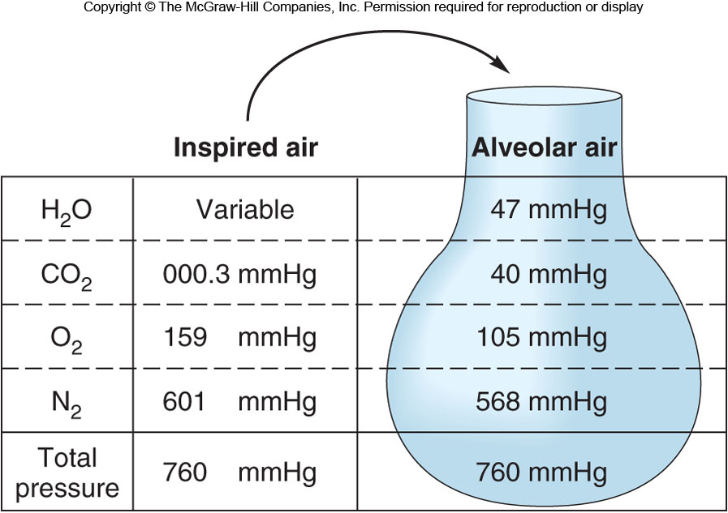
Role of Gas Exchange

Slide 142
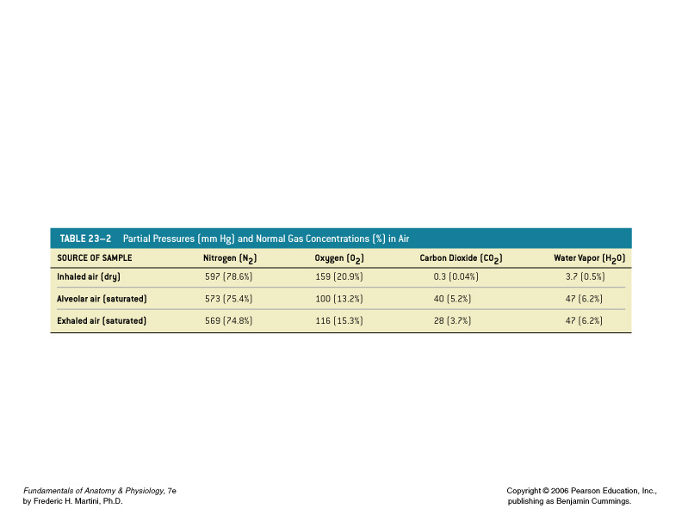
Partial Pressure
The pressure contributed by each gas in the atmosphere
All partial pressures together add up to 760 mm Hg

Slide 143
Diffusion of Gases

Slide 144
Diffusion of Gases
While in the alveolar capillaries, the diffusion of gases occurs: oxygen diffusion from the alveoli into the blood & carbon dioxide from the blood into the alveoli.
  Leaving the alveolar capillaries
    PO₂ = 100 mm Hg
    PCO₂ = 40 mm Hg

Slide 145
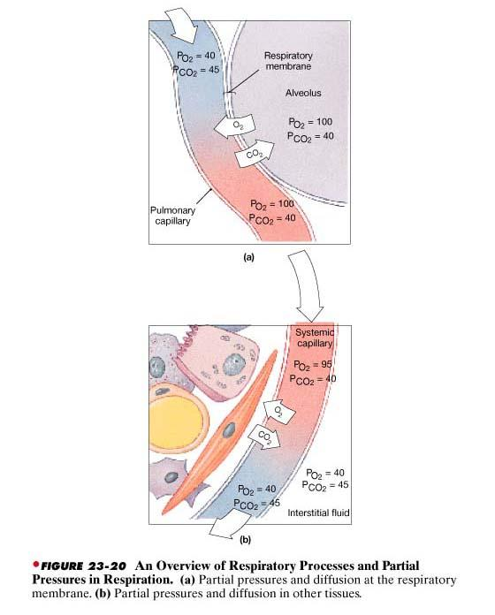

Slide 146
Diffusion of Gases
Partial Pressures of O₂ and CO₂ in the body (normal, resting conditions):
Alveoli
  PO₂ = 100 mm Hg
  PCO₂ = 40 mm Hg
Alveolar capillaries
  Entering the alveolar capillaries
    PO₂ = 40 mm Hg (relatively low because this blood has just returned from the systemic circulation & has lost much of its oxygen)
    PCO₂ = 45 mm Hg (relatively high because the blood returning from the systemic circulation has picked up carbon dioxide)

Slide 147
Partial Pressure
The pressure contributed by each gas in the atmosphere
All partial pressures together add up to 760 mm Hg

Slide 148
Diffusion of Gases
If one breathes pure oxygen so that alveoli contain only oxygen, alveolar pO₂ will be 670 mm Hg.
Mixed venous blood perfusing the lungs has a pO₂ of only 40 mm Hg.
Because of the large gradient, diffusion will be almost instantaneous.

Slide 149
Diffusion of Gases
If one breathes room air, alveolar pO₂ will be 100 mm Hg, and the rate of oxygen diffusion will be slow enough so that it will take about 0.3 seconds for capillary blood to nearly equilibrate with alveolar air.
If there is an obstruction to diffusion, e.g. fluid leak/protein exudate (inflammation), the time for equilibration will increase (due to the longer diffusion path).

Slide 150
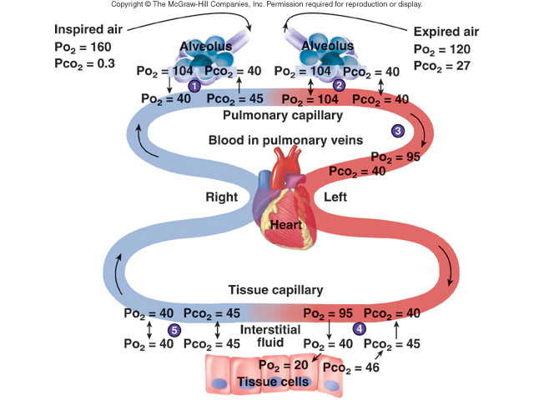
Gas transport
Transport of CO₂
In combination with Hb = 23%
In form of HCO₃⁻ = 70%
Dissolved in plasma = 7%
Transport of O₂
In combination
with Hb = 97%
2. Dissolved in plasma = 3%

Slide 151
Diffusion of Gases
If the equilibration time exceeds 0.75 seconds, then the pO₂ of blood leaving the pulmonary capillary bed may be less than 100 mm Hg.
If oxygen were carried in the blood only as dissolved oxygen, then an increase in the diffusion barrier could lead to hypoxia
Carbon dioxide diffuses from pulmonary capillaries across the alveolar membrane.
Diffusion of CO₂ is 21 times faster than diffusion of O₂ since CO₂ is 20 times more water soluble than oxygen.
Thus, factors slowing the outward diffusion of CO₂ should not cause a clinical problem.

Slide 152
Diffusion of Gases
Blood leaving the alveolar capillaries returns to the left atrium & is pumped by the left ventricle into the systemic circulation.
This blood travels through arteries & arterioles and into the systemic, or body, capillaries.
As blood travels through arteries & arterioles, no gas exchange occurs.
  Entering the systemic capillaries
    PO₂ = 100 mm Hg
    PCO₂ = 40 mm Hg
  Body cells (resting conditions)
    PO₂ = 40 mm Hg
    PCO₂ = 45 mm Hg

Slide 153
Diffusion of Gases
Because of the differences in partial pressures of oxygen & carbon dioxide in the systemic capillaries & the body cells, oxygen diffuses from the blood & into the cells, while carbon dioxide diffuses from the cells into the blood.
  Leaving the systemic capillaries
    PO₂ = 40 mm Hg
    PCO₂ = 45 mm Hg
Blood leaving the systemic capillaries returns to the heart (right atrium) via venules & veins (and no gas exchange occurs while blood is in venules & veins).
This blood is then pumped to the lungs (and the alveolar capillaries) by the right ventricle.

Slide 154
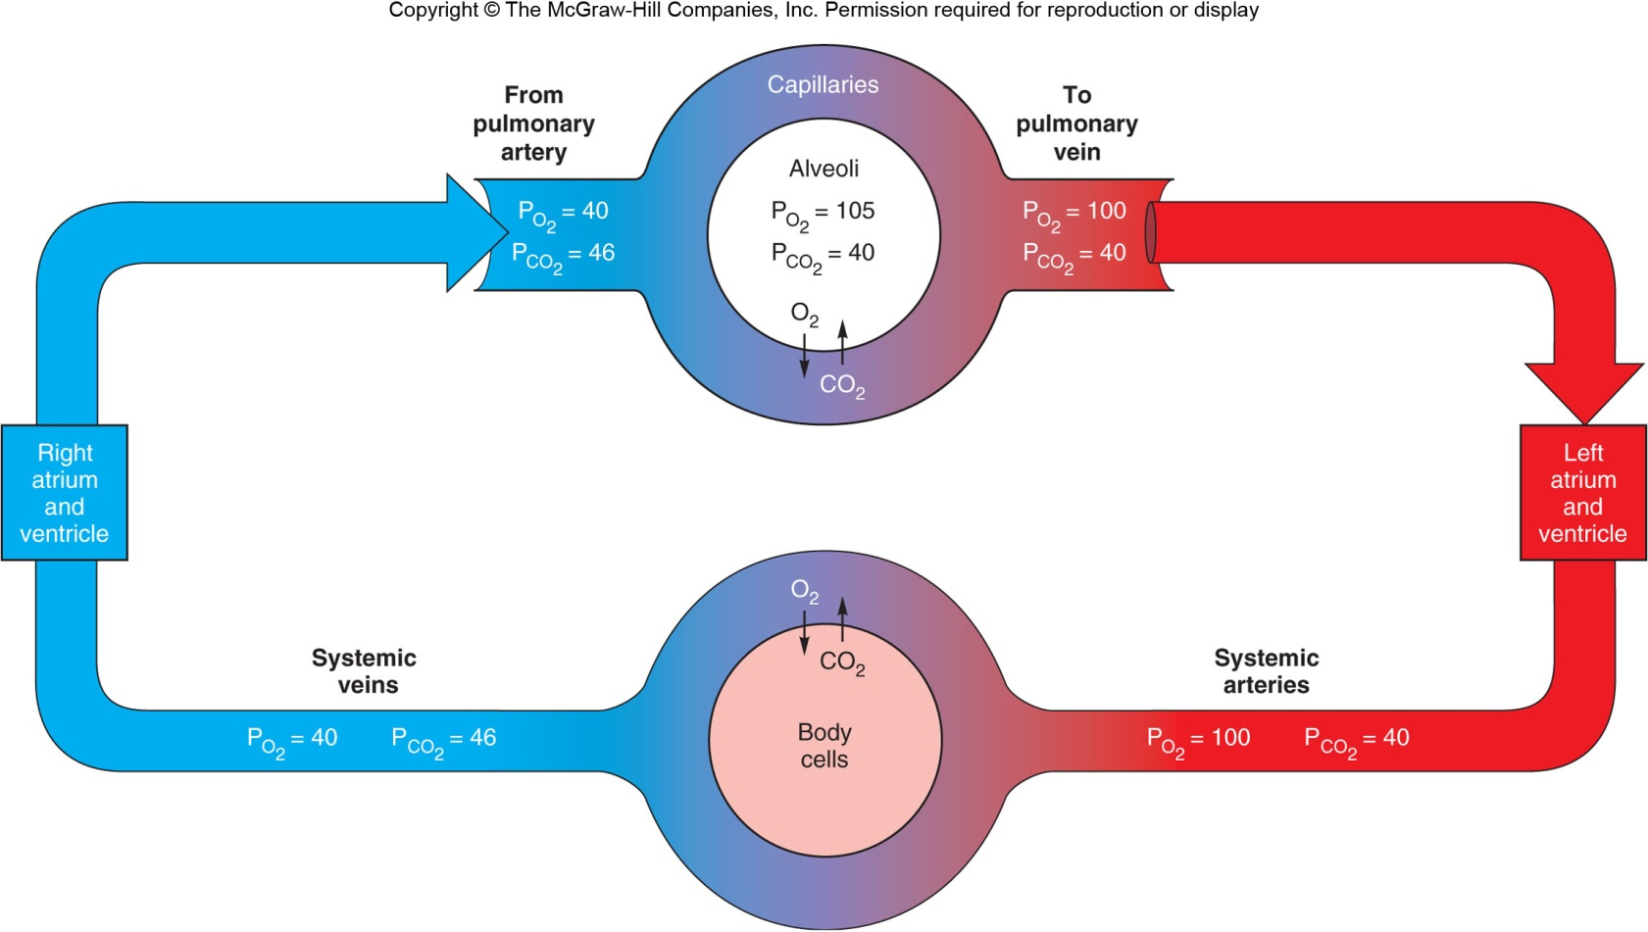
Partial Pressure of Gas in Blood

Slide 155
Henry’s Law
The amount of gas that can dissolve in liquid depends on:
  Solubility of the gas in the liquid (constant)
  Temperature of the fluid (more gas can dissolve in cold liquid); doesn’t change for blood
  Partial pressure of the gases, the determining factor

Slide 156
Diffusion of Gases
Why are the measurements of pO2 and pCO2 important?

Slide 157
Diffusion of Gases
Why are the measurements of pO2 and pCO2 important?
The measurement of PO2 of arterial blood is particularly important because it provides a good index of lung function.
The actual amount of dissolved O2 is a linear function of the pO2:
The higher pO2 indicates that more O2 is dissolved.

Slide 158
Diffusion of Gases
Blood pO2 measurements are not affected by the O2 in red cells (bound with Hb).
A normal pO2 in the inspired air together with low arterial PO2 means that the gas exchange in the lungs is impaired.
In summary, the measurement of pO₂ is important for
  (1) treating patients with pulmonary diseases
  (2) performing safe surgery (when anaesthesia is used)
  (3) the care of premature babies with respiratory distress syndrome.

Slide 159
Disorders Caused by High Partial Pressure of Gases
The total atmospheric pressure increased by one atmosphere [760 mmHg] for every 10 m below sea level.
If a diver descends 10, 20, 30 meters below sea level, therefore partial pressure and amount of dissolved gases in the plasma will be twice, three and four times those values at sea level
The increased amounts of nitrogen and oxygen dissolved in the blood plasma under these condition can have serious effects on the body

Slide 160
Disorders Caused by High Partial Pressure of Gases
Problems for deep-sea divers
  Oxygen toxicity: 100% oxygen is dangerous at 2.5 atmospheres.
    Due to oxidation of enzymes and other destructive changes that can damage the nervous system and lead to coma and death
    For these reasons, deep sea divers commonly use gas mixtures in which oxygen is diluted with inert gases such as N₂ or helium
  Nitrogen narcosis: occurs if nitrogen is inhaled under pressure; results in dizziness and drowsiness

Slide 161
Disorders Caused by High Partial Pressure of Gases
Problems for deep-sea divers
  Decompression sickness: When a diver comes to the surface too fast, nitrogen bubbles can form in the blood and block small vessels.
  Can also happen if an airplane suddenly loses pressure

Slide 162
Transport of Gases

