Slide 1
Respiratory Physiology
SAMUEL NGIGI K.
Copyright © The McGraw-Hill Companies, Inc. Permission required for reproduction or display.

Slide 2
Course Content
What is respiration
Purposes of respiration
Upper respiratory tract
Structure and Function of lungs
Mechanics of Breathing [pressure changes/ compliance/Pneumothorax/The work of breathing/Surfactants]

Slide 3
Course Content
3. Ventilation [pulmonary and Alveolar ventilation]
4. Anatomical and physiological dead spaces.
5. Composition of inspired, alveolar and expired air.

Slide 4
Course Content
6. Pulmonary circulation [Ventilation-perfusion ratio].
7. Lung Volumes and Pulmonary Function Tests
8. Review of Gas Laws
9. Diffusion of gases across alveolar walls [Gas exchange in the lungs]
10. The exchange of gasses in the tissues

Slide 5
Course Content
11. Gas Transport to the Periphery [The carriage of oxygen and Carbondioxide]
12. Acid-Base Regulation [The role of respiration in maintenance of blood pH]
13. Regulation & Control of Breathing [Neural, chemical and non-chemical control ]

Slide 6
Discovery Is To See What Everybody Has Seen And Think What Nobody Has Thought.
- Albert Szent - Gyorgyi
“No one, unless he is grossly ignorant of what science has done for mankind, can entertain any doubt of the incalculable benefits which will hereafter be derived from physiology.” — Charles Darwin

Slide 7
Introduction
Definition
Respiration is the processes resulting in exchange of gas between environment and cells
Respiratory System is divided into:
  Respiratory zone: site of gas exchange
  Conduction zone: gets air to the respiratory zone

Slide 8
Processes
ventilation
this represents the mechanics of breathing, i.e. moving gases into and from the airways
gas exchange
exchange of gas between air and blood (external respiration)
exchange of gas between blood and tissues (internal respiration)
oxygen utilization by tissues (internal respiration)

Slide 9
Respiration
Includes:
  Ventilation (breathing)
  Gas exchange between blood and lungs and between blood and tissues
  Oxygen utilization by tissues to make ATP
Ventilation and gas exchange in lungs = external respiration
Oxygen utilization and gas exchange in tissues = internal respiration

Slide 10
The Respiratory System
functions
  provide oxygen to tissues and remove carbon dioxide
  maintain tissue pH
general mechanics
  gas transporting system (blood)
Notes:
the pump for the gas transporting system is a positive pressure pump
- gas exchanging system (lungs)
the pump for the gas exchanging system is a negative pressure pump.

Slide 11
The Respiratory System
Includes respiratory airways leading into (& out of) lungs plus the lungs themselves
Pathway of air: nasal cavities (or oral cavity) > pharynx > trachea > primary bronchi (right & left) > secondary bronchi > tertiary bronchi > bronchioles > alveoli (site of gas exchange)

Slide 12
Gas Exchange in Lungs
Occurs via diffusion
O₂ concentration is higher in the lungs than in the blood, so O₂ diffuses into blood.
CO₂ concentration in the blood is higher than in the lungs, so CO₂ diffuses out of blood.

Slide 13
Alveoli
Air sacs in the lungs where gas exchange occurs
300 million of them
  Provide large surface area (760 square feet) to increase diffusion rate

Slide 14
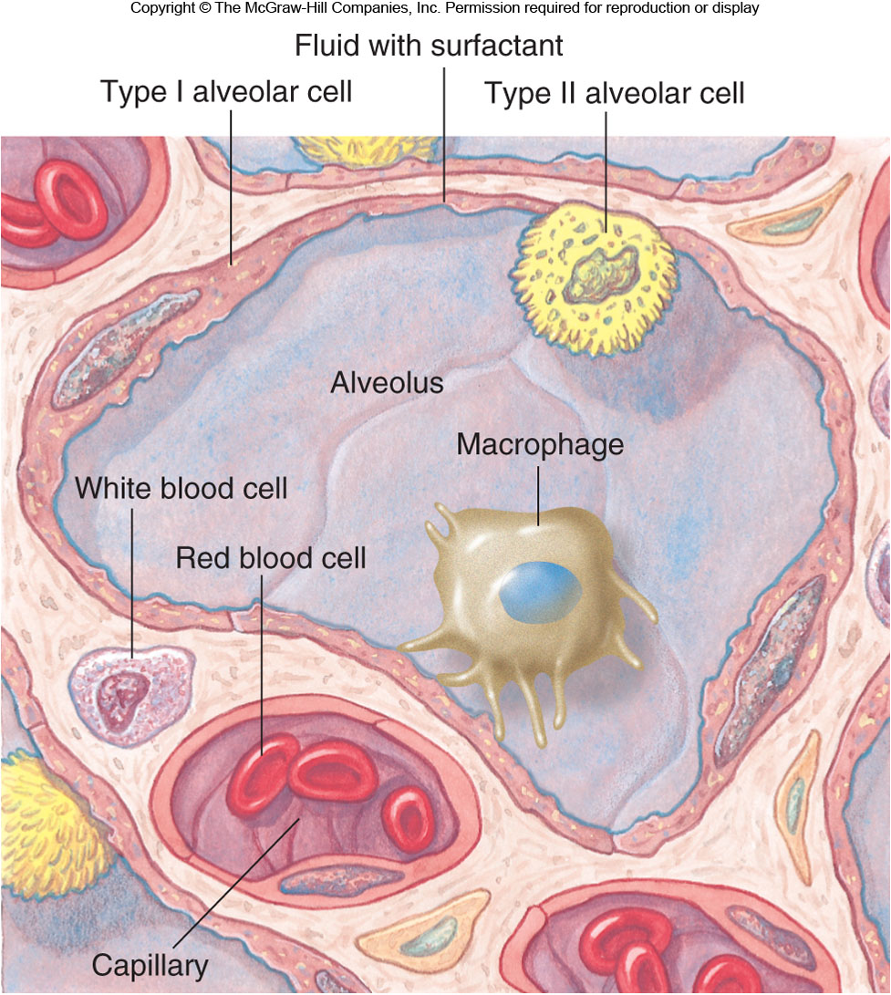
Alveoli

Slide 15
Alveolar Cells
Type I: 95−97% total surface area where gas exchange occurs
Type II: secrete pulmonary surfactant and reabsorb sodium and water, preventing fluid buildup

Slide 16
Conducting Zone
Air travels down the nasal cavity →
Pharynx →
Larynx →
Trachea →
Right and left primary bronchi →
Secondary bronchi →
Tertiary bronchi → (more branching) →
Terminal bronchioles →
Respiratory zone (respiratory bronchioles →
Terminal alveolar sacs

Slide 17
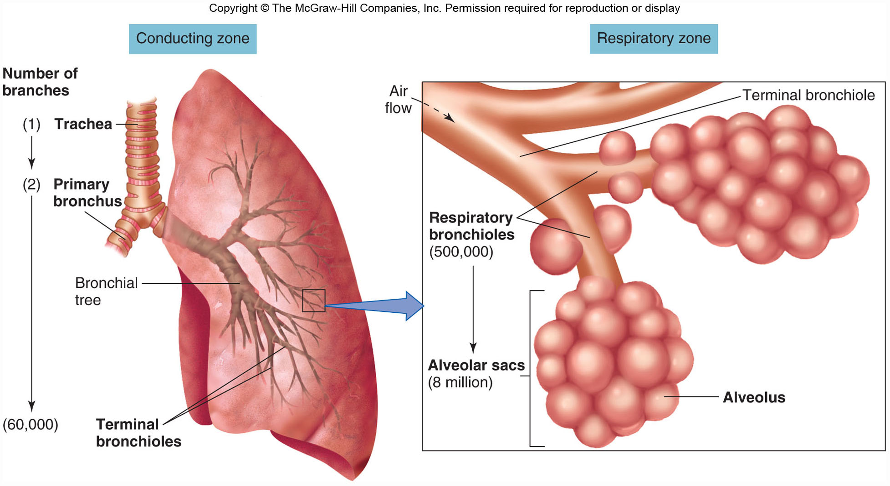
Respiratory Structures

Slide 18
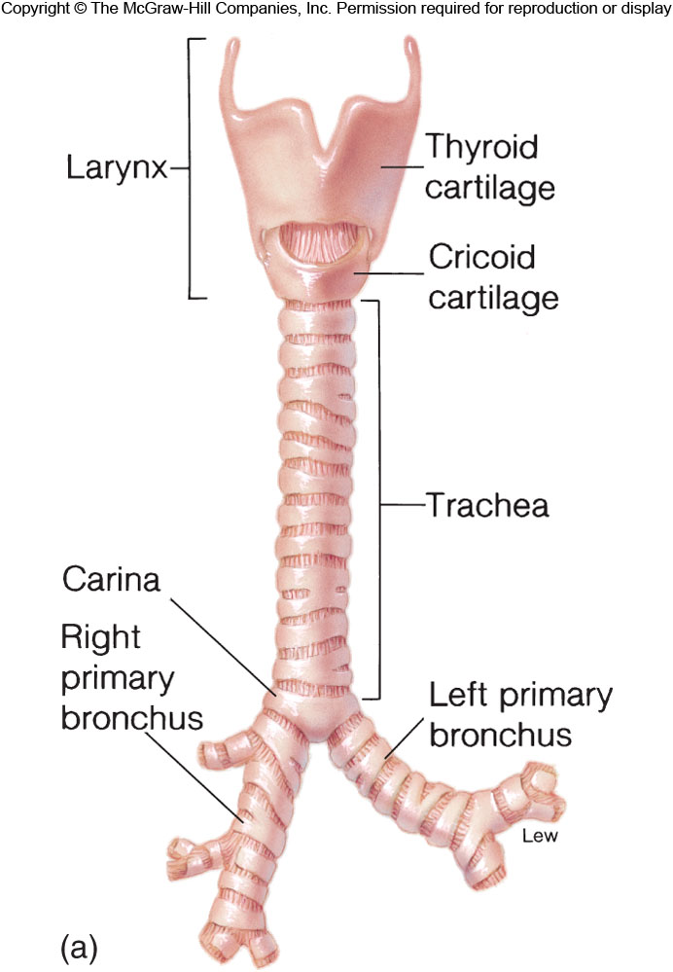
Trachea and Respiratory Bronchi

Slide 19
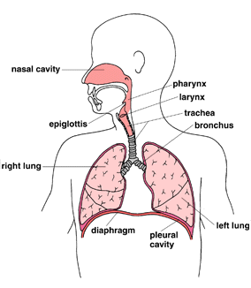

Slide 20
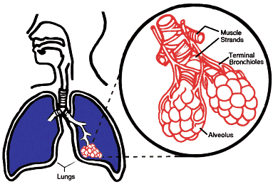

Slide 21
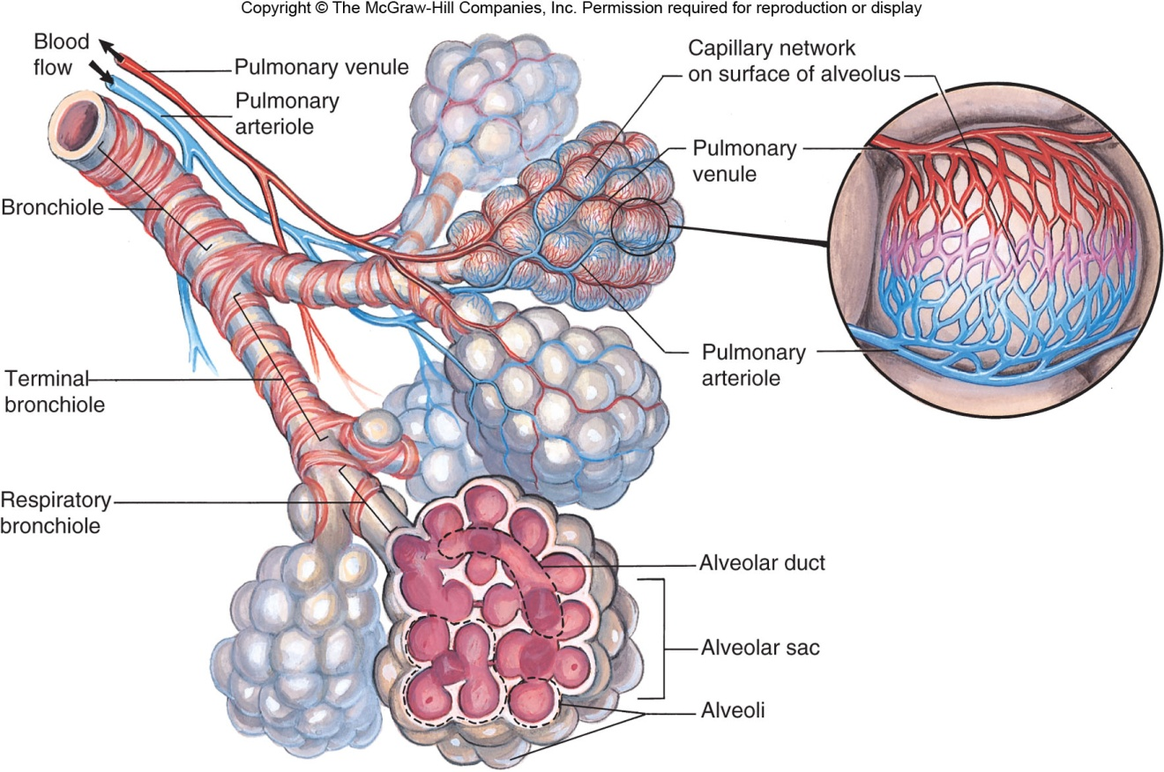
The Respiratory System

Slide 22
The respiratory tract, where external respiration occurs, starts at the nose and mouth.
There is a brief complication where the air stream crosses the path taken by food and drink in the pharynx:
  air flows on down the trachea while food normally passes down the esophagus to the stomach.
The trachea (windpipe) extends from the neck into the thorax, where it divides into right and left main bronchi, which enter the right and left lungs, breaking up as they do so into smaller bronchi and bronchioles and ending in small air sacs or alveoli, where gaseous exchange occurs.

Slide 23
The lungs are divided first into right and left, the left being smaller to accommodate the heart, then into lobes (three on the right, two on the left) supplied by lobar bronchi.
Bronchi, pulmonary arteries and veins (which supply deoxygenated blood and remove oxygenated blood), bronchial arteries and veins (which supply oxygenated blood to the substance of the lung itself) and lymphatics all enter and leave the lung by its root (or hilum).

Slide 24
Lymph nodes blackened by soot particles can often be seen here and the substance of the lung itself may be blackened by soot in city dwellers or heavy smokers.
Gaseous exchange relies on simple diffusion.
In order to provide sufficient oxygen and to get rid of sufficient carbon dioxide there must be:

Slide 25
A large surface area for gaseous exchange
a very short diffusion path between alveolar air and blood
concentration gradients for oxygen and carbon dioxide between alveolar air and blood.

Slide 26
The surface available in an adult is around 140m² in an adult, around the area of a singles tennis court.
The blood in the alveolar capillaries is separated from alveolar air by 0.6* in many places (1* = one thousandth of a mm) .
Diffusion gradients are maintained by

Slide 27
ventilation (breathing) which renews alveolar air, maintaining oxygen concentration near that of atmospheric air and preventing the accumulation of carbon dioxide
the flow of blood in alveolar capillaries which continually brings blood with low oxygen concentration and high carbon dioxide concentration
Haemoglobin in blood continually take dissolved oxygen from the blood and binds with it.

Slide 28
Outside air:
varies in temperature.
At the alveolar surface it must be at body temperature
varies from very dry to very humid.
At the alveolar surface it must be saturated with water vapor

Slide 29
contains dust and debris.
These must not reach the alveolar wall.
contains micro-organisms, which must be filtered out of the inspired air and disposed of before they reach the alveoli, enter the blood and cause possible problems.

Slide 30
The exchange of gases (O₂ & CO₂) between the alveoli & the blood occurs by simple diffusion:
O₂ diffusing from the alveoli into the blood & CO₂ from the blood into the alveoli.
Diffusion requires a concentration gradient.

Slide 31
So, the concentration (or pressure) of O₂ in the alveoli must be kept at a higher level than in the blood & the concentration (or pressure) of CO₂ in the alveoli must be kept at a lower lever than in the blood.
We do this, of course, by breathing - continuously bringing fresh air (with lots of O₂ & little CO₂) into the lungs & the alveoli.

Slide 32
Functions of Conducting Zone
Transports air to the lungs
Warms, humidifies, filters, and cleans the air
  Mucus traps small particles, and cilia move it away from the lungs.
Voice production in the larynx as air passes over the vocal folds

Slide 33
Conducting Zone of respiratory System

Slide 34
Thoracic Cavity
Contains the heart, trachea, esophagus, and thymus within the central mediastinum
The lungs fill the rest of the cavity.
  The parietal pleura lines the thoracic wall.
  The visceral pleura covers the lungs.
  The parietal and visceral pleura are normally pushed together, with a potential space between called the intrapleural space [pleural cavity].

Slide 35
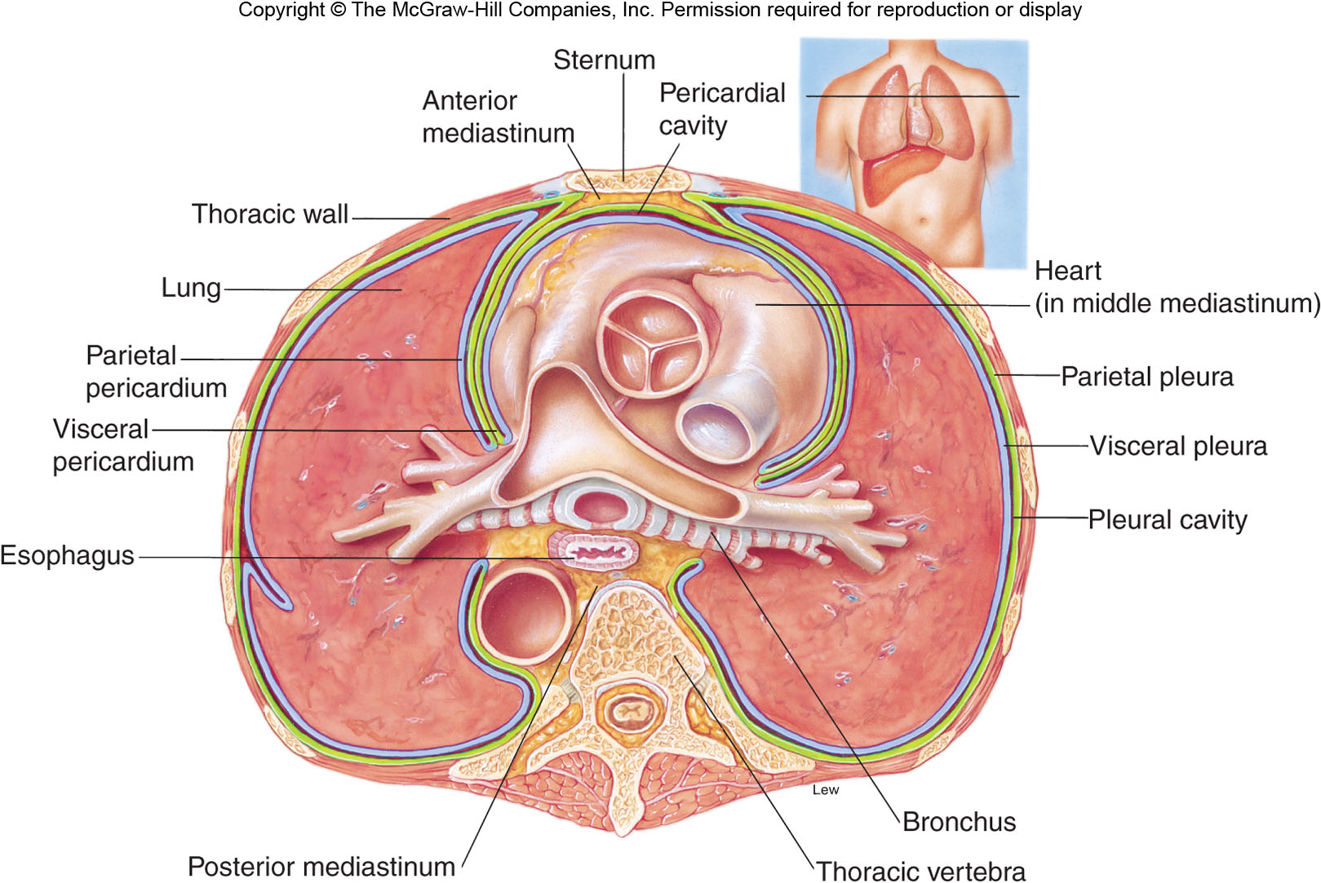
Thoracic Cavity Cross Section

Slide 36
COUPLING OF THE LUNGS AND THE CHEST WALL
The lungs are not directly attached to the chest wall but they change their volume and shape according to the changes in shape and volume of the thoracic cavity.
Pleura covering the surfaces of the lungs (visceral) or the thoracic cavity (parietal) together with a thin (20 μm) layer of liquid (pleural fluid) between them create a liquid coupling.
The pleural fluid lubricates the movement of the lungs within the cavity.

Slide 37
Mechanics of Breathing

Slide 38
Breathing
Also called pulmonary ventilation
  Inspiration: breathe in
  Expiration: breathe out
Accomplished by changing thoracic cavity/ lung volume
Breathing is an active process - requiring the contraction of skeletal muscles.

Slide 39
Muscles Involved in Breathing
The primary muscles of respiration include the external intercostal muscles (located between the ribs) and the diaphragm (a sheet of muscle located between the thoracic & abdominal cavities).
accessory muscles of inspiration
  sternomastoids-from behind ear to sternum
  Anterior serrati,scaleni

Slide 40
Muscles Involved in Breathing
muscles of expiration
  transversus abdominis
  rectus abdominis
  internal oblique
  external oblique, internal intercostals

Slide 41
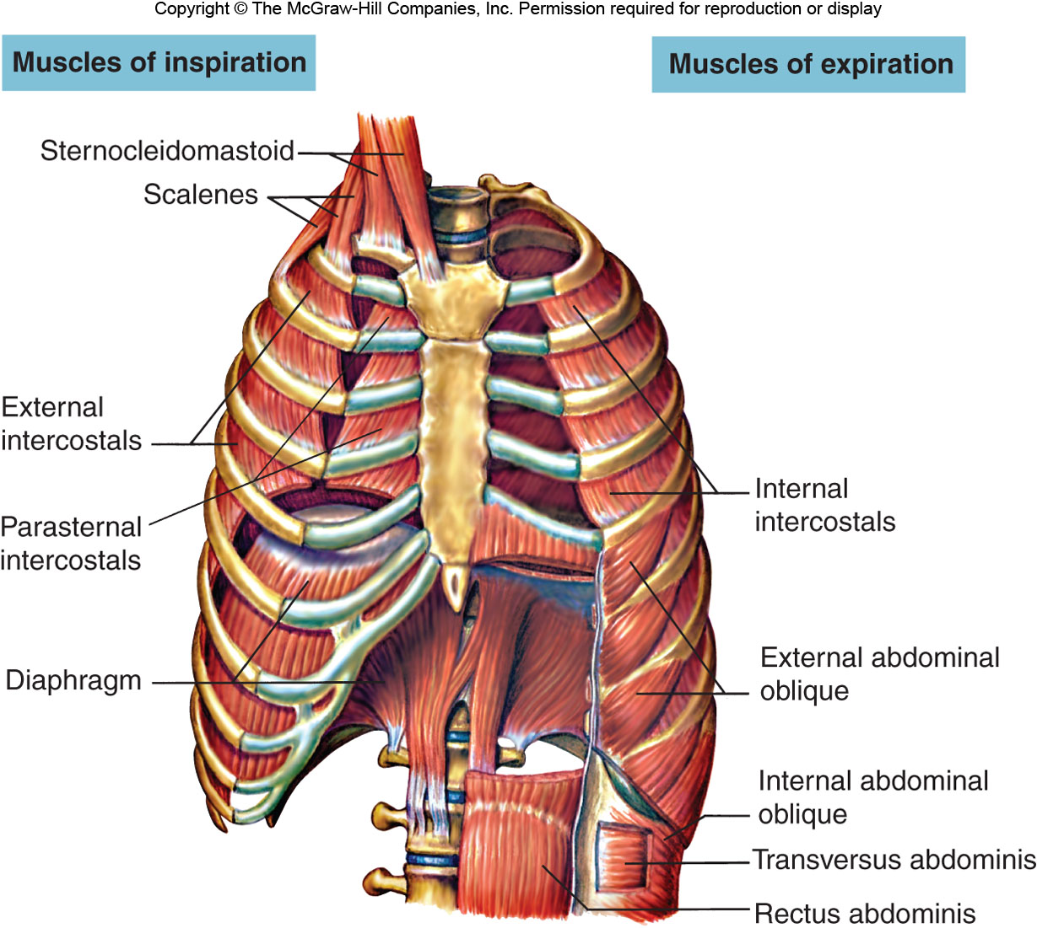
Muscles Involved in Breathing

Slide 42
Mechanics of breathing
Contraction of external intercostal muscles > elevation of ribs & sternum > increased front- to-back dimension of thoracic cavity > lowers air pressure in lungs > air moves into lungs
Contraction of diaphragm > diaphragm moves downward > increases vertical dimension of thoracic cavity > lowers air pressure in lungs > air moves into lungs:

Slide 43
Mechanics of breathing
Expiration is usually passive, and normally occurs by recoil of stretched tissue of
lungs and thorax.
At high rates of ventilation or with airway obstruction the muscles of expiration actively contract.
They lower the ribs and increase
intra-abdominal pressure which forces the diaphragm upward.

Slide 44
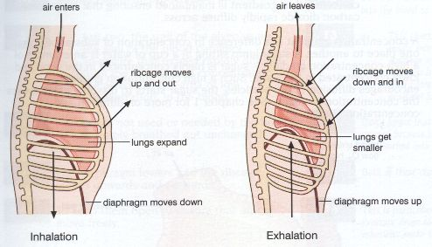
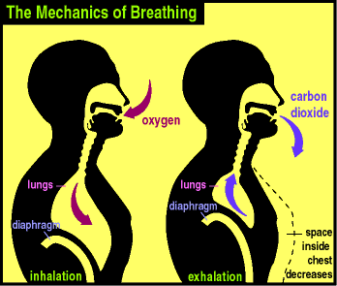
Mechanics of breathing

Slide 45
Mechanics of breathing
To exhale:
relaxation of external intercostal muscles & diaphragm > return of diaphragm, ribs, & sternum to resting position > restores thoracic cavity to pre inspiratory volume > increases pressure in lungs > air is exhaled

Slide 46
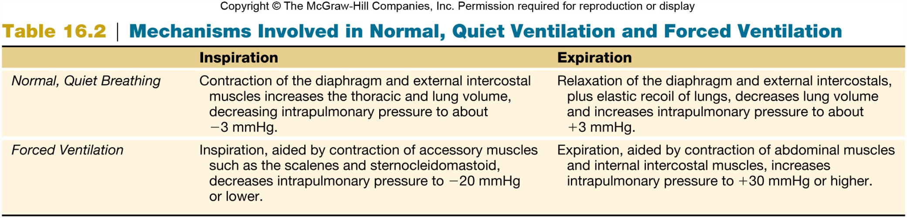
Normal vs. Forced Breathing

Slide 47
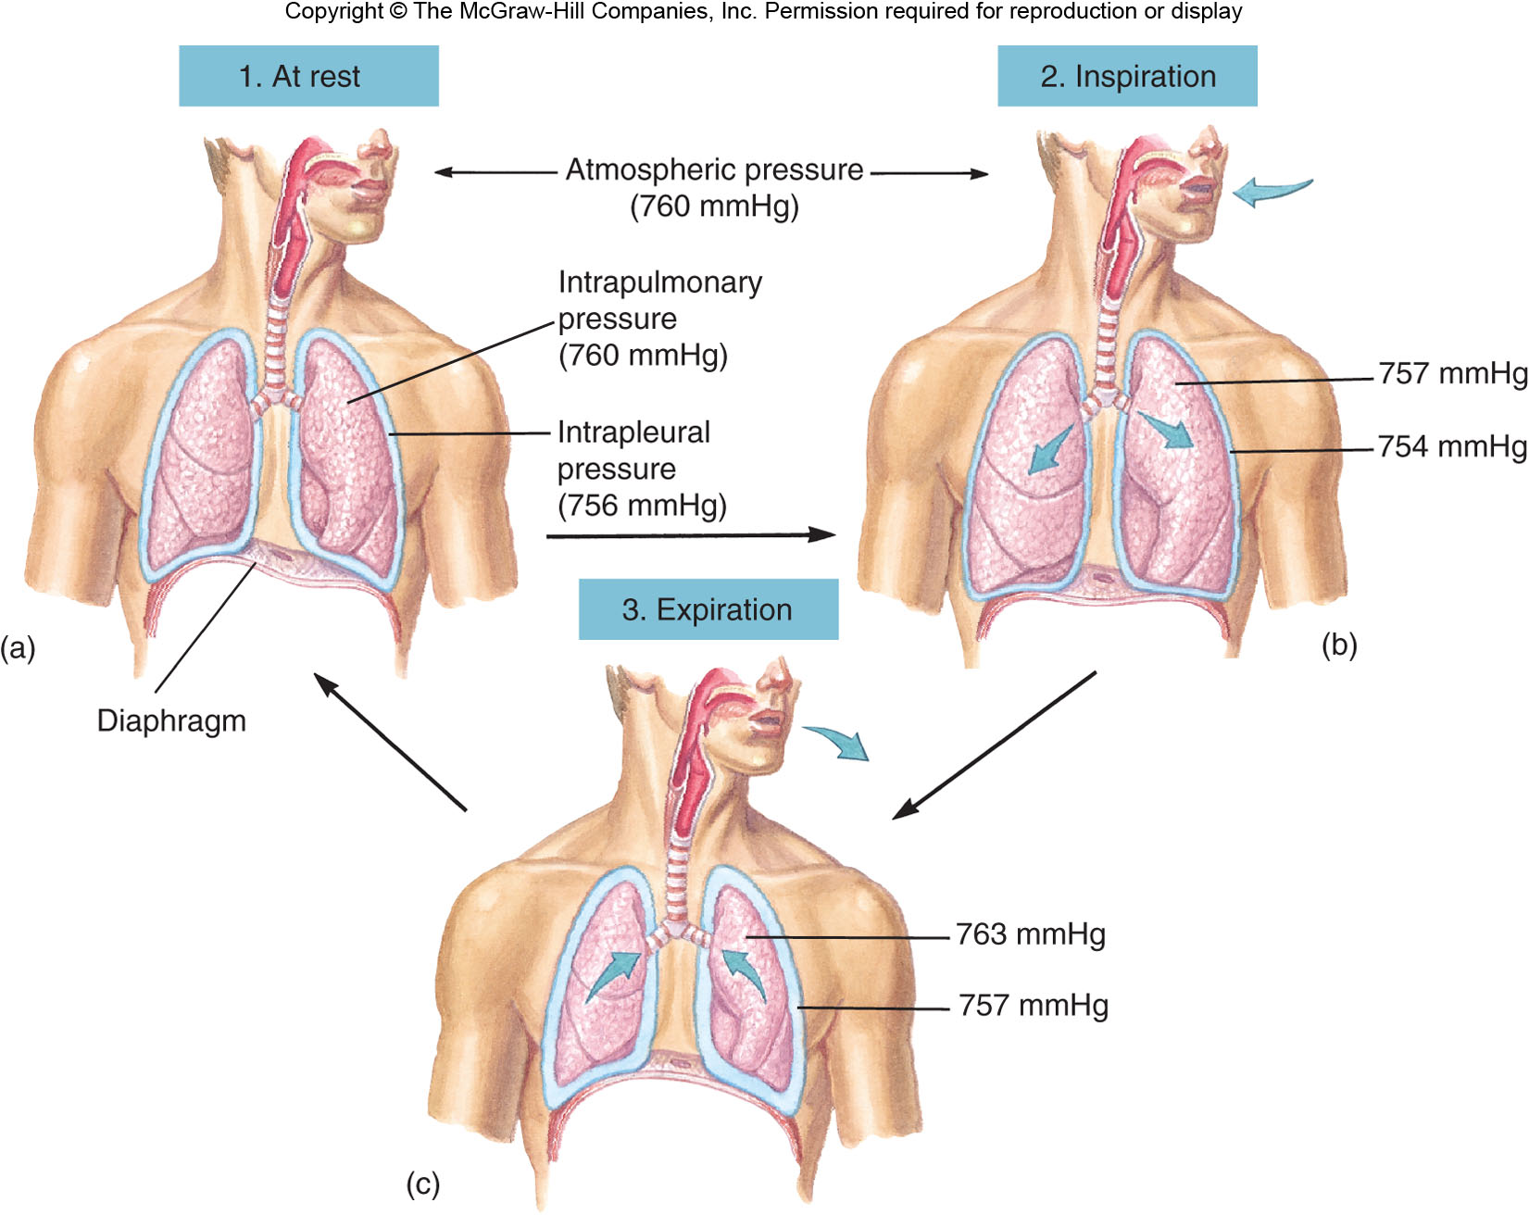
Mechanisms of Breathing

Slide 48
Pressure
Atmospheric pressure [barometric pressure]: pressure of air outside the body
Intrapulmonary pressure [alveolar pressure]: pressure in the lungs
Intrapleural pressure: pressure within the intrapleural space (between parietal and visceral pleura)

Slide 49
Pressure cnt’d…
-ve force always required on the outside to keep the lungs expanded
Provided by –ve pressure in the pleural space
-ve pressure provided by continuous pumping of fluid from this space by the lymphatics
Normal collapse pressure of lungs about -4mmHg, pleural pressure must be at least -4mmHg to keep lungs expanded

Slide 50
Pressure cnt’d…
Usual pressure about -7mmHg
Thus negativity of pleural fluid keeps normal lungs pulled against the parietal pleural of the chest cavity except for an extremely thin layer of mucoid fluid that acts as a lubricant

Slide 51
Pressure Changes during inspiration & expiration
lungs are housed in a hermetically sealed compartment known as the pleural space
As the external intercostals & diaphragm contract, the lungs expand.
The expansion of the lungs causes the pressure in the lungs (and alveoli) to become slightly negative relative to atmospheric pressure.
Notes:
Hermetically: in a way that is completely airtight.

Slide 52
Pressure Changes during inspiration & expiration
As a result, air moves from an area of higher pressure (the air) to an area of lower pressure (lungs & alveoli).
During expiration, the respiration muscles relax & lung volume decreases.
This causes pressure in the lungs (and alveoli) to become slight positive relative to atmospheric pressure. As a result, air leaves the lungs.
Animation\Ventilation Animation.ppsx

Slide 53
by changing the dimensions of the thorax one can increase or decrease intrapleural pressure, which in turn will influence transpulmonary pressure.
the muscles of respiration regulate the size of the thorax.
they act as a negative pressure pump to enlarge the thorax, and lower the pressure in the alveoli to below atmospheric pressure.

Slide 54
Pressure Differences When Breathing
Inspiration: Intrapulmonary pressure is lower than atmospheric pressure.
  Pressure below that of the atmosphere is called subatmospheric or negative pressure
Expiration: Intrapulmonary pressure is greater than atmospheric pressure.

Slide 55
Ventilation
Air moves from higher to lower pressure.
  Pressure differences between the two ends of the conducting zone occur due to changing lung volumes.
  Compliance, elasticity, and surface tension are important physical properties of the lungs.

Slide 56
Boyle’s Law
States that the pressure of a gas is inversely proportional to its volume
  An increase in lung volume during inspiration decreases intrapulmonary pressure to sub-atmospheric levels.
    Air goes in.
  A decrease in lung volume during exhalation increases intrapulmonary pressure above atmospheric levels.
    Air goes out.

Slide 57
Compliance of the Lungs
The extent to which the lungs expands for each unit increase in transpulmonary pressure is called compliance [ΔV/ΔP]
The compliance of the human lung is 0.15 L/cm H₂O.
However, it gets stiffer (compliance smaller) as it is expanded above the normal range.

Slide 58
Compliance is reduced when:
The pulmonary venous pressure is increased and the lung becomes engorged with blood
There is alveolar oedema due to insufficiency of alveolar inflation
The lung remains unventilated for a while and
Because of diseases causing fibrosis of the lung e.g. chronic restrictive lung disease.
Notes:
Oedema, also known as dropsy, is the medical term for fluid retention in the body. The build-up of fluid causes affected tissue to become swollen. The swelling can occur in one particular part of the body.
Fibrosis, also known as fibrotic scarring, is a pathological wound healing in which connective tissue replaces normal parenchymal tissue to the extent that it goes unchecked, leading to considerable tissue remodelling and the formation of permanent scar tissue.

Slide 59
On the contrary in chronic obstructive pulmonary disease (COPD, e.g. emphysema) the alveolar walls progressively degenerate, which increases the compliance.
The lung compliance is changed according to the lung size
At birth the lung compliance is the smallest and increased with age (until adulthood) due to increase in the size of the lungs.
Notes:
Emphysema is a lung condition that causes shortness of breath. In people with emphysema, the air sacs in the lungs (alveoli) are damaged.

Slide 60
CHEST WALL COMPLIANCE
Changes in chest wall compliance are less common than changes in the lung compliance:
pathologic situations preventing the normal movement of the rib cage, such as, distortion of the spinal column,
pathologic (cancer) or physiologic (pregnancy) reasons increasing the intra abdominal pressure,
stiff chest, such as broken ribs.

Slide 61
Elasticity
Lungs return to initial size after being stretched.
  Lungs have lots of elastin fibers.
  Because the lungs are stuck to the thoracic wall, they are always under elastic tension.

Slide 62
Surface Tension
Resists distension
Exerted by fluid secreted in the alveoli
Raises the pressure of the alveolar air as it acts to collapse the alveolus

Slide 63
SURFACE TENSION
A thin film of liquid lines the alveoli and the surface tension of this film is another important factor in the pressure-volume relationship of the lung.
The surface tension arises because the attractive forces between adjacent molecules of water are much stronger than those of between the liquid and the gas.
As a result of that, the liquid surface is always attempting to contract.

Slide 64
SURFACE TENSION
At the interface between the liquid and the alveolar gas, intermolecular forces in the liquid tend to cause the area of the lining to shrink (the alveoli tend to get smaller).
the attraction of the liquid molecules creates a force called surface tension.
This surface tension increases as water molecules come closer together, which is what happens when we exhale & our alveoli become smaller (like air leaving a balloon).

Slide 65
SURFACE TENSION
Potentially, surface tension could cause alveoli to collapse and, in addition, would make it more difficult to 're-expand' the alveoli (when you inhaled).
Both of these would represent serious problems: if alveoli collapsed they'd contain no air & no oxygen to diffuse into the blood &, if 're-expansion' was more difficult, inhalation would be very, very difficult if not impossible.
Fortunately, our alveoli do not collapse & inhalation is relatively easy because the lungs produce a substance called surfactant that reduces surface tension.

Slide 66
Law of Laplace
Pressure is directly proportional to surface tension and inversely proportional to radius of alveolus.
  Small alveoli would be at greater risk of collapse without surfactant.

Slide 67
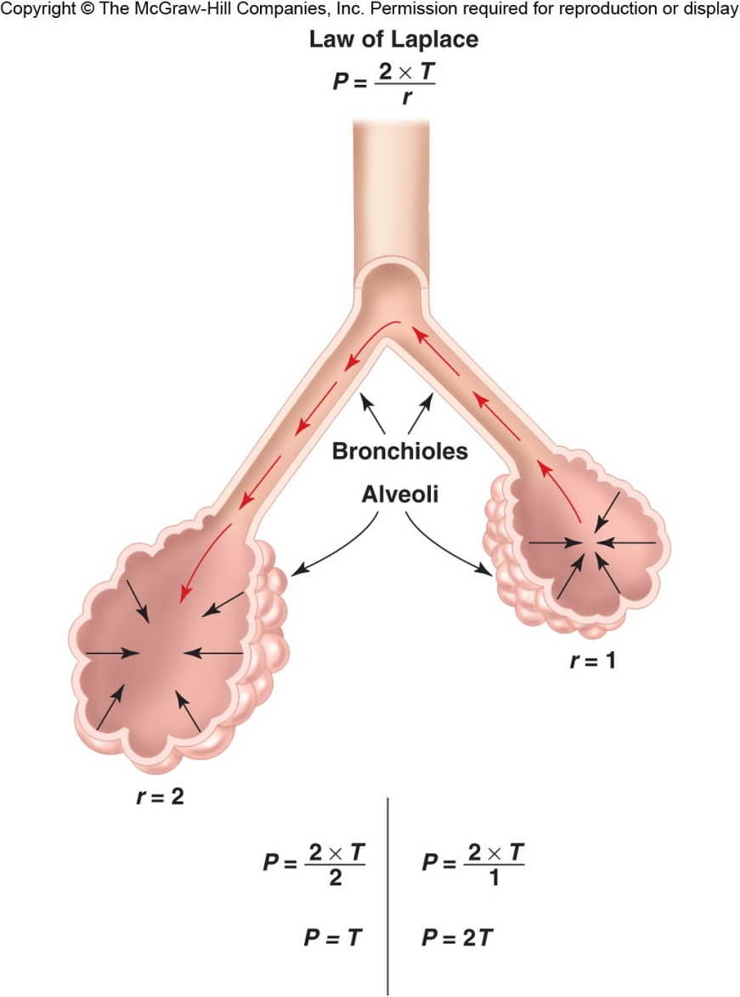
Law of Laplace

Slide 68
SURFACE TENSION
Surfactant is produced by type 2 alveolar epithelial cells and its major constituent is dipalmitoyl phosphotidylcholine (DPPC), a phospholipid with detergent properties.
Other important components include surfactant apoproteins and calcium.
The phospholipid DPPC is synthesized in the lung from fatty acids that are either extracted from the blood or are themselves synthesized in the lung.
DPPC along with other phospholipids is responsible for reducing the surface tension.
They do not dissolve in the fluid but spread over its surface

Slide 69
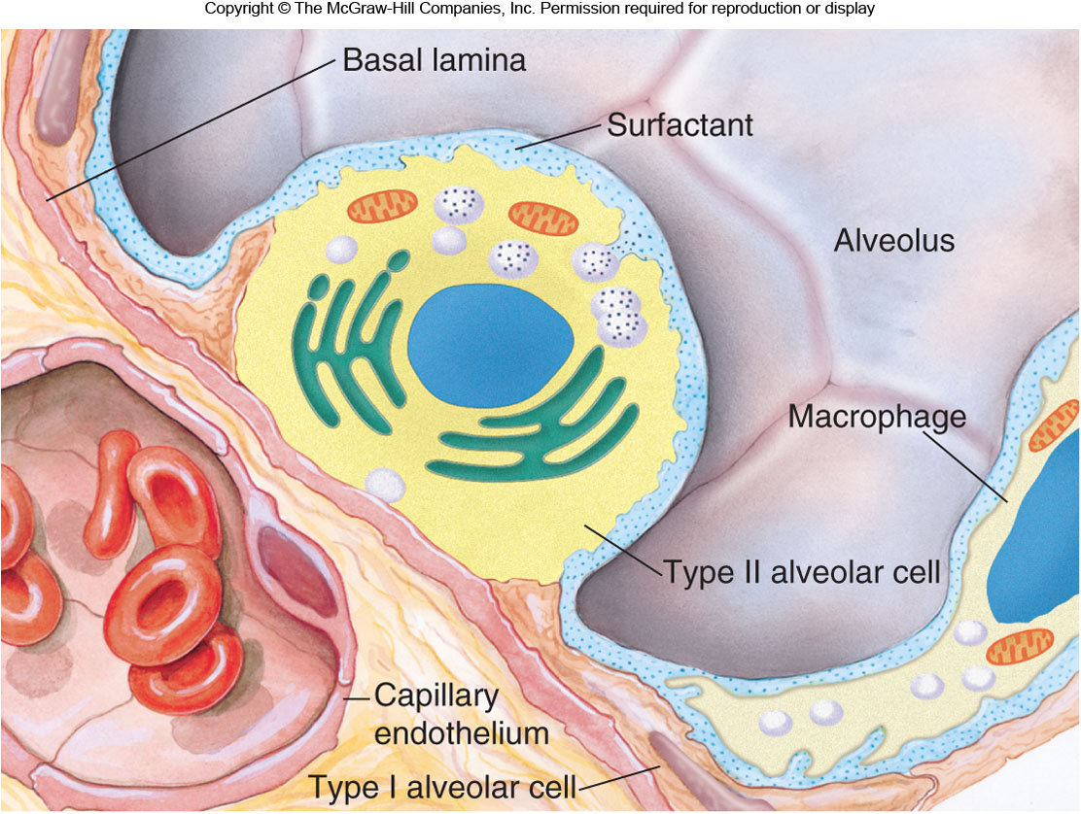
Surfactant

Slide 70
SURFACE TENSION
Synthesis is fast and there is a rapid turnover of surfactant.
If the blood flow to a region of lung is restricted due to an embolus the surfactant may be depleted in the effected area.
Surfactant synthesis starts relatively late in foetal life [from 7th month] and premature babies without adequate amount of surfactant develop respiratory distress syndrome [RDS] of the new born which could be life threatening.

Slide 71
SURFACE TENSION
What are the advantages of having surfactant and the low surface tension?
It increases the compliance of the lung
It reduces the work of expanding the lung with each breath
It stabilizes the alveoli (thus the smaller alveoli do not collapse at the end-expiration)
It keeps the alveoli dry (as the surface tension tends to collapse alveoli, it also tends to suck fluid into the alveolar space from capillaries).

Slide 72
Work of breathing
The respiratory muscles perform work to cause inspiration and not to cause expiration.
The work performed by the muscles during inspiration can be divided into 3 fractions
  Work required to expand the lungs against the lung and chest elastic forces-compliance work or elastic work.
  Work required to overcome the viscosity of the lungs and chest wall structures-tissue resistance work.
  Work required to overcome airway resistance during movement of air into the lungs-airway resistance work.

Slide 73
Work of breathing
Most of the work performed by the respiratory muscle is used to expand the lungs.
Only a small percentage of the total work is used to overcome tissue resistance [tissue viscosity] and more to overcome airway resistance.
In pulmonary disease all 3 type of work are frequently vastly increased.

Slide 74
Lung Volumes & Capacities
The total volume contained in the lung at the end of a maximal inspiration is subdivided into volumes and subdivided into capacities.
There are four volume subdivisions which:
  do not overlap.
  can not be further divided.
when added together equal total lung capacity.
Lung capacities are subdivisions of total volume that include two or more of the 4 basic lung volumes.

Slide 75
Lung Volumes & Capacities
Basic lung volumes
Tidal Volume (TV). The amount of gas inspired or expired with each breath (500 ml)
Inspiratory Reserve Volume (IRV). Maximum amount of additional air that can be inspired from the end of a normal inspiration [3000 ml].

Slide 76
Lung Volumes & Capacities
Expiratory Reserve Volume (ERV). The maximum volume of additional air that can be expired from the end of a normal expiration [1100].
Residual Volume (RV). The volume of air remaining in the lung after a maximal expiration [1200].

Slide 77
Lung Volumes & Capacities
Basic lung capacities
Total Lung Capacity (TLC). The volume of air contained in the lungs at the end of a maximal inspiration.
  Called a capacity because it is the sum of the 4 basic lung volumes. TLC=RV+IRV+TV+ERV

Slide 78
Lung Volumes & Capacities
Vital Capacity (VC). The maximum volume of air that can be forcefully expelled from the lungs following a maximal inspiration.
  Called a capacity because it is the sum of inspiratory reserve volume, tidal volume, and expiratory reserve volume. VC=IRV+TV+ERV=TLC-RV

Slide 79
Lung Volumes & Capacities
Functional Residual Capacity (FRC). The volume of air remaining in the lung at the end of a normal expiration.
  Called a capacity because it equals residual volume plus expiratory reserve volume. FRC=RV+ERV
Inspiratory Capacity (IC). Maximum volume of air that can be inspired from end expiratory position.
  Called a capacity because it is the sum of tidal volume and inspiratory reserve volume. IC=TV+IRV

Slide 80
Minute Respiratory volume (Total Minute Vol)
This is the total amount of new air moved into the respiratory passage each minute.
  This is equal to TV x Respiratory rate
    TV = 500 ml
    Respiratory rate = 15/min
MRV = ?L/min

