Slide 1
Respiratory system
land marks

Slide 2
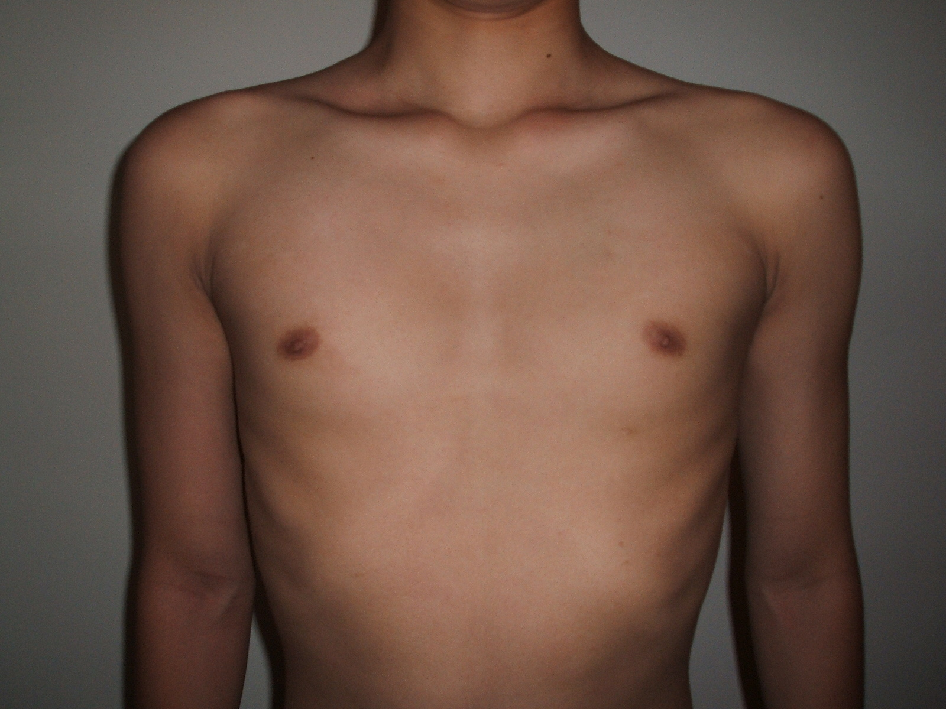
Anterior imaginary lines and landmarks
Suprasternal fossa
Supraclavicular fossa
Infraclavicular fossa
Sternal line
Parasternal line
Anterior midline
Midclavicular line
epigastric angle

Slide 3
Lateral imaginary lines
Posterior axillary line
Anterior axillary line
Midaxillary line

Slide 4
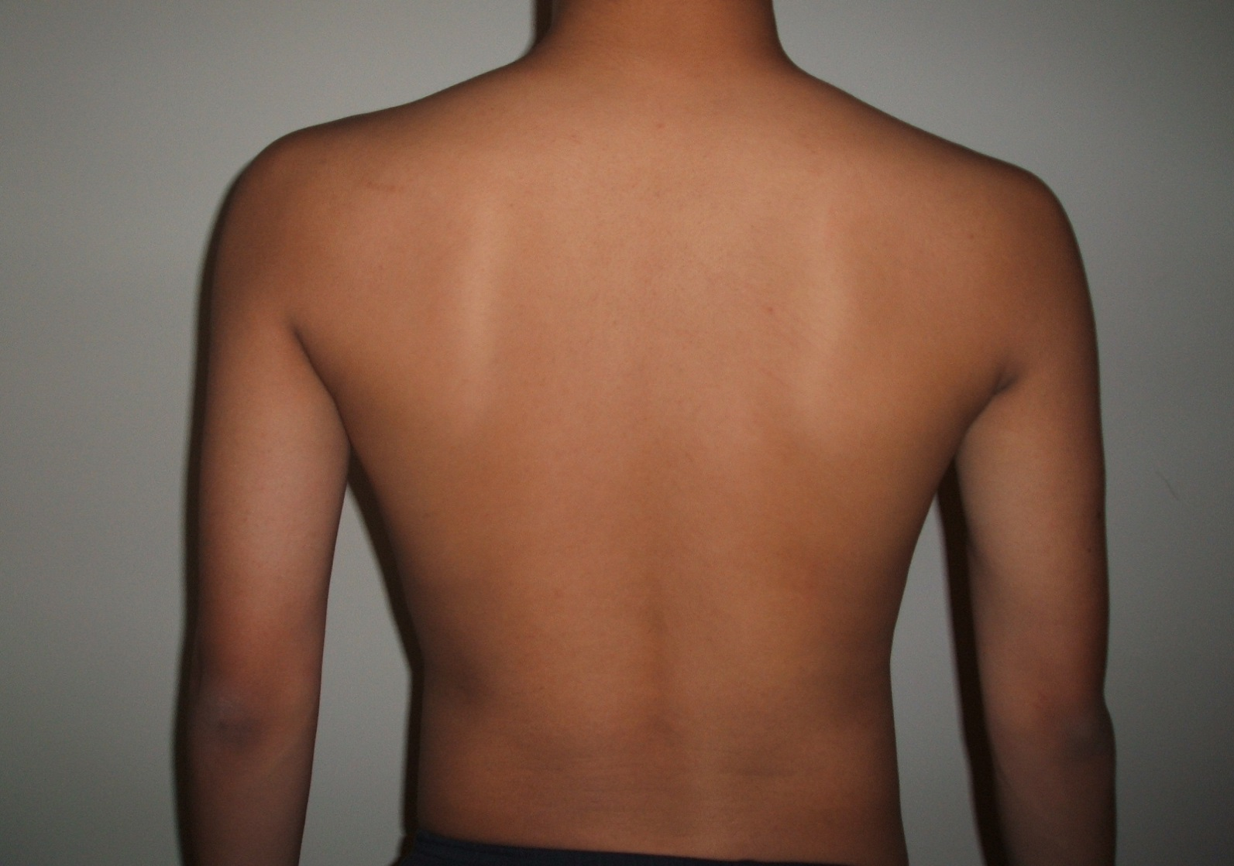
Suprascapular region
Interscapular region
Infrascapular region
Scapular line
Posterior midline

Slide 5
Anterior view of lobes

Slide 6
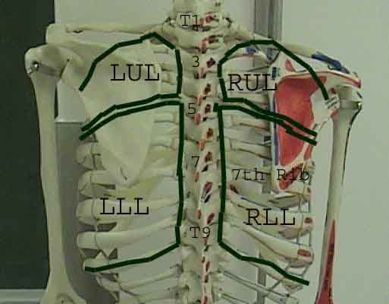
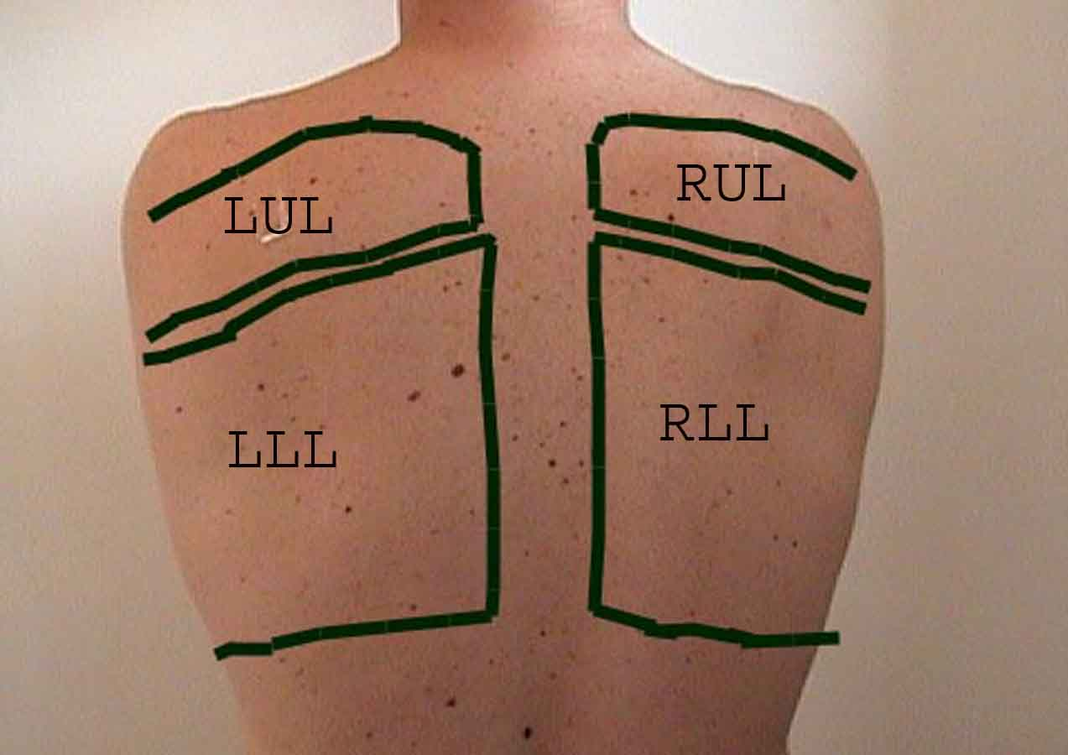
Posterior view of lobes

Slide 7
Right lateral view of lobes

Slide 8
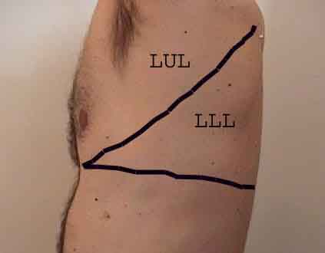
Left lateral view of lobes

Slide 9
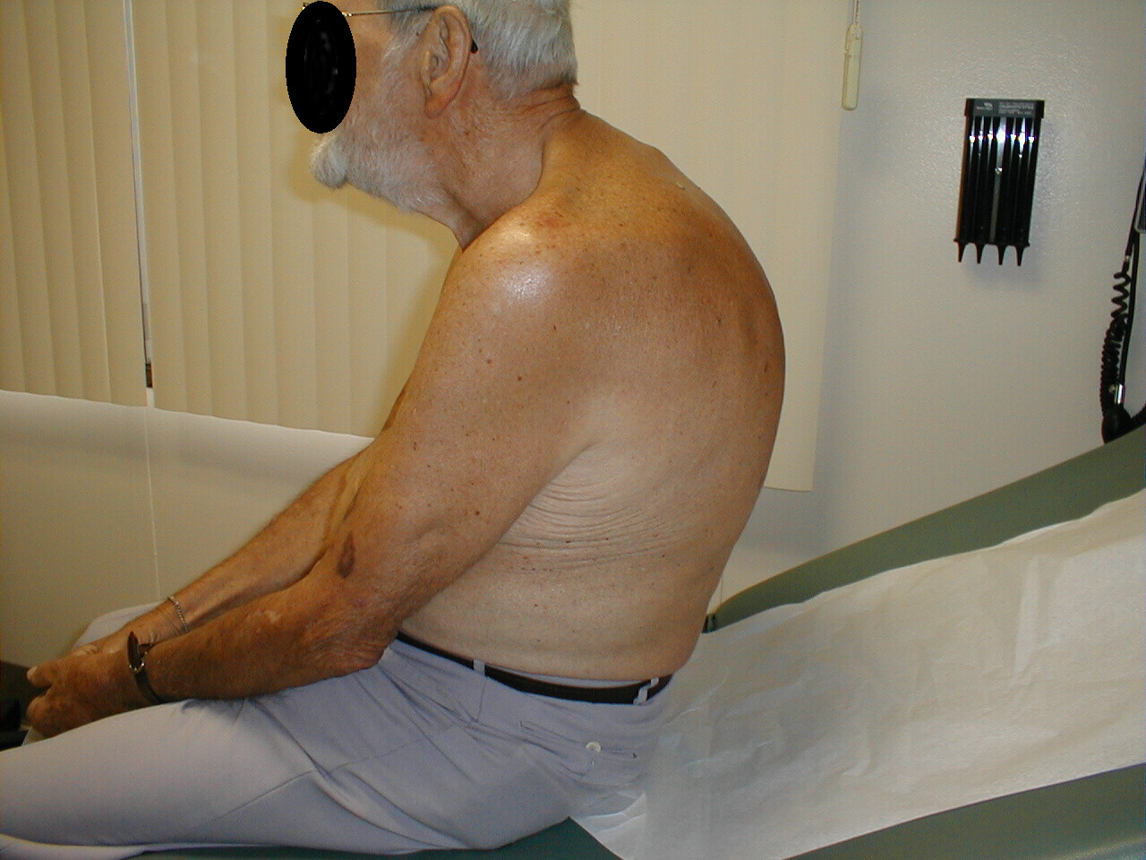
Thoracic deformity
Kyphosis

Slide 10
Pectus exacavatum

Slide 11
. Severe kyphosis and chest deformity - Gaucher disease

Slide 12
History:
Symptoms:
Cough
Sputum
Hemoptysis
Dyspnea
Chest pain (chest tightness)
Wheezing

Slide 13
Cough
Type
dry, moist, wet, productive, hoarse, hacking, barking, whooping
Onset
Duration
Pattern
activities, time of day, weather
Severity
effect on ADLs
Wheezing
Associated symptoms
Treatment and effectiveness

Slide 14
Sputum:
Amount: Normal amount < 100mls of mucus/day
Color: Normal, clear & white mucus
Smell: Normal, not smelly
Note
chronic large amount of purulent sputum may suggest bronchiectasis while acute one may indicate lobar pneumonia.
foul-smelling purulent sputum may indicate lung abscess with anaerobic infection
pink frothy secretions occurs in pulmonary edema

Slide 15
Hemoptysis:
It’s a blood-stained sputum
Varies from streaks of blood to massive bleeding (>100 - 600mls /24 hrs)
It should be investigated thoroughly
Commonest cause is acute infection like exacerbation of COPD but other serious causes should be ruled out.
Other causes: Pulmonary Embolism, Bronchogenic ca., Pulmonary TB, bronchiectasis, lung abscess.

Slide 16
Cont’n
Pulmonary hemorrhage from any cause like: Good pasture's syndrome or rupture of a mucosal blood vessel after a vigorous coughing
Non-respiratory causes: CVS: severe MS, & acute LVF.
Rusty sputum (when purulent sputum is mixed with blood) eg: lobar pneumonia

Slide 17
Dyspnoea
Def: experience of discomfort in breathing or an awareness of respiratory distress & physiologically its an ↑ in the level & work of breathing.
Onset:
Instantaneous: pneumothorax, Pulmonary Embolism
Mins – hrs:
Air way disease: (Bronchial Asthma, COPD exacerbation, Upper Air Way obstruction)
Parenchymal disease: (pneumonia, pulmonary hemorrhage, pulmonary edema..)
Pulmonary vascular disease: (PE)
Cardiac disease: ( MI. )
Metabolic acidosis
Hyperventilation syndrome.

Slide 18
Cont’n:
3. Subacute (days):
Many days plus:
Pleural effusion
lobar collapse
Acute Interstitial pneumonia
Superior Vena Cava obstruction
Pulmonary vasculitis
4. Chronic (months-years):
COPD & Bronchial Asthma
Diffuse parenchymal disease: ( sarcoidosis, bronchiectasis)
Hypoventilation
Anemia
Thyrotoxicosis

Slide 19
Chest pain:
Pulmonary causes of Chest Pain:
1. pulmonary vasculature:
Acute Pulmonary Embolism
Pulmonry HTN & Corpulmonale
2. Lung parenchyma:
Pneumonia
Cancer
sarcoidosis

Slide 20
Cont’n:
3 . Pleura & plural spaces:
Pneumothorax
Pleuritis & serositis
Pleural effusion
4. Psychogenic - physical illnesses that are believed to arise from emotional or mental stressors, or from psychological or psychiatric disorders.
Psychosomatic -physical illness or other condition) caused or aggravated by a mental factor such as internal conflict or stress.

Slide 21
Wheezing:
It’s a continuous whistling, 1st sign of asthma but not diagnostic for asthma since it can occur in other respiratory Diseases with obstruction.

Slide 22
Other symptoms:
Runny, blocked nose & sneezing: may occur in both common cold & allergic rhinitis (loss of smell = anosmia, runny nose = rhinorrhea)
Nocturnal fever may accompany TB& pneumonia.
Nocturnal sweating can occur in TB, lymphoma, & lung abscess.
Hoarseness may be secondary to laryngitis, Vocal Cords tumor, & Recurrent Laryngeal Nerve palsy .
Symptoms of corpulmonale (abd & ankle swelling) - abnormal enlargement of the right side of the heart as a result of disease of the lungs or the pulmonary blood vessels

Slide 23
Other aspects of history:
Details of the respiratory system symptom should be inquired such as; onset, duration, character, radiation/severity/grading, frequency, aggravating & relieving factors, & associated symptoms.
PMH of a respiratory disease
Smoking history in details
Drug history including IV drug abuser (lung abscess) & alcohol consumption (aspiration pneumonia)
Inquiry about occupation & or previous jobs
Pets history

Slide 24
Clinical examination (signs):
* General appearance
* General system
* Chest examination
In general appearance, look for:
Respiratory distress {count RR, normal 14-20bpm Tachypnea = ↑ rate of breathing
Hyperapnea = ↑ level of ventilation, and
look to the accessory muscles; sternomastoids, scalene, platysma & strap muscles of neck & abdominal muscles, if they are in use?}

Slide 25
Cont’n
Coughing; character
Abnormal sound; stridor (croaking noise, loudest on inspiration 2° to larynx, trachea or large airways obstruction), or wheezing.
Abnormal voice; hoarseness
Surroundings; like containers of sputum, O2 mask, IV lines or medications respiratory aids or machines..

Slide 26
General system examination:
Hands:
Clubbing (check respiratory causes)
Tar staining
Weakness of hand’s small muscles (abduction)
Wrist:
Pulse: rate & character
Tremors
3. BP: pulsus paradoxus , is an abnormally large decrease in systolic blood pressure and pulse wave during inspiration. Occurs in asthma.

Slide 27
Cont’n
Neck:
JVP: ↑ in corpulmonale & SVC obstruction.
LN: enlargement in CA bronchus or metastases
Face:
Eyes: jaundice or other abnormalities
Tongue: central cyanosis
SVC obstruction: plethoric & cyanosed, periorbital edema, injected conjuctiva .

Slide 28
Chest examination
Inspection:
Shape: AP diameter compared to transverse (barrel-chest), pectus excavatum, pectus carinatum, kyphoscoliosis,…. others
Symmetry: assessment of upper & lower lobes should be done posteriorly looking for ↓ or delayed chest movement during moderate respiration.
Scars: from previous operation or chest drains or traditional marks or radiotherapy markings.
Prominent veins: in case of SVC obstruction

Slide 29
Respiratory rate:
16-20 breaths/min – normal in an adult
Tachypnea: >20 breaths/min
Bradypnea: <12 breaths/min
Shallow and fast
respiratory muscular paralysis, elevated intra abdominal pressure, pneumonia, pleurisy
Deep and fast
Agitation, intension
Deep and slow
Severe metabolic acidosis (Kussmaul’s breathing)

Slide 30
Respiratory rhythm
Cheyne-Stokes’ breathing - Is an abnormal pattern of breathing characterized by progressively deeper and sometimes faster breathing.
Biot’s breathing —also known as ataxic breathing—is a breathing pattern in patients with acute neurological disease.
Decreased excitability of respiratory center
Inhibited breathing
Sudden cessation of breathing due to chest pain
Pleurisy, thoracic trauma
Sighing breathing
Depression, intension

Slide 31
Palpation:
Trachea: normally central, slight Rt displacement could be NORMAL. Check for gross displacement. Tracheal tug means the Normal distance between sternal notch & cricoid cartilage is < 3-4 finger breadths & occurs in chest overexpansion as in COPD.
Apex beat & mediastinum: Check for displacement.
Chest expansion: Normal expansion ≥ 5cm
Tactile vocal fremitus (TVF): can be done with the palm of one hand.

Slide 32
Thoracic expansion

Slide 33
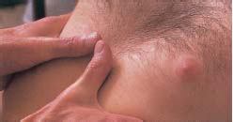
Thoracic expansion
Assessing chest expansion in expiration (left) and inspiration (right).

Slide 34
Vocal fremitus (tactile fremitus)

Slide 35
Percussion:
Should be done symmetrically (Lt compared with the Rt), posteriorly (the back), anteriorly (the front) & laterally (the sides).
Supraclavicular area, then clavicles should be percussed directly to evaluate the upper lobes.
Liver dullness: of the upper edge starting at the 6th rib MCL, resonant note below this area indicates hyper-inflation (COPD, severe asthma)
Cardiac dullness: may be ↓ in hyperinfated chest.

Slide 36
percussion

Slide 37
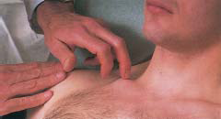
percussion
Percussion over the anterior chest.
Direct percussion of the clavicles for disease in the lung apices

Slide 38
Classification
Resonance - Normal
Hyperresonance
Emphysema
Tympany
Cavity or pneumothorax
Dullness
Hydrothorax, atelectasis
Flatness - Massive Hydrothorax

Slide 39
Normal sound
Lung’s sound in percussion
Resonance
Slight dullness in some areas (upper, right, back) due to thickness of muscles and skeletons

Slide 40
Cont’n
Border of lungs in percussion
Apex of lungs - Kronig’s isthmus: 5cm in width
Narrow: TB, fibrosis
wider: emphysema
Anterior border - absolute cardiac dullness area
Lower border
6th, 8th, 10th intercostal space in mid clavicular line, mid axillary line, scapular line, respectively
Down: emphysema
Up: atelectasis, intra abdominal pressure goes up

Slide 41
Abnormal sound
Dullness, flatness, hyper resonance or tympany appear in the area of supposed resonance.
Unchanged sound (resonance) depends on
The depth of the lesion
The diameter of the lesion
Mild hydrothorax

Slide 42
Abnormal sound
Dullness or flatness
Decreased containing gas in alveoli
Pneumonia,Atelectasis?
TB, Pulmo. embolism
Pulmo. Edema, Pulmo. fibrosis
No gas in alveoli
Tumor, Pulmo. Hydatid
Pneumocystis ,Non-liquefied lung abscess
Others - Hydrothorax
Pleural thickness

Slide 43
Abnormal sound
Hyperresonance -Emphysema
Tympany - Pneumothorax
Large cavity (TB, lung abscess, lung cyst)
Amphorophony
Large and shallow cavity with smooth wall
Tension pneumothorax

Slide 44
Tympanic dullness
Decreased tension and gas in alveoli
Atelectasis
Congestive or resolution stage of pneumonia
Pulmo. edema

Slide 45
Auscultation:
Using the diaphragm of a stethoscope & comment on the following:
Breath sounds (BS):
Intensity: N or ↓ as in (consolidation, collapse, pleural effusion, pneumothorax, lung fibrosis)
Quality: Vesicular or bronchial in consolidation
Differentiation between vesicular & bronchial BS:

Slide 46
Cont’d
Vesicular: louder &longer on inspiration than expiratory phase & has no gap between the 2 phases
Bronchial: louder &longer on expiration phase & has a gap between the 2 phases

Slide 47
Order of auscultation

Slide 48
Normal breath sound
Tracheal breath sound
Bronchial breath sound
Larynx, suprasternal fossa, around 6th, 7th cervical vertebra, 1st, 2nd thoracic vertebra
Bronchovesicular breath sound
1st, 2nd intercostal space beside of sternum, the level of 3rd, 4th thoracic vertebra in interscapular area, apex of lung
Vesicular breath sound
Most area of lungs

Slide 49
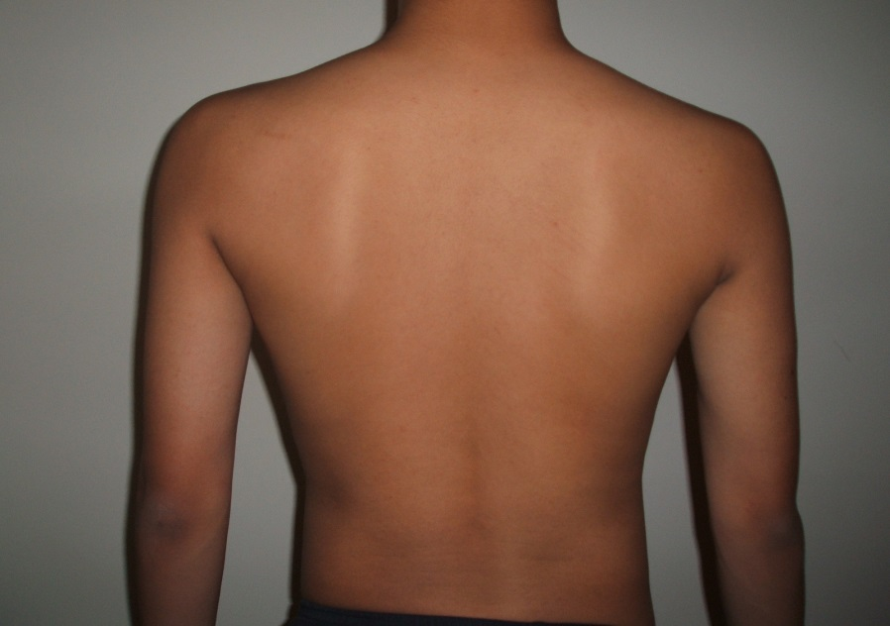
Bronchial
Bronchial
Bronchovesicular
Bronchovesicular

Slide 50
Abnormal breath sound
Abnormal vesicular breath sound
Abnormal bronchial breath sound
Abnormal broncho vesicular breath sound

Slide 51
Abnormal vesicular breath sound(1)
Decreased or disappeared
Movement of thoracic wall
Respiratory muscle weakness
Obstruction of airway
Hydrothorax or pneumothorax
Abdominal diseases: ascites, large tumor
Increased
Movement of respiration

Slide 52
Abnormal vesicular breath sound (2)
Prolonged expiration
Bronchitis
Asthma
emphysema
Cogwheel breath sound
TB
Pneumonia
Coarse breath sound
Early stage of bronchitis or pneumonia

Slide 53
Abnormal bronchial breath sound (tubular breath sound)
Bronchial breath sound appears in supposed vesicular breath sound area
Consolidation: lobar pneumonia (consolidation stage)
Large cavity: TB, lung abscess
Compressed atelectasis: hydrothorax, pneumothorax.

Slide 54
Abnormal bronchovesicular breath sound
Bronchovesicular breath sound appears in supposed vesicular breath sound area
The lesion is relatively smaller or mixed with normal lung tissue

Slide 55
Added Sounds:
Type:
Wheezes or Crackles or friction rub
Timing:
inspiratory or expiratory
.

Slide 56
Wheezes
Are continuous musical polyphonic sound, heard louder on expiration & can be heard on inspiration which may imply severe Air Way narrowing.
High pitched- wheezes are found in Bronchial Asthma due to acute/chronic airflow limitation & low pitched in COPD. Localized monophonic wheeze due to fixed Air Way obstruction in CA bronchus

Slide 57
Characteristics of rhonchi
Adventitious sound
High pitch
Dominance in phase of expiration
Variable intensity of character or site
Wheezing

Slide 58
Site of rhonchi
Both fields
Asthma
Chronic bronchitis
Acute left heart failure
Local site
Tumor
Endobronchial TB

Slide 59
Crackles:
interrupted non-musical inspiratory sound
Crackles may be early, late or pan-inspiratory & fine, medium or coarse.
Examples: late/pan-inspiratory coarse crackles in bronchiectasis, late/pan-inspiratory medium crackles in pulmonary edema , late/pan-inspiratory fine crackles in pulmonary fibrosis

Slide 60
Classification of crackles
According to intensity of the sound
Loud moist crackles
Slight moist crackles
According to diameter of the airway crackles appeared
Coarse: trachea, main bronchi, or cavity
Bronchiectasis, pulmo. edema, TB, lung abscess, coma
Medium: bronchi - bronchitis, pneumonia
Fine: bronchioli - pneumonia
Crepitus:Bronchiolitis, alveolitis, early pneumonia (pulmo. Congestion), elder subject, pat. bed rest for long time

Slide 61
Site of crackles
Local: local lesion
Pneumonia, TB, bronchiectasis
Both bases
Pulmo. edema, bronchopneumonia,
chronic bronchitis
Full fields
Acute pulmo. edema, severe bronchopneumonia, chronic bronchitis with severe infection

Slide 62
friction rub:
It’s due to thickened or roughened pleural surfaces rubbing together as lungs expand & contract & give off a continuous or intermittent grating sound. It indicates pleurisy & may be heard in pneumonia or pulmonary infarction.

Slide 63
Pleural friction rub
Area of auscultation - Anterolateral thoracic wall (maximal shifting area of lung)
Causes
Tuberculous pleurisy
Pulmo. embolism
Uremia
Pleural tumour

Slide 64
Vocal Resonance:
It’s the ability to transmit sounds.
Ask patients to say 99 (English) & listen for the transmitted sound which may be ↓ or ↑ or Normal (low pitched component of speech heard with booming & high pitched become attenuated).

Slide 65
cont’n
Bronchophony
Consolidation
Pectoriloquy
Massive consolidation
Egophony
Upper area of hydrothorax
Whispered
Consolidation

Slide 66
Cont’n
Egophony:
When the patient with consolidation is asked to say ‘e’ it sounds like ‘a’
Whispering pectoriloquy:
The whispered speech is heard very loudly over the consolidated area.

Slide 67
Secondary pul HTN or corpulmonale:
Should be suspected in:
Chronic airflow limitation such as COPD
Pulmonary fibrosis
Chronic pulmonary thromboembolism
Obstructive Sleep Apnea
Severe kyphoscoliosis/marked obesity

Slide 68
Main symptoms and signs in common respiratory diseases
Lobar pneumonia
symptoms
Chill, Continued fever: 39-40ºC
Chest pain, Tachypnea, Cough ,Rusty sputum
Signs
Acute facial features, Nares flaring (dyspnea),
Cyanosis, Tachycardia and Simple herpes around lips.
Others: Congestion, decreased respiratory movement, Increased vocal resonance

Slide 69
Chronic bronchitis with emphysema
symptoms
Chronic productive cough ,
White mucous sputum or pus sputum (infection)
Exertion dyspnea or Breathlessness (dyspnea),
Chest depression

Slide 70
signs
Barrel chest
Hyper resonance
The lower border of lungs downward
Shifting range of bottom of lung
Cardiac dullness area
Decreased vesicular breath sound
Prolonged expiration
Moist crackles and/or rhonchi (acute episode)

Slide 71
Bronchial asthma
Symptom.
Expiratory dyspnea with wheezing
signs
Expiratory dyspnea with wheezing
Orthopnea, Cyanosis, Severe sweat
Decreased movement of respiration
Decreased vocal fremitus
Hyper resonance
Rhonchi in full fields of lungs

Slide 72
Hydrothorax (pleural effusion)
symptoms
Dry cough
Chest pain
Disappeared with growing of pleural effusion
Reappeared with the fluid decreasing
Pain on affected side lying
Dyspnea, orthopnea
The symptoms of underlying disease

Slide 73
Signs (Moderate to massive effusion)
Tachypnea
Limited movement of affected side
Costal interspaces of affected side are wider
Trachea shifts to opposite side
Decreased vocal fremitus
Dullness or flatness
Decreased or disappeared vesicular breath sound
Pleural friction rub
Abnormal bronchial breath sound in upper area of the fluid

Slide 74
Pneumothorax
symptoms
Sudden chest pain , Dyspnea
Forced sitting position
Unaffected side lying
Dry cough
Tension pneumonia
Progressive dyspnea
Tachycardia
Cyanosis
Respiratory failure

Slide 75
signs
Costal interspaces in affected side are wider
Limited movement of affected side
Decreased vocal fremitus
Trachea and heart shift to opposite side
Tympanic
Vesicular breath sound decreased or disappeared

