Slide 1
Acquired heart diseases in children

Slide 2
Outline
Rheumatic fever
Rheumatic heart disease
Pericardial diseases
Myocarditis
Infective endocarditis
Heart failure in children
Basics of ECG

Slide 3
Rheumatic Fever

Slide 4
Objectives
At the end of the session, student should be able to describe:
Etiology
Epidemiology
Pathogenesis and Pathophysiology
Clinical manifestations
Diagnosis
Treatment & Prevention
Prognosis

Slide 5
Definition/Etiology
Acute rheumatic fever is a systemic disease of childhood, often recurrent that follows Group A beta hemolytic streptococcal pharyngitis.
It is a delayed non-suppurative sequelae to URTI with Group A Beta Hemolytic streptococci (GABH).
It is a diffuse inflammatory disease of connective tissue, primarily involving the heart, blood vessels, joints, subcutaneous tissue and CNS

Slide 6
Epidemiology
Ages 5-15 yrs are most susceptible
Rare <3 yrs
Girls = boys - prognosis is worse for females than for males.
Common in 3rd world countries
Race (when controlled for socioeconomic variables) has not been documented to influence disease incidence.
Environmental factors -- over crowding, poor sanitation, poverty.
The incidence of RF in Developing countries is 27-100/100,000 /yr

Slide 7
Kenyan data
Data on Rheumatic Fever scanty.
Each year, it is estimated that Kenya has approximately 200,000 new cases of rheumatic heart disease, making it among the world’s hardest-hit countries.
Prevalence rate of RHD = 1.7-2.4/1000 (170-240/100,000)
(Epidemiology of rheumatic heart disease among primary school children in western Kenya. International Journal of cardiology … Anabwani GM¹, Amoa AB, Muita AK.)

Slide 8
Pathogenesis
Delayed immune response to infection with group A beta hemolytic streptococci.
After a latent period of 1-3 weeks, antibody induced immunological damage occur to heart valves, joints, subcutaneous tissue & basal ganglia of brain
The mechanism of this immune reaction is not yet understood, however, the most accepted hypothesis is antigenic similarity (mimicry) hypothesis.

Slide 9
Group A Beta Hemolytic Streptococcus
Common cause of Pharyngitis.
M sero-types - 1, 3, 5, 6, 18, 24
Skin infection- produced by GABHS leads to post streptococcal glomerulonephritis only. It will not result in Rheumatic Fever or carditis as skin lipid cholesterol inhibit antigenicity..

Slide 10
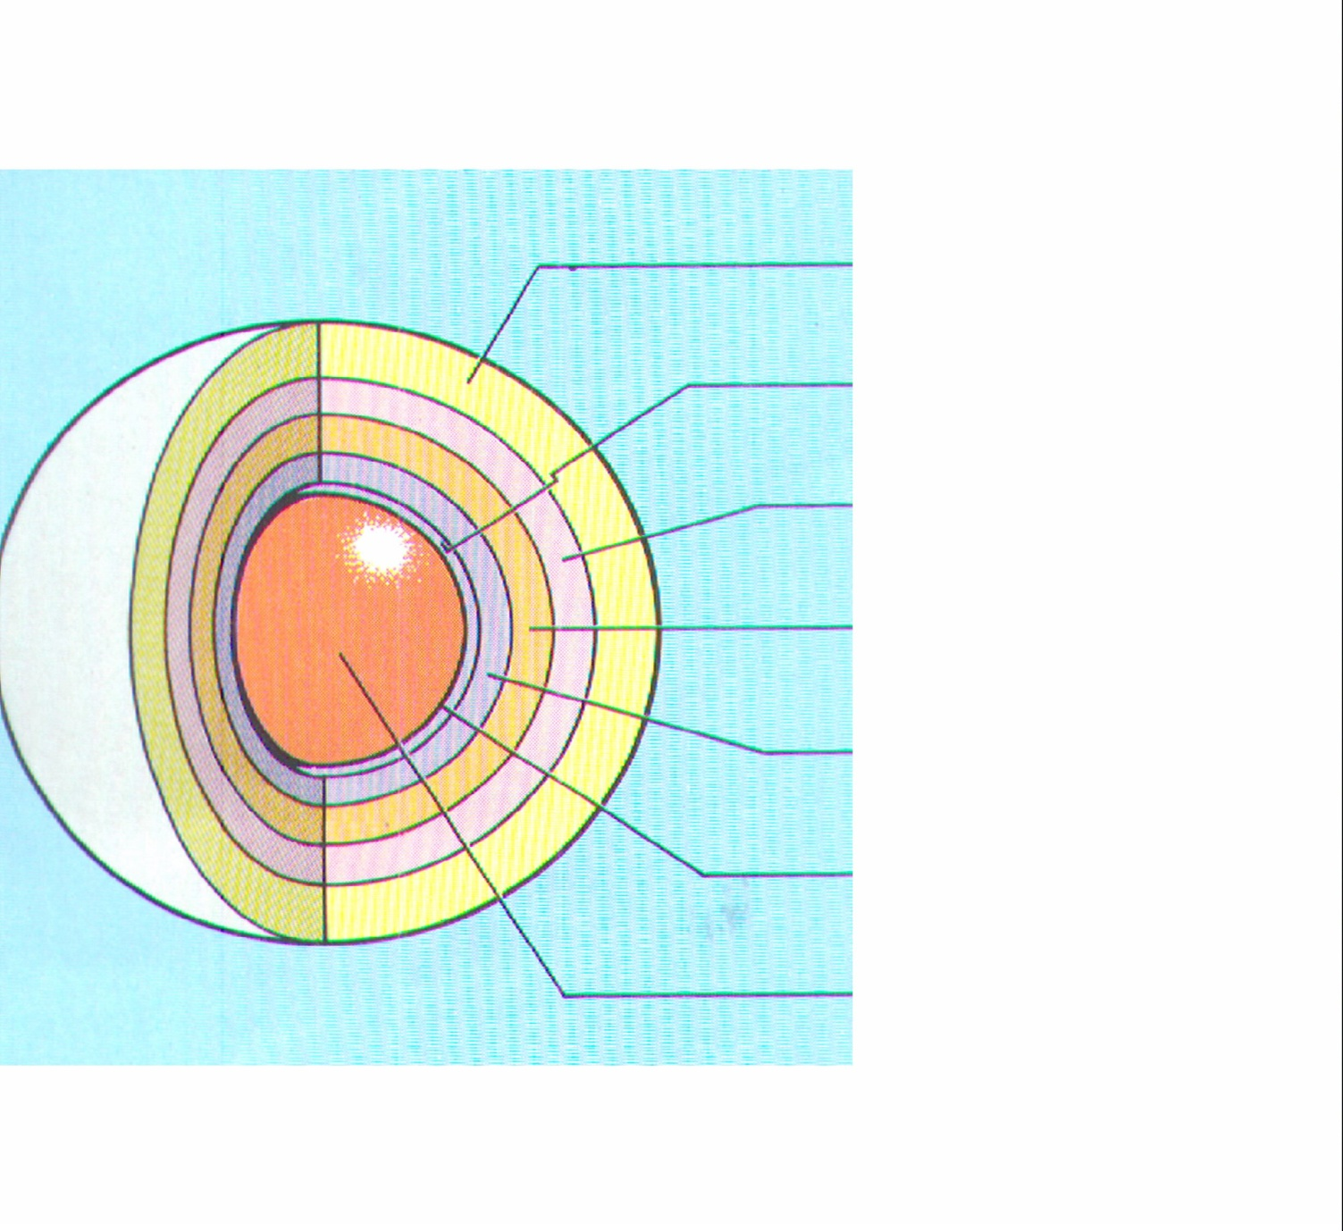
Diagrammatic structure of the group A beta hemolytic streptococcus
Capsule
Antigen of outer protein cell wall of GABHS induces antibody response in victim which result in autoimmune damage to heart valves, sub cutaneous tissue, tendons, joints & basal ganglia of brain
Cell wall
Protein antigens
Group carbohydrate
Peptidoglycan
Cyto.membrane
Cytoplasm
…………………………………………………...

Slide 11
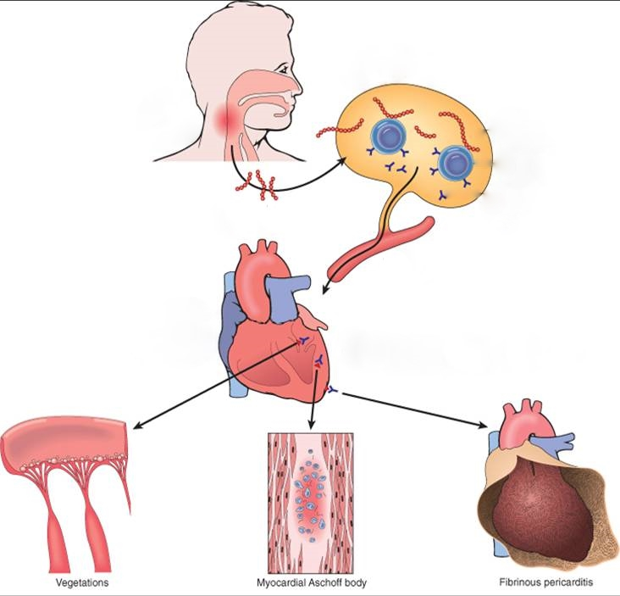
Strep throat
Antibody
production
Antibody cross-reaction
with heart
vegetations
Aschoff body
pericarditis

Slide 12
Pathogenesis
M antibody+Vascular smooth muscle
C antibody+Cardiovascular connective tissue
Antigen - antibody complex
activation of
coagulation
system
Local deposition
alexin
platelet
Embolism,
bleeding
Neutrophil infiltration
Release of lysosomal enzymes(Neutral, acid hydrolases, elastase, collagenase and so on
Blood vessel, tissue injury

Slide 13
Pathologic Lesions
The characteristic lesion of acute rheumatic fever is the Aschoff body (nodule), consisting of a focus of necrosis (representing the site of antigen – antibody reaction) surrounded by activated histiocytes and lymphocytes.
The histiocytes may be mononuclear or multinuclear, and are referred to as Anitschkow's or Aschoff cells.
These foci may be found in the pericardium, the myocardium, or uncommonly in the valves.
They ultimately "heal" by fibrosis.

Slide 14
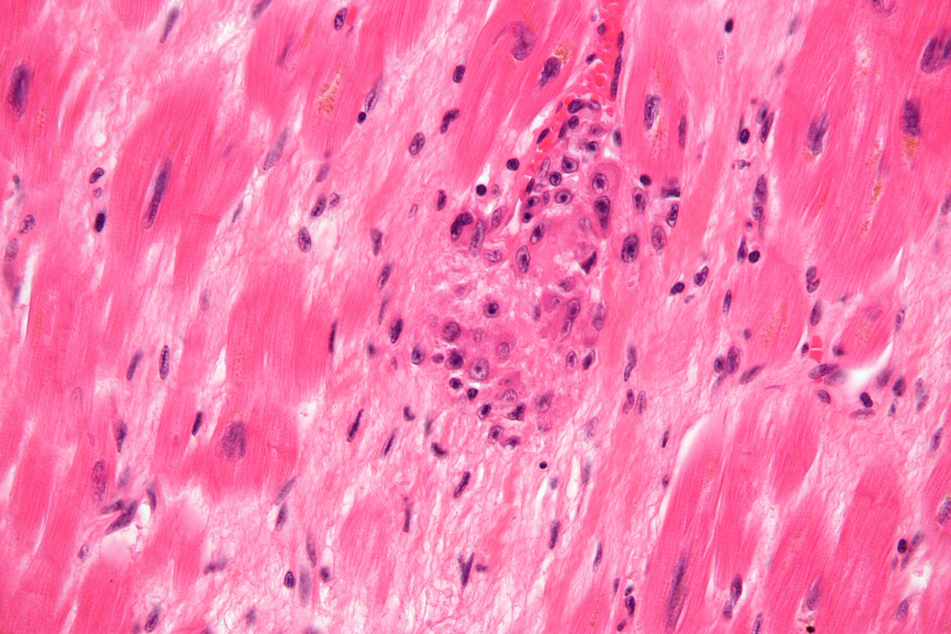
Aschoff’s body

Slide 16
Basic pathological changes
Exudative and degenerative phase
The proliferative phase (Granulomatous period)
Scar phase (healed phase\Fibrosis phase\Hardening phase)

Slide 17
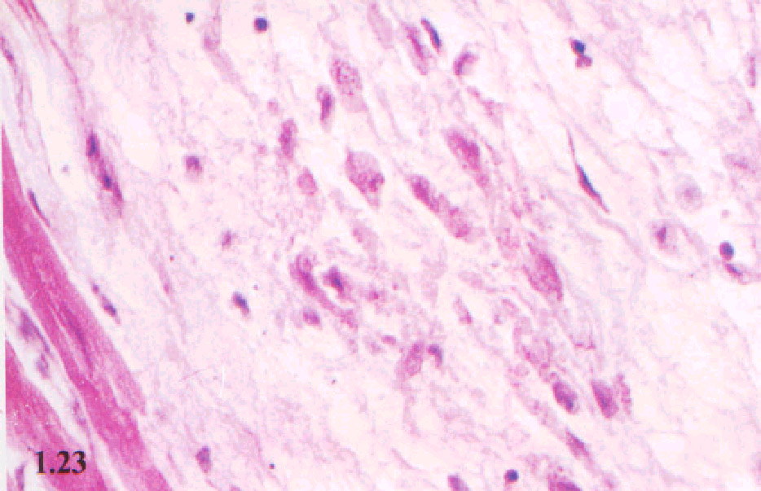
a) Exudative and degenerative phase
It is characterized by serofibrinous exudate, with deposits of
immune precipitate on collagen fibers that lead to fibrinoid
Necrosis – Takes about 1 month.

Slide 18
b) The proliferative phase (Granulomatous period)
Aschoff Body:
Pathognomonic for RF
Structure:
Center： Fibrinoid necrosis
around the center：Anitschkow cells , lymphocytes, occasional plasma cells
Distribution:
Myocardial interstitial, subendocardial and subcutaneous connective tissue.
Epicardial, joints and blood vessels is rare.

Slide 19
c) Scar phase
Emergence of fibroblasts and collagen production, formation of small spindle scar, 2-3 months or so.
The above three stages repeated attacks, the old and new lesions coexist.
The whole course about 4-6 months.

Slide 20
Clinical features

Slide 21
1. Arthritis
Flitting & fleeting migratory polyarthritis, involving major joints
Commonly involved joints - knee, ankle, elbow & wrist
Occur in 80%, involved joints are exquisitely tender
In children below 5 yrs arthritis usually mild but carditis more prominent
Arthritis do not progress to chronic disease

Slide 22
2. Carditis
Manifest as pancarditis(endocarditis, myocarditis and pericarditis),occur in 40-50% of cases
Carditis is the only manifestation of rheumatic fever that leaves a sequelae & permanent damage to the organ
Valvulitis occur in acute phase
Chronic phase- fibrosis, calcification & stenosis of heart valves (fish mouth valves or button hole valves)

Slide 23
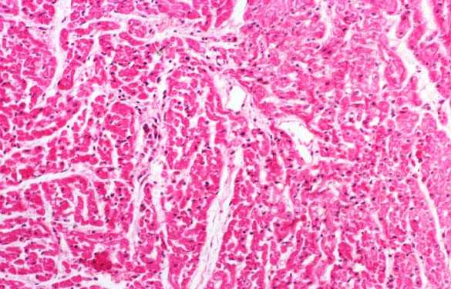
Histology of Myocardium in Rheumatic Carditis (200X)

Slide 24
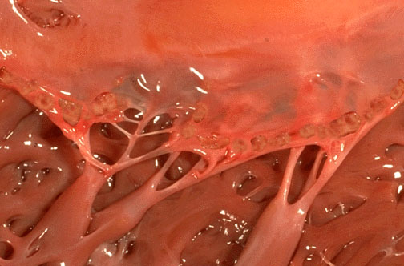
Acute rheumatic endocarditis: small (diameter 1- to 2-mm) vegetations along the mitral valve margin, insufficient to cause valvular deformation.

Slide 25
Rheumatic vegetations

Slide 26
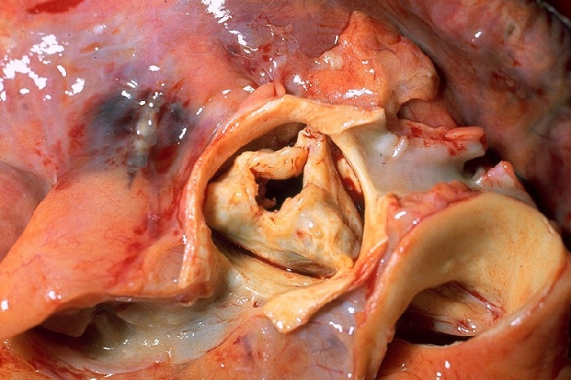
Aortic valve stenosis

Slide 27
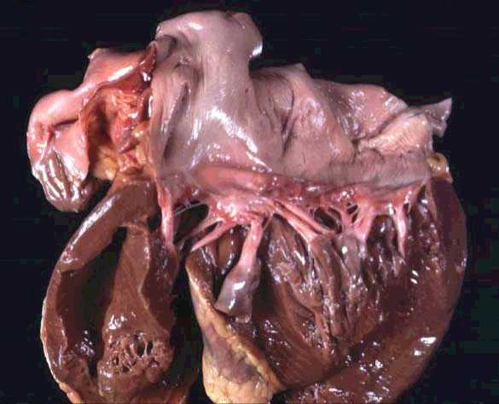
Rheumatic heart disease. Abnormal mitral valve. Thick, fused chordae

Slide 28
Clinical Manifestations
Carditis is most commonly detected by:
- Tachycardia out of proportion to fever.
- New or changing murmurs - rheumatic valvulitis.
- Congestive heart failure - Patients may complain of dyspnea, mild-to-moderate chest discomfort, pleuritic chest pain, edema, cough, or orthopnea

Slide 29
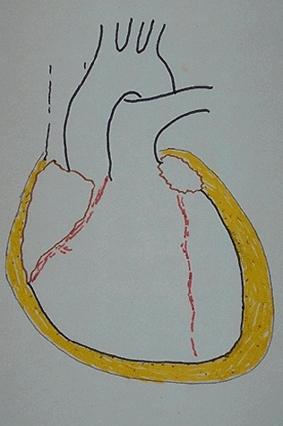
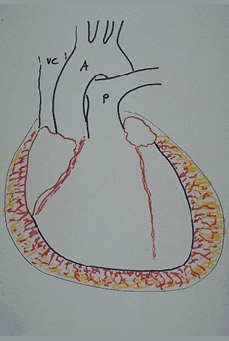
Rheumatic pericarditis
A serous or sero-fibrinous inflammation. Can
form a pericardial effusion and constrictive pericarditis.
Serous pericarditis
Fibrinous pericarditis

Slide 30
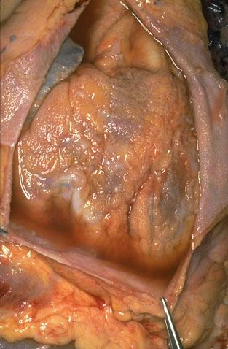
Can lead to heart sound far, around the heart boundary expanding, serious cardiac X-ray showed a flask
pericardial effusion

Slide 31
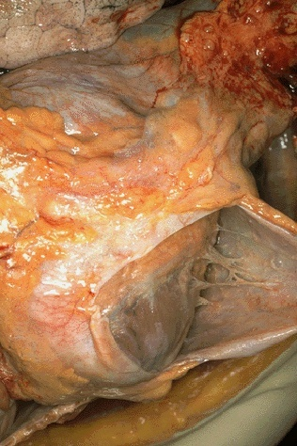
Adhesive pericarditis in cardiac surface of patients. From the epicardial surface to the pericardial sac visible fibrinous exudate, which is typical for a fibrinous pericarditis.

Slide 32
3.Sydenham Chorea
Occur in 10-15% of cases
Mainly in girls of 5-15 yrs age
May appear even 6/12 after the attack of rheumatic fever
Clinical manifestations
Emotional lability.
Clumsiness.
Poor school performance with deterioration of hand writing.
Uncontrollable movements with inco-ordination, and facial grimacing, exacerbated by stress and disappearing with sleep.

Slide 33
Chorea occasionally is unilateral.
Onset can be insidious, with symptoms being present for several months before recognition.
Clinical maneuvers to elicit features of chorea include:
(1) Demonstration of milkmaid's grip (irregular contractions of the muscles of the hands while squeezing the examiner's fingers).
(2) Spooning and pronation of the hands when the patient's arms are extended.
(3) Wormian movements of the tongue upon protrusion.
(4) Examination of handwriting to evaluate fine motor movements.
Diagnosis is based on clinical findings with supportive evidence of group A streptococcal antibodies.
Chorea rarely leads to permanent neurologic sequelae.

Slide 34
4.Erythema Marginatum
Occur in <5%.
Unique, transient, serpiginous - looking lesions of 1-2 inches in size
Pale center with red irregular margin
More on trunks & limbs & are non-itchy
Worsens with application of heat
Often associated with chronic carditis

Slide 35
Annular erythema

Slide 36
5.Subcutaneous nodules
Occur in 10%
Painless, pea-sized, palpable nodules
Mainly over extensor surfaces of joints, spine, scapulae & scalp
Associated with strong seropositivity
Always associated with severe carditis

Slide 37
Other features.
Fever-(up to 39 degrees C)
Arthralgia
Pallor
Anorexia
Loss of weight

Slide 38
Laboratory Findings
High ESR
Elevated C-reactive protein
CBC - Anemia, leucocytosis
ASO titre >200 Todd units - 80-85% sensitive
(Peak value attained at 3 weeks, then comes down to normal by 6 weeks)
Anti-DNAse B test
Throat culture - GABH streptococci

Slide 39
Laboratory findings
Other tests
Rapid antigen detection test - rapid detection of group A streptococcal antigen
antihyaluronidase
antistreptokinase
antistreptococcal esterase
Antibody tests for cellular components of group A streptococcal antigens - antistreptococcal polysaccharide, antiteichoic acid antibody, and anti–M protein antibody.

Slide 40
IMAGING STUDIES
Chest roentgenography
Cardiomegaly, pulmonary congestion, and other findings consistent with heart failure may be seen on chest radiography.
When the patient has fever and respiratory distress, chest radiography helps differentiate heart failure from pneumonia.

Slide 41
IMAGING STUDIES
ECG- Prolonged PR interval, 2nd or 3rd degree blocks, ST depression, T inversion – due to inflamed heart tissues.
2D/3D Echocardiography- may show valve edema, mitral regurgitation, LA & LV dilatation, pericardial effusion, decreased contractility

Slide 42
IMAGING STUDIES
Doppler-echocardiogram
In acute rheumatic heart disease, it identifies and quantitates valve insufficiency and ventricular dysfunction.
With mild carditis, Doppler evidence of mitral regurgitation may be present during the acute phase of disease but resolves in weeks to months.
The most important echocardiographic features of mitral regurgitation from acute rheumatic valvulitis are annular dilatation, elongation of the chordae to the anterior leaflet, and a posterolaterally directed mitral regurgitation jet.

Slide 43
Diagnosis
Rheumatic fever is mainly a clinical diagnosis
No single diagnostic sign or specific laboratory test available for diagnosis
Diagnosis based on JONES CRITERIA

Slide 44
Jones criteria
A. Major criteria:
Carditis.
Polyarthritis
Sydenham’s chorea.
Erythema marginatum.
Subcutaneous nodules.
B. Minor criteria:
Previous history of rheumatic fever.
Arthralgia.
Fever.
Lab tests indicative of inflammation : ESR (erythrocyte sedimentation rate), CRP (C-Reactive protein), leukocytosis.
ECG changes – prolonged PR interval

Slide 45
Jones criteria
Diagnosis - Need 2 major criteria or 1 major and 2 minor criteria.
Plus
Supporting evidence of streptococcal infection:
Increased titres of antistreptococcal antibodies (anti-streptolysin O) ASOT
Positive throat culture for Group A streptococcus, recent scarlet fever infection.

Slide 46
Exceptions to Jones Criteria
Chorea alone, if other causes have been excluded
Insidious or late-onset carditis with no other explanation
Patients with documented RHD or prior rheumatic fever, one major criterion, and/or fever, arthralgia or high CRP suggests recurrence

Slide 47
Differential Diagnosis
Juvenile rheumatiod arthritis
Septic arthritis
Sickle-cell arthropathy
Kawasaki disease
Myocarditis
Scarlet fever
Leukemia
etc

Slide 48
Treatment
Step I - Primary prevention – focus on eradication of streptococci.
Step II – control of inflammation - Anti inflammatory treatment - aspirin/NSAIDS, steroids.
Step III- Supportive management & management of complications
Step IV- Secondary prevention - focus on prevention of recurrent attacks.

Slide 49
STEP I: Primary Prevention of Rheumatic Fever (Treatment of Streptococcal Tonsillopharyngitis)
Agent Dose Mode Duration
Benzathine penicillin G 600 000 U for patients Intramuscular Once <27 kg. 1 200 000 U for patients >27 kg or
Penicillin V Children: 250 mg 2-3 times daily Oral 10 d (phenoxymethyl penicillin) Adolescents and adults: 500 mg 2-3 times daily
For individuals allergic to penicillin
Erythromycin: 20-40 mg/kg/d 2-4 times daily Oral 10 d Estolate (maximum 1 g/d)
or
Ethylsuccinate 40 mg/kg/d 2-4 times daily Oral 10 d (maximum 1 g/d)
Recommendations of American Heart Association

Slide 50
Step II: Anti inflammatory treatment
Clinical condition Drugs

Slide 51
3.Step III: Supportive management & management of complications
Bed rest
Treatment of congestive cardiac failure: - digitalis, diuretics
Treatment of chorea: -diazepam or haloperidol
Rest to joints & supportive splinting

Slide 52
STEP IV : Secondary Prevention of Rheumatic Fever (Prevention of Recurrent Attacks)
Agent Dose Mode
Benzathine penicillin G 1 200 000 U every 4 weeks* Intramuscular
or
Penicillin V 250 mg twice daily Oral
or
Sulfadiazine 0.5 g once daily for patients 27 kg Oral 1.0 g once daily for patients >27 kg
For individuals allergic to penicillin and sulfadiazine
Erythromycin 250 mg twice daily Oral
*In high-risk situations, administration every 3 weeks is justified and recommended
Recommendations of American Heart Association

Slide 53
Duration of Secondary Rheumatic Fever Prophylaxis
Category | Duration
Rheumatic fever with Carditis and residual heart disease (persistent valvular disease*) | At least 10 y since last episode and at least until age 40 yrs, sometimes lifelong prophylaxis
Rheumatic fever with Carditis, but no residual heart disease (no valvular disease*) | 10 y or well into adulthood, whichever is longer
Rheumatic fever without Carditis | 5 y or until age 21 yrs, whichever is longer

Slide 54
Do not use penicillin, ampicillin, or amoxicillin for endocarditis prophylaxis in patients already receiving penicillin for secondary rheumatic fever prophylaxis (relative resistance of PO streptococci to penicillin and aminopenicillins.
Alternate drugs recommended by the American Heart Association for these patients include PO clindamycin (20 mg/kg) and PO azithromycin or clarithromycin (15 mg/kg)

Slide 55
Prognosis
Rheumatic fever can recur whenever the individual experience new GABH streptococcal infection, if not on prophylactic medicines
Good prognosis for older age group & if no carditis during the initial attack
Bad prognosis for younger children & those with carditis with valvular lesions

Slide 56
Rheumatic Heart Disease
Next session

