Slide 1
PATHOLOGY
UNIT 4,5 &6
CERTIFICATE
HRI CLASS
BY;
MS. MERCY M. AGITA

Slide 2
Pathogenic microorganism
It is an organism capable of causing disease in its host. A human pathogen is capable of causing illness in humans. Common examples of pathogenic organisms include specific strains of bacteria like Salmonella, Listeria and E. coli, and viruses such as Cryptosporidium.

Slide 3
What is a Parasite?
A plant or an animal organism that lives in or on another and takes its nourishment from that other organism. Parasitic diseases include infections that are due to protozoa, helminths, or arthropods. For example, malaria is caused by Plasmodium, a parasitic protozoa.

Slide 4
Classification of pathogenic bacteria
Staphylococci
Pus-forming bacteria that grow in clusters like bunches of grapes, can cause abscesses, pustules and boils

Slide 5
Streptococci
Pus-forming bacteria arranged in curved lines resembling a string of beads; they cause infections such as strep throat and blood poisoning

Slide 6
Diplococci
Spherical bacteria that grow in pairs and cause diseases such as pneumonia

Slide 7
Bacilli
Short rod-shaped bacteria. they are the most common bacteria and produce diseases such as tetanus (lockjaw), typhoid fever, tuberculosis, and diphtheria

Slide 8
Spirilla
Spiral or corkscrew shaped bacteria. They are subdivided into subgroups, such as Treponema papillida which causes syphilis, a sexually transmitted disease (std), or Borrelia burgdorferi, which causes lyme disease

Slide 9
How antibodies inhibit the growth of bacteria
Neutralization:
Bacteria can reproduce by hijacking other cells in the body. When antibodies attach to the bacteria, it is unable to use its antigens to communicate as they are all taken up by the antibodies. It will eventually die off are get consumed.

Slide 10
Opsonization:
Phagocytes are specifically designed to consume bacteria or other pathogens. When an antibody binds to bacteria, it releases a chemical attracting phagocytes.

Slide 11
Agglutination:
Antibodies can also clump several bacteria together, rendering them useless. They cannot do a single thing except wait for phagocytes to consume them.

Slide 12
Complement Activation:
The antibodies latch onto bacteria and attack it with a membrane attack complex. A membrane attack complex is a structure formed on a bacterial or cell wall caused by the body’s immune response. It opens the cell membrane, causing cell lysis, cell death. This can also attract phagocytes.

Slide 13
Mode of action of virus infection
A virus is a small infectious organism—much smaller than a fungus or bacterium—that must invade a living cell to reproduce (replicate).
The virus attaches to a cell (called the host cell), enters it, and releases its DNA or RNA inside the cell. The virus’s DNA or RNA is the genetic material containing the information needed to make copies of (replicate) the virus.

Slide 14
The virus’s genetic material takes control of the cell and forces it to replicate the virus. The infected cell usually dies because the virus keeps it from performing its normal functions. When it dies, the cell releases new viruses, which go on to infect other cells.

Slide 15
Viruses are classified as;
DNA viruses or RNA viruses, depending on whether they use DNA or RNA to replicate. RNA viruses include retroviruses, such as HIV (human immunodeficiency virus— Human Immunodeficiency Virus (HIV) Infection).

Slide 16
Some viruses do not kill the cells they infect but instead alter the cell's functions. Sometimes the infected cell loses control over normal cell division and becomes cancerous. Some viruses, such as herpes viruses and HIV, leave their genetic material in the host cell, where the material remains dormant for an extended time (called latent infection).

Slide 17
Did You Know...
‘A virus takes control of the cell it infects and forces it to make more viruses.’

Slide 18
Viruses usually infect one particular type of cell. For example, common cold viruses infect only cells of the upper respiratory tract. Additionally, most viruses infect only a few species of plants or animals. Some infect only people. Many viruses commonly infect infants and children

Slide 19
Viruses are spread (transmitted) in various ways;
  Swallowing,
  Inhalation,
  Bites of insects, such as mosquitoes, certain biting flies, or ticks.
  Sexually (Sexually Transmitted Diseases (STDs))
  Transfusion of contaminated blood.

Slide 20
Many viruses that were once present in only a few parts of the world are now spreading. These viruses include;
Chikungunya virus,
Crimean-Congo hemorrhagic fever virus,
Japanese encephalitis virus,

Slide 21
Rift Valley Fever virus,
West Nile virus,
Ross River virus,
Zika virus,
and louping ill virus.

Slide 22
Defenses against viruses
The body has a number of defenses against viruses. Physical barriers, such as the skin, discourage easy entry. Infected cells also make interferons; substances that can make uninfected cells more resistant to infection by many viruses.

Slide 23
When a virus enters the body, it triggers the body's immune defenses. These defenses begin with white blood cells, such as lymphocytes and monocytes, which learn to attack and destroy the virus or the cells it has infected.

Slide 24
If the body survives the virus attack, some of the white blood cells remember the invader and are able to respond more quickly and effectively to a subsequent infection by the same virus. This response is called immunity. Immunity can also be produced by getting a vaccine.

Slide 25
Types of viral infections
Probably the most common viral infections are
Respiratory infections: Infections of the nose, throat, upper airways, and lungs
The most common respiratory infections are upper respiratory infections, which include sore throat, sinusitis, and the common cold.
Other viral respiratory infections include influenza and pneumonia.

Slide 26
In small children, viruses also commonly cause croup (which is inflammation of the upper and lower airways, called laryngotracheobronchitis) or lower airways (bronchiolitis).
Respiratory infections are more likely to cause severe symptoms in infants, older people, and people with a lung or heart disorder.

Slide 27
Other viruses infect other specific parts of the body:
Gastrointestinal tract: Infections of the gastrointestinal tract, such as gastroenteritis, are commonly caused by viruses, such as noroviruses and rotaviruses.
Liver: These infections result in hepatitis.

Slide 28
Nervous system: Some viruses, such as the rabies virus and the West Nile virus, infect the brain, causing encephalitis. Others infect the layers of tissue that cover the brain and spinal cord (meninges), causing meningitis or polio.

Slide 29
Skin: Viral infections that affect only the skin sometimes result in warts or other blemishes. Many viruses that affect other parts of the body, such as chickenpox, also cause a rash.

Slide 30
Infections caused by fungi
Fungal infections are common throughout much of the natural world. In humans, fungal infections occur when an invading fungus takes over an area of the body and is too much for the immune system to handle.
Fungi can live in the air, soil, water, and plants. There are also some fungi that live naturally in the human body.

Slide 31
Who is at risk?
Fungal infections are common in humans and are usually not very serious if they are treated quickly and correctly.
Anyone with a weakened immune system may be more likely to contract a fungal infection, as well as anyone who is taking antibiotics.
Cancer treatment and diabetes may also make a person more prone to fungal infections.

Slide 32
Common types of fungal infection
Athlete's foot
Athlete's foot is a common infection where the fungus grows in warm and moist environments.
Tinea pedis or athlete's foot is a common fungal infection that affects the foot.
Athlete's foot is commonly associated with sports and athletes because the fungus grows perfectly in warm, moist environments, such as socks and shoes, sports equipment, and locker rooms.

Slide 33
Symptoms
The symptoms of athlete's foot may vary slightly from person to person. Classic symptoms include:
Redness or blisters on the affected area
The infected skin may be soft, or layers may start to break down
Peeling or cracking skin
The skin may scale and peel away
Itching, stinging, or burning sensations in the infected area

Slide 34
Diagnosis, treatment, and prevention
Not all itchy feet are the result athlete's foot. Doctors usually diagnose the infection by scraping scaling skin off of a person and inspecting it under a microscope for evidence of any fungus.

Slide 35
Athlete's foot is often treated with topical antifungal ointments. Severe infections can require additional oral medications as well. The feet will also need to be cared for and kept dry to help kill the fungus.

Slide 36
Prevention methods include allowing the feet plenty of air to breathe and keeping them clean and dry. It is a good idea to wear sandals in public showers or locker rooms.

Slide 37
Yeast infection
A yeast infection may commonly cause fungal toenail infections.
Vaginal yeast infections are a common form of Candida overgrowth in women, usually caused by Candida albicans.

Slide 38
An overgrowth of Candida disrupts the normal balance of the bacteria and yeast in the vagina. This imbalance of bacteria may be due to antibiotics, stress, and hormone imbalances, or poor eating habits, among other things.

Slide 39
Symptoms
Symptoms of a yeast infection include:
itching and swelling around the vagina
burning sensations or pain during urination or intercourse
redness and soreness on and surrounding the vagina

Slide 40
unusual vaginal discharge, such as gray clumps that resemble cottage cheese or a very watery discharge
A rash may develop over time in some cases. Yeast infections should be treated quickly, as the symptoms may become severe if left untreated.

Slide 41
Diagnosis, treatment, and prevention
The classic symptoms of a yeast infection make them easy to diagnose. Doctors may ask about the person's medical history, such as any previous yeast infections or sexually transmitted infections(STIs). They may also ask whether the person was recently taking antibiotics.
Doctors will then examine the vaginal walls and cervix for signs of infection, taking cells from the vagina if necessary for proper diagnosis.

Slide 42
Treatment of yeast infections depends on their severity. Standard treatments include over-the-counter or prescription creams, tablets, or suppositories. Complicated infections may require complex treatments.

Slide 43
Avoiding yeast infections begins with a balanced diet and proper hygiene. Wearing loose-fitting clothing made from natural fibers may also help prevent infection. Washing underwear in very hot water and changing feminine products often can also help prevent fungal growth.

Slide 44
Jock itch
Tinea cruris, commonly known as jock itch, is another common fungal skin infection.
These fungi love warm and damp environments, and thrive in moist areas of the body, such as the groin, buttocks, and inner thighs. Jock itch may be more common in summer or in warm, humid areas of the world.

Slide 45
Jock itch is mildly contagious and is often spread through direct contact with an infected person or an object that is carrying the fungus.
Jock itch appears on the body as an itchy, red rash that often has a circular shape to it.

Slide 46
Symptoms
redness in the groin, buttocks, or thighs
chafing, irritation, itching, or burning in the infected area
a red rash with a circular shape and raised edges
cracking, flaking, or dry peeling of the skin in the infected area

Slide 47
Diagnosis, treatment, and prevention
Jock itch has a very particular look and can usually be identified based on its appearance. If doctors are uncertain, they may take a skin sample to inspect and confirm their diagnosis.

Slide 48
Treating jock itch usually involves topical antifungal ointments and proper hygiene. Many cases of jock itch are improved by over-the-counter medications, though some require prescription medications. Cleaning the affected area and keeping it dry can also help kill the fungus.

Slide 49
Jock itch can be prevented by wearing loose-fitting natural fibers and avoiding contact with others who have the infection. Avoiding shared items, such as towels and sporting equipment may also help.

Slide 50
Ringworm
Ringworm is a skin infection that causes jock itch and athlete's foot.

Slide 51
Tinea corporis or ringworm is a skin infection caused by a fungus that lives on dead tissues, such as the skin, hair, and nails. Ringworm is the fungus that causes both jock itch and athlete's foot. When it appears anywhere else on the body, the infection is just called ringworm.

Slide 52
Symptoms
Ringworm is usually easy to notice because of its shape. A red patch that may itch or be scaly will often turn into a raised, ring-shaped patch of skin over time. It may even spread out into several rings.
The outside of this ring is red and may appear raised or bumpy, while the inside of the ring will remain clear or become scaly.

Slide 53
Ringworm is highly contagious, and it can be transmitted by skin-to-skin contact, or from contact with pets, such as dogs. The fungus may also survive on objects, such as towels, clothes, and brushes.

Slide 54
Diagnosis, treatment, and prevention
Other skin conditions may look like ringworm, so doctors will usually want to take a skin sample to inspect for the fungus.

Slide 55
After their diagnosis is confirmed, doctors will recommend a treatment based on the severity of the case. Over-the-counter creams and medicated ointments are often sufficient to treat many cases of ringworm. Ringworm of the scalp or severe ringworm may require a prescription.

Slide 56
Basic hygiene can help treat and prevent ringworm as well. Keeping the skin clean and dry can help avoid infection.
Safety in public includes wearing sandals into public showers or locker rooms and avoiding shared items and towels.

Slide 57
Parasitic infestations and how they are acquired
Parasites
are organisms that live off other organisms, or hosts, to survive. Some parasites don’t noticeably affect their hosts. Others grow, reproduce, or invade organ systems that make their hosts sick, resulting in a parasitic infection.

Slide 58
Common parasitic infections
trichomoniasis
giardiasis
cryptosporidiosis
toxoplasmosis

Slide 59
Trichomoniasis is a sexually transmitted infection caused by a parasite that often produces no symptoms. In some cases, it may cause itching, redness, irritation, and an unusual discharge in your genital area.

Slide 60
Giardiasis is an infection in your small intestine. It’s caused by a microscopic parasite called Giardia lamblia. Giardiasis spreads through contact with infected people. And you can get giardiasis by eating contaminated food or drinking contaminated water. Pet dogs and cats also frequently contract giardia.

Slide 61
Giardiasis may cause diarrhea, gas, upset stomach, greasy stools, and dehydration

Slide 62
Cryptosporidiosis is a diarrheal disease caused by parasites named Cryptosporidium; the parasites have a life cycle that can be completed in humans and many types of animals.
Cryptosporidiosis may cause stomach cramps, stomach pain, nausea, vomiting, dehydration, weight loss, and fever.

Slide 63
Toxoplasmosis is an infection caused by a parasite. This parasite is called Toxoplasma gondii. It can be found in cat feces and undercooked meat, especially venison, lamb, and pork. It can also be transmitted through contaminated water.

Slide 64
Toxoplasmosis may cause flu-like symptoms, including swollen lymph nodes and muscle aches or pains that can last for over a month.

Slide 65
What causes parasitic Infections?
Parasitic infections can be caused by three types of organisms:
  Protozoa
  Helminths
  Ectoparasites

Slide 66
Protozoa
are single-celled organisms that can live and multiply inside your body. Some infections caused by protozoa include giardiasis. This is a serious infection that you can contract from drinking water infected with Giardia protozoa.

Slide 67
Amoeba
Amoeba use pseudopodia (singular: pseudopodium) to creep or crawl over solid substrates. Pseudopodia are temporary thread-like or balloon-like extensions of the cell membrane into which the protoplasm streams.

Slide 68
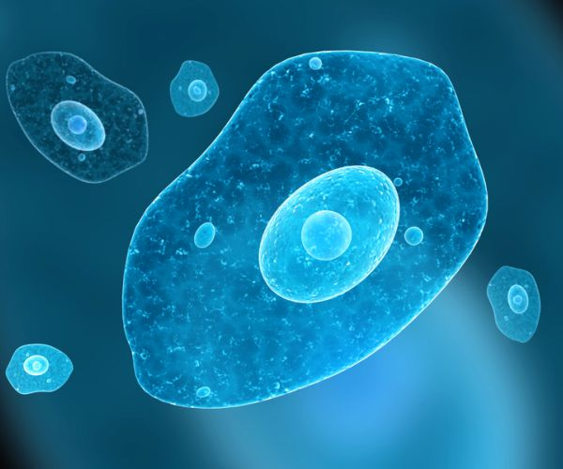

Slide 69
Flagellates
Flagellates use elongate flagella (singular: flagellum) which undulate to propel the cell through liquid environments. Flagella are ‘whip-like’ extensions of the cell membrane with an inner core of microtubules.

Slide 70
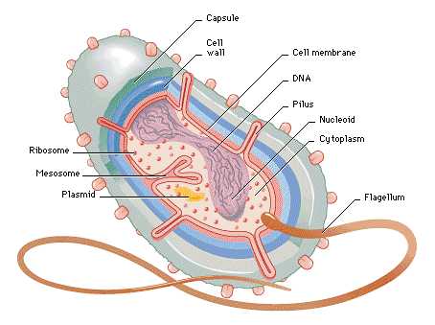

Slide 71
Ciliates
Ciliates use numerous small cilia (singular: cilium) which undulate in waves allowing cells to swim in fluids. Cilia are ‘hair-like’ extensions of the cell membrane similar in construction to flagella but with interconnecting basal elements.

Slide 72


Slide 73
Helminths
are multi-celled organisms that can live in or outside of your body. They’re more commonly known as worms. They include, tapeworms, roundworms etc

Slide 74
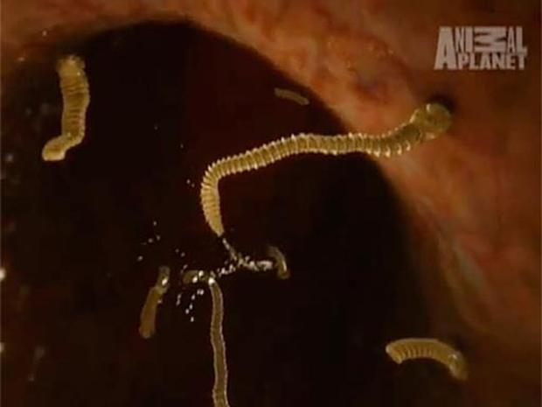
Tapeworms

Slide 75
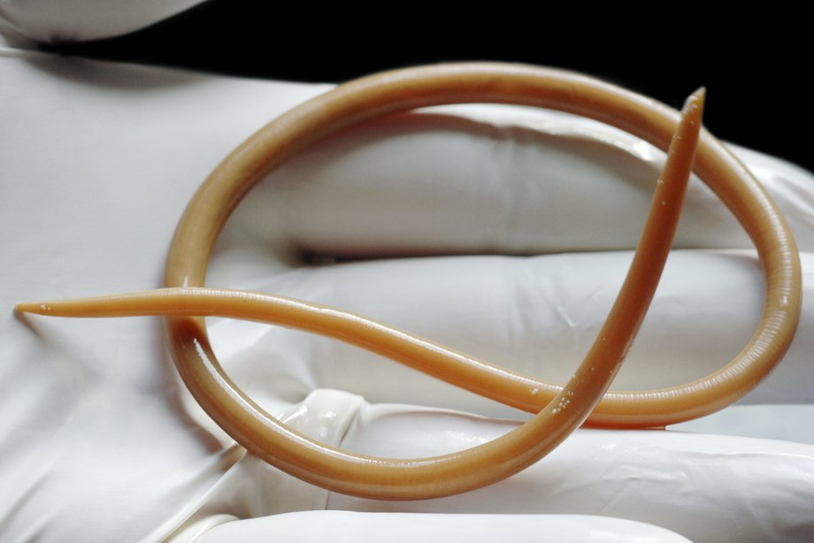
Round warm

Slide 76
Ectoparasites
are multicelled organisms that live on or feed off your skin. They include some insects and arachnids, such as mosquitos, fleas, ticks, and mites.

Slide 77
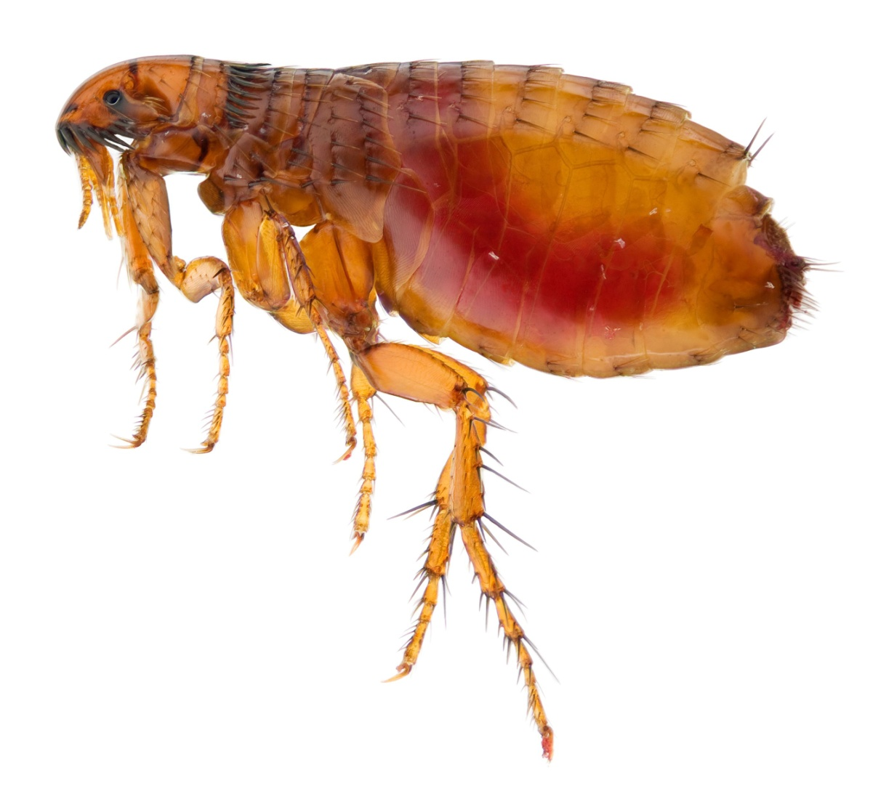
Flea

Slide 78
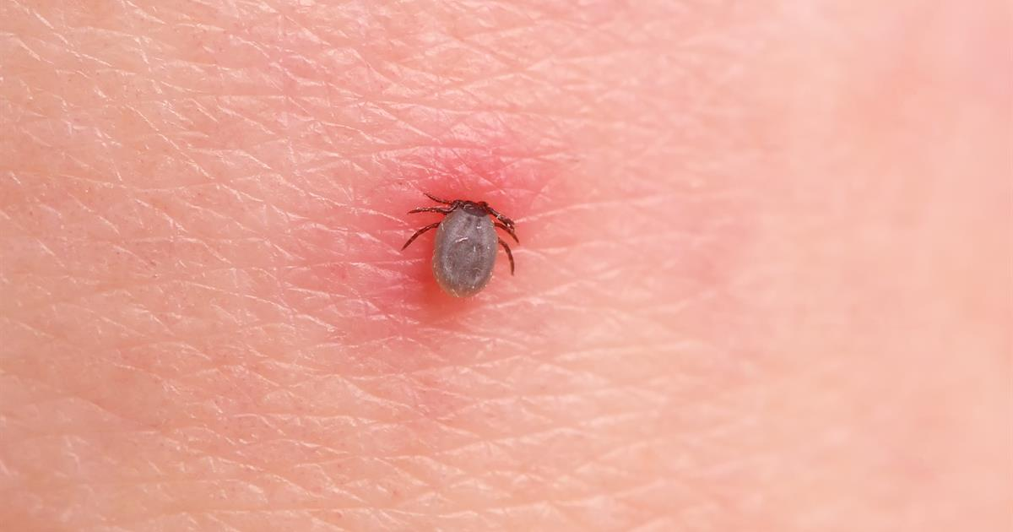
Tick

Slide 79
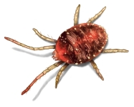
Mite

Slide 80
How they can be spread
Parasitic infections can be spread in a number of ways.
  protozoa and helminths can be spread through contaminated water, food, waste, soil, and blood.
  sexual contact.
  insects that act as a vector, or carrier, of the disease. ie, malaria is caused by parasitic protozoa that are transmitted by mosquitos when they feed on humans.

Slide 81
Who’s at risk
Anyone can get a parasitic infection. But some people are at greater risk than others. You’re more likely to contract a parasitic infection if you:
have a compromised immune system or are already sick with another illness
live or travel in tropical or subtropical regions of the world
lack a clean supply of drinking water
swim in lakes, rivers, or ponds where Giardia or other parasites are common
work in childcare, work with soil regularly, or work in other contexts where you come into contact with feces on a consistent basis

Slide 82
How to prevent parasitic infections
Practice safe sex, using a condom.
Wash your hands regularly, especially after handling uncooked food or feces.
Cook food to its recommended internal temperature.
Drink clean water, including bottled water when you’re traveling.
Avoid swallowing water from lakes, streams, or ponds.
Avoid cat litter and feces when you’re pregnant.

Slide 83


Slide 84
Communicable Disease transmission and control
Communicable, or infectious diseases, are caused by microorganisms such as bacteria, viruses, parasites and fungi that can be spread, directly or indirectly, from one person to another. Some are transmitted through bites from insects while others are caused by ingesting contaminated food or water.

Slide 85
Examples of Communicable diseases:
  Tuberculosis
  HIV
  Hepatitis B
  Typhoid
  Meningitis
  Measles
  Hepatitis A
  Whooping Cough
  Malaria
  Influenza

Slide 86
Rabies
Mumps
Syphilis
Yellow Fever
Gonorrhea
Cholera
Leprosy

Slide 87
Chicken Pox
Rubella
Ebola

Slide 88
Classification of communicable diseases
Communicable diseases can be classified in different ways into groups with similar characteristics.
Classification will help in selection and application of appropriate prevention and control measures that are common to a class of communicable diseases.

Slide 89
there are two main ways of classifying communicable diseases:
clinical - based on the main clinical manifestations (symptoms and signs) of the disease
Epidemiologic- based on the main mode of transmission of the disease.

Slide 90
Clinical classification
Clinical classification can further be classified as :
Diarrheal diseases
Febrile illnesses
Respiratory diseases

Slide 91
Epidemiologic classification
The importance of this classification is that it enables one to select prevention and control measures which are common to (shared by) communicable diseases in the same class, so as to interrupt the mode of transmission.

Slide 92
Based on the mode of transmission of the infectious agent, communicable diseases can be classified as:
Waterborne diseases: transmitted by ingestion of contaminated water.
Foodborne diseases: transmitted by the ingestion of contaminated food.

Slide 93
Airborne diseases: transmitted through the air.
Vector-borne diseases: transmitted by vectors, such as mosquitoes and flies

Slide 94
Approaches in the prevention and control of communicable diseases
Prevention it refers to measures that are applied to prevent the occurrence of a disease.
Control it refers to measures that are applied to prevent transmission after the disease has occurred.

Slide 95
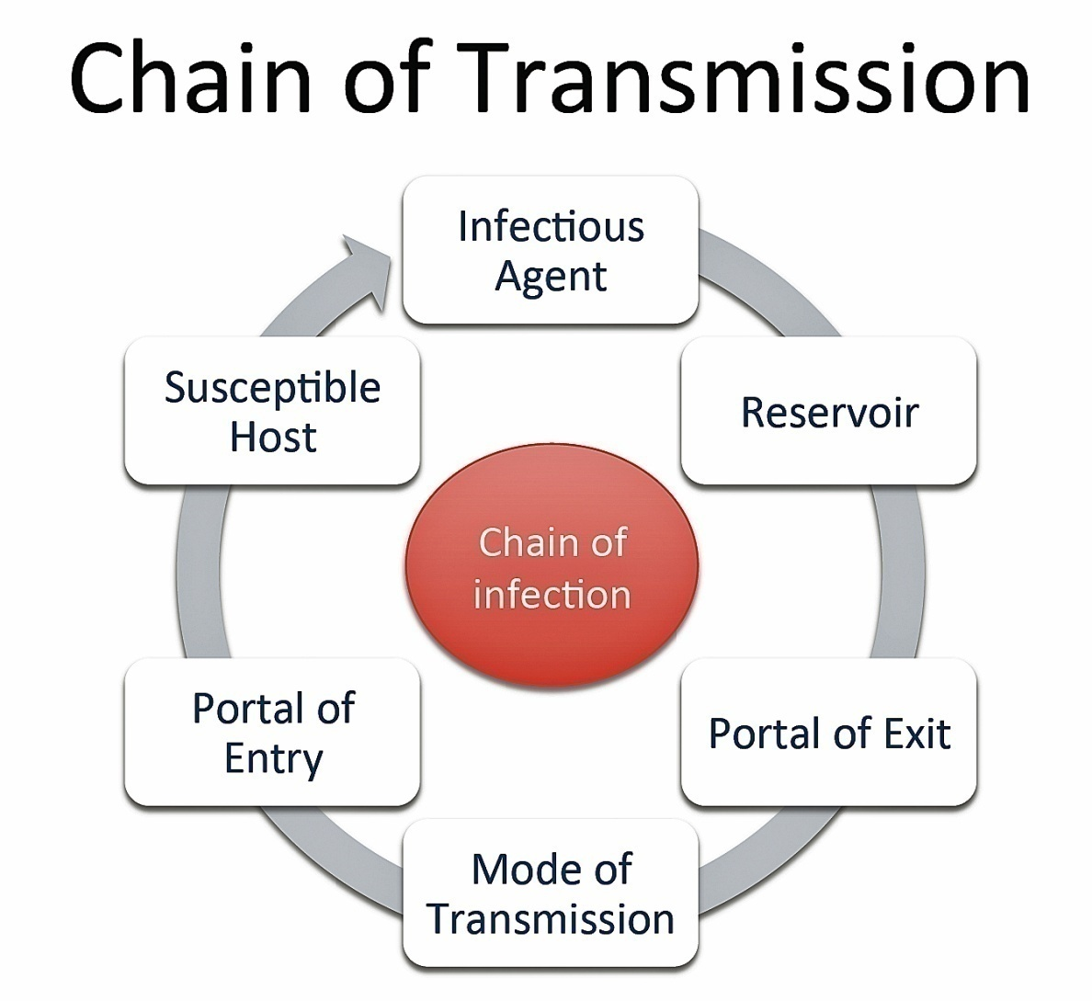

Slide 96
1. Measures targeting the reservoir of infection
Diagnosis and treatment
The first step is to ask about the main complaints of the patient.
Then ask about the presence of other related symptoms and risk factors.
Examine the patient physically to detect signs of any diseases you suspect.
Finally, refer the patient for laboratory examinations if available (e.g. blood examination for malaria)

Slide 97
Screening refers to the detection of an infection in an individual who does not show any signs or symptoms of the disease.

Slide 98
Isolation is the separation of patients from others to prevent transmission to healthy people following detection of an infectious disease.

Slide 99
Reporting Cases of communicable diseases should be reported to a nearby public Health Office periodically, using the national surveillance guidelines.

Slide 100
Animal reservoirs (Discuss)

Slide 101
Measures targeting the mode of transmission
Water
Disinfection
is the procedure of killing most infectious agents outside the body by direct exposure to chemicals
Adding chemicals like chlorine
Boiling the water,
Filtering water
Proper use of latrines

Slide 102
Food
washing raw vegetables and fruits,
boiling milk
cooking meat and other food items thoroughly before eating.
Contamination with faeces can be prevented by hand washing and proper use of latrines.

Slide 103
Other vehicles
Sterilisation
involves destruction of all forms of micro-organisms by physical heat, irradiation, gas or chemical treatment.

Slide 104
Contaminated objects like household utensils for cooking, eating and drinking should be washed with soap and water.
Contaminated medical instruments and clothing can be sterilized, disinfected or properly disposed of.

Slide 105
THINK…..
What is the difference between sterilization and disinfection?

Slide 106
Vectors
Include preventing breeding of vectors
Through proper disposal of fecal matter and other wastes, eradication of breeding sites, and disinfestation.

Slide 107
Disinfestation
Is the procedure of destroying or removing small animal pests, particularly arthropods and rodents, present upon a person, clothing, or in the environment of an individual, or on domestic animals.
Is usually achieved by using chemical or physical agents, e.g. Spraying insecticides to destroy mosquitoes, and removing lice from the body and clothing.

Slide 108
Measures targeting the susceptible host
Vaccination
Refers to administration of vaccines to increase the resistance of the susceptible host against specific vaccine-preventable infections.

Slide 109
Chemoprophylaxis
Refers to the drugs given to exposed and susceptible hosts to prevent them from developing an infection.

Slide 110
Maintaining a healthy lifestyle
Proper nutrition and exercise improves a person’s health status, supports the effective functioning of their immune system, and increases resistance to infection.

Slide 111
Limiting exposure to reservoirs of infection
Condom use to prevent transmission of HIV and other sexually transmitted infections (STIs).
Use of insecticide treated nets (ITNs) over the bed at night, insect repellants and wearing protective clothing to prevent diseases transmitted by insect vectors.

Slide 112
Wearing surgical or very clean gloves and clean protective clothing while examining patients, particularly if they have wounds, or the examination involves the genital area.
Keeping personal hygiene, like taking a daily bath and washing your hands frequently.

Slide 113
Hand washing with soap and water is the simplest and one of the most effective ways to prevent transmission of many communicable diseases

Slide 114
When to wash hands with soap and clean water
After using the toilet
After handling animals or animal waste
After changing a diaper (nappy) or cleaning a child’s bottom
Before and after preparing food
Before eating
After blowing the nose, coughing, or sneezing
Before and after caring for a sick person
After handling waste material.

Slide 115


Slide 116
Common Sexually Transmitted diseases
Bacterial Vaginosis (BV)
Chlamydia
Genital Herpes (HSV)
Genital Warts (HPV)
Gonorrhoea
Hepatitis B
HIV
Pubic Lice (Crabs)
Syphilis
Thrush
Trichomonas Vaginalis (TV)

Slide 117
Bacterial Vaginosis (BV)
What is BV?
BV is the most common cause of abnormal discharge from the vagina. Any woman can get BV, not just women who are sexually active. The normal vagina contains a mixture of bacteria. BV is an overgrowth of some of the bacteria resulting in an overall imbalance of the bacteria.

Slide 118
How to get BV?
Any woman can get BV but you have a higher risk if you:
have a new partner
smoke
douche
have oral sex
have sex with multiple partners.

Slide 119
Common symptoms include:
An abnormal smell from the vagina, like a ‘fishy’ smell
Discharge from the vagina which can be grey, pale and thin.
Sometimes the ‘fishy’ smell is worse after sex. BV does not cause itch, soreness or irritation.

Slide 120
Diagnosis
BV can be diagnosed based on the symptoms you describe and some simple tests on the vaginal discharge.

Slide 121
Treatment
BV is treated with antibiotics. It sometimes comes back and needs to be treated again. Your male partner does not need to be tested or treated.

Slide 122
Prevention
Avoid:
douching
frequent bathing
use of perfumed washes, bubble baths, antiseptic solutions, feminine washes.

Slide 123
Chlamydia
What is chlamydia?
Chlamydia is a bacterial infection. It is one of the most common STIs.

Slide 124
Transmission
Chlamydia is passed from one person to another from:
unprotected sex (oral, vaginal, anal)
using unwashed sex toys
from mother to baby during delivery. Chlamydia infects the cervix (neck of the womb), the urethra (the tube through which you pass urine) and the rectum (back passage). It can also sometimes cause eye infections.

Slide 125
You cannot catch chlamydia by:
hugging
kissing
swimming
sitting on toilet seats
sharing cutlery or towels

Slide 126
Symptoms
Your symptoms will depend on where the infection is.
Men
No symptoms in 1 in 2 men with the infection
Discharge from the tip of the penis
Pain or discomfort passing urine
Bowel symptoms such as diarrhoea, pain, mucus discharge or bleeding from the back passage.

Slide 127
Women
No symptoms in 7 out of 10 women with the infection
Bleeding after sex
Bleeding between periods
Change in your normal vaginal discharge/liquid
Pain passing urine
Pain in your abdomen (tummy)
Pain during or after sex.

Slide 128
Diagnosis
Chlamydia is diagnosed by taking a urine sample in men and a vaginal swab in women. Sometimes a swab from the rectum (back passage) or throat is also taken.

Slide 129
Treatment
Chlamydia is treated with antibiotics – usually a once-off dose.

Slide 130
Is it ok to have sex again? Yes. You will have to wait at least one week after finishing treatment before having sex again. Make sure your partner is tested and treated too. It’s really important that you don’t have sex with your partner before they are tested and treated as you could become infected again.

Slide 131
Prevention
Using condoms correctly and every time you have sex will reduce your risk of getting chlamydia.
Having a test for chlamydia before having unprotected sex with a new partner will also reduce your risk of getting chlamydia.

Slide 132
Genital Herpes (HSV)
What is genital herpes?
Genital herpes is a viral infection caused by the herpes simplex virus (HSV). There are two types: HSV 1 and HSV 2. HSV 1 is the virus that causes ‘cold sores’ around the mouth. HSV 2 is usually sexually transmitted.

Slide 133
Transmission
HSV is transmitted by skin to skin contact, unprotected sex, rimming (mouth to anus contact) and from mother to baby during delivery.

Slide 134
Symptoms
HSV 1 causes ‘cold sores’, usually on the mouth or lips.
HSV 2 causes genital sores or blisters.
Some people do not get any symptoms.
If you get symptoms, your first episode (sometimes referred to as an attack or an outbreak) will usually be the most severe. As well as having painful ulcers or blisters,
swollen glands in the groin
flu-like symptoms,
a feeling of being unwell and pain when passing urine.

Slide 135
Treatment
Once you have HSV, the virus stays in your body. It can become active again if you are ill, under stress or pregnant.
These outbreaks are usually less severe than the first and ease off over time.
The main treatments involve pain relief and antiviral medicine.
Usually the pain can be managed with simple painkillers and a local anaesthetic (numbing) cream.
The antiviral medicine is usually for 3 or 5 days. If you have been diagnosed with HSV it is a good idea to keep antiviral medicine at home in case you get another outbreak.

Slide 136
Prevention
In some cases your partner should be tested to see if they also have genital herpes. You can discuss this further with your doctor or nurse.
Using condoms and taking antiviral medicine can reduce the risk of passing on genital herpes but it doesn’t always work.
Do not have sex during an outbreak.

Slide 137
Genital Warts (HPV)
What are genital warts?
Genital warts are ‘warts’ in the genital area caused by a virus called the Human Papilloma Virus (HPV). There are many types of HPV and some of them may lead to cervical cancer. The types of HPV that cause genital warts do not lead to cervical cancer.

Slide 138
Transmission
HPV is passed by skin to skin contact, usually genital skin to skin contact. It is common for sexually active people to come in contact with HPV. Lots of people who come into contact with HPV don’t develop warts.

Slide 139
Symptoms
Most people with HPV do not have any symptoms and they don’t know that they have the infection. If you do get genital warts, they are often flesh-coloured lumps or bumps on the skin. They may appear weeks to months after you come into contact with the virus.

Slide 140
Can I be tested for genital warts? There is no blood test or swab to diagnose genital warts. Genital warts are diagnosed by the doctor or nurse examining the genitals.

Slide 141
Can genital warts be treated? Sometimes genital warts go away on their own but most people prefer to get them treated. Treatments may take a few weeks or months to work. Sometimes the warts come back after treatment. Treatments include: > cryotherapy (freezing) > creams > surgery – if the warts are severe and do not respond to other treatments.

Slide 142
Gonorrhoea
What is gonorrhoea?
Gonorrhoea is a curable bacterial infection. If it is not treated, it can cause infertility in women and infections in the testicles in men.
Caused by Neisseria gonorrhea.

Slide 143
How do I get gonorrhoea? Gonorrhoea is passed from one person to another through: > unprotected sex (oral, vaginal, anal) > using unwashed sex toys > from mother to baby during delivery > rimming (mouth to anus contact). Gonorrhoea infects the cervix (neck of the womb), the urethra (the tube through which you pass urine) and the rectum. It can also sometimes cause eye and joint infections.

Slide 144
You cannot catch gonorrhoea by:
> hugging > kissing > swimming > sitting on toilet seats > sharing cutlery or towels.

Slide 145
What symptoms would I have?
Men > Discharge/liquid from the tip of the penis > Pain passing urine > No symptoms – 1 in 10 men. Women > No symptoms – 7 in 10 women

Slide 146
How can I be tested? The type of test will depend on your symptoms. For men, a urine sample or a swab from the penis is taken. For women a swab is taken from the vagina. Sometimes a swab will also be taken from the throat or rectum (back passage).

Slide 147
Can gonorrhoea be treated? Yes. Gonorrhoea is treated with antibiotics. Your partner will also be tested and treated.

Slide 148
How can I prevent myself from getting gonorrhoea again?
Use condoms every time you have sex. Also, get regular STI tests if you are sexually active.

Slide 149
Hepatitis B
What is hepatitis B?
Hepatitis B is a viral infection that infects the liver.

Slide 150
How is hepatitis B transmitted?
> Unprotected sexual contact {vaginal, anal, oral, rimming (mouth to anus contact)} > Sharing needles > Mother to child during pregnancy or delivery > Sharing toothbrushes, razors or towels contaminated with infected blood.

Slide 151
What symptoms would I have?
Most people have no symptoms. Some people may have symptoms when they first become infected. These may include flu-like symptoms, yellow skin, nausea, vomiting or diarrhoea.

Slide 152
How is hepatitis B diagnosed?
Hepatitis B is diagnosed by a blood test.

Slide 153
Can hepatitis B be prevented?
There are vaccines that prevent infection with hepatitis B. It can also be prevented by using condoms and not sharing needles.

Slide 154
Who should be vaccinated?
The following people should consider vaccination: > men who have sex with men > people who inject drugs > commercial sex workers > anyone who has paid for sex > anyone with more than one sex partner > partners and everyone who lives with someone who has hepatitis B > anyone who has been sexually assaulted

Slide 155
Treatment

Slide 156
HIV
What is HIV?
Human Immunodeficiency Virus (HIV) is a virus that attacks the human immune system and weakens its ability to fight infection and disease. AIDS (Acquired Immunodeficiency Syndrome) is the final stage of HIV infection, when the immune system is severely damaged.

Slide 157
How could I get HIV?
HIV is transmitted by: > unprotected sexual contact (vaginal, anal) with someone who is HIV positive > sharing needles with someone who is HIV positive > contaminated blood products (very unlikely in Ireland as all donors are tested) > mother to child during pregnancy, delivery or breastfeeding.

Slide 158
You cannot get HIV from:
> kissing > hugging > through sweat or urine. Most new cases of HIV in Ireland are among men who have sex with men (MSM).

Slide 159
What symptoms would I have?
Some people have no symptoms, so it is important to get tested if you are at risk (especially if you are a man who has sex with other men). Other people may get a flu-like illness when they first become infected. HIV infection can cause a wide variety of symptoms. Over time, the virus attacks your immune system and you may keep getting infections and other illnesses.

Slide 160
How can I protect myself from getting HIV?
> use condoms for sexual contact > do not share needles or other injecting equipment (spoons and so on) > taking post-exposure prophylaxis.

Slide 161
What is post-exposure prophylaxis (PEP)?
PEP is medication which you can take up to 72 hours (3 days and nights) after unprotected sex, sharing needles, pricking yourself with an infected needle, and so on, to stop you becoming infected with HIV.

Slide 162
How is HIV diagnosed?
HIV is diagnosed with a blood test.

Slide 163
Can HIV be treated?
HIV can be treated effectively with medications. These medications let most people live a long and healthy life. The earlier you are diagnosed, the better. At the moment there is no cure for HIV.

Slide 164
How soon after exposure should I get a HIV test?
If you think you are at risk, you should get medical advice straightaway. You will be tested as soon as possible and will have follow-up tests to make sure you have not become infected

Slide 165
Pubic Lice (Crabs)
What are pubic lice?
Pubic lice are small insects that live in coarse hair. Their eggs are called ‘nits’. They are found in hair on the chest, abdomen, underarms and pubic areas. They do not live in head hair.

Slide 166
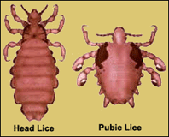

Slide 167
Transmission
Pubic lice are passed from person to person by:
  Skin to skin contact
  Sexual contact
  Sharing clothing, towels or bedding.

Slide 168
Symptoms
You may have one or more of the following symptoms:
Itch
Black droppings on your underwear
Brown lice eggs in your pubic hair
Small blood spots on your skin.

Slide 169
Diagnosis
Pubic lice are diagnosed by a careful clinical exam.

Slide 170
Treatment
They are treated with a cream, shampoo or lotion.
This treatment is repeated after 3 to 7 days. You do not need to shave off your body hair. You will need to wash all your clothing in a hot (50 degree or higher) wash. You can remove nits (eggs) with a special comb available in pharmacies.
Your sexual partner will also need to be treated.

Slide 171
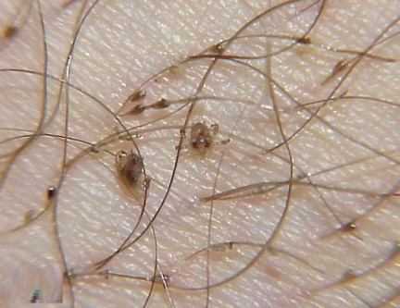

Slide 172
Syphilis
What is syphilis?
Syphilis is caused by a bacteria called Treponema pallidum.

Slide 173
Transmission
You can get syphilis from:
skin to skin contact
oral, vaginal and anal sex
mother to child during pregnancy (congenital syphilis)
blood transfusion (although this is very unlikely in Ireland as all blood donors are tested).

Slide 174
Symptoms
There are different stages of infection. Some people have no symptoms. This is why it is important to get tested if you are at risk. Symptoms can vary from a painless sore (ulcer) in the genital, anal or mouth area to a rash all over the body.

Slide 175
The symptoms often depend on how long you have had the syphilis infection. If syphilis is not treated, it can cause problems with your heart, brain, eyes and nervous system.

Slide 176
Diagnosis
Syphilis is usually diagnosed by a blood test. Sometimes a swab is taken from a sore (ulcer). This is generally done in an STI clinic.
VDRL (Veneral Disease Research Laboratory)

Slide 177
syphilis can be treated and cured with antibiotics.
Treatment depends on your symptoms and how long you have had the infection. You will be followed up to make sure the infection has cleared.

Slide 178
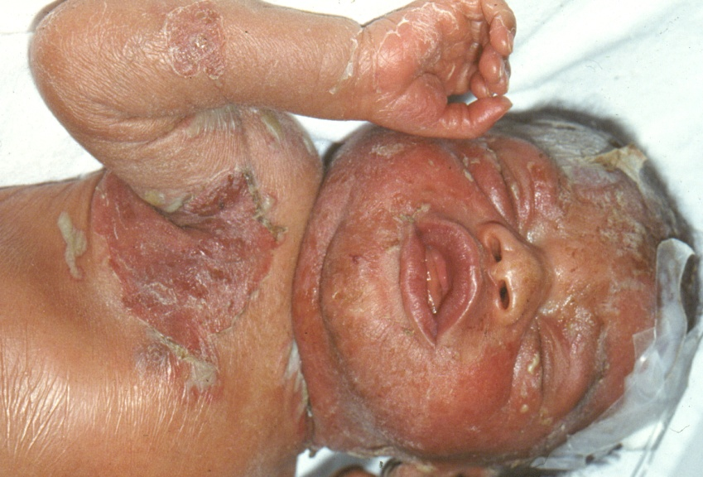
Congenital syphilis

Slide 179
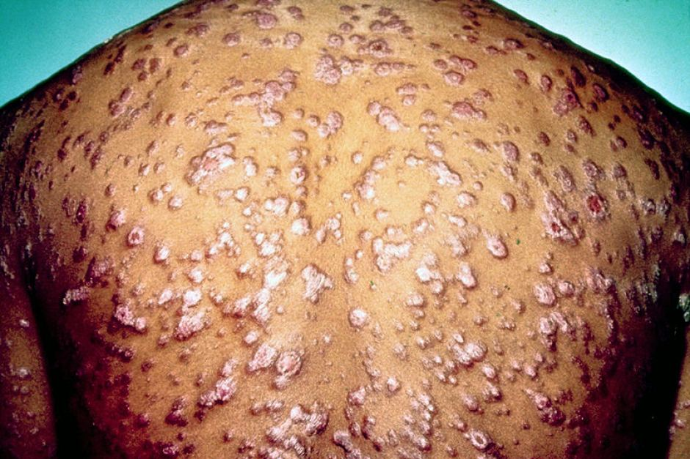

Slide 180
Genital Thrush
Thrush is a very common cause of itch and discomfort in the genital area.
It is caused by an overgrowth of yeast (candida).

Slide 181
Who is at risk?
Thrush is more common in women than men. It is also more common in pregnancy, and in people who have diabetes or HIV.
However, anyone can get thrush.

Slide 182
Symptoms
In men;
  Irritation under the foreskin or tip of the penis
  Spotty, red rash at the tip of the penis
  White discharge under the foreskin.

Slide 183
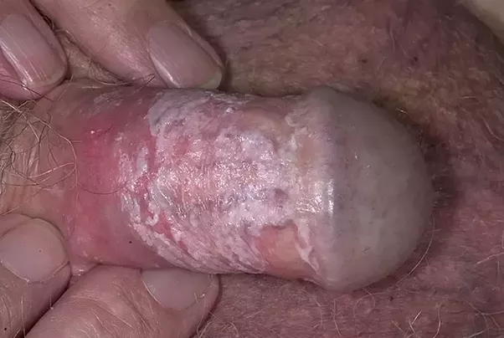

Slide 184
In women;
Vaginal itch
Vaginal soreness
Vaginal redness
White, thick discharge
Discomfort during sex or urinating.

Slide 185
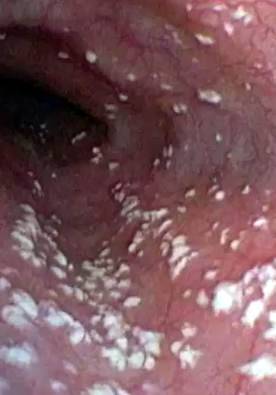

Slide 186
Diagnosis
The diagnosis is usually made based on your description of your symptoms and an examination by a doctor or nurse.

Slide 187
Treatment
Thrush can be treated with creams, pessaries (vaginal tablets) or oral tablets.
Some treatments are available from a pharmacy without a prescription.
If your symptoms do not improve, you should see your GP.

Slide 188
Prevention
Wear cotton underwear
Avoid tight clothing
Avoid taking antibiotics unless absolutely necessary
Avoid too much washing of the genitals
Do not use soaps, perfumed products or vaginal deodorant products.

Slide 189
Trichomoniasis
What is Tricomoniasis?
Trichomoniasis is a sexually transmitted infection caused by a protozoan called Trichomonas Vaginalis (TV)

Slide 190
Transmission
TV is passed from one person to another in three ways:
unprotected sex (oral, vaginal, anal)
using unwashed sex toys
from mother to baby during delivery

Slide 191
Symptoms
Symptoms will depend on where the infection is.
In men;
May have no symptoms
Discharge (liquid) from the penis
Pain passing urine
Soreness around the foreskin
Passing urine more frequently.

Slide 192
In women;
May have no symptoms
Discharge from the vagina
Smell
Itching or soreness
Pain during or after sex.

Slide 193
Diagnosis
A swab will be taken and tested.

Slide 194
Treatment
Trichomoniasis is treated with antibiotics.

Slide 195
Prevention
Make sure your partner is tested and treated and use condoms every time you have sex.

Slide 196
Group assignment
What is a genetic disease? Do all genetic diseases have a family history?
Are genetic diseases necessarily congenital? Are familial diseases necessarily genetic?
What is the relationship between gene, DNA and chromosomes?
Discuss the categories of genetic diseases
What is chromosome analysis and how useful is it?
Discuss any 5 congenital anomalies

