Slide 1
SENSORY SYSTEMS
BY
SAMUEL NGIGI K.
KMTC

Slide 2
SENSORY RECEPTORS
Perceptions of the world are created by the brain from action potentials sent from sensory receptors.
Sensory receptors respond to a particular modality (differences in neural pathways and synaptic connections) of environmental stimuli.
Receptors transduce (change) different forms of sensation to nerve impulses that are conducted to CNS.

Slide 3
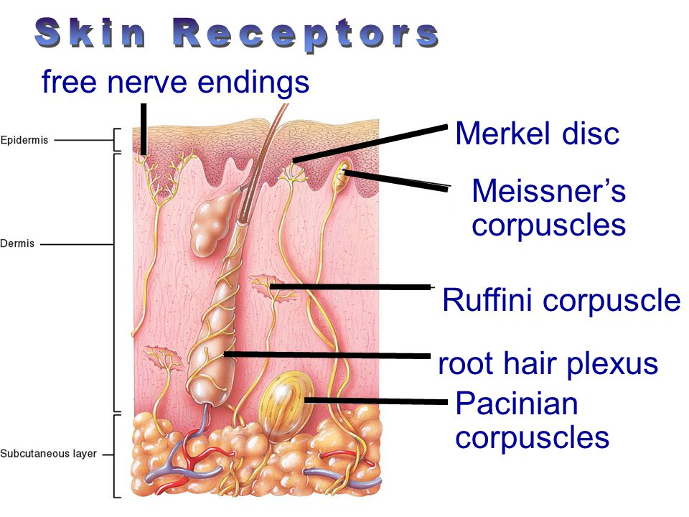
Structural Categories of Sensory Receptors
Dendritic endings of sensory neurons:
Free: Pain, temperature
Encapsulated: Pressure, Touch
Rods and cones:Sight
Modified epithelial cells:Taste

Slide 4
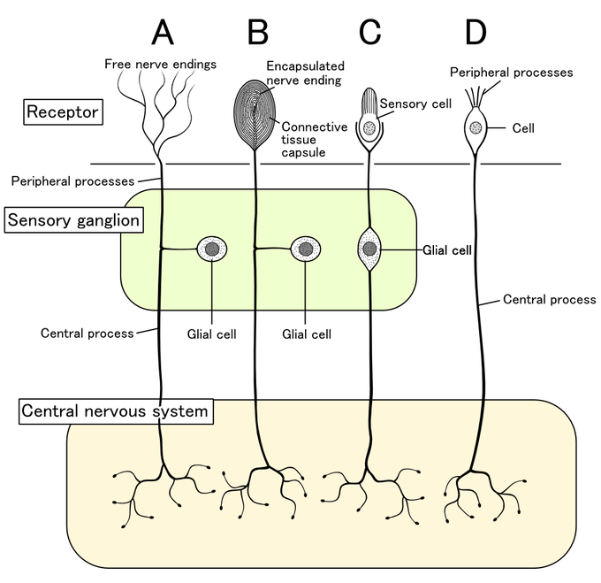
Cont…

Slide 5
Functional Categories of Sensory Receptors
Grouped according to type of stimulus energy they transduce.
Chemoreceptors: Chemical stimuli in environment or blood (pH, C0 2 ).
Photoreceptors: Rods and cones.
Thermoreceptors: Temperature.
Mechanoreceptors: Touch and pressure.
Nociceptors: Pain.
Proprioceptors: Body position.
Categorized according to type of sensory information delivered to brain:
Cutaneous receptors: Touch, pressure, temperature, pain.
Special senses: Sight, hearing, equilibrium.

Slide 6
CONT…
Sensory receptors can be classified by location:
Cutaneous receptors are sensory receptors found in the dermis or epidermis.
Muscle spindles contain mechanoreceptors that detect stretch in muscles.
Somatic sensory receptors near the surface of the skin can usually be divided into two groups based on morphology:
Free nerve endings characterize the nociceptors and thermoreceptors.
Encapsulated receptors consist of the remaining types of cutaneous receptors. Encapsulation exists for specialized functioning.
Rate of Adaptation
A tonic receptor is a sensory receptor that adapts slowly to a stimulus, while a
Phasic receptor is a sensory receptor that adapts rapidly to a stimulus.

Slide 7
CONT…
Remarkably, specialized receptors have evolved to transmit sensory inputs from each of these sensory systems. Sensory receptors code four aspects of a stimulus:
Modality (or type)
Intensity
Location
Duration

Slide 8
CUTANEOUS MECHANORECEPTORS
They provide the senses of touch, pressure, vibration and proprioception.
Ruffini’s end organs detect tension deep in the skin.
Meissner’s corpuscles detect changes in texture (vibrations around 50 Hz) and adapt rapidly.
Pacinian corpuscles detect rapid vibrations (about 200–300 Hz).
Merkel’s discs detect sustained touch and pressure.
Mechano receiving free nerve endings detect touch, pressure, and stretching.
Hair follicle receptors are located in hair follicles and sense the position changes of hair strands

Slide 9
Proprioceptive Sensations
Proprioception refers to the sense of knowing how one’s body is positioned in three-dimensional space.
The initiation of proprioception is the activation of a proprioreceptor in the periphery. The proprioceptive sense is believed to be composed of information from sensory neurons located in the inner ear (motion and orientation) and in the stretch receptors located in the muscles and the joint-supporting ligaments (stance).

Slide 10
MUSCLE SPINDLE
Muscle spindles are sensory receptors within the belly of a muscle that primarily detect changes in the length of a muscle.
They convey length information to the central nervous system via sensory neurons.
This information can be processed by the brain to determine the position of body parts.
The responses of muscle spindles to changes in length also play an important role in regulating the contraction of muscles.

Slide 11
GOLGI TENDON ORGAN
The Golgi organ is a proprioceptive sensory receptor organ that is located at the insertion of skeletal muscle fibers onto the tendons of skeletal muscle. It provides the sensory component of the Golgi tendon reflex.
The Golgi tendon reflex is a normal component of the reflex arc of the peripheral nervous system. In a Golgi tendon reflex, skeletal muscle contraction causes the agonist muscle to simultaneously lengthen and relax. This reflex is also called the inverse myotatic reflex, because it is the inverse of the stretch reflex.
Although muscle tension is increasing during the contraction, alpha motor neurons in the spinal cord that supply the muscle are inhibited. However, antagonistic muscles are activated.

Slide 12
RECEPTIVE FIELDS
The receptive field of an individual sensory neuron is the particular region of the sensory space (e.g., the body surface, or the visual field) in which a stimulus will modify the firing of that neuron.
This region can be a hair in the cochlea or a piece of skin, retina, tongue or other part of an animal's body.

Slide 13
THE AUDITORY SYSTEM
The auditory system processes the temporal features (time domain features) and spectral features (i.e. frequency based features) characteristics of sound waves, so the receptive fields of neurons in the auditory system are modeled as spectro-temporal patterns that cause the firing rate of the neuron to modulate with the auditory stimulus.
Auditory receptive fields are often modeled as spectro-temporal receptive fields (STRFs), which are the specific pattern in the auditory domain that causes modulation of the firing rate of a neuron.

Slide 14
THE SOMATOSENSORY SYSTEM
In the somatosensory system, receptive fields are regions of the skin or of internal organs. Some types of mechanoreceptors have large receptive fields, while others have smaller ones.
Large receptive fields allow the cell to detect changes over a wider area, but lead to a less precise perception. Thus, the fingers, which require the ability to detect fine detail, have many, densely packed (up to 500 per cubic cm) mechanoreceptors with small receptive fields (around 10 square mm), while the back and legs, for example, have fewer receptors with large receptive fields. Receptors with large receptive fields usually have a "hot spot", an area within the receptive field (usually in the center, directly over the receptor) where stimulation produces the most intense response.

Slide 15
VISUAL SYSTEM
In the visual system, receptive fields are volumes in visual space. They are smallest in the fovea where they can be a few small arc like a dot on this page, to the whole page.
For example, the receptive field of a single photoreceptor is a cone-shaped volume comprising all the visual directions in which light will alter the firing of that cell. Its apex is located in the center of the lens and its base essentially at infinity in visual space.

Slide 16
CONT…
The receptive field is often identified as the region of the retina where the action of light alters the firing of the neuron. In retinal ganglion cells, this area of the retina would encompass all the photoreceptors, all the rods and cones from one eye that are connected to this particular ganglion cell via bipolar cells, horizontal cells, and amacrine cells.
Receptive fields have been mapped for all levels of the visual system from photoreceptors, to retinal ganglion cells, to lateral geniculate nucleus cells, to visual cortex cells, to extrastriate cortical cells.

Slide 17
LATERAL INHIBITION
It is the capacity of an excited neuron to reduce the activity of its neighbors.
It disables the spreading of action potentials from excited neurons to neighboring neurons in the lateral direction, creating a contrast in stimulation that allows increased sensory perception.
It is also referred to as lateral antagonism and occurs primarily in visual processes, but also in tactile, auditory, and even olfactory processing.
Cells that utilize lateral inhibition appear primarily in the cerebral cortex and thalamus and make up lateral inhibitory networks (LINs).

Slide 18
CONT…
VISUAL INHIBITION
Lateral inhibition increases the contrast and sharpness in visual response.
This phenomenon already occurs in the human retina. In the dark, a small light stimulus will enhance the different photoreceptors (rod cells). The rods in the center of the stimulus will transduce the "light" signal to the brain, whereas different rods on the outside of the stimulus will send a "dark" signal to the brain due to lateral inhibition from horizontal cells. This contrast between the light and dark creates a sharper image.

Slide 19
CONT…
TACTILE INHIBITION
Sensory information collected by the peripheral nervous system is transmitted to specific areas of the primary somatosensory area in the parietal cortex according to its origin on any given part of the body.
For each neuron in the primary somatosensory area, there is a corresponding region of the skin that is stimulated or inhibited by that neuron.
The regions that correspond to a location on the somatosensory cortex are mapped by a homonculus. This corresponding region of the skin is referred to as the neuron's receptive field. The most sensitive regions of the body have the greatest representation in any given cortical area, but they also have the smallest receptive fields. The lips, tongue, and fingers are examples of this phenomenon.

Slide 20
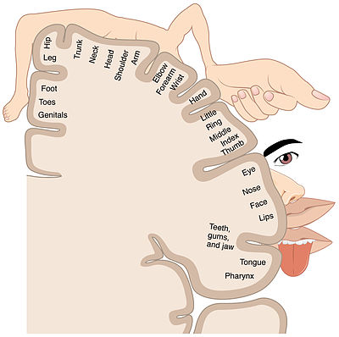
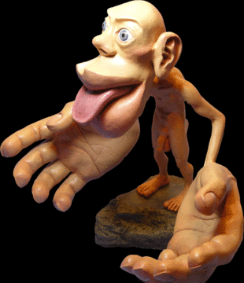

Slide 21
CONT…
AUDITORY INHIBITION
The basilar membrane in the cochlea has receptive fields similar to the receptive fields of the skin and eyes. Also, neighboring cells in the auditory cortex have similar specific frequencies that cause them to fire, creating a map of sound frequencies similar to that of the somatosensory cortex.
The role that lateral inhibition plays in auditory sensation is unclear.
Some scientists found that lateral inhibition could play a role in sharpening spatial input patterns and temporal changes in sensation, others propose it plays an important role in processing low or high tones.

Slide 22
TWO POINT DISCRIMINATION
Two-point discrimination (2PD) is the ability to discern that two nearby objects touching the skin are truly two distinct points, not one.
It is often tested with two sharp points during a neurological examination and is assumed to reflect how finely innervated an area of skin is.
In clinical settings, two-point discrimination is a widely used technique for assessing tactile perception. It relies on the ability and/or willingness of the patient to subjectively report what they are feeling and should be completed with the patient’s eyes closed. The therapist may use calipers or simply a reshaped paperclip to do the testing. The therapist may alternate randomly between touching the patient with one point or with two points on the area being tested (e.g. finger, arm, leg, toe).

Slide 23
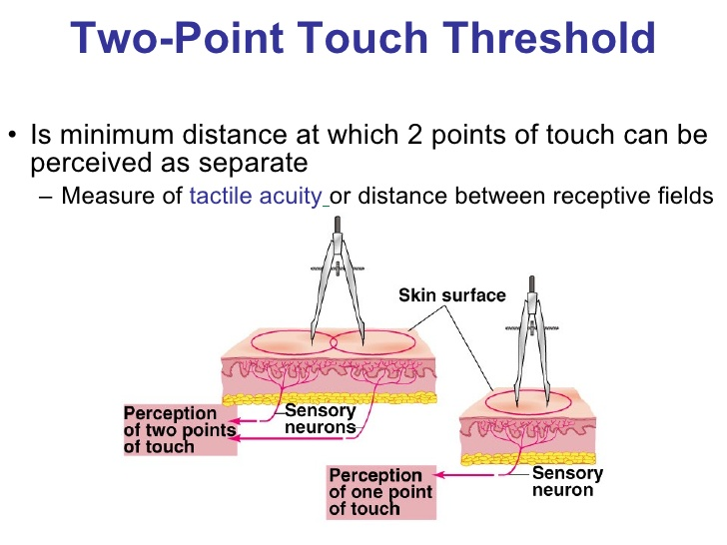
CONT...

Slide 24
CONT…
The patient is asked to report whether one or two points was felt. The smallest distance between two points that still results in the perception of two distinct stimuli is recorded as the patient's two-point threshold. Performance on the two extremities can be compared for discrepancies. Although the test is still commonly used clinically, it has been roundly criticized by many researchers as providing an invalid measure of tactile spatial acuity, and several highly regarded alternative tests have been proposed to replace it.

Slide 25
CONT…
The two-point threshold is the distance between two points at which an individual recognizes they are being touched by two objects rather than one.
It's a spatial measure.
For example, if you take a pair of tweezers, squeeze the two points together, then touch yourself on the arm with the tweezers it will feel like one point is touching you rather than two. The two-point threshold is that distance between the points of the tweezers when your brain recognizes that you're being touched by two points instead of just one.

Slide 26
SENSORY TRANSDUCTION
sensory transduction is the conversion of a sensory stimulus from one form to another.
Transduction in the nervous system typically refers to stimulus alerting events wherein a physical stimulus is converted into an action potential, which is transmitted along axons towards the central nervous system where it is integrated.
A receptor cell converts the energy in a stimulus into a change in the electrical potential across its membrane. It causes the depolarization of the membrane to allow the action potential to be transduced to the brain for integration

Slide 27
VISUAL PHOTOTRANSDUCTION
In the visual system, sensory cells called rod and cone cells in the retina convert the physical energy of light signals into electrical impulses that travel to the brain.
The light causes a conformational change in a protein called rhodopsin. This conformational change sets in motion a series of molecular events that result in a reduction of the electrochemical gradient of the photoreceptor.
The decrease in the electrochemical gradient causes a reduction in the electrical signals going to the brain. Thus, in this example, more light hitting the photoreceptor results in the transduction of a signal into fewer electrical impulses, effectively communicating that stimulus to the brain.

Slide 28
AUDITORY TRANSDUCTION
In the auditory system, sound vibrations (mechanical energy) are transduced into electrical energy by hair cells in the inner ear.
Sound vibrations from an object cause vibrations in air molecules, which in turn, vibrate your ear drum. The movement of the eardrum causes the bones of your middle ear (the ossicles) to vibrate.
These vibrations then pass in to the cochlea, the organ of hearing. Within the cochlea, the hair cells on the sensory epithelium of the organ of Corti bend and cause movement of the basilar membrane.
The membrane undulates in different sized waves according to the frequency of the sound. Hair cells are then able to convert this movement (mechanical energy) into electrical signals (graded receptor potentials) which travel along auditory nerves to hearing centres in the brain

Slide 29
The olfactory system
In the olfactory system, odorant molecules in the mucus bind to G-protein receptors on olfactory cells. The G-protein activates a downstream signalling cascade that causes increased level of cyclic-AMP (cAMP), which trigger neurotransmitter release.

Slide 30
The gustatory system
In the gustatory system, our perception of five primary taste qualities (sweet, salty, sour, bitter and umami [savoriness] ) depends on taste transduction pathways, through taste receptor cells, G proteins, ion channels, and effector enzymes.

Slide 31
The somatosensory system
In the somatosensory system the sensory transduction mainly involves the conversion of the mechanical signal such as pressure, skin compression, stretch, vibration to electro-ionic impulses through the process of mechanotransduction. It also includes the sensory transduction related to thermoception and nociception.

Slide 32
SENSORY ADAPTATION
Neural adaptation or sensory adaptation is a change over time in the responsiveness of the sensory system to a constant stimulus.
It is usually experienced as a change in the stimulus.
For example, if one rests one's hand on a table, one immediately feels the table's surface on one's skin. Within a few seconds, however, one ceases to feel the table's surface. The sensory neurons stimulated by the table's surface respond immediately, but then respond less and less until they may not respond at all; this is an example of neural adaptation.
All sensory and neural systems have a form of adaptation to constantly detect changes in the environment.

Slide 33
Fast and slow adaptation
Fast adaptation occurs immediately after stimulus presentation i.e., within 100s of milliseconds.
Slow adaptive processes that take minutes, hours or even days.
The time scale over which adaptation builds up and recovers depends on the time course of stimulation.
Brief stimulation produces adaptation which occurs and recovers while more prolonged stimulation can produce slower and more lasting forms of adaptation.
Repeated sensory stimulation appears to temporarily decrease the gain of thalamocortical synaptic transmission. Adaptation of cortical responses was stronger and recovered more slowly.

Slide 34
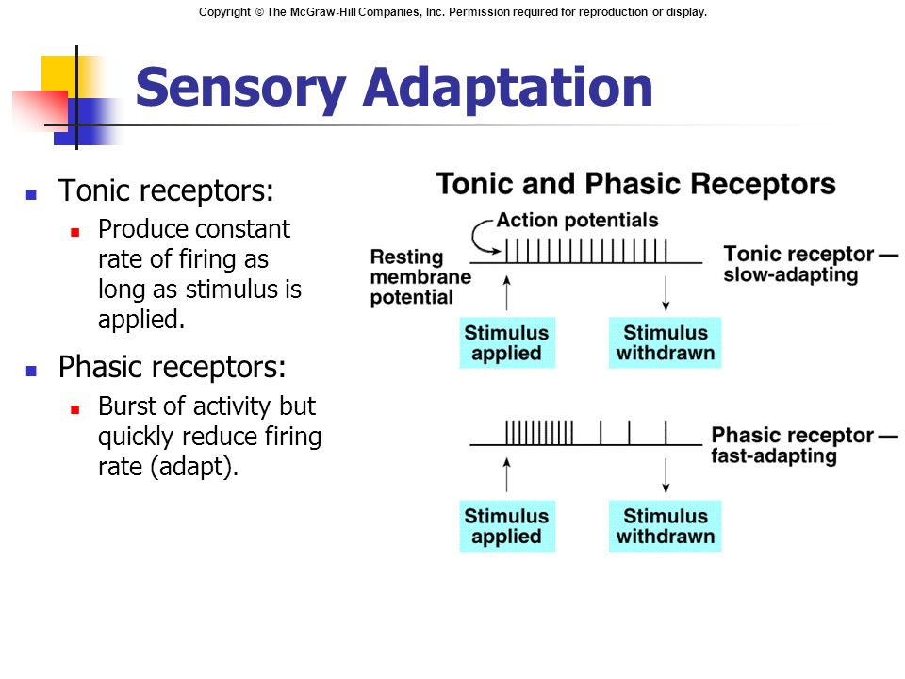
CONT…

Slide 35
VISUAL ADAPTATION
Adaptation is considered to be the cause of perceptual phenomena like afterimages and the motion aftereffect.
In the absence of fixational eye movements, visual perception may fade out or disappear due to neural adaptation.
When an observer's visual stream adapts to a single direction of real motion, imagined motion can be perceived at various speeds.
If the imagined motion is in the same direction as that experienced during adaptation, imagined speed is slowed; when imagined motion is in the opposite direction, its speed is increased; when adaptation and imagined motions are orthogonal, imagined speed is unaffected.
Notes:
An afterimage in general is an optical illusion that refers to an image continuing to appear after exposure to the original image has ceased.
Orthogonal: of or involving right angles; at right angles.

Slide 36
AUDITORY ADAPTATION
Auditory adaptation is the process by which individuals adapt to sounds and noises.
As time progresses, individuals tend to adapt to sounds and tend to distinguish them less frequently after a while.
Sensory adaptation tends to blend sounds into one, variable sound, rather than having several separate sounds as a series.
Moreover, after repeated perception, individuals tend to adapt to sounds to the point where they no longer consciously perceive it, or rather, "block it out".
Eg: An individual that lives close to the train tracks, will eventually stop noticing the sounds of passing trains.

Slide 37
OLFACTORY ADAPTATION
An individual can adapt to a certain smell with time. Smokers, or individuals living with smokers, tend to stop noticing the smell of cigarettes after some time, whereas people not exposed to smoke on a regular basis will notice the smell instantly.
The human brain can distinguish smells that are unfamiliar to the individual, while adapting to those it is used to and no longer require to be consciously recognized.
Olfactory neurons utilize a feedback system from the levels of Ca²⁺ions to activate its adaptation to prolonged smells.

Slide 38
SOMATOSENSORY ADAPTATION
Pain
While large mechanosensory neurons such as type I/group Aß display adaptation, smaller type IV/group C nociceptive neurons do not.
As a result, pain does not usually subside rapidly but persists for long periods of time; in contrast, one quickly stops receiving touch or sensory information if surroundings remain constant.

Slide 39
Law of Specific Nerve Energies
Sensation characteristic of each sensory neuron is that produced by its normal or adequate stimulus.
Adequate stimulus: Requires least amount of energy to activate a receptor.
Regardless of how a sensory neuron is stimulated, only one sensory modality will be perceived.
Allows brain to perceive the stimulus accurately under normal conditions.

Slide 40
SENSORY PATHWAYS
A neural or sensory pathway, is a series of neurons connected together to enable a signal to be sent from one brain region to another.
Neurons are connected by a single nerve fibre or by bundles of nerve fibres known as tracts.
A neural pathway that serves to connect relatively distant areas of the brain or nervous system is a bundle of neurons, known collectively as white matter.
A neural pathway that spans a shorter distance between structures, such as most of the pathways of the major neurotransmitter systems, is usually called grey matter.

Slide 41
Functional aspects
In general, neurons receive information either at their dendrites or cell bodies.
The axon of a nerve cell is, in general, responsible for transmitting information over a relatively long distance. Therefore, most neural pathways are made up of axons.
If the axons have myelin sheaths, then the pathway appears bright white because myelin is primarily lipid. If most or all of the axons lack myelin sheaths (i.e., are unmyelinated), then the pathway will appear a darker beige color, which is generally called grey.

Slide 42
CONT…
Some neurons are responsible for conveying information over long distances.
For example, motor neurons, which travel from the spinal cord to the muscle, can have axons up to a meter in length in humans.
The longest axon in the human body belongs to the Sciatic Nerve and runs from the great toe to the base of the spinal cord.

Slide 43
Major neural pathways
Arcuate fasciculus
Cerebral peduncle
Corpus callosum
Pyramidal or corticospinal tract
Medial forebrain bundle
Posterior column–medial lemniscus pathway
Retinohypothalamic tract is a photic neural input pathway involved in the circadian rhythms

Slide 44
THE SOMATOSENSORY CORTEX
The primary somatosensory cortex is located in the postcentral gyrus, and is part of the somatosensory system.
At the primary somatosensory cortex, tactile representation is orderly arranged (in an inverted fashion) from the toe (at the top of the cerebral hemisphere) to mouth (at the bottom).
However, some body parts may be controlled by partially overlapping regions of cortex.
Each cerebral hemisphere of the primary somatosensory cortex only contains a tactile representation of the opposite (contralateral) side of the body.

Slide 45
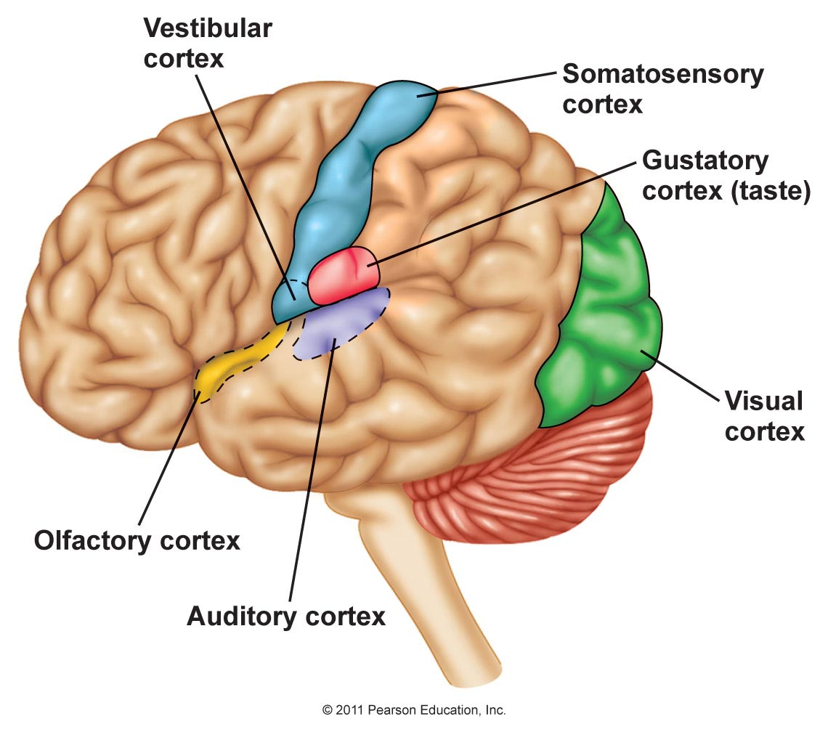
CONT…

Slide 46
CONT…
The amount of primary somatosensory cortex devoted to a body part is not proportional to the absolute size of the body surface, but, instead, to the relative density of cutaneous tactile receptors on that body part.
The density of cutaneous tactile receptors on a body part is generally indicative of the degree of sensitivity of tactile stimulation experienced at said body part. For this reason, the human lips and hands have a larger representation than other body parts.

Slide 47
CLINICAL SIGNIFICANCE
Lesions affecting the primary somatosensory cortex produce characteristic symptoms including: agraphesthesia, astereognosia, hemihypesthesia, and loss of vibration, proprioception and fine touch (because the third-order neuron of the medial-lemniscal pathway cannot synapse in the cortex). It can also produce hemineglect, if it affects the non-dominant hemisphere.
It could also reduce nociception, thermoception, and crude touch, but, since information from the spinothalamic tract is interpreted mainly by other areas of the brain (see insular cortex and cingulate gyrus), it is not as relevant as the other symptoms.
Notes:
Agraphesthesia: Agraphesthesia is a disorder of directional cutaneous kinesthesia or a disorientation of the skin's sensation across its space. It is a difficulty recognizing a written number or letter traced on the skin after parietal damage.
Astereognosis (or tactile agnosia if only one hand is affected) is the inability to identify an object by active touch of the hands without other sensory input, such as visual or sensory information.
Hemihypesthesia is a reduction in sensitivity on one side of the body. A person with this condition may not be able to perceive being lightly touched on one side, but has normal function on the other side of the body. It can occur from damage to the thalamocortical fibers in the posterior limb of the internal capsule.
Hemineglect, also known as unilateral neglect, hemispatial neglect or spatial neglect, is a common and disabling condition following brain damage in which patients fail to be aware of items to one side of space.

Slide 48
SOMATOSENSORY PATHWAYS
A somatosensory pathway will typically have three long neurons: primary, secondary, and tertiary.
The first always has its cell body in the dorsal root ganglion of the spinal nerve.
The second has its cell body either in the spinal cord or in the brainstem; this neuron’s ascending axons will cross to the opposite side either in the spinal cord or in the brainstem. The axons of many of these neurons terminate in the thalamus, and others terminate in the reticular activating system or the cerebellum.

Slide 49
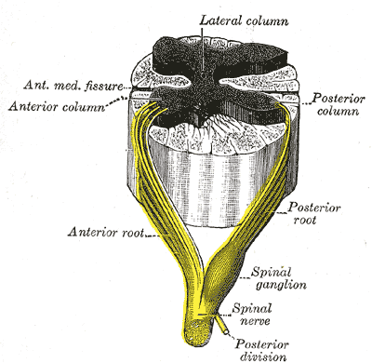
CONT…
In the case of touch and certain types of pain, the third neuron has its cell body in the ventral posterior nucleus of the thalamus and ends in the postcentral gyrus of the parietal lobe.

Slide 50
CONT…
In the periphery, the somatosensory system detects various stimuli by sensory receptors, such as by mechanoreceptors for tactile sensation and nociceptors for pain sensation. The sensory information (touch, pain, temperature, etc.,) is then conveyed to the central nervous system by afferent neurons, of which there are a number of different types with varying size, structure, and properties.
Generally, there is a correlation between the type of sensory modality detected and the type of afferent neuron involved. For example, slow, thin, unmyelinated neurons conduct pain whereas faster, thicker, myelinated neurons conduct casual touch.

Slide 51
ASCENDING PATHWAYS
In the spinal cord, the somatosensory system includes ascending pathways from the body to the brain. One major target within the brain is the postcentral gyrus in the cerebral cortex. This is the target for neurons of the dorsal column–medial lemniscal pathway and the ventral spinothalamic pathway.
Note that many ascending somatosensory pathways include synapses in either the thalamus or the reticular formation before they reach the cortex. Other ascending pathways, particularly those involved with control of posture, are projected to the cerebellum, including the ventral and dorsal spinocerebellar tracts.
Another important target for afferent somatosensory neurons that enter the spinal cord are those neurons involved with local segmental reflexes.

Slide 52
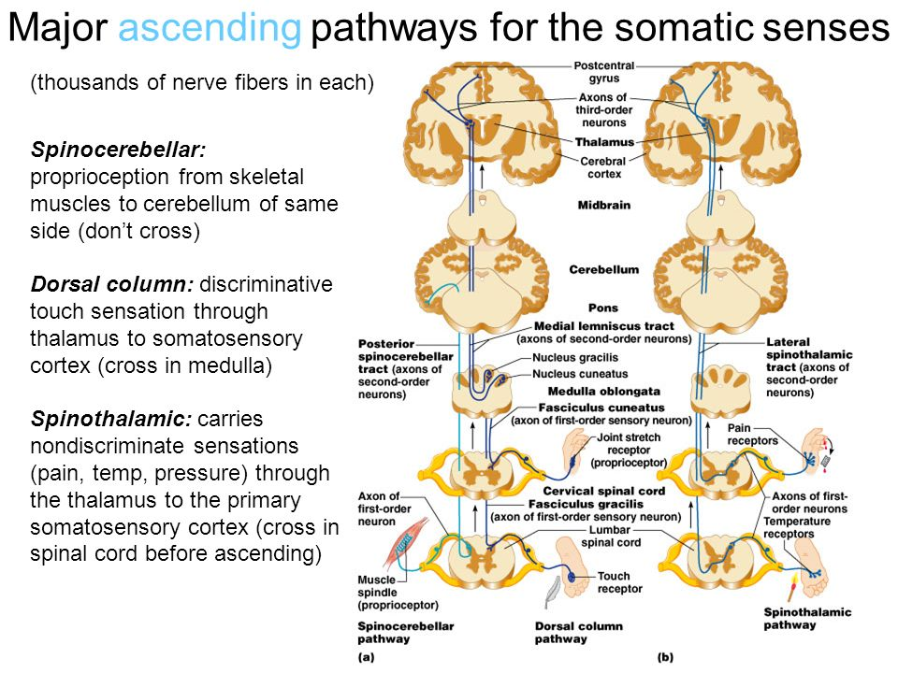
CONT…

Slide 53
Primary Somatosensory Area
The primary somatosensory area in the human cortex is located in the postcentral gyrus of the parietal lobe. This is the main sensory receptive area for the sense of touch.
Like other sensory areas, there is a map of sensory space called a homunculus at this location. Areas of this part of the human brain map to certain areas of the body, dependent on the amount or importance of somatosensory input from that area.
For example, there is a large area of cortex devoted to sensation in the hands, while the back has a much smaller area. Somatosensory information involved with proprioception and posture also target an entirely different part of the brain, the cerebellum.

Slide 54

Cortical Homunculus

Slide 55
THE THALAMUS
The thalamus is a midline symmetrical structure within the brain of vertebrates including humans; it is situated between the cerebral cortex and midbrain, and surrounds the third ventricle.
Its function includes relaying sensory and motor signals to the cerebral cortex, along with the regulation of consciousness, sleep, and alertness.

Slide 56
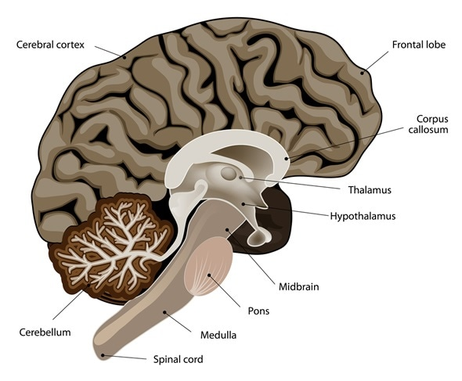

Slide 57
Somatic Sensory Pathways to the Cerebellum
The ventral and dorsal spinocerebellar tracts convey proprioceptive information from the body to the cerebellum.
Senses are transducers from the physical world to the realm of the mind where we interpret the information, creating our perception of the world around us.
The ventral spinocerebellar tract conveys proprioceptive information from the body to the cerebellum. It is part of the somatosensory system and runs in parallel with the dorsal spinocerebellar tract.
Both tracts involve two neurons. The ventral spinocerebellar tract will cross to the opposite side of the body then cross again to end in the cerebellum (referred to as a double cross). The dorsal spinocerebellar tract does not decussate, or cross sides, at all through its path.

Slide 58
CONT…
The ventral tract (under L2/L3) gets its proprioceptive/fine touch/vibration information from a first order neuron, with its cell body in a dorsal ganglion. The axon runs via the fila radicularia (nerve rootlets) to the dorsal horn of the gray matter. There it makes a synapse with the dendrites of two neurons that send their axons bilaterally to the ventral border of the lateral funiculi (transmit the contralateral corticospinal and spinothalamic tracts). The ventral spinocerebellar tract then enters the cerebellum via the superior cerebellar peduncle (connects the cerebellum to the midbrain).

Slide 59
This is in contrast with the dorsal spinocerebellar tract (C8 – L2/L3), which only has one unilateral axon that has its cell body in Clarke’s nucleus (only at the level of C8 – L2/L3). The fibers of the ventral spinocerebellar tract then eventually enter the cerebellum via the superior cerebellar peduncle.
This is one of the few afferent tracts through the superior cerebellar peduncle. Axons first cross midline in the spinal cord and run in the ventral border of the lateral funiculi. These axons ascend to the pons where they join the superior cerebellar peduncle to enter the cerebellum.
Once in the deep, white matter of the cerebellum, the axons recross the midline, give off collaterals to the globose and emboliform nuclei (deep cerebellar nuclei), and terminate in the cortex of the anterior lobe and vermis of the posterior lobe.

Slide 60
The dorsal spinocerebellar tract (also called the posterior spinocerebellar tract, Flechsig’s fasciculus, or Flechsig’s tract) conveys inconscient proprioceptive information from the body to the cerebellum. It is part of the somatosensory system and runs in parallel with the ventral spinocerebellar tract.
Proprioceptive information is taken to the spinal cord via central processes of the dorsal root ganglia (where first order neurons reside). These central processes travel through the dorsal horn where they synapse with second order neurons of Clarke’s nucleus.
Axon fibers from Clarke’s nucleus convey this proprioceptive information in the spinal cord to the peripheral region of the posterolateral funiculus ipsilaterally until it reaches the cerebellum, where unconscious proprioceptive information is processed. This tract involves two neurons and ends up on the same side of the body.

Slide 61
REFERENCES
Viaene A.N.; et al. (2011). "synaptic properties of thalamic input to layers 2/3 and 4 of primary somatosensory and auditory cortices". Journal of Neurophysiology. 105 (1): 279–292. doi:10.1152/jn.00747.2010
Faddis, B. T. (2008). "Structural and functional anatomy of the outer and middle ear". In W. Clark & K. Ohlemiller (Eds.), Anatomy and physiology of hearing for audiologists (pp. 93–108). Thomson Delmar Learning.
Silverthorn, Dee Unglaub. Human Physiology: An Integrated Approach, 3rd Edition, Inc, San Francisco, CA, 2004

Slide 62
THANK YOU.
QUESTIONS?

