Slide 1
SKELETAL SYSTEM

Slide 2
FUNCTIONS
SUPPORT-strong bone is well suited for bearing weight and is the major supporting tissue of the body
-cartilage provides firm yet flexible support within certain structures such as nose, external ear, thoracic cage and trachea.
-ligaments are strong bands of fibrous connective tissue that attach to bones and hold them together.
PROTECTION-Bone is hard and protects the organs it sorrounds.Eg the skull encloses and protects the brain and the vertebrae surrounds the spinal cord. The rib cage protects.

Slide 3
MOVEMENT-skeletal muscles attach to bones
by tendons which are strong bands of connective tissue.
-Contraction of the skeletal muscles move the bones producing body movements. Joints allow movements between bones.
-ligaments allow some movement between bones but prevent excessive movements.

Slide 4
STORAGE-some minerals in the blood-principally calcium and phosphorus area stored in bones. If blood levels of the minerals decrease the minerals are released from bone into the blood.
-Adipose tissue is also stored within bone cavities .If needed the lipids are released into the blood and used by other tissues as a source of energy.
BLOOD CELL PRODUCTION-Many bones contain cavities filled with red bone marrow which produces blood cells and platelets.
Form passageways for blood vessels and nerves.

Slide 5
EXTRACELLULAR MATRIX(ECM)
Bone,cartilage,tendons and ligaments are all connective tissues.
Their characteristics is determined by the composition of extracellular matrix(ECM).
ECM contains collagen, ground substance and other organic molecules as well as water and minerals.
Collagen is a tough ,ropelike protein.(colla- glue,gen-producing).
ECM of tendons and ligaments contains large amounts of collagen fibers making these structures very tough like ropes or cables.

Slide 6
ECM of cartilage contains collagen and proteoglycans. Collagen makes cartilage tough whereas the water-filled proteoglycans make it smooth and resilient.
Cartilage is relatively rigid but it springs back to its original shape after being bent or slightly compressed. It is an excellent shock-absorber.
ECM of bones contain collagen and minerals including calcium and phosphate. The ropelike collagen fibers lend flexible strength to the bone.
The mineral component gives the bone compression strength(weight bearing).
Most of the mineral in bone is in form of calcium phosphate crystals called hydroxyapatite.

Slide 7
BONE DEVELOPMENT AND GROWTH
Parts of the skeletal system begin to form during the first few weeks of prenatal development and bony structures continue to develop and grow into adulthood.
Bones form by replacing existing connective tissue in either of two ways:-
-Intramembranous bones originate between sheet like layers of connective tissue.
-Endochondral bones begin as masses of cartilage that are later replaced by bone tissue.
Ossification-is the formation of a bone.

Slide 8
INTRAMEMBRANOUS OSSIFICATION
Occurs when osteoblasts begin to produce bone in connective tissue membranes.
Occurs primarily in the bones of the skull.
Osteoblasts line up o the surface of connective tissue fibers and begin depositing bone matrix to form trabeculae.
The process begins in areas called ossification centers and the trabeculae radiate out from the centers.
Two or more ossification centers exist in each flat skull bone and the skull bones result from fusion of these centers as they enlarge.
The trabeculae are constantly remodeled after the initial formation and they may enlarge or be replaced by compact bone.

Slide 9
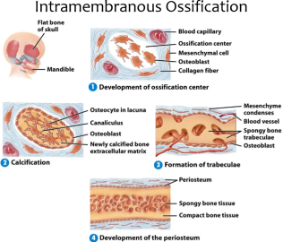

Slide 10
ENDOCHONDRAL OSSIFICATION
Bones of the base of the skull and most bones of the skeleton are endochondral bones.
They develop in the fetus from masses of hyaline cartilage shaped like future bony structures.
During endochondral ossification cartilage cells called chondrocytes increase in number, enlarge and die. Then the cartilage matrix becomes calcified.
As this process is occurring in the centre of the cartilage model, blood vessels accumulate in the perichondrium.

Slide 11
Presence of blood vessels in the outer surface of future bone causes some of the unspecified connective tissue cells on the surface to become osteoclasts.
The osteoblasts then produce a collar of bone around part of the outer surface of the diaphysis ,and the perichondrium becomes periosteum in that area.
Blood vessels also grow into the center of the diaphyses,bringing in osteoblasts and stimulating ossification.
The center part of the diaphysis where bone first begins to appear is called the primary ossification center.

Slide 12
Osteoblasts invade spaces in the center of the bone left by the dying cartilage cells.
Some of the calcified cartilage matrix is removed by osteoclasts and osteoblasts line up on the remaining calcified matrix and begin to form the trabeculae.As the bone develops it is constantly changing.
A medullary cavity forms in the centre of the diaphysis as osteoclasts remove bone and calcified cartilage which are replaced by bone marrow. Later secondary ossification centers form in the epiphyses.

Slide 13
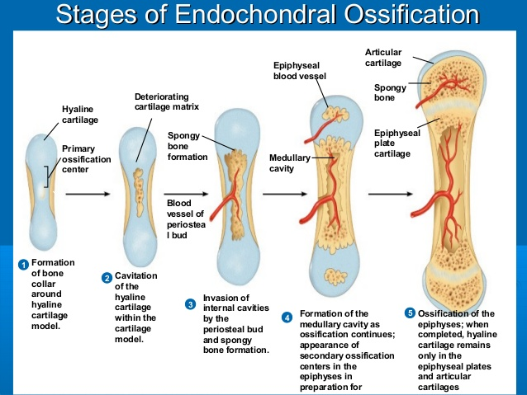

Slide 14
BONE GROWTH
Occurs by deposition of new bone lamellae onto existing bone or other connective tissue.
As ostoeblasts deposit new bone matrix on the surface of bones between the periosteum and the existing bone matrix ,the bone increases in width or diameter. This process is called appositional growth.
Growth in the length of a bone which brings about increase in height occurs in the epiphyseal plate.

Slide 15
Chondrocytes increase in number on the epiphyseal side of the epiphyseal plate .They line up in columns parallel to the long axis of the bone causing the bone to elongate .Then the chondrocytes enlarge and die.
The cartilage matrix becomes calcified .Much of the cartilage that form around the enlarged cells is removed by osteoclasts and the dying chondrocytes are replaced by osteoblasts. These osteoblasts start forming bone by depositing bone lamellae on the surface of the calcified cartilage .This process produces bone on the diaphyseal side of the epiphyseal plate.

Slide 16
BONE STRUCTURE
Bones of the skeletal system differ greatly in size and shape though they are similar structure, development and function.
BONE CLASSIFICATION
Bones are classified according to their shapes into four:-
LONG BONES
-Are longer than they are wide.
-have long longitudinal axes and expanded ends.
Examples:forearm,femur,humerus,tibia fibula etc

Slide 17
SHORT BONES
-Are approximately as wide as they are long .
-Are somewhat cube like with roughly equal lengths and widths.
Examples: bones of wrist joint and ankle.
FLAT BONES
-Have a relatively thin flattened shape.
-are plate like structures with broad surfaces.
-Examples: Ribs,scapulae,certain skull bones and sternum.

Slide 18
IRREGULAR BONES
-Have a variety of shapes and are usually connected to several other bones.
Examples: vertebrae and facial bones.

Slide 19
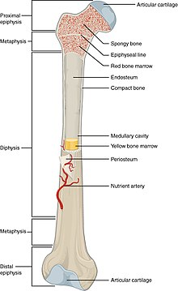
STRUCTURE OF A LONG BONE

Slide 20
A long bone series as a useful model for illustrating the parts of a typical bone.
It consists of :-
Diaphysis –the central shaft
Epiphyses-expanded portion/end.
-the epiphyses nearest to the trunk is called proximal epiphyses and the one farthest from the trunk is distal epiphyses.

Slide 21
Articular cartilage-layer of hyaline cartilage that coats the articulating portion of the epiphyses.
Periosteum-a tough, vascular covering of dense connective tissue that encloses the bone except for the articular cartilage on the bones ends.
-Periosteum is firmly attached to the bone connecting ligaments and tendons.
-It contains blood vessels and nerves.
-Periosteum helps form and repair bone tissues.
Endosteum-is a thin vascular membrane of connective tissue that lines the inner surface of the bony tissue that forms the medullary cavity of long bones. This endosteal surface is usually absorbed during long periods of malnutrition, resulting in less cortical thickness. It lacks a distinct fibrous layer.

Slide 22
Medullary cavity-it is a semi rigid tube which has a hollow chamber in the diaphysis of the long bone.
-The medullary cavity is filled with marrow which is a specialized type of soft connective tissue:-
Yellow marrow consists mainly of adipose tissue.
Red marrow consists of blood forming cells and is the only site of blood formation in adults.

Slide 23
Children's bones have proportionately more red marrow than do adult bones because as a person ages it is replaced by yellow marrow(from 7 yrs and above).
In adults red marrow is confined to the bones in the central axis of the body and in the most proximal epiphyses of the limbs.

Slide 24
MICROSCOPIC STRUCTURE /HISTOLOGY OF BONE
Periosteum and endosteum contains osteoblasts (bone-forming cells) which function in the formation of bone as well as repair and remodeling of bone.
When osteoblasts become surrounded by matrix they are referred to as osteocytes.
Osteoclasts (bone-eating cells)contribute to bone repair and remodeling by removing existing bone.
Bone is formed in thin sheets of extracellular material called lamellae with osteocytes located between the lamellae within spaces called lacunae which form concentric circles around called central canals (harvesian canals).
Cell processes extend from the osteocytes across the extracellular matrix of the lamellae within tiny canals called canaliculi.

Slide 25
Bone tissue formed throughout the skeleton is divided into two types based on histological structure:-
Compact bone-mostly solid matrix and cells
-The osteocytes and layers of ECM are concentrically clustered around a central canal forming a cylinder shaped unit called osteon(haversian system)-a predictable pattern of repeating units.
-Each central canal contains blood vessels usually capillaries and nerve fibers surrounded by loose connective tissues. The blood in these vessels nourish bone cells associated with the central canal.

Slide 26
Central canals extend longitudinally through bone tissue and transverse perforating canals (volk’sman canals) connect them.
Perforating canals contain larger blood vessels and nerves by which the smaller blood vessels and nerve fibers in central canals communicate with the surface of the bone and the medullary cavity.
Nutrients leave the blood vessels of central canals and diffuse to the osteocytes through the canaliculi.

Slide 27
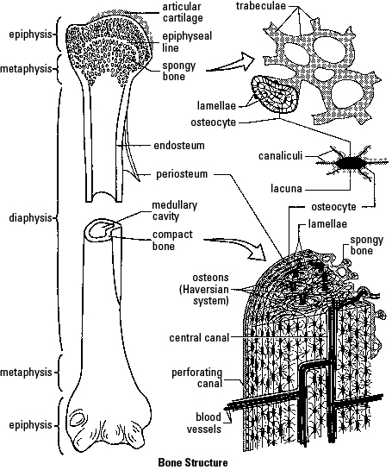

Slide 28
Spongy bone-composed of osteocytes and ECM but the bones do not aggregate around central canals.
-located mainly in the epiphyses of long bones .
-It forms the interior of all other bones .
-It consists of delicate interconnecting rods or plates of bone called trabeculae.
-The spaces between trabeculae are filled with marrow.
-Each trabeculae consists of several lamellae with osteocytes between them.
-No blood vessels penetrate the trabeculae and it has no central canals.
-Nutrients exit vessels in the marrow and pass by diffusion through canaliculi to osteocytes of the trabeculae.

Slide 29
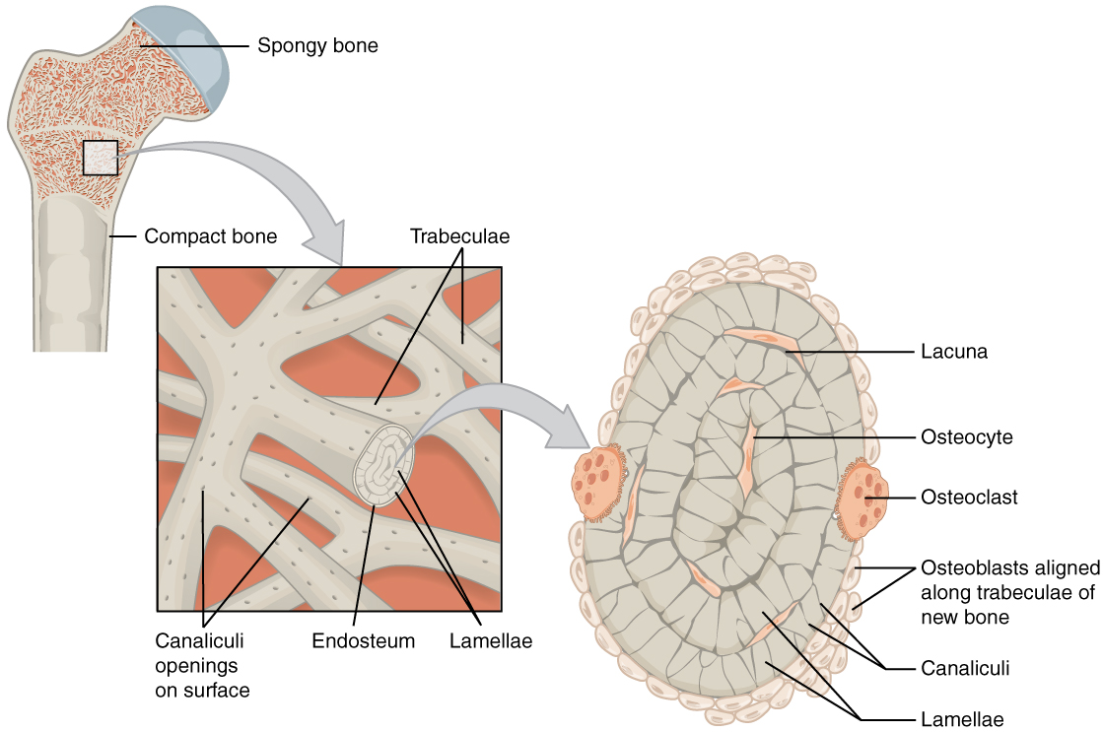

Slide 30
BONE REMODELLING
Involves removal of existing bone by osteoclasts and the deposition of of a new bone by osteoblasts.
Occurs in all bones.
It’s responsible for changes in bone shape,adjustment of bone to stress ,bone repair and calcium ion regulation in the body fluids.
Bone is a major storage site for calcium in the body ,bone remodelling is very important in mantaining blood calcium levels within normal limits.

Slide 31
BONE REPAIR
When a bone is broken the blood vessels in the bone are also damaged.The following occur:-
  STEP 1:HEMATOMA FORMATION
  The vessels bleed and a clot (hematoma)forms in the damaged region.
  STEP 2:CALLUS FORMATION
  Two or three days after injury ,blood vessels and cells from surrounding tissue begin to invade the clot.

Slide 32
Some of those cells produce a fibrous network of connective tissues between the broken bones which hold the fragments together and fills the gap between them.
Other cells produce islets of cartilage in the fibrous network.
The network of fibers and islets of cartilage between the two bone fragments is called a callus.

Slide 33
STEP 3 :CALLUS OSSIFICATION
-Osteoblasts enter the callus and begin forming spongy bone which is usually complete 4-6 weeks after injury.
-immobilization of the bone is critical upto this time because movement can refracture the delicate new matrix.
STEP 4:BONE REMODELING
-The spongy bone is remodeled to form compact and spongy bone and part of the internal callus is removed,restoring the medullary cavity.Repair is complete.

Slide 34
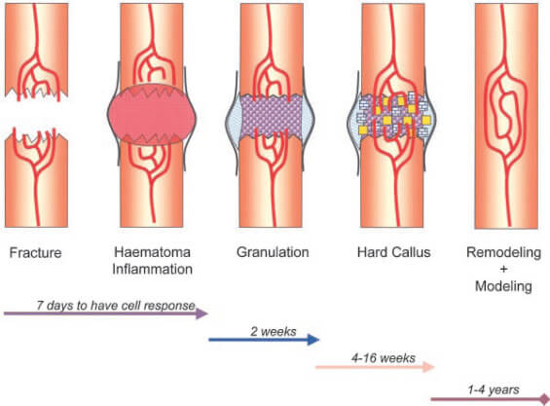

Slide 35
BONE AND CALCIUM HOMEOSTASIS
Bone is a major storage and site for calcium .
Movement of calcium into and out of bones helps determine blood calcium levels which is critical for normal muscle and nervous system function.
Calcium (Ca2+) moves into the bone as osteoblasts build new bone and out of the bone as osteoclasts breakdown bone.
When osteoblast and osteoclast activity is balanced ,the movements of calcium into and out of the bone are equal.

Slide 36
When blood calcium levels are too low, osteoblasts activity increases to release calcium from bone into the blood and blood calcium levels increase.
If blood calcium levels are too high,osteoclasts activity decreases,osteoblasts remove calcium from the blood to produce new bone and blood calcium levels decreases.

Slide 37
Calcium homeostasis is maintained by three hormones :-
Parathyroid hormone(PTH)-from parathyroid gland
Vitamin D-from skin or diet
Calcitonin-from thyroid gland
PTH and Vitamin D are secreted when blood calcium levels are too low.
Calcitonin is secreted when blood calcium levels are too high.

Slide 38
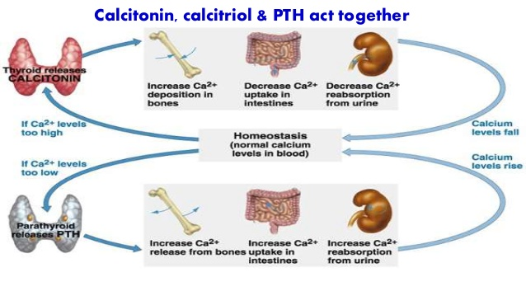

Slide 39
SURFACE MARKINGS/FEATURES OF BONES
ARTICULAR SURFACES
Condyle-a large ,round articulating knob example the occipital condyle of the occipital bone.
Facet –a flattened or shallow articulating surface.
Head-a prominent ,round articulating end of a bone

Slide 40
DEPRESSIONS AND OPENINGS
Alveolus-a deep pit or socket.
Fissure-a narrow ,slit-like opening.
foramen-a round opening through a bone.
Fossa-a flattened or shallow surface/depression.
Sinus-a cavity or hollow space in a bone.
Sulcus-a groove that accommodates a vessel, nerve or tendon.
Meatus /canal-tunnel.

Slide 41
NON-ARTICULATING PROMINENCES
Crest-a narrow,ridgelike projection.
Epicondyle-a projection adjacent to a condyle
Process-any marked bony prominence.
Ramus-a flattened angular part of a bone.
Spine-a sharp slender process.
Trochanter-a massive process found only in the femur.
Tubercle-a small ,rounded process.
Tuberosity-a large, roughened process.

