Slide 1
THE SKIN
&
SKIN CONDITIONS

Slide 2
STUDY OBJECTIVES
Review of the anatomy and physiology of skin
Assessment of the skin lesions
Diagnostic tests
Principles of therapy
Classification of skin conditions, etiology/ causes/ risk factors; clinical manifestations, diagnostic tests and therapy (medical and nursing management).

Slide 3
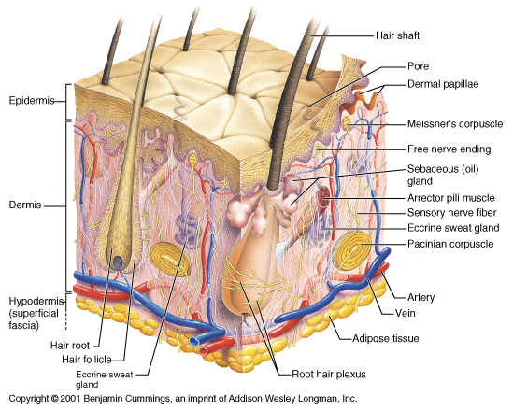

Slide 4
The Integumentary System
Integument is skin
Skin and its appendages make up the integumentary system
A fatty layer (hypodermis) lies deep to it
It has three distinct regions
  Epidermis
  Dermis
  Hypodermis

Slide 5
The Skin
The human skin is the outer covering of the body. In humans, it is the largest organ with a total area of about 20 square feet.
There are two general types of skin, hairy and glabrous skin (hairless skin found on the ventral portion of the fingers, palmar surfaces of hands, soles of feet, lips, labia minora and glans penis).

Slide 6
Skin Pigments
There are at least five different pigments that determine the color of the skin, present at different levels and places.
Melanin
It is brown in color and present in the germinative zone of the epidermis. It is primarily responsible for skin color. The more melanin, the darker the skin
Melanoid
It resembles melanin but is present diffusely throughout the epidermis.

Slide 7
Keratin
This pigment is yellow to orange in color. It is present in the stratum corneum and fat cells of dermis and superficial fascia. Is a principle hardening ingredient of hair and nails.
Haemoglobin
It is found in blood and is not a pigment of the skin but develops a purple color.
Oxyhaemoglobin
It is also found in blood and is not a pigment of the skin. It develops a red color.

Slide 8
Layers of the skin
Skin is composed of three primary layers:
Epidermis: Provides waterproofing and serves as a barrier to infection;
Dermis: Serves as a location for the appendages of skin; and
Hypodermis (subcutaneous/ adipose layer).

Slide 9
1. Epidermis
Is the outermost layer of the skin. It forms the waterproof, protective wrap over the body's surface and is made up of stratified squamous epithelium with an underlying basal lamina.
It contains no blood vessels, and cells in the deepest layers are nourished by diffusion from blood capillaries extending to the upper layers of the dermis.
The main type of cells which make up the epidermis are Merkel cells, keratinocytes, with melanocytes and Langerhans cells also present.

Slide 10
Keratinocytes : Form a barrier against environmental damage such as pathogens, (bacteria, fungi, parasites, viruses), heat, UV radiation and water loss.
Melanocytes: Melanin-producing cells located in the bottom layer (the stratum basale) of the skin's epidermis.
Langerhans cells : Antigen-presenting immune cells of the skin and mucosa.
Merkel cells: Nerve receptor essential for the specialized coding

Slide 11
Skin thickness ranges from 0.1mm(eyelids) to 1mm(on the palm)
Is further subdivided into the 5 sublayers or strata (beginning with the outermost layer):
    Stratum corneum
    Stratum lucidum( only in palms of hands and bottoms of feet)
    Stratum granulosum
    Stratum spinosum
    Stratum germinativum(also called "stratum basale")

Slide 12
Cells are formed through mitosis at the basale layer.
The external layer gets replaced continuously in life. This process is called keratinization and takes place within about 27 days.
This keratinized layer of skin is responsible for keeping water in the body and keeping other harmful chemicals and pathogens out, making skin a natural barrier to infection.

Slide 13
2. Dermis
It is the layer of skin beneath the epidermis that consists of connective tissue and cushions the body from stress and strain.
Makes the largest portion of skin
Contains the hair follicles, sweat glands, sebaceous glands, apocrine glands, lymphatic vessels and blood vessels. The blood vessels in the dermis provide nourishment and waste removal from its own cells as well as from the Stratum basale of the epidermis.

Slide 14
3. Hypodermis (Subcutaneous layer)
Is the innermost layer of skin, lying below the dermis
It consists of loose connective tissue and elastin
The main cell types are fibroblasts, macrophages and adipocytes (the hypodermis contains 50% of body fat). Fat serves as padding and insulation for the body
Its purpose is to attach the skin to underlying bone and muscle as well as supplying it with blood vessels and nerves
It moulds the body contours and insulates the body
Fat is distributed and deposited according to sex hence accounts for difference in body shapes between men and women

Slide 15
Hair
Covers the entire human body, apart from areas of glabrous skin
Consists of two parts, the root (beneath the skin) and shaft (hard filamentous part extending above the skin)
Hair in different parts of the body serve different functions e.g. The eyebrows provide some protection to the eyes from dirt, sweat and rain. More importantly, they play a key role in non-verbal communication

Slide 16
The eyelash protects the eye from dirt. The eyelash is to humans, what whiskers are to cats ; they are used to sense when dirt, dust, or any other potentially harmful object is too close to the eye. The eye reflexively closes as a result of this sensation.
Hair of skin provide thermo insulation, especially on the head serves as primary sources of heat insulation and cooling (when sweat evaporates from soaked hair) as well as protection from ultra-violet radiation exposure.

Slide 17
Nails
A nail is a horn-like envelope covering the dorsal aspect of the terminal part of fingers and toes
Made of keratin
Protects the distal phalanx, the fingertip, and the surrounding soft tissues from injury. It also acts as a counterforce when the end of the finger touches an object, thereby enhancing the sensitivity of the fingertip

Slide 18
Nails grow continuously throughout life at an average rate of 3 mm (0.12 in) a month (0.1 mm daily)
Actual growth rate is dependent upon age, sex, season, exercise level, diet, and hereditary factors.
N.B.
Contrary to popular belief, nails do not continue to grow after death; the skin dehydrates and tightens, making the nails (and hair) appear to grow.
The length and growth rate of nails is related to the length of the terminal phalanges (outermost finger bones). Thus, in humans, the nail of the index finger grows faster than that of the little finger; and fingernails grow up to four times faster than toenails.

Slide 19
Glands of the skin
The skin has two types of glands
Sebaceous glands
Are microscopic glands in the skin that secrete an oily/waxy matter, called sebum, to lubricate and waterproof the skin and hair.
Found in greatest abundance on the face and scalp, though they are distributed throughout all skin sites except the palms and soles

Slide 20
Sweat glands
Are small tubular structures of the skin that produce sweat. Heavily concentrated in palms and sole of feet
Only the margin of lips, external ear, nail bed and glans penis are devoid of sweat glands
Of two types: eccrine and apocrine

Slide 21
Eccrine sweat glands: They are distributed all over the body (except for the lips, tip of penis and clitoris) although their density varies from region to region. Utilized as primary form of cooling.
Are not connected to hair follicles, open directly to the skin surface fxn throught life.
Apocrine sweat glands: Are larger, have different mechanism of secretion, and are limited to axilla (armpits) and perianal areas. They contribute little to cooling. Their ducts open on to the hair follicles, become active at puberty. In women they enlarge and recede with each menstrual cycle.

Slide 22
Note: Sweat glands are located on various parts of the body and respond to different stimuli. Those on the trunk generally respond to thermal stimulation; those on the palms and soles respond to nervous stimulation; and those on the axillae and on the forehead respond to both stimuli.

Slide 23
Functions of Skin
Skin performs the following functions:
1. Protection: an anatomical barrier from pathogens and damage between the internal and external environment in bodily defense; Langerhans cells in the skin are part of the adaptive immune system.
2. Sensation: contains a variety of nerve endings that react to heat and cold, touch, pressure, vibration, and tissue injury;
3. Fluid balance: the skin provides a relatively dry and semi-impermeable barrier to fluid loss. Loss of this function contributes to the massive fluid loss in burns

Slide 24
4. Aesthetics and communication: others see our skin and can assess our mood, physical state and attractiveness.
5. Storage and synthesis: acts as a storage center for lipids and water, as well as a means of synthesis of vitamin D by action of UV on certain parts of the skin.
6. Excretion: sweat contains urea, however its concentration is 1/130th that of urine, hence excretion by sweating is at most a secondary function to temperature regulation.
7. Absorption: the cells comprising the outermost 0.25–0.40 mm of the skin are "almost exclusively supplied by external oxygen“. Medicine can be administered through the skin, by ointments or by means of adhesive patch, such as the nicotine patch.

Slide 25
9. Heat regulation: The skin contains a high blood supply which allows precise control of energy loss by radiation, convection and conduction. Dilated blood vessels increase perfusion and heat loss, while constricted vessels greatly reduce cutaneous blood flow and conserve heat.
10. Water resistance: The skin acts as a water resistant barrier so essential nutrients aren't washed out of the body.

Slide 26
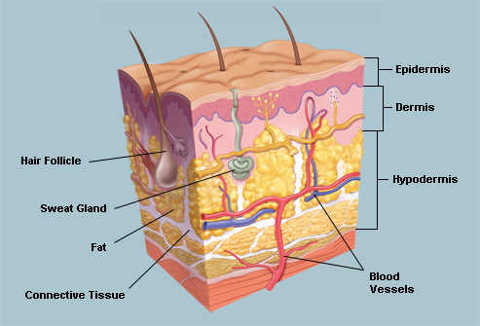
The Skin(Diagram 1)

Slide 27
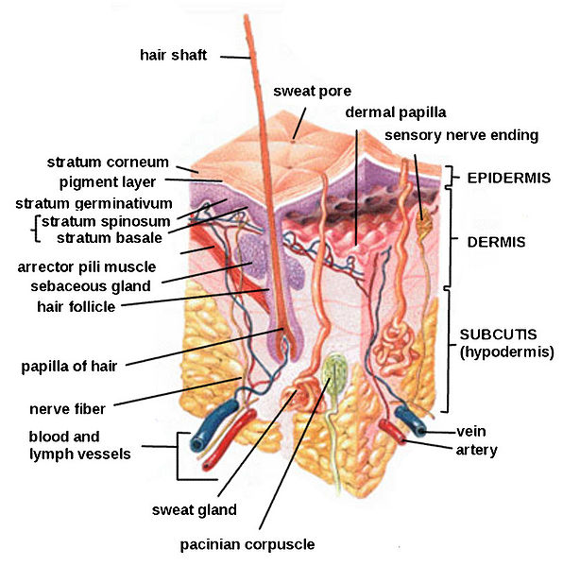
The Skin (Diagram 2)

Slide 28
SKIN-ASSESSMENT
Health History
Personal and family history of skin allergies, allergic reaction to food, medicine, chemicals, previous problems with skin
Name of soaps, cosmetics & other personal hygiene products, incase of recent skin problems related to their use
Information about onset, location, duration, itchiness etc..

Slide 29
Physical Examination
Begins with a general inspection followed by a detailed examination. When preparing to assess the skin, wear gloves if the patient has any lesions, complains of itching skin, or if the mucous membranes are to be examined.
Room should be well lighted, examine entire skin including nails, scalp, hair and mucous membranes
Use inspection and palpation

Slide 30
Factors to consider while describing Skin Lesions
1. Morphology( color, size, shape and demarcation and texture)
Color: Note the color of the skin first. Depending upon the person’s race the skin should be flesh-toned appropriate for the person. Helps in identifying whether lesions are secondary to inflammation, infection and sun exposure or hereditary
Shape and Demarcation: Shape describes the contour of a lesion (round, oval, polygonal and asymmetric). Demarcation refers to the sharpness of edge of the lesion, whether discrete or diffuse

Slide 31
Size: The metric system is used for measurement
Texture: Lesion described as being rough or smooth, dry, moist and on the surface, or deeply penetrating into the tissue
2. Configuration
Is arrangement or pattern of lesions in relation to other lesions. Skin lesions can occur discretely or in groupings (linear, annular, ring like etc.) while disseminated refers to multiple scattered lesion diffusely distributed over body
3. Distribution
Considers both arrangement of lesions over an area of skin as well as pattern e.g. discrete(isolated), localized, regional and generalized

Slide 32
QUIZ
1. Which epidermal layer is found in thick skin only?
A) stratum basale
B) stratum spinosum
C) stratum lucidum
D) stratum corneum
2. From the basement membrane outward, the strata of the epidermis are
A) spinosum, corneum, granulosum, basale
B) basale, spinosum, granulosum, corneum
C) lucidum, basale, granulosum, corneum
D) basale, granulosum, spinosum, corneum

Slide 33
3. Apocrine sweat glands occur in all of the following locations except
A) the areola
B) the palms
C) the axillae
D) the groin
4. Which type of gland secretes a lipid material that coats the epidermis and hair shafts to provide lubrication and inhibit bacterial growth?
A) sebaceous
B) sudoriferous
C) eccrine
D) apocrine

Slide 34
Skin Lesions
1. Primary Lesions: Are those originally produced by trauma or other stimulation. They include:
Macule: Discoloration of skin often flat and non – palpable
Patch: A patch is a large macule. May have some subtle surface change, such as a fine scale or wrinkling, despite the change in consistency of the surface, the lesion itself is not palpable

Slide 35
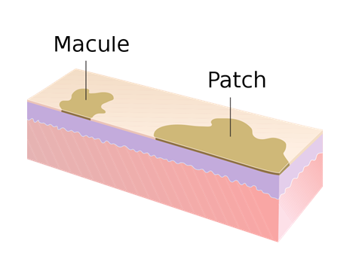

Slide 36
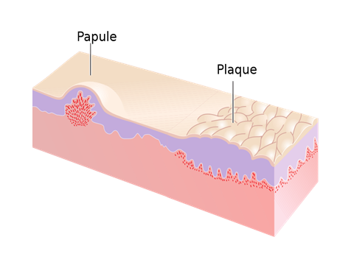
Papule: An elevated, sharply circumscribed, small, colored lesion. Seen in ringworm and psoriasis.
Plaque: Is an elevated, plateau-like lesion that is greater in its diameter than in its depth

Slide 37
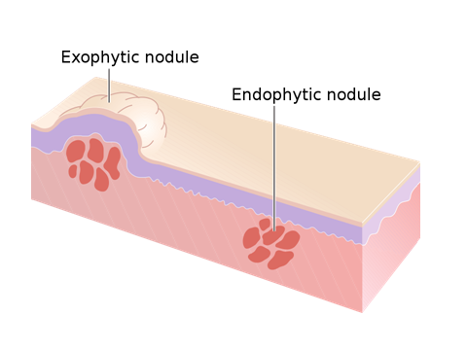
Nodule: Is an elevated palpable solid mass with extensions deeper into the dermis than a papule. The depth of involvement is what differentiates a nodule from a papule

Slide 38
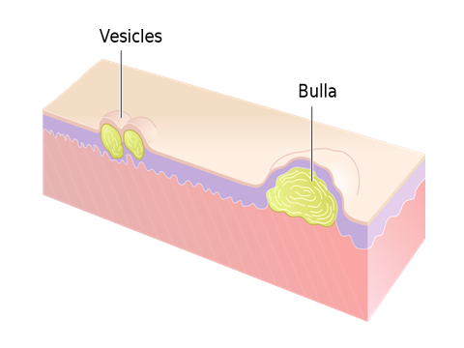
Vesicle or blister: A bulging, small, sharply defined lesion filled with clear, free fluid.
Bullae: Large vesicles.

Slide 39
Pustule: A small elevation of the skin containing cloudy or purulent material usually consisting of necrotic inflammatory cells. (Pus- filled vesicle)
Cyst : An epithelial-lined cavity containing liquid, semi-solid, or solid material
Wheal: An elevated, white to pink edematous lesion that is unstable and associated with pruritus. Wheals are evanescent – they appear and disappear quickly. Seen in mosquito bites and hives.

Slide 40
Telangiectasia : An enlargement of superficial blood vessels to the point of being visible.
Burrow: A slightly elevated, grayish, tortuous (not straight) line in the skin, and is caused by burrowing organisms.
Petechiae: Tiny, reddish purple, sharply circumscribed spots of hemorrhage in the superficial layers of the skin or epidermis. May indicate severe systemic disease such as bacterial endocarditis and must be reported immediately.

Slide 41
2. Secondary Skin Lesions: Result from some alteration, usually traumatic, to the primary lesion. They include:
Crust: Dried blood, serum, scales, and pus from corrosive lesions, usually mixed with epithelial and sometimes bacterial debris
Lichenification : Pronounced thickening of the epidermis and dermis from chronic scratching or rubbing

Slide 42
Erosion: A discontinuity of the skin exhibiting incomplete loss of the epidermis, a lesion that is moist, circumscribed, and usually depressed.
Ulcer: A destruction and loss of epidermis, dermis, and possibly subcutaneous layers.
Fissure: A vertical, linear crack through the epidermis and dermis. Usually narrow but deep.

Slide 43
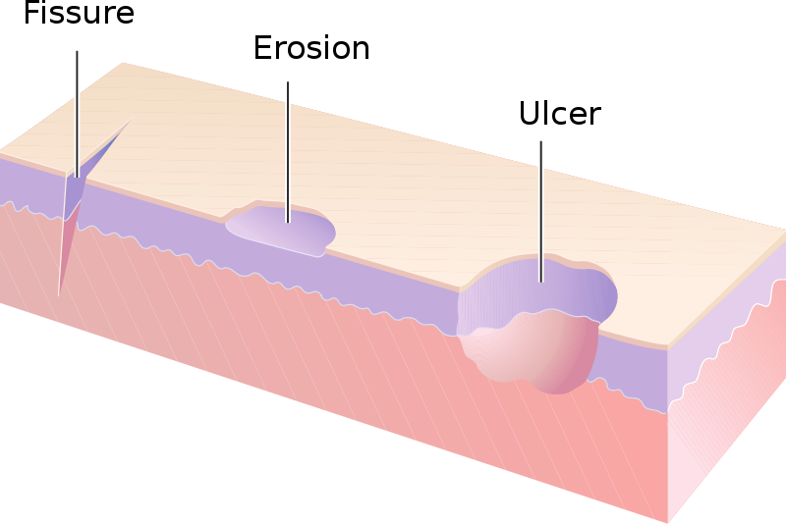

Slide 44
Excoriation: An abrasion produced by mechanical means (often scratching), usually involving only the epidermis but not uncommonly reaching the papillary dermis.
Induration: Dermal thickening causing the cutaneous surface to feel thicker and firmer.
Atrophy: A loss of tissue, and can be epidermal, dermal, or subcutaneous. With epidermal atrophy, the skin appears thin, translucent, and wrinkled. Dermal or subcutaneous atrophy is represented by depression of the skin

Slide 45
Maceration: Softening and turning white of the skin due to being consistently wet.
Umbilication: Formation of a depression at the top of a papule, vesicle, or pustule.
Scar: Formation of dense connective tissue resulting from destruction of skin.
Scale: Dried fragments of sloughed dead epidermis

Slide 46
DIAGNOSTIC EVALUATION
1. Skin Biopsy: Performed to obtain tissue for microscopic evaluation. Performed on skin nodules, plagues, blisters and other lesions to rule out malignancy and establish exact diagnosis.
2. Skin Scrapings: Tissue samples are scraped from suspected fungal lesions with a scalpel blade moistened with oil so that the scraped skin adheres to the blade. The scraped material transferred to a glass slide, covered with a slip and examined microscopically.

Slide 47
3. Immunofluorescence: Designed to establish sites of immunological reaction
4. Culture and Sensitivity: A culture is done to find out what kind of organism (usually a bacteria) is causing an illness or infection. Done by collecting a sample of body fluid or tissue and then adding it to a substance that helps promote the growth of bacteria or other disease-causing organisms. A sensitivity test checks to see what kind of medicine, such as an antibiotic, will work best to treat the illness or infection.

Slide 48
5. Tzanck smear: Used to examine cells from blistering conditions such as herpes zoster, varicella and herpes simplex. The secretions from suspected blisters are applied to a slide, stained and examined
6. Patch Testing: Performed to identify substances which the patient has developed an allergy

Slide 49
PRINCIPLES OF THERAPY
1. Balneotherapy
May involve hot or cold water, massage through moving water, relaxation or stimulation
Useful when large areas of skin are involved
The bath removes crusts, scales, old medications, relieves inflammation on a pruritus.

Slide 50
2. Wound Dressing
There are three major classification of dressings for skin conditions: wet; moisture – retentive and occlusive dressings.
a) Wet Dressings: They are used to:
Reduce inflammation by causing constriction of blood vessels;
Clean the skin off exudates, crusts and scales
Maintain drainage of infected areas
Promote healing by facilitating free movement of epidermal cells through across the involved skin so that new granule tissue forms

Slide 51
Note: There is danger that the closed dressing may cause not only softening but actual maceration of underlying skin
b) Moisture – Retentive Dressings: Can perform the same functions as wet dressings but are more efficient in removing exudates because of their higher moisture – vapor transmission rate.
Some have reservoirs that can hold excessive exudate

Slide 52
Their advantages over wet dressing include:
Reduced pain
Fewer infections
Lesser scar tissue
Decreased frequency of dressings
c) Occlusive Dressings: Cover topical medication that is applied to a skin lesion. The area is then kept air tight using a plastic wrap.

Slide 53
3. Pharmacotherapy: Skin is accessible and therefore easy to treat, hence topical medications are often used.
Medicated lotions, creams, powder and ointments are frequently used to treat skin lesions
Note: Moisture retentive dressings with or without medications are used in acute stage, lotions and creams are reserved for sub acute stage and ointments are used when inflammation has become chronic and the skin is dry and scaling.

Slide 54
a) Topical Medication
Lotions: Usually applied directly to the skin or a dressing soaked in lotion can be placed on the affected area. They are used to replenish lost skin or relieve pruritus. Are of two types:
Suspensions: Consist of powder in water requiring shaking before application and clear solutions containing completely dissolved active agents e.g. calamine lotion
Liniments: Are lotions with oil added to prevent crusting

Slide 55
Powders: Usually contain zinc oxide, talc and cornstarch base and are dusted on the skin with a shaker or cotton sponge. They act as hygroscopic agents that absorb and retain moisture form the air and reduce friction between skin surfaces and cloths or beddings.
Spray and Aerosols: Used on any widespread dermatological conditions.
Gels: Semisolid emulsions that become liquid when applied to the skin or scalp. Useful in acute dermatitis in which there is weeping exudate

Slide 56
Creams: May be suspensions of oil in water or emulsions of water in oil, with a additional ingredients to prevent bacterial and fungal growth. Are used for their moisturizing and emollient effects.
Pastes: Mixtures of powders and ointments and are used in inflammatory blistering conditions
Ointments: Reduce water loss, lubricate and protect skin. Preferred in chronic or localized dry skin conditions like eczema or psoriasis

Slide 57
Corticosteroids: Used in treating dermatological conditions to provide ant – inflammatory, anti – pruritic and vasoconstrictive effects
Note: Inappropriate use can result to local (skin atrophy and thinning – inhibition of collagen synthesis; striae and telangiectasia) or systemic (hyperglycemia) side effects
Caution required when being used around the eye because long term use may cause glaucoma and cataracts.

Slide 58
b) Intralesional Therapy
Consists of injecting a sterile suspension of medical (usually corticosteroid) into or just below a lesion.
Skin lesions treated with this therapy include psoriasis and acne
c) Systemic Medications
They include corticosteroids, antibiotics, antifungals, antihistamines, sedatives, tranquilizers, analgesics and cytotoxic agents

Slide 59
CLASSIFICATION OF SKIN DISORDERS
Secretory Disorders e.g. Hydradenitis suppurativa, Seborrheic dermatitis, Acne vulgaris,
Bacterial Skin Infections (pyodermas – pus forming) e.g. Impetigo, Folliculitis,
Viral Skin Infections e.g. Herpes zo0ster, Herpes simplex, Orolabial herpes, Genital herpes

Slide 60
Fungal (Mycotic) Skin Infections e.g. Superficial: Dermatophytes ( Tinea pedis , Tinea corposis, Tinea cruris, Tinea capitis, Tinea unguium) and Candidiasis. Deep: Actinomycosis
Parasitic Skin Infestations e.g. Pediculosis – lice infestation (capitis, corpori and pubis), Scabies
Inflammatory conditions: Contact dermatitis
Non Infectious Inflammatory Dermatoses e.g. Psoriasis, Exfoliative dermatitis

Slide 61
Blistering Diseases e.g. Pemphigus, Bullous Pemphigoid, Dermatitis herpetiformis, Herpes gestationis
Benign Skin Tumours e.g. Cysts, Actinc seborrheic keratoses, Warts, Keloids, Angiomas, Moles
Malignant Skin Tumors (Skin Cancer) e.g. Basal cell and Squamous cell carcinomas

Slide 62
QUIZ
1. Which term specifically means abnormal condition of the skin?
A) Dermatopathy
B) Dermatosis
C) Dermatoplasty
D) Dermatitis
2. Which of the following is a secondary lesion?
A) Macule
B) Vesicle
C) Ulcer
D) Petechiae

Slide 63
3. Which of the following is a primary lesion?
A) Umbilication
B) Maceration
C) Plaque
D) Scar
4. A bulging, small, sharply defined lesion filled with clear, free fluid is a …………….
A) Bullae
B) Vesicle
C) Pustule
D) Papule

Slide 64
5. Which of this lesions is commonly called a blister?
A) Pustule
B) Vesicle
C) Papule
D) Wheal
6. Which of the following lesions does NOT have pus?
A) Pustule
B) Abscess
C) Furuncle
D) Papule

Slide 65
7. Which of the following diagnostic tests is used to determine the disease causing organism and the medicine to treat it?
A) Immunofluorescence
B) Patch test
C) Culture and sensitivity
D) Tzanck smear
8. List four (4) advantages of moisture – retentive dressings over wet dressings.
-fewer infections
-Reduces scars formation
-Reduces frequency of dressing
-Reduces pain

Slide 66
Skin Conditions caused by Systemic Conditions
1. Diabetes
a) Diabetes Dermopathy (shin spots): Skin lesion characterized by dull-red papules that progress to well-circumscribed, small, round, atrophic hyper pigmented skin lesions on the shins (front part of the human leg between the knee and the ankle). It is the most common of several diabetic conditions

Slide 67
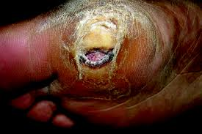

Slide 68
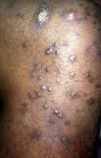

Slide 69
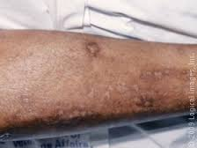

Slide 70
b) Stasis Dermatitis (Stasis eczema or Varicose eczema): Skin changes that occur in the leg as a result of "stasis" or blood pooling from insufficient venous return. Insufficient venous return results in increased pressure in the capillaries with the result that both fluid and cells may "leak" out of the capillaries.
c) Skin Infections: The skin of a diabetic is prone to bacterial and fungal infections

Slide 71
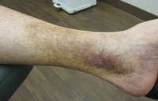
Stasis eczema

Slide 72
d) Leg Ulcer: Changes in peripheral nerves results to reduced sensation to minor injuries to the lower legs and feet. Ulceration is not often noticed hence become large before being treated. Ulcerations not responsive to treatment are leading causes of diabetic foot and leg amputation
2. HIV/AIDS
Cutaneous sign may be the first manifestation of HIV as the immune function deteriorates. They include: Kaposi’s sarcoma, Oral candidiasis and Herpes zoster

Slide 73
PRURITUS (ITCH)
Is a sensation that causes the desire or reflex to scratch
May be an indication of a systemic internal disease e.g. diabetes mellitus, blood disorders and cancer.
May also accompany renal, hepatic and thyroid diseases
Can also be as a result of Oral medications, some soaps and chemicals, Psychological factors

Slide 74
Pathophysiology
Scratching the itchy area causes the inflamed cells and nerve endings to release more histamine, which produces more pruritus, generating a vicious itch – scratch cycle
Is more severe at night than the day, because of less distractors at night hence the slightest urge to itch cant be ignored
Response to an itch by a scratch alters skin integrity and can result to excoriation, redness, wheals, infection or change in pigmentation

Slide 75
Medical Management
Thorough physical exam and history taking to determine the cause
Identify signs of infection if any
Patient to avoid soap and hot water, rather use warm water
Use of cold compressors
Topical corticosteroids and ant – inflammatory agents
Oral anti – histamines
Tricyclic antidepressants for pruritus of psychogenic origin

Slide 76
Nursing Management
Reinforce reasons for prescribed regimen
For baths, remind patient to use tepid water, shake off excess water and blot areas with folds dry, after which emollient should be applied immediately to trap moisture
Discourage vigorous rubbing as it stimulates more itching
If troubled at night with itching, encourage wearing of cotton clothing next to the skin rather than the synthetic material

Slide 77
Instruct the patient to avoid situations that cause vasodilation like overly warm environment, alcohol and hot bath or foods. These can induce or intensify itching. Use of a humidifier is helpful if the environment is dry.
Instruct the patient to limit activities that may result to perspiration because this may irritate and promote itching.
Keep the room cool and humidified
Discourage vigorous scratching, nails should be trimmed to avoid skin damage and infection

Slide 78
SEBORRHEIC DERMATOSES
Is a chronic inflammatory condition affecting the skin and especially the areas that are well supplied with sebaceous glands or lie between skin folds, where the bacteria count is high.
The areas include the face, scalp, eyebrows, eyelids, sides of the nose and upper lip, cheeks, ears, axillae, under the breasts, groin and gluteal crease of buttocks
Seborrhea is excessive secretion of sebum especially in areas with large numbers of sebaceous glands

Slide 79
Causes/ Risk Factors
Fungal
Genetic
Hormonal e.g. androgen
Environmental
Immune – system factors - HIV
Excessive intake vitamin A especially in children
Deficiency of vitamin B6 (pyridoxine) and B2 (riboflavin)
Note: May be aggravated by illness, psychological stress, fatigue, sleep deprivation, change of season and poor general health

Slide 80
Clinical Manifestations
Two forms: Oily and Dry
Oily Form
Appears moist and greasy
Patches of sallow (unhealthy looking), greasy skin, with or without scaling and slight erythema (redness) mostly on the forehead, nasolabial folds, beard area, scalp, and between adjacent skin surfaces in the regions of axillae, groin and breasts.
Small pustules or papulopustules resembling acne may appear on the trunk

Slide 81
Dry Form
Commonly called dandruff
Flaky desquamation of scalp with a profuse amount of fine, powdery scales
Note: Mild forms of the disease are asymptomatic, but when scaling occurs, it is often accompanied with pruritus, which may lead to scratching and secondary infections and excoriation

Slide 82
Medical Management
Objective of therapy is to control the disorder and allow the skin to repair itself
Topical corticosteroid cream for body and facial seborrheic dermatitis to allay secondary inflammatory response. To be used with caution near eyelids.
Maximum aeration of the skin and careful cleaning of areas with creases and folds to prevent secondary candidal infection
Use of medicated shampoo properly and frequently for dandruff. Two or three different types of shampoo to be used in rotation to avoid development of resistance to a particular shampoo

Slide 83
Nursing Management
Advise the patient to avoid external irritants, excessive heat and perspiration
Discourage rubbing and scratching because they prolong the disorder
Reinforce the use of medicated shampoo for those with dandruff that requires treatment
Caution and reassure patient that seborrheic dermatoses is chronic and is prone to reappear. The goal is to keep it under control.
Psychological support

Slide 84
ASSIGNMENT
Read and Make notes on Acne Vulgaris
Definition
Causes/ Risk Factors
Clinical Manifestations
Medical Management - Nutritional and Hygiene therapy, Pharmacotherapy
Nursing Management

Slide 85
ACNE VULGARIS
Is a common follicular disorder affecting susceptible hair follicles, most commonly found on the face, neck and upper trunk
Characterized by camedones (primary acne lesions), both open and closed, and papules, pustules nodules and cysts
Most common in adolescents and young adults between 12 – 35 years. Both gender affected equally but with early onset in girls

Slide 86
Causes/ Risk Factors
Hormonal: Hormonal activity, such as menstrual cycles and puberty, may contribute to the formation of acne. During puberty, an increase in male sex hormones called androgens cause the follicular glands to grow larger and make more sebum. Acne becomes more marked at this stage because the androgen is functioning at peak activity

Slide 87
Genetic: The tendency to develop acne runs in families. For example, school aged boys with acne often have other members in their family with acne. A family history of acne is associated with an earlier occurrence of acne.
Psychological: While the connection between acne and stress has been debated, scientific research indicates that increased acne severity is significantly associated with increased stress levels.

Slide 88
Infection: Propionibacterium acnes (P. acnes) is the anaerobic bacterium species that is widely concluded to cause acne, though Staphylococcus epidermidis has been universally discovered to play some role since normal pores appear colonized only by P.acnes.
Diet: A high glycemic load diet is associated with worsening acne. There is also a positive association between the consumption of milk and a greater rate and severity of acne.

Slide 89
Clinical Manifestations
Closed comedones (whiteheads ): Obstructive lesions formed from impacted lipids or oils and keratin that plug the dilated follicle
Open comedones (blackheads): Contents of duct are open, the black color resulting from lipid, bacterial and epithelial debris
Papules (pinheads), and Pustules (pimples),
Nodules (large papules) and Scarring

Slide 90
Nutrition and Hygiene Therapy
Elimination of specific food or food products associated with fare – up of acne e.g. chocolate, cola, fried foods and milk products
Maintenance of good nutrition to equip the immune system for effective action against bacteria and infection
Washing face twice a day with a cleansing soap for mild cases
Positive assurance, listening attentively and being sensitive to patient’s feeling

Slide 91
Pharmacotherapy
a) Topical Therapy
1. Benzoyl peroxide:
Produce a rapid and sustained reduction of inflammatory lesions;
They depress sebum production and promote breakdown of comedo plugs;
Produce antibacterial effect by suppressing P. acnes.
Initially causes redness and peeling hence patient should be informed

Slide 92
The gel should be applied once a day
Improvement may take 8 to 12 weeks
Caution patient against sun exposure while using this topical medication since it can cause exaggerated sunburns
2. Topical Retinoid
Vitamin A acid (tretinoin) is applied to clear keratin plugs from pilosebaceous ducts.
It speeds cellular turnover, forces out comedones and prevents knew

Slide 93
3. Topical Antibiotics
Include tetracycline, clindamycin and erythromycin
Suppress growth of P. acnes
Reduce superficial free fatty acid levels
Decrease comedones, papules and pustules
Produce no systemic side effects
b) Systemic Therapy
Systemic Antibiotics
Oral antibiotics like tetracycline, minocycline and doxycycline are used in small doses over a long period of time (months to years)
Effective in moderate and severe acne

Slide 94
Note:
Tetracycline family of antibiotics is contraindicated in children below 12 years and pregnant women
Their administration during pregnancy can affect the development of teeth, causing enamel hypoplasia and permanent discoloration of teeth in infants
Side effects of tetracycline include: photosensivity, nausea, diarrhea, cutaneous infection and vaginitis
Broad – spectrum antibiotics may suppress normal vaginal bacteria and predispose the patient to candidiasis

Slide 95
2. Oral Retinoid/ Vit. A
Synthetic vitamin A compounds are used in patients with nodular cystic acne unresponsive to conventional therapy
Reduces sebaceous gland size and inhibits sebum production
Causes epidermal shed, thereby unseating and expelling existing comedones

Slide 96
3. Hormone Therapy
Estrogen therapy suppresses sebum production and reduces skin oiliness
Reserved for women when acne begins somewhat later than usual and tends to flare up at certain times during the menstrual cycle

Slide 97
Nursing Management
Largely aimed at monitoring and managing potential skin complications
Patients should be warned against discontinuing the drugs because this can exacerbate acne, lead to more flare – ups and increase the chances of scarring
Discourage manipulation of comedones, papules and pustules because it increases the potential of scarring

Slide 98
Advice clients on long – term antibiotics like tetracycline especially women to watch out for side – effects like oral and genital candidiasis
Teach patient on the need to wash the face with mild soaps and water at least twice a day to remove surface oils and prevent obstruction of oil glands
Caution patients against scrubbing the face because it worsens the acne. It causes minute scratches on the skin surface and increases possible bacterial contamination

Slide 99
Advice the patient against all forms of trauma including propping the hands against the face, rubbing the face and wearing tight collars and helmets
Instruct patients to avoid manipulating the pimples or blackheads. Squeezing merely worsens the acne
Cosmetics, shaving and lotions can aggravate acne, these substances are best avoided unless otherwise
Encourage the patient to eat a nutritious diet to help maintain a strong immunity

Slide 100
IMPETIGO
A bacterial skin infection caused by the staphylococcus or, more rarely, streptococcus bacteria.
The first sign of impetigo is a patch of red, itchy skin. Pustules develop on this area, soon forming crusty, yellow-brown sores that can spread to cover entire areas of the face, arms, and other body parts.
Most patients are children.
Treatment is by antibiotics.

Slide 101
Risk Factors
Poor hygienic conditions
Malnutrition
Anemia
Being between the ages of two and five years old
Warm, humid conditions
Trauma to the skin (cuts, sores, shaving, or insect bites)
People with scabies

Slide 102
Clinical Manifestations
Of sudden onset
Begin as small, red macules which quickly develop discrete thin walled vesicles that soon rupture and become covered with loosely adherent honey – yellow crusts
The crusts are easily removed to reveal smooth, red, moist surfaces on which new crusts soon develop
If the hair is involved, the hair is matted (tangled in a big mass)

Slide 103
Medical Management
Systemic antibiotics e.g. flucloxacillin (floxapen): Reduces contagious spread, treats deep infection and prevents acute glomerulonephritis, which may occur as an aftermath of streptococcal skin diseases
Topical antibiotics e.g. neomycin can be used. When being applied, lesions are first soaked or washed with soap solution to remove central site of bacterial growth, giving the topical antibiotic an opportunity to reach the infected site

Slide 104
Nursing Management-Cont’d
Instruct patient and family members to bathe at least daily with bactericidal soap. Cleanliness and good hygiene practices help prevent spread of lesions from one skin area to another and from one person to another
Each person to have a separate towel and wash cloth
Since impetigo is contagious, infected people should avoid contact with other people until lesions heal

Slide 105
FOLLICULITIS, FURUNCLES AND CARBUNCLES
Folliculitis
An infection of bacterial or fungal origin that arises within the hair follicles.
May be deep or superficial. Commonly affects the beard area for men who shave and women’s legs.
Other areas affected include the trunk, axillae and buttocks
Pseudo folliculitis barbae (shaving bumps)
Are inflammatory reaction that occurs on curly haired men as a result of shaving

Slide 106
Furuncle (boil)
Is an acute inflammation that arises deep in one or more hair follicles and spreading into the surrounding dermis
Is a deeper form of folliculitis
More prevalent in areas subjected to irritation, pressure, friction and excessive perspiration e.g. back, neck, axillae and buttocks
Carbuncle
An abscess of skin and subcutaneous tissue that represents a furuncle that has invaded several follicles and is large and deep seated

Slide 107
Medical Management
Do not rupture or squeeze
Systemic antibiotics, cloxacilin and flucloxacillin are first – line medications
Cephalosporins and erythromycin are also effective
Bed rest for patients with boils in the perineum and anal region
Small incision with a scalpel when pus is localized helps speed resolution by relieving the tension and ensuring direct evacuation of pus and slough

Slide 108
Nursing Management
Administration of IV fluids
Fever reduction - antipyretics
Warm, moist compresses
Cleaning the surrounding skin with antibacterial soap and applying antibacterial ointment
Standard precaution while handling soiled dressing

Slide 109
HERPES ZOSTER
Also called shingles
A viral disease characterized by a painful skin rash with blisters in a limited area on one side of the body, often in a stripe
Caused by varicella – zoster virus, a group of DNA viruses
Characterized by a painful vesicular eruption along the area of distribution of sensory nerves

Slide 110
Clinical Manifestations
The earliest symptoms, which include headache, fever, and malaise, are nonspecific, and may result in an incorrect diagnosis.
These are commonly followed by sensations of burning pain, itching, hyperesthesia (oversensitivity), or paresthesia ("pins and needles": tingling, pricking, or numbness).
Patches of grouped vesicles then appear
Early vesicles which contain serum which later become purulent rupture to form crusts

Slide 111
The inflammation is usually unilateral, involving thoracic, cervical or cranial nerves
Inflammation and rash on the trunk may cause pain with slightest touch
The healing time varies from 7 – 26 days
May complicate to post herpetic neuralgia (persistent pain of affected nerve after healing)

Slide 112
Medical Management
Analgesics to relieve pain, since adequate pain control during the acute phase helps prevent persistent pain patterns
Systemic corticosteroids may be prescribed in patients older than 50 years to reduce incidence and duration of post herpetic neuralgia
Oral antiviral agents e.g. acyclovir effective in arresting the infection

Slide 113
IV acyclovir if started early effective in reducing pain and halting the progress of the disease
Note
Ophthalmic herpes zoster is an ophthalmic emergency and the patient should be referred to an ophthalmologist immediately to prevent a possible sequelae of keratitis, uveitis, ulceration and blindness

Slide 114
Nursing Management
Controlling Pain
Assess patient's level of discomfort and medicate as prescribed; monitor for adverse effects of pain medications.
Teach patient to apply wet dressings for soothing effect. If old, teach the relatives
Encourage distraction techniques such as music therapy.
Teach relaxation techniques, such as deep breathing, progressive muscle relaxation, and imagery, to help control pain.

Slide 115
Improving Skin Integrity
Apply wet dressings to cool and dry inflamed areas by means of evaporation.
Administer antiviral medication in dosage prescribed (usually high dose); warn the patient of adverse effects such as nausea.
Apply antibacterial ointments (after acute stage) as prescribed, to soften and separate adherent crusts and prevent secondary infection.

Slide 116
Patient Education and Health Maintenance
Teach patient to use proper hand-washing technique, to avoid spreading herpes zoster virus.
Advise patient not to open the blisters, to avoid secondary infection and scarring.
Reassure that shingles is a viral infection of the nerves; nervousness does not cause shingles.

Slide 117
A caregiver may be required to assist with dressings and meals. In older persons, the pain is more pronounced and incapacitating.
Encourage on balanced diet to help boost the patient’s immunity
Educate patient on the importance of keeping the given appointments and ensure adequate follow - up

Slide 118
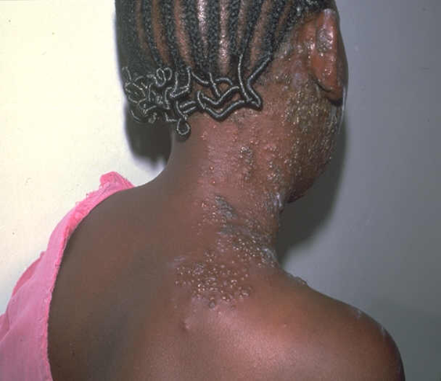

Slide 119
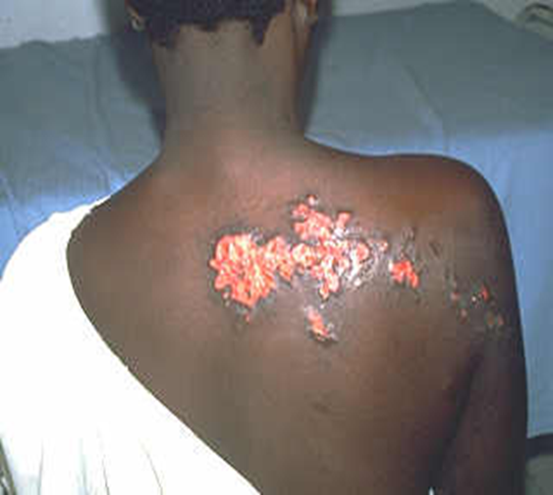

Slide 120
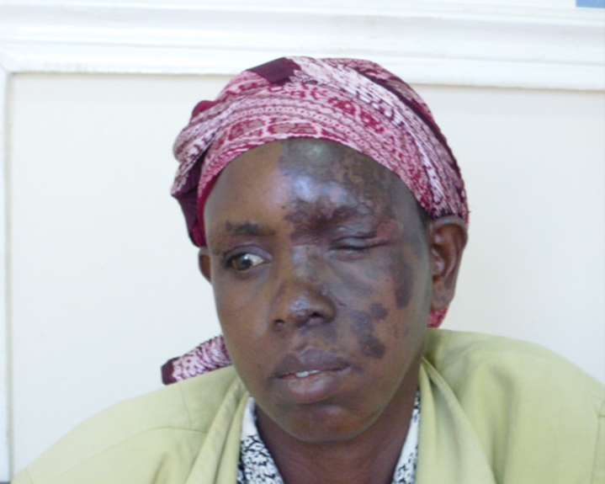

Slide 121
HERPES SIMPLEX
A common skin infection with two types of causative virus
Herpes Type 1, affecting the mouth
Herpes Type 2, affecting the genital area
Prevalence of type 2 is lower, usually appears at onset of sexual activity

Slide 122
Orolabial Herpes
Also called fever blisters or cold sores
Consists of erythematous – based clusters of grouped vesicles on the lips
May be preceded by a sensation of tingling or burning with pain

Slide 123
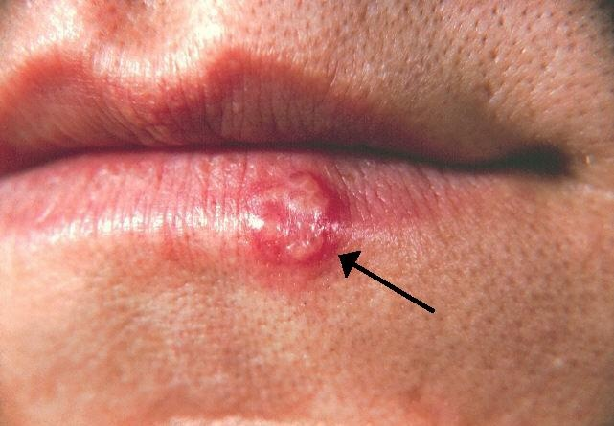

Slide 124
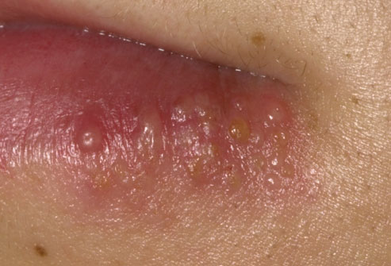

Slide 125
Genital Herpes
Minor infections may produce no symptoms
Lesions appear as grouped vesicles on an erythematous base initially involving the vagina, rectum or penis
New lesions can continue to appear in 7 – 14 days

Slide 126
Lesions are symmetrical and usually cause regional lymphadenopathy
Fever and flulike symptoms are common
As vesicles rupture, erosions and ulcerations begin to appear. Severe infections can cause extensive erosions of vaginal or anal canal

Slide 127
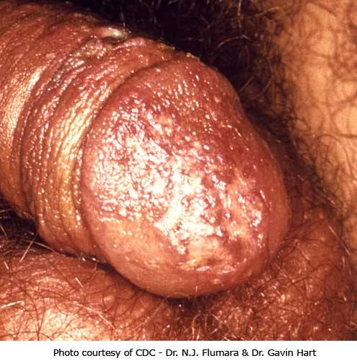

Slide 128
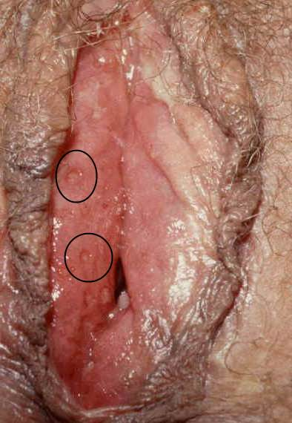

Slide 129
Complications
Eczema herpeticum
Neonatal infection
Fetal anomalies e.g. skin lesions, microcephaly, encephalitis and intra - cerebral calcifications

Slide 130
Medical Management
Use of sunscreen on face and lips for those with recurrent orolabial herpes since sun exposure is a common trigger
Topical treatment with drying agents
Local or systemic antiviral agents and use of analgesics to alleviate pain
All women with active lesions at time of delivery should undergo cesarean section to prevent transmission to the newborn

Slide 131
Nursing Management
Teach patient that herpes simplex can be transmitted by close and sexual contact; good personal and hand hygiene are required for facial cases; sexual abstinence or condom use is required for genital cases.
Recurrence may be brought on by fever, illness, emotional stress, menses, pregnancy, sunlight, and other factors.

Slide 132
Advise patients with active herpes simplex infection to avoid contact with immunosuppressed individuals, such as those with diabetes, HIV disease, cancer (including those undergoing cancer treatment), alcoholism, and malnutrition, because herpes simplex infection can be severe in these individuals.
Tell patients that lesions usually resolve in 1-2 weeks without scarring.

Slide 133
DERMATOPHYTES
Dermatophytes are a group of fungi that cause skin, nail and hair infections and require keratin for growth.
TINEA PEDIS: ATHLETE’S FOOT
Most common fungal infection
Occurs on the soles of feet or between the toes. May also affect finger nails
Clinical Manifestations
Erythematous, inflamed, and vesicular lesions of feet.
Itching and irritation

Slide 134
Management
Topical antifungal agents e.g. miconazole and clotrimazole. Should be continued for several weeks because of high rate of recurrence
Soaking feet in potassium permanganate solutions to remove crusts, scales and debris and to reduce inflammation
Instruct patient to keep the feet as dry as possible and especially between the toes.
Small pieces of cotton can be put between toes at night to absorb moisture

Slide 135
Soaks should be made from cotton since it is a good absorber of perspiration
Encourage use of open shoes or canvas sneakers especially for people who perspire excessively and avoidance of tight shoes or plastic or rubber-soled shoes or boots.
Application of talcum powder or antifungal powder twice daily helps keep feet dry
Several pairs of shoes should be alternated so that they can dry completely before being worn again

Slide 136
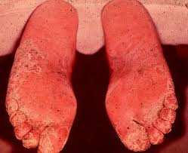

Slide 137
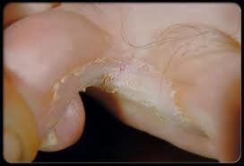

Slide 138
TINEA CORPORIS (RINGWORM OF THE BODY)
The typical ringed lesions appear on the face, neck, trunk and extremities
Clinical Manifestations
Begin as a macule which spreads to form ring like papules or vesicles with central clearing
Lesions are found in clusters, and very pruritic
Clusters of pustules may be seen around the borders

Slide 139
Management
Topical antifungal to be used on small areas. Should be used continuously for 4 weeks even if lesions disappear
Oral antifungal to be used in extensive cases e.g. fluconazole
Note: Side effects of oral antifungals include: photosensitivity, skin rashes, headache and nausea
Instruct patient to use a clean towel and to wash clothes daily. Clean cotton clothes be dressed next to the body daily
Instruct patient to keep all skin areas and folds that retain moisture dry

Slide 140
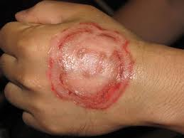

Slide 141
TINEA CAPITIS (RINGWORM OF SCALP)
Contagious fungal infection of the hair shafts and a common cause loss of hair in children
Any child with scaling on the scalp should be considered to have tinea capitis until proven otherwise
Clinical Manifestations
Starts as one or several round, erythematous scaling patches
Small pustules or papules may be seen at the edges of such patches
Hairs in affected area become brittle and break off at or near the scalp. Since in most cases tinea capitis heals without scarring, the hair loss is temporary

Slide 142
Management
Systemic antifungal agents e.g. griseofulvin and ketoconazole
Topical agents do not provide an effective cure because the infection occurs within the hair shaft and below the surface of scalp. However, they can be used to inactivate the organisms already in the hair, minimizing contagion and eliminating the need to clip the hair
Hair should be washed with shampoo two or three times a week
Improve on hygiene

Slide 143
Each member of the family should have his/her own comb and brush. Should also avoid exchanging hats and other headgear
All family members and pets should be examined and treated

Slide 144
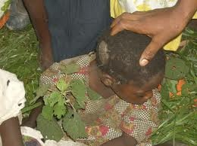

Slide 145
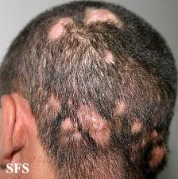

Slide 146
TINEA CRURIS (RINGWORM OF GROIN)
Ringworm infection of groin, which may spread to inner areas of thighs and buttock area
Common in obese people and those who wear tight clothing
Incidence high in people with diabetes
Management
Topical antifungals for mild cases e.g. miconazole, clotrimazole for 3 to 4 weeks to ensure eradication of infection

Slide 147
Oral antifungals for severe cases
Instruct patient to avoid excessive heat and humidity and to avoid wearing nylon underwear and tight – fitting clothing
Groin area should cleaned thoroughly, dried well and dusted with a topical antifungal agent as a preventive measure to prevent recurrence

Slide 148
TINEA UNGUIUM (ONYCHOMYCOSIS)
Also called ringworm of nails
Chronic infection of toe nails or, less commonly finger nails
Associated with long – standing fungal infection of the feet
The nails become thickened, friable (easily crumbled) and lusterless, and eventually the nail plate separates
Since infection is chronic, the entire nail may be destroyed

Slide 149
Management
Oral antifungal for 6 weeks if the fingernails are involved and 12 weeks if the toenails are involved
Encourage patient to comply with lengthy treatment, as fungal infections of the nail are difficult to treat.
Examine patient for other areas of tinea infection (feet, groin), encourage treatment, and teach patient that infection may be spread from fingernails by scratching.
After nail removal, advise patient to keep hand or foot elevated for several hours, and change dressing daily by applying gauze and antibiotic ointment or other prescribed medication until nail bed is free of exudate or blood.

Slide 150
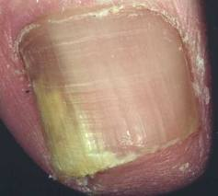
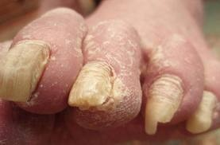

Slide 151
CANDIDIASIS
A fungal infection of any of the Candida species (all yeasts), of which Candida albicans is the most common. Also commonly referred to as a yeast infection
Encompasses infections that range from superficial, such as oral thrush and vaginitis, to systemic and potentially life-threatening diseases.

Slide 152
Risk Factors
Immunosuppression caused by HIV/AIDS, diabetes
Misuse of steroids and antibiotics
Tight clothing especially nylon
Pregnancy and use of contraceptives
External use of detergents
Hormone replacement therapy
Infertility treatments
Wearing wet swimwear for long periods of time is also believed to be a risk factor.

Slide 153
Different Candidal Infections
1. Oral Candidiasis
Also called oral thrush.
Thick, white lacy patches on top of a red base can form on the tongue, palate, or elsewhere inside the mouth.
These patches look like milk curds but cannot be wiped away as easily as milk can. If the white plaques are wiped away with a blade or cotton-tipped applicator, the underlying tissue may bleed.

Slide 154
This infection also may make the tongue look red without the white coating. Thrush can be painful and make it difficult to eat. Care should be given to make sure a person with thrush does not become dehydrated
Common in children, HIV/AIDS patients and may also result from prolonged use of antibiotics

Slide 155
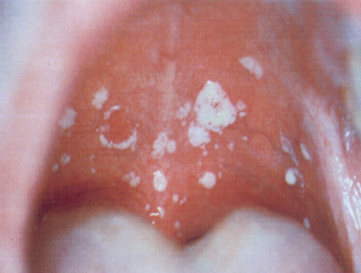

Slide 156
2. Genital Candidiasis
Affects both sexes, but is very common in women
Occurs more frequently and more severely in people with weakened immune systems. Other predisposing factors include: Pregnancy, Diabetes mellitus, Use of broad-spectrum antibiotics and Use of corticosteroid medications

Slide 157
Can be transmitted through sexual intercourse
Women usually experience genital itching or burning, with or without a "cottage cheese-like" vaginal discharge. Men are usually asymptomatic though may experience an itchy rash on the penis.

Slide 158
3. Vulvovaginitis
Is inflammation or infection of the vulva and vagina in which the vulvovaginal irritation is pronounced. Affects women
Signs and symptoms include:
Irritation and itching of the genital area
Inflammation (irritation, redness, and swelling) of the labia majora, labia minora, or perineal area;
Vaginal discharge;
Foul vaginal odour
Discomfort or burning when urinating

Slide 159
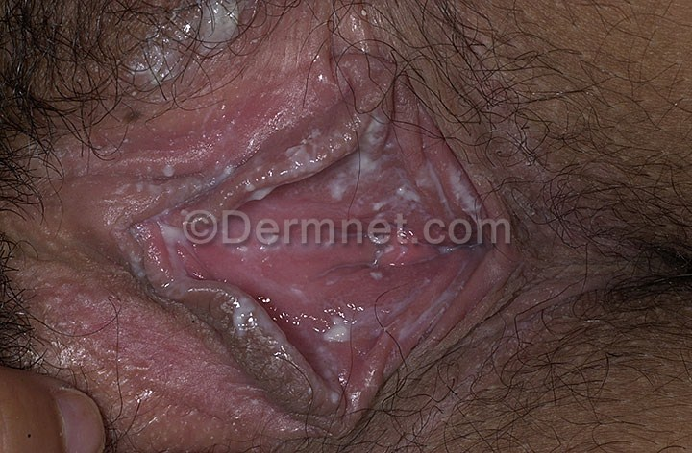

Slide 160
4. Balano Posthitis
Candidal infection affecting men
The inflammation affects both the surfaces of the glans penis and the inner side of the prepuce at the same time
Note:
The inflammation of the membrane covering the glans penis is called balanitis; while the inflammation of the membrane covering the prepuce is called posthitis

Slide 161
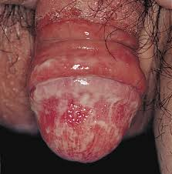

Slide 162
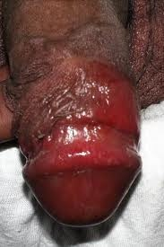

Slide 163
Signs and Symptoms include:
Some irritation and itching referable to the glans and the prepuce;
Pain and burning while passing urine and frequency of micturation may be complained of;
Edema and swelling of the prepuce, yellowish purulent discharge exuding from the preputial opening and tender lymphadenitis in the groin;
Retraction of prepuce- if possible- reveals bright red mucous membrane with submucosal swelling and edema.
Superficial epithelium is macerated and full of erosive small superficial ulcers.

Slide 164
5. Candidal Intertrigo
Is an infectious inflammatory condition of the skin by Candida albicans, of two closely opposed skin surfaces (intertriginous area).
The warm, moist environment of the skin folds is ideal for the growth of Candida .
The risk of infection is increased by specific factors that increase skin friction, increase moisture within folds, or interfere with the immune response and/or promote fungal overgrowth.

Slide 165
Factors that may increase skin friction include: Obesity; Clothing (especially tightly fitting); Activities that promote skin-on-skin rubbing
Most common cutaneous infection of hair-bearing skin
The perineal, the groin and axillary region are mostly affected

Slide 166
6. Candidal Paronychia
An inflammation of the nail fold produced by Candida albicans.
The main symptom is a painful, red, swollen area around the nail, often at the cuticle or at the site of a hangnail or other injury.
On applying pressure, cheesy discharge is elicited
The nail itself may have infection – candidal onychia
Nail changes may occur e.g. the nail may look detached, abnormally shaped, or have an unusual color.

Slide 167
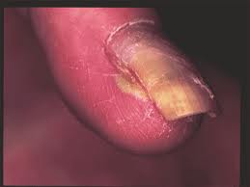

Slide 168
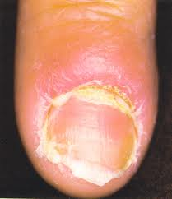

Slide 169
MANAGEMENT OF CANDIDIASIS
Antifungal drugs commonly used to treat candidiasis are topical clotrimazole, topical nystatin, fluconazole, and topical ketoconazole.
Local treatment may include vaginal pessaries or medicated douches eg clotrimazole 200mg nocte 3/7
C. albicans can develop resistance to antimycotic drugs. Recurring infections may be treatable with other antifungal drugs, but resistance to these alternative agents may also develop.

Slide 170
Educate the patient on predisposing factors
Emphasize on importance of general body cleanliness and the need to keep areas with folds dry
Control conditions like obesity, diabetes, anemia and immunosuppression
Encourage the patient to take a balanced diet and especially vitamins to boost immunity
Use of light dressing and preferably cotton

Slide 171
ASSIGNMENT
Read and Make Notes on Categories of Pediculosis (Lice Infestation) and their
Clinical Manifestations
Medical Management
Nursing Management

Slide 172
PEDICULOSIS (LICE INFESTATION)
Affects all age groups
Lice are ectoparasites since they live outside the body
Depend on their host for nourishment, feeding on human blood approximately 5 times a day
They inject their digestive juices and excrement into the skin which causes severe itching

Slide 173
PEDICULUS HUMANUS CAPITIS (HEAD LOUSE)
Is an infestation of scalp by head louse
Female louse lay eggs (nits) close to the scalp. The nits become firmly attached to hair shafts with a sticky substance
The young lice hatch in a about 10 days and reach maturity in 2 weeks

Slide 174
Clinical Manifestations
Lice found most commonly along the back of the head and behind the ears
Eggs appear silvery glistening white oval bodies difficult to remove from the hair
Severe itching as a result of bites of the lice, scratching results to secondary bacterial infection
Transmitted directly by physical contact or indirectly by infested combs, brushes, hats, wigs and beddings

Slide 175
PEDICULOSIS CORPORIS AND PUBIS
Pediculosis corporis is infestation of body by body louse
Pediculosis pubis is the infestation of the genital region and is transmitted chiefly by sexual contact
Clinical Manifestations
Intense itching as a result of bites, scratching then results to skin excoriation
Skin may become dark, dry and scaly, with dark pigmented areas

Slide 176
Reddish brown dust (excretion of lice) may be found on the patient’s underclothing
Macules may be seen on trunk, axillae and thighs as a result of reaction of the lice’s saliva with bilirubin
Note: Pubis infestation by lice may coexist with some STIs like gonorrhea, syphilis and herpes

Slide 177
Management
Bathing with soap and applying lindane (antiparasitic agent)
If eyelashes are involved petroleum may be applied to eyelashes, then lice and nits removed
Antipruritus, antibiotics and corticosteroids for complications e.g. pruritus, pyoderma and dermatitis
Advise patient that pediculosis pubis is considered a sexually transmitted disease; partners must be examined and treated

Slide 178
Urge patient to wash all clothing, towels, linens, combs, and hair items by soaking in hot water for 10 minutes. Alternatively, clothes may be dry-cleaned or ironed, paying close attention to the seams.
Items that cannot be washed or dry-cleaned can be stored for 30 days without use.
Advise patient not to use antiparasitic preparations more frequently than recommended.

Slide 179
SCABIES
Is an infestation of the skin by the itch mite – Sarcoptes scabiei
May be found in people living in substandard hygienic conditions but is also common in very clean people
Is highly contagious
Transmitted by close personal contact

Slide 180
Clinical Manifestations
Itching, more intense at night because the increased warmth of the skin has stimulating effect on the parasite.
Small erythematous papules and short, wavy burrows are seen on skin surface.
Frequently seen between fingers and on the wrist. Other sites are the groin area, around the nipples, extensor surfaces of the elbows, the knees, the edges of feet and axillary folds .

Slide 181
Spares head and scalp except in children under age 1.
Atypical scabies may be found in immune compromised people and may be resistant to standard treatment
Secondary lesions include vesicles, papules, excoriation and crusts
Bacterial superinfection may result from excoriation of burrows and papules

Slide 182
Medical Management
Patient instructed to take a warm soapy bath or shower to remove the scaling debris from the crusts and then dry well
Treated with antiparasitic, such as lindane (kwell), permethrin (Nix)
Topical or systemic steroids may be needed to treat symptoms of allergic reaction to mites.
Oral antihistamines can be used to relieve itching

Slide 183
Nursing Management
Teach proper use of medication: Apply thin layer from neck downward, with particular attention to hands, feet; every inch of skin must be treated because mites are migratory. Apply to dry skin. (Wet skin allows more penetration and the possibility of toxicity.) Leave medication on for 8-12 hours but not longer, as doing so will irritate the skin. Wash thoroughly.
Advise patient to avoid close contact for 24 hours after treatment to prevent transmission.

Slide 184
Encourage treatment of all family members and close contacts simultaneously to eliminate the parasite.
Tell patient that itching may persist for days to weeks following treatment due to an allergic reaction to mites; retreatment is not necessary.
Advise patient to wash all beddings and clothing in hot water and dried

Slide 185
CONTACT DERMATITIS
Inflammatory condition caused by exposure to irritating or allergenic substances, such as plants, cosmetics, cleaning products, soaps and detergents, hair dyes, metals, and rubber
There are four basic types:
Allergic contact dermatitis
Irritant contact dermatitis
Photoallergic contact dermatitis
Phototoxic contact dermatitis

Slide 186
1. Allergic Contact Dermatitis
Result from contact of skin with an allergen. There is immunologic involvement
2. Irritant Contact Dermatitis
Contact with substances that chemically or physically damage the skin. There is no immunologic involvement

Slide 187
3. Phototoxic Contact Dermatitis
Refers so skin damage that result from combination of sun and chemicals
4. Photoallergic Contact Dermatitis
Is of allergic type but is primarily as a result light exposure

Slide 188
Clinical Manifestations
Allergic dermatitis is usually widespread trigger actually touched the skin, whereas irritant dermatitis is confined to the area on the skin.
Symptoms of both forms include the following:
Red rash: This is the usual reaction. The rash appears immediately in irritant contact dermatitis; in allergic contact dermatitis, the rash sometimes does not appear until 24–72 hours after exposure to the allergen.

Slide 189
Blisters or wheals and urticaria (hives): Often form in a pattern where skin was directly exposed to the allergen or irritant
Itchy, burning skin: Irritant contact dermatitis tends to be more painful than itchy, while allergic contact dermatitis often itches.

Slide 190
While either form of contact dermatitis can affect any part of the body, irritant contact dermatitis often affects the hands, which have been exposed by resting in or dipping into a container containing the irritant.
Progresses to weeping, crusting, drying, fissuring, and peeling.
Lichenification (thickening of skin) and pigmentation changes may occur with chronicity

Slide 191
Medical Management
Topical or oral steroids, depending on severity. Oral steroids usually given in tapered doses (start with high dose and gradually decrease) to provide greatest anti-inflammatory effect without adrenal suppression.
Removal or avoidance of causative agent.
Antipruritics, systemic or topical antihistamines or topical calamine preparations.

Slide 192
Nursing Management
Take thorough history to determine causative agent or contributing factors
Advise patient to rest the involved skin and protect it from further damage
Cool and wet dressings applied over areas of vesicular dermatitis
Teach patient to use allergen-free products, wear gloves and protective clothing, wash and rinse skin thoroughly, and wash clothing after contact with potential irritants

Slide 193
CELLULITIS
Is an inflammation of the deep dermal and subcutaneous tissue that results from an infectious process.
Caused by infection with group A beta-hemolytic streptococci, Staphylococcus aureus, Haemophilus influenzae, or other organisms.
Usually results from break in skin that may be as simple as athlete's foot.
Infection can spread rapidly through lymphatic system.

Slide 194


Slide 195


Slide 196
Clinical Manifestations
Tender, warm, erythematous, and swollen area that is poorly demarcated.
Tender, warm, erythematous streak that extends proximally from the area, indicating lymph vessel involvement.
Possible fluctuant abscess or purulent drainage.
Possible fever, chills, headache, malaise.

Slide 197
Medical Management
Oral antibiotics (penicillinase-resistant penicillins, cephalosporins, or quinolones) may be adequate to treat small, localized areas of cellulitis of legs or trunk.
Parenteral antibiotics may be needed for cellulitis of the hands, face, or lymphatic or widespread involvement
Surgical drainage and debridement for suppurative areas.

Slide 198
Nursing Management
Protecting Skin Integrity
  Administer, or teach patient to administer, antibiotics as prescribed; teach dosage schedule and adverse effects.
  Maintain I.V. infusion or venous access to administer I.V. antibiotics, if indicated.
  Elevate affected extremity to promote drainage from area.
  Prepare patient for surgical drainage and debridement, if necessary.

Slide 199
Relieving Pain
  Encourage comfortable position and immobilization of affected area.
  Administer, or teach patient to administer, analgesics as prescribed; monitor for adverse effects.
  Use bed cradle to relieve pressure from bed covers.

Slide 200
Patient Education and Health Maintenance
  Be sure that patient understands dosage schedule of antibiotics and the importance of complying with therapy to prevent complications.
  Advise patient to notify health care provider immediately if condition worsens; hospitalization may be necessary.
  Outpatient-treated cellulitis should be observed within 48 hours of starting antibiotics to determine efficacy.
  Teach patient with impaired circulation or impaired sensation proper skin care and how to inspect skin for trauma.

Slide 201
PSORIASIS
Is a chronic noninfectious inflammatory disease of the skin in which epidermal cells are produced at a rate that is about six to nine times faster than normal
Formerly considered idiopathic, now thought to be genetically linked and immune system modulated.
Tends to affect the scalp, the extensor part of elbows and knees, the lower part of the back and genitalia. Nails may be involved

Slide 202
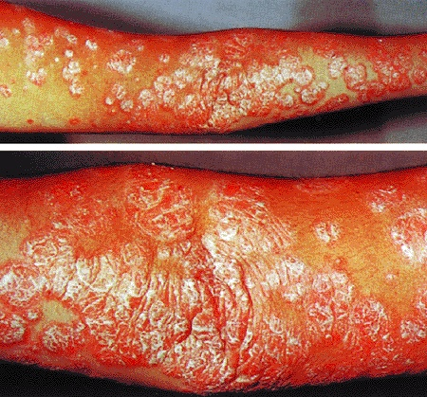
Psoriasis (diagram)

Slide 203
Pathophysiology
The cells in the basal layer of the skin divide too quickly and the newly formed cells move so rapidly to the skin surface that they become evident as profuse scales or plaques of epidermal tissue
The psoriatic epidermal cells may travel from the basal cell layer of the epidermis to the stratum corneum and be cast of in 3 to 4 days, which is in sharp contrast to the normal 26 to 27 days
As a result of increased number of basal cells and rapid cell passage, the normal events of cell maturation and growth can not take place. Hence the normal protective layers of the skin do not form.

Slide 204
Clinical Manifestations
Erythematous plaques with silvery scales. May be pruritic and painful.
Scraping of scales exposes the dark red base of lesion
Nails involved show signs of pitting, discoloration, crumbling beneath free edges and separation of nail plate
Palm and sole involvement cause pustular lesions called palmar pustular psoriasis

Slide 205
Complications
Psoriatic arthritis – is a rheumatoid factor negative arthritis
Erythromatic psoriasis – involvement of total body surface

Slide 206
Medical Management
Coal tar inhibit excessive skin turnover. Applied topically, with no systemic adverse effects. Application may be messy, odorous, and may stain clothing.
Topical corticosteroids are the mainstay. Adverse effects may include striae, thinning of the skin, adrenal suppression.

Slide 207
Topical calcipotriene, a vitamin D derivative, used for mild to moderate psoriasis; is generally without adverse effects.
Phototherapy and photochemotherapy
Oral methotrexate and cyclosporine also are used for severe cases. Hepatotoxicity may occur with methotrexate. Hypertension and renal failure may occur with cyclosporine

Slide 208
Nursing Management
Assist patient with daily tub bath to soften scales and plaques; may gently rub with bath brush.
Apply topical preparations after bath and scale removal.
Warn patient that coal tar preparations may stain clothing; let dry before dressing.

Slide 209
Advise patient to wear goggles for phototherapy, to prevent cataracts and to follow up with periodic eye exams.
Advise patients to use good lubricants to prevent drying and cracking of skin, which can lead to hyperkeratinization
Encourage patient to follow up closely with primary care provider or with dermatologist and to report for blood work, to check renal function and liver function tests as indicated.

Slide 210
Reinforce to women of childbearing age that retinoids and methotrexate are teratogenic; woman must be using birth control.
Encourage patients to try to identify triggers that may cause flare-ups and to practice avoidance techniques, such as relaxation therapy, to avoid stress.
Teach patients to avoid direct sun exposure by wearing protective clothing and sunscreen, especially after photochemotherapy.

Slide 211
PEMPHIGUS
Is a serious autoimmune disease of the skin and of the mucous membranes, characterized by the appearance of flaccid blisters (bullae) of various sizes on apparently normal skin and mucous membranes (mouth, esophagus, conjunctiva, vagina)
Genetics may play a role in its development

Slide 212
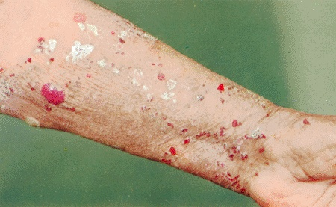
Pemphigus (diagram)

Slide 213
Pathophysiology
Normally, the immune system produces antibodies against foreign bodies, such as harmful viruses and bacteria.
However in pemphigus, the immune system produces antibodies against specific proteins in the skin and mucus membranes called desmogleins that bind the skin cells to each other.
These antibodies break the bonds between skin cells. This then results to separation and breakdown of cell layer in the epidermis (acantholysis). This leads to the formation of a blister.

Slide 214
Risk Factors
Chelating agents (agents which remove certain materials from the blood) e.g. penicillamine
Antihypertensive medications: ACE inhibitors
Cancer especially lymphoma or leukemia

Slide 215
Clinical Manifestations
Initial lesions may appear in oral cavity; flaccid blisters (bullae) may arise on normal or erythematous skin.
The bullae enlarge and rupture, forming painful, raw, and denuded areas that eventually become crusted.
The eroded skin heals slowly; eventually, widespread areas of the body may become involved.

Slide 216
In the mouth, blisters are usually multiple, of varying size and irregular shape, painful, and persistent.
Following oral lesions, the pharynx and esophagus; the conjunctivae, larynx, urethra, cervix, and rectum may also be affected.
An offensive odor may emanate from the bullae due to infection
There is a positive Nikolsky's sign (separation of epidermis or sloughing of uninvolved skin when minimal pressure is applied to the skin). Downward pressure on a bulla will cause it to expand laterally

Slide 217
Medical Management
The goals are to bring disease under control; to prevent serum loss and development of secondary infection; and to promote renewal of epithelial tissue
Corticosteroids are administered in high doses to control the disease and keep the skin free of new blisters.

Slide 218
Immunosuppressive agents e.g. cyclophosphamide given to help control the disease and reduce the corticosteroid dose
Plasmapheresis (reinfusion of specially treated plasma cells); temporarily decreases serum level of antibodies. Reserved for life threatening conditions
Treatment of denuded skin.

Slide 219
Nursing Management
Assess for odor or drainage from lesions, which may indicate infection.
Assess for fever and signs of systemic infection.
Assess for adverse effects of corticosteroids, such as abdominal pain, white patches in mouth that indicate Candida infection, and emotional changes.

Slide 220
Restoring Oral Mucous Membrane Integrity
  Inspect oral cavity daily; note and report any changes (oral lesions heal slowly).
  Keep oral mucosa clean and allow regeneration of epithelium.
  Give topical oral therapy as directed.
  Offer prescribed mouthwashes through a straw, to rinse mouth of debris and to soothe ulcerative areas. Teach patient to apply petroleum to lips frequently.
  Use cool-mist therapy to humidify environmental air.

Slide 221
Restoring Skin Integrity
  Keep skin clean and eliminate debris and dead skin, the bullae will clear if epithelium at the base is clean and not infected.
  Administer cool, wet dressings or baths or teach patient to administer, to soothe and cleanse skin. Large areas of blistering have a characteristic odor that is lessened when secondary infection is under control.

Slide 222
  After the bath, dry and cover with talcum powder as directed; this enables the patient to move more freely in bed. Large amounts are necessary to keep clothes and sheets from sticking.
  The nursing management of patients with blistering or with bullous skin conditions is similar to that of the patient with a burn eg use of bed cradle to keep off weight of beddings

Slide 223
Restoring Fluid Balance
  Evaluate for fluid and electrolyte imbalance (extensive denudation of the skin leads to fluid and electrolyte imbalance).
  Monitor vital signs for hypotension or tachycardia.
  Weigh patient daily.

Slide 224
  Monitor intake and output.
  Administer I.V. solutions as directed and encourage the patient to maintain hydration; suggest cool nonirritating fluids.
  Suggest soft, high-protein, high-calorie diet, or liquid supplements that will not be irritating to oral mucosa but will replace lost protein.

Slide 225
Promoting Positive Body Image
  Develop a trusting relationship with the patient.
  Educate patient and family about the disease and its treatment; this reduces uncertainty and clears up misconceptions.
  Encourage expression of anxieties, embarrassment, discouragement.
  Encourage patient to maintain social contacts and activities among support network.

Slide 226
BENIGN SKIN TUMORS
1. Keloids
Benign overgrowths of connective tissue expanding beyond the site of scar or trauma in predisposed individuals.
More prevalent among dark-skinned individuals.
Usually asymptomatic but may cause disfigurement and cosmetic concern.
Management though not satisfactory is by intralesional therapy, corticosteroid therapy, surgical removal and radiation

Slide 227
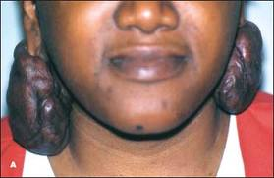

Slide 228
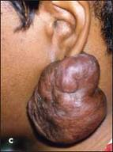

Slide 229
2. Verrucae (Warts)
Common, benign skin tumors caused by human papilloma virus.
Often disappear spontaneously, so may not need treatment.
Treatment options:

Slide 230
Freezing with liquid nitrogen (destroys wart and spares rest of skin).
Area may be treated surgically with curettage
Application of salicylic acid, topical fluorouracil, topical vitamin A acid, or other irritants may be helpful, especially for flat warts.

Slide 231
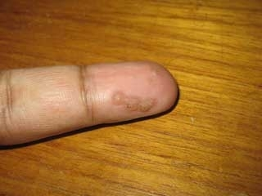

Slide 232
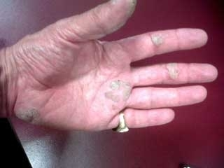

Slide 233
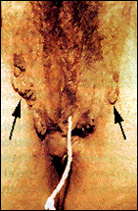
Vaginal Genital HPV

Slide 234
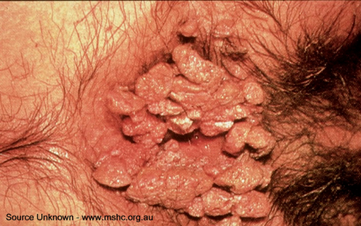
Anal Genital HPV

Slide 235
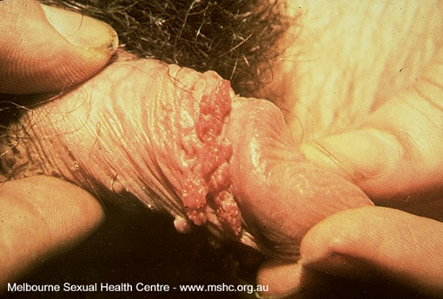

Slide 236
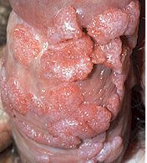

Slide 237
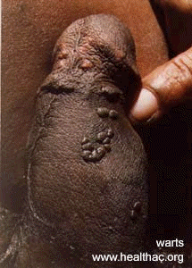

Slide 238
3. Hemangiomas
Hemangiomas are benign tumors of the capillaries, which presents shortly after birth.
They grow rapidly for 6 to 18 months, followed by stabilization and subsequent regression. Most hemangiomas resolve by age 9.
Surgery is reserved for complicated hemangiomas that may be obstructing the airway.

Slide 239
Hemangiomas blocking the visual axis or compressing against the eye are treated with high doses of corticosteroids or interferon.
For hemangiomas that do not threaten vision or life, no intervention is preferred.
Lasers can be used for ulcerated hemangiomas.

Slide 240
4. Pigmented Nevi (Moles)
Common skin tumors of various sizes and shapes, ranging from yellowish to brown to black; may be flat, macular lesions, elevated papules, or nodules that occasionally contain hair.
Most pigmented nevi are harmless; however, in rare cases, malignant changes supervene and a melanoma develops at the site of the nevus.

Slide 241
Nevi at sites subject to repeated irritation from clothing or jewelry can be removed for comfort.
Nevi that show change in size, shape, or color, become symptomatic (itch or bleed), or develop notched borders should be removed to determine if malignant changes have occurred. This is especially true for nevi with irregular borders or variations of red, blue, and blue-black

Slide 242
MALIGNANT TUMORS OF THE SKIN (SKIN CANCERS)
Most common cancer in the US
Basal cell carcinomas (BCCs) are the most common but easily curable because of early diagnosis and slow progression. They are locally invasive and tend not to metastasize.
Squamous cell carcinomas (SCCs) are less common than BCCs and have an increased potential for metastasis

Slide 243
Malignant melanomas are least common and have a higher risk of metastasize.
Most basal and squamous cell carcinomas are located on sun-exposed areas and are directly related to ultraviolet radiation. Sun damage is cumulative – the harmful effects may be severe by age of 20 years.
Exposure to the sun is a leading cause of skin cancer; incidence is related to the total amount of exposure to the sun
Diagnosed by skin biopsy and histologic evaluation

Slide 244
Risk Factors
Fair complexion (skin, hair), blue eyes; particularly those with insufficient skin pigmentation to protect underlying tissues
Working outdoors (farmers, fishermen, construction workers)
Older people with sun-damaged skin.

Slide 245
Exposure to certain chemical agents (nitrates, tar, oils, and paraffin).
Burn scars, damaged skin in areas of chronic osteomyelitis, fistulae openings.
Long-term immunosuppressive therapy.
Genetic susceptibility.

Slide 246
Multiple dysplastic nevi (moles that are larger, irregular, more numerous, or variable colors) or family history of dysplastic nevi.
Congenital nevi that are large (more than 20 cm in size)
History of X-ray treatment of skin conditions for acne or benign lesions

Slide 247
BASAL CELL CARCINOMA
Is the most common type of skin cancer, rarely metastasizes
Generally appears on the sun exposed areas of the skin
More prevalent in regions where the population is subjected to intense and extensive exposure to the sun
Incidence is proportional to the age of the patient (average age of 60 years) and the total amount of sun exposure and it is inversely proportional to the amount of melanin in the skin

Slide 248
Pathophysiology
Over exposure to sun leads to the formation of thymine dimers, a form of DNA damage.
While DNA repair removes most UV-induced damage, not all crosslinks are excised. There is, therefore, cumulative DNA damage leading to mutations.
Apart from the mutagenesis, over exposure to sunlight depresses the local immune system, possibly decreasing immune surveillance for new tumor cells.

Slide 249
Clinical Manifestations
Begin as small nodules with a rolled, pearly, translucent border
Telangiectasia may be present
Crusting, and occasionally ulceration occur as it grows
Appear most frequently on sun-exposed skin, frequently on face between hairline and upper lip.
If neglected, may cause local destruction, hemorrhage, and infection of adjacent tissues, producing severe functional and cosmetic disabilities.

Slide 250
SQUAMOUS CELL CARCINOMA
Is a malignant proliferation arising from the epidermis
Usually appear on a sun – damaged skin but may als0 arise from normal skin or from preexisting skin condition
Is a truly invasive carcinoma, metastasizing by blood or lymphatic system

Slide 251
Clinical Manifestations
Appears as reddish rough, thickened, scaly lesion with bleeding and soreness
May be asymptomatic; border may be wider, more indurated, and more inflammatory than BCC
May be preceded by leukoplakia (premalignant lesion of mucous membrane) of the mouth or tongue, actinic keratoses, scarred or ulcerated lesions.
Seen most commonly on lower lip, rims of ears, head, neck, and backs of the hands.

Slide 252
Prognosis
Because skin is easily inspected, skin cancer is readily seen and detected and is the most successfully treated type of cancer
Prognosis for BCC is usually good. Tumors remain localized, and although some require wide excision with resultant disfigurement, the risk for death from BCC is low
The prognosis of SCC depends on the incidence of metastasis, which is related to the histologic type and the level or depth of invasion

Slide 253
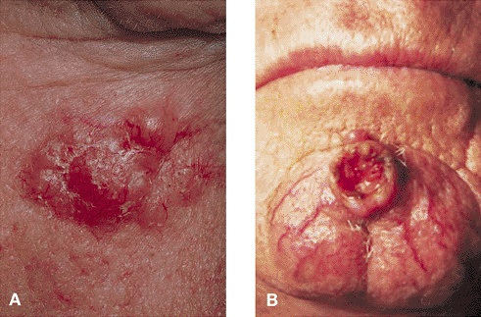
Basal Cell Carcinoma
Squamous Cell Carcinoma

Slide 254
Medical Management
Method of treatment depends on tumor location, cell type (location and depth), history of previous treatment, and whether it is invasive, or if metastasis has occurred.
Curettage followed by electrodessication (usually done on small tumors of basal or squamous cell type – less than 1 cm).
Surgical excision for larger lesions or for those in areas more likely to recur (around nose, eyes, ears, lips); may be followed by simple closure, flap, or graft.

Slide 255
Mohs' surgery, a microscopically controlled excision, with immediate examination of frozen or chemically fixed sections for evidence of cancer cells. Layers are removed until a reasonable cancer-free margin is achieved.
Radiation therapy can be done for cancer of eyelid, tip of nose, in or near vital structures, such as facial nerve or where tissue sparing is difficult with other forms of treatment; also used for extensive malignancies where goal is palliation, or when other medical conditions contraindicate other forms of therapy.
Other therapeutic regimen include: topical interferon, retinoids, photoradiation.

Slide 256
Nursing Management
1. Increasing Knowledge and Awareness
Encourage follow-up skin examinations and instruct the patient to examine skin monthly as follows:
  Use a full-length mirror and a small hand mirror to aid in examination.
  Learn where moles/birthmarks are located.
  Inspect all moles and other pigmented lesions; report any change in color, size, elevation, thickness, or development of itching or bleeding.

Slide 257
Teach the patient to use a sunscreen routinely and to avoid becoming sunburned by:
  Avoiding unnecessary exposure to the sun, especially during times when ultraviolet radiation is most intense (10 A.M. to 3 P.M.).
  Wearing protective clothing (long sleeves, broad-brimmed hat, high collar, long pants). However, clothing does not provide complete protection; up to 50% of sun's damaging rays can penetrate clothes.

Slide 258
2. Reducing Anxiety
Provide dressing changes and wound care while teaching patient to take control, as directed after surgical intervention.
Administer chemotherapy with attention to possible adverse effects, as directed.
Allow patient to express feelings about the seriousness of diagnosis.
Answer questions, clarify information, and correct misconceptions.
Emphasize use of positive coping skills and support system.

Slide 259
3. Patient Education and Health Maintenance
Encourage lifelong follow-up appointments with dermatologist or primary care provider with examinations every 6 months.
Encourage all individuals to have moles removed that are accessible to repeated friction and irritation, congenital, or suspicious in any way.
Teach all individuals the importance of sun-avoidance measures
Teach proper use of sunscreen

Slide 260
ASSIGNMENT
Read and make notes on Malignant Melanomas
Risk Factors
Clinical Manifestations
Medical Management
Nursing Management

Slide 261
VITILIGO
Is a condition that causes depigmentation of sections of skin.
It occurs when melanocytes, the cells responsible for skin pigmentation, die or are unable to function.
Cause of vitiligo is unknown, but research suggests that it may arise from autoimmune, genetic, oxidative stress, neural, or viral causes.
Incidence worldwide is less than 1%

Slide 262
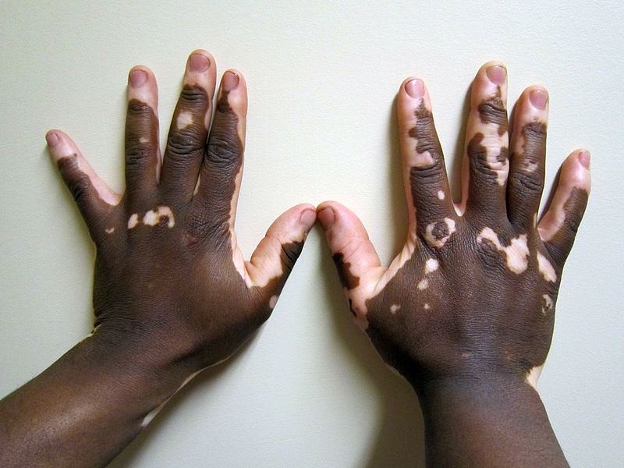

Slide 263
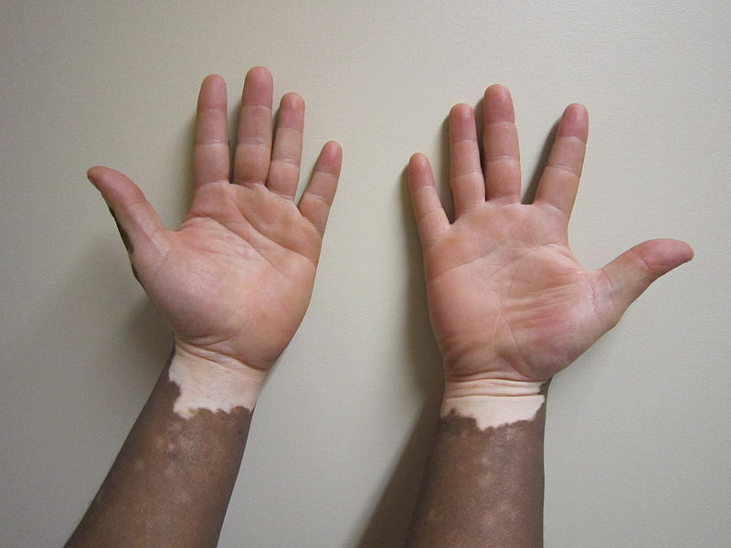

Slide 264
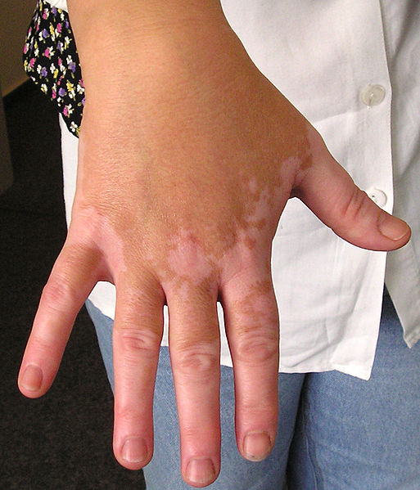

Slide 265
Types of Vitiligo
1. Non-Segmental Vitiligo (NSV)
There is usually some form of symmetry in the location of the patches of depigmentation.
New patches also appear over time and can be generalized over large portions of the body or localized to a particular area.
NSV can come about at any age, unlike segmental vitiligo, which is far more prevalent in teenage years.
Vitiligo where little pigmented skin remains is referred to as vitiligo universalis.

Slide 266
Classes of Non – Segmental Vitiligo
Generalized Vitiligo: The most common pattern, wide and randomly distributed areas of depigmentation.
Universal Vitiligo: Depigmentation encompasses most of the body.
Focal Vitiligo: One or a few scattered macules in one area, most common in children
Acrofacial Vitiligo: Fingers and periorificial areas
Mucosal Vitiligo: Depigmentation of only the mucous membranes.

Slide 267
2. Segmental Vitigo (SV)
Segmental vitiligo (SV) differs in appearance, etiology and prevalence from associated illnesses.
Its treatment is different from that of NSV.
It tends to affect areas of skin that are associated with dorsal roots from the spine and is most often unilateral.
It spreads much more rapidly than NSV and, without treatment, it is much more stable/ static in course and is not associated with auto-immune diseases. It is a very treatable condition that responds to topical treatment.

Slide 268
Risk Factors
Genetics: Gene TPY
Autoimmune diseases
Inflammatory diseases
Thyroid overexpression and under expression.

Slide 269
Treatment
Ultraviolet light treatment: Taking a drug which increases the skin's sensitivity to ultraviolet light
Transplanting melanocytes
Skin camouflage: In mild cases, vitiligo patches can be hidden with makeup or other cosmetic camouflage solutions. If the affected person is pale-skinned, the patches can be made less visible by avoiding both sunlight and the tanning of unaffected skin.
Reversal: The traditional treatment is the application of corticosteroid cream

Slide 270
De-pigmenting: In cases of extensive vitiligo the option to de-pigment the unaffected skin with topical drugs like monobenzone, mequinol or hydroquinone may be considered to render the skin an even colour. The removal of all the skin pigment with monobenzone is permanent and vigorous. Sun-safety must be adhered to for life to avoid severe sun burn and melanomas. Depigmentation takes about a year to complete.

Slide 271
THE END

Slide 272
RAT – 24 ½ Marks
Time: 50 Minutes

Slide 273
1. Which epidermal layer is found in thick skin only?
A) Stratum basale
B) Stratum spinosum
C) Stratum lucidum
D) Stratum corneum
2. Which of the following is true about the dermis layer of the skin?
A) It makes the smallest portion of the skin.
B) It does not have blood vessels.
C) It is also called hypodermis.
D) It contains sweat glands.

Slide 274
3. From the skin surface inwards to the basement membrane, the strata of epidermis are:
A) Corneum, Granulosum, Spinosum,Germinativum
B) Spinosum, Granulosum, Corneum, Germinativum
C) Corneum, Spinosum, Granulosum,Germinativum
D) Granulosum, Germinativum, Corneum, Spinosum
4. Where are apocrine sweat glands located?
A) Underarm area
B) Palms and soles
C) Around the lips
D) Arms and legs

Slide 275
5. A culture and sensitivity will detect:
A) Cancer
B) A bacterial infection
C) A viral infection
D) A lice infection
6. Which of the following is a primary lesion?
A) Burrow
B) Erosion
C) Fissure
D) Umbilication

Slide 276
7. Which of the following conditions is caused by a mite infestation?
A) Wheal
B) Impetigo
C) Pediculosis
D) Scabies
8. Which condition is also called hives?
A) Purulent
B) Pruritus
C) Urticaria
D) Verruca

Slide 277
9. Tinea cruris is ……………
A) Ringworm of the scalp
B) Ringworm of the feet
C) Ringworm of the body
D) Ringworm of the groin
10. Which of the following is true about verrucae?
A) They are benign skin tumors caused by human papillomavirus.
B) They are benign overgrowths of connective tissue expanding beyond the site of scar or trauma in predisposed individuals.
C) They are also called moles.
D) They are malignant tumors of the skin

Slide 278
11. List four (4) main types of cells which make up the epidermis. (2 Marks)
12. Outline four (4) advantages of moisture retentive dressings. (2 Marks)
13. List five (5) factors considered when describing the morphology of skin lesions. (2½ Marks)
14. Outline four (6) types of Candidal infection. (3 Marks)
15. List six (4) basic types of Contact Dermatitis. (2 Marks)
16. Briefly describe the pathophysiology of Psoriasis. (3 Marks)
END

Slide 279
ANSWERS
1. C
2. D
3. A
4. A
5. B
6. A
7. D
8. C
9. D
10. A

Slide 280
11. i) Merkel cells
ii) Keratinocytes
iii) Melanocytes
iv) Langerhans
12. i) Reduced pain
ii) Fewer infections
iii) Lesser scar tissue
iv) Decreased frequency of dressings

Slide 281
13. i) Color
ii) Size
iii) Shape
iv) Demarcation
v) Texture
14. i) Oral Candidiasis
ii) Genital Candidiasis
iii) Vulvovaginitis
iv) Candidal Paronychia
v) Candidal Intertrigo
vi) Balano Posthitis

Slide 282
15. i) Allergic contact dermatitis
ii) Irritant contact dermatitis
iii) Photoallergic contact dermatitis
iv) Phototoxic contact dermatitis
16. The cells in the basal layer of the skin divide too quickly. The newly formed cells move so rapidly to the skin surface that they become evident as profuse scales or plaques of epidermal tissue
As a result of increased number of basal cells and rapid cell passage, the normal events of cell maturation and growth can’t take place. Hence the normal protective layers of the skin do not form.

