Slide 1
SPECIAL ORGAN SYSTEM
Henry Katua

Slide 2
INTRODUCTION.
- There are five senses:-
- Touch,
- Taste,
- Smell,
- Sight,
- Hearing.
- The four senses—smell, taste, sight, and hearing—are called special senses.

Slide 3
The Eye and Vision
- Vision is dominant sense.
- 70% of all sensory receptors in body are in eyes.
- Half of cerebral cortex is involved in visual processing.

Slide 4
.
Adult eye is sphere with a diameter of about 2.5 cm.
- Only anterior one-sixth of the eye’s surface is visible, the rest is enclosed and
protected by a cushion of fat and the walls of the bony orbit.

Slide 5
Accessory Structures of the Eye
- The accessory structures of the eye include:-
- Eyebrows,
- Eyelids,
- Conjunctiva,
- Lacrimal apparatus,
- Extrinsic eye muscles.

Slide 6
Eyebrows
- The eyebrows are short, coarse hairs that overlie the supraorbital margins of the
skull.
- They help shade eyes from sunlight and prevent perspiration trickling down the
forehead from reaching the eyes.

Slide 7
.
- Deep to skin of eyebrows are parts of the orbicularis oculi and corrugator
muscles.
- Contraction of the orbicularis muscle depresses the eyebrow, whereas the
corrugator moves the eyebrow medially.

Slide 8
Eyelids
- Anteriorly, eyes are protected by the mobile eyelids or palpebrae.
- The eyelids are separated by palpebral fissure (“eyelid slit”).
- They meet at the medial and lateral angles of the eye—the medial and lateral
commissures (canthi), respectively.
- The medial canthus sports a fleshy elevation called the lacrimal caruncle.

Slide 9
.
- The caruncle contains sebaceous and sweat glands and produces the whitish, oily
secretion (fancifully called the Sandman’s eye-sand) that sometimes collects at
the medial canthus, especially during sleep.
- most Asian peoples, a vertical fold of skin called the epicanthic fold commonly
appears on both sides of the nose and sometimes covers the medial commissure.

Slide 10
.
- Eyelids are thin, skin-covered folds supported internally by connective tissue
sheets called tarsal plates.
- The tarsal plates also anchor the orbicularis oculi and Levator palpebrae
superioris muscles that run within the eyelid.
- The orbicularis muscle encircles the eye; when it contracts, the eye closes.

Slide 11
.
- The two eyelids, the larger, upper one is much more mobile.
- The eyelid muscles are activated reflexively to cause blinking every 3–7 seconds
and to protect the eye when it is threatened by foreign objects.
- Reflex blinking helps prevent drying of the eyes because each time we blink,
accessory structure secretions (oil, mucus, and saline solution) are spread across
the eyeball surface.

Slide 12
Eyelashes
- Projecting from the free margin of each eyelid are the eyelashes.
- The follicles of eyelash hairs are innervated by nerve endings and anything that
touches the eyelashes (even a puff of air) triggers reflex blinking.
- The tarsal glands are embedded in the tarsal plates, and their ducts open at the
eyelid edge just posterior to the eyelashes.

Slide 13
.
- The sebaceous glands produce an oily secretion that lubricates eyelid and eye
and prevents eyelids from sticking together.
- The ciliary glands lie between the hair follicles.

Slide 14
.
- Infection of a tarsal gland results in an unsightly cyst called a chalazion.
- Inflammation of any of the smaller glands is called a style.

Slide 15
Conjunctiva
- Conjunctiva is a transparent mucous membrane.
- It lines the eyelids as the palpebral conjunctiva and reflects (folds back) over the
anterior surface of the eyeball as the bulbar conjunctiva.
- Bulbar conjunctiva covers only the white of the eye, not the cornea (the clear
“window” over the iris and pupil).
- The bulbar conjunctiva is very thin, and blood vessels are clearly visible beneath
it. (They are even more visible in irritated “bloodshot” eyes.)

Slide 16
.
- When the eye is closed, a slit like space occurs between the conjunctiva-covered
eyeball and eyelids.
- The so-called conjunctival sac is where a contact lens lies, and eye medications
are often administered into its inferior recess.
- The major function of the conjunctiva is to produce a lubricating mucus that
prevents the eyes from drying out.

Slide 17
.
- Inflammation of the conjunctiva, called conjunctivitis, results in reddened,
irritated eyes.
- Pinkeye, a conjunctival infection caused by bacteria or viruses, is highly
contagious.

Slide 18
Lacrimal Apparatus
- Lacrimal Apparatus consists of the lacrimal gland and the ducts that drain excess
lacrimal secretions into the nasal cavity.
- Lacrimal gland lies in orbit above lateral end of the eye and is visible through the
conjunctiva when the lid is averted.
- It continually releases a dilute saline solution called lacrimal secretion, (tears)—
into the superior part of the conjunctival sac through several small excretory
ducts.

Slide 19
.
Blinking spreads tears downward and across eyeball to medial commissure, to
enter the paired lacrimal canaliculi via two tiny openings called lacrimal puncta,
tiny red dots on the medial margin of each eyelid.
- From lacrimal canaliculi, tears drain into the lacrimal sac and then into the
nasolacrimal duct, which empties into the nasal cavity at the inferior nasal
meatus.

Slide 20
.
- Lacrimal fluid contains mucus, antibodies, and lysozyme, an enzyme that
destroys bacteria.
- Thus, it cleanses and protects the eye surface as it moistens and lubricates it.
- When lacrimal secretion increases substantially, tears spill over the eyelids and
fill the nasal cavities, causing congestion and the “sniffles.”

Slide 21
.
This happens when the eyes are irritated and when we are emotionally upset.
- In the case of eye irritation, enhanced tearing serves to wash away or dilute the
irritating substance.
- The importance of emotionally induced tears is poorly understood.

Slide 22
.
- Because the nasal cavity mucosa is continuous with that of the lacrimal duct
system, a cold or nasal inflammation often causes the lacrimal mucosa to
become inflamed and swell.
- This constricts the ducts and prevents tears from draining from the eye surface,
causing “watery” eyes

Slide 23
Extrinsic Eye Muscles
- Movement of each eyeball is controlled by six strap like extrinsic eye muscles,
which originate from the bony orbit and insert into the outer surface of the
eyeball.
- These muscles allow the eyes to follow a moving object, and provide external “
guy-wires” that help to maintain the shape of the eyeball and hold it in the orbit.

Slide 24
.
- When movements of the external muscles of the two eyes are not perfectly
coordinated, a person cannot properly focus the images of the same area of the
visual field from each eye and so sees two images instead of one.
- This condition is called diplopia, or double vision.
- It can result from paralysis or weakness of certain extrinsic muscles, or it may be
a temporary consequence of acute alcohol intoxication.

Slide 25
.
- Congenital weakness of the external eye muscles cause strabismus (“cross-
eyed”), a condition in which the affected eye rotates medially or laterally.
- Strabismus is treated with eye exercises to strengthen the weak muscles or by
temporarily placing a patch on the stronger eye, which forces the child to use the
weaker eye.
- Surgery is needed for unyielding conditions

Slide 26
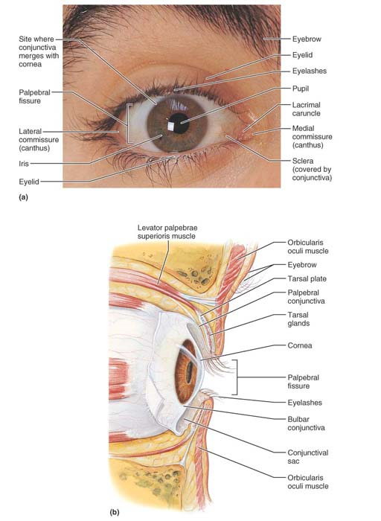
.

Slide 27
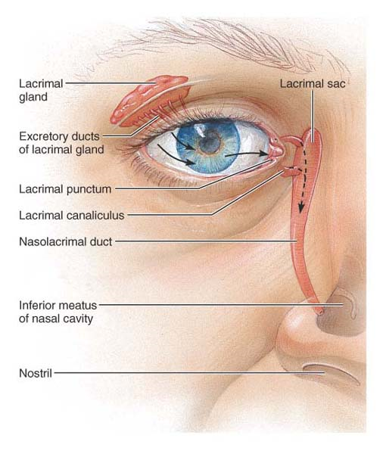
.

Slide 28
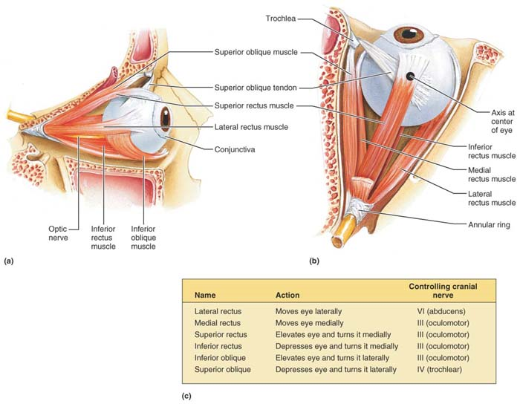
.

Slide 29
Structure of the Eyeball
- The eye itself, commonly called the eyeball, is a slightly irregular hollow sphere.
- Eyeball is shaped like the globe of the earth, it is said to have poles.
- Anterior point is the anterior pole.
- Posterior point, the posterior pole.

Slide 30
.
- Its wall is composed of three layers: fibrous, vascular, and sensory layers.
- Its internal cavity is filled with fluids called humors that help to maintain its
shape.
- The lens, the adjustable focusing apparatus of the eye, is supported vertically
within the internal cavity, dividing it into anterior and posterior segments, or
cavities.

Slide 31
Layers Forming the Wall of the Eyeball
The Fibrous Layer:-
- Outermost coat of the eye, is composed of dense avascular connective tissue.
- Has two regions: Sclera and Cornea.
- Sclera, forms posterior portion, the bulk of fibrous layer, is white and opaque.

Slide 32
.
- Sclera protects and shapes the eyeball and provides a sturdy anchoring site for
the extrinsic eye muscles.
- Posteriorly, sclera is pierced by optic nerve, it is continuous with Dura mater of
the brain.

Slide 33
.
The anterior sixth of the fibrous layer is modified to form the transparent cornea,
which bulges anteriorly from its junction with the sclera.
- The crystal-clear cornea forms a window that lets light enter the eye, and is a
major part of the light-bending apparatus of the eye.

Slide 34
.
- Cornea is covered by epithelial sheets on both faces.
- External sheet, a stratified squamous epithelium protect cornea from abrasion.
- It merges with bulbar conjunctiva at sclera-cornea junction.
- Epithelial cells that continually renew the cornea are located here.

Slide 35
.
- Deep corneal endothelium, composed of simple squamous epithelium, lines the
inner face of the cornea.
- Cornea is well supplied with nerve endings, most of which are pain receptors.
- Cornea is the most exposed part of the eye and is very vulnerable to damage

Slide 36
.
- Luckily, its capacity for regeneration and repair is extraordinary.
- Cornea is the only tissue in the body that can be transplanted from one person to
another with little or no possibility of rejection.
- Because it has no blood vessels, it is beyond the reach of the immune system.

Slide 37
The Vascular Layer (Uvea)
- The vascular layer, or middle coat of the eyeball, is also called the uvea.
- The pigmented uvea has three regions: choroid, ciliary body, and iris.
- Choroid is highly vascular, dark brown membrane that forms the posterior five-
sixths of the uvea.
- Its blood vessels provide nutrition to all eye layers.

Slide 38
.
Its brown pigment, helps absorb light, preventing it from scattering and reflecting
within the eye.
- Choroid is incomplete posteriorly where the optic nerve leaves the eye.
- Anteriorly, it becomes the ciliary body, a thickened ring of tissue that encircles
the lens.

Slide 39
.
The ciliary body consists of interlacing smooth muscle bundles called ciliary
muscles, which controls lens shape.
- The lens, posterior surface has radiating folds called ciliary processes, which
contain the capillaries that secrete the fluid that fills the cavity of the anterior
segment of the eyeball.
- The ciliary zonule (suspensory ligament) extends from the ciliary processes to the
lens; this halo of fine fibers encircles and helps hold the lens in its upright
position in the eye.

Slide 40
.
- The iris, the visible colored part of the eye, is the most anterior portion of the
uvea.
- it lies between cornea and lens and is continuous with the ciliary body
posteriorly.
- Its round central opening, the pupil, allows light to enter the eye.

Slide 41
.
The iris is made up of two smooth muscle layers with bunches of sticky elastic
fibers that congeal into a random pattern before birth.
- Its muscle fibers allow it to act as a reflexively activated diaphragm to vary pupil
size.
- In close vision and bright light, the sphincter pupillae (circular muscles) contract
and the pupil constricts.

Slide 42
.
In distant vision and dim light, the dilator pupillae (radial muscles) contract and
the pupil dilates, allowing more light to enter the eye.
- Pupillary dilation and constriction are controlled by sympathetic and
parasympathetic fibers, respectively.

Slide 43
.
- Pupil dilation often occurs when subject matter is appealing, in response to fear,
and during problem solving.
- On the other hand, boredom or subject matter that is personally repulsive causes
pupil constriction.
- Iris contain brown pigment, when pigment is much, eyes appear brown or black.

Slide 44
.
- If pigment is small, restricted to posterior surface of the iris, the shorter
wavelengths of light are scattered from the unpigmented parts, and eyes appear
blue, green, or gray.
- Most new-born babies’ eyes are slate gray or blue because their iris pigment is
not yet developed.

Slide 45
The Inner Layer (Retina)
- The innermost layer of the eyeball is the delicate, two-layered retina.
- Its outer pigmented layer, a single-cell-thick lining, abuts the choroid, and
extends anteriorly to cover the ciliary body and the posterior face of the iris.
- The pigmented epithelial cells, absorb light and prevent it from scattering in the
eye.

Slide 46
.
- They act as phagocytes to remove dead or damaged photoreceptor cells, and
store vitamin A needed by the photoreceptor cells.
- The transparent inner neural layer extends anteriorly to posterior margin of the
ciliary body.

Slide 47
.
- This junction is called the ora serrata.
- Originating as an out pocketing of brain, retina contains millions of
photoreceptors that transduce light energy.
- Only the neural layer of the retina plays a direct role in vision.

Slide 48
.
- Posterior to anterior, the neural layer is composed of three main types of
neurons: photoreceptors, bipolar cells, and ganglion cells.
- Signals are produced in response to light and spread from the photoreceptors to
bipolar neurons and innermost ganglion cells, where action potentials are
generated.

Slide 49
.
- The ganglion cell axons make a right-angle turn at the inner face of the retina,
then leave the posterior aspect of the eye as the thick optic nerve.
- Optic disc, where optic nerve exits the eye, is a weak spot in the fundus .
- Optic disc, also called blind spot, lacks photoreceptors, so light focused on it
cannot be seen.
READ MORE ON RETINA - RODES
- CONES

Slide 50
Internal Chambers and Fluids
- Lens and its halolike ciliary zonule divide the eye into two segments, anterior
segment in front of the lens and the larger posterior segment behind it.
- The posterior segment (cavity) is filled with a clear gel called vitreous humor that
binds amounts of water.

Slide 51
.
- Vitreous humor:-
(1). Transmits light.
(2). Supports posterior surface of lens, holds neural retina firmly against
pigmented layer.
(3). Contributes to intraocular pressure, helping to counteract the pulling force
of the extrinsic eye muscles.

Slide 52
.
- Anterior segment (cavity) is partially subdivided by the iris into the anterior
chamber (between the cornea and the iris) and the posterior chamber (between
the iris and the lens).
- Anterior segment is filled with aqueous humor, a clear fluid similar in
composition to blood plasma.

Slide 53
.
- Aqueous humor forms and drains continually and is in constant motion.
- Aqueous humor is produced and drained at the same rate, maintaining a
constant intraocular pressure of about 16 mm Hg, which helps to support the
eyeball internally.
- Aqueous humor supplies nutrients and oxygen to the lens and cornea and to
some cells of the retina, and it carries away their metabolic wastes.

Slide 54
.
- If drainage of aqueous humor is blocked, pressure within the eye increases to
dangerous levels and compress the retina and optic nerve—a condition called
glaucoma.
- The eventual result is blindness (glaucoma = vision growing gray).

Slide 55
Lens
- The lens is a biconvex, transparent, flexible structure that can change shape to
allow precise focusing of light on the retina.
- It is enclosed in a thin, elastic capsule and held in place just posterior to the iris
by the ciliary zonule.
- The lens is avascular; blood vessels interfere with transparency.

Slide 56
.
The lens has two regions: lens epithelium and lens fibers.
Lens epithelium, confined to anterior lens surface, consists of cuboidal cells that
eventually differentiate into the lens fibers that form the bulk of the lens.
- Lens fibers, are packed tightly together, contain no nuclei and few organelles.

Slide 57
.
- They contain transparent, proteins called crystallins that form the body of the
lens.
- New lens fibers are continually added, the lens enlarges throughout life,
becoming denser, more convex, and less elastic, all of which gradually impair its
ability to focus light properly.

Slide 58
.
- A cataract is a clouding of the lens that causes the world to appear
distorted, as if seen through frosted glass.
- Some cataracts are congenital, but most result from age-related hardening
and thickening of the lens or are a secondary consequence of diabetes
mellitus.

Slide 59
.
Heavy smoking and frequent exposure to intense sunlight increase the risk for
cataracts.
- Direct cause of cataracts seems is inadequate delivery of nutrients to the deeper
lens fibers.
- Fortunately, the offending lens can be surgically removed and an artificial lens
implanted to save the patient’s sight

Slide 60
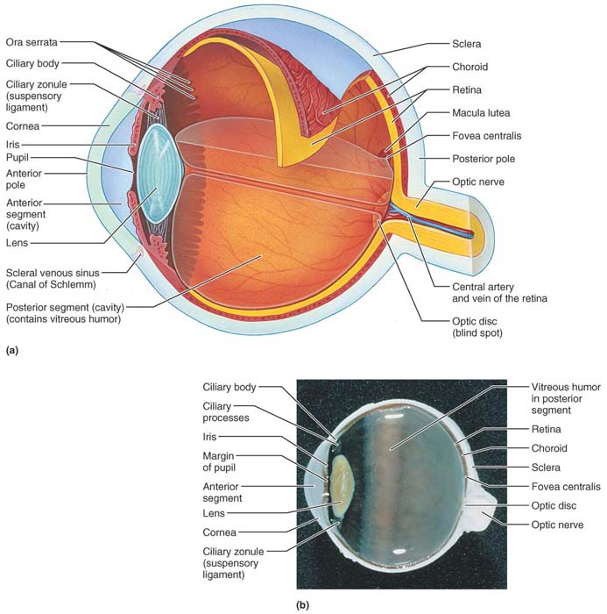
.

Slide 61
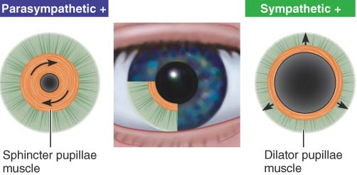
.

Slide 62
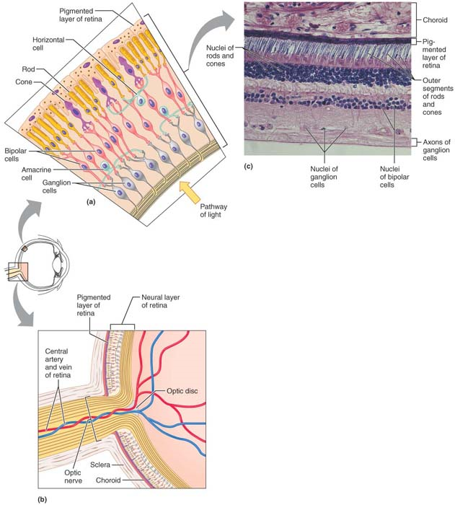
.

Slide 63
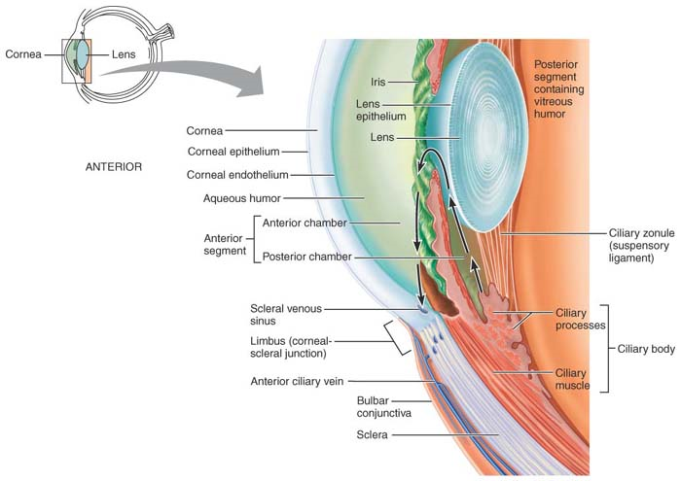
.

Slide 64
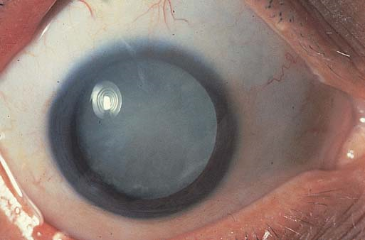
.

Slide 65
The Olfactory Epithelium and the Sense of Smell
- Although olfactory sense is far less acute than that of many other animals,
human nose is still no slouch in picking up small differences in odours.
- Some people capitalize on this ability by becoming wine tasters.

Slide 66
Localization and Structure of Olfactory Receptors
- The organ of smell is a yellow-tinged patch (about 5cm²) of pseudostratified
epithelium, called the olfactory epithelium, located in the roof of the nasal cavity.
- Air entering nasal cavity must make a hairpin turn to stimulate olfactory
receptors before entering the respiratory passageway below.

Slide 67
.
- The olfactory epithelium covers the superior nasal concha on each side of the
nasal septum.
- These are surrounded and cushioned by columnar supporting cells, which make
up the bulk of the penny-thin epithelial membrane.

Slide 68
.
- The olfactory receptor cells are bipolar neurons.
- Each has a thin apical dendrite that terminates in a knob from which several long
cilia radiate.
- The olfactory cilia, increases receptive surface area, lie flat on nasal epithelium
and covered by thin mucus produced by the supporting cells and by olfactory
glands in the underlying connective tissue.

Slide 69
.
- The mucus is a solvent that “captures” and dissolves airborne odorants.
- The unmyelinated axons of the olfactory receptor cells are gathered into small
fascicles that form the filaments of the olfactory nerve (cranial nerve I).
- They project superiorly through the openings in the cribriform plate of the
ethmoid bone, where they synapse in the overlying olfactory bulbs.

Slide 70
The Olfactory Pathway
- Axons of olfactory receptor cells constitute the olfactory nerves that synapse in
the overlying olfactory bulbs, the distal ends of the olfactory tracts.
- The filaments of the olfactory nerves synapse with mitral cells, which are second-
order neurons, in complex structures called glomeruli.
- Axons from neurons bearing the same kind of receptor converge on a given type
of glomerulus.

Slide 71
.
- Each glomerulus represents a “file” that receives only one type of odour signal.
- The mitral cells refine the signal, amplify it, and then relay it.
- When the mitral cells are activated, impulses flow from the olfactory bulbs via
the olfactory tracts to two main destinations.

Slide 72
.
The first pathway travels to the piriform lobe of the olfactory cortex and the part
of the frontal lobe just above the orbit, where smells are interpreted and
identified.
- Each olfactory cortical neuron receives input from up to 100 receptors to analyse.
- The second pathway flows via the subcortical route to the hypothalamus,
amygdala, and other regions of the limbic system, which elicits emotional
responses to odours.

Slide 73
.
Smells associated with danger—smoke, cooking gas, or skunk scent—trigger the
sympathetic fight-or-flight response.
- Appetizing odours cause increased salivation and stimulation of the digestive
tract, and unpleasant odours can trigger protective reflexes such as sneezing and
choking.
READ ON PHYSIOLOGY ON OF SMELL

Slide 74
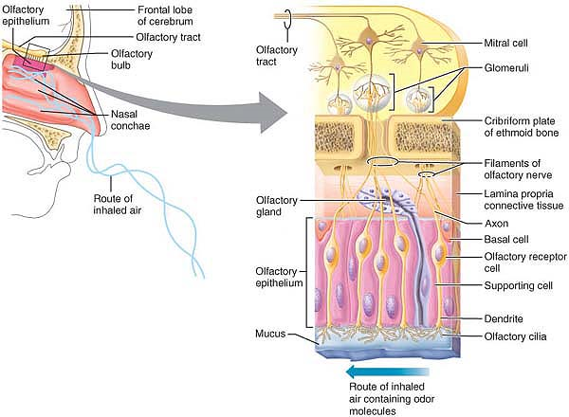
.

Slide 75
Taste Buds and the Sense of Taste
- The word taste comes from the Latin taxare, meaning “to touch, estimate, or
judge.”
- When we taste things, we are in fact intimately testing or judging our
environment.
- The sense of taste is considered by many to be the most pleasurable of the
special senses.

Slide 76
Localization and Structure of Taste Buds
- The taste buds, the sensory receptor organs for taste, are located in the oral
cavity.
- Of 10,000 or so taste buds, most are on the tongue.
- A few taste buds are scattered on the soft palate, inner surface of the cheeks,
pharynx, and epiglottis of the larynx.

Slide 77
.
Most are found in papillae, peg like projections of the tongue mucosa that give
the tongue surface a slightly abrasive feel.
- Taste buds are located on tops of fungiform papillae (scattered over tongue
surface), epithelium of side walls of foliate papillae and the large round
circumvallate papillae.
- The vallate papillae are the largest and least numerous papillae; 7 to 12 of these
form an inverted V at the back of the tongue.

Slide 78
.
- Each taste bud consists of 50 to 100 epithelial cells of two major types:
gustatory, or taste cells, and basal cells.
- Long microvilli called gustatory hairs project from the tips of all gustatory cells
and extend through a taste pore to the surface of the epithelium, where they are
bathed by saliva.
- The gustatory hairs are the sensitive portions (receptor membranes) of the
gustatory cells.

Slide 79
.
Coiling around the gustatory cells are sensory dendrites that represent the initial
part of the gustatory pathway to the brain.
- Each afferent fiber receives signals from several receptor cells within the taste
bud.
- Taste bud cells are subjected to huge amounts of friction and are routinely
burned by hot foods.

Slide 80
.
They are the most dynamic cells in the body, and they are replaced every seven
to ten days.
- The basal cells act as stem cells, dividing and differentiating into new gustatory
cells.

Slide 81
The Gustatory Pathway
- Afferent fibers carrying taste information from the tongue are found in two
cranial nerve pairs.
- A branch of the facial nerve (VII), the chorda tympani, transmits impulses from
taste receptors in the anterior two-thirds of the tongue.

Slide 82
.
The lingual branch of the glossopharyngeal nerve (IX) services the posterior third
and the pharynx just behind.
- Taste impulses from the few taste buds in the epiglottis and the lower pharynx
are conducted by the vagus nerve (X).

Slide 83
.
These afferent fibers synapse in the solitary nucleus of the medulla, and from
there impulses stream to the thalamus and ultimately to the gustatory cortex in
the insula.
- Fibers also project to the hypothalamus and limbic system structures, regions
that determine appreciation of what is tasted.

Slide 84
.
- An important role of taste is to trigger reflexes involved in digestion.
- As taste impulses pass through the solitary nucleus, they initiate reflexes (via
synapses with parasympathetic nuclei) that increase saliva secretion into the
mouth and gastric juice into the stomach.

Slide 85
.
Saliva contains mucus that moistens food and digestive enzymes that begin the
digestion of starch.
- Acidic foods are particularly strong stimulants of the salivary reflex.
- When revolting or foul-tasting substances are eaten, gagging or even reflexive
vomiting may be initiated.

Slide 86
.
1. Basic Taste Sensations.
2. Physiology of Taste.
- Activation of Taste Receptors.
- Mechanism of Taste Transduction.
3. Influence of Other Sensations on Taste.

Slide 87
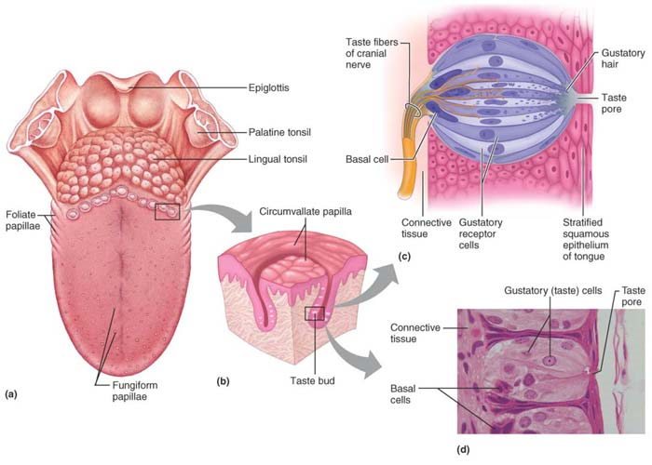
.

Slide 88
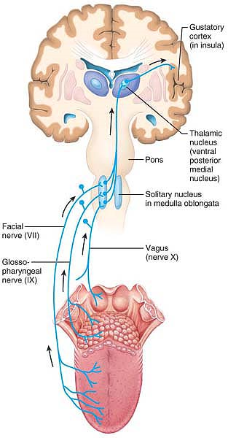
.

Slide 89
The Ear: Hearing and Balance
- Fluids must be stirred to stimulate the mechanoreceptors of the internal ear.
- Hearing apparatus allows to hear extraordinary range of sound, and equilibrium
receptors keep the nervous system continually informed of head movements and
position.
- The organs serving these two senses are structurally interconnected within the
ear, their receptors respond to different stimuli and are activated independently
of one another.

Slide 90
Structure of the Ear
- The ear is divided into three major areas:-
1. External ear,
2. Middle ear,
3. Internal ear.
- The external and middle ear structures are involved with hearing only.
- The internal ear functions in both equilibrium and hearing and is extremely
complex.

Slide 91
The External (Outer) Ear
- Consists of auricle and external acoustic meatus.
- The auricle, or pinna, is what most people call the ear—the shell-shaped
projection surrounding the opening of the external acoustic meatus.
- The auricle is composed of elastic cartilage covered with thin skin and an
occasional hair.

Slide 92
.
- Its rim, the helix, is thicker, fleshy, dangling lobule (“earlobe”) lacks supporting
cartilage.
- The function of the auricle is to direct sound waves into the external acoustic
meatus.
- The external acoustic meatus (auditory canal) is a short, curved tube (about 2.5
cm long by 0.6 cm wide) that extends from the auricle to the eardrum.

Slide 93
.
- Near the auricle, its framework is elastic cartilage; the remainder of the canal is
carved into the temporal bone.
- The entire canal is lined with skin bearing hairs, sebaceous glands, and apocrine
sweat glands called ceruminous glands.
- These glands secrete yellow-brown waxy cerumen, or earwax, which provides a
sticky trap for foreign bodies and repels insects.

Slide 94
.
- The ear is naturally cleansed as the cerumen dries and then falls out of the
external acoustic meatus. (Jaw movements as a person eats, talks, and so on,
create an unnoticeable conveyor-belt effect that moves the wax out.).
- In others, cerumen builds up excessively and becomes compacted, a condition
that can impair hearing.
- Sound waves entering the external acoustic meatus eventually hit the tympanic
membrane, or eardrum, the boundary between the outer and middle ears.

Slide 95
.
- The eardrum is a thin, translucent, connective tissue membrane, covered by skin
on its external face and by a mucosa internally.
- It is shaped like a flattened cone, with its apex protruding medially into the
middle ear.
- Sound waves make the eardrum vibrate. The eardrum, in turn, transfers the
sound energy to the tiny bones of the middle ear and sets them into vibration.

Slide 96
The Middle Ear
- The middle ear, or tympanic cavity, is a small, air-filled, mucosa-lined cavity in the
petrous portion of the temporal bone.
- It is flanked laterally by the eardrum and medially by a bony wall with two
openings.
- The superior oval (vestibular) window and the inferior round (cochlear) window.

Slide 97
.
Superiorly the tympanic cavity arches upward as the epitympanic recess, the
“roof” of the middle ear cavity.
- The mastoid antrum, a canal in the posterior wall of the tympanic cavity, allows it
to communicate with mastoid air cells housed in the mastoid process.
- The anterior wall of the middle ear abuts the internal carotid artery (the main
artery supplying the brain) and contains the opening of the pharyngotympanic
(auditory) tube.

Slide 98
.
This tube, called the Eustachian tube, runs obliquely downward to link the middle
ear cavity with the nasopharynx (the superior most part of the throat).
- The mucosa of the middle ear is continuous with that lining the pharynx (throat).
- Normally, the pharyngotympanic tube is flattened and closed, but swallowing or
yawning opens it briefly to equalize pressure in the middle ear cavity with
external air pressure.

Slide 99
.
This is important because the eardrum vibrates freely only if the pressure on both
of its surfaces is the same; otherwise sounds are distorted.
- The ear-popping sensation of the pressures equalizing is familiar to anyone who
has flown in an airplane.

Slide 100
.
- Otitis media, or middle ear inflammation, is a common result of a sore throat,
especially in children, whose pharyngotympanic tubes are shorter and run more
horizontally.
- Otitis media is most frequent cause of hearing loss in children.
- In acute infectious forms, the eardrum bulges and becomes inflamed and red.

Slide 101
.
- Most cases of otitis media are treated with antibiotics.
- When large amounts of fluid or pus accumulate in the cavity, an emergency
myringotomy (lancing of the eardrum) may be required to relieve the pressure.
- A tiny tube implanted in the eardrum permits pus to drain into the external ear.
The tube falls out by itself within the year

Slide 102
.
- The tympanic cavity is spanned by the three smallest bones in the body: the
auditory ossicles.
- These bones, named for their shape:-
1. Malleus ( “hammer”);
2. Incus ( “anvil”);
3. Stapes ( “stirrup”).
- The “handle” of the malleus is secured to the eardrum, and the base of the
stapes fits into the oval window.

Slide 103
.
- Tiny ligaments suspend the ossicles, and mini synovial joints link them together
into a chain that spans the middle ear cavity.
- The incus articulates with the malleus laterally and the stapes medially.
- The ossicles transmit the vibratory motion of the eardrum to the oval window,
which sets the fluids of the internal ear into motion, eventually exciting the
hearing receptors.

Slide 104
.
- Two tiny skeletal muscles, tensor tympani arises from the wall of the
pharyngotympanic tube and inserts on the malleus.
- The stapedius, runs from the posterior wall of the middle ear cavity to the stapes.
- When ears are assaulted by very loud sounds, these muscles contract reflexively
to prevent damage to the hearing receptors.

Slide 105
.
- Tensor tympani tenses the eardrum by pulling it medially.
- Stapedius checks vibration of the whole ossicle chain and limits the movement of
the stapes in the oval window

Slide 106
The Internal (Inner) Ear
- The internal (inner) ear is also called the labyrinth (“maze”) because of its
complicated shape.
- It lies deep in the temporal bone behind the eye socket and provides a secure
site for all of the delicate receptor machinery housed there.
- The internal ear has two major divisions:-
- Bony labyrinth.
- Membranous labyrinth.

Slide 107
.
- The bony, or osseous, labyrinth is a system of tortuous channels worming
through the bone.
- Its three regions are the vestibule, the cochlea , and the semi circular canals.
- The membranous labyrinth is a continuous series of membranous sacs and ducts
contained within the bony labyrinth.

Slide 108
The Auditory Pathway to the Brain
- The ascending auditory pathways to the brain involve several brain stem nuclei,
- Impulses generated in the cochlea pass through the spiral ganglion,
- The auditory bipolar neurons, along the afferent fibers of the cochlear nerve to
the cochlear nuclei of the medulla.

Slide 109
.
The impulses are sent on to the superior olivary nucleus and then via the lateral
lemniscal tract to the inferior colliculus (auditory reflex centre in the midbrain)
and the auditory cortex (which provides for conscious awareness of sound) in the
temporal lobe.
- Relays also communicate with the medial geniculate body of the thalamus and
the superior colliculus of the midbrain.

Slide 110
.
The colliculi act together to initiate auditory reflexes to sound, such as the startle
reflex and head turning.
- The auditory pathway is unusual in that not all of the fibers from each ear
decussate (cross over); therefore each auditory cortex receives impulses from
both ears.

Slide 111
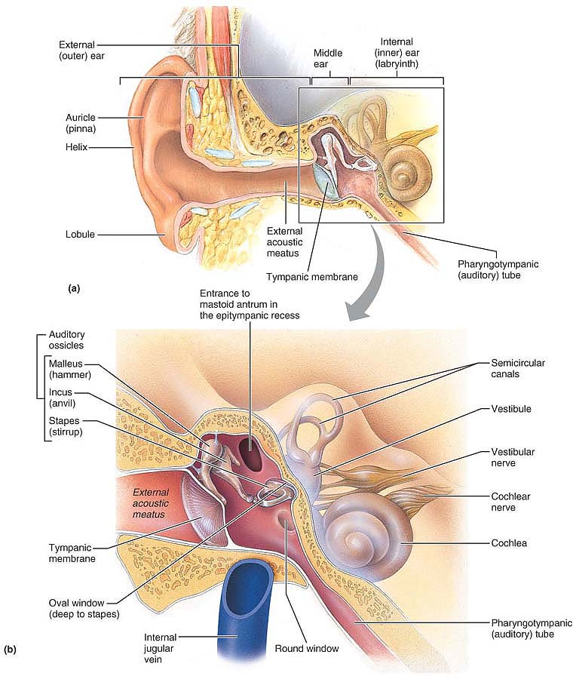
.

Slide 112
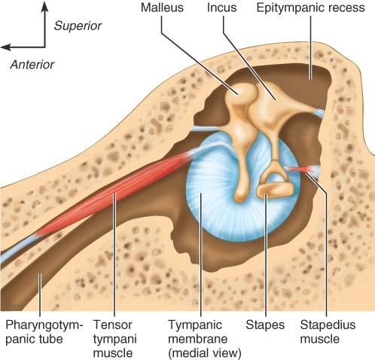
.

Slide 113
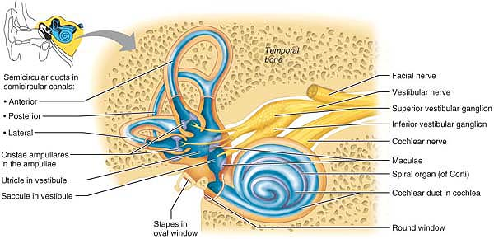
.

Slide 114
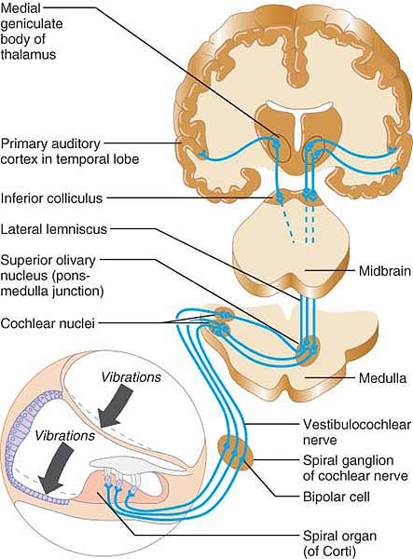
.

Slide 115
.
1. Physiology of Hearing
2. Properties of Sound
3. Transmission of Sound to the Internal Ear
- Resonance of the Basilar Membrane
- Excitation of Hair Cells in the Spiral Organ
4. Auditory Processing
- Perception of Pitch
- Detection of Loudness
- Localization of Sound
5. Mechanisms of Equilibrium and Orientation
6. The Maculae and Static Equilibrium
- Anatomy of the Maculae
- Activating Maculae Receptors

Slide 116
.
7. The Crista Ampullaris and Dynamic Equilibrium
- Anatomy of the Crista Ampullaris
- Activating Crista Ampullaris Receptors
8. The Equilibrium Pathway to the Brain
9. Motion sickness

