Slide 1
SPECIFIC PRINCIPLES OF FRACTURE MANAGEMENT
KUVALI TOLI

Slide 2
FACTORS INFLUENCING FRACTURE MANAGEMENT
1. Degree of illness of the patient.patient may require resuscitation.
2. Nature of the fracture that is if open or closed
3. Age of the patient.
4. The type of bone involved
5. The fracture line.

Slide 3
THE 5 Rs OF FRACTURE MANAGEMENT
1. Resuscitation- In the severely injured patients resuscitation will be necessary. Follow the ABC of resuscitation.
A. Open the Airway by positioning the patient properly (Head tilt chin lift). Support the tongue if the patient is unconscious and Remove any foreign body.
B. Breathing – Assist the patient in breathing using mouth to mouth, giving oxygen using an ambu bag or use end tracheal tube.
C. Ensure that there is sufficient circulation. If the patient is in hypovolaemic shock, give Intra venous fluids or whole blood.
D. Deal with the diagnosis.

Slide 4
2. Reduction: - The facture needs to be reduced so that healing can
occur. Reduction of a fracture can be done in two ways:
Closed reduction
Open reduction

Slide 5
Closed reduction
a) Manual- where the clinician pulls the two fragments using his hands e.g. in upper limb.
b) Skin – This is by use of pulleys and a weight over the patients skin using a strapping.
This is usually indicated in children or where there is less masculative not more than 7 Ib is required

Slide 6
c) Skeletal fraction. This involves use of Steinman pin through a bone. The selected sites include the following:
a) Skull
b) Olecranon
c) Supracodylar Refion of femur
d) Tibial tuberosity.
e) Calcaneum.
This is usually done in adults & or where more than 7 Ibs adults will be required to reduce a fracture to over 18 years

Slide 7
Open reduction:
This is where a patient must be operated on to reduce a fracture and fix it. It involves use of implants for instance
a) Kuntcher nail K- nail
b) Plate ;straight or angle
c) Screws.

Slide 8
Primary Indications of open reduction and internal fixation
1. Failed conservative #
2. Segmental fracture
3. in elderly
4. Early mobilization is required
5. Multiple fractured patient
6. Early mobilization

Slide 9
3. Restriction of movement:
The objectives are;
To prevent angulations or displacement of fragments
To prevent movements that interferes with union of a fracture
To relieve pain

Slide 10
This is usually achieved by use of splints such as;
a) Plaster of Paris- is anhydrous calcium sulphate
b) Traction
- Skin
- Skeletal
c) Internal fixators
d) External fixators

Slide 11
4. Restoration of the function:
This is achieved through physiotherapy
i) Exercise ; Passive or Active
ii) Massage – Kneading – friction - Effleurage
iii) Heat treatment: -
IRR, SWD, MWD, UVL, Faradic stimulation, Wax bath.

Slide 12
5. Rehabilitation
Patient needs to back to his/ her normal duties after treatment of fractures. This includes counseling and where applicable compensation by insurance firms.

Slide 13
Describing the fracture
Age and mechanism (traumatic, pathological, stress)
Closed vs. Open
Anatomical site – bone and location in bone; R vs L; hand dominance
Fracture position (proximal, supracondylar)
Fracture type (transverse, oblique, spiral, crush, comminuted)
Intra-articular involvement – fracture/dislocation
Deformity (short, shift, tilt, twist)
Grade or classification of fracture
Soft tissue injury (nerves, vessels, tendons, tissue loss)

Slide 14
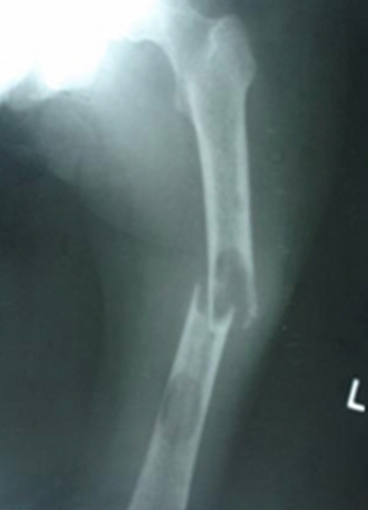

Slide 15
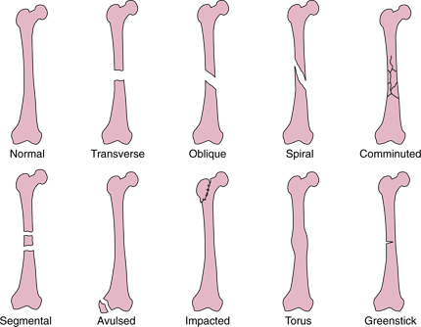

Slide 16
Factors affecting fracture healing
Energy transfer of the injury
The tissue response
Two bone ends in apposition or compressed
Micro-movement or no movement
Blood supply (scaphoid, talus, femoral & humeral head)
Type of bone
No infection
The patient
The method of treatment

Slide 17
Pathophysiology of fracture healing
Stage of Haematoma (24-48Hrs)
Injury (fracture) leads to haematoma formation from the damaged blood vessels of the periosteum, endosteum, and surrounding tissues & there is necrosis of bone immediately adjacent to the fracture.
Stage of Inflammation & Cellular proliferation
There is immediate release of cytokines that;
Within hours attract an inflammatory infiltrate of neutrophils and macrophages into the haematoma that debride and digest necrotic tissue and debris, including bone, on the fracture surface.
Attract undifferentiated stem cells - probably from the periosteum & the endosteum, which migrate in & start differentiating into fibroblasts & bone-producing cells (chondroblasts, osteoblasts). Low-oxygen tension, low pH, and movement favour the differentiation of chondrocytes; high-oxygen tension, high pH, and stability predispose to osteoblasts.

Slide 18
Stage of Callus formation (4-6wks)
The haematoma is gradually replaced by specialized granulation tissue with the power to form bone - callus, from both sides of the fracture.
Callus is composed of fibroblasts, endothelial cells, and bone-forming cells (chondroblasts, osteoblasts).
The extent to which callus forms from the medulla, the periosteum, or cortical bone depends upon;
the site of fracture
the degree of immobilization
the type of bone injured

Slide 19
Stage of Consolidation
This final phase, involving the replacement of woven bone (Immature bone or osteoid which is calcified callus) by lamellar bone in various shapes and arrangements, is necessary to restore the bone to optimal function.
This process - consolidation - involves the simultaneous meticulously coordinated removal of bone from one site (osteoclasts) and deposition in another (osteoblasts) & Ossification - the process of deposition of inorganic bone substance by osteoblasts about themselves - starts at the centre of the fracture cleft, where oxygen levels may be low.
Osteoclasts are derived from monocytes and are large multinucleated cells that remove bone. They are located on the resorption surfaces of the bone. Osteoblasts are mononuclear and are responsible for the accretion of bone.

Slide 20
Stage of Remodelling
Bone is strengthened in the lines of stress & resorbed elsewhere

Slide 21
GENERAL COMPLICATIONS OF FRACTURE
Despite effective management of fractures, complications are likely to occur. They can be early, intermediate and late complications.

Slide 22
1. Early complications (local) within few weeks
Fracture fever – due to normal tissue response to trauma.
Soft tissue injuries to blood vessels, muscles and nerves.
Bleeding –This may be revealed or concealed.
Crush syndrome – When there is prolonged compression of muscles, after release there is tendency release myohaematin acid which is circulated in blood. When it reaches the kidney it may block the renal tubules or cause renal artery spasm which leads to renal tubular necrosis leading to renal failure.

Slide 23
2. Early general.
Hemorrhage – If severe leads to hypovalaemic shock.
Neurogenic shock- This s due to involvement of the nerves # Ribs.

Slide 24
3. Intermediate local (24-48hrs).
a) Infections -if the wound is left uncovered or contaminated. It can lead
to the following;
i) Local wound infection
ii) Tetanus
iii) Gangreen gas-gas
iv) Osteomyelitits
b) Fat Embolism
c) Pulmonary Embolism- far- gas
d) Compartment syndrome

Slide 25
4. Intermediate general.
Hypostatic pneumonia due to inhalation of secretions
Bed sores due to prolonged bed rest.
Anuria due to renal failure.

Slide 26
5. Late local complications.
Mal union
non- union
Osteoarthritis – if fracture occurs through a joint.
Sudecks atrophy- due to lack of use of the limb.(Disuse atrophy)
Contracture due to stiffness of the joins.

Slide 27
6. Late general.
generalized bony osteoporosis
Delirium tremens – due to withdrawal
Accident neurosis.

