Slide 1
HIV/AIDS & STIs/RTIs
MARK.M.W. BScN.

Slide 2
Learning Objectives
Define STI/RTIs
Discuss the relationship between HIV infection and other STI/RTIs
Describe the clinical features of STI/RTIs
Describe the management of STI/RTIs
Describe preventive measures for STI/RTIs
Describe HIV/AIDs

Slide 3
INTRODUCTION
STDS refers to a variety of clinical syndromes that are transmitted mainly through sexual contact but are also transmitted through other routes
There has been a steady rise in the diseases despite efforts to curb HIV/AIDS which is an STD that continually receives international attention due to its epidemic nature
This is mainly due to liberal behavior among young people, media influence ,drug use, and culture changes

Slide 4
DEFINITION:
Communicable infections transmitted predominantly through sexual means.
The terms Sexually Transmitted Infections- (STI) or Sexually Transmitted Diseases- STD have replaced the term Venereal Disease (VD) and is currently Reproductive Tract Infections (RTI)

Slide 5
The commonest pathogens include:
Bacteria: Chlamydia, Gonococcus, Haemophilus ducreyi, Treponema pallidum
Viruses:, Hepatitis B, HIV, HPV (Human Papilloma Virus) genital herpes simplex
Protozoa: Trichomonas vaginalis
Others: pubic lice

Slide 6
Routes of transmission
Direct sexual contact; 95% of cases
Others;
Maternal child transmission-(congenital)HIV , gonorrhoea, syphilis
Transfusion of blood and blood products.
Organ transplants
Iatrogenic-needle pricks, health workers to patients and vise versa

Slide 7
Risk factors
Early sexual debut in adolescent girls –HPV
Multiple sexual partners -serial monogamy or polygamous behaviour
Drug and alcohol use
Cervical immaturity ;columnar epithelium as opposed to squamous cell in adults.
Immunity is less dev in adolescents when they start early sexual activity against a backdrop of naivity.

Slide 8
Cont…
Poverty
Lack of formal education
‘core groups’ like long distance truck driver
IV drug users

Slide 9
Challenges in treating STIs
Embarrassing nature of illness prompts patients to self treat leading to inadequate or inappropriate treatment
Lack of confidentiality amongst care givers especially when dealing with adolescents
Poor attitude of care givers towards patients with STIS.
Harsh response from parents instills fear in adolescents willing to seek treatment.
Contact tracing; unfaithful partners scared of telling spouses

Slide 10
Clinical prevention guidelines
The prevention and control of STDs are based on the following five major strategies:
Education and counseling of persons at risk on ways to avoid STDs through changes in sexual behaviors and use of recommended prevention services
Identification of asymptomatically infected persons and of symptomatic persons unlikely to seek diagnostic and treatment services

Slide 11
Strategies cont…
Effective diagnosis, treatment and counseling of infected persons
Evaluation, treatment and counseling of sex partners of persons who are infected with an STD
Pre-exposure vaccination of persons at risk for vaccine-Preventable STD

Slide 12
Special considerations
Pregnant women
Patients in correctional facilities
Men who have sex with other men (MSM)
Women who have sex with other women
Children with STIS following sexual abuse

Slide 13
Special consideration cont…
Adolescents
STIS in patients with mental and physical disabilities
STIS and their r/ship with HIV/AIDS
Patients with allergies to conventional medication

Slide 14
The general principles in management
Establish the diagnosis or syndrome by examination and screen for other possible STDS (multiple concomitant STDS are possible).
Routine screening and counselling even in asymptomatic patients(especially females)
Prompt and simple treatment(prefferably single dose Rx to improve compliance.

Slide 15
Principles cont….
4) Contact tracing by patient referral.
5) Routine screening for contact
6) Health education on safe sex, monogamous relationships, proper and consistent condom use, prompt and routine medical consultation after unsafe exposure.
7) Follow up for test and cure.

Slide 16
Syndromic treatment algorithms
Flow charts for diagnosis and treatment formalising the syndromic approach for STI/RTIs
Provide HCW with step by step instruction to diagnose and treat the STI/RTIs with the recommended drugs

Slide 17
Case management of STI/RTI patients
Management includes:
Proper clinical assessment
Correct diagnosis
Prescription of appropriate medication
4Cs
  Education on risk reduction-counselling
  Treatment compliance
  Condom use-consistent and proper use
  Contact tracing-Partner management

Slide 18
Component of case management
Clinical assessment based on appropriate history taking
Physical examination
Syndromic classification
Specific syndromic treatment
Education/counselling

Slide 19
Advantages of Syndromic approach
Highly sensitive
Manages mixed infections
Immediate treatment
Avoids expensive lab tests
Implementable at primary care level
Incorporates counselling and partner management
Allows uniformity of case mx

Slide 20
Disadvantages of syndromic approach
Requires retraining of staff
Resistance from medical staff who prefer doing things the usual way
Over diagnosing and over treatment leading to drug resistance, increased drug costs, domestic violence
Does not detect asymptomatic cases
Requires periodic survey for drug sensitivity and disease epidemiology

Slide 21
WHO guidelines on management of STDs; the syndromic approach.
The main syndromic presentations of STIs are;
1)Urethral Discharge
2) Vaginal Discharge
3) Genital ulcer Disease
4) LAP and with or w/out Discharge.(PID)

Slide 22
Syndromic presentation cont…
5) Genital growth.
6) Scrotal pain and swelling
7)Inguinal bubo
8)Neonatal conjunctivitis
9) Balinitis and Bartholins abscess

Slide 23
Urethral discharge
Presents with purulent or mucopurulent discharge
Syndromic diagnosis; urethritis
Differential diagnosis ; gonococcal (60%)or non gonococcal urethritis.
Non gonococcal; Chlamydia trachomatis, Trichomonas v, mycoplasma genitalium, Hsv, enteric bacteria

Slide 24
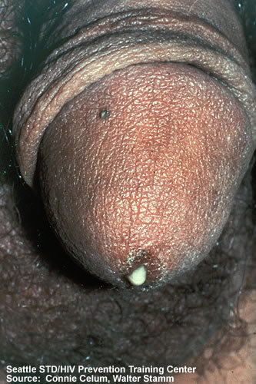

Slide 25
MALE PATIENT COMPLAINING OF URETHRAL DISCHARGE
History and examination
Milk urethral D
Ask for VDRL/HIV ab test
Education for behaviour change
Provide condoms/protection
Review if symptoms persist.
No
Diagnosis confirmed
yes
Rx for gonorrhoea/c trachomatis
Education for behaviour
change
Promote/provide condoms
Partner mgt
A revisit/follow up

Slide 26
Treatment: Gonoccocal infections of Urethra, Cervix,
Ceftriaxone IM x 1 OR Cefixime orally x 1
PLUS
Azithromycin orally x 1 OR
Doxycycline orally twice daily x 7 d
Alternative:
Spectinomycin IM x 1 OR
Single-dose cephalosporin regimens
  Ceftizoxime IM OR
  Cefoxitin IM + probenecid 1 g orally OR
  Cefotaxime IM OR
  Cefpodoxime orally OR
  Cefuroxime axetil orally
Treat sex partners + abstain until therapy complete
Notes:
26

Slide 27
VAGINAL D
Patient complains of yellow purulent discharge with/without dysuria.
Normal genital exam findings but copious purulent discharge.
Syndromic Diagnosis ; vaginitis
D/D;- Bacterialvaginitis, Candidiasis, trichomoniasis, atrophic vaginitis, physiologic leucorrhea, local irritants

Slide 28
Characteristics of Vaginal Discharge by causative agent
Neisseria gonorrhea- greenish yellow
Chlamydia trachomatis- scanty muco-purulent or purulent
Trichomonas vaginalis-frothy, profuse, greenish yellow foul smelling discharge
Candida albicans- white, curd- like discharge
Gardnerella vaginalis- profuse foul smelling and homogenous greenish- white discharge

Slide 29
PATIENT WITH PV DISCHARGE
Risk assessment
LAP
partner has symptoms
Risk factors positive
No
Rx for vaginitis
Education
Provide protection
Yes
No
Rx for cervicitis / vaginitis
Education
Ask for VDRL/HIV antibodies
Provide protection
Partner management/ return date
Abdominal pain
Presence of guarding
Missed periods
Recent delivery/PV bleeding
Yes
Refer to A/E to R/o Acute abdomen
(PID,Ectopic PG, Appendicitis, pelvic abscess)

Slide 30
Bacterial vaginosis treatment
Recommended:
Metronidazole orally twice a day x 7 d OR
Metronidazole gel, intravaginally, once a day for 5 d OR
Clindamycin cream, intravaginally at bedtime x 7 d
Alternative:
Clindamycin orally twice a day x 7d OR
Clindamycin ovules intravaginally once at bedtime x 3
Notes:
30
TREATMENT OF SEX PATNERS NOT REQUIRED.

Slide 31
Recurrent VulvoVaginalCandidiasis
≥ 4 episodes of symptomatic VVC in 1 year
Frequency and severity of episodes increase with increasing immunosuppression
Obtain vaginal culture to look for non-albicans species
Consider longer treatment course (7-14 days of topical therapy or oral fluconazole on days 1, 4, and 7)
Consider suppressive maintenance therapy if needed (fluconazole orally once weekly)
Treat immunosuppression
Notes:
31

Slide 32
Patient with genital ulcer disease;
Patient complains of genital sore or genital ulcer.
Syndromic DX –GUD
DDX for GUD.
Genital herpes(HSV 1or 2)
Syphyllis
Lympogranuloma venerium
Granuloma inguinale
?drug erruption.

Slide 33
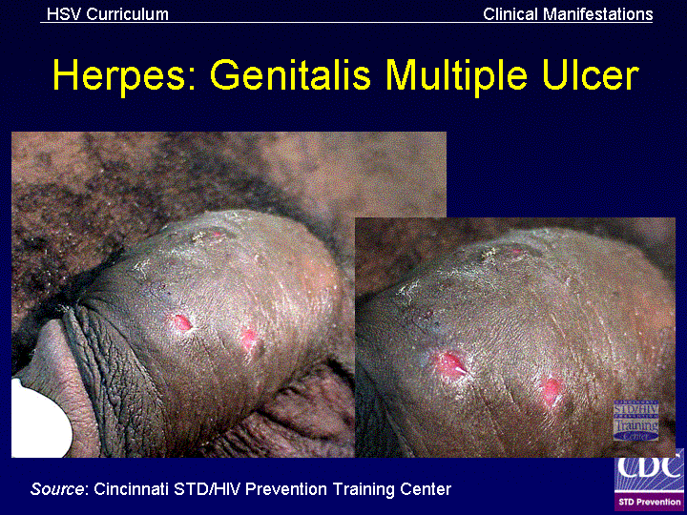

Slide 34
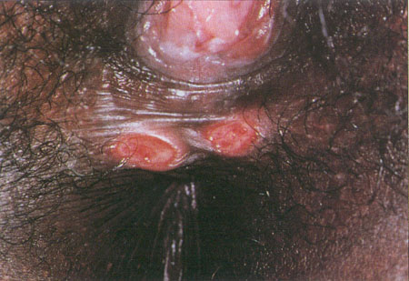
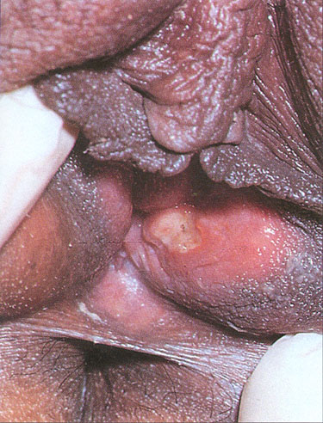
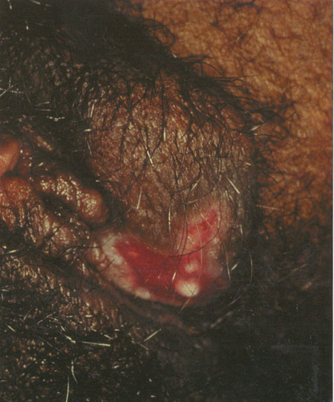
Genital Ulcer Disease
Wilkinson and Stone, 1995; Fig 8.46
J. Anderson, MD, ed.
Holmes, 1999; Plate 32
Syphilis
Chancroid
Herpes Simplex
Notes:
Genital ulcers are most commonly caused by syphilis, chancroid, or herpes simplex. These etiologies cannot be reliably distinguished from one another on clinical grounds and may coexist in the same individual. HIV-infected persons with syphilis may have abnormal serologic results, such as unusually high titers, false negatives, or delayed seroreactivity, although generally serologic tests can be interpreted in the usual manner. The clinical presentation of syphilis is variable at all stages, but atypical manifestations may be seen in the setting of HIV infection. Neurosyphilis should be considered in the differential diagnosis when HIV-infected individuals present with neurologic signs or symptoms. Therapy is not altered by the presence of HIV infection.
With chancroid, response to treatment may be diminished in the HIV-infected person; with use of single dose therapies, close follow-up is necessary since treatment failure may be more likely. Herpes simplex infections are chronic, involving relapsing infections that cannot be cured by current therapies, although infections can be controlled by suppressive or intermittent antiviral agents such as acyclovir. In the HIV-infected client with genital herpes, more frequent, prolonged, and/or severe episodes are common with progressive immunesuppression and lesions may be atypical in appearance or location.

Slide 35
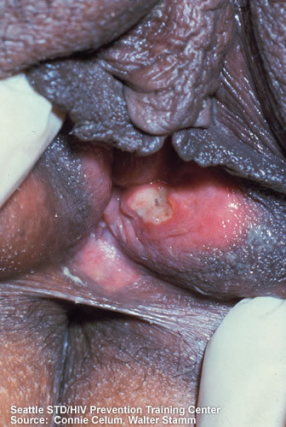
Chancroid

Slide 36
Diagnosis
Syphilis serology
Culture for hsv1 or hsv2
Serologic testing for type specific antibody
Culture for Haemophilus ducreyi

Slide 37
Chancroid: Diagnosis
Probable diagnosis: All of
  ≥ 1 painful genital ulcer
  No evidence of T. pallidum by darkfield or serology performed ≥ 7 days after ulcer onset
Clinical presentation, appearance of painful dirty grey genital ulcers and Buboes in the groin
  HSV lesion culture or fluorescent antibody test negative
Diagnostic confirmation:
  Culture of H. ducreyi (special media), sensitivity <80%
Notes:
37

Slide 38
CHANCROID;MNGT
Recommended Regimens
Azithromycin orally in a single dose
OR
Ceftriaxone intramuscularly (IM) in a single dose
OR
Ciprofloxacin* orally twice a day for 3 days*
OR
Erythromycin base orally three times a day for 7 days
* Ciprofloxacin is contraindicated for pregnant and lactating women.

Slide 39
Syphilis
Systemic infection with T. pallidum
Primary: Ulcer or chancre
Secondary: Rash (papular or pustular), mucous patches, condylomata lata, lymphadenopathy
Early and late latent: Asymptomatic
Tertiary: Cardiac, ophthalmic, auditory, gummatous lesions
Neurosyphilis: Basilar meningitis, meningovascular syphilis, general paralysis, tabes dorsalis
Notes:
39

Slide 40
Treatment.
Benzathine PCN G IM x 1
Consider LP
Repeat serologies 3, 6, 9, 12, 24 months
Alternatives (not for use in pregnancy):
  Doxycycline orally twice daily x 14 d
  Tetracycline mg orally x 14 days
  Azithromycin po x 1
Treat all sex partners exposed within 90 days
Test all sex partners within 6 months for secondary and within 1 year for early latent

Slide 41
Neurosyphilis: Treatment
Recommended treatment:
Aqueous crystalline PCN G, administer continuous, x 10-14 d
Alternative treatment:
Procaine PCN IM daily + Probenecid orally four times daily x 10-14 d OR
Ceftriaxone IM or IV daily x 10-14 d
Repeat LP every 6 months; re-treat if not normal at 24 months

Slide 42
Genital herpes
Chronic life long infection
Two implicated viruses;HSV1 and HSV2
HSV2-Main cause of recurrent disease
Diagnosis-non sensitive and non specific since one may not have the classical vesicular or ulcerative lesions.
Serological tests e.g. IGM antibodies

Slide 43
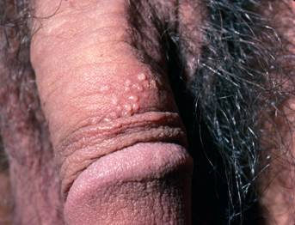
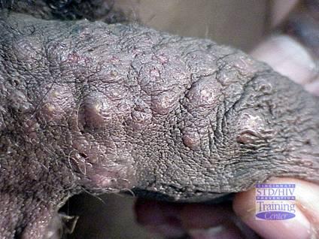
Genital herpes vesicles

Slide 44
Treatment of First Clinical Episode of Genital Herpes
Acyclovir orally three times a day x 7-10 d OR
Famciclovir three times a day for 7-10 d OR
Valacyclovir 1 g orally twice a day for 7-10 d
Severe disease: acyclovir 5 mg/kg IV until lesion regresses, then oral therapy until lesion has healed
Notes:
44

Slide 45
Lymphogranuloma venereum:
Clinical presentation
Heterosexuals: Tender inguinal and/or femoral lymphadenopathy, typically unilateral
Self-limited genital ulcer or papule
Rectal exposure in women and MSM: Proctocolitis—Mucoid and/or hemorrhagic rectal discharge, anal pain, constipation, fever, tenesmus. Can lead to chronic colorectal fistulas and strictures.
Caused by some types of C .Trachomatis
Notes:
45

Slide 46
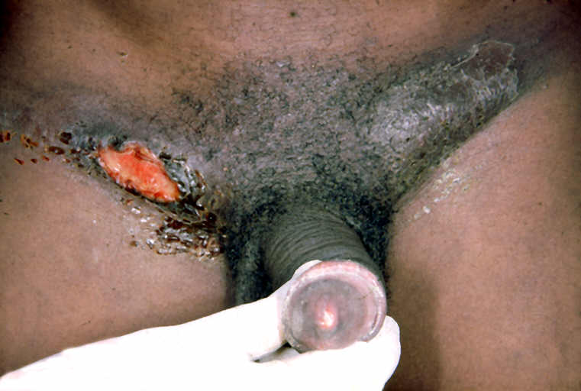
Lymphogranuloma venereum
Aspirate bubo if needed.
HIV test
No active papule or ulcer in this case
Bubo has ruptured
Doxycycline 100 mg bd x 14 days
OR (in pregnancy) Erythromycin 500 mg 4 times daily x 14 days
Sometimes longer treatment is needed
Notes:
Lymphogranuloma venereum causes unilateral or bilateral buboes. There may be a genital papule or ulcer associated with this, but often there is no genital lesion. It is treated with prolonged doxycyline or erythromycin, with aspiration of the buboes as needed. As usual, RPR and HIV tests are offered and prevention counseling, condom use, and referral of the partner are important.
Image Source: ©Wellcome Trust. CD Rom: Topics in International Health – Sexually Transmitted Infections. The Trustee of the Wellcome Trust, London, Second Edition, 2003. ISBN 0-85199-631-0

Slide 47
Lymphogranuloma venereum:
Treatment
Recommended:
Doxycycline orally twice a day x 21 d
Alternative:
Erythromycin base orally four times a day x 21 d
Azithromycin orally once weekly x 3 weeks also probably effective
Buboes may require aspiration
Examine and treat sex partners prior 60 days with standard Chlamydial regimen

Slide 48
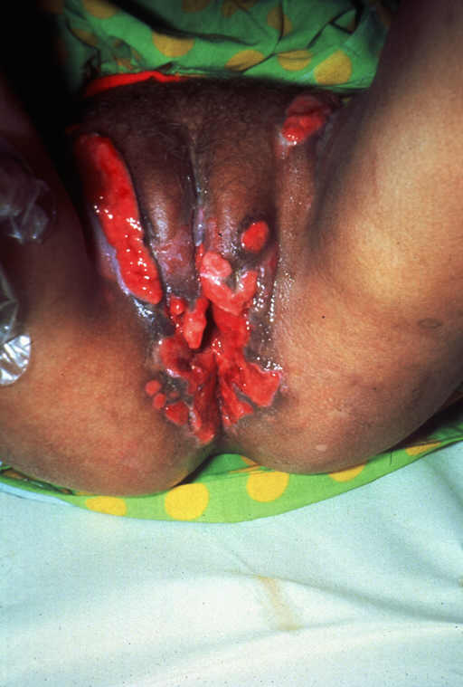
Granuloma Inguinale (Donovanosis)
Caused by Calymmatobacterium granulomatis or Klebsiella granulomatis
Uncommon
Large chronic ulcers
Painless and Beefy red
Bleed easily
Treatment
Doxycycline
OR Erythromycin
Notes:
Granuloma inguinal is a rare cause of genital ulcer in Namibia. These are very large, chronic, but painless ulcers that can have heaped up tissue. Treatment is with a long course of doxycycline or erythromycin.
In summary, ask the participants to suggest a diagnosis for the case presented. Do not force participants to respond or wait too long for an answer. Acknowledge any diagnoses offered; then simply proceed to the following slides and present the diagnosis, treatment, and management
Image Source: ©Wellcome Trust. CD Rom: Topics in International Health – Sexually Transmitted Infections. The Trustee of the Wellcome Trust, London, Second Edition, 2003. ISBN 0-85199-631-0

Slide 49
Lower abdominal pain;
PRESENTATION
LAP
Cramping pain
Slight fever
Dysuria
No or little PV D
EXAM-tenderness in lower quadrants with light palpation,
Speculum exam-some vaginal Discharge, Cervical mucopus,
Bimanual exam-uterine and adnexial tenderness, cervical motion tenderness, uterus usually in normal size.

Slide 50
Syndromic dx;
PID
Differentials-UTI, ectopic pregnancy, pelvic abcess
Do the necessary lab tests;
Cbc, PDT, urinalysis, KOH wet mount.
Test for chlamydia, gonorhoea culture.
Pelvic imaging; ultra sound, ct scan.

Slide 51
Clinical dx for PID
Sexually active young woman or woman at risk of STDS or has been treated for an STD before.
Pelvic or LAP
Cervical motion or uterine adnexial tenderness.
Temp-normal or raised
Abnormal cervical or vaginal muco purulent or abundant no. of WBCs

Slide 52
Aetiology PID
Neisseria Gonorrhoea
Clamydia .trachomatis
Anaerobes (bactiroides, peptostreptococcus,
Enteric gram negative Rods e.g (E. Coli)

Slide 53
Patient C/O LAP
Gyne HX and exam
Abdominal and vaginal exam
Cervical excitation
& tenderness
Or LA tenderness
Vaginal D/fever
Any other illness?
YES
?missed periods
Recent delivery or miscarriage
Abdominal guarding or rebound tenderness
Abdominal mass
Abn .PV bleeding
Manage as PID
Review after 3 days
Manage as appropriately
Patient has improved?
NO
Refer patient
YES
YES
CT RX for PID
Provide protection
HIV counseling
& testing
Refer patient for Surgical
treatment or gyne. assesment
Start IV fluids to stabilize
Notes:
YES
NO
Abdominal guarding or rebound tenderness
Abdominal mass
Abn .PV bleeding
Refer patient for SX or gyne.assesment
Start IV fluids to stabilize
Cervical excitation tenderness
Or LA tenderness
Vaginal D/fever
Manage as PID
Review after 3 days
Patient has improved?
CT RX for PID
Provide protection
HIV counselling and testing
Any other illness?
Manage as appropriately
Refer patient

Slide 54
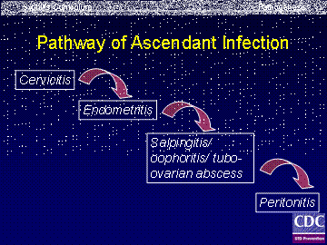

Slide 55
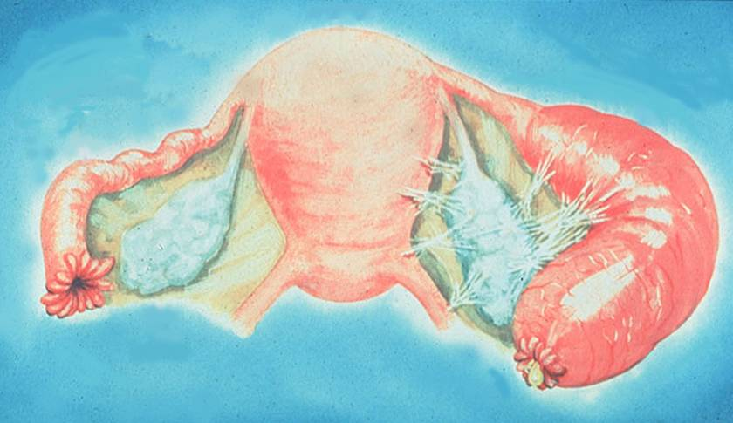
Acute Salpingitis
Source: Cincinnati STD/HIV Prevention Training Center

Slide 56
Criteria for hospitalization for PID
Inability to exclude surgical emergencies (appendicitis, ectopic pregnancy)
Pregnancy
Severe illness or high fever
Inability to tolerate oral therapy
Inability to return to clinic within 48-72 hrs
Failure to respond clinically to or tolerate outpatient therapy within 48-72 hours
Immunodeficiency (HIV infection with low CD4 count)
Tubo-ovarian abscess
Notes:
56

Slide 57
PID outpatient treatment
Ceftriaxone OR
Cefoxitin plus Probenecid OR
Other parenteral third generation cephalosporin (ceftizoxime or cefotaxime)
PLUS
Doxycycline
PLUS or MINUS
Metronidazole
Notes:
57

Slide 58
PID Inpatient Treatment
Recommended:
Cefotetan
Doxycycline
OR
Recommended:
Clindamycin
Gentamicin
Notes:
58

Slide 59
PID Sequelae
Ectopic pregnancy
  Risk increased 6- to 10-fold
Infertility
  20% of women after 1 episode
  50% of women after 3 episodes
Chronic pelvic pain
Sequelae present in 25% of women with a single episode of symptomatic PID
Notes:
59

Slide 60
PT c/o scrotal pain or swelling
Take Hx and exam
Reassure PT and educate
Provide analgesics PRN
Promote and provide condoms
HIV counsel/testing
NO
Swelling/pain confirmed
YES
NO
Treat for gonorrhoea and chlamydia (epidydimoorchitis)
Educate and counsel
Promote and provide condoms
Partner Mnx.
HIV counsel/testing
Review after 7 days
Testis rotated or
elevated or Hx of trauma
YES
Refer to surgery
Notes:
YES NO
Testis rortated or elevated or Hx of trauma
Refer to surgery
Reassure PT and educate
Provide analgesics PRN
Promote and provide condoms
HIV counsel/testing
Treat for gonorrhoea and chlamydia
Educate and counsel
Promote and provide condoms
Partner nmx
HIV counsel/testing
Review after 7 days

Slide 61
Patient complain of inguinal swelling
Take the checks and exam
NO
Inguinal/femoral
bubos present
Educate,counsel and test for HIV
Promote use of condoms
YES
NO
Treat for LGV and chancroid
If flactuant do aspiration
Partner RX
Education
HIV counsel/testing
Review after 7days
Ulcers present?
YES
Use GUD flowchart
Notes:
YES
Take the checks and exam
Inguinal/femoral bubos present
Ulcers present?
Use GUD flowchartkbgg===
Educate,counsel and test for HIV
Promote use of condoms
Treat for LGV and chancroid
If flactuand do aspiration
Partner RX
Education
HIV counsel/testing
Review after 7days

Slide 62
NEONETAL CONJUCTIVITIS
Neonate with eye D
Take HX and exam
NO
Bilateral or unilateral swollen eyelids
With purulent D
Reassure mother
TCA PRN
YES
Treat for gonorrhoea and chlamydia
Treat mother and partner for G&C
Educate mother
Return in 3 days
YES
NO
REFFER
Improved?
YES
CT RX
Notes:
YES NO
Take HX and exam
Bilateral or unilateral swollen eyelids
With purulent D
Treat for gonorrhoea and chlamydia
Treat mother and partner for G&C
Educate mother
Return in 3 days
Improved?
CT RX
Reassure mother
TCA PRN
REFFER

Slide 63
Human Papilloma virus
Lives in skin cells at pubic area, interior areas of vagina, cervix, urethra , penis and anus
Spread through contact
Once infected, a person is infected for life
Known to cause genital warts-flesh coloured cauliflower like growths on the genitals
Treated with podophyllin 10-25% solution once a week
99.7 %cause of cervical cancer

Slide 64
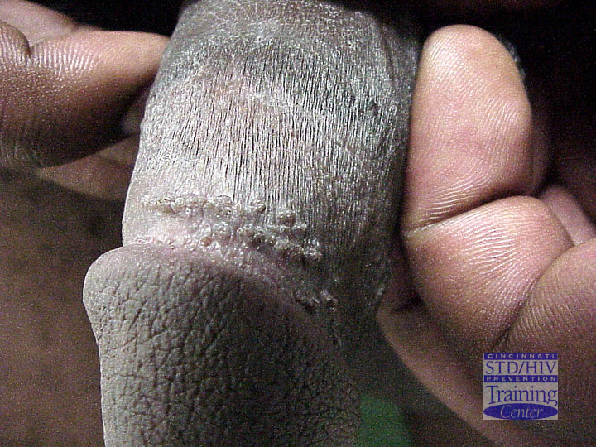
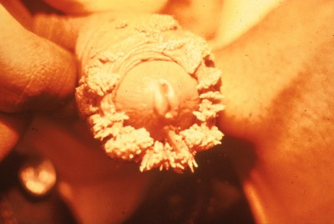
Genital Warts in a Male
Source: CDC/ NCHSTP/ Division of STD Prevention,
STD Clinical Slides
Source: Cincinnati STD/HIV Prevention Training Center

Slide 65
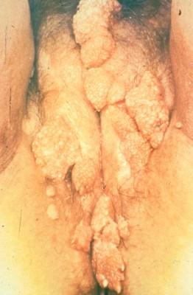
Female Genital Warts
Source: CDC/NCHSTP/Division of STD, STD Clinical Slides

Slide 66
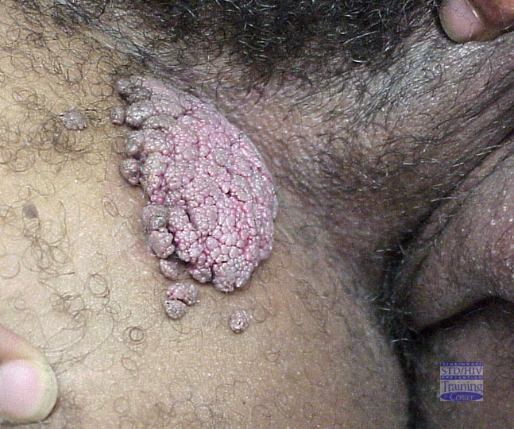
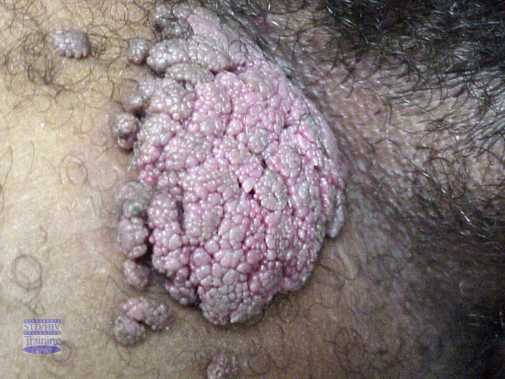
HPV Warts on the Thigh
Source: Cincinnati STD/HIV Prevention Training Center

Slide 67
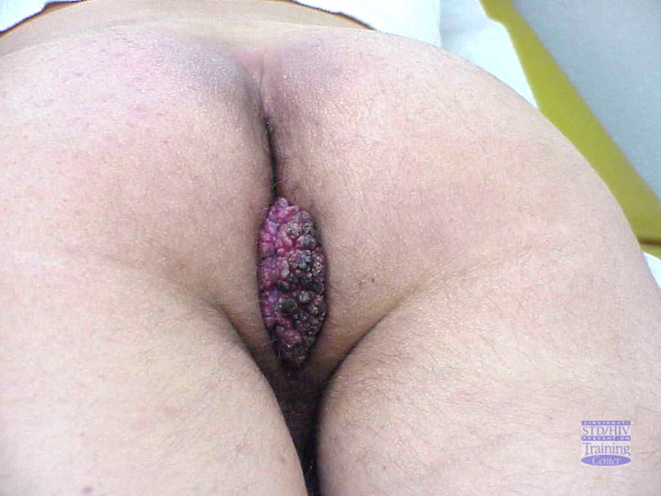
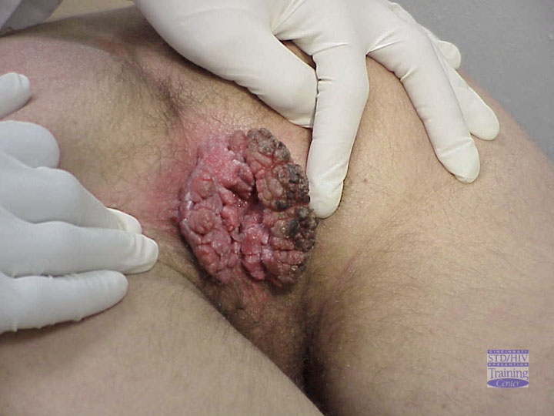
Perianal Warts
Source: Cincinnati STD/HIV Prevention Training Center

Slide 68
Preventing HPV
Vaccination
Risk reduction
Screening-pap smear , VIA/VILI, HPV DNA test, cytology screening

Slide 69
SEQUEALAE OF STIs- Adult
Pain, discomfort,
Psychological stress
Spontaneous abortion
Ectopic pregnancy
Epididymitis
Pelvic inflammatory disease
Infertility-both male and female
Chronic pelvic pain
Cancers-cervical and liver
Death(HIV)

Slide 70
Sequelae : Children
Prematurity
Low birth weights
Still births
Abortions
Congenital syphilis
Conjunctivitis
Blindness
Meningitis
Pneumonia
Death

Slide 71
Prevention of RTI/STIs
Primary
  Abstinence
  Mutual monogamy
  Correct and consistent use of condoms
  Safer sex practices
Secondary
  Early diagnosis, prompt and correct treatment
  Promotion of care seeking behaviour
  Notification of partners and treatment
  Screening for asymptomatic cases
  Community Education

Slide 72
HIV/AIDS
Brief Description

Slide 73
Types of Human Immunodeficiency Virus
Basic Virology:
There are two types of HIV.
HIV – 1
  Is found worldwide
  Is the main cause of the worldwide pandemic
HIV – 2
  Is mainly found in West Africa, Mozambique and Angola.
  Causes a similar illness to HIV – 1
  Less efficiently transmissible rarely causing vertical transmission
  Less aggressive with slower disease progression

Slide 74
Modes of Transmission
Sexual contact
  In Africa mainly heterosexual (male ↔ female)
  Includes homosexual (men having sex with men)
  Non-consensual sexual exposure (assault)
Parenteral
  Transfusion of infected blood or blood products
  Exposure to infected blood or body fluids through contaminated sharps- IDU through needle-sharing or needle stick accidents
  Donated organs, Traditional procedures
Perinatal
  Transplacental, during labor/delivery and breastfeeding

Slide 75
Transmission route | %
Sexual intercourse | 70-80
Mother-to-child-transmission | 5-10
Blood transfusion | 3-5
Injecting drug use | 5-10
Health care – e.g. needle stick injury | <0.01

Slide 76
Factors not associated with risk of transmission
  Insect bites
  Saliva (kissing)
  Sneezing or coughing
  Skin contact (e.g. hugging)
  Shared use of facilities (e.g. toilets)

Slide 77
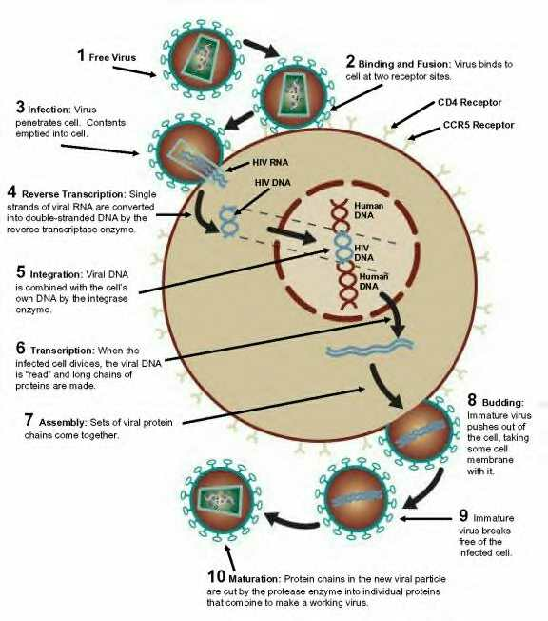
Life cycle

Slide 78
Stages
Window period- average 6 wks
Asymptomatic-several months to few years -av. 7 years
Symptomatic –several months to a few years

Slide 79
WHO CLINICAL STAGING
WHO Clinical Staging is designed to
  Be used where HIV infection is confirmed with an antibody/virological test
  Help monitor patients and determine prognosis
  Help determine prioritize need for preventive therapies
  Provide guidance as to when to start or review ARV drug therapy
  Help assess clinical response to therapy in the absence of appropriate laboratory tests

Slide 80
Clinical stage | Selected symptoms
Primary HIV Infection | Unrecognized Acute retroviral syndrome Acute febrile illness 2-4 wks post-exposure often with lymphadenopathy and skin manifestations
Stage I | Asymptomatic Persistent generalized lymphadenopathy
Stage II | Moderate unexplained weight loss (<10% of presumed or measured body weight) Recurrent upper respiratory tract infections (sinusitis, bronchitis, otitis media, pharyngitis) Herpes zoster (past or current episodes in last 2 years) Angular cheilitis Recurrent oral ulcerations (2 or more episodes in 6 months) Papular pruritic eruptions; Seborrhoeic dermatitis; Fungal nail infections of fingers

Slide 81
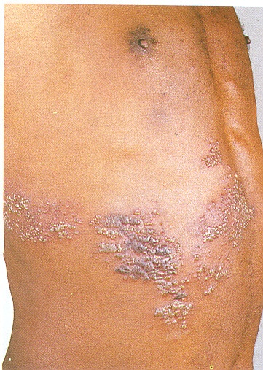
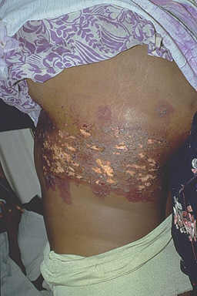
STAGE 2

Slide 82
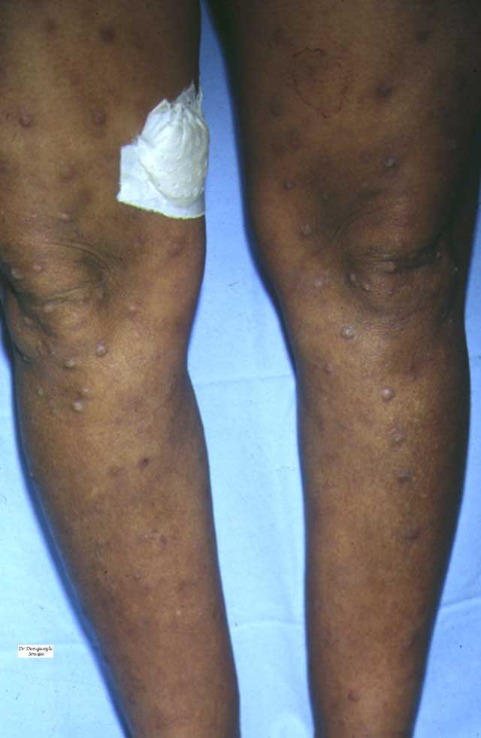
STAGE 2

Slide 83
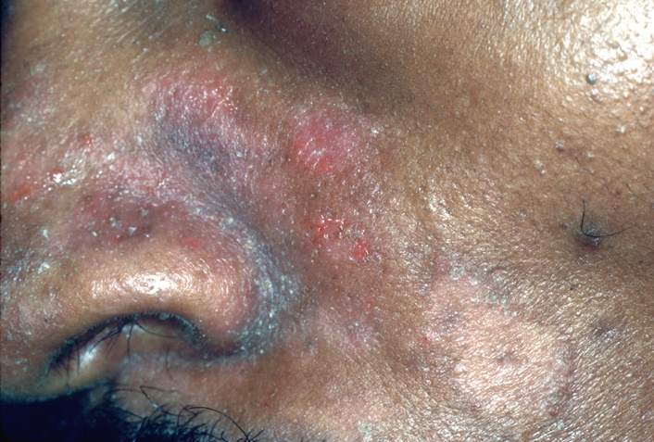
STAGE 2

Slide 84
Clinical Stage | Selected symptoms
Stage III | Conditions where a presumptive diagnosis can be made using clinical signs or simple investigations Severe weight loss (>10% presumed or measured body weight) Unexplained chronic diarrhea for > 1 month Unexplained persistent fever (intermittent or constant for > 1month) Oral candidiasis Oral hairy leucoplakia Pulmonary tuberculosis (diagnosed in last 2 years) Severe presumed bacterial infections (e.g. pneumonia, empyema, pyomyositis, bone or joint infection, meningitis, bacteremia ) Acute necrotizing ulcerative stomatitis, gingivitis or periodontitis Conditions where confirmatory diagnostic testing is necessary Unexplained anemia (<8gm/dl), neutropenia (<1,000/mm3) or thrombocytopenia (<30,000/ mm3) for > 1 month

Slide 85
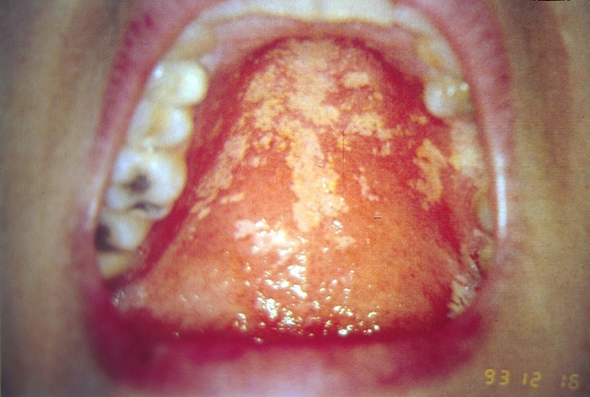
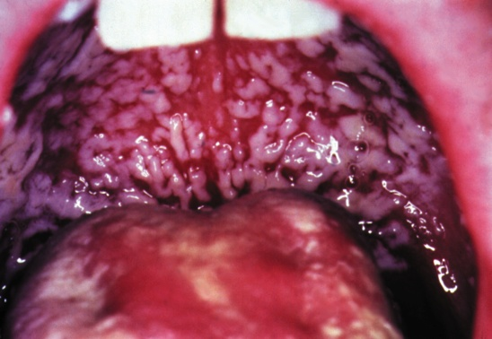
STAGE 3

Slide 86
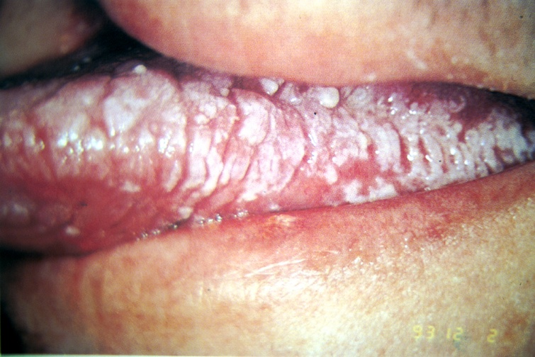
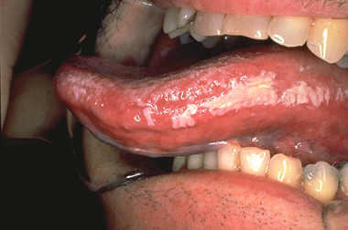
STAGE 3

Slide 87
Revised WHO Classification Clinical Stage IV
Conditions where a presumptive diagnosis can be made using clinical signs or simple investigations:
HIV wasting syndrome
Pneumocystis carinii pneumonia (PCP)
Recurrent severe bacterial pneumonia
Cryptococcal meningitis
Toxoplasmosis of the brain
Chronic orolabial, genital or anorectal herpes simplex infection for > 1month
Kaposi’s sarcoma (KS)
HIV encephalopathy
Extrapulmonary tuberculosis
Cryptosporidiosis, with diarrhea >1 month
Isosporiasis

Slide 88
Revised WHO Classification Clinical Stage IV cont..
Conditions where confirmatory diagnostic testing is necessary
Candidiasis of the esophagus or airways
Cytomegalovirus (CMV) retinitis or disease of organs (other than liver, spleen, or lymph nodes)
Non-typhoid salmonella septicemia (NTS)
Lymphoma cerebral or B cell NHL
Invasive cervical carcinoma
Visceral Leishmaniasis
Cryptococcosis (extrapulmonary)
Disseminated non tuberculous mycobacterial infection
Progressive multifocal leukoencephalopathy
Any disseminated endemic mycosis (e.g. histoplasmosis)

Slide 89
STAGE 4

Slide 90
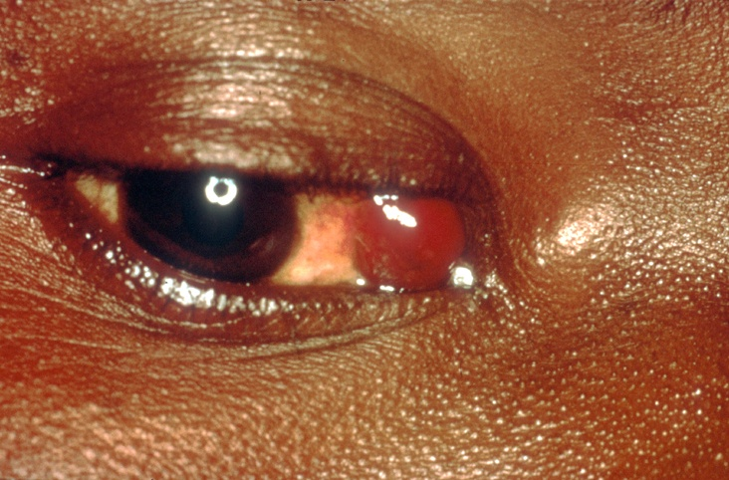
STAGE 4

Slide 91
STAGE 4

Slide 92
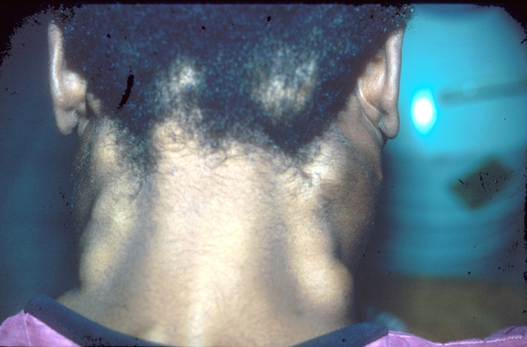
STAGE 4

Slide 93
Classification of ART
NRTIs - inhibit reverse transcription by being incorporated into the newly synthesized viral DNA and preventing its further elongation.
NNRTIs- inhibit reverse transcriptase directly by binding to the enzyme and interfering with its function
PIs (Protease Inhibitors) - target viral assembly by inhibiting the activity of protease, an enzyme used by HIV to cleave nascent proteins, for final assembly of new virons

Slide 94
Classification cont..
Entry Inhibitors/Fusion inhibitors - interfere with binding, fusion and entry of HIV-1 to the host cell by blocking one of several targets – maraviroc & enfurvitide
Integrase Inhibitors - inhibit the enzyme integrase which is responsible for integration of viral DNA into the DNA of the infected cell – Raltegravir
Maturation inhibitors - inhibit the last step

Slide 95
Nucleotide/Nucleoside Reverse Transcriptase inhibitors
  Zidovudine (AZT, ZDV, Retrovir®)
  Didanosine (ddI, Videx®, Videx EC®)
  Zalcitabine (ddC, Hivid®)
  Stavudine (d4T, Zerit®)
  Lamivudine (3TC, Epivir®)
  Abacavir (ABC, Ziagen®)
  Combivir® (AZT/3TC)
  Trizivir® (AZT/3TC/ABC)
  Tenofovir (TDF, Viread®)
  Emtricitabine (FTC, Emtriva ®)
  Epzicom® (ABC/3TC)
  Truvada® (TDF/FTC)

Slide 96
NNRTI
  Nevirapine (NVP, Viramune®)
  Delavirdine (DLV, Rescriptor®)
  Efavirenz (EFV, Sustiva®)
  Etravirine (Intelence™)

Slide 97
Protease inhibitors
  Saquinavir-HGC (SQV-HGC, Invirase®)
  Ritonavir (RTV, Norvir®)
  Indinavir (IDV, Crixivan®)
  Nelfinavir (NFV, Viracept®)
  Amprenavir (APV, Agenerase®)
  Lopinavir/ritonavir (KAL, Kaletra®)
  Atazanavir (ATV, Reyataz®)
  Fosamprenavir (fos-APV, Lexiva®)
  Tipranavir (TPV, Aptivus®)
  Darunavir (DRV, Prezista™)

Slide 98
ARV Combinations
Factors to consider:
  Efficacy- Viral suppression
  Quality of life- toxicity, pill burden
  Future options
  Improvement in immune function
  Resistance patterns
  Co-morbidities
Notes:
98

Slide 99
ARV COMBINATIONS
Base/backbone
Base- NNRTI or PI
  EFV preferable to NVP
Backbone-2 NRTIs
  TDF/FTC
  TDF/3TC
  ABC/3TC
  ABC/FTC
  Local- AZT/3TC or TDF/3TC
Notes:
99

Slide 100
Criteria for ART initiation: Kenya chapter
All HIV-infected adolescents and adults with CD4 count <500 cells/mm3 irrespective of WHO stage
All HIV-infected pregnant women irrespective of CD4 count, WHO stage or gestation age*
All HIV-infected breastfeeding women irrespective of CD4 count, WHO stage*
All HIV-infected spouses and sexual partners in sero-discordant relationships irrespective of their WHO stage or CD4 cell count

Slide 101
Criteria for ART initiation: Kenya chapter
All HIV-infected adolescents and adults with WHO stage 3 and 4 disease irrespective of CD4 count
All Hepatitis B Virus/HIV co-infected persons irrespective of CD4 count
All TB/HIV co-infected persons irrespective of CD4 count of WHO stage

Slide 102

QUESTIONS?

Slide 103
Assigmnent
Describe the association/relationship between HIV/AIDS infection and other RTI/STIs.
Describe partner management in STI/RTIs
Write notes on Hepatitis B
Describe the biological, behavioral and socio-economic risk factors facilitating transmission of HIV/AIDS or Risk factors associated with acquisition of STIs.
PREVENTION HIV/AIDS.

Slide 104
Describe the association/relationship between HIV/AIDS infection and other RTI/STIs.

Slide 105
HIV infection and other STIs comprise a single interrelated problem. Implying that controlling STIs significantly contribution to controlling HIV/AIDS.
1. HIV/AIDS & STIs are transmitted through conduct with infected body fluids i.e semen,cervical/vaginal secreations,blood and blood products. Usually during sexual intercourse but sometimes through activities. E.g skin peacing practices,BTs,organ transplants,drug injections, FGM, and other operations.

Slide 106
2. STIs are risk factors for HIV infxn bcz:
A. ulcerative STI e.g primary syphylis,chanchoid and herpes facilitate transmission bcz they produce skin breaks through which infxn can pass.
B. Non ulcerative STIs e.g. gonorrhoea, chlymedia, trichomoniasis- facilitate transmission bcz they increase the No of WBCs which are both targets and sources of HIV in genital tract and bcz they may cause microscopic infection which alow HIV to enter the body.

Slide 107
3. HIV infxn increases the risk of conracting another STI: -because it affectes the immune system HIV increases susceptibility to other STIs and severity of the additional infxn.
In pple with HIV infection OTHER STIs become more resistant to treatment.
Since HIV/AIDS & STIs are transmitted by the same behaviors & share the same risk factors they both can be controlled by preventing transmission through safer sexual practices depending on pples willingness to modify their sexual & health seeking behaviors.

Slide 108
Risk factors associated with acquisition of STIs.
OR.
Describe the biological, behavioral and socio-economic risk factors facilitating transmission of HIV/AIDS .

Slide 109
1.Biological risk factor:
A. micro-biological:-vaginal PH Normal- acidic (4) physiologically. Vagina is filled with columnar cells which are filled with glycogen- when glycogen is metabolized produces lactic acid.
B.. hormonal –can lead to disruption of cx mucus.
Also controls the mucus.
C. immunological factors.- if the immune system of a person is decreased then protection of the person is decreased.

Slide 110
2.Individual risk factor:
Individuals who starts sexual activitiy:
Age of first sexual intercourse esp women.
Young women/many sexual act are prone to tears.
Multiple sexual partners esp if sex is unprotected- increases the risk.
The frequency of exposure- increased frequency, increased risk, how many rounds.
The frequency of partners change, more frequntly the higher the risk.

Slide 111
Sexual practices- many kenyans do heterosexual, a few homosexuals-anal sex, having sex with a CSW.
Substance abuse- alcohol, drugs.

Slide 112
3.Health behavior risk factor:
Condom- reduces risk.
Pills protect pg rather than STI/D/HIV.
NON compliance with medication.
Self RX for STIs/Ds.
Inadequate health seeking behaviour.
Inadequate partner RX.- THESE have negative impact to individual.
Dishonest btn married couples.

Slide 113
4. Demographic risk factors:
Age groups- sexually active.starts from adolescents and older. Greatest risk occurs in age groups 18-35 years.
Marrital status-single men/women are at high risk of STIs..
Occupation CSW,BAR maids, military personale, police officers, seasonal labourars,students-when they leave home.

Slide 114
5. Social-economic risk factors:
Most pple migrate to cities to look for job ,live in slums/shantees-single, little pay. Do sexual intercourse for pleasure or financial gain is rampand. Pple exchange sex for money in slums to get food.
Some communities, rituals after death /customary, wife inheritance, cleansers –to clean the sex.
Cultural practices- circumcision using one knife,tattoos.

Slide 115
6. Environmental risk factors:
Civil war- normal fxn of the community is affected. E.g health services, like in case of IDPs- no acces to drugs.
Mvt of pop.
Breakdown of health care services- no proper mnx of dzzs.
Rape-unprotected sex.,sexual abuse- blaming the victim, instead of empathizing with the sex survivors.

Slide 116
Impact of HIV/AIDS:
DEATHS-loose 300 pple/day in Kenya, 60% of economically potential pple are affected.
PERFORMANCE- go down.
LIFE EXPECTANCY-b4 HIV,avr life time was upto 65 yrs, with HIV life expectancy has reduced to 46 yrs.
HOSPITOLIZATION-many HIV pts are in H/C facilities , should get drugs.

Slide 117
Prevention of HIV/AIDS:
ABCs ,4 Cs.
H/E.
Decrease sexual partiners.
PMCTC-THE INFXN can occur during PG,DELIVARY,BF.
If infected mother –exclusive BF OR no BF.
MOD-C/S esp cpd,prom,decrease birth trouma,decrease Ves.
Control/RX STIs.-these persons have more than 4 times of conducting HIV.
BT- blood must be screened for HIV virus.

Slide 118
Promotion of behavior change/behavior formation:
A. Despite high levels of HIV awereness of over90% this has not translated to behavior change.
B. To achieve these target adolescent youth and pop in slums and border towns ,nomadic and beach communities, CSW,LONG DISTANCE TRACK DRIVERS,SHOOLS,COLLEGES and UNIVERSITIES MUST BE given H/E.

Slide 119
REFRENCES
CDC WEBSITE
National guidelines on management of STI/RTIs
WHO WEBSITE

