Slide 1
SEXUALLY TRANSMITTED INFECTIONS (STIs) AND HIV/AIDS 30 HOURS SEP, 2019 CLASS Mr Bernard chepkwony

Slide 2
Broad Objective
The student will acquire knowledge, skills and attitudes to be able to promote health, prevent illness, diagnose, manage and rehabilitate clients/patients suffering from STI/HIV/AIDS

Slide 3
Specific Objectives
Explain the major trends in the extend and distribution of infection
Explain common STIs
Explain the importance of health messages on STI
Explain counseling approaches to clients/patients with STI
Discuss community mobilization

Slide 4
Introduction
The term sexually transmitted infections (STIs) is used to refer to a variety of clinical syndromes caused by pathogens that can be acquired and transmitted through sexual activity.
STIs are a major global cause of acute illness, infertility, long-term disability and death with serious medical and psychological consequences of millions of men, women and infants.

Slide 5
Ct
There are over 30 bacterial, viral and parasitic pathogens that have been identified to date that can be transmitted sexually
STIs have also been shown to have a link with increased vulnerability to HIV infection.

Slide 6
Intro ct’
The World Development Report (1993) estimated that, globally, in high-prevalence urban areas, STIs account for up to 17% of productive healthy life years lost.

Slide 7
Why STI’S and HIV/AIDS Kenyans most serious public health problem?
Rapid spread
Inevitable death (HIV/AIDS)
Far reaching consequences for families and communities
Results in problems which affect nation development and hence the welfare of all Kenyans

Slide 8
All STIs comprise a single interrelated problem
They are co-factors e.g syphilis, chancroid & herpes. Are risk factors to HIV/AIDs infections
Are transmitted the same way i.e through contact with body fluids that are infected
Their control primarily depends upon the same condition i.e pple willingness to modify their sexual behaviour and health seeking behaviour

Slide 9
Epidemiology of STIs
The total number of new cases in adults of STIs in 2008 was estimated to be 498.9 million.
105.7 million cases of C. trachomatis
106.1 million cases of N. gonorrhoea
10.6 million cases of syphilis
276.4 million cases of T. Vaginalis
Males accounted for 266.1 million or 53% of the new cases

Slide 10
Prevalence of HIV/AIDS in Kenya
COUNTY PREVALENCE %
COUNTY PREVALENCE %
HOMA BAY 25.7
SIAYA 23.7
KISUMU 19.3
MIGORI 14.7
NAIROBI 8.0
KISII 8.0
TURKANA 7.6
MOMBASA 7.4
TRANS NZOIA 5.1
NAROK 5.0
UASIA GISHU 4.3
MAKUENI 5.6
KILIFI 4.4
BARINGO 3.0
MACHAKOS 5.0
KAKAMEGA 5.9
BUSIA 6.8
BUNGOMA 3.2
WEST POKOT 2.8
MERU 3.0
GARISSA 2.10
ISIOLO 4.20
E/MARAKWET 2.5
SAMBURU 5.0
MARSABIT 1.20
LAMU 2.30
TANA RIVER 1.00
WAJIR 0.20

Slide 11
Prevalence of STIs and HIV/AIDs
They differ by;
Urban/rural residence
Geographical region
Age groups
Sex
Occupation

Slide 12
1. Urban/rural residence
Proportions is higher in urban than rural areas but 80% of Kenyans live in rural areas , the absolute total of the infected rural dwellers exceeds the urban
2. Geographical regions
Present all parts of Kenya.
Prevent in places of high pop mobility to urban areas

Slide 13
3. Age
Largest concentration of STIs is among adults aged 20-45 years
These are most economically productive members of pop.
4. Sex
Even though the number of infected male-female are roughly equal, women are likely infected in younger age than men

Slide 14
5. Occupation
Pple who work away from home, away from their sexual partner are higher than average rate to STIs
6. others
Groups that are higher than average include;
Babies with infected mothers, uncircumcised men, sexually active teenagers

Slide 15
Consequences of STIs for the infected
Death- HIV infection within 10yrs or more or within 1-2yrs after onset of serious illness
Other STIs
Infertility in men and women
Death to sepsis, ectopic pregnancy, cancer of cervix in females
Urethral stricture which can lead to renal failure in men
Congenital blindness & congenital malformation

Slide 16
Ct consequences
Painful intercourse
general debilitation
loss of energy and productivity
increases subset ability to HIV infections
STIs are among the top ten causes of morbidity in Kenya

Slide 17
Consequences of STIs for the family
Health
Easily transmitted and therefore threaten health of the persons sexual partner and the outcome of pregnancy
Economic status
Infections change adults from produces of resources and providers of services to consumers of family income
Cost
The cost of treatment of servere and re-current illness plus reduced income lead to accumulation of housed hold expenditure

Slide 18
Social welfare
All STIs disrupt family relationships
Contribute to marital instability
Loss of trust and conflict
Infertility
Pregnancy wastage
Divorce
Stigmatization

Slide 19
Children affected
Loss of care and emotional support
Insufficient attention to health and socialization means
Malnutrition
Curtailed schooling
Loss of rights and possations
Exploitation and in risk of contracting HIV

Slide 20
Consequences for the country
Health sector
Cost of Rx STI strains resources
Increase death rates in hospitals
Increases of ministry recurrent expenditure
Economic consequences
STIs/AIDS threaten to slow the rate of economic development
Demographic
HIV lowers average life expectancy by 17 years
Rise of child mortality

Slide 21
GENDER IMPLICATION OF STIS
Role expectations lead men towards high risk, but biological, social and economic factors make women more vulnerable

Slide 22
Factors that make male to be at risk
Customary practices like polygamy, wife inheritance
Migrant labour patterns
Male economic power over female economic dependence
The belief that frequent sexual intercourse is a male right and necessity

Slide 23
Social economic factors that contributing to female risk
Lack of economic opportunity- leads to dependency on male
Cultural traditions dependency make it had for females to negotiate for condom use (safe sex)

Slide 24
Reasons why STIs are prevalent
a. Avoiding treatment
Lack of symptoms- failure to recognise s/s
Lack of access of health care
Preference to traditional healers
Fear of stigma, lack of confidence on health workers
b. Reluctance to refer partners
Pple with STI are reluctant to refer their partners

Slide 25
c. Reluctance to use condoms
Lack of familiarity
Stigma associated with condom use
Cultural and religious prohibition
Fear that sex is less enjoyable
Fear of side effects (allergy)

Slide 26
GOVERNMENT POLICY ON STIs
Govt of Kenya has recognized that STI/AIDs have become National crisis and taken significant action towards their control
Govt has committed itself to the following;
Prevention of transmission of STIs/HIV sexually
Prevention of HIV thro blood and blood products
Reduction of social-economic impact of STIs
Coordination of research
Mx & coordination of multi-sectral AIDs control programs e.g NASCOP etc

Slide 27
Significant aspect of govt programs
Attendance to HIV/AIDs and other STIs
Recognition that will form a single interrelated problem and emphasis on prevention through safer sex practices which can be achieved through;
Education
Counselling
mobilization

Slide 28
UNDERSTANDING STIs
Most of them are primarily preventable by means which bring an individual into contact with semen, vaginal secretions, blood of an infected sexual partner

Slide 29
Modes of transmission
Unprotected sexual intercourse (over 80%)
Others for HIV
Blood transfusion or contact with contaminated blood or blood products (3 to 5% )
Transplant of contaminated organs
Use unsterile needles skin piercing implants including surgical instrument

Slide 30
Mother to child transmission (13 to 40%)
During pregnancy for HIV and syphils
During delivery i.e gonorrhoea, HIV, Herpes simplex virus, and Chlamydia
After birth HIV
Non sexual behaviours
Tattooing
Traditional circumcision
Traditional delivery with unsterile equipments

Slide 31
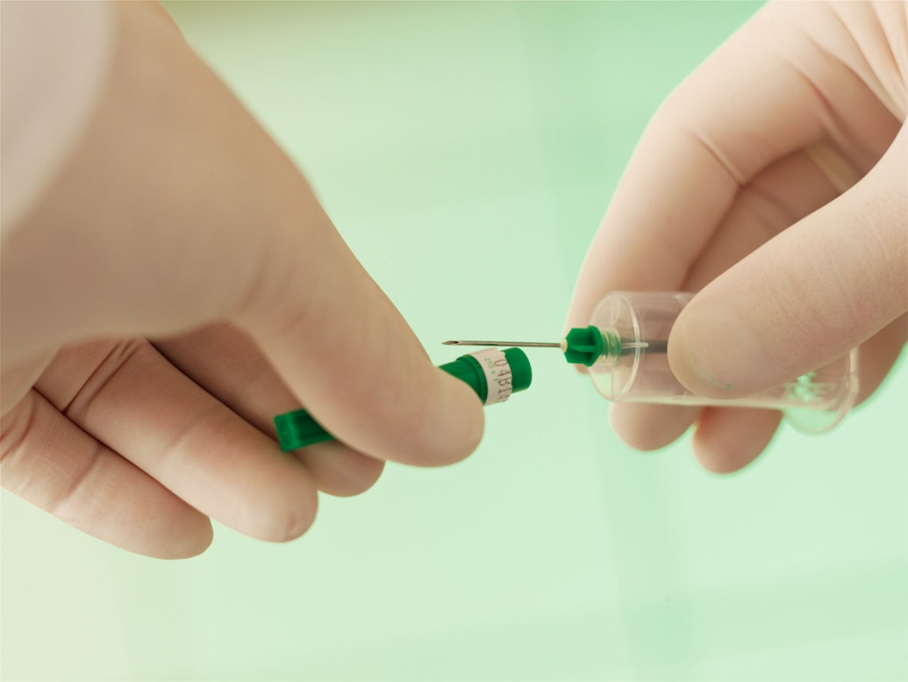
Intravenous (IV) Drug Use (5 – 10% )
Occupational Exposure to HIV infected Material/specimens

Slide 32
Association Between HIV/AIDS and STI/RTI (assign)
STI primarily disrupt the integrity of the skin/mucosal barrier, enabling HIV easy access to the body.
The presence of genital ulcers is known to increase the risk of HIV transmission by 10 to 100 times.
STIs that primarily cause inflammation, such as gonorrhoea, trichomoniasis, and Chlamydia, weaken the skin barrier to HIV.

Slide 33
Ct association
Increased viral shedding has been reported in genital fluids of patients with STI/RTI.
STI/RTI treatment has been demonstrated to significantly reduce HIV viral shedding.

Slide 34
HIV infection affects STIs through:
HIV alters the response of STIs pathogens to antibiotics. This has been reported for chancroid and syphilis.
HIV alters the clinical appearance and natural history of STI/RTI as in genital herpes and syphilis.
HIV-infected individuals have increased susceptibility to STI/RTI.

Slide 35
Ct
Number of sexual partners and high risk partner selection, and are associated with increased heterosexual HIV transmission.
Due to this epidemiological synergy, STI/RTI control is considered a key strategy in the primary prevention of HIV transmission.

Slide 36
STIs/RTI MANAGEMENT

Slide 37
Syndromic Approach to STI
STI syndromes refer to a group of consistent symptoms and/or easily recognizable signs caused by two or more STI/RTI agents.
Diagnosis is based on identification of a group of consistent symptoms and easily recognized signs (syndromes).

Slide 38
Ct
The provision of treatment deals with the majority or most serious organisms responsible for producing the syndrome, rather than for specific STI/RTI.
Syndromic case management is ideal in settings where facilities for laboratory diagnosis to support aetiological diagnosis are lacking.

Slide 39
Rationale for Syndromic Approach
Traditionally, health care providers rely on two approaches to diagnose STI
Aetiological Diagnosis
Clinical Diagnosis

Slide 40
Aetiological Diagnosis
Identifying the organism causing the symptoms through laboratory tests. This is not only expensive and manpower intensive, but also time consuming
Clinical Diagnosis
Identifying the STI based on clinical experience. However, even experienced STI/RTI service providers often make wrong diagnoses.

Slide 41
Challenges with Aetiological Approach
In most health care settings in Kenya, health care providers lack time and equipment to diagnose STI through laboratory tests.
The reliability of test results in most settings is affected by the sensitivity and specificity of the available STI tests and competence of the laboratory staff.

Slide 42
Ct
Use of laboratories is time consuming for patients and clinicians. It is common for many patients not to return for test results, so the opportunity to treat them is lost.
Many health workers often diagnose STI/RTI based on clinical judgment alone, which in most cases turns out to be wrong.
Mixed infections with STI agents that produce similar signs and symptoms are common and may be missed with clinical approach.

Slide 43
Advantages of the Syndromic Approach
Improved management of STIs
Easy for primary health care workers to learn and apply
Enables treatment of symptomatic patients in one visit without being referred for laboratory tests, which may not be available the same day, necessitating a return visit

Slide 44
Ct
Enables treatment for STI/RTI to be provided even in peripheral health units
Referrals are limited to complicated cases
Economical, timely
Allows for bulk drug purchasing

Slide 45
Common STI/RTI Syndromes
Urethral discharge
Genital ulcer disease (GUD)
Lower abdominal pain
Abnormal vaginal discharge
Ophthalmia neonatorum

Slide 46
Categories of STIs
Bacterial: Syphilis, Gonorrhoea
Fungal: Candidiasis
Protozoa: Chlamydia, Trichomoniasis
Viral: Hepatitis, Genital Herpes Simplex, HIV, Genital Warts

Slide 47
Components of Syndromic STI Case Management
Case management of STI/RTI refers to the care of a person with an STI/RTI syndrome.
The objective of effective STI/RTI case management is to cure the patient, break the chain of transmission, prevent re-infection, and avoid complications.

Slide 48
STI/RTI case management includes;
proper clinical assessment Ct case mx
correct diagnosis
prescription of appropriate medication
education about risk reduction
treatment compliance
condom use
partner management

Slide 49
Components of STI Case Management
Clinical assessment based on appropriate history taking
Physical examination
Syndromic classification
Specific Syndromic treatment
Education/counselling

Slide 50
1. History Taking
Name, age, address, sex, marital status, occupation, date of consultation
Presenting complaint, nature of symptoms and their duration
History of previous medication for the complaint and duration of treatment
Previous history of STI/RTI
Past medical history and treatment for allergies

Slide 51
Hx taking ct
Recent sexual partners:
Last sexual intercourse, with who, when, and condom use
Previous sexual intercourse with another person before the one above, with who, when, and condom use
Number of sexual partners in the last one and three months
Whether any of the partners have an STI/RTI complaint

Slide 52
In addition, for females:
Last normal menstruation period and pregnancies
Regularity of flow and the amount of blood
Number of children with their ages from the youngest to oldest
Number of abortions with ages of gestation in order of occurrence

Slide 53
2. Physical Examination
General Physical Examination
Look for important findings in: hair and skin, the palms and soles, preauricula rand epitrochlear lymph nodes, eyes, mouth, abdomen, and inguinal lymph nodes

Slide 54
Genital Examination: Males
Pubic hair, scrotum, inguinal lymph nodes, testes, epididymis, shaft of penis, prepuce, glans/coronal sulcus, urethral meats, genital discharge after milking the penis, and lastly, perineum

Slide 55
Genital Examination: Females
Pubic hair, inguinal lymph nodes, labia, vulva, urethral opening, bimanual palpation, cervical excitation, tenderness, masses, discharge on examining finger (colour, smell, consistency), and perineum
Speculum examination: Check for vaginal polyps, discharge, cervical polyps, tumours, IUCD threads, cervicitis, etc.

Slide 56
3. Education/Counselling
Educate and counsel on:
Treatment compliance
Nature of infection
Mode of transmission of infection
Risk reduction
Proper use of condoms and other safer sex methods
Early STI/RTI care seeking behaviour
Partner notification and treatment
Four Cs

Slide 57
4 Cs
Counselling: Empathise with your patient.
Compliance: Your patient should avoid self-medication, take full course of medication and not share or keep it, and follow instructions as advised.
Contact tracing: Encourage disclosure and tell all his/her sexual partners to seek medication.
Condoms

Slide 58
1. Urethral Discharge Syndrome
Urethral discharge is one of the most common STI/RTI syndromes among men, and is associated with serious complications.
This syndrome is commonly caused by Neisseria gonorrhoeae and Chlamydia trachomatis in over 98% of cases.
Other infectious agents include Trichomonas vaginalis, Ureaplasma urealyticum, and Mycoplasma spp.
Mixed infections, especially of Neisseria gonorrhoeae and Chlamydia trachomatis, occur.

Slide 59
Ct
It is characterized by purulent urethral discharge with or without dysuria.
The amount of discharge varies depending on the causative pathogens as well as prior antibiotic treatment.

Slide 60
Ct
If the discharge is not readily apparent, it may be necessary to milk the penis and massage it forwards before the discharge becomes apparent.
In uncircumcised patients, examination with the foreskin retracted will ascertain whether the discharge is from the urethra or from beneath the prepuce.

Slide 61
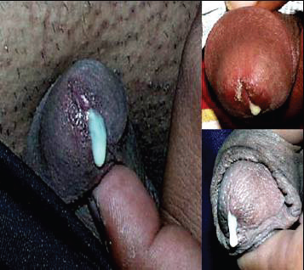

Slide 62
Management
Patients should be managed according to the National STI/RTI Syndromic Mx
proper clinical assessment
correct diagnosis
prescription of appropriate medication
education about risk reduction
treatment compliance
condom use
partner management

Slide 63
Ct Mx
Norfloxacin 800mg stat (or Ciprofloxacin 500mg stat) and Doxycycline 100mg BD x 7 days
ALTERNATIVE TREATMENT
IM Spectinomycin 2g stat (or IM Ceftriaxone 125-250mg single dose) and Doxycycline 100mg BD x 7 days
Emphasize 4Cs
Offer or refer for HIV testing services.

Slide 64
2. Genital Ulcer Disease
Genital ulcer disease is one of the most common syndromes that affect men and women.
The aetiology of the syndrome varies in different geographical areas and can change over time.
Genital ulcers have an epidemiologically synergistic relationship with HIV.

Slide 65
GUD
HIV alters the natural history of syphilis and chancroid, where more aggressive lesions may manifest.
HIV transmission, on the other hand, is enhanced in presence of ulcerative STI/RTI.

Slide 66
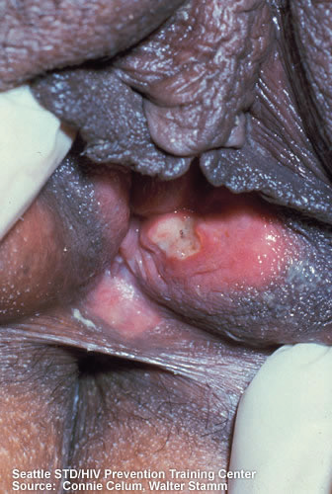

Slide 67
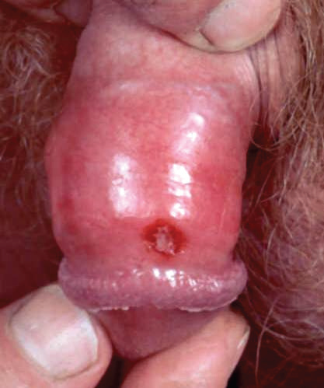

Slide 68
Ct’
In men, GUD occurring under the prepuce may present as a discharge.
Similarly, GUD in women may also present as a discharge, underlying the importance of clinical examination.
Genital herpes manifest with more persistent lesions.
Single or multiple ulcers can present.

Slide 69
A. Chancroid
Chancroid is caused by a bacterium known as Haemophilus Ducreyi.
Both males and females with chancroid develop painful, dirty-grey, genital ulcers.
In males, ulcers are commonly found on the edge of the glans-penis, but can appear anywhere on the external genitalia.

Slide 70
Ct’
In females, ulcers may be found anywhere on the external genitalia including around the vulva, clitoris, and anus, or inside the vagina and on the cervix.
A chancroid ulcer is painful while a syphilitic ulcer is not.

Slide 71
Clinical features
Ulcer
Enlarged, red, hot lymph nodes in the groin, called buboes. They should be aspirated with a wide-bore needle every two days if necessary.
When a bubo is ready for aspiration, the skin overlying it is shiny and the area underneath it is soft.

Slide 72
B. Syphilis
The disease is caused by a bacterium known as Treponema Pallidum.
It can affect all organs of the body. It occurs in two forms: early (primary) and late syphilis.
In early syphilis a client is infectious to his/her sexual partners. During late syphilis, the client is not infectious to sexual partners.

Slide 73
Primary Syphilis
Three weeks after contact with an infected partner, the ulcer develops at the site of infection. This is the primary chancre.
It may be found anywhere on the penis in males. In females it is found on the external genitalia, the vaginal opening, inside the vagina, or on the cervix.
In both men and women, it is a painless, single, firm ulcer with a punched-out appearance.

Slide 74
Ct 1⁰ syphilis
It may heal without treatment but the client can still infect others and may develop serious cardiac and CNS symptoms later. The client needs to be treated.

Slide 75
Secondary Syphilis
Between two and four months following initial infection, clients may develop secondary syphilis.
The first sign is a non-itchy rash all over the body which may become papular(round, solid raised lesion), pustular(infected pimples), or may develop into flat warts (condylomata lata).

Slide 76
Ct manifestations of 2⁰ syphilis
There may be whitish lines on the tongue and mucous membrane of the mouth called snail track ulcers. They may be generalised lymph node enlargement.
Neurologic infection- cranial nerve dysfunction, meningitis, stroke, acute or chronic altered mental status, loss of vibration sense, and auditory/ophthalmic abnormalities, which might occur through the natural history of untreated infection

Slide 77
Latent Syphilis
During this stage, there are no signs or symptoms but a blood test is positive and the client should be treated.
Late syphilis
Untreated syphilis may progress. After two to 15 years, the heart and brain may be affected. At this time the disease cannot be passed to other people.

Slide 78
C. Genital Herpes
Infection is caused by the herpes simplex virus.
In males, the client develops itchiness at the site of infection. This may be on the foreskin, the shaft of the penis, or the glans-penis. A small area of redness appears which develops into small blisters. This may break down to reveal painful, shallow ulcers.

Slide 79
Ct’
In the first attack, lesions are more extensive and cause severe pain. The attacks heal after about two to three weeks.
In females, the lesions are on the cervix, the labia, the vagina, or around the anus. During the first attack, there may be quite extensive inflammation of the cervix, the vulva, and the vagina.

Slide 80
Ct’
Recurrence of lesions occurs in about 50% of clients; lesions are usually less extensive and heal within five to seven days.
Recurrences in both males and females may follow sexual contact and stress. In females they may also follow the menstrual period.

Slide 81
Ct’
There is no effective cure. Clients should be reassured, but warned that a recurrence of ulceration is possible and that they should not have sexual intercourse while lesions are present.
Herpes simplex virus can be passed on when there are ulcers.
Tell the client to keep the lesions clean and dry and wash with soap and water.

Slide 82
Management of Genital Ulcer Disease
Erythromycin 500mg TID x 7 days
&
Benzathine Penicillin 2.4 MU IM stat
If Penicillin allergy:
Use Erythromycin 500mg QID x 14 days
Alternative GUD Rx:
Ciprofloxacin 500mg single dose

Slide 83
CT’ Mx
Treatment should be given as soon as possible owing to the increased risk of HIV transmission.
Emphasize 4Cs as per the Syndromic chart.
Offer or refer for HIV testing services.
N/B
Treat HSV2 with Acyclovir 400mg TID for 7 days if client presents with an ulcer with multiple vesicles (painful) grouped together with history of recurrence.

Slide 84
3. Vaginal Discharge
Physiological discharge: normal
Clear or white
Viscous in consistency
Located in the posterior fornix of the vagina
Microscopy of normal vaginal secretions reveals:
Superficial epithelial cells
Lactobacilli with long rods
Few white blood cells
Physiologic vaginal discharge requires no Rx

Slide 85
Vaginal Discharge

Slide 86
Abnormal Vaginal Discharge
Abnormal vaginal discharge is one of the most common STI/RTI syndromes among women, but also one of the most complicated to manage.
All women have a physiological vaginal discharge which may increase during certain situations.
Normally, women will only complain if they perceive the discharge to be abnormal.

Slide 87
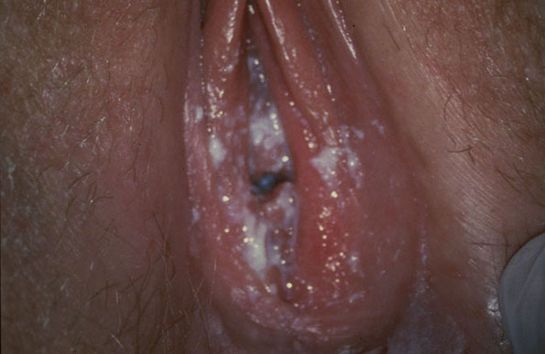

Slide 88
Aetiology
The symptom of abnormal vaginal discharge is highly indicative of vaginitis and poorly predictive of cervicitis
Bacterial vaginosis, vulvovaginal candidiasis, and trichomoniasis are the most common causes of vaginitis
Gonococcal and chlamydial infections cause cervicitis.
Distinction between the two on clinical grounds is usually difficult.

Slide 89
Characteristics of Vaginal Discharge by Causative Agent
Neisseria Gonorrhoea– Greenish-yellow discharge
Chlamydia trachomatis– Scanty muco-purulent or purulent discharge
Trichomonas vaginalis– Frothy, profuse, greenish-yellow foul-smelling discharge
Candida albicans– White, curd-like discharge
Gardnerella vaginalis– Profuse foul-smelling and homogenous greyish-white discharge

Slide 90
Management of Vaginal Discharge
Speculum examination and referral for specialist management may be necessary.
Persistent abnormal vaginal discharge should be evaluated to exclude cervical cancer.
Patients should be informed about the endogenous and recurrent nature of vaginitis to avoid partner discord.

Slide 91
Ct’ Mx
Emphasize 4Cs as per the syndromic chart.
Offer or refer for HIV testing services
VAGINITIS Rx
Clotrimazole 1 pessary intravaginally daily for 6 days Or
Clotrimazole 200mgs pessaries intravaginally daily for 3 days) AND Metronidazole 400mg
If pregnant
Clotrimazole 1 pessary intravaginally daily x 6 days Or
Clotrimazole 200mgs pessaries intravaginally daily for 3 days)

Slide 92
CERVICITIS RX
Norfloxacin 800mg stat (or Ciprofloxacin 500mg stat)
&
Doxycycline 100mg BD x 7 days
IF PREGNANT
IM Spectinomycin 2gm stat (or IM Ceftriaxone 250mg single dose)
&
Erythromycin 500mg QID x 7 days

Slide 93
Lower Abdominal Pain Syndrome (PID)
This is one of the most common and most serious STI syndromes among women, with very serious reproductive health and socioeconomic consequences.
PID comprises a spectrum of inflammatory disorders of the upper female genital tract, including any combination of endometritis, salpingitis, tubo-ovarian abscess, and pelvic peritonitis

Slide 94
Causes
Sexually transmitted organisms, especially N. gonorrhoeae and C. trachomatis, are implicated in many cases; however, microorganisms that comprise the vaginal flora (e.g., anaerobes, G. vaginalis, Haemophilus influenzae, enteric Gram-negative rods, and Streptococcus agalactiae) have been associated with PID

Slide 95
Clinical manifestations
Abdominal pain,
abnormal cervical or vaginal mucopurulent vaginal bleeding
Dyspareunia
fever, and sometimes vomiting.
N/B
Patients should be carefully evaluated for abdominal tenderness, cervical motion and adnexial tenderness, enlargement of uterine tubes, and tender pelvic masses.

Slide 96
Diagnosis
A thorough history and examination to exclude other surgical and/or gynaecological emergencies must be done.
Bimanual vaginal examination

Slide 97
Management
Norfloxacin 800mg stat (or Ciprofloxacin 500mg single dose) AND
Doxycycline 100mg BD x 7 days
Metronidazole 400mg BD x 10 days
If pregnant:
Refer for obstetric evaluation if PID is suspected

Slide 98
ALTERNATIVE TREATMENT
Azithromycin 1gm PO single dose or
Cefixime 400mg PO single dose
Emphasize 4Cs as per the syndromic chart.
Offer or refer for HIV testing services.

Slide 99
4. Ophthalmia Neonatorum
This refers to conjunctival infection of neonates.
Neonates acquire this infection during passage through an infected birth canal during delivery.
Occurs between 4–7 days of life, but can occur anytime in the first 28 days.
Caused by Neisseria gonorrhoea(GC) or Chlamydia trachomatis(Chlamydia).

Slide 100
Clinical manifestations
This disease is often characterized by bilateral purulent eye discharge. In early stages, the discharge may be “sticky,” causing the eyelids to be stuck together in the morning, rather than the thick, greenish pus seen later.
The conjunctiva is inflamed and eyelids swollen.
Corneal scarring may occur if treatment is delayed.
Blindness in children is associated with high infant morbidity and mortality.

Slide 102
Treatment
1% TETRACYCLINE eye ointment TDS x 10 days
Treat mother for cervicitis and partner for urethritis
Alternative
Ceftriaxone 62.5mg IM stat and 1%
Tetracycline eye ointment TDS x 10 days and 4Cs

Slide 103
5. OTHER STI SYNDROMES
Inguinal Buboes
Painful scrotal swelling
Balanitis
Bartholin’sabscess
Genital warts
Congenital syndromes

Slide 104
Genital warts
Genital warts are caused by a virus –human papilloma virus.
They usually have the appearance of flesh-coloured cauliflower-like growths on the genitals.
The penis and foreskin (men) and the labia or vagina (women) are the most common sites of the warts.
The warts can be variable in number and size, either few or multiple, small to very large.

Slide 105
Clinical manifestations
Are usually asymptomatic, but depending on the size and anatomic location, they can be painful or pruritic.
Genital warts are usually flat, papular, or pedunculated growths on the genital mucosa
Genital warts occur commonly at the introitus in women, under the foreskin of the uncircumcised penis, and on the shaft of the circumcised penis.

Slide 106
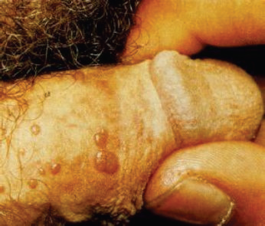
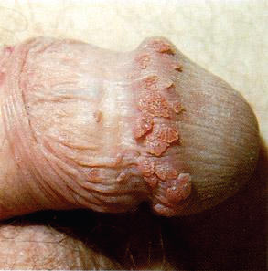

Slide 107
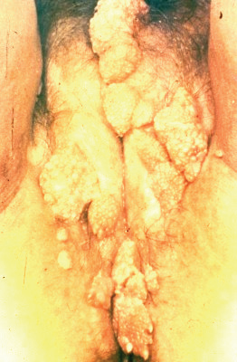
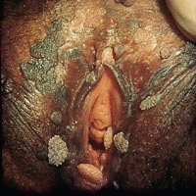

Slide 108
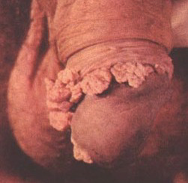
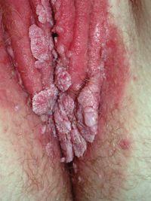

Slide 109
Management
Warts are treated with local application of podophyllin(10-25% solution) once a week.
After treatment of warts, the medication must be washed off within 2-4 hours to avoid developing sores at the site of treatment.
Podofilox 0.5% solution or gel
OR
Imiquimod 5% cream
OR
Sinecatechins 15% ointment

Slide 110
PREVENTION AND CONTROL OF STIs
Although most STI can be treated and cured, it is more cost effective to prevent them.
Community education on the risk factors and promotion of behaviour change in prevention and control of STI are important.
STI prevention measures revolve around intervention on sexual behaviour of individuals.
Various intervention measures are needed to accommodate different desired outcomes of sex for different people.

Slide 111
Primary Preventive Measures
Some of the measures one can employ to avoid STI include:
Abstinence
Mutual monogamy
Correct and consistent use of condoms
Safer sex practices

Slide 112
1. ABSTINENCE
This might be total abstinence from sex or, for groups such as students and youth not yet married, one should encourage “postponed sex” till one is ready for marriage.

Slide 113
2. MUTUAL MONOGAMY
Mutually faithful sexual relationship or what is usually termed as “Zero grazing” if both partners are not already infected.

Slide 114
3. CORRECT AND CONSISTENT USE OF CONDOMS
This intervention is recommended for those who cannot abstain and yet cannot have a mutually faithful relationship.

Slide 115
4. SAFER SEX PRACTICES
Safer sex practices are many and varied but all revolve around the principle of avoiding exchange of sexual or body fluids, yet enabling the individual(s) to obtain what they desire out of sex.

Slide 116
Some of the safer sexual practices include:
Sex with other parts of the body that don’t produce body fluids (non-penetrative sex)
Correct and consistent use of condoms
Masturbation of self or with objects

Slide 117
SECONDARY PREVENTION
Early diagnosis and prompt and correct treatment of STI
Promotion of STI care-seeking behaviour, including reduction of barriers to care
Notification of partners and treatment
Screening for asymptomatic cases

