Slide 1
THE RESPIRATORY SYSTEM
PRESENTATION BY BOSIRE SYLVIA

Slide 2
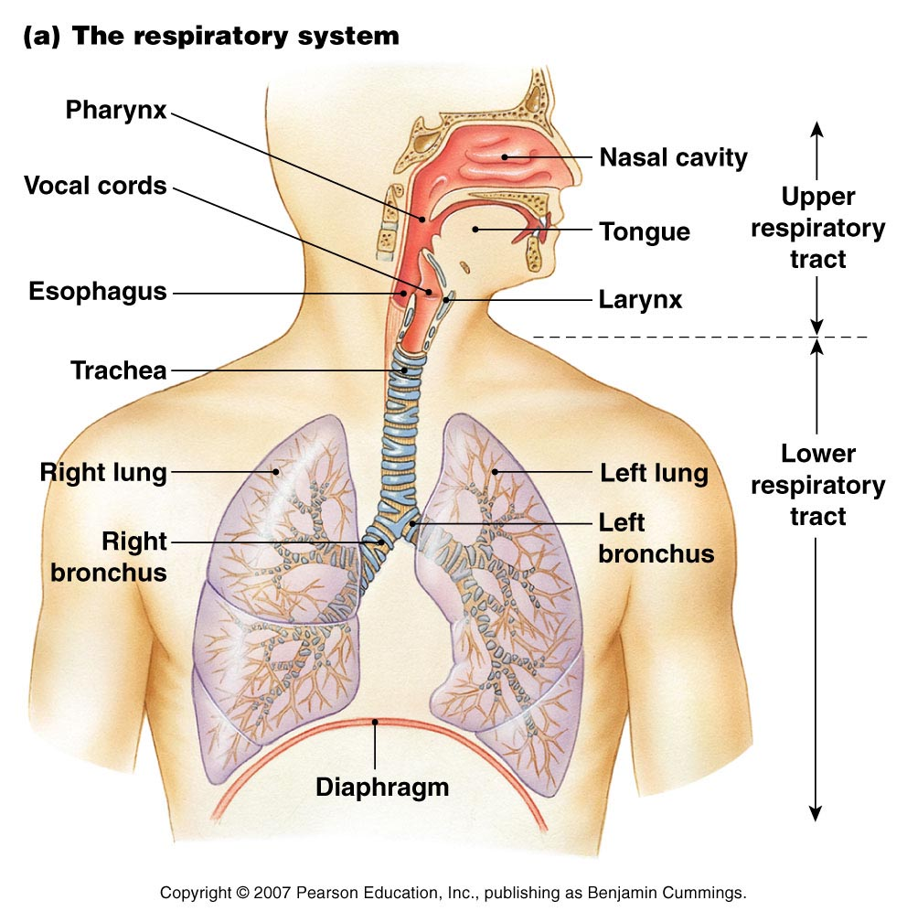

Slide 3
Introduction
The respiratory system (respiratory apparatus,ventilatory system) is a biological system consisting of specific organs and structures used for gaseous exchange in human.

Slide 4
Introduction
The respiratory system consists of the upper and lower respiratory tracts.
Upper Respiratory Tract includes: nose, pharynx, larynx
Lower Respiratory Tract includes: trachea, bronchi and lungs

Slide 5
Respiratory system
Consists of the respiratory and conducting zones
Respiratory zone
Site of gas exchange
Consists of bronchioles, alveolar ducts, and alveoli
Conducting zone
Includes all other respiratory structures (e.g nose, nasal cavity, pharynx, trachea)

Slide 6
Major Functions of the Respiratory System
1. Provides oxygen to the blood stream and removes carbon dioxide
2. Enables sound production or vocalization as expired air passes over the vocal chords
3. Enables protective and reflexive non-breathing air movements such as coughing and sneezing, to keep the air passages clear
4. Control of acid-base balance
5. Control of blood ph

Slide 7
Respiration processes
There are four distinct processes which must happen
Pulmonary ventilation – moving air into and out of the lungs
External respiration – gas exchange between the lungs and the blood
Transport – transport of oxygen and carbon dioxide between the lungs and tissues
Internal respiration – gas exchange between systemic blood vessels and tissues

Slide 8
Nose
The only externally visible part of the respiratory system that functions by:
Providing an airway for respiration
Moistening and warming the entering air
Filtering inspired air and cleaning it of foreign matter
Housing the olfactory receptors

Slide 9
Nose
The external openings to the nose are called nostrils or nares.
Air enters the nose and passes into the nasal cavity.
Inside the nasal cavity, there are tiny hairs that filter out dust particles found in the air.
The nasal cavity also contain conchae, which moisten and warm the air.

Slide 10
Pharynx (throat)
Funnel-shaped tube of skeletal muscle that connects to the:
Nasal cavity and mouth superiorly
Larynx and esophagus inferiorly
Extends from the base of the skull to the level of the sixth cervical vertebra

Slide 11
Regions of the pharynx
Based on location the pharynx it has three regions :from superior to inferior ,they are nasopharynx, oropharynx and laryngopharynx
Nasopharynx –lies behind the nose above the level of soft palate

Slide 12
Regions of the pharynx
Oropharynx -lies behind the mouth, extending from below the level of soft palate to the level of the upper part of the body of the 3rd cervical vertebra
Laryngopharynx –extends from the oropharynx above and continues as the oesophagus below ,with larynx lying anteriorly

Slide 13
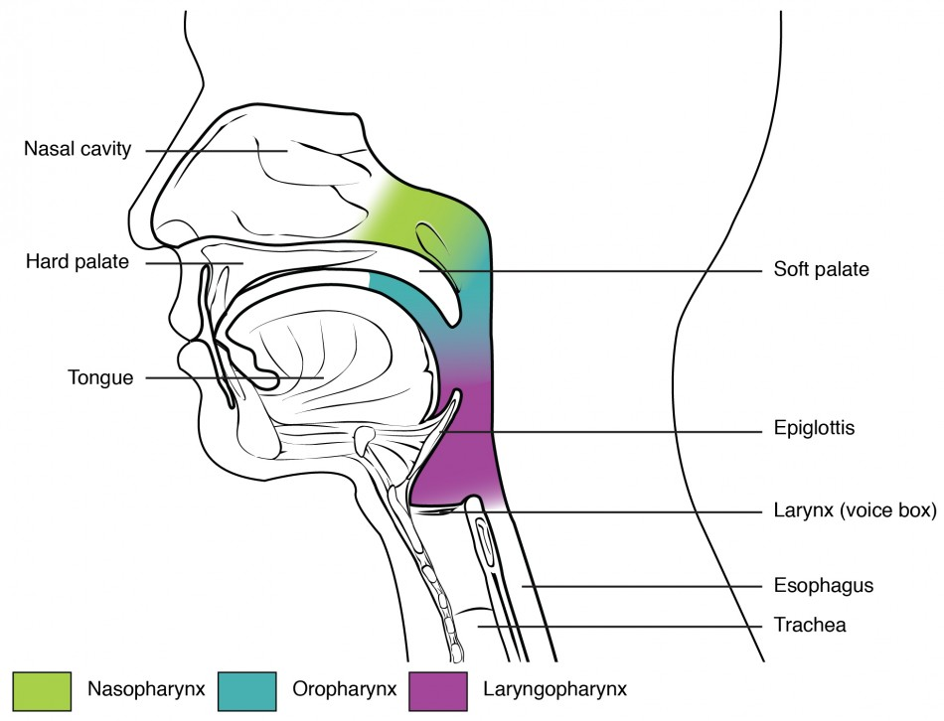

Slide 14
Pharynx Functions
Allow passage of air through nasal and oral sections & food through oral and laryngeal sections
Warming and humidifying air as it passes towards the lungs
Enhance hearing as the auditory tube extends from the nasopharynx to middle ear allowing air to enter protecting the tympanic membrane from atmospheric pressure

Slide 15
Pharynx Functions
Protection as a result of lymphatic tissues of the pharyngeal and laryngeal which produce antibodies in response to swallowed /inhaled antigens.
Pharynx functions in speech by acting as a resonating chamber for sound ascending from the larynx ,together with sinuses it helps to give voice its individual characteristics

Slide 16
Larynx (Voice Box)
Lies in front of the laryngopharynx and the 3rd,4th,5th and 6th cervical vertebrae
There is a little difference in size of larynx between sexes as it grows larger in male which explains the prominence of the adam’s apple and deeper voice

Slide 17
Larynx (Voice Box) Cont..
The larynx or voice box is responsible for sound production.
The voice box takes the sound that is produced by the air passing through it and changes the pitch(tone) by changing shape of the cords.

Slide 18
Larynx (Voice Box) Cont..
At the top of the larynx is a small leaf-shaped flap of cartilage known as the epiglottis.
During swallowing, the epiglottis closes off the larynx so that food and liquid are directed into the esophagus.
When foreign material enters the larynx , a cough attempts to expel the material to avoid choking.

Slide 19
Larynx Cartilages
The larynx consists of several irregularly shaped cartilages attached to each other by ligaments and muscles .
They include
1 thyroid cartilage
1 cricoid cartilage
2 arytenoid cartilages
1 epiglottis

Slide 20
Larynx functions
Acts as a passageway for air (larynx links the pharynx above with the trachea below)
As air travels through larynx it is humidified ,filtered and warmed
Protects the lower respiratory tract by ensuring food passes into the oesophagus and not in the trachea

Slide 21
Larynx functions Cont..
Enhances speech by amplification of vocal cords and manipulation by the tongue ,cheek and lips
Sound production which has properties of pitch, volume and resonance

Slide 22
Trachea /windpipe
Is a continuation of the larynx and extends downwards to about the level of the 5th thoracic vertebra where it divides at the carina into the right and left primary bronchi ,one bronchus going to each lung
It is approximately 10 -11 cm long and lies mainly in the median plane infront of the oesophagus

Slide 23
Trachea /windpipe
The trachea connects the throat/larynx to the lungs.
The trachea is composed of smooth muscle that is embedded with rings of cartilage.
These rings provide the necessary rigidity that is needed to prevent collapsing of the tube.

Slide 24
Functions of Trachea
Warming ,humidifying and filtering of air
Initiate cough reflex as a result of irritation which generates nerve impulse conducted by vagus nerves to the respiratory centre in the brain stem
Muciliatory escalator –the synchronous and regular beating of cilia of the mucous membrane lining wafts mucus with the adherent particles upwards towards the larynx where it is either swallowed or coughed up

Slide 25
Functions of Trachea
Support & patency –tracheal cartilages hold the trachea permanently open(patent) but the soft tissue bands in between the cartilages allow flexibility so that the head and neck can move freely without obstructing or kinking the trachea .Absence of cartilage posteriorly permits the oesophagus to expand comfortably during swallowing.

Slide 26
Bronchi & Bronchioles
Air reaching the bronchi is:
Warmed and cleansed of impurities
Saturated with water vapor
Bronchi subdivide into secondary bronchi, each supplying a lobe of the lungs
Air passages undergo 23 orders of branching in the lungs

Slide 27
Conducting Zone: Bronchial Tree
- Tissue walls of bronchi mimic that of the trachea
- As conducting tubes become smaller, structural changes occur:
Cartilage support structures change
Epithelium types change
Amount of smooth muscle increases

Slide 28
Bronchial Tree
Bronchioles:
Consist of cuboidal epithelium
Have a complete layer of circular smooth muscle
Lack cartilage support and mucus-producing cells

Slide 29
Respiratory Zone
Defined by the presence of alveoli; begins as terminal bronchioles feed into respiratory bronchioles
Respiratory bronchioles lead to alveolar ducts, then to terminal clusters of alveolar sacs composed of alveoli
Approximately 300 million alveoli:
Account for most of the lungs’ volume
Provide tremendous surface area for gas exchange

Slide 30
Lungs
They occupy the entire thoracic cavity except for the mediastinum which houses the heart ,great blood vessels ,bronchi, esophagus e.t.c
Each lung is suspended in its own pleural cavity and connected to the mediastinum by vascular and bronchial attachments collectively referred to as its root
The anterior ,lateral and posterior lung surfaces lie in close contact with the ribs and form a continuous curving surface called a costal surface

Slide 31
Lungs
Just deep to the clavicle is the apex, the narrow superior tip of the lung .The concave inferior surface that rests on the diaphragm is the base

Slide 32
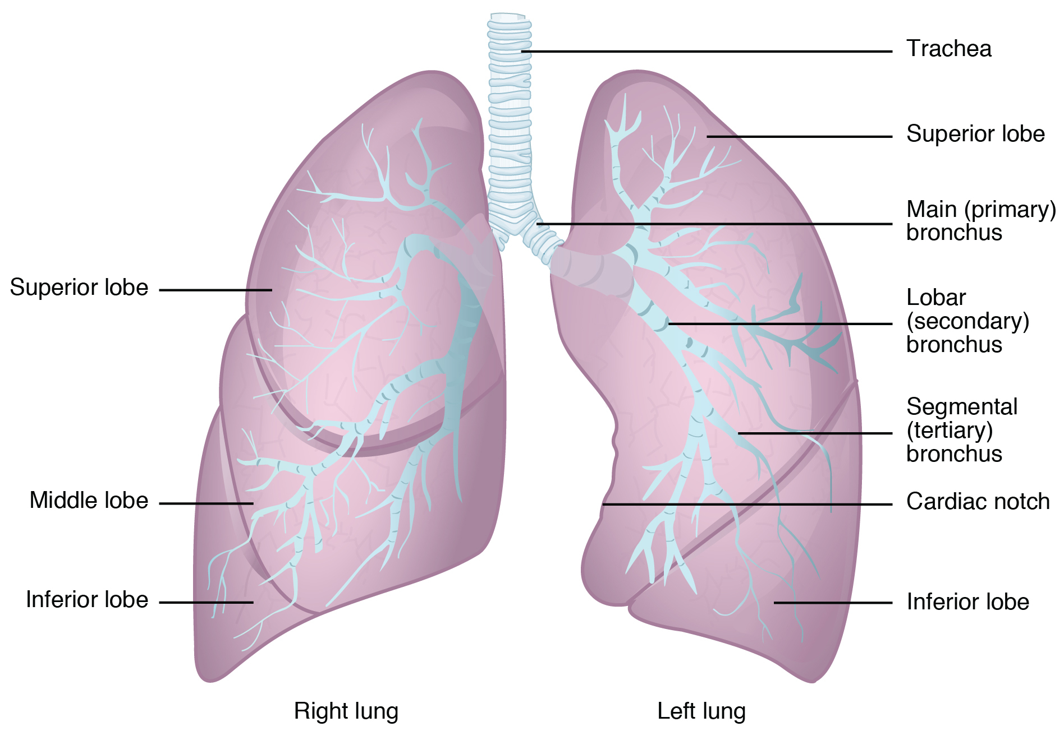

Slide 33
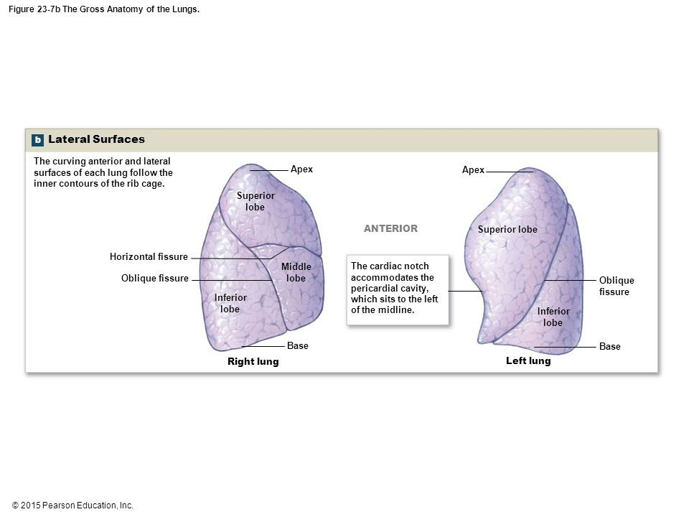

Slide 34
Pleura
Serous membrane that lines the outer surface of each lung and the internal thoracic wall
They are mainly two i.e visceral and parietal pleura
Visceral pleura-covers the outer surface of each lung
Parietal pleura-covers the internal thoracic walls, lateral surfaces & superior surface of the diaphragm

Slide 35
Pleural Cavities
Refers to the space between the serous membrane layers
Pleural membranes produce a thin serous pleural fluid that circulates in the pleural cavity and acts as a lubricant, to minimize friction during breathing

Slide 36
RESPIRATION
Respiration refers to exchange of gases between body cells and the environment which involves two main processes i.e
Breathing (pulmonary ventilation)-movement of air into and out of the lungs .This enhances oxygen to the alveoli and elimination of carbon dioxide
Gaseous exchange –takes place in the lungs ;external respiration and in tissues ;internal respiration

Slide 37
Breathing muscles
Chest expansion during inspiration occurs as a result of muscular activity partly voluntary and partly involuntary
Main muscles used in normal quiet breathing are the external intercostal muscles and the diaphragm

Slide 38
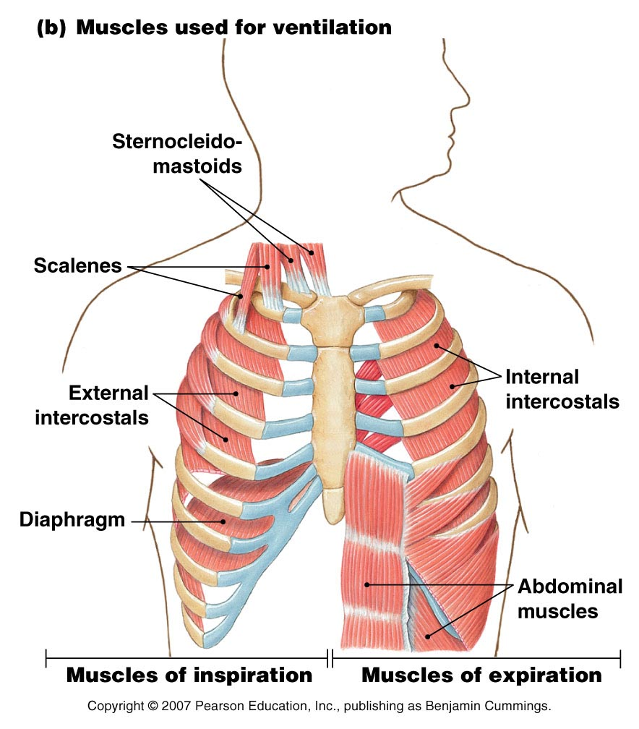

Slide 39
Intercostal muscles
They are of 11 pairs occupying the spaces between the 12 pairs of ribs .
They are arranged in two layers the external and internal muscles
External intercostal muscles ;they extend downwards and forwards from the lower border of the rib above to the upper border of the rib below .They are involved in inspiration .

Slide 40
Intercostal muscles
Internal intercostal muscles ;they extend downwards and backwards from the lower border of the rib above to the upper border of the rib below ,crossing the external intercostal muscle fibres at right angles .
They are used when expiration becomes active as in exercise

Slide 41
Intercostal muscles Cont.…
First rib is fixed ,therefore during contraction of external intercostal muscles all other ribs are pulled to it allowing the ribcage to move as a unit upwards and outwards allowing thoracic cavity enlargement
Stimulation of intercostal muscles contraction is by intercostal nerves

Slide 42
Diaphragm
It is a dome shaped muscular structure separating the thoracic and abdominal cavities
Forms the floor of the thoracic cavity and roof of the abdominal cavity and consists of a central tendon from which muscle fibres radiate to be attached to the lower ribs and sternum and to the vertebral column by the two crura

Slide 43
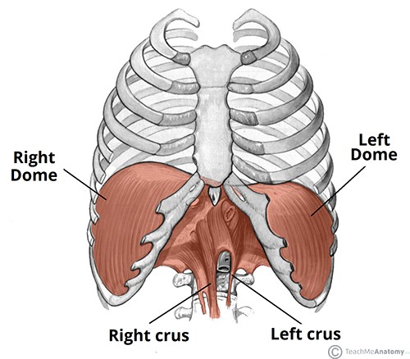

Slide 44
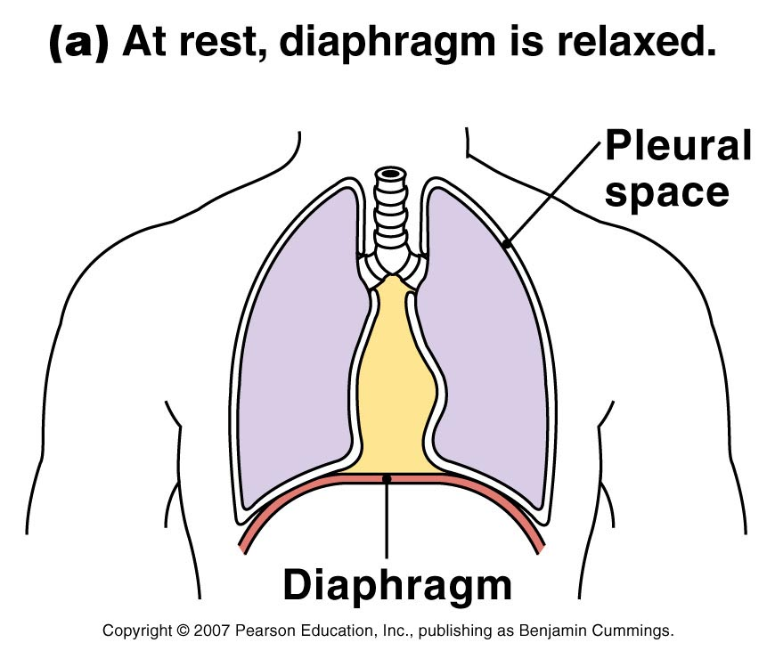

Slide 45
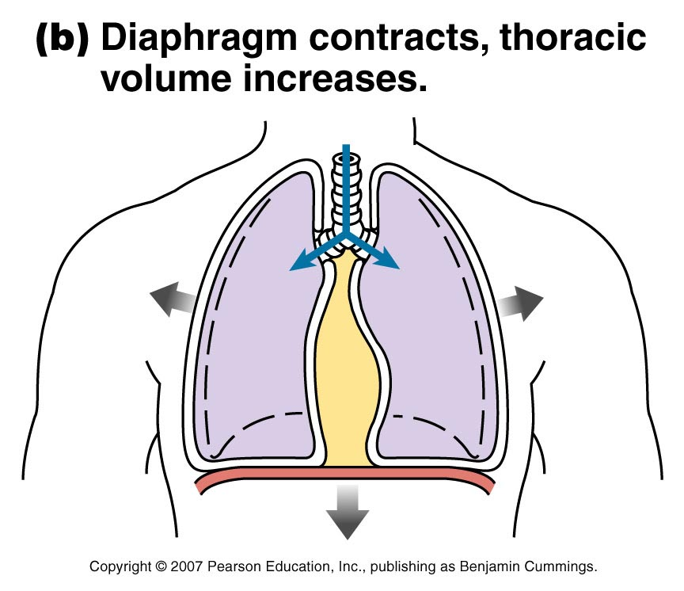

Slide 46
Accessory muscles of respiration
When extra respiratory effort is required additional muscles are used
Forced inspiration is assisted by sternocleidomastoid muscles and the scalene muscles increase ribcage expansion
Forced expiration is helped by activity of internal intercostal muscles and sometimes abdominal muscles which increase the pressure in the thorax by squeezing the abdominal contents

Slide 47
Lung volume and capacities
Normally there are about 15 complete respiratory cycles per minute
Lungs and air passages are never empty and as gaseous exchange takes place only across the walls of the alveolar ducts and alveoli the remaining capacity is called the anatomical dead space about 150 ml

Slide 48
Lung volume and capacities
Tidal Volume (TV) – amount of air inhaled or exhaled with each breath under resting conditions (about 150 ml)
Inspiratory Reserve Volume (IRV) – amount of air that can be inhaled during forced breathing in addition to resting tidal volume
Expiratory Reserve Volume (ERV) – amount of air that can be exhaled during forced breathing in addition to tidal volume
Residual Volume (RV) – Amount of air remaining in the lungs after a forced exhalation.

Slide 49
Lung volume and capacities
Vital Capacity – maximum amount of air that can be expired after taking the deepest breath possible (VC = TV + IRV + ERV)
Inspiratory Capacity – maximum volume of air that can be inhaled following exhalation of resting tidal volume (IC = TV + IRV)
Functional Residual Capacity – volume of air remaining in the lungs following exhalation of resting volume (FRC = ERV + RV)

Slide 50
Lung volume and capacities
Total Lung Capacity – total volume of air that the lungs can hold (TLC = VC + RV) .In adults is about 6 L
Alveolar ventilation –this is volume of air that moves into and out of the alveoli per minute. It is equal to the tidal volume minus the anatomical dead space, multiplied by the respiratory rate (AV=TV-anatomical dead space x respiratory rate) =(500-150)ml x 15 per minute =5.25 liters per minute

Slide 51
Exchange of Gases
Although breathing involves alternate process of inspiration and expiration ,gaseous exchange at the respiratory membrane and tissues is continuous and ongoing process.
Diffusion of oxygen and carbon dioxide depends on pressure differences e.g between atmospheric air and blood or blood and tissues

Slide 52
Respiratory process
Pulmonary Ventilation
Movement of air into the lungs (inspiration)
Movement of air out of the lungs (expiration)
External Respiration
Movement of oxygen from the lungs to the blood
Movement of carbon dioxide from the blood to the lungs

Slide 53
Respiratory process
Transport of Respiratory Gases
Transport of oxygen from the lungs to the tissues
Transport of carbon dioxide from the tissues to the lungs
Internal Respiration
Movement of oxygen from blood to the tissue cells
Movement of carbon dioxide from tissue cells to blood

Slide 54
Control of respiration
Effective control of respiration enables the body involuntary to regulate blood gas levels over a wide range of physiological, environmental and pathological conditions.
Voluntary control is exerted during activities such as speaking and singing but is overridden if blood CO2 rises (hypercapnia)

Slide 55
Respiratory centre
Formed by groups of nerves in the medulla (the respiratory rhythmicity centre) that controls respiratory pattern i.e. rate and depth of breathing
Activity of the respiratory centre is adjusted by nerves in the pons (pneumotaxic centre & apneustic centre ) in response to input from other brain parts .
Motor impulses leaving the respiratory centre pass in the phrenic and intercostal nerves to the diaphragm and intercostal muscles respectively to stimulate respiration

Slide 56
Chemoreceptors
These are receptors that respond to changes in partial pressures of oxygen and carbon dioxide in the blood and cerebrospinal fluid
They are located centrally –on surface of medulla oblongata and peripheral –in the arch of aorta and carotid bodies

Slide 57
Effects of Exercise on Respiratory System
During exercise the muscle cells use up more oxygen and produce increased amounts of carbon dioxide.
The lungs and heart have to work harder to supply the extra oxygen and remove the carbon dioxide.
The breathing rate increases and one breathes more deeply. Heart rate also increases in order to transport the oxygenated blood to the muscles.

Slide 58
Effects of Exercise on Respiratory System
The brain detects increasing levels of carbon dioxide - a signal is sent to the lungs to increase breathing.
Breathing rate and the volume of air in each breath increase - This means that more gaseous exchange takes place.
The brain also tells the heart to beat faster so that more blood is pumped to the lungs for gaseous exchange.
More oxygenated blood gets to the muscles and more carbon dioxide is removed.

Slide 59
Ageing and Respiratory system
The effects of ageing on the respiratory system are similar to those that occur in other organs: maximum function gradually declines. Age-related changes in the lungs include;
Decreases in peak airflow and gas exchange
Decreases in measures of lung function such as vital capacity (the maximum amount of air that can be breathed out following a maximum inhalation)

Slide 60
Ageing and Respiratory system
Weakening of the respiratory muscles
Decline in the effectiveness of lung defense mechanisms

