Slide 1
Sexually transmitted INFECTIONS (sti)
September 2017 Class

Slide 2
Key Characteristics of the Common STIs
Grouped according to their signs and symptoms
STI management flow charts used
Conventional STIs managed on the basis of syndromes rather than by the causative organisms
A syndrome simply means a group of signs and symptoms

Slide 3
The STIs are divided into five main syndromes
Vaginal discharge (Pruritus) in women
Urethral discharge in men
Lower abdominal pain in women
Genital ulcer disease in both men and women
Ophthalmia neonatorum in newborns

Slide 4
Signs and Symptoms for the Main Syndromes of STIs and their Aetiologies
Syndromes | Symptoms | Signs | Most common aetiology
Vaginal discharge | Vaginal discharge Vaginal itching Dysuria (pain on urination) Dyspareunia (pain during sexual intercourse) | Vaginal discharge | Vaginitis: Trichomoniasis Candidiasis Bacterial vaginosis Cervicitis: Gonorrhoea Chlamydia
Urethral discharge | Urethral discharge Dysuria Frequent urination | Urethral discharge (if necessary ask patient to milk the urethra) | Gonorrhoea Chlamydia

Slide 5
Signs and Symptoms for the Main Syndromes of STIs and their Aetiologies
Syndromes | Symptoms | Signs | Most common aetiology
Lower abdominal pain | Lower abdominal pain Pain during sexual intercourse | Vaginal discharge Lower abdominal pain and tenderness on palpation Temperature < 38 celsius | Gonorrhoea Chlamydia Mixed Bacteria
Genital ulcer | Genital sore | Genital ulcer Enlarged inguinal lymph nodes | Syphilis Chancroid Genital Herpes
Ophthalmia neonatorum | Swollen eyelids Discharge Baby cannot open eyes | Oedema of the eyelids Purulent discharge | Gonorrhoea Chlamydia

Slide 6
4 Cs
Counselling
discuss the condition with the patient with an aim of finding a solution or ways of preventing STIs re-infection and spread
Compliance
explain to the patient the danger of self medication and that they should take the full dose of the prescribed medicine for better results.

Slide 7
4 Cs
Condoms
explain and demonstrate proper use of the condom, if abstinence is impossible
Contact Tracing
for the purpose of treating sex partner(s) to avoid re-infection and spread of STI

Slide 8
Vaginal Discharges

Slide 9
Vaginal Discharges
Discharge in this context means the flow of secretions from the vagina. Normal vaginal discharge, which is clear, mucoid with no smell, and small in amount

Slide 10
Causes of Vaginal Discharges
Vaginitis refers to inflammation of the vaginal wall, which could be caused by fungus candida albicans
Factors that make candida albicans overgrow include pregnancy, diabetes, lowered immunity of the individual, or if the patient is on antibiotic or corticosteroids therapy
Vaginitis can be caused by a protozoa trichomonas vaginalis (trichomoniasis) or overgrowth of several species of bacteria including gardnerella vaginalis or anaerobic bacteria.
The other cause of vaginal discharge is cervicitis. This is an infection of the cervix caused by neisseria gonorrhoea (gonorrhoea) or chlamydia trachomatis (chlamydia).

Slide 11
Multiple red spots (“strawberry cervix”) typical of Trichomonas cervicitis.
After application of Lugol’s iodine, the cervix has a “leopard skin” appearance.

Slide 12
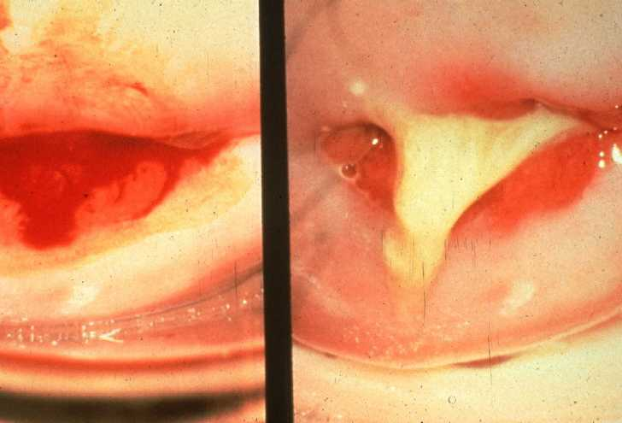
Cervicitis—Chlamydia or Gonorrhea
Note mucosal
bleeding where
purulent discharge
has been wiped
away.

Slide 13
Signs and Symptoms of Vaginal Discharge
The abnormal discharge is more than usual and it has unpleasant smell. Its colour depends on the causative organisms, so it is green, yellow or curd like.
In both vaginitis and cervitis, the discharge may be associated with painful urination due to inflammation of the urethra, or dyspareunia (painful sexual intercourse) and is accompanied by itching of the vulva or vagina, or an inflamed and swollen vulva.
In cervicitis there is redness, inflammation and bleeding from the cervix (this is symptomatic in most women). The Bartholin’s glands are swollen and tender and the patient complains of abdominal pain.

Slide 14
Diagnosis
The various signs and symptoms already discussed can be used to distinguish vaginitis and cervicitis.
To confirm cervicitis, a speculum should be used to visualise the cervix.
Now look at the NASCOP flow chart used in the syndromic management of vaginal discharge. It is an easy tool to use

Slide 15
Management
Syndromic management

Slide 16
The possible consequences of both vaginitis and cervicitis include:
Vaginal discharges can create problems with partners during sexual intercourse due to the foul smell or pain (dyspareunia).
Cervicitis and vaginitis increase susceptibility to HIV infection.
In cervicitis ascending infection may lead to inflammation of the pelvic organs causing blockage of the fallopian tubes, leading to ectopic pregnancy or infertility.
In cervicitis the infection could spread to the Bartholin’s gland, leading to abscesses or spread in blood circulation (septicaemia) causing arthritis, endocarditis or meningitis, especially if it is of gonococcal origin.

Slide 17
Urethral Discharge

Slide 18
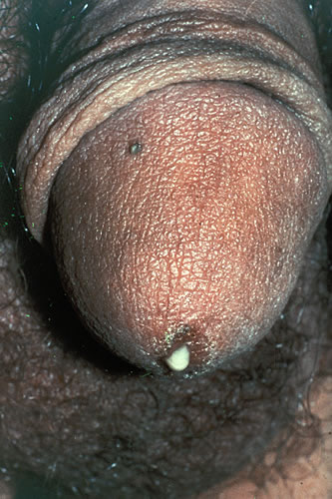

Slide 19
Urethral Discharge
The urethral discharge usually refers to a discharge from the penis, although women can develop an infection in the urethra, which results in urethral discharge.
Due to the internal position of the urethra in women, it is often confused with vaginal discharge or goes unnoticed hence the delay in seeking treatment

Slide 20
Causes of Urethral Discharge
Most urethral discharges indicate the presence of gonorrhoea or chlamydia, or both.
The discharges could also be due to trichomoniasis.
It is usually difficult to tell the difference through physical examination, especially when there is a mixed infection and this is why, in the absence of laboratory investigations, the flow chart becomes an essential tool.

Slide 21
Signs and Symptoms
The discharge may be abundant and purulent (pus like) or watery and whitish.
The discharge may be associated with
painful and frequent urination, with or without testicular pain, itching of the glans penis, foreskin or urethra, a foreskin which is swollen (oedematous), tight (phimosis) or cracked and shows an increased severity of symptoms before or during the first urination of the morning.

Slide 22
Diagnosis
You diagnose urethral discharge through the information you obtain from the patient and physically examining the penis to note the amount and type of discharge.
Laboratory tests help to isolate the causative organisms where possible.

Slide 23
Management
Syndromic management

Slide 24
Complications
Urethral abscesses.
Urethral stricture (causing urinary blockage), which is a progressive condition which produces renal failure after many years.
Infection of epididymis and testis (Epididymo-orchitis) leading to infertility.
Inflammation of the prostrate gland (prostatitis).
Inflammation of the urinary bladder (cystitis).

Slide 25
Lower abdominal pain

Slide 26
Lower abdominal pain
PID gives rise to lower abdominal pain as a symptom.
PID occurs when the bacteria causing cervicitis spread to involve the internal reproductive organs, which include the ovaries, fallopian tubes and uterus.
PID is almost always caused by a combination of bacteria.
This includes the same bacteria that cause cervitis (neisseria gonorrhoeae and chlamydia trachomatis) but also several other species including anaerobic bacteria and streptococci.

Slide 27
Lower abdominal pain
PID is usually transmitted sexually.
However, infection in the reproductive organs also may occur after childbirth or abortion (Puerperal sepsis) or after gynaecologic surgery (Pelvic cellulitis and thrombophlebitis).

Slide 28
Signs and Symptoms of PID
The patient will complain of lower abdominal pain and tenderness (appendicitis and an ectopic pregnancy should be ruled out).
PID may be associated with:
Offensive vaginal discharge
Both urethral and vaginal discharge
Painful intercourse (dyspareunia)
Low grade fever
Urgent or frequent urination
General malaise

Slide 29
Diagnosis
To diagnose lower abdominal pain, you should obtain a history from the patient, which will indicate pelvic inflammation diseases and may even give the clues of the cause.
Please, look at other causes of PID

Slide 30
Diagnosis
A lower abdominal examination should also be carried out to assess the intensity of pain and from which side of the abdomen the pain emanates.
A bimanual examination should also be done where the state of the uterus and cervix are assessed.
Vaginal discharge is also assessed to note the amount, texture, colour and the smell

Slide 31
Management
Syndromic Management
As part of the management, you should advise the patient to abstain from sex because it is uncomfortable for her and it will also spread the infection to others.
She should also be asked to bring in her sexual partner who will be put on the same treatment to avoid re-infection after she is cured.

Slide 32
Surgical or gynaecological causes are determined by:
Rebound and/or guarding tenderness • Delayed menstrual periods • Recent delivery or abortion • Menorrhagia or metrorrhagia

Slide 33
Complications of PID
If not treated, PID will cause considerable pain and suffering with severe long term complications, for example, infertility and even death

Slide 34
Complication
The most likely complications include:
Increased susceptibility to HIV infection.
Chronic low back pain or chronic low- grade fever.
Frequent miscarriages.
Ectopic pregnancy.
Infertility due to scarring and blockage of the fallopian tubes.
Other organs can be infected, for example, the perimetrium, leading to peritonitis or urinary bladder leading to cystitis.

Slide 35
Consequences
Women debilitated by PID find it difficult to fulfil family and economic responsibilities, thus leading to poverty.
They may also suffer painful intercourse, irregular bleeding, frequent miscarriage or infertility, which can lead to marital problems such as separation or divorce.
Also, the bacteria causing PID usually are the same ones causing cervicitis, that is, neisseria gonorrhoeae and chlamydia trachomatis which are easily transmitted, endangering the health of the woman’s partners and her new born.

Slide 36
Consequences
Her partner, once infected, will develop urethritis and the newborn may develop pneumonia or opthalmia neonatorum.
Recognise lower abdominal pain and take appropriate action since it’s a pointer to PID.
If treatment is delayed, it causes misery to the individual patient and her family.

Slide 37
Genital Ulcer Disease (GUD)

Slide 38
Genital Ulcer Disease (GUD)
These are a group of three sexually transmitted infections, which produce ulcers in the genital or anal area.
They are chancroid, syphilis and herpes. These infections affect both sexes alike.
with the AIDS pandemic, GUD has assumed a special significance because it facilities transmission of HIV infection, therefore it requires special attention.

Slide 39
Chancroid
The mode of transmission is through sexual contact and the causative organism is a gram-negative bacterium called Haemophilus Ducreyi.
The incubation period in men is four to seven days while in women it takes about ten days.
Some of the factors that may enhance transmission include non circumcision in men, working in the commercial sex industry, and pregnancy due to lowered immunity.

Slide 40
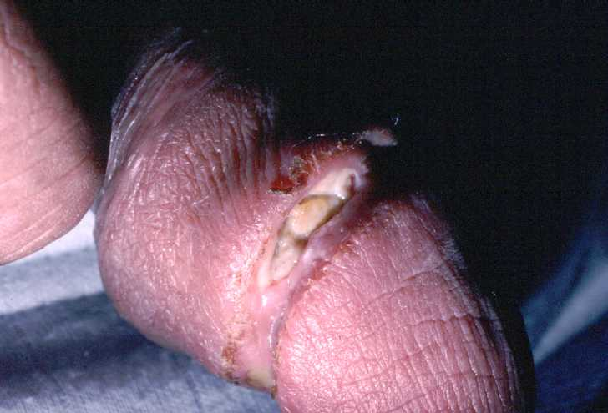
Chancroid—“Dirty” Ulcer

Slide 41
Signs and Symptoms
Male patients may complain of painful ulcers on the penis, which may be single or multiple.
In a circumcised male patient, the ulcer is usually on the glans penis, the shaft, or the coronal sulcus
In uncircumcised males the ulcer may be either within the mucosal surface of the prepuce, on the skin surface, or on the edge of the prepuce
Men always show symptoms if infected but women may be carriers of the disease for sometime before they show symptoms. In women, the ulcers are often painless.

Slide 42
Signs and Symptoms
In both sexes, the ulcer may be single or multiple
They are dirty looking with irregular margins.
The base of the ulcer is covered by yellow grey necrotic purulent exudates.
The ulcer is very friable and bleeds easily on touch or any form of manipulation.
Inflammation of the inguinal glands (adenitis) and bubo formation are more common which spontaneously release thick, creamy pus.

Slide 43
Diagnosis
To diagnose genital ulcers, you start with history obtained from the patient where they report the presence of ulcers on the genital area.
You should then examine the patient to check on the location of the ulcers, how many there are, and what the ulcers look like, to differentiate from ulcers caused by syphilis or herpes.
Laboratory investigations should also be undertaken to confirm the diagnosis by isolating the causative organisms.

Slide 44
Complications
 | Acute Complications | Chronic Complications
Male | Oedema and swelling of prepuce Phimosis Balanitis or inflammations of glans penis Inguinal buboes | Secondary warts Fibroses Cicatrization or auto amputation of the penis
Female | Oedema of vulva Vaginal and/or rectal bleeding Buboes | Fibrosis Secondary warts Recto-vaginal scarring Chronic ulceration

Slide 45
Syphilis

Slide 46
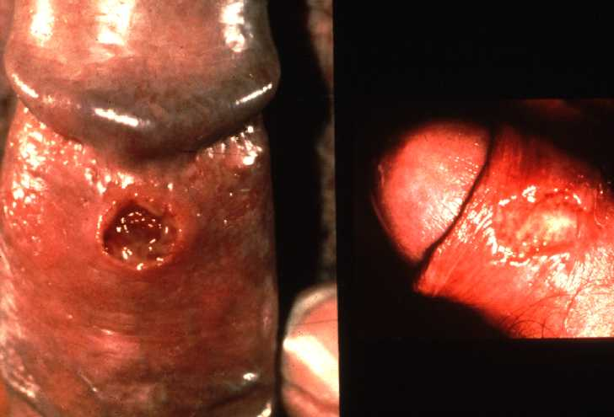
Primary Syphilis— “Clean” Ulcer on Penis

Slide 48
Syphilis
Syphilis is one of the infections that cause genital ulcers but it is different from chancroid in that it follows serious disease stages as it advances.
Also the mode of transmission is slightly different, although the main mode is sexual contact.

Slide 49
Causative Organisms
A spirochete organism called treponema pallidum causes syphilis.
Most common mode of transmission is sexual contact.
It can also be transmitted from the mother to the unborn baby (vertical transmission and may lead to congenital syphilis)
It also can be acquired by coming into physical contact with a patient in the secondary stage of infection that has mucosal or cutaneous lesions and through blood transfusion.

Slide 50
Syphilis can be transmitted through:
Sexual contact
Blood transfusion
Vertical transmission
Physical contact

Slide 51
Clinical features
The clinical features will depend on the stage of infection the patient presents himself or herself in.
As mentioned earlier, there are four stages of syphilis namely
Primary,
Secondary,
Latent
Tertiary.

Slide 52
Primary Syphilis
After an incubation period of 10 to 90 days, a primary chancre develops at the site of inoculation.
The chancre is typically painless, indurated with a clean base and raised edges and does not bleed on contact, although it oozes clear fluids containing Treponema pallidum.
At this stage there is usually one lesion.
In a female the chancre is on the cervix or the vulva, while in the male the lesion is most commonly on the glans penis, the foreskin, and the coronal sulcus or on the penile shaft.
The primary chancre resolves spontaneously if left untreated over several weeks but disease progresses to the secondary stage.

Slide 53
Secondary Syphilis
This stage follows a few weeks or months after the appearance of the primary chancre.
It is during this stage that the micro-organisms begin to affect other systems in the body.
Also, it is at this stage that signs and symptoms become manifest. These include skin rashes that take different forms like papular, macular or pustular.
In moist areas of the body, soft, raised condylomata lata may be seen. These condylomata lata do not itch.

Slide 57
Secondary Syphilis
There may also be patches on the mucous or oral ulceration, sometimes referred to as snail track ulcer.
Also, in addition to its cutaneous manifestation, secondary syphilis may present with fever and general malaise as a result of systemic illness.
There could also be generalised lymphadenopathy, nephritis, hepatitis, meningitis or uveitis. These lesions generally resolve after several weeks but the disease progresses to the next stage.

Slide 58
Latent Syphilis
In the absence of adequate treatment, the disease enters in latent stage.
At this stage there are no clinical manifestations but there is history of syphilis and a blood test will give positive serological evidence.
This patient is liable to develop tertiary syphilis in the future.

Slide 59
Tertiary Syphilis
This is the last stage and it accounts for the morbidity and mortality of syphilis.
It begins during the third to fifth year of disease and sometimes it takes an extended period of time to manifest.
Lesions of tertiary syphilis fall into three categories, namely,
gumma,
cardiovascular disease,
and central nervous system disease.

Slide 60
Tertiary Syphilis
Gumma Lesions
The gamma lesions are painless ulcers with little or no inflammation, which sometimes affect bones, making them fragile.
Cardiovascular lesions The lesions affect the aorta and may cause aortitis or aortic valve disease. They also cause coronary ostial occlusion.
Neurological lesions The micro-organisms cross the blood brain barrier to reach the cerebrospinal fluid (CSF) and cause symptomatic neurosyphilis, presenting as epilepsy, hydrocephalus, general paralysis of the insane, syphilitic meningo-encephalitis, cranial nerve palsy or dementia. There could also be asymptomatic neutrosyphilis where the patient is clinically normal, yet the cerebral spinal fluid (CSF) shows the presence of treponema pallidum.

Slide 61
Tertiary syphilis

Slide 64
Congenital Syphilis
As mentioned earlier if an infected pregnant woman is not treated, she is likely to pass the infection to the foetus in utero through the placenta barrier and therefore, the baby will be born already infected.
This type of disease is referred to as congenital syphilis and is acquired through vertical transmission.
Signs of congenital syphilis in a neonate include syphilitic pemphigus, (which is highly contagious) anaemia, jaundice, hepatospleenomegaly, cleft lip and cleft palate.
In addition, there may be ulcers of the nasoperiosteum leading to watery nasal discharge.

Slide 65
Congenital Syphilis
The babies are born small and they do not thrive well.
At birth the baby might appear normal but later develops the characteristic rash affecting the soles and palms, then persistent nasal discharge, which is sometimes blood stained.
This progresses to anaemia, jaundice and hepatospleenomegaly.
The prognosis is poor but the few who live longer or reach adolescent age develop late congenital syphilis, which is like tertiary syphilis in adults.
Those who reach this stage, manifest in bone and dental abnormalities, and inflammatory lesions of the cornea (interstitial keratitis).

Slide 68
Diagnosis
This will start with the history given by the patient.
It is followed by a physical examination.
This may reveal an ulcer in the genital region suggestive of syphilis but clinically it could be impossible to distinguish syphilitic primary chancre from other genital ulcers.
In serological diagnosis, that is, blood tests, you may receive positive results, which are normally reported as VDRL,
This will indicate the presence of treponema antibody, but in vertical transmission, a positive maternal test gives sufficient reason to start the neonate on treatment.

Slide 69
Genital Herpes

Slide 70
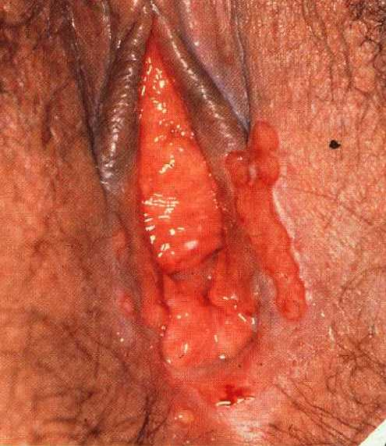
Genital Herpes—First Episode

Slide 71
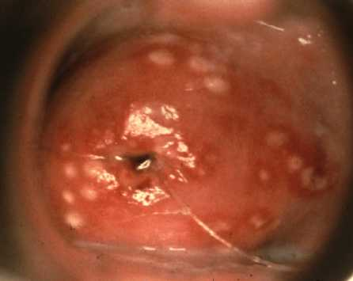
Cervicitis—Recurrent Genital Herpes

Slide 72
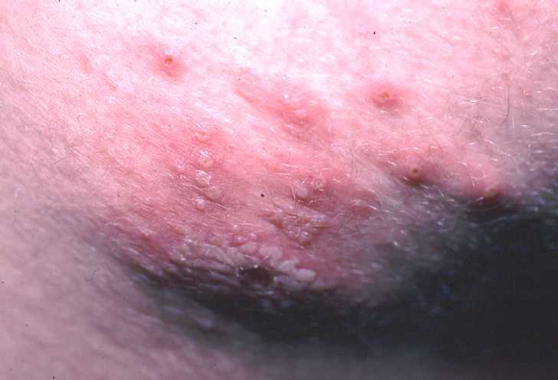
Genital Herpes—Recurrence on the Buttocks

Slide 73
Genital Herpes
Genital herpes is an ulcerative sexually transmitted disease caused by the herpes simplex virus type 2 (HSV2.
HSV1 causes oral herpes).
The incubation period ranges from two to seven days.
The disease can also be transmitted through close physical contact with infected body fluid or from mother to the unborn baby, that is, vertical transmission.

Slide 74
Clinical Features
Localised clusters of vesicles, which break down to form ulcers are the main clinical features.
These ulcers crust over and then resolve.
Areas involved include external genitalia and neighboring skin, urethra, cervix and rectum.
Sometimes tender lymphadenopathy may occur.

Slide 75
Clinical Features
During the primary attack, the virus ascends the peripheral nerves to local ganglia where latency is established.
The nerve damage is made worse by periodic recurrences of the disease, which continues for the remainder of the patient’s life.
Nevertheless, primary attack is more severe than subsequent episodes, with the lesions covering a wider and more symmetric area.

Slide 76
Diagnosis
History obtained and the
Clinical features

Slide 77
Complications of the genital herpes
Sacro radiculomyelopathy, which may manifest with constipation, retention of urine and shooting pain down the legs. This neuritic pain is particularly troublesome in recurrent disease.
Excruciating urethritis in women.
Aseptic meningitis.

Slide 78
Complications of the genital herpes
Extra genital lesions.
Yeast vaginitis.
Disseminated herpes.
In pregnancy, recurrences are more frequent and in a primary attack premature delivery may occur.

Slide 79
Management of Genital Ulcer Diseases (GUD)
The three main diseases that present with genital ulcers have very serious complications for the patient as well as affecting other members of the family.
Therefore, treatment needs to be started as soon as you notice the ulcers, without waiting for laboratory tests, which might take a long time.

Slide 80
Opthalmia Neonatorum
Opthalmia neonatorum is defined as an acute conjunctivitis occurring in the first month of life.
Causative organisms are neisseria gonorrhoeae or chlamydia trachomatis.
The micro organisms are found in the vagina of an infected individual and as the baby passes through the birth canal during the process of birth, they pick up the infection.
Occasionally, the infection is transmitted even to infants delivered by caesarean section when there has been prolonged rupture of membranes.
Opthalmia neonatorum presents as an acute bilateral purulent conjunctivitis.

Slide 82
Clinical features
Purulent discharge from the eyes of a newborn any time within 21 days of life.
In the early stages, the discharge causes the eyelids to stick together. Later, the pus is thick and greenish in colour.
The conjunctiva may be red and swollen due to the inflammation.

Slide 83
Gonococcal infections frequently present within the first week of life and may lead to blindness

Slide 84
Diagnosis
Diagnosis is mainly based on the presence of discharge in the eyes and then confirmed by laboratory investigations where the causative organisms will be isolated.
If the mother is infected, then it is obvious that the baby is infected and treatment has to be started right away.

Slide 85
Management
Once the discharge is noticed, the baby should be started on treatment immediately because any delay will risk loss of sight forever.

Slide 86
Complications
Untreated opthalmia neonatorum results to corneal ulceration, which subsequently leads to partial or total blindness.

Slide 87
Prevention
During the antenatal period all women having vaginal discharge should be detected and treated before delivery.
Also, their sex partners should be treated to avoid reinfection.
At birth the baby should be given prophylactic tetracycline eye ointment immediately.
The eyes should be cleaned using normal saline before instilling the eye ointment.
It is the government policy that all babies should get the eye ointment to make sure no baby goes unprotected because at times the state of the mother is not known.

