Slide 1
Anatomy and Physiology of the Skin

Slide 2
Learning Objectives
Develop a basic understanding of the characteristics of the various layers of skin and its underlying structures
Review the primary functions of skin
Understand some of the factors that may negatively affect skin integrity
Reflect on the effects of aging on skin
Identify some preventative interventions to reducing a persons risk of impaired skin integrity

Slide 3
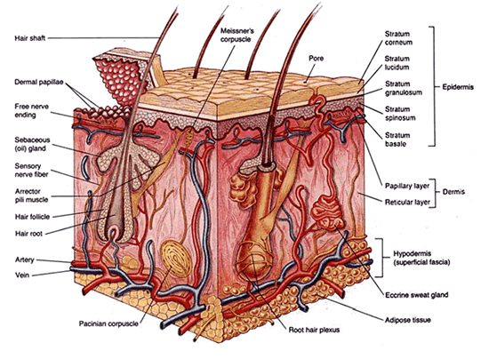
What is Skin?
The body’s largest organ contributing to one sixth of the total body weight
Covers 20 square feet in area (adult)
Three primary layers:
Epidermis
Dermis
Subcutaneous tissue

Slide 4
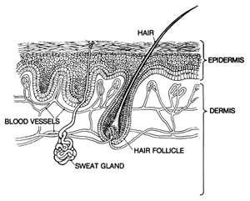
Epidermis
The outmost/top layer of the skin (protective layer)
Has an average thickness of 0.1mm
Avascular (no blood vessels)
Divided into five sub layers:
Stratum corneum
Stratum lucidum
Stratum granulosum
Stratum spinosum
Stratum basale

Slide 5
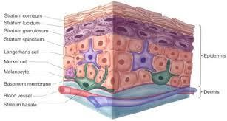
Stratum Corneum
Avascular
Multilayer
Barrier to environment and prevents transepidermal water loss:
Dressing adhesives can strip stratum corneum and cause
transepidermal water loss
Involved in formation of an acid mantle:
Makes skin less permeable to water
Protects skin from microorganism invasion
Notes:
The acid mantle is a very fine, slightly acidic film on the surface of human skin acting as a barrier to bacteria, viruses and other potential contaminants that might penetrate the skin. Sebum is secreted by the sebaceous gland and when mixed with sweat becomes the acid mantle.

Slide 6
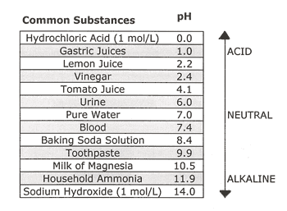
Skin pH
Normal skin pH (4 - 6.5)
Open wound pH (6.5 – 8.5)

Slide 7
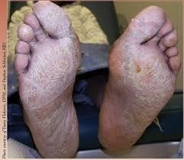
Acid Mantle
Damage to the skin increases it’s pH and risk of infection
Diseases/conditions associated with increased skin pH:
Eczema
Dermatitis
Dry skin
Diabetes
Chronic renal failure
CVD
Urine, stool, perspiration on the skin increases it’s pH
Notes:
Eczema is a condition wherein patches of skin become inflamed, itchy, cracked, and rough. Some types can also cause blisters.
Dermatitis is a general term for skin inflammation. With dermatitis, your skin will typically look dry, swollen, and red.
Cardiovascular disease (CVD)

Slide 8
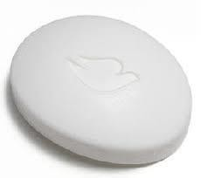
Acid Mantle Continued
To maintain acid mantle:
Avoid adhesives
Use mild pH balanced non-scented skin cleansers
Use mild pH balanced non-scented moisturizers

Slide 9
Epidermal Layer
Contains four distinct layers of cells:
Keratinocytes (formation of a barrier)
Melanocytes
Same number in all skin colors
Size and activity greater in darker skin
Cells in dark skin more compact therefore skin more resistant to injury
Merkel Cells (Light touch sensation)
Langerhan Cells (immune function)
The external layer is almost completely replaced every three to four weeks (continually shedding and reviewing)

Slide 10
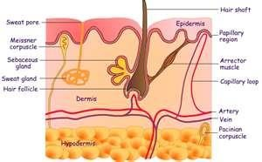
Dermis
Immediately below the epidermis (nourishes epidermis)
Fibroblasts, macrophages, mast cells
Largest portion of the skin
Composed of two layers:
Papillary (superficial):
ECM (Extracellular matrix)
Blood and lymph vessels
Epithelial cells
Connective and nerve tissue
Muscle, fat
Reticular (deep):
Blood vessels
Collagen fibers
Connective tissue

Slide 11
Dermal Layer
Made up of blood and lymph vessels, nerves, sweat and sebaceous glands and hair roots
Often referred to as true skin
Functions:
Provides tensile strength, mechanical support and protection to the underlying muscles, bones, and organs
Regulates temperature
Senses the environment
Notes:
tensile strength: the resistance of a material to breaking under tension.

Slide 12
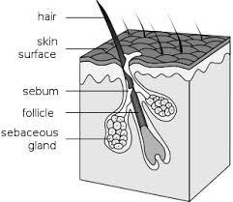
Dermal Appendages
Includes:
Hair follicles
Sebaceous and sweat glands (lubricate, control pH, temperature)
Fingernails and toe nails
Originates in dermis and protrude into the epidermis
Contribute epithelial cells for reepithelialization

Slide 13
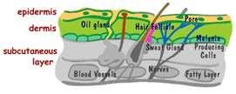
Subcutaneous
A.k.a adipose or hypodermis layer
Innermost layer of the skin, various thickness
Composed of fat, blood vessels, and connective tissue
Functions:
Anchors to deep tissue
Regulates body and skin temperature (insulates)
Stores energy in the form of fat
The thicker the adipose layer, the poorer the blood supply through it

Slide 14
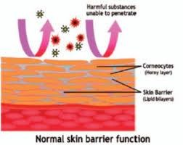
Function of Skin
Six primary functions:
Social interaction
Temperature regulation
A sensory organ for pain, temperature, and touch
Eliminates waste
A protective barrier between internal organs and the external environment
Synthesis of Vitamin D

Slide 15
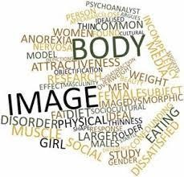
Function: Social Interaction
Psychosocial function
Linked to:
Body image
Physical attraction
Damage to skin can contribute to:
Poor self esteem
Functional limitations
Physiologic consequences

Slide 16
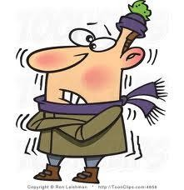
Function: Temperature Regulation
Thermoregulation accomplished through combined function of nerves, glands, and blood vessels
When skin exposed to cold:
Blood vessels constrict and blood flow reduced to skin
Body temperature falls
Body conserves heat
When skin exposed to heat:
Blood vessels dilate and blood flow increased to skin
Body temperature rises
Sweat production increases allowing body to cool

Slide 17
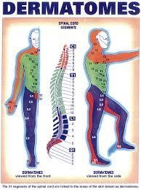
Function: Sensation
Nerve endings in skin sense:
Pain
Pressure
Temperature
Nerve fibers (which originate in nerve roots in the spine), supply the skin,
a.k.a. Dermatomes
Loss or reduction in sensation increases risk for injury
Notes:
Dermatomes are areas of skin that send signals to the brain through the spinal nerves. These signals give rise to sensations involving temperature, pressure, and pain. A dermatome is an area of skin that is mainly supplied by afferent nerve fibres from the dorsal root of any given spinal nerve.

Slide 18
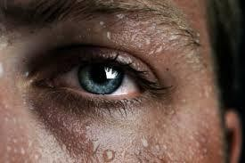
Function: Waste Elimination
Excretes:
Waste products
Electrolytes
Water
Average adult looses 500mL water through skin per day
2 million skin pores release water and body waste to air

Slide 19
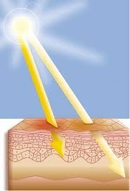
Function: Skin Barrier
Barrier to:
Trauma
Bacterial invasion
Excessive loss of fluids and protein
Also protects tissues and underlying structures from injury
Skin pigmentation protects against UV radiation

Slide 20
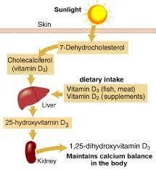
Function: Vitamin D Synthesis
Vitamin D assists in mineralization of bones and teeth
Vitamin D that is synthesized in skin is transferred to other parts of body

Slide 21
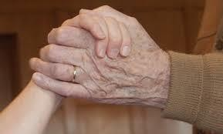
Factors That May Impair Skin Integrity
Dryness
Age
Nutrition
Hydration
Environment

Slide 22
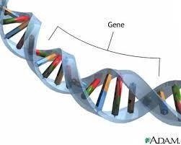
The Aging Process
Biological age does not correlate with chronological age
The rate at which we age is dependent on:
Our genes
Our environment
How we look after our bodies

Slide 23
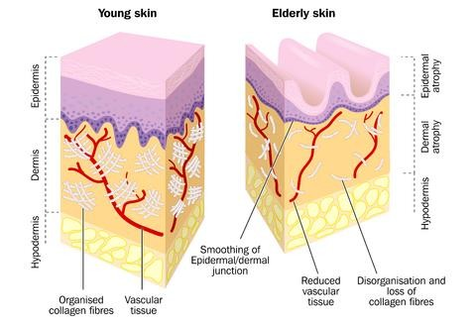
Aging Skin
20% decrease in dermal thickness leads to thinning of the skin
Epidermal-dermal papillae become flattened, increasing susceptibility to friction and shear
Irritants more readily absorbed
Elastin fibers are lost – skin less elastic

Slide 24
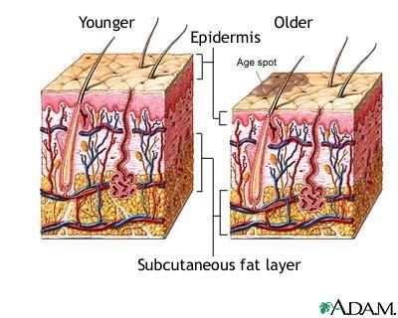
Skin and the Effects of Aging
Dermis atrophies:
Slows wound contraction
Increases risk of dehiscence
Diminished dermis vascularity
Subcutaneous fat atrophies (most noticeable in face, backs of hands and shins)
Collagen in the skin reduces (collagen fibers become compressed)
Notes:
Wound dehiscence is the failure of a wound to close properly.

Slide 25
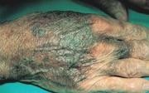
Skin as it Ages
Blood vessels become thinner and more fragile causing small hemorrhages called senile purpura
Reduction in sweat glands and sebum resulting in decreased skin hydration (dry, itchy, inelastic skin)
30

Slide 26
PREVENTION OF IMPAIRED SKIN INTEGRITY
Keep the skin clean
Hydrate the skin
Closely monitor the skin
32

Slide 27
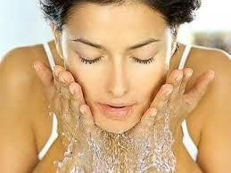
Keep the Skin Clean
When skin is clean and has been dried properly it is less likely to develop infections or wounds

Slide 28
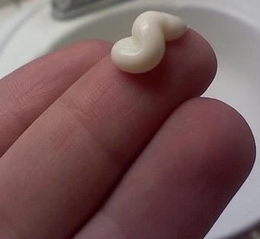
Hydrate the Skin
Hydration and lubrication of the stratum corneum necessary to keep skin intact
Use a mild, non-scented, pH balanced moisturizer to:
Prevent damage to the stratum corneum
Block penetration of substances into the skin
Reduce transepidermal water loss

Slide 29
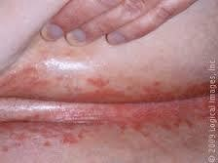
Monitor the Skin
Check the skin at least daily (twice is better) and report any problems IMMEDIATELY
Look closely at:
Skin folds
Perineum
Most common pressure areas:
Heels
Hips
Sacrum
Ischeal tuberosities

Slide 30
Look and Feel!
Look for and report:
Redness
Blisters
Rashes
Open areas
Dark colored ‘bruised’ looking areas
Dryness
Unusual or new lesions
Cracked areas
Indentation marks that suggest socks or clothes are too tight
Areas that feel warmer or colder than usual
Unusual swelling
Anything that concerns you

Slide 31
Review
Characteristics of the various layers of skin and its underlying structures
Primary functions of skin
Factors that may negatively affect skin integrity
Effects of aging on skin
Preventative interventions to reducing a persons risk of impaired skin integrity

