Slide 1
EMBRYOLOGY
Embryology simply means the study of embryos.
It generally refers to prenatal development of embryos and developmental anatomy is the field of embryology concerned with the changes that cells, tissues , organs and the body as whole undergo from a germ cell of each parent to the resulting adult.
Pre-natal development is more rapid than posnatal development.

Slide 2
Why study embryology?
Interests in human development before birth is widespread, largely because of curiosity about our beginnings and the desire to improve quality of life.
Human development is a continuous process that begins when an oocyte (ovum) from a female is fertilized by a sperm (Spermatozoon) from a male. Cell division, cell migration, differentiation growth and cell rearrangement transform the fertilized oocyte a highly specialized potent cell a zygote into a multicellular human being. Although most development changes occur during the embryonic and fetal periods , important changes occur during later periods of development- infancy childhood adolescence and early childhood.
Development does not stop at birth important changes in addition to growth occur after birth e.g. development of teeth and female breasts. The brain triples in weight between birth and 16 years most development changes are complete by the age of 25 years.

Slide 3
Embryological Terminologies
The following terms are commonly used in discussions of the developing humans.
Most terms have Latin (L.) Greek (Gr.) origins.
Understanding the origin of embryological terms adds clarity and often serves as a memory key.
For example the word Zygote is derived from a Greek word Zygotos meaning yoked or joined , which indicates that the sperm and oocyte unite to form a new cell the Zygote.

Slide 4
4. Fertilization age:
It is difficult to determine exactly when fertilization (conception) occurs because the process cannot be observed in vivo (within the living body).
Physicians calculate the age of the embryo or fetus from the presumed first day of the last normal menstrual period (LNMP). This is the gestational age, which is about two weeks longer than the fertilization age because, the oocyte is not fertilized until about two weeks after the proceeding menstruation consequently when a physician states the age of an embryo or fetus, two weeks must be deducted to determine the actual or fertilization age of the developing human

Slide 5
5. Cleavage:
This is the series of mitotic cell division of the zygote that results is the formation of the early embryonic cells- blastomeres. The size of the cleaving zygote remains unchanged because at each succeeding cleavage division, the blastomeres become smaller.
6. Morula- (L. Morus Mulbery): This solid mass of about 12-32 blastomeres is formed by cleavage of a zygote. The blastomeres change their shape and fightly align themselves against each other to form a compact ball of cells this phenomenon- compaction is probably mediated by cell surface adhesion glycoproteins . The morula was given this name because of its resemblance to the fruit a mulberry or blackberry bush. The morula stage occurs 3-4 days after fertilization, just as the early embryo enters the uterus.

Slide 6
7.Blastocyst: (Gr. Blastos, germ +kystis)
After the morula enters the uterus from the uterine tube – fallopian tube - a fluid filled cavity – the blastocystic cavity –develops inside it . This change converts the morula into a blatocyst. Its centrally located cells- the inner cell mass or embryoblast are the primodium or beginning of the embryo.
8. Implantation: The process during which the blastocyst attaches to the endometrium – mucous memberane or lining of the uterus- and subsequently embeds in it. The pre-implantation period of embryonic development is the time between fertilization and the beginning of implantation takes 6days.

Slide 7
9. Gastrula- This is the period of transformation a blastocyst into a three layered or trilaminar embryonic disc. This takes place in the 3rd week . The three germ layers of the gastrula – Ectoderm, mesoderm and Endoderm subsequently differentiate into the tissues and organs of the embryo e.g. Muscular tissue and stomach .
10. Neurula- (Gr. Neuron, nerve- The early embryo during the third and fourth weeks when the neural tube is developing from the neural plate. It is the 1st appearance of the nervous system , and the next stage after the gastrula.

Slide 8
11. Conceptus - (derivatives of Zygote). The embryo and its associated membranes ( the products of conception). The conceptus includes all structures that develop from the zygote, both embryonic and extra-embrayonic hence it includes the embryo as well as the embryonic part of the placenta and its associated memberanes - Amnions
-Chorionic sac (gestational sac)
- and yolk sacs
12. Fetus: (unborn off spring ). After the embryonic period 8weeks the developing human is called a fetus. During the fetal period -9th week to birth differentiation and growth of the tissues and organs formed during the embryonic period occur.
Although developmental changes are not so dramatic as those happening during the embryonic periods they are very important because they make it possible for the tissues and organs to function.
The rate of body growth is remarkable, especially during the 3rd and 4th months, and weight gain is terminal during the terminal months.

Slide 9
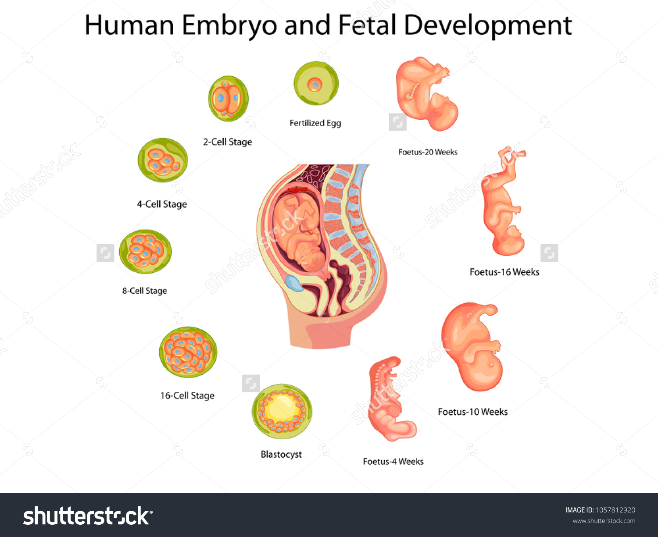

Slide 10
13. Primodium-
(L. Primus – first to begin)
The beginning or first indication of organ or structure.
The term enlarge or rudiment have similar meanings. The premodium of the upper limits appears as a bud on day 26.

Slide 11
Stages of Development
Early embryonic development is described in stages because of the variables period it takes for embryos to develop certain morphological characteristics.

Slide 12
Stage 1 of development
Begins at fertilization and embryonic development ends at stage 23 which occurs on day 56 . The fetal period begins on day 57 and ends when the fetus is completely outside the mother. The stages of embryonic development
Can be assessed by an ultrasound

Slide 13
Abortions (L. Aboriri, to miscarry)
A premature stoppage of development and expulsion of a conceptus from the uterus or expulsion of an embryo or fetus before it is viable- capable of living outside the uterus.
There are different types of abortions:-
Threatened abortion: Bleeding with the possibility of abortion)
Accidental abortion: Occurs because of an accident e.g. fall, trauma etc.
Spontaneous abortion: Is the one that occur naturally and is most common during 3rd wk after fertilization.

Slide 14
4. Habitual abortion: spontaneous expulsive of a dead or non-viable embryo on fetus in three or more consecutive pregnancies.
5. Induced abortion: Is a birth that is induced before 20 weeks (i.e. before the fetus is viable) . This type of abortion refers to the expulsion of an embryo or fetus that is brought on intentionally by drugs or mechanical means e.g. by vacuum curettage- removal of conceptus by a hollow curette introduced into the uterus through which sunction is applied.

Slide 15
6. Complete abortion: This is which all products of conception are expelled from the uterus.
7. Criminal abortion: Is one that is produced illegally.
8. Legally induced: (elective, justifiable or therapeutic abortions are usually produced by drugs curettage.
These abortions are usually induced because of the mothers poor health (physical or mental) or to prevent the birth of a severely malformed child e.g. one without most of its brain.

Slide 16
9. Missed abortion: Is the retention of a conceptus in the uterus after death of the embryo or fetus.
10. A miscarriage: Is the spontaneous abortion of the fetus and its membranes before the middle of the 2nd trimester- about 135 days).
11. An abortus: Is the product of an abortion . i.e. the embryo , fetus and its membranes.

Slide 17
Trimester
A period of three calendar months during a pregnancy. Obstetricians commonly divide the 9 months of gestation into three trimesters. The most critical stages of development occur during the first trimester (13wks) when embryonic and early fetal development is occurring.
Notes:
<number>

Slide 18
Congenital Anomalies or Birth defects
Abnormalities of development that are present at birth or born with e.g. a cleft lip or palate. In some cases the anomalies are not detected until childhood or even adulthood e.g. three kidneys instead of two.

Slide 19
Postnatal Period
Changes occurring after birth

Slide 20
Infancy
Infancy refers to the earliest period of extrauterine life roughly the first year after birth. An infant aged one month or less is called a newborn or neonate.
Transition from intrauterine to extrauterine existence requires many critical changes especially in the cardiovascular and respiratory systems. If a neonate survives the first crucial hours after.

Slide 21
Teratology
In Greek word means monster . It is the divisions of embryology and pathology that deals with abnormal development (or birth defects). This branch of embryology is concerned with various genetic and environmental factors that disturb normal development and produce birth defects.

Slide 22
Significance of Embryology
Bridges the gap between prenatal development and obstetrics , perinatal medicine, peadiatrics and clinical anatomy.
Develops knowledge concerning the beginning of human life and the changes occurring during prenatal development.
It is of practical value in helping to understand the causes of variations in human structure.
Explains how normal and abnormal relations develop.

Slide 23
NB:
Knowledge that physicians have of normal development and the causes of anomalies is necessary for giving embryo and fetus the greatest possible chance of developing normally.
Much of the modern practice of obstetrics involves applied embryology.
Embryological topics of special interest to obstetricians are :-
Ovulation
Oocyte and sperm transport
Fertilization
Implantation
Fetal maternal relations
Fetal circulation
Critical periods of development and
Causes of birth defects.

