Slide 1
SOCIOLOGY AND ANTHROPOLOGY
DIPLOMA
KRCHN MARCH 2019 CLASS
BY;
PETER NDIRANGU NGUNDI

Slide 3
Introduction
Family functions and types
Learning objectives
At the end, learners should be able to;
Define the term family.
State the various types of family.
Explain the functions of a family.
Describe the influence of families of health.

Slide 4
Types of Family Structures
Traditional or Nuclear family
Married couple and one or more children
Copyright © Notice: The materials are copyrighted © and trademarked ™ as the property of The Curriculum Center for Family and Consumer Sciences, Texas Tech University.

Slide 5
Types of Family Structures
Single-parent family
One parent, either the mother or the father, and one or more children who all reside together.
Single parents may be divorced, widowed, unmarried, or abandoned.
Copyright © Notice: The materials are copyrighted © and trademarked ™ as the property of The Curriculum Center for Family and Consumer Sciences, Texas Tech University.

Slide 6
Types of Family Structures
Blended family
Married couple, their children and their children from previous marriages
Copyright © Notice: The materials are copyrighted © and trademarked ™ as the property of The Curriculum Center for Family and Consumer Sciences, Texas Tech University.

Slide 7
Types of Family Structures
Childless couple
Married couple without children
Copyright © Notice: The materials are copyrighted © and trademarked ™ as the property of The Curriculum Center for Family and Consumer Sciences, Texas Tech University.

Slide 8
Types of Family Structures
Multigenerational household
Nuclear, single-parent, blended, childless, or foster families, plus other relatives, such as grandparents, aunts, uncles, and cousins, who reside together
Copyright © Notice: The materials are copyrighted © and trademarked ™ as the property of The Curriculum Center for Family and Consumer Sciences, Texas Tech University.

Slide 9
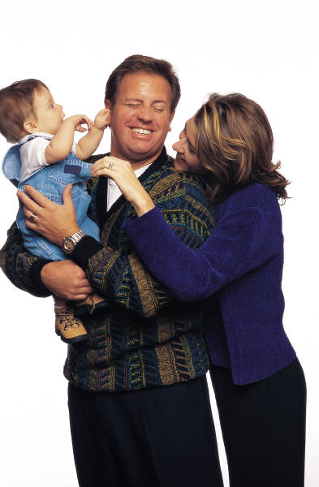
Types of Family Structures
Foster family
Families who care for children when their parents are unable to care for them
Copyright © Notice: The materials are copyrighted © and trademarked ™ as the property of The Curriculum Center for Family and Consumer Sciences, Texas Tech University.

Slide 10
Types of Family Structures
Single person
Single adult living alone
Copyright © Notice: The materials are copyrighted © and trademarked ™ as the property of The Curriculum Center for Family and Consumer Sciences, Texas Tech University.

Slide 11
Types of Family Structures
Grandparents as parents
Grandparents take the role of parents when parents are not able or willing to care for their children
Copyright © Notice: The materials are copyrighted © and trademarked ™ as the property of The Curriculum Center for Family and Consumer Sciences, Texas Tech University.

Slide 12
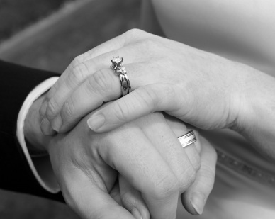
Marriage
Two Basic Forms of Marriage
Monogamy: marriage between one man & one women
Polygamy: marriage of man/women to more than one person
Two Types of Marriage
Exogamy: marriage to person outside kind or group
Result: Heterogamy (different)
Ex: outside blood line
Endogamy: marriage to person inside kind or group
Result: Homogamy (similar)
Ex: within race/age/caste

Slide 13
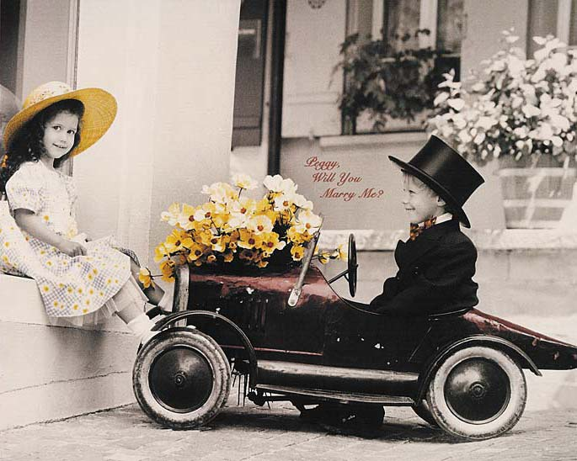
Reasons for Marriage
Love
Arrangement
Economic Benefit
Social Class
Companionship

Slide 14
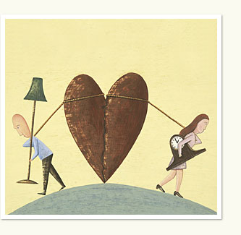
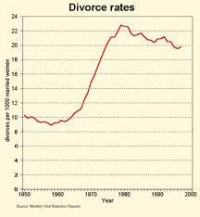
Reasons for Divorce
Personal Factors
- age - years -quality
Societal Factors
- economic changes
- generational change
- independence
- values/attitudes of society
10% of American adults over age 15 are divorced!
Divorce rate is ten times what it was a century ago!

Slide 15
Recent Family Trends
Ways in which American families are changing:
Cohabitation: people living together without marrying
500,000 in 1970 to 5.6 million in 2005 (U.S. Census Bureau, 2006)
9% of all couples (U.S. Census Bureau, 2005)
Postponing Marriage: people are delaying marriage
1950 average median age for marriage was 20.3 (women) & 22.8 (men)
2003 average median age jumped to 25.3 (women) & 27.1 (men) (U.S. Census Bureau, 2004)
Single Parents: children being raised by just one parent
2005 1 in 3 families with children under 18 had just one parent in the household 9 (U.S. Census Bureau, 2006)
Since 1970 the number has more than doubled
Same-Sex Families: movement to win the right to marry
25% of same-sex couples are raising children (U.S. Census Bureau, 2002)
Mothers Joining the Workforce:
18% of young children are spending time in child-care programs (Urban Institute, 2004)

Slide 16
Percent of Workforce That Is Female, Selected Occupations, 1983 and 1999
Occupation | 1983 | 1999
Secretaries | 99.0 | 97.6
Registered Nurses | 95.8 | 92.5
Sales | 58.7 | 72.7
Accountants | 38.7 | 58.2
Financial Managers | 38.6 | 53.3
College Faculty | 36.3 | 42.3
Physicians | 15.8 | 26.6
Lawyers | 15.3 | 28.5
Clergy | 5.6 | 12.0

Slide 17
Studying the Family
Functionalist View
The family serves six functions for society:
Reproduction
Protection
Socialization
Regulation of sexual behavior
Affection
Providing of social status

Slide 18
A Healthy Family
Spends time together
Shows trust
Shows respect
Expresses Understanding and Love
Establishes traditions

Slide 19
ENERGIZER
What else on the shoulder should a Scottish soldier show- * 3.

Slide 20
ENERGIZER
Energizer Activity - Ju Ger Jar

Slide 21
Assignment
Find out how the various types of family influence health.

Slide 22
END

Slide 23
QUESTIONS

