Slide 1
SOCIOLOGY AND ANTHROPOLOGY
DIPLOMA
KRCHN MARCH 2019 CLASS
BY;
PETER NDIRANGU NGUNDI

Slide 3
Introduction
Socialization process
Learning objectives
At the end, learners should be able to;
Define the term socialization.
Explain social stratification.
Describe social mobility.
Describe the role of social institutions in the provision of healthcare.

Slide 4
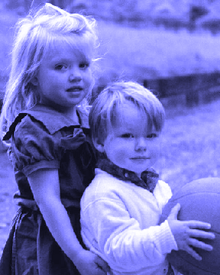
What is Socialization?

Slide 5
The Socialisation Process
According to Peil (1977) it refers to all the things that a child needs to know in order to function as a confirmed member of society.
Akinsola (1983) defines socialisation as the fundamental social process by which a person is introduced to be part of society into which one was born and learns its culture.

Slide 6
Although much of this learning takes place in the first two or three years of life, socialisation continues throughout life. When we attend school, move to
a new place, take a new job or whenever we are called to make changes in customs, norms or behaviour, additional socialisation is necessary. Socialisation integrates a child into the community by teaching them the disciplines, aspirations, social roles and skills necessary for group membership.

Slide 7
Parts of the Socialisation Process
The socialisation process is made up of two parts:
Primary socialisation
Secondary socialisation

Slide 8
Primary Socialisation
This is the type of socialisation that starts from infancy with parents and other family members who are in close contact with the young one.
The mother plays an active role in bonding with her infant.
As the child advances in age, they are taught the expected roles according to age and sex.
For example, children are taught to be obedient to parents and other older persons in the neighbourhood.
Children also learn by observing and imitating others.
Therefore, parents should be role models if they expect their children to attain acceptable behaviour

Slide 9
Secondary Socialisation
This takes us outside the home with playmates in the neighbourhood, at school and with other community agents, for example, religious forums.

Slide 10
Agents of Socialisation
Family - parents, children and close relatives.
Social Institutions - family, schools, religious organisations, government and hospitals.
Peers, School Friends and Neighbours.
Electronic and Printed Media - books, magazines, journals, television, radio, computer (internet) and others.

Slide 11
Social Stratification
Social stratification is thus defined as a process ranking members of society according to wealth, prestige and power.
In African societies, members are ranked according to sex, age, ethnic origin and occupation (Peil 1977).

Slide 12
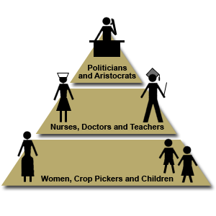

Slide 13
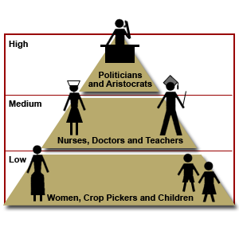
How an Individual is Rated in Different Roles

Slide 14
SOCIAL MOBILITY
DEFINITION
The ability to move up or down the social level is referred to as social mobility.
Types of Social Mobility
There are two types of social mobility:
Vertical social mobility
Horizontal social mobility

Slide 15
Vertical Social Mobility
This refers to the ability of the individual to move up the social ladder, thereby raising their social status and role. It also refers to any upward or downward change in the absolute or relative rank of an individual or group

Slide 16
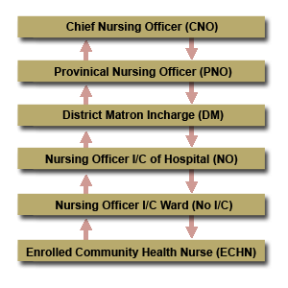

Slide 17
An example of this would be the nurse, who joins the profession as a community nurse and, by increasing their knowledge through in-service education, acquires the new position of a professor in nursing.

Slide 18
Horizontal Social Mobility
This refers to the type of social mobility where the individual maintains the same status.
It is also defined as an alteration of position with no significant movement up or down in the system of social stratification, for example a general nurse who trains as a midwife but has no change in salary.
This nurse maintains the same status although their role may have changed.

Slide 19
ENERGIZER
Bush Said She is Shy - * 3.

Slide 20
SOCIAL CHANGE
Social change is the transformation of culture and social institutions over time.
All societies experience change in their social structure and culture over time.
Societies change because they are in contact with other societies.
As a result the ideas, norms and institutions spread from one society to another.

Slide 21
Social change takes place in various aspects of the society, for example, cultural patterns (religious values, symbols of status), social structure (family adjustment to the absence of migrant fathers), aggregated attributes (the proportion of the population which is illiterate or engaged in farming), and rates of behaviour (increased crime, decreased self-employment).
Change may also be examined from the point of view of the social system, that is, the whole society or from the view of an individual.

Slide 22
Types of Social Change
Evolution
Revolution
Reform

Slide 23
Evolution
The term evolution refers to slow or gradual change, which occurs with very low human effort, with almost unnoticeable changes in social structure.
Examples are language, marriage patterns, child rearing practices and so on.

Slide 24
Revolution
This term refers to a rapid and deliberate change, which can radically change a society's way of doing things.
Revolutions are planned for a specific purpose and are initiated by direct human action.
For example, the Russian revolution and in East Africa, the Ugandan revolution that brought a new political system under President Idi Amin.

Slide 25
Reform
This term refers to a deliberate effort by humans to alter the society's way of doing things. Reforms apply lesser force than revolutions and their effects are much more extensive than revolution. An example is the changes that will occur when Kenya's educational system fully switches from the 8-4-4 to the 2-6-3-3-3 new system of education.

Slide 26
Assignment
Read and make notes on the processes by which Social Change Occur.
The Seven Steps of Social Change (The Seven Doors)

Slide 27
SOCIAL INSTITUTIONS
Definition.…Social institutions are organs, which perform some of the functions that benefit society, for example, the government and schools.
Each society should have social institutions for survival.

Slide 28
1. The Family
The definition of the family, which is the basic unit of social structure, can vary greatly from time to time and from culture to culture
However, for the purpose of this class you shall define the family as a universal human institution in a small kinship structured group with the key function of nurturing the socialisation of the new-born.

Slide 29
There has been much recent discussion of the nuclear family, which consists only of parents and children, but the nuclear family is by no means universal.
The nuclear family also may be extended through the acquisition of more than one spouse (polygamy), or through the common residence of two or more married couples and their children or of several generations connected in the male or female line.
This is called the extended family

Slide 30
The primary functions of the family are reproductive, economic, social and educational.
It is through their kin (also variously defined) that children first absorb the culture of their group.
Some family institutions include gender, marriage, parenthood and kinship

Slide 31
Kinship Relationship
This consists of parents and children.
Kinship implies ties of blood (biological kinship), descent (jural or legal kinship) and marriage (affiliation).
As a basic principle of social organisation, kinship gives a person his place in society; he is the son of X and grandson of Y.

Slide 32
Extended Family
This is the type of family that consists of several generations of relatives all living together or near each other.
The relationship is based on birth or marriage, for example, auntie, in-laws, grandparents and so on.

Slide 33
Functions of the Family
Control of Sexual Behaviour
Nurturing Children
Education
Legal Function
Spiritual Function

Slide 34
2. Educational Institutions
Education is the deliberate instruction through which a society’s social and technical skills are acquired (Casper Odegi Awuondo, 1993).
It is a lifelong process that begins as soon as a child is conceived.
What happens to the mother during pregnancy affects the child’s personality development and learning process.
There are two aspects of education: formal and informal.

Slide 35
Formal education is acquired through formally established institutions of learning.
Informal education takes place in informal places, for example, the work place, recreational place, among peer groups, in the church or other religious settings.

Slide 36
What are the Functions of Education?
Secondary Socialisation
Custodial Functions
Cultural Transmission
Social Integration
Innovation
Selection and Allocation
Personal Development

Slide 37
Political Institutions
As you studied earlier, historically in African families the man took the leadership role.
However, as a result of population increase amongst other social changes, the family as an institution was unable to continue with its political/leadership functions.
The control system of the family was weakened gradually.
This led to the formation of political institutions such as governments in order to create and enforce laws so as to maintain functions.

Slide 38
The government rules its people through various styles of leadership.
The three styles of leadership are:
Autocratic (Authoritarian)
Democratic (Participative)
Laissez-faire (Delegative, Free-reign)

Slide 39
1. Autocratic (Authoritarian)
This type of leader controls all the power to make and enforce laws and they assume all responsibility for the actions.
This method is used when the leader tells their employees what they want done and how they want it done, without allowing them to participate in the decision making process.
They elect themselves into a leadership position. Examples include leaders like Babangida of Nigeria and Adolf Hitler in Germany.

Slide 40
2.Democratic (Participative)
This style involves the leader, including one or more employees in the decision making process (determining what to do and how to do it).
However, the leader is the final decision making authority.
Using this style is not a sign of weakness.
It is a sign of strength that your employees will respect.

Slide 41
3.Laissez-faire (Delegative, Free-reign)
In this style, the leader allows the employees to make the decision.
However, the leader is still responsible for the decisions that are made.
This is used when employees are able to analyse the situation and determine what needs to be done and how to do it.

Slide 42
Health Care Institutions
In order for the society to meet its health needs, various health care institutions are established.
In Kenya there are several types of health care institutions with different functions,

Slide 43
Traditional Medicine
Many African societies had traditional healers, whose indigenous knowledge of folk medicine was respected.
They used herbs and some practised magic and divination as they strived to meet the health needs of their clients.
Today, fewer people subscribe to services of traditional healers.

Slide 44
Public Health Facilities
These are government-run health facilities and are present in most parts of the country.
In Kenya, health facilities are classified according to their structure (mainly size and catchment population) and by extension, their functions.
The largest hospital in Kenya is the Kenyatta National Hospital.
It serves as a teaching, research and national referral hospital.
Many nurses, doctors, pharmacists, laboratory technologists and other health professionals have trained here.

Slide 45
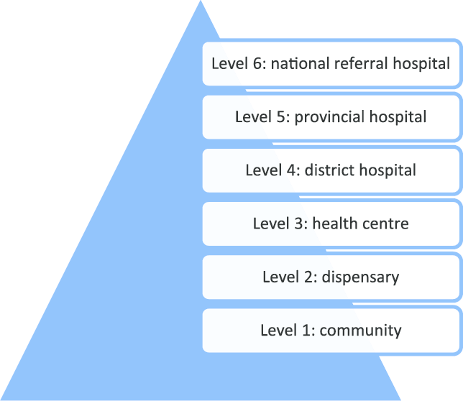

Slide 46
Private Health Facilities
These are health facilities owned and/or run by religious and private organisations.
They are popular in areas without government health facilities.
CHAK
KCCB
NGO

Slide 47
CHAK is a leading national Faith Based Organization (FBO) of Protestant churches' health facilities and programs from all over Kenya.
Established in 1946, CHAK has the goal of promoting access to quality health care.
The organization's structure includes member health facilities and member programmes, governance organs which include a regional structure and the Secretariat based in Nairobi.

Slide 48
Faith-based health care in Kenya
Faith based organizations provide 30-70 percent of the health care in many countries throughout Africa.
For many other people, however, faith-based organizations are the only health care providers available.

Slide 49
Policies on NGO
Non-Governmental Organisations (“NGOs”) in Kenya are governed by the provisions of the Non-Governmental Organizations Co-ordination Act, 1990 (the “NGO Act”) and the Non-Governmental Organisations Co-ordination Regulations, 1992 (the “NGO Regulations”).
The Public Benefit Organisations Act, No. 18 of 2013 (the “PBO Act”) passed in 2013 is not yet in force and therefore has no force of law.

Slide 50
National Budget for Health
The Government is the largest of the three main medical service providers operating in Kenya, the other two being the Commercial Private Sector and Faith Based Organisations (FBOs).
Therefore, the need for quality healthcare raises the question of government spending on the health sector.
So the question is, how much of Kenya’s total budget is going towards financing healthcare?

Slide 51
Kenya Siddharth Chatterjee argues that while Kenya’s health financing is progressing gradually, only about 4% of the national budget is going towards healthcare.
In April 2001, heads of state of African Union countries met and pledged to set a target of allocating at least 15% of their annual budget to improve the health sector, which became a component of the Abuja Declaration of 2001.

Slide 52
The New Constitution devolved health services to the 47 counties leaving the national government with the function of policy, research and regulation of the sector.
Additionally, the national government is responsible for Level Six hospitals, which are mainly referral facilities — the National Spinal Injury Hospital in Nairobi, Eldoret’s Moi Teaching and Referral Hospital and the Kenyatta National Hospital.
The counties are responsible for facilities classified between level 1 and level 5.

Slide 53
Assignment
Read and make notes on :-
Sessional paper no 10 of 1965.
Universal health coverage

Slide 54
ENERGIZER
Energizer Activity – Eric says

Slide 55
END

Slide 56
QUESTIONS

