Slide 1
SOCIOLOGY AND ANTHROPOLOGY
DIPLOMA
KRCHN CLASS
BY;
PETER NDIRANGU NGUNDI

Slide 3
Introduction
Concepts of Sociology and Anthropology
Learning objectives
At the end, learners should be able to;
Define terms in sociology and anthropology.
Describe the relationship between social anthropology and health.
Explain social cultural beliefs and practices that affect health.
Explain social change and factors that influence it.

Slide 4
Definitions of Sociology
L.F. Ward defines, “Sociology is the science of society or of social phenomena”.
Ginsberg says, “Sociology is the study of human interaction and interrelation of their conditions and consequences”.
Emile Durkheim defines, “ Sociology as a science of social institutions”.
Ogburn and Nimkoff defines, “Sociology as the study of social life”.
Kimball Young defines, “Sociology deals with the behavior of men in groups”.

Slide 5
Sociology is
the study of society
the science of social life.
the study of social relationships.
the study of human behavior in groups.
the study of forms of social relationships.
the study of social action.
the study of social groups and social systems.

Slide 6
Anthropology is
Anthropology is the scientific study of the origins of humans, how we have changed over the years, and how we relate to each other, both within our own culture and with people from other cultures.

Slide 7
Sociology and anthropology
The key difference between the two social sciences is that sociology concentrates on society while anthropology focuses on culture.

Slide 8
Terminologies used in sociology
Group - this is a combination of more than two persons with common values and objectives, for example, a group of boys walking to the market, a family.
Role - this is defined as an expected behavior attached to social status.
Status - this refers to one's position in a society or social group.

Slide 9
Norms are the standards that govern behavior in roles.
Folkways are customary practices that are considered appropriate behavior but are not rigidly enforced. For example, if one builds their house in a somewhat different shape from the others, they may be considered eccentric or an individualist but people will not be particularly bothered by their behavior.

Slide 10
Mores
Mores are subject to strong sanctions because they are considered much more important to the welfare of the society. For instance, wives should be faithful to their husbands and not commit adultery. Mores also include taboos, for example, certain communities are not allowed to eat certain animals

Slide 11
Values
Values are usually inferred from observed behavior. If a person regularly associates with certain people, it can be assumed that they value this relationship.

Slide 12
Culture
The general public often thinks of culture as the aesthetic code of society: art, music, drama and literature.
In their definition of culture, social scientists include everything passed down by human society except its biology.
This consists of language and technology, laws and customs, beliefs and moral standards.
The child is born into a society and learns its culture in the process of growing up.

Slide 13
Social group
The word group may refer to a categorical group, that is, any set of people that the speaker wants to treat as a unit.
On the other hand, it is also used for corporate groups, that is, people who interact over a period of time and who have some form of organisation, a sense of solidarity and common values, norms and goals which allow them to undertake joint action.

Slide 14
Institution
An institution may be defined as an enduring complex of norms, roles, values and sanctions embracing a distinct segment of human life.
The family and kinship institutions are basic to social relations as they give every member of the society a place at birth and are essential for the continuance of the society..

Slide 15
Function and Dysfunction
Sociologists are concerned with how a society works as a whole and with how each of the parts fit together.
Activities that are detrimental to the system are termed dysfunctions.

Slide 16
ENERGIZER
Nduthi za thika na za Zambia - * 3.

Slide 17
Importance of Sociology in Nursing
Sociology is included in the curriculum of nursing because health is included as a social component.
Most of the illness have social causes and social consequences.
Sociology gives knowledge to deal with patient and to understand this habits norms, culture and behavior etc..
The nurse has to understand the necessity of changing the environment or surrounding.

Slide 18
Importance of Sociology in Nursing
So this knowledge helps her to avoid prejudices and discrimination.
As well as a nurse should understand the social position, status and social responsibilities with regard to health field by studying sociology.
She as to work is accordance with rules and norms of it by removing egoistic and impulse based behavior.
The nurse to understand the necessity to changing the environment for making recovery better.

Slide 19
Medicine as a social science
“‘Medicine is a social science in its very bone and marrow’....” Salomon Neumann 1847.
The tools of 21st century medicine include anatomy, physiology, pharmacology, and the related sciences, but it is only when social science is added to the tool box that medicine gains the ability to understand and respond to the wants and needs of individual patients, social networks, and whole communities.

Slide 20
Anthropological inquiry may be strange and foreign to biological scientists because, to quote Geertz¹⁰ again, anthropology is “not an experimental science in search of law but an interpretive one in search of meaning.”

Slide 21
Sociology in modern health
Sociologists have demonstrated that the spread of diseases is heavily influenced by the socioeconomic status of individuals, ethnic traditions or beliefs, and other cultural factors.

Slide 22
Where medical research might gather statistics on a disease, a sociological perspective on an illness would provide insight on what external factors caused the demographics who contracted the disease to become ill.

Slide 23
diseases are sociologically examined and compared based on the traditional medicine, economics, religion, and culture that is specific to each region.

Slide 24
Conflict
Conflict is a person's struggle with him/herself, another person, or a thing.
It is a problem or disagreement and results in a situation that needs resolution.
Conflict is present in every person's life.
According to Powler, conflict is defined as a fight, a struggle with others or groups, also as a collision or clashing of opposed principles. It is inescapable.
However, conflict can be dealt with creatively, if a person has the right tools.

Slide 25
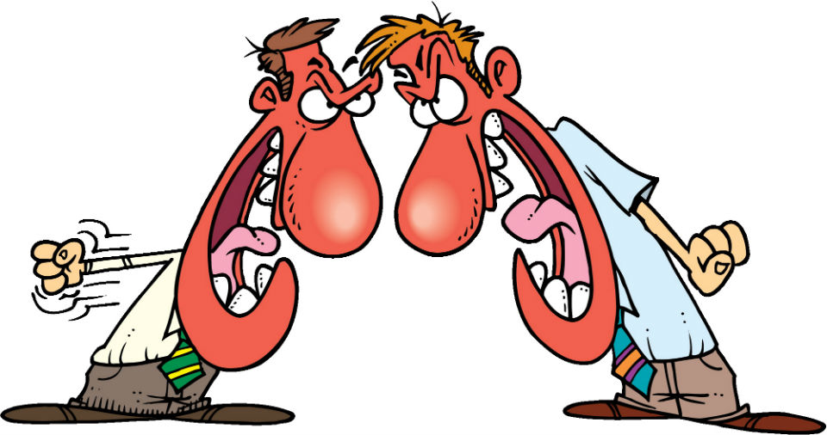

Slide 26
What is Conflict Resolution?
Conflict resolution is the process of finding a way to manage or solve a problem.
There are several methods of conflict resolution.
Some result in win-lose solutions, while others can be win-win.
Through programs like peer mediation, children learn to go for the win-win solution!

Slide 28
Situations That May Lead to Conflict
Factors that may contribute to conflict are varied.
Here are some examples of the situations where conflict may arise:
During the process of adjustment to forced change
When various groups are not in agreement
When some societal groups feel left out when new agreements are being implemented

Slide 29
Conflict Resolution Styles
There are many different ways of resolving conflict.
The three most common ways are:
fight,
flight
flow.

Slide 30
Fight
In a fight, two or more people are aggressive with one another. Fighting can be done with words, weapons or fists. Following a battle of some description there will be a winner and a loser, or both may lose.

Slide 31
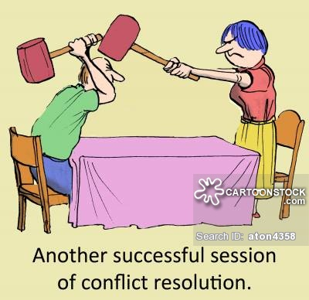

Slide 32
Flight
In a flight situation, one party walks away from the conflict. The problem is left unresolved and there may be a winner and a loser. Common 'flight' language includes 'never mind', 'just forget it' and 'whatever'.

Slide 33
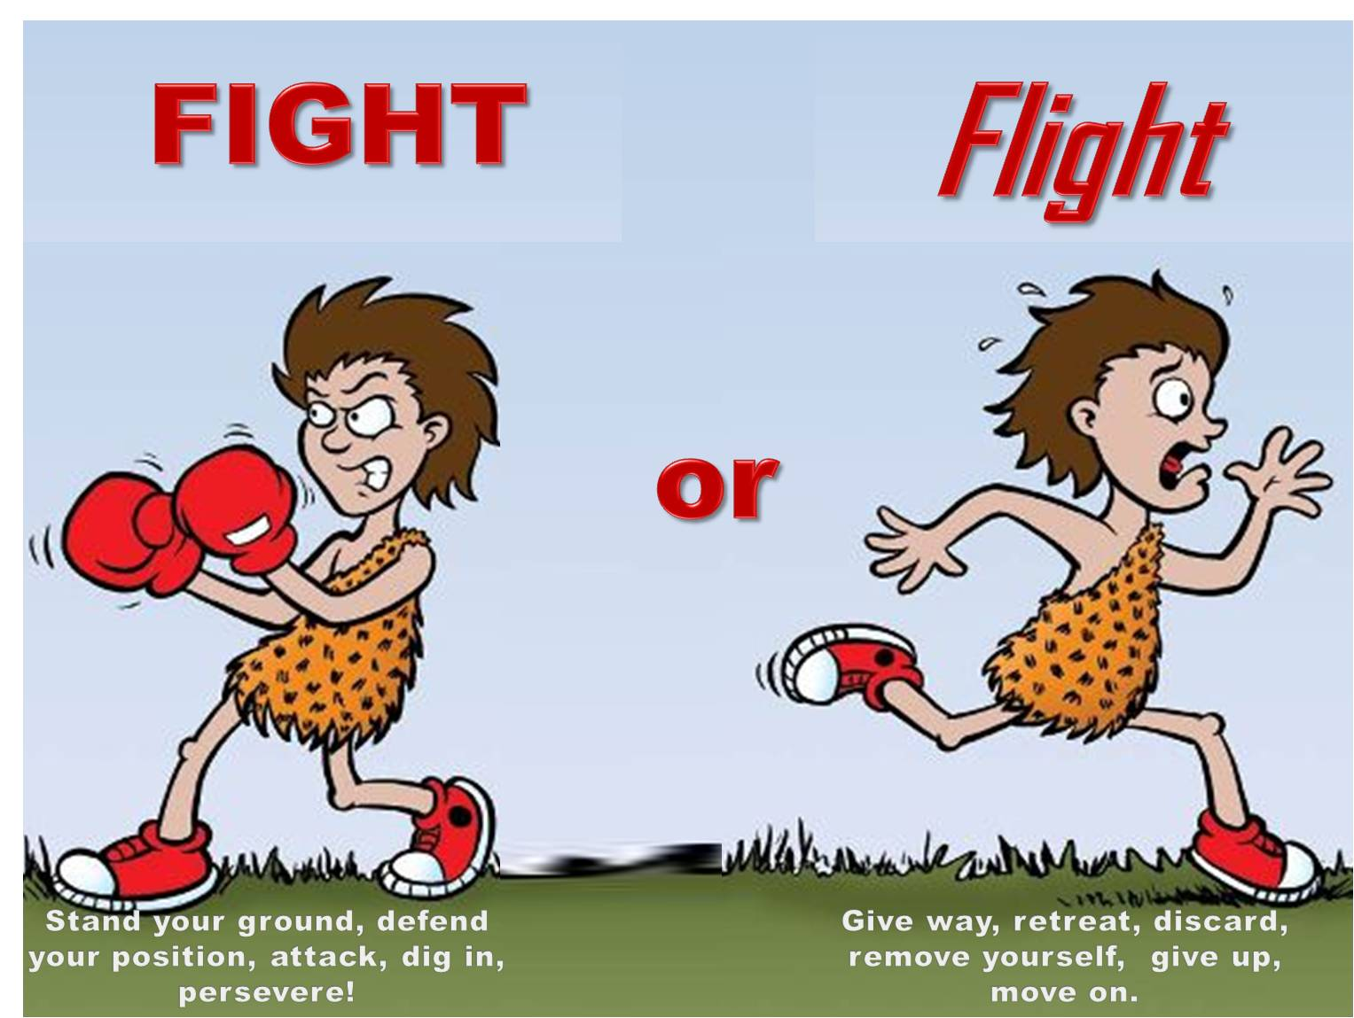

Slide 34
Flow
In a flow situation both people walk away from the conflict satisfied with the solution which they have reached together. Conflict resolution encourages everyone to 'go with the flow' and create solutions!

Slide 36
Skills to Resolve Conflict Peacefully
Be an active listener
Look and listen for the other person's feelings
Look for anger cues and triggers
Maintain good eye contact
Use a calm voice
Make sure you have ‘cooled down’ before trying to work things out

Slide 37
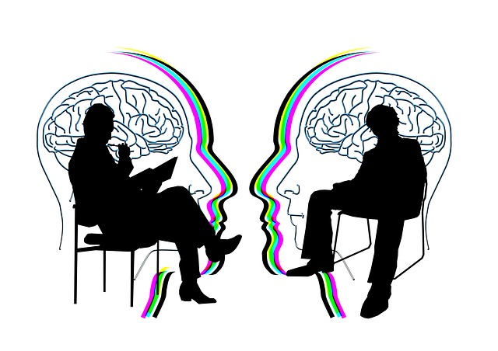
The Negotiation Process
The process of negotiation consists of three important phases.
The Information Phase
The Competitive Phase
The Cooperative Phase

Slide 38
ENERGIZER
Energizer Activity - Ju Ger Jar

Slide 39
The Information Phase
During this phase, you should collect and evaluate information on all factors that will have an effect on the negotiation.
Work out a defensive plan to protect sensitive information that the opposition is likely to inquire about.
Decide whether the negotiations will be carried out by yourself or an agent.

Slide 40
The Competitive Phase
The bargaining begins during this phase. You should decide who should go first on particular issues.
Support your position on an appropriate rationale and actively manage the concession process.

Slide 41
The Cooperative Phase
It is important to understand that, ultimately, cooperation is a worthy and necessary stage in the negotiation process.

Slide 42
While acknowledging that negotiations are inherently competitive, it helps to remember the following:

Slide 43
Be cooperative.
Do not use threats.
Assess the value of your position accurately.
Be willing to share information.
Approach negotiations in an objective, fair, trustworthy manner.
Seek agreement in the open exchange of information.
Get a settlement that is fair to both sides.

Slide 44
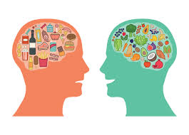
Elements of Culture
The elements of culture include:
Material life
Language
Social interactions
Religion
Education
Values

Slide 45
characteristics of culture are that:
It is learned
It is shared
It is an adaptation
It is a dynamic system changing constantly

Slide 46
Cultural Beliefs
A cultural belief is a personal conviction and disposition to retain and abandon actions taking into account values of one's own culture.
Cultural beliefs may pertain to child rearing or housing.
Several studies have noted that, besides inadequate availability of health care services in many areas, especially the less developed countries, certain disease specific and non-disease specific cultural beliefs may influence people's health seeking behaviour.

Slide 47
Social cultural beliefs and practices that affect health
Food Taboos
Overcrowding

Slide 48
Food Taboos
Outbreaks of malnutrition among children in this country may not only be associated with lack of food but also with culture patterns affecting food.
For example, in some parts of Kenya, children and women are not given eggs in the belief that the child will learn to be a thief when grown up or that a mother feeding on eggs may harm her unborn baby. Instead, the eggs are reserved for the men to eat or to be sold at the market.
In many homes that keep poultry, these eggs could serve as source of protein for young ones, were it not for these cultural beliefs.

Slide 49
Overcrowding
When several family members live in congested homes with a low standard of hygiene, this may contribute to poor health. This mainly occurs in urban centres, where a family may rent one room, which serves as the kitchen, bedroom and dining room.
There may be communal water but often there is none, and in such cases the family has to buy water or fetch it from a stream.
Under such living conditions children suffer from diarrhoea, intestinal worms and sometimes malnutrition.

Slide 50
Assignment
Find out more social cultural beliefs and practices that affect health.

Slide 51
Social change
Definition….Social change is the transformation of culture and social institutions over time.
All societies experience change in their social structure and culture over time, explanations of the causes and nature of this change have been part of the sociologist's task from the beginning of this discipline.

Slide 52
Societies change because they are in contact with other societies.
As a result the ideas, norms and institutions spread from one society to another.
Even the most isolated society changes from time to time as its members adjust to varying environmental conditions (such as prolonged drought) or invent new ways of doing things.

Slide 53
Theories of Change
Before looking at the types of social change, you will briefly take a look at the theories of change. Three major theories have been advanced to explain social change.
Evolution and Differentiation
Equilibrium and Conflict
Modernisation

Slide 54
Evolution and Differentiation
Early sociologists were concerned chiefly with the origins of society and the transformations necessary to reach the type of society that people are now experiencing.
Since Darwin's ideas of biological evolution were gaining acceptance at this time, the theory of societal evolution also became popular.
Theories of structural differentiation take humankind somewhat further than the evolutionism from which they are derived. The basic idea is that as societies develop, they become characterised by increased separation and specialisation.

Slide 55
Equilibrium and Conflict
The equilibrium and conflict theory maintains that the basic function of any society is to maintain equilibrium (stability, order) and eliminate conflicts that may arise in the process of change.
Conflict may arise mainly during the process of adjustment to forced change, when consensus is imperfect or among people who were inadequately socialised so that they do not fully share the consensus of the majority.
The equilibrium theory is better for explaining gradual, long-term change such as the Industrial Revolution and changes applying to the society as a whole, than in accounting for the more sudden political revolution and smaller endogenous changes where conflict often plays an obvious part.

Slide 56
Modernisation
The modernisation theory assumes that change is synonymous with improvement of social conditions, for the benefit of societies.
Modernisation is the process by which agricultural societies were transformed into industrial societies.
Modernisation theorists tend to see only the front end of the process of social change (what the modern society should look like) and ignore the traditional end of the process.
Nevertheless, some attention must be given to modernisation theories because they are so prevalent and because they alert us to ways of examining long-term change.

Slide 57
Factors that influence social change
1.Physical Environment:
Certain geographic changes sometimes produce great social change. Climate, storms, social erosion, earthquakes, floods, droughts etc., definitely affect social life and induce social change. Human life is closely bound up with the geographical conditions of the earth.

Slide 58
2. Demographic (biological) Factor:
Broadly speaking, demography is concerned with the size and structure of human population. The social structure of a society is closely related with the changes in the size, composition and distri­bution of population. The size of the population is based mainly upon three factors—birth rate, death rate and migration (immigration and emigration).

Slide 59
3. Cultural Factor:
It is an established fact that there is an intimate connection between our beliefs and social institutions, our values and social relationships. Values, beliefs, ideas, institutions are the basic elements of a culture. Certainly, all cultural changes involve social change.
Social and the cultural aspects are closely interwoven. Thus, any change in the culture (ideas, values, beliefs etc.) brings a corresponding change in the whole social order.

Slide 60
4. Ideational Factor:
Among the cultural factors affecting social change in modern times, the development of science and secularisation of thought have contributed a lot to the development of the critical and innovative character of the modern outlook. We no longer follow many customs or habits merely because they have the age-old authority of tradition. On the contrary, our ways of life have increasingly become on the basis of rationality.

Slide 61
5. Economic Factor:
Of economic influences, the most far-reaching is the impact of indus­trialisation. It has revolutionised the whole way of life, institutions, organisations and community life. In traditional production systems, levels of production were fairly static since they were geared to habitual, customary needs. Modern industrial capitalism promotes the constant revision of the technology of production, a process into which science is increasingly drawn.

Slide 62
6. Political Factor:
State is the most powerful organisation which regulates the social relationships. It has the power to legislate new laws, repeal old ones to bring social change in the society. Laws regarding child marriage, widow remarriage, divorce, inheritance and succession, untouch­ability are some of the examples which have brought many changes in the social structure of Indian society.

Slide 63
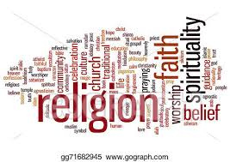
Religion
Paul Taylor (1996) presents a minimal definition of religion as a belief.
Durkheim (1912) defines religion as ‘a unified system of beliefs and practices relative to sacred things, that is to say, things set apart and forbidden – beliefs and practices which unite into one single moral community …all those who adhere to them.’

Slide 64
Religion is as old as humankind.
Sociologists have noted that in different societies religious beliefs and practices are different.
As important as the universality of religion is, it has remarkable diversity.

Slide 65
Functions of Religion
1. Religion provides mental peace:
Human life is uncertain.
He struggles for his survival amidst the uncertainties, insecurities and dangers, Some-times he feels helplessness.
It is the religion which consoles and encourages him in all such time of crisis.

Slide 66
2. It inculcates social virtues:
Religion promotes the major social virtues like truth, honesty, non-violence, service, love, discipline etc.
A follower of the religions internalizes these virtues and becomes disciplined citizen of the society.

Slide 67
3. Religion promotes social solidarity:
Religion gives rise to the spirit of brotherhood. Durkheim viewed that religion strengthens social solidarity.
A.W. Geen also pointed out that religion has the supremely integration and verifying force in human society.

Slide 68
4. Religion converts the animal qualities to human qualities:
Religion inculcates the spirit of self-service.
It demands that people should be charitable and benevolent.

Slide 69
5. Religion is an agent of socialization and social control:
Parsons viewed that religion is one of the most important agents of socialization and social control.
It has significant role in organizing and directing social life.
It helps in preserving social norms and strengthening social control.

Slide 70
END

Slide 71
QUESTIONS

