Slide 1
Specialized procedures I
A. SAMBU

Slide 2
MODULE OUTCOMES.
By the end of the module the learner should:
Provide care to patients undergoing specialized diagnostic procedures.
Manage patients scheduled for radiological examinations.

Slide 3
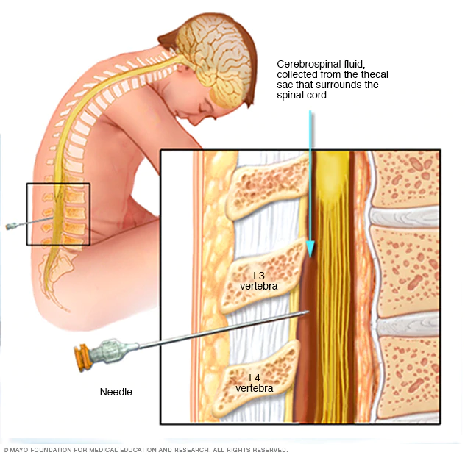

Slide 4
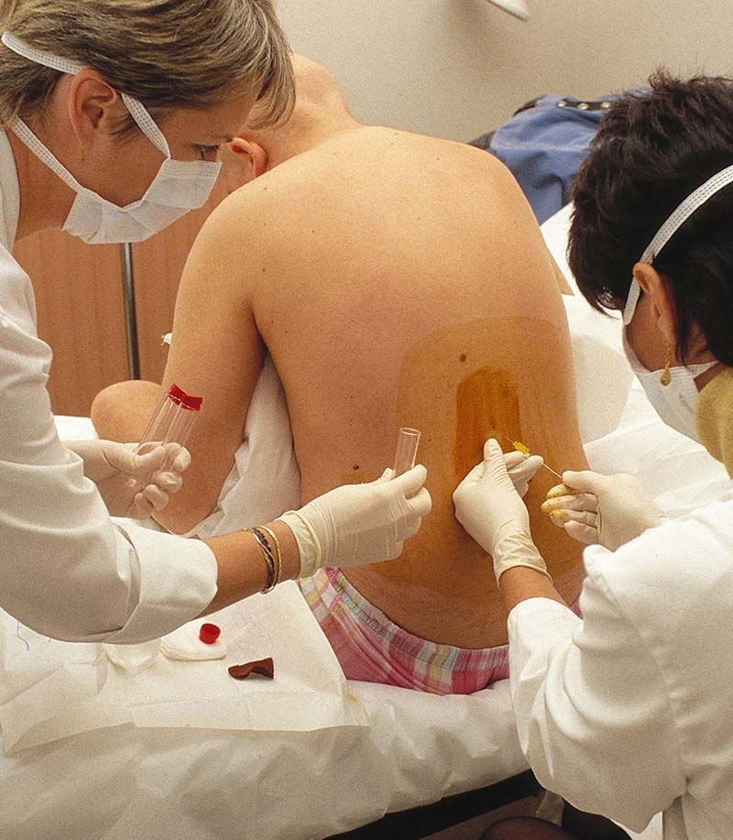

Slide 5
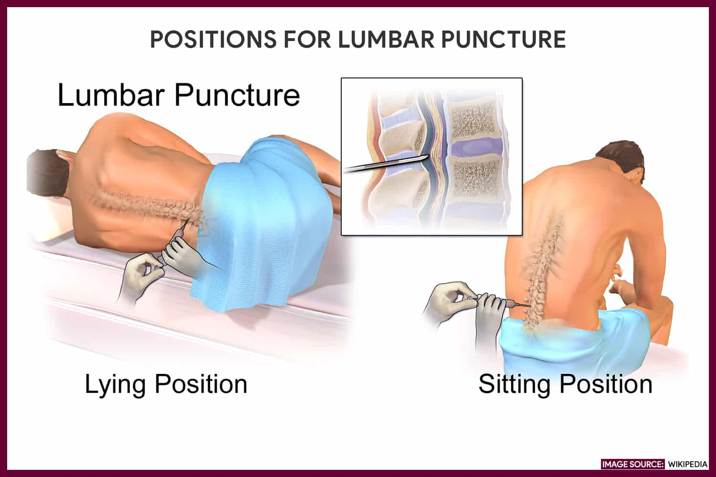

Slide 6
LUMBAR PUNCTURE.
A lumbar puncture (spinal tap) is performed at the lower back, in the lumbar region. During a lumbar puncture, a needle is inserted between two lumbar bones (vertebrae) to remove a sample of cerebrospinal fluid. This is the fluid that surrounds your brain and spinal cord to protect them from injury.

Slide 7
Cont.
A lumbar puncture can help diagnose serious infections, such as meningitis; other disorders of the central nervous system, such as Guillain-Barre syndrome and multiple sclerosis; or cancers of the brain or spinal cord. Sometimes doctors use lumbar punctures to inject anesthetic medications or chemotherapy drugs into the cerebrospinal fluid.

Slide 8
Role of the nurse
Before the procedure
The following are the nursing interventions prior to a lumbar puncture:
Explain the procedure to the patient. Explain to the patient the purpose of lumbar puncture, how and where it’s done, and who will perform the procedure.
Obtain informed consent. Make sure the patient has signed a consent form if required by the institution.
Reinforce diet. Advise the patient that fasting is not required.

Slide 9
Cont.
Promote comfort. Instruct the patient to empty the bladder and bowel before the procedure.
Establish a baseline assessment data. Do vital signs monitoring and neurologic assessment of the legs by assessing the patient’s movement, strength, and sensation.

Slide 10
Cont.
Place the client in a lateral decubitus position. Assist the client to assume a lateral decubitus (fetal) position, near the side of the bed with the neck, hips, and knees drawn up to the chest. An alternative position is to have the patient sit on the edge of the bed while leaning over a bedside table.

Slide 11
Cont.
Instruct to remain still. Explain that he or she must lie very still throughout the procedure. Any unnecessary movement may cause traumatic injury.

Slide 12
After the procedure
The nurse should note of the following nursing interventions post-lumbar puncture:
Apply brief pressure to the puncture site. Pressure will be applied to avoid bleeding, and the site is covered by a small occlusive dressing or band-aid.

Slide 13
Cont.
Place the patient flat on bed. The patient remains flat on bed for 4 to 6 hours depending on the physician. He or she may turn from side to side as long as the head is not elevated.

Slide 14
Cont.
Monitor vital signs, neurologic status, and intake and output. Take vital signs, measure intake and output, and assess neurologic status at least every 4 hours for 24 hours to allow further evaluation of the patient’s condition.

Slide 15
Cont.
Monitor the puncture site for signs of CSF leakage and drainage of blood. Signs of CSF leakage includes positional headaches, nausea and vomiting, neck stiffness, photophobia (sensitivity to light), sense of imbalance, tinnitus (ringing in the ear), and phonophobia (sensitivity to sound).

Slide 16
Cont.
Encourage increased fluid intake. An increased amount of fluid intake (up to 3,000 ml in 24 hours) will replace CSF removed during the lumbar puncture.
Label and number the specimen tube correctly. Ensure all samples are properly labeled and sent to the laboratory immediately for further evaluations.

Slide 17
Cont.
Administer analgesia as ordered. Headaches after the procedure can last for a few hours or days and is usually treated with analgesics.

Slide 18
BIOPSIES.
The removal of tissue or cells for analysis is called a biopsy.
While a biopsy may sound scary, it’s important to remember that most are entirely pain-free and low-risk procedures. Depending on your situation, a piece of skin, tissue, organ, or suspected tumor will be surgically removed and sent to a lab for testing.

Slide 19
Cont.
Biopsies may require some preparation on the part of the patient such as bowel prep, clear liquid diet, or nothing by mouth.
As always before a medical procedure, client will explain what medications and supplements being taken. client may need to stop taking certain drugs before a biopsy, such as aspirin or nonsteroidal anti-inflammatory medications.

Slide 20
Cont.
A member of health care team will explain the procedure.
Client will be asked to sign a consent form that states understanding the benefits and risks of the biopsy and agree to have the test done.

Slide 21
Cont.
Immediately after the biopsy
How you feel after the biopsy depends on what sort of procedure was performed. Generally, you can expect after a biopsy:

Slide 22
Cont.
Some pain around the biopsy site. This should resolve, or at least ease over the next two or three days.
doctor will prescribe appropriate pain relieving medication.
Nurses monitor your condition for some hours and check for bleeding from the biopsy site.

Slide 23
Cont.
You may have a blood count test to double-check that you are not bleeding internally from the biopsy site.
You may undergo other tests to make sure all is well, for example, a chest x-ray (or two) if you had a lung biopsy.
Surgical medications can sometimes make you drowsy so you should not drive yourself home

Slide 24
PARACENTESIS
Paracentesis is a procedure in which a needle or catheter is inserted into the peritoneal cavity to obtain ascitic fluid for diagnostic or therapeutic purposes. Ascitic fluid may be used to help determine the etiology of ascites, as well as to evaluate for infection or presence of cancer.

Slide 25
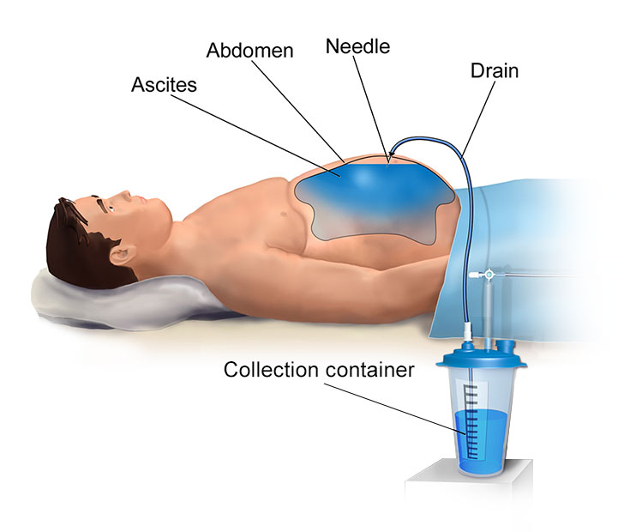

Slide 26
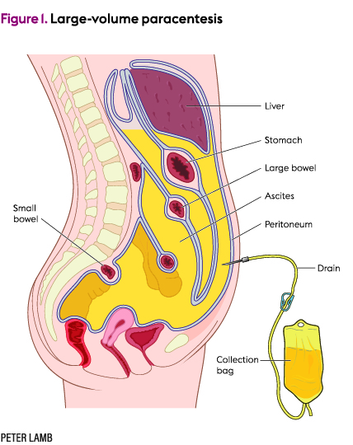

Slide 27
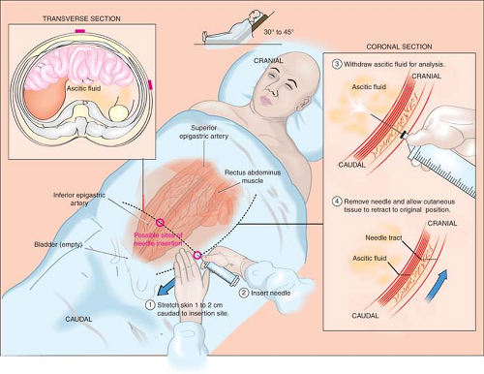

Slide 28
Indications.
It is used for a number of reasons:
to relieve abdominal pressure from ascites
to diagnose spontaneous bacterial peritonitis and other infections (e.g. abdominal TB)
to diagnose metastatic cancer
to diagnose blood in peritoneal space in trauma

Slide 29
Cont.
Before the procedure the patient is instructed to empty the bladder to reduce the danger of accidental puncture of the bladder. The skin below the umbilicus and overlying the rectus muscle is cleansed with an antiseptic. A local anesthetic is used to anesthetize the skin and underlying tissues at the site of insertion of the trocar.

Slide 30
Cont.
During the procedure the patient may be placed in a sitting position with the feet resting on a foot stool or on the floor. The back and arms should be well supported. The container for collecting the drainage is placed at the patient's feet. As the fluid is being withdrawn the patient is observed for symptoms of fainting or shock.

Slide 31
Cont.
The amount and character of the fluid obtained are recorded and a specimen is saved if the physician requests laboratory examination of the fluid. After the trocar is removed a sterile dressing is applied to the site. A more permanent procedure for relief of accumulations of excess fluid in the peritoneal cavity is insertion of a peritoneovenous shunt.

Slide 32
THORACENTESIS
is an invasive procedure to remove fluid or air from the pleural space for diagnostic or therapeutic purposes. A cannula, or hollow needle, is carefully introduced into the thorax, generally after administration of local anesthesia.
A thoracentesis is a procedure that is done to remove excess fluid from the pleural space.

Slide 33
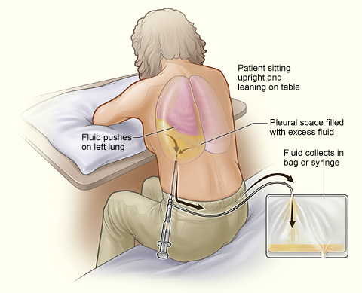

Slide 34
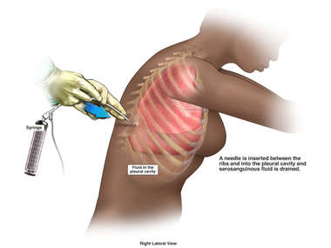

Slide 35
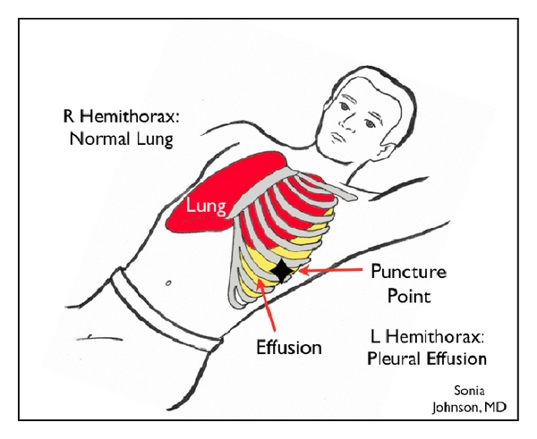

Slide 36
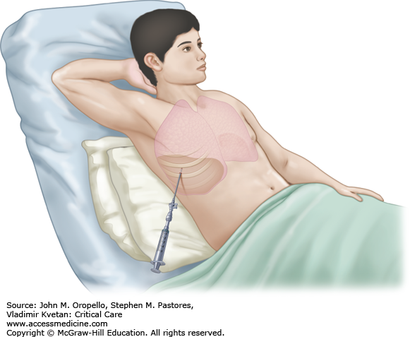

Slide 37
Nursing responsibility.
Before the procedure
Check if the consent form has been completed and signed.
Assess client for known allergies, especially to local anesthetic.
Place patient on the proper position. Proper positioning stretches the chest or back and allows easier access to the intercostal spaces. The nurse can position the client in one either of the following:

Slide 38
Cont.
Assist the client to sit on the edge of the bed with the feet supported and arms and head on a padded over-the-bed table
Assist the patient to straddle on a chair with his or her arms and head resting on the back of the chair
If the client is unable to assume a sitting position, assist him or her to lie on the unaffected side. Then elevate the head of bed to 30 to 45 degrees

Slide 39
During the procedure
Inform the client of the cold sensation to be felt when antiseptic skin solution is applied to the puncture site. A stinging sensation is also felt during the injection of the local anesthesia.
Instruct the client to refrain from coughing, breathing deeply or moving during the procedure to avoid injury to the lung.

Slide 40
After the procedure
After the needle is withdrawn, apply pressure over the puncture site and a small, sterile dressing is fixed in place.
Place the client on bed rest.
Obtain post-procedure chest x-ray results. The x-ray verifies that there is no pneumothorax.

Slide 41
Cont.
Record total amount of fluid withdrawn, nature of fluid and its color and viscosity.
If ordered, prepare samples for laboratory evaluation. A specimen container with formalin may be needed if a pleural biopsy is to be obtained.

Slide 42
Cont.
Evaluate the patient at intervals for increased respiration rate, asymmetric lung movement, vertigo, tightness in the chest area, uncontrolled cough with blood-tinged mucus, rapid pulse and signs of hypoxemia.

Slide 43
Cont.
To prevent pulmonary edema and hypovolemic shock after the procedure, fluid is removed slowly and no more than 1000 ml of fluid is removed during the first 30 minutes. Also, it is vital to check the client for complications post-thoracentesis to provide timely interventions.

Slide 44
BLADDER IRRIGATION.
Irrigation is a procedure used to wash out your bladder. The bladder will be irrigated (flushed) with saline (salt water) to keep the urine draining freely through the catheter and to keep the catheter from getting plugged. As you are healing, it may be necessary to irrigate the bladder five times a day, but eventually will be needed to be done only once a day.

Slide 45
Cont.
Supplies
A 60 cc catheter-tipped syringe
Plastic container for liquid
Saline
Basin for collecting urine
Catheter plug or plastic clamp

Slide 46
Procedure
Wash your hands
Pour saline into the container
Put about 50 to 60 cc of saline into the syringe. (Note: The amount of saline needed will be different for each person.)
Attach the syringe to the catheter and gently push the saline into the bladder. Do not force fluid into the bladder.

Slide 47
Cont.
Remove the saline by pulling back on the syringe. Do not pull back forcefully. Do not attempt to pull back more than you pushed in.
If the saline contains a lot of mucous, continue to irrigate the bladder until most of the mucous has been removed.

Slide 48
Cont.
Let the saline drain out into the basin or toilet. You may remove it with the syringe. Wash your hands and supplies.
Your nurse will make sure that you are comfortable irrigating your bladder before you’re discharged. You’ll be given instructions and a schedule for doing the irrigations.

Slide 49
Continuous bladder irrigation
A catheter (thin tube) will be placed in your bladder. The catheter will have holes that are large enough to allow clots to pass. It will have 3 tubes coming from the end. The first will be attached to your drainage bag. The second will be used to inflate the balloon that keeps the catheter in place.

Slide 50
Cont.
The third will be attached to tubing that goes into 2 bags of saline (salt water). The fluids will hang from an IV pole. The tubing may be put through a pump so that the speed of the fluid can be controlled.

Slide 51
Cont.
The clamp for the first bag will be open until the bag is empty. Then your healthcare provider will close that clamp and open the clamp on the second bag. While the second bag is flowing, your healthcare provider will replace the first bag.

Slide 52
CHOLECYSTOGRAM.
A cholecystogram is an x-ray procedure used to help evaluate the gallbladder. For the procedure, a special diet is consumed prior to the test and contrast tablets are also swallowed to help visualize the gallbladder on x-ray. The test is used to help in diagnosing disorders of the liver and gallbladder, including gallstones and tumors.

Slide 53
Cont.
An oral cholecystogram is an X-ray examination of your gallbladder. Your gallbladder is an organ located in the upper right-hand side of your abdominal cavity, just underneath your liver. It stores bile, a fluid produced by your liver that aids in digestion and absorption of fats from your diet.

Slide 54
Cont.
Oral refers to the oral medication you take before the test. The medication is an iodine-based contrast agent that makes your gallbladder more clearly visible on the X-ray.

Slide 55
Cont.
This procedure is now rarely performed since the first-line method for imaging of your gallbladder is an abdominal ultrasound or CT scan typically followed by a hepatobiliary scan or endoscopic retrograde cholangiopancreatography. These tend to be more accurate when it comes to diagnosis of gallbladder conditions.

Slide 56
Preparation.
Advice client to follow a low-fat or fat-free diet the day before the procedure. Ideal choices include:
Chicken, fish, vegetables, fruits, bread, skim milk

Slide 57
Cont.
The evening of the day before the test, you’ll take the contrast agent medication. The medication is available in pill form. You’ll take a total of six pills, one each hour.

Slide 58
Cont.
Take each dose of medication with a full glass of water. On the evening before the test, don’t eat any solid foods after you’ve started taking the contrast agent. Drinking water is fine until midnight. By then, you should be fully fasting. You should also refrain from smoking cigarettes or chewing gum.

Slide 59
Cont.
Don’t eat or drink anything the morning of your procedure. If you’ve completed certain types of gastrointestinal imaging in the few days before your oral cholecystogram, your doctor may recommend a rectal laxative, or enema, to clear your bowels. Clearing your bowels makes your gallbladder more visible.

Slide 60
Cont.
Oral cholecystogram is painless. However, you might experience diarrhea, nausea, or stomach cramping due to the contrast agent. If done as an outpatient imaging study, typically you can go home after the procedure, as long as no complications arise.

Slide 61
CHOLANGIOGRAM.
An intraoperative cholangiogram (IOC) is an X-ray of your bile ducts. It’s usually done during surgery to remove your gall bladder. Having a view of your bile duct during surgery involving your gallbladder helps your surgeon check for gallstones and avoid damaging your bile duct.

Slide 62
Cont.
Gallstones are made of hardened substances, usually cholesterol, that have collected inside your gallbladder. In addition to causing pain and inflammation in your bile ducts, gallstones can also cause a blockage in those ducts, even if you’ve had your gallbladder removed.

Slide 63
How It's Done
When it's time to get imaging during surgery, your doctor will:
Put a clip on the cystic duct, which runs right into your gallbladder. This stops anything from flowing in or flowing out.
Put a thin tube into the cystic duct.
Push a contrast dye into the tube, which helps highlight the bile ducts.
Take live X-rays with a tool called a fluoroscope

Slide 64
Cont.
You don’t need to do anything to prepare for an IOC. However, you can prepare for gallbladder surgery by:
getting a physical exam to check your overall health
letting your doctor know about any allergies you have, especially to contrast dye
not eating for at least 12 hours before the surgery
avoiding blood thinners, aspirin, or nonsteroidal anti-inflammatory drugs (NSAIDs), such as ibuprofen

Slide 65
Cont.
So generally you prepare patient using the preoperative check list since this involves surgical procedure in theatre.

Slide 66
VENOGRAM
A venogram is a test that lets your healthcare provider see the veins in your body, especially in your legs. A special dye is injected that can be seen on an X-ray. The dye lets your healthcare provider see your veins and how healthy they are.

Slide 67
Cont.
A venogram is used to diagnose deep vein thrombosis (DVT) or other abnormalities of your veins. This test can also help your healthcare provider diagnose other health problems.
A venogram can be done in several ways:

Slide 68
Cont.
Ascending venography. This looks for a DVT and finds out where it is in your vein.
Descending venography. This looks at how well your deep vein valves are working.
Venography of the upper extremities. This looks for blockages, blood clots, or other vascular problems in your neck and armpits.

Slide 69
cont
Venacavography. This looks at your inferior or superior vena cava. The vena cava is the vein that brings blood to your heart. The healthcare provider looks for blockages or other problems.

Slide 70
Procedure.
Generally, a lower leg venogram follows this process:
You will be asked to remove your jewelry or other objects that might get in the way of the test.
You will be asked to remove clothing. You will be given a gown to wear.
The healthcare provider may use a pen to mark places on your leg where pulses are before the test. This will make it easier for the medical team to check the pulses after the test.

Slide 71
Cont.
You will lie on your back on the X-ray table.
The healthcare provider will clean an area on your foot. Then he or she will put an intravenous (IV) line into a vein in your foot.

Slide 72
Cont.
The healthcare provider will inject the contrast dye. You may feel some effects when the dye is added to the IV line. These effects include a flushing sensation, a brief headache, nausea, or vomiting. These effects usually last for a few moments. Let the healthcare provider know if you are having problems breathing, itchy skin, or hives.

Slide 73
Cont.
The healthcare provider will take X-rays at timed intervals as the dye moves through your legs.
The healthcare provider may use a tourniquet on your leg to control how fast the blood flows.

Slide 74
Cont.
When the test is done, the healthcare provider will flush the IV site, and remove the needle from the vein.
The healthcare provider will put a pressure dressing over the puncture site.

Slide 75
Cont.
After the procedure, the medical team will watch your heart rate, breathing rate, and blood pressure. They will also check the pulses in your feet, as well as the temperature, color, and sensation in your legs. They will watch the injection site for redness, warmth, swelling, and tenderness.

Slide 76
MYELOGRAM
A myelogram is a diagnostic imaging test generally done by a radiologist. It uses a contrast dye and X-rays or computed tomography (CT) to look for problems in the spinal canal. Problems can develop in the spinal cord, nerve roots, and other tissues. This test is also called myelography.

Slide 77
Cont.
The contrast dye is injected into the spinal column before the procedure. The contrast dye appears on an X-ray screen allowing the radiologist to see the spinal cord, subarachnoid space, and other nearby structures more clearly than with standard X-rays of the spine.

Slide 78
Cont.
The radiologist will also use a CT scan when doing a myelogram. A CT or CAT scan is an imaging test that uses X-rays and a computer to make detailed images of the body. A CT scan shows details images of the spinal canal. CT scans show more details than standard X-rays.

Slide 79
Procedure.
Generally, a myelogram follows this process:
Your healthcare provider will explain the procedure to you and ask if you have any questions.
You will be asked to sign a consent form that gives your permission to do the procedure. Read the form carefully and ask questions if anything is not clear.
You may be asked to remove any clothing, jewelry, or other objects that may interfere with the procedure.

Slide 80
Cont.
You may be asked to wear a gown. However, the procedure may also be done while you remain in your clothes from home. For this reason, please try to wear non-restrictive, comfortable clothing and slip on shoes if possible.
You will be reminded to empty your bladder prior to the start of the procedure.

Slide 81
Cont.
During the procedure, you will lie on your stomach on a padded table.
Your back will be cleaned with an antiseptic solution and draped with sterile towels.
The radiologist will numb the skin by injecting a local anesthetic (numbing) drug using a thin needle. This injection may sting for a few seconds, but it makes the procedure less painful.

Slide 82
Cont.
A needle will be inserted through the numbed skin and into the space where the spinal fluid is located. You will feel some pressure while the needle goes in, but you must remain still.
The radiologist will remove some of the spinal fluid from the spinal canal. Next, a small amount of contrast dye will be injected into the spinal canal through the needle. You may feel a warming sensation when the contrast dye is injected.

Slide 83
Cont.
The X-ray table will be tilted in various directions to allow gravity to help move the contrast dye to different areas of your spinal cord. You will be held in place by a special brace or harness. More contrast dye may be given during this process through the secured lumbar puncture needle.

Slide 84
Cont.
The needle is then removed and the X-rays and/or CT scan pictures are taken.
You should tell the radiologist right away if you feel any numbness, tingling, headache, or lightheadedness during the procedure.

Slide 85
Cont.
You need to sit or lay down for several hours after the procedure to reduce your risk of developing a CSF (cerebral spinal fluid) leak. Most patients are asked to lie down for two hours after the procedure. If you need to urinate, you may need to do so in a bedpan or urinal during the time that you need to stay flat.

Slide 86
Cont.
You will be asked to drink extra fluids to rehydrate after the procedure. This helps to wash out the contrast dye and it helps your body replace the spinal fluid that was removed. It also reduces the chance of developing a headache.
If the headaches persist for more than 24 hours after the procedure, or are worse when you change positions, seek medical attention.

Slide 87
HYSTEROSALPINGOGRAPHY.
A hysterosalpingography is a type of X-ray that looks at a woman’s uterus (womb) and fallopian tubes (structures that transport eggs from the ovaries to the uterus). This type of X-ray uses a contrast material so that the uterus and fallopian tubes show up clearly on the X-ray images. The type of X-ray used is called a fluoroscopy, which creates a video image rather than a still picture.

Slide 88
Cont.
The radiologist can watch the dye as it moves through your reproductive system. They will then be able to see if you have a blockage in your fallopian tubes or other structural abnormalities in your uterus. Hysterosalpingography may be also referred to as uterosalpingography.

Slide 89
Preparation and procedure
They may prescribe an antibiotic to take before or after the test to help prevent infection. Your doctor may also prescribe a sedative to help you relax if you’re nervous about the procedure. They may prescribe an antibiotic to take before or after the test to help prevent infection.

Slide 90
Cont.
The test will be scheduled a few days to a week after you’ve had your menstrual period. This is done to ensure that you’re not pregnant. It also helps lower your risk of infection. It’s important to let your doctor know if you might be pregnant because this test can be hazardous to the fetus. Also, you should not have this test if you have pelvic inflammatory disease (PID) or unexplained vaginal bleeding.

Slide 91
Cont.
Metal can interfere with the X-ray machine. You’ll be asked to remove any metal on your body, such as jewelry, before the procedure. There will be an area to store your belongings, but you may wish to leave your jewelry at home.

Slide 92
Cont.
This test requires that you put on a hospital gown and lie on your back with your knees bent and your feet spread, as you would during a pelvic examination. The radiologist will then insert a speculum into your vagina. This is done so that the cervix, which is located at the back of the vagina, can be seen. You may feel some discomfort.

Slide 93
Cont.
The radiologist will then clean the cervix and may inject a local anesthetic into the cervix to reduce discomfort. The injection may feel like a pinch. Next, an instrument called a cannula will be inserted into the cervix and the speculum will be removed. The radiologist will insert dye through the cannula, which will flow into your uterus and fallopian tubes.

Slide 94
Cont.
You’ll then be placed under the X-ray machine, and the radiologist will begin taking X-rays. You may be asked to change positions several times so that the radiologist can capture different angles. You may feel some pain and cramping as the dye moves through your fallopian tubes. When the X-rays have been taken, the radiologist will remove the cannula.

Slide 95
Cont.
After the test, you may continue to have cramps similar to those experienced during a menstrual cycle. You may also experience vaginal discharge or slight vaginal bleeding. You should use a pad instead of a tampon to avoid infection during this time.
Some women also experience dizziness and nausea after the test. These side effects are normal and will eventually go away.

Slide 96
RETROGRADE PYELOGRAM
A retrograde pyelogram is an imaging test that uses X-rays to look at your bladder, ureters, and kidneys. This test is usually done during a test called cystoscopy. It uses an endoscope, which is a long, flexible, lighted tube. During a cystoscopy, the healthcare provider can inject contrast dye directly into the ureters. The contrast helps parts of the body show up more clearly on an X-ray. The exam is done using anesthesia.

Slide 97
Cont.
Before having an RPG done, there are a few things you should do in preparation:
Fast for a few hours before the procedure.
Take a laxative. You may be given an oral laxative or an enema to make sure your digestive system is cleaned out.
Take some time off work.
Stop taking certain medications. Your doctor may tell you to stop taking blood thinners or certain herbal supplements before the test.

Slide 98
Cont.
Before this procedure, you’ll be asked to:
remove all jewelry and, in some cases, your clothing
put on a hospital gown (if you’re asked to remove your clothing)
lie flat on a table with your legs up.

Slide 99
Cont.
Then, an intravenous (IV) tube will be inserted in a vein in your arm to give you anesthesia.
During the RPG, your doctor or urologist will:
Insert an endoscope into your urethra
Push the endoscope slowly and carefully through your urethra until it reaches your bladder, at this point, your doctor may also insert a catheter into your bladder

Slide 100
Cont.
introduce dye into the urinary system
use a process called dynamic fluoroscopy to take X-rays that can be viewed in real time
remove the endoscope (and catheter, if used) from your body

Slide 101
ENDOSCOPIC RETROGRADE CHOLANGIOPANCREATOGRAPHY (ERCP)
Endoscopic retrograde cholangiopancreatography, or ERCP, is a procedure to diagnose and treat problems in the liver, gallbladder, bile ducts, and pancreas. It combines X-ray and the use of an endoscope—a long, flexible, lighted tube. Your healthcare provider guides the scope through your mouth and throat, then down the esophagus, stomach, and the first part of the small intestine (duodenum).

Slide 102
Cont.
Your healthcare provider can view the inside of these organs and check for problems. Next, he or she will pass a tube through the scope and inject a dye. This highlights the organs on X-ray.

Slide 103
Cont.
Recommendations for ERCP preparation include the following:
Your healthcare provider will explain the procedure and you can ask questions.
You may be asked to sign a consent form that gives your permission to do the test. Read the form carefully and ask questions if something is not clear.
Tell your healthcare provider if you have ever had a reaction to any contrast dye, or if you are allergic to iodine.

Slide 104
Cont.
Do not eat or drink liquids for 8 hours before the procedure. You may be given other instructions about a special diet for 1 to 2 days before the procedure.
If you are pregnant or think you could be, tell your healthcare provider.

Slide 105
Cont.
Tell your healthcare provider if you have a history of bleeding disorders or if you are taking any blood-thinning medicines (anticoagulants), aspirin, ibuprofen, naproxen, or other medicines that affect blood clotting. You may be told to stop these medicines before the procedure.
If you have heart valve disease, your healthcare provider may give you antibiotics before the procedure.

Slide 106
Procedure.
Generally, an ERCP follows this process:
You will need to remove any clothing, jewelry, or other objects that may interfere with the procedure.
You will need to remove clothes and put on a hospital gown.
An intravenous (IV) line will be put in your arm or hand.
You may get oxygen through a tube in your nose during the procedure.

Slide 107
Cont.
You will be positioned on your left side or, more often, on your belly, on the X-ray table.
Numbing medicine may be sprayed into the back of your throat. This helps prevent gagging as the endoscope is passed down your throat. You will not be able to swallow the saliva that collects in your mouth during the procedure. It will be suctioned from your mouth as needed.
A mouth guard will be put in your mouth to keep you from biting down on the endoscope and to protect your teeth.

Slide 108
Cont.
Once your throat is numbed and you are relaxed from the sedative. Your provider will guide the endoscope down the esophagus into the stomach and through the duodenum until it reaches the ducts of the biliary tree.
A small tube will be passed through the endoscope to the biliary tree, and contrast dye will be injected into the ducts. Air may be injected before the contrast dye. This may cause you to feel fullness in your abdomen.

Slide 109
Cont.
Various X-ray views will be taken. You may be asked to change positions during this time.
After X-rays of the biliary tree are taken, the small tube for dye injection will be repositioned to the pancreatic duct. Contrast dye will be injected into the pancreatic duct, and X-rays will be taken. Again, you may be asked to change positions while the X-rays are taken.

Slide 110
Cont.
If needed, your provider will take samples of fluid or tissue. He or she may do other procedures, such as the removal of gallstones or other blockages, while the endoscope is in place.
After the X-rays and any other procedures are done, the endoscope will be withdrawn.

Slide 111
Cont.
You will not be allowed to eat or drink anything until your gag reflex has returned. You may have a sore throat and pain with swallowing for a few days. This is normal.

Slide 112
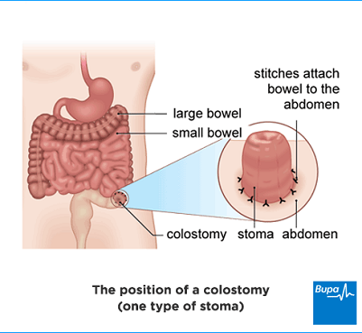
STOMA CARE.

Slide 113
Cont.
A stoma is an opening in your belly's wall that a surgeon makes in order for waste to leave your body if you can't have a bowel movement through your rectum.
An ostomy refers to the actual opening in your abdomen.
A stoma refers to the end of the intestine that’s sewn into the ostomy.

Slide 114
Cont.
To create a stoma, your doctor will pull part of your small or large intestine onto the surface of your skin and sewn it onto an opening in your abdomen. The intestine end empties waste into an ostomy appliance, which is a pouch attached to your stoma. Stomas are usually round, red, and moist, and they measure about 1 or 2 inches wide.

Slide 115
Types.
Colostomy. A stoma is created with part of your colon
Urostomy. They’ll connect your ureters to the pouch so that urine can drain outside of your body without passing through your bladder.
Ileostomy. A stoma is created using your small intestine so waste can bypass your colon and rectum.

Slide 116
Management.
Your ostomy appliance includes a pouch that your stoma drains into. Depending on the type of pouch you have, you’ll need to change it every three to seven days. When you change the pouch, clean the skin around your stoma with warm water and let it dry completely. You don’t need to use soap, but if you do, make sure it’s very mild and unscented.

Slide 117
Cont.
While the pouch is removed, look for any signs of irritation, blood, or changes in the size and color of your stoma. Seek medical attention if you notice any of these. While some changes are normal as your stoma heals, it’s best to be safe and check with your doctor.

Slide 118
Cont.
Aside from changing out the pouch every few days, you should also empty your pouch several times a day. Try to empty it when it’s about one-third full to avoid any leaks.
As you recover, you can start reintroducing different foods back into your diet. Try to do this slowly so you can note if you have a hard time digesting a certain food.

Slide 119
Cont.
Keep in mind that you may have trouble digesting some of the foods you used to eat. You can also monitor the consistency and amount of the waste in your pouch to check for signs of dehydration or other issues.
Make sure you fully understand how to care for your stoma before leaving the hospital. Your doctor should provide you with a full set of instructions that you can take home as well. Depending on your underlying condition, your stoma can be either permanent or temporary.

Slide 120
RADIOLOGICAL EXAMINATIONS.
Examination by various means of visualizing body spaces and organs and their functions, e.g., by computed tomography, fluoroscopy, magnetic resonance imaging, ultrasonography, or related techniques.

Slide 121
Nursing Responsibilities for Chest X-ray
Remove all metallic objects. Items such as jewelry, pins, buttons etc can hinder the visualization of the chest.
No preparation is required. Fasting or medication restriction is not needed unless directed by the health care provider.
Ensure the patient is not pregnant or suspected to be pregnant. X-rays are usually not recommended for pregnant women unless the benefit outweighs the risk of damage to the mother and fetus.

Slide 122
Cont.
Assess the patient’s ability to hold his or her breath. Holding one’s breath after inhaling enables the lungs and heart to be seen more clearly in the x-ray.
Provide appropriate clothing. Patients are instructed to remove clothing from the waist up and put on an X-ray gown to wear during the procedure.
Instruct patient to cooperate during the procedure. The patient is asked to remain still because any movement will affect the clarity of the image.

Slide 123
After Chest X-ray
The nurse should note of the following nursing interventions after chest x-ray:
No special care. Note that no special care is required following the procedure
Provide comfort. If the test is facilitated at the bedside, reposition the patient properly.

Slide 124
SKULL X-RAY
A skull x-ray is a picture of the bones surrounding the brain, including the facial bones, the nose, and the sinuses.

Slide 125
Preparation and procedure.
You will be asked to remove any clothing, jewelry, hairpins, eyeglasses, hearing aids, or other metal objects that might interfere with the procedure.
If you are asked to remove clothing, you will be given a gown to wear.
You will be positioned on an X-ray table that carefully places the part of the skull that is to be x-rayed between the X-ray machine and a cassette containing the X-ray film.

Slide 126
Cont.
Body parts not being imaged are covered with a lead apron (shield) to avoid exposure to the X-rays.
The radiologic technologist will ask you to hold still in a certain position for a few moments while the X-ray exposure is made.

Slide 127
Cont.
If the X-ray is being done to find an injury, special care will be taken to prevent further injury. For example, a neck brace may be applied if a cervical spine fracture is suspected.

Slide 128
Cont.
The X-ray beam will be focused on the area to be photographed.
The radiologic technologist will step behind a protective window while the image is taken.

Slide 129
BONE X-RAYS
Bone x-ray uses a very small dose of ionizing radiation to produce pictures of any bone in the body. It is commonly used to diagnose fractured bones or joint dislocation. Bone x-rays are the fastest and easiest way for your doctor to view and assess bone fractures, injuries and joint abnormalities.

Slide 130
Cont.
This exam requires little to no special preparation. Tell your doctor and the technologist if there is any possibility you are pregnant. Leave jewelry at home and wear loose, comfortable clothing. You may be asked to wear a gown.

Slide 131
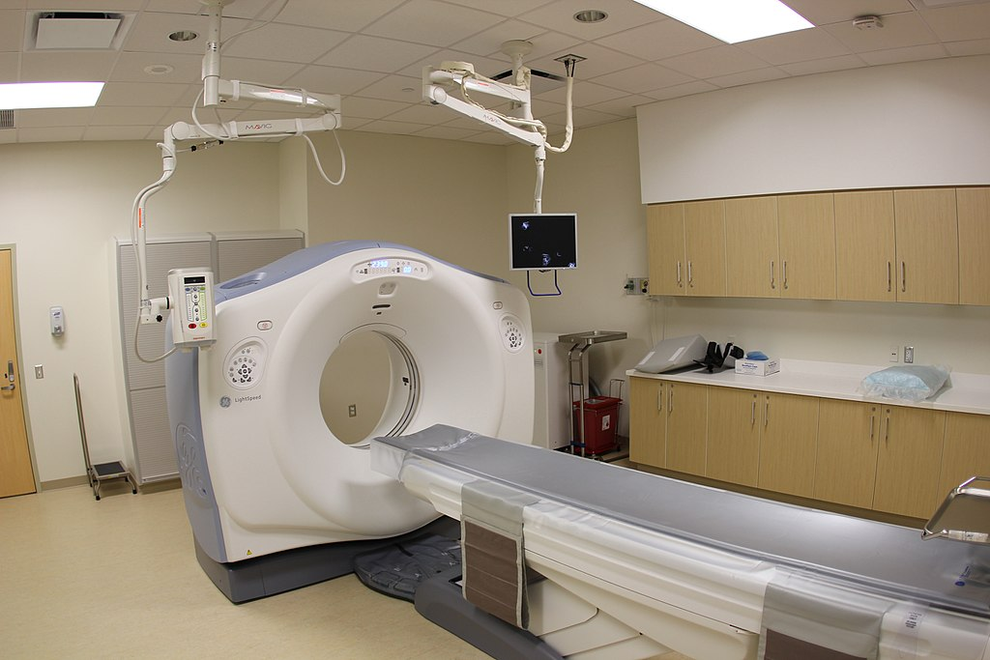
CT SCAN

Slide 132
CT SCANS
A CT scan or computed tomography scan makes use of computer-processed combinations of many X-ray measurements taken from different angles to produce cross-sectional images of specific areas of a scanned object, allowing the user to see inside the object without cutting.

Slide 133
Cont.
A special dye called contrast material is needed for some CT scans to help highlight the areas of your body being examined. The contrast material blocks X-rays and appears white on images, which can help emphasize blood vessels, intestines or other structures

Slide 134
CT SCAN
A CT scan may be used to visualize the:
head
shoulders
spine
heart
abdomen
knee
chest

Slide 135
Cont.
During a CT scan, you lie in a tunnel-like machine while the inside of the machine rotates and takes a series of X-rays from different angles. These pictures are then sent to a computer, where they’re combined to create images of slices, or cross-sections, of the body. They may also be combined to produce a 3-D image of a particular area of the body.

Slide 136
USES
diagnose infections, muscle disorders, and bone fractures
pinpoint the location of masses and tumors (including cancer)
study the blood vessels and other internal structures
assess the extent of internal injuries and internal bleeding
guide procedures, such as surgeries and biopsies
monitor the effectiveness of treatments for certain medical conditions, including cancer and heart disease

Slide 137
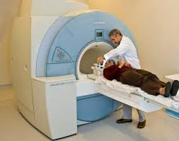
MRI

Slide 138
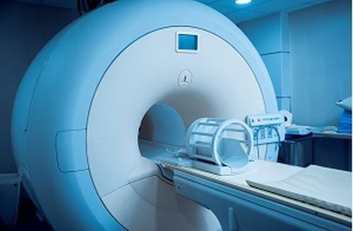

Slide 139
MRI
Magnetic resonance imaging (MRI) is a medical imaging technique used in radiology to form pictures of the anatomy and the physiological processes of the body. MRI scanners use strong magnetic fields, magnetic field gradients, and radio waves to generate images of the organs in the body.

Slide 140
Cont.
MRI does not involve X-rays or the use of ionizing radiation, which distinguishes it from CT or CAT scans and PET scans. Compared with CT scans, MRI scans typically take longer and are louder, and they usually need the subject to enter a narrow, confining tube. In addition, people with some medical implants or other non-removable metal inside the body may be unable to undergo an MRI examination safely.

Slide 141
USES.
The following are examples in which an MRI scanner would be used:
anomalies of the brain and spinal cord
tumors, cysts, and other anomalies in various parts of the body
breast cancer screening for women who face a high risk of breast cancer
injuries or abnormalities of the joints, such as the back and knee

Slide 142
CONT.
certain types of heart problems
diseases of the liver and other abdominal organs
the evaluation of pelvic pain in women, with causes including fibroids and endometriosis
suspected uterine anomalies in women undergoing evaluation for infertility
This list is by no means exhaustive. The use of MRI technology is always expanding in scope and use.

Slide 143
ULTRA SOUND
Ultrasound is a type of imaging. It uses high-frequency sound waves to look at organs and structures inside the body. Health care professionals use it to view the heart, blood vessels, kidneys, liver, and other organs. During pregnancy, doctors use ultrasound to view the fetus. Unlike x-rays, ultrasound does not expose you to radiation.

Slide 144
Cont.
During an ultrasound test, you lie on a table. A special technician or doctor moves a device called a transducer over part of your body. The transducer sends out sound waves, which bounce off the tissues inside your body. The transducer also captures the waves that bounce back. The ultrasound machine creates images from the sound waves.

Slide 145
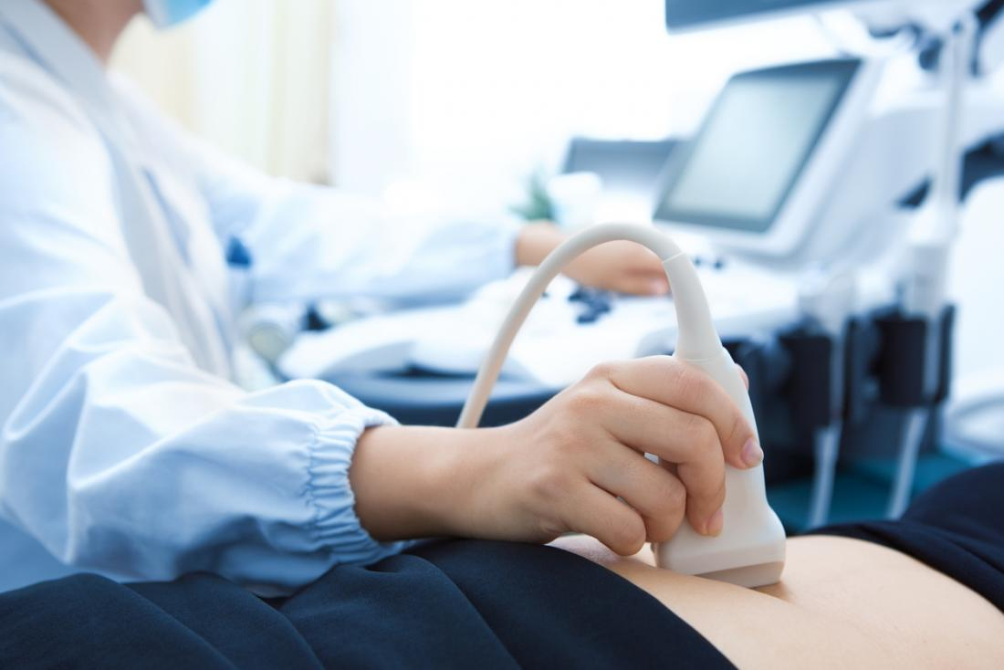

Slide 146
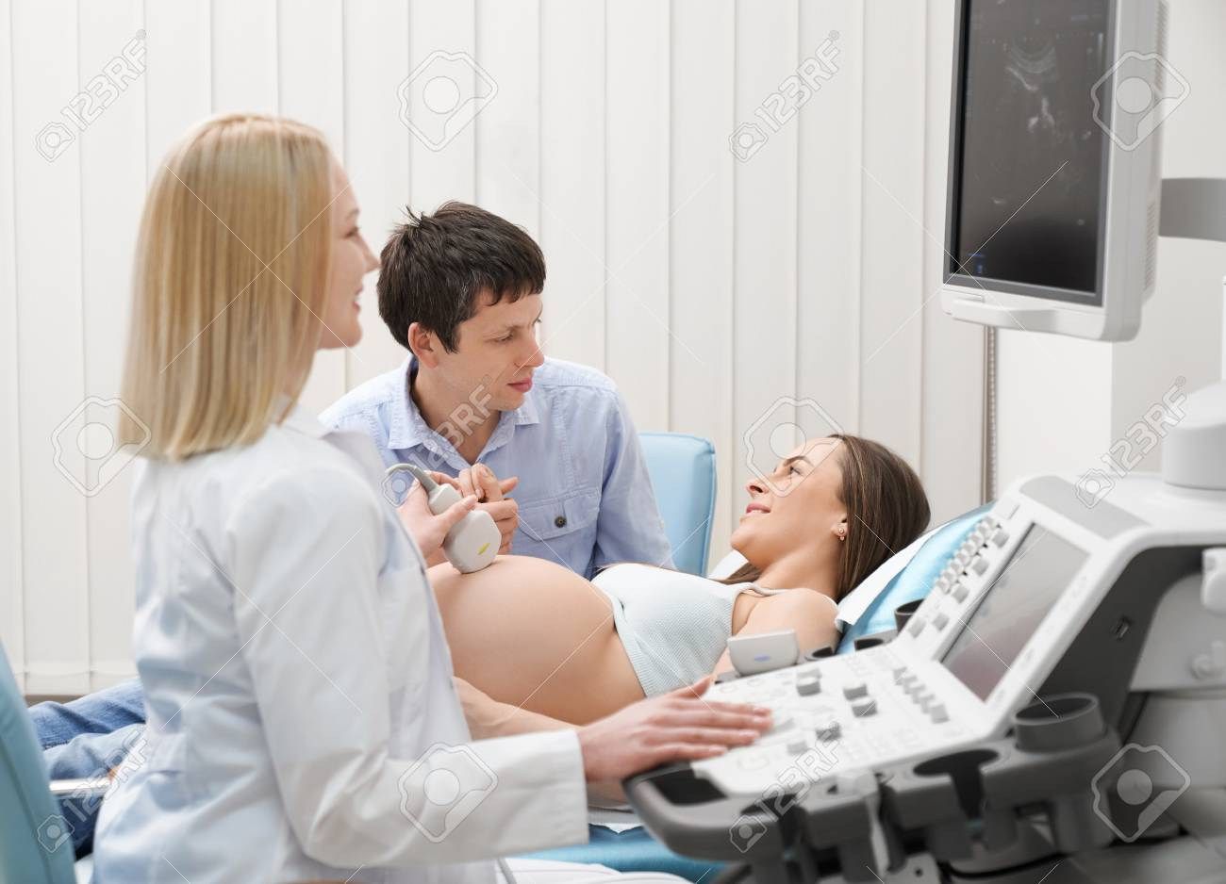

Slide 147
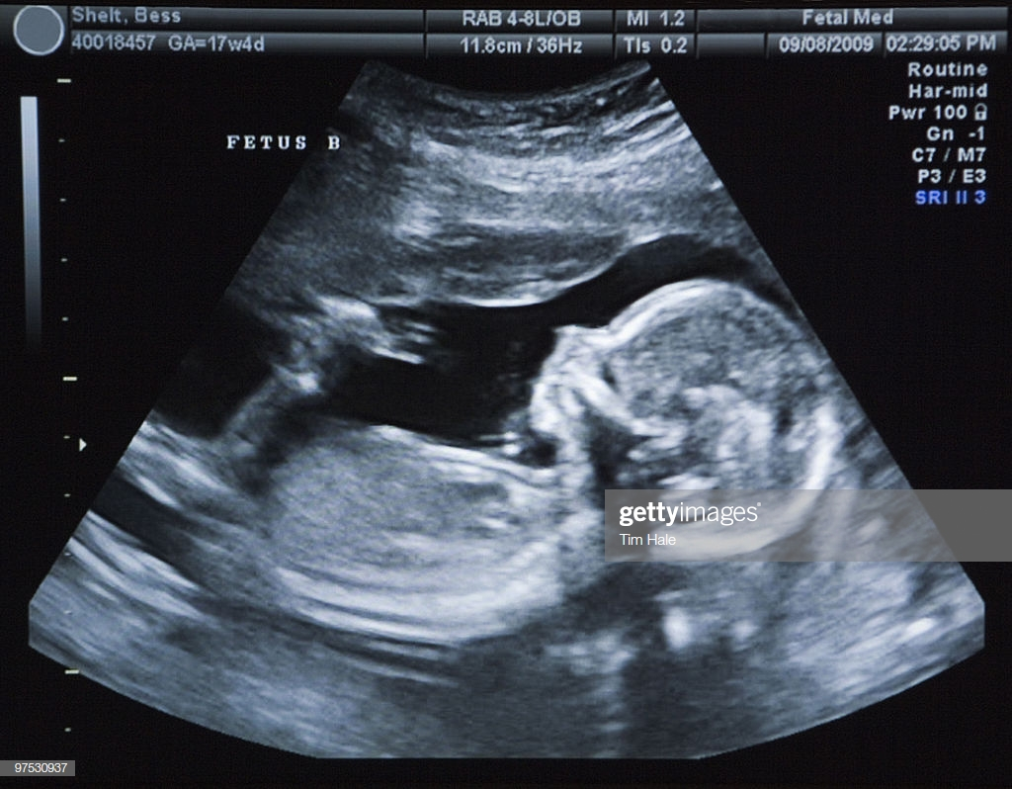

Slide 148
How you prepare
Most ultrasound exams require no preparation. However, there are a few exceptions:
For some scans, such as a gallbladder ultrasound, your doctor may ask that you not eat or drink for up to six hours before the exam.
Others, such as a pelvic ultrasound, may require a full bladder. You may need to drink up to six glasses of water two hours before the exam and not urinate until the exam is completed.

Slide 149
Cont.
Young children may need additional preparation. When scheduling an ultrasound for yourself or your child, ask your doctor if there are any specific instructions you'll need to follow.

Slide 150
Before the procedure.
Before your ultrasound begins, you may be asked to do the following:
Remove any jewelry from the area being examined.
Remove some or all of your clothing.
Change into a gown.
You'll be asked to lie on an examination table

Slide 151
During the procedure
Gel is applied to your skin over the area being examined. It helps prevent air pockets, which can block the sound waves that create the images. This water-based gel is easy to remove from skin and, if needed, clothing.

Slide 152
During the procedure
A trained ultrasound imaging professional (sonographer) presses a small, hand-held device (transducer) against the area being studied and moves it as needed to capture the images. The transducer sends sound waves into your body, collects the ones that bounce back and sends them to a computer, which creates the images.

Slide 153
Uses.
Ultrasou­nd has been used in a variety of clinical settings, including obstetrics and gynecology, cardiology and cancer detection.

Slide 154
Obstetrics and Gynecology
measuring the size of the fetus to determine the due date
determining the position of the fetus to see if it is in the normal head down position or breech
checking the position of the placenta to see if it is improperly developing over the opening to the uterus (cervix)
seeing the number of fetuses in the uterus
checking the sex of the baby (if the genital area can be clearly seen)

Slide 155
Cont.
checking the fetus's growth rate by making many measurements over time
detecting ectopic pregnancy.
determining whether there is an appropriate amount of amniotic fluid cushioning the baby
monitoring the baby during specialized procedures
seeing tumors of the ovary and breast

Slide 156
Cardiology
seeing the inside of the heart to identify abnormal structures or functions
measuring blood flow through the heart and major blood vessels

Slide 157
Urology
measuring blood flow through the kidney
seeing kidney stones
detecting prostate cancer early
In addition to these areas, there is a growing use for ultrasound as a rapid imaging tool for diagnosis in emergency rooms.

Slide 158
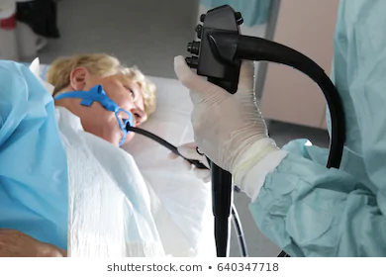
ENDOSCOPIC EXAMINATIONS

Slide 159
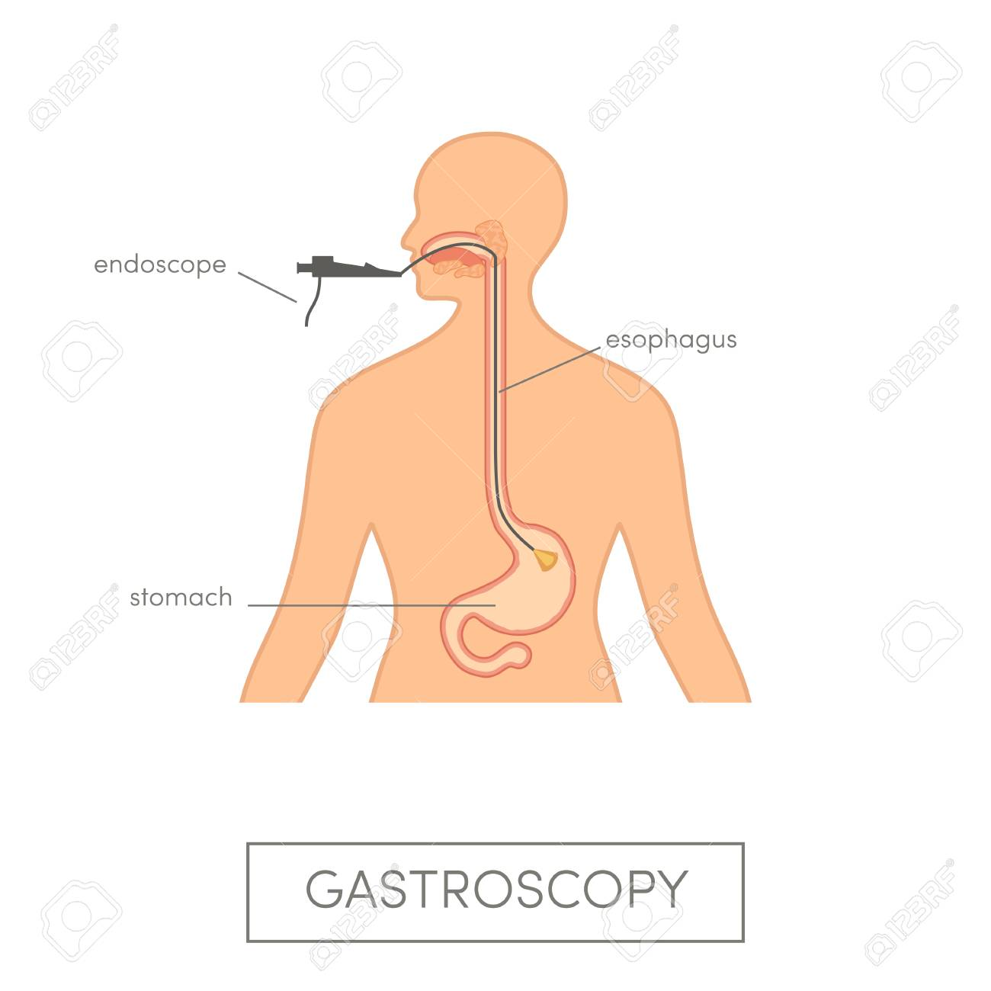

Slide 160
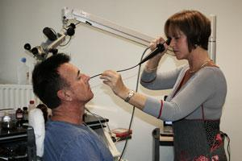

Slide 161
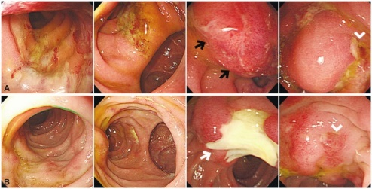

Slide 162
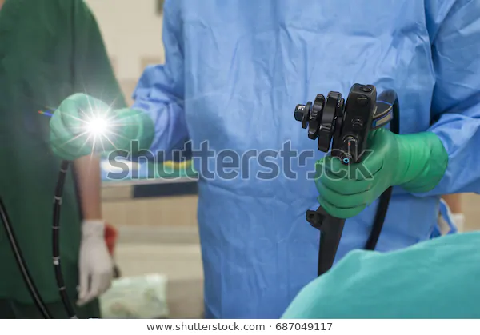

Slide 163
Endoscopy.
Endoscopy is a procedure that allows a doctor to view the inside of a person's body. Doctors use it to diagnose diseases in the following parts of the body:
Esophagus, Stomach, Colon, Ears , Nose, Throat, Heart, Urinary tract, Joints, Abdomen

Slide 164
Cont.
During an endoscopy, the doctor inserts a tool called an endoscope into a person’s body. Most endoscopes are thin tubes with a powerful light and tiny camera at the end.
The endoscope's length and flexibility depend on the part of the body the doctor needs to see.
For example, a straight endoscope helps a doctor look at joints. Meanwhile, a flexible one helps a doctor view the inside of the colon.

Slide 165
Cont.
Your doctor may recommend an endoscopy for various reasons:
To screen for and prevent cancer. For example, doctors use a type of endoscopy called a colonoscopy to screen for colorectal cancer. During a colonoscopy, your doctor may remove growths called polyps. Without removal, polyps could develop into cancer.

Slide 166
Cont.
To diagnose a disease or find out the cause of symptoms. The type of endoscopy your doctor will recommend depends on the part of the body under examination.
To give treatment. Doctors use endoscopes for certain treatments: Medication delivery, Laser therapy, which uses a powerful beam of light to destroy cancer cells etc

Slide 167
Types of endoscopy.
Arthroscopy: examination of joints for diagnosis and treatment (arthroscopic surgery)
Bronchoscopy: examination of the trachea and lung's bronchial trees to reveal abscesses, bronchitis, carcinoma, tumors, tuberculosis, alveolitis, infection, inflammation

Slide 168
Cont.
Colonoscopy: examination of the inside of the colon and large intestine to detect polyps, tumors, ulceration, inflammation, colitis diverticula, Chrohn's disease, and discovery and removal of foreign bodies.
Colposcopy: direct visualization of the vagina and cervix to detect cancer, inflammation, and other conditions.

Slide 169
Cont.
Cystoscopy: examination of the bladder, urethra, urinary tract, uteral orifices, and prostate (men) with insertion of the endoscope through the urethra.
EGD (Esophogealgastroduodensoscopy): visual examination of the upper gastro-intestinal (GI) tract. (also referred to as gastroscopy) to reveal hemorrhage, hiatal hernia, inflammation of the esophagus, gastric ulcers.

Slide 170
Cont.
Endoscopic biopsy is the removal of tissue specimens for pathologic examination and analysis.

Slide 171
Cont.
Gastroscopy: examination of the lining of the esophagus, stomach, and duodenum. Gastroscopy is often used to diagnose ulcers and other sources of bleeding and to guide biopsy of suspect GI cancers.
Laparoscopy: visualization of the stomach, liver and other abdominal organs including the female reproductive organs, for example, the fallopian tubes.

Slide 172
Cont.
Laryngoscopy: examination of the larynx (voice box).
Proctoscopy, sigmoidoscopy, proctosigmoidoscopy: examination of the rectum and sigmoid colon.
Thoracoscopy: examination of the pleura (sac that covers the lungs), pleural spaces, mediastinum, and pericardium.

Slide 173
EEG and ECG
Electroencephalogram or EEG is related to the brain and electrocardiogram or ECG is related to the heart. EEG is the equipment used for measuring electrical activities of the brain. On the other hand, ECG is used for measuring activities of heart.

Slide 174
Cont.
EEG is mainly used for diagnosing seizure disorders, infections, tumors, degenerative disorders and metabolic disturbances that could affect the brain. On the contrary, ECG is used to determine the rate of heartbeats, heart chamber positions and if there is any damage to heart. The ECG helps in determining if a person has any problems of the heart.

Slide 175
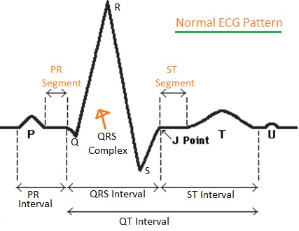

Slide 176
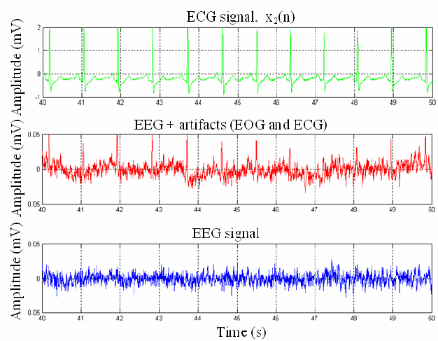

Slide 177
USES OF ECG
assess your heart rhythm
diagnose poor blood flow to the heart muscle (ischemia)
diagnose a heart attack
diagnose abnormalities of your heart, such as heart chamber enlargement and abnormal
electrical conduction

Slide 178
USES OF EEG
The measurements given by an EEG are used to confirm or rule out various conditions, including:
seizure disorders (such as epilepsy)
head injury
encephalitis (inflammation of the brain)

Slide 179
USES.
brain tumor
encephalopathy (disease that causes brain dysfunction)
memory problems
sleep disorders
stroke
dementia

