Slide 1
Specialized procedures II
A. SAMBU

Slide 2
MODULE OUTCOMES
To provide care to patients undergoing radiotherapy.
To provide care to patients undergoing endoscopic examination.

Slide 3
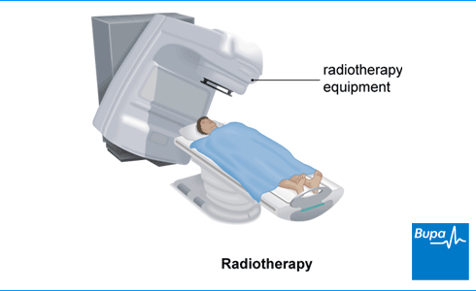

Slide 4
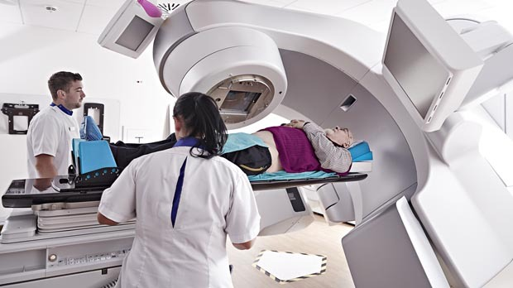

Slide 5
overview
Cancer is the second leading cause of death globally, and is responsible for an estimated 9.6 million deaths in 2018. Globally, about 1 in 6 deaths is due to cancer.
Approximately 70% of deaths from cancer occur in low- and middle-income countries.

Slide 6
overview
Late-stage presentation and inaccessible diagnosis and treatment are common. In 2017, only 26% of low-income countries reported having pathology services generally available in the public sector. More than 90% of high-income countries reported treatment services are available compared to less than 30% of low-income countries.

Slide 7
overview
A correct cancer diagnosis is essential for adequate and effective treatment because every cancer type requires a specific treatment regimen that encompasses one or more modalities such as surgery, radiotherapy, and chemotherapy.

Slide 8
overview
Radiotherapy constitutes for 60% of cancer treatments and currently used as a targeted treatment method. The area with tumor is identified and only the cancer cells are irradiated with high dose radiation during radiotherapy. Since radiotherapy is a regional treatment method, patients can go on with their daily lives after daily sessions of 15 to 20 minutes.

Slide 9
overview
Radiotherapy can be used for almost all types of cancer while it is the only treatment method for certain cancer types. Radiotherapy can sometimes be preoperatively used to reduce the tumor size. It may also be used to eliminate possible postoperative residual cancer cells for certain tumors. Radiotherapy is given to more than half of cancer patients in addition to treatments such as surgery and medical treatment.

Slide 10
Radiotherapy.
Radiation therapy is a treatment for cancer and, less commonly, thyroid disease, blood disorders, and noncancerous growths.
A doctor may recommend radiation for cancer at different stages. In the early stages, radiation therapy can help reduce the size of a tumor before surgery or kill remaining cancer cells afterward. In the later stages, it may help relieve pain as part of palliative care

Slide 11
Radiation.
Radiation breaks up the DNA of cancer cells in a way that disrupts their growth and division. In this way, radiation can kill cancer cells, preventing or slowing the spread of the disease.
Sometimes a doctor prescribes radiation therapy alone, but usually, they recommend it in combination with other treatments, such as chemotherapy, surgery, or both.

Slide 12
Cont.
Radiotherapy is completely painless and is targeted directly at the tumour or metastases. Radiotherapy is usually divided over a 2 – 8 week period. It is generally provided in small single daily doses five days a week.

Slide 13
Cont.
Each treatment takes a few minutes. Dividing radiotherapy into several small parts reduces the harm caused to healthy tissue and improves the effectiveness of the therapy.

Slide 14
Cont.
Patients usually go about their lives as normal during the period of treatment. In some cases accelerated radiotherapy may be given instead of phased radiotherapy. Radiotherapy is often a well-tolerated form of treatment, but it does have side effects.

Slide 15
When radiotherapy is used
Radiotherapy may be used in the early stages of cancer or after it has started to spread.
It can be used to:
try to cure the cancer completely (curative radiotherapy)
make other treatments more effective – for example, it can be combined with chemotherapy (chemoradiation) or used before surgery (neo-adjuvant radiotherapy)

Slide 16
Cont.
reduce the risk of the cancer coming back after surgery (adjuvant radiotherapy)
relieve symptoms if a cure isn't possible (palliative radiotherapy)
Radiotherapy is generally considered the most effective cancer treatment after surgery, but how well it works varies from person to person.

Slide 17
Approaches to radiotherapy.
There are two forms of radiation therapy.
i) External beam radiation therapy
This is the most common type. It involves an external machine emitting a beam of radiation that targets the treatment area.
Different forms are available, depending on the need. High-energy beams, for example, can target cancer that is deeper within the body.

Slide 18
Cont.
External beam radiation therapy is radiation delivered from a distant source, from outside the body and directed at the patient's cancer site. Systems which produce different types of radiation for external beam therapy include orthovoltage x-ray machines, Cobalt-60 machines, linear accelerators, proton beam machines, and neutron beam machines.

Slide 19
Cont.
A radiation oncologist makes decisions regarding the type of system that is best suited to treat a specific cancer patient. External beam therapy is the radiation therapy treatment option used for most cancer patients. It is used to treat many types of tumors including cancers of the head and neck area, breast, lung, colon, and prostate.

Slide 20
Cont.
Depending upon tumor location, different levels of radiation are used for external beam therapy. Low-energy radiation does not penetrate very deeply into the body and is used mainly to treat surface tumors such as skin cancer. High-energy radiation is used to treat other deeper cancers.

Slide 21
Cont.
Stereotactic radiation therapy involves focusing the radiation beam on a small area and delivering very high doses. The therapy targets a tumor from many different directions so the beams of radiation converge on the tumor.

Slide 22
Cont.
This way, the ideal amount of radiation needed to destroy tumor cells is delivered directly to the tumor growth, while the amount of exposure to the area surrounding the tumor is minimized. Stereotactic radiation therapy is very effective in treating small tumors such as those in the head and brain.

Slide 23
Cont.
External beam therapy is painless. Most patients do not need to stay in the hospital while they are having external beam therapy. Patients do not see or feel the actual treatment. Many patients can go home following each treatment, and most patients can even continue with their normal daily activities.

Slide 24
ii) Internal radiation therapy
There are different types of internal radiation therapy. Both involve implanting or introducing a radioactive substance into the body.
Brachytherapy involves inserting a radioactive implant in or close to the cancerous tissue. The implant may be temporary or permanent. Another type of internal radiation therapy involves drinking or receiving an injection of radioactive liquid.

Slide 25
Cont.
The goal is to limit the extent to which healthy tissue around the cancer is exposed to the radiation. Doctors may recommend this treatment for prostate or ovarian cancer, for example.

Slide 26
Internal.
Brachytherapy involves placing radiation sources as close as possible to the tumor site. Sometimes, they may be inserted directly into the tumor. The radioactive sources or isotopes are in the form of wires, seeds (or molds), or rods.

Slide 27
Internal.
This technique is particularly effective in treating cancers of the cervix, uterus, vagina, rectum, eye, and certain head and neck cancers. It is also occasionally used to treat cancers of the breast, brain, skin, anus, esophagus, lung, bladder, and prostate.

Slide 28
Internal.
In some instances, brachytherapy may be used in conjunction with external beam therapy. When both forms are employed, the external beam radiation is intended to destroy cancerous cells in a large area surrounding the tumor, while the brachytherapy delivers a boost, or higher dose of radiation, to help destroy the main concentrated mass of tumor cells.

Slide 29
Internal.
There are several types of brachytherapy characterized by different methods of placing radiation inside the body: interstitial brachytherapy, intracavitary brachytherapy, intraluminal radiation therapy, and radioactively tagged molecules given intravenously.

Slide 30
Internal.
Interstitial brachytherapy involves implanting radioactive needles or wires in the tumor area. The radioactive sources may be put in and taken out on the same day; removed from the body after several days; or may stay in the patient permanently.

Slide 31
Internal.
With intracavitary brachytherapy, a radiation oncologist places radioactive sources, using a metal or plastic device (applicator), in body cavities such as the vagina, uterus, or larynx to irradiate the walls of the cavity or nearby tissues.

Slide 32
Internal.
Usually the radioactive source is after loaded into the applicator. When the specified dose of radiation has been delivered to the tumor, the physician removes the applicator containing the radioactive isotope.

Slide 33
Internal.
Intraluminal radiation therapy delivers radiation to hollow organs. For example, a surgeon or a radiation oncologist inserts a specially designed tube or applicator into the lumen, or opening, of the esophagus to treat cancer.

Slide 34
Internal.
Finally, radioactive particles can be attached to small molecules and given intravenously. For example, I-131 is used intravenously to treat bony metastases.

Slide 35
Combination.
A doctor may recommend undergoing both main types of radiation therapy. The decision will depend on:

Slide 36
Cont.
the type of cancer
the size of the tumor
the tumor's location, including the types of tissue nearby
the person's age and overall health
other treatments

Slide 37
Common side effects of radiotherapy.
Radiotherapy can cause side effects, although many of these can be treated or prevented and most will pass once treatment stops.

Slide 38
Cont.
It's difficult to predict what side effects you'll get.
It varies from person to person and depends on things such as the part of your body being treated and the type of radiotherapy you have.

Slide 39
side effects
Some of the main side effects are listed below, but it's unlikely you'll have all of these.

Slide 40
Side effects.
In some people, radiotherapy can make the skin sore and red (similar to sunburn), darker than normal or dry and itchy. This tends to start a week or two after treatment begins.
Many people having radiotherapy feel tired a lot of the time or tire very easily doing everyday activities. This usually starts during treatment and can continue for several weeks or months after treatment finishes.

Slide 41
Side effects.
Hair loss is a common side effect of radiotherapy. But unlike chemotherapy, it only causes hair loss in the area being treated. Your hair will usually start to fall out 2 to 3 weeks after treatment starts.
It should start to grow back a few weeks after treatment finishes, although sometimes it may be a slightly different texture or colour than it was before.

Slide 42
Side effects.
Occasionally, hair loss can be permanent if you have a high dose of radiotherapy.
Some people feel sick during, or for a short time after, radiotherapy treatment sessions. This is more likely to happen if the treatment area is near your stomach, or if your brain is being treated.

Slide 43
Side effects.
Radiotherapy can sometimes cause:
a sore mouth
loss of appetite and weight loss
discomfort when swallowing

Slide 44
Side effects.
Diarrhoea is a common side effect of radiotherapy to the tummy or pelvic area.
It usually starts a few days after treatment begins and may get a bit worse as treatment continues.
Diarrhoea should disappear within a few weeks of treatment finishing.

Slide 45
Side effects.
Radiotherapy can sometimes makes the joints and muscles in the area being treated stiff, swollen and uncomfortable.
Exercising and stretching regularly can help to prevent stiffness.

Slide 46
Side effects.
Radiotherapy can have an effect on your sex life and fertility, especially if your lower tummy, pelvic area or groin is treated i.e loss of interest in sex – this tends to gradually improve after treatment stops and infertility

Slide 47
Side effects.
Having radiotherapy can be a frustrating, stressful and traumatic experience. It's natural to feel anxious and to wonder if your treatment will be successful.
Stress and anxiety can also increase your risk of getting depression.

Slide 48
Side effects.
Radiotherapy can damage body's lymphatic system, a network of channels and glands that form part of the immune system (the body's defense against illness).
One of the jobs of the lymphatic system is to stop fluid building up in your body. If it becomes damaged, you may experience pain and swelling. This is known as lymphoedema.

Slide 49
Side effects.
it's most common in the arms or legs, but it can affect other areas, depending on the part of the body that was treated.
It may be possible to reduce risk of lymphoedema by looking after the skin and doing regular exercises.

Slide 50
Basic principles of radiotherapy.
Radiotherapy ionises chemicals within cells. The crucial lesion is DNA strand breakage which may be repaired or fixed and lead to apoptotic or mitotic cell death.
Different types of normal and malignant cells vary in their susceptibility to ionising radiation. In radical curative treatments, total radiation doses are close to the tolerance of normal tissues. In palliative treatments, usually low doses are used.

Slide 51
Cont.
Some tumours, such as seminoma of the testis and lymphoma, are very sensitive to radiotherapy and can be treated with relatively low doses, with an expectation of cure. Other tumours, such as melanoma of the skin and glioblastoma multiforme in the brain, are notoriously resistant, even to large doses.
A course of radiotherapy may be spread over days or weeks. This is known as fractionating, and the radiation delivered to a patient in a single treatment session is called a fraction.

Slide 52
Cont.
Fractionating allows normal tissues to repair much of the radiation damage, while tumour cells, which are less efficient at repair, do not recover. A beam of radiation is called a field. A fraction consists of one or more fields delivered sequentially.

Slide 53
Cont.
In general, most modern radiotherapy is delivered with very high-energy, highly-focused beams, which can reach deeper tumour tissues while depositing relatively small doses in the normal tissues through which they pass. External-beam radiotherapy can be delivered by cobalt machines or linear accelerators, collectively known as megavoltage machines.

Slide 54
Cont.
However, both acute (early) and late (chronic) side effects do occur. The side effects depend on several factors, including the body site being treated, the volume of normal tissue irradiated (the larger the volume, the higher the risk and severity of side effects), the total dose, and the rate of dose accumulation (the amount per week).

Slide 55
Cont.
Early side effects result from damage to proliferating tissues, such as the mucosa (lining) of the gastro-intestinal tract or the skin. For example, radiotherapy to an abdominal tumour may damage the mucosa of the small bowel, causing malabsorption and diarrhoea. Most patients recover completely.

Slide 56
Cont.
Late reactions occur at least three months after a treatment course has ended, and are usually permanent or progressive. They usually result from damage to non-proliferating differentiated tissues, which cannot compensate for cell death by dividing to replace lost cells. Once late effects occur, it is very difficult to reverse them, but they are very uncommon.

Slide 57
Cont.
Late effects, such as second cancers, may occur many years after treatment. Even relatively low doses of radiation may increase the risk of developing a malignancy. There is a long latent period after exposure. Leukaemia may appear up to 7 years after exposure and solid tumours may develop 10 or 20 years later.

Slide 58
Cont.
Side effects of radiation can be minimised by meticulous planning and delivery of a course of radiotherapy. Late-reacting tissues are particularly sensitive to the size of each radiation dose, so they can be protected to a large extent by giving small fractions of radiation, provided the total dose is not too high.

Slide 59
Importance of radiotherapy.
While radiotherapy has been around since the early 1900s, advances in medical technology starting in the 1960s — such as linear accelerators, imaging technologies, diagnostic devices and sophisticated hardware and software — have made this form of treatment extremely targeted and highly effective.

Slide 60
Cont.
All of this means that doctors can carefully measure and precisely deliver radiation to the tumor while minimizing healthy tissue exposure and side-effects.

Slide 61
Cont.
Today, radiation therapy is well tolerated by most patients, and it isn’t typically associated with the side effects of chemotherapy or surgery. While side effects such as fatigue, the most common one, can occur, their severity and frequency are lessened greatly by the precision of advanced, image-guided approaches to radiation delivery.

Slide 62
Cont.
Radiotherapy can be an effective part of a patient’s cancer treatment regimen. It can be used as a front-line cancer treatment, although it is not always thought of that way. That’s because doctors often wait to refer their patients to a radiation oncologist as a last resort or as part of end-of-life cancer treatment.

Slide 63
Cont.
Radiation therapy can actually be used as a curative treatment in place of or in combination with surgery or chemotherapy, or to shrink a tumor before surgery so it’s safer to remove.

Slide 64
Cont.
Also, after surgery, radiotherapy can target remaining cancer cells to prevent cancer from returning. Additionally, radiotherapy is frequently employed in the treatment of metastatic and recurrent cancer, and in many cases it can provide months and even years of high-quality life.

Slide 65
Cont.
When it is used near the end of life it is an effective and efficient means of managing the pain which may accompany progressive cancer.

Slide 66
Cont.
Today, as patients live longer with cancer and because of the recurring nature of many forms of the disease, some advanced radiation technologies can also be used to retreat patients who have been previously treated. This is a result of the extreme precision of some of these advanced radiation therapy treatments.

Slide 67
Cont.
The main goals of radiation therapy are to shrink tumors and kill cancer cells. While the therapy also will likely injure healthy cells, the damage isn’t permanent. Your normal, noncancerous cells have the ability to recover from radiation therapy.

Slide 68
Cont.
To minimize the effect radiation has on the body, the radiation is targeted only to specific points in your body.
Radiation therapy can be used during different stages of cancer treatment and for different outcomes. Radiation therapy can be used:

Slide 69
Cont.
to alleviate symptoms in advanced, late-stage cancer
as the primary treatment for cancer
in conjunction with other cancer treatments
to shrink a tumor before surgery
to kill any remaining cancer cells after surgery

Slide 70
Benefits of radiotherapy
If radiation therapy is recommended as part of your treatment, potential benefits may include:
many patients find that their radiation therapy sessions have a minimal effect on their daily schedules.
treatment sessions are typically given on an outpatient basis, meaning no hospital stay is required.

Slide 71
Cont.
sessions typically takes less than an hour, and sometimes as little as 15 minutes—from entering the waiting room to leaving the hospital or clinic

Slide 72
Protecting the patient during radiotherapy.
A large number of measures before and during radiation treatment protect the patient from too high a dose of radiation. These include
an individual radiotherapy treatment plan
the immobilisation of the irradiated area of the body using positioning aids
regular verification of the radiation field
a dose distribution which is optimally adapted to the tumour and the surrounding healthy organs

Slide 73
Cont.
The basic principle of fractionation (dividing the total radiation dose into many small individual doses, so-called fractions) is aimed at preventing side effects in healthy tissue and thus at protecting the patient.

Slide 74
OCCUPATIONAL PROTECTION.
You can work safely around radiation and/or contamination by following a few simple precautions:
Use time, distance, shielding, and containment to reduce exposure.
Wear dosimeters (e.g., film or TLD badges) if issued.

Slide 75
Cont.
Avoid contact with the contamination.
Wear protective clothing that, if contaminated, can be removed.

Slide 76
Cont.
Wash with nonabrasive soap and water any part of the body that may have come in contact with the contamination.
Assume that all materials, equipment, and personnel that came in contact with the contamination are contaminated. Radiological monitoring is recommended before leaving the scene.

Slide 77
Stages in radiotherapy process
Overall, there are five basic steps of radiation therapy that we can share to give patients an idea of what to expect. These steps include initial consul­tation, simulation, treatment planning, treatment delivery and post treatment follow-up.

Slide 78
1.Initial consultation
Consul­tation is the first step of the radiation therapy process. This involves an appointment with a radiation oncologist, who reviews a patient’s medical records, pathology reports and radiology images and performs a physical exami­nation. If, based on this review, treatment by radiation therapy is chosen, the patient will be offered an appointment for simulation.

Slide 79
2.Simulation
Following your initial consultation, you will undergo a “simulation” process. The simulation allows the radiation oncologist to define the exact location and configuration of the treatment for your cancer or tumor. In order to accomplish this, x-rays or CT scans will be taken in the radiation oncology department.

Slide 80
Cont.
Sometimes, the area on your body that requires treatment will be marked with a tiny tattoo “dot”.

Slide 81
3.Treatment planning
This step of the radiation process involves the radiation oncologist, the physicist and dosimetrist. Using the CT scan images (and a MRI , if needed), they work together to design the field of radiation therapy treatment. The focus of treatment planning is to deliver a high dose of radiation to the tumor while limiting the dose received by surrounding tissue that is normal.

Slide 82
4. Treatment Delivery
On the first day of treatment, the patient is placed in the position for treatment using immobi­lization devices that might be necessary for them. Radiation therapists are responsible for positioning the patient and for delivering the radiation dose prescribed by the radiation oncologist.

Slide 83
5.Post Treatment Follow-up
Upon completion of your treatment, a follow-up appointment will be scheduled to monitor the recovery and overall health of our patients. Additional diagnostic tests may be ordered. Reports on the status of our patients are sent to all physicians involved in patient care.

Slide 84
Role of nurse in radiotherapy.
The radiation oncology nursing role is multifaceted. Role components include patient assessment, patient education, support and counseling, physical care, continuity of care, research, and administrative and leadership activities.

Slide 85
Role.
A Radiation Oncology Nurse has special training in the care and treatment of patients with cancer. They educate patients about radiation treatment and help manage any symptoms or side effects.

Slide 86
Cont.
In some countries, oncology nurses are specialised in radiation technology and are responsible for the treatment delivery, which includes direct patient care, positioning and the actual application of the radiation treatment. In other countries, this responsibility is taken by radiation therapists.

Slide 87
Cont.
Under such circumstances, oncology nurses are specialised to provide care to radiation oncology patients – for example, when they receive chemotherapy during radiotherapy, or to provide a special service to patients to cope with side effects of radiotherapy, for example, inflammation of the skin within the radiation field.

Slide 88
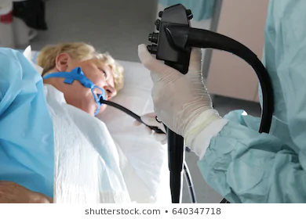
ENDOSCOPIC EXAMINATIONS

Slide 89
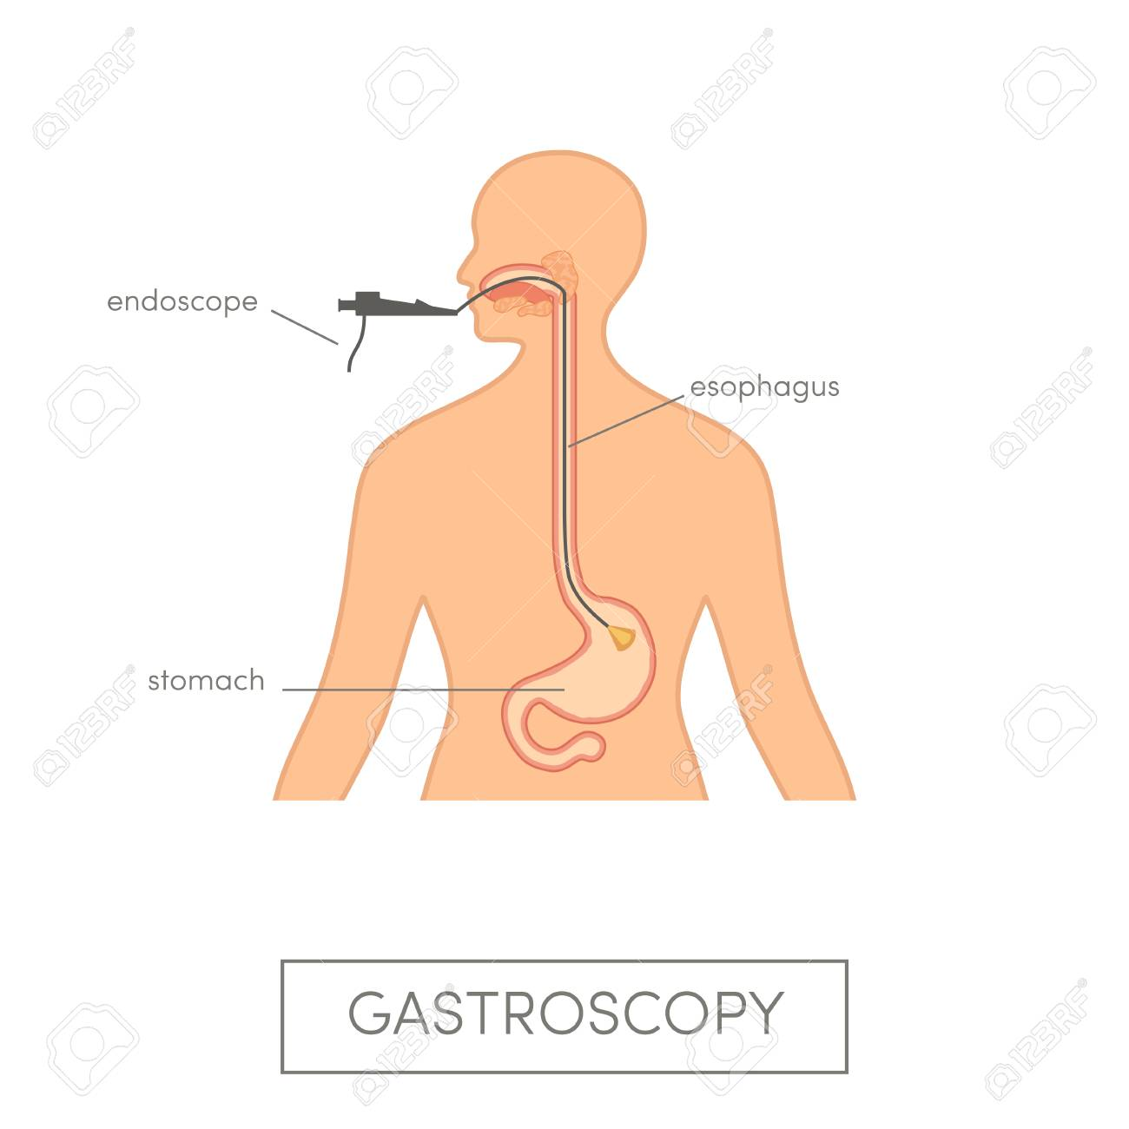

Slide 90
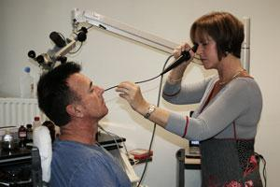

Slide 91
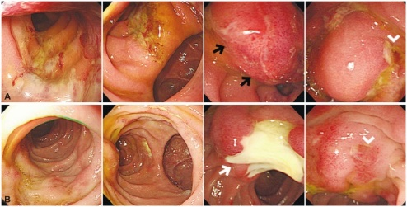

Slide 92
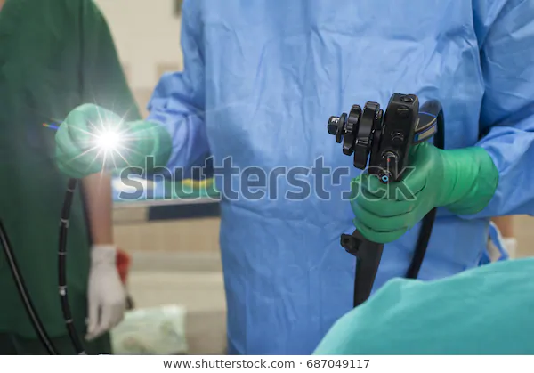

Slide 93
Endoscopy.
Endoscopy is a procedure that allows a doctor to view the inside of a person's body. Doctors use it to diagnose diseases in the following parts of the body:
Esophagus, Stomach, Colon, Ears , Nose, Throat, Heart, Urinary tract, Joints, Abdomen

Slide 94
Cont.
During an endoscopy, the doctor inserts a tool called an endoscope into a person’s body. Most endoscopes are thin tubes with a powerful light and tiny camera at the end.
The endoscope's length and flexibility depend on the part of the body the doctor needs to see.
For example, a straight endoscope helps a doctor look at joints. Meanwhile, a flexible one helps a doctor view the inside of the colon.

Slide 95
cont.
Typically, an endoscope has a channel through which the doctor can insert tools. These tools collect tissue or provide treatment.
Types of tools include:

Slide 96
Cont.
Flexible forceps. These tong-like tools take a tissue sample.
Biopsy forceps. These remove a tissue sample or a suspicious growth.
Cytology brushes. These take cell samples.
Suture removal forceps. These remove stitches inside the body

Slide 97
Cont.
Your doctor may recommend an endoscopy for various reasons:
To screen for and prevent cancer. For example, doctors use a type of endoscopy called a colonoscopy to screen for colorectal cancer. During a colonoscopy, your doctor may remove growths called polyps. Without removal, polyps could develop into cancer.

Slide 98
Cont.
To diagnose a disease or find out the cause of symptoms. The type of endoscopy your doctor will recommend depends on the part of the body under examination.
To give treatment. Doctors use endoscopes for certain treatments: Medication delivery, Laser therapy, which uses a powerful beam of light to destroy cancer cells etc

Slide 99
Types of endoscopy.
Arthroscopy: examination of joints for diagnosis and treatment (arthroscopic surgery)
Bronchoscopy: examination of the trachea and lung's bronchial trees to reveal abscesses, bronchitis, carcinoma, tumors, tuberculosis, alveolitis, infection, inflammation

Slide 100
Cont.
Colonoscopy: examination of the inside of the colon and large intestine to detect polyps, tumors, ulceration, inflammation, colitis diverticula, Chrohn's disease, and discovery and removal of foreign bodies.
Colposcopy: direct visualization of the vagina and cervix to detect cancer, inflammation, and other conditions.

Slide 101
Cont.
Cystoscopy: examination of the bladder, urethra, urinary tract, uteral orifices, and prostate (men) with insertion of the endoscope through the urethra.
EGD (Esophogealgastroduodensoscopy): visual examination of the upper gastro-intestinal (GI) tract. (also referred to as gastroscopy) to reveal hemorrhage, hiatal hernia, inflammation of the esophagus, gastric ulcers.

Slide 102
Cont.
Endoscopic biopsy is the removal of tissue specimens for pathologic examination and analysis.

Slide 103
Cont.
Gastroscopy: examination of the lining of the esophagus, stomach, and duodenum. Gastroscopy is often used to diagnose ulcers and other sources of bleeding and to guide biopsy of suspect GI cancers.
Laparoscopy: visualization of the stomach, liver and other abdominal organs including the female reproductive organs, for example, the fallopian tubes.

Slide 104
Cont.
Laryngoscopy: examination of the larynx (voice box).
Proctoscopy, sigmoidoscopy, proctosigmoidoscopy: examination of the rectum and sigmoid colon.
Thoracoscopy: examination of the pleura (sac that covers the lungs), pleural spaces, mediastinum, and pericardium.

Slide 105
1.Bronchoscopy.
A bronchoscopy is a procedure that allows a doctor to examine the inside of the lungs, including the bronchi, which are the main pathways into the lungs.

Slide 106
Uses.
A doctor may recommend a bronchoscopy to:
follow up on a scan that has indicated a lung infection or tumor, or a collapsed lung
determine why someone is coughing up blood
find the cause of a chronic cough
discover the reason for shortness of breath

Slide 107
Uses.
look for blockages in the airways
check for lung rejection, following a transplant
assess damage after someone has inhaled chemicals or toxic gases
take a biopsy

Slide 108
Uses.
Doctors also use bronchoscopies to treat certain conditions, for example, by:
removing fluid, mucus plugs, or foreign objects in the airways
widening a blocked or narrowed airway
treating cancer
draining an abscess

Slide 109
Procedure.
In most cases, a bronchoscopy will follow this process:
You may be asked to remove your clothes. If so, you will be given a hospital gown to wear.
You may be asked to remove jewelry or other objects.
You will sit on a procedure table with the head raised like a chair.
An IV (intravenous) line may be put into your arm or hand.
You may be given antibiotics before and after the procedure.

Slide 110
Cont.
You will be awake during the procedure. You will be given medicine to help you relax (sedative). You will also be given a liquid medicine to numb your nose and throat. For a rigid bronchoscopy, you will be given general anesthesia. This is medicine that prevents pain and lets you sleep through the procedure.
You may be given oxygen through a nasal tube or face mask. Your heart rate, blood pressure, and breathing will be watched during the procedure.

Slide 111
Cont.
Numbing medicine will be sprayed into the back of your throat. This is to prevent gagging as the bronchoscope is passed down your throat. The spray may have a bitter taste to it. Once the tube passes down your throat the gagging feeling will go away.
You won’t be able to talk or swallow saliva during the procedure. Saliva will be suctioned from your mouth as needed.

Slide 112
Cont.
The healthcare provider will move the bronchoscope down your throat and into the airways. You may have some mild pain. Your airway will not be blocked. You can breathe around the bronchoscope. You will be given extra oxygen if needed.

Slide 113
Cont.
As the bronchoscope is moved down, the lungs will be examined. Tissue samples or mucus may be taken for testing. Other procedures may be done as needed. This may include giving medicine or stopping bleeding.
When the exam and other procedures are done, the bronchoscope will be taken out.

Slide 114
After the procedure.
After the procedure, you will spend some time in a recovery room. You may be sleepy and confused when you wake up from general anesthesia or sedation. Your healthcare team will watch your vital signs, such as your heart rate and breathing.

Slide 115
Cont.
A chest X-ray may be done right after the procedure. This is to make sure your lungs are okay. You may be told to gently cough up and spit your saliva into a basin. This is so a nurse can check your secretions for blood.

Slide 116
Cont.
You may have some mild pain in your throat. You will not be allowed to eat or drink until your gag reflex has returned. You may notice some throat soreness and pain with swallowing for a few days. This is normal. Using throat lozenges or gargle may help.

Slide 117
Risks and Side Effects
A bronchoscopy is usually safe, but there are a few risks. If your oxygen levels drop during the procedure, the doctor may give you oxygen.
Afterward, you could get a fever or pneumonia. Or you might notice some bleeding.

Slide 118
Risks.
It’s rare, but a bronchoscopy can cause a collapsed lung. Doctor may order a chest X-ray after a bronchoscopy to check for any problems.

Slide 119
2.Oesophagoscopy.
Oesophagoscopy is the procedure of inserting an endoscope through the mouth or the nostrils and guiding it into the oesophagus.

Slide 120
Indications.
The indications for esophagoscopy are as follows:
Food bolus or foreign object impaction
Evaluation and management of gastroesophageal reflux disease (GERD), including noncardiac chest pain.
Screening and surveillance of Barrett esophagus

Slide 121
Indications.
Treatment and surveillance of esophageal varices.
Evaluation and management of dysphagia, including dilation of esophageal strictures
Evaluation and management of odynophagia

Slide 122
Indications
Evaluation and management of esophageal cancer, including placement of esophageal stents
Evaluation of the esophagus after abnormal imaging studies

Slide 123
How is the Procedure Performed?
The patient is sedated before the physician inserts the endoscope between the teeth. The tube is gently guided over the tongue and into the oesophagus. The epiglottis and vocal cords are properly visualised before advancing the endoscope into the oesophageal lumen. To inflate the lumen, gas is gently blown into the oesophagus.

Slide 124
Procedure.
The physician then proceeds to carefully examine the internal part of the oesophagus, taking note of the state of the mucosal lining. Any abnormal growth can also be detected, as well as any lesion or inflamed part of the oesophagus.

Slide 125
Procedure.
Oesophagoscopy can also be accomplished by inserting the endoscope into the nostrils. The patient is applied with local anaesthesia and the tube is gently inserted. When the tube reaches the nasopharynx, it is turned downwards to observe the surrounding structures.

Slide 126
Procedure.
The endoscope is advanced through the neck, with the patient asked to lean the head toward the chest. The tube is guided until it reaches the oesophagogastric junction. The scope is then rotated and gently pulled back while the physician examines the oesophageal lumen.

Slide 127
Possible Risks and Complications
Pain and discomfort in the throat is a common complaint after this procedure. The patient faces the risk of bleeding, especially if the wall of the oesophagus is injured. In some cases, infections can develop in the mucosa. This is often the result when the oesophageal wall is injured.

Slide 128
Risks.
Nosebleed can occur for those undergoing nasal oesophagoscopy. Though happening only rarely, a patient might experience perforation of the oesophageal wall.

Slide 129
Risks.
Also, vasovagal syncope might occur in which the patient faints due to stress and discomfort. Vomiting and gagging can also happen. Laryngospasm is another possible complication. This condition is characterised by brief spasms of the vocal cords that can sometimes lead to difficulty in breathing.

Slide 130
Risks.
In some cases, the patient is unable to speak for a short period. Some patients might have their teeth injured after undergoing oesophagoscopy.

Slide 131
3.Gastroscopy.
A gastroscopy is a procedure where a thin, flexible tube called an endoscope is used to look inside the oesophagus (gullet), stomach and first part of the small intestine (duodenum).

Slide 132
Indications.
Doctor may recommend you have a gastroscopy to find out why you’re having certain symptoms. These include:
indigestion (acid reflux or discomfort in your upper tummy) that doesn’t go away with treatment
difficulty or pain when you swallow (dysphagia)

Slide 133
Cont.
pain in your upper abdomen (tummy)
being sick (vomiting) repeatedly
vomiting blood or having very dark tar-like blood in your faeces (melaena)

Slide 134
Cont.
A gastroscopy helps doctor to confirm or rule out suspected medical conditions such as peptic ulcers, coeliac disease, Barrett’s oesophagus, and cancer of the oesophagus or stomach cancer. In some cases, doctor may take small samples of tissue (a biopsy) during the endoscopy.

Slide 135
Cont.
Although a gastroscopy is usually done to diagnose the cause of symptoms, doctor can also use a gastroscopy to carry out certain treatments. These include stopping bleeding, removing small growths and widening oesophagus if it has become narrowed.

Slide 136
Procedure.
Shortly before the gastroscopy, your mouth and throat will be anesthetized using a spray. Any removable dentures need to be taken out before the procedure. You may be given a sedative.

Slide 137
Cont.
Gastroscopy generally lasts about 5 to 10 minutes. You will usually lie on your left side. A small tube or a protective ring is put between your teeth so your mouth stays open and you do not bite the gastroscope. First you have to swallow so the gastroscope can enter your esophagus (food pipe). Then it is slowly pushed into the stomach and down to the entrance of the duodenum

Slide 138
Cont.
Using the video images, your doctor can examine your food pipe and stomach lining to look for redness or inflammations. Things like bleeding, varicose veins, unusually narrow passages and stomach ulcers can also be seen on the screen. If necessary, a tissue sample will be taken. This is not painful.
Bleeding, unusually narrow passages, and certain medical conditions can be treated directly during the procedure.

Slide 139
possible risks or complications.
You may have a sore throat or a numb feeling in your mouth after a gastroscopy, caused by the anesthetic spray. Because the doctor may have pumped some air into your stomach in order to see more, you may feel full for a short while.

Slide 140
Risks.
Complications like bleeding and injury to organs are very rare. If your teeth are not firmly attached, the gastroscope may cause damage to your teeth when it is put into your mouth. Only in very rare cases do sedatives lead to complications such as breathing problems or cardiovascular problems.

Slide 141
Risks.
Although the sedatives only cause you to sleep for a short while, you may still have trouble concentrating and feel tired for several hours afterwards.

Slide 142
4.Sigmoidoscopy
A sigmoidoscopy is a way to view the lower 20 inches of a person's sigmoid colon and rectum. It is one way to screen for colorectal cancer or intestinal polyps. Polyps are small abnormal growths that may become cancerous. Sigmoidoscopy is also a diagnostic test for people who have rectal bleeding, a change in bowel habits, or other symptoms.

Slide 143
Why it's done.
Doctor may recommend a flexible sigmoidoscopy exam to:
Investigate intestinal signs and symptoms. A flexible sigmoidoscopy exam can help your doctor explore possible causes of abdominal pain, rectal bleeding, changes in bowel habits, chronic diarrhea and other intestinal problems.

Slide 144
Cont.
Screen for colon cancer. If you're age 50 or older and you have no colon cancer risk factors other than age — which puts you at average risk — your doctor may recommend a flexible sigmoidoscopy exam every five years to screen for colon cancer.
Sigmoidoscopy is one option for colon cancer screening, but there are other options that allow visualization of the whole colon.

Slide 145
Cont.
Sigmoidoscopy may occasionally be preferred over colonoscopy because the preparation for sigmoidoscopy and the test itself may take less time. In addition, anesthetic is often not required. There is a lower risk of direct harm such as perforation with sigmoidoscopy compared with colonoscopy.

Slide 146
Procedure.
Generally, a sigmoidoscopy follows this process:
Your provider will do a rectal exam to check for any blood, mucus or stool. He or she will also gently dilate (enlarge) your anus.
Your provider will slowly insert a lubricated tube into your anus and move it into your rectum and the lower part of your colon. After the lower part of your colon is checked, the tube will be removed.

Slide 147
Cont.
Air may be injected into your bowel to improve visibility. A suction device may be used to remove liquid stool.
A sigmoidoscopy may be done together with an anoscopy (a test to check your anus) or a proctoscopy (a test to check your anus and rectum). If another test is done, a special tube will be inserted to check your lower rectum or anal canal.

Slide 148
Cont.
A sigmoidoscopy can cause mild discomfort. You may feel a strong urge to have a bowel movement when the tube is inserted. You may also have brief muscle spasms or lower belly pain during the test. Taking deep breaths while the tube is being inserted may help decrease any pain.

Slide 149
Cont.
During the test, biopsies (tissue samples) may be taken from the lining of your large intestine. This will be done using a special brush, forceps or a swab. If a polyp is seen, it may be removed, biopsied or left alone until a future surgery is performed.

Slide 150
Risks of a flexible sigmoidoscopy?
Bleeding and perforation are the most common complications from flexible sigmoidoscopy. Most cases of bleeding occur in patients who have polyps removed. The doctor can treat bleeding that occurs during the flexible sigmoidoscopy right away.

Slide 151
Cont.
However, you may have delayed bleeding up to 2 weeks after the procedure. The doctor diagnoses and treats delayed bleeding with a colonoscopy or repeat flexible sigmoidoscopy. The doctor may need to treat perforation with surgery.

Slide 152
5.proctoscopy (rigid sigmoidoscopy)
A proctoscopy (also called rigid sigmoidoscopy) is a procedure to examine the inside of the rectum and the anus. It is usually done to look for tumors, polyps, inflammation, bleeding, or hemorrhoids.

Slide 153
Cont.
A proctoscope is a straight, hollow metal or plastic tube, sometimes with a tiny light at the end, that allows the gastroenterologist to make a detailed examination of the rectum. An instrument that can take tissue samples for biopsy may be inserted through the hollow tube.

Slide 154
Why is a proctoscopy done?
A proctoscopy is done to:
Detect disease in the rectum or anus.
Find the source of anal bleeding.
Find the cause of diarrhea or constipation.
Remove or monitor the development of existing polyps or growths.
Screen for colon cancer or monitor rectal cancer that has already been treated.

Slide 155
Procedure.
A proctoscopy can be done at a hospital or outpatient clinic. You shouldn’t need any anesthesia, unless you want it to feel more comfortable.
You’ll lie on your side with your knees bent.

Slide 156
Cont.
First, doctor will insert a gloved, lubricated finger into the rectum. This is called a digital exam. It’s done to check for any blockages or sore areas.
Then the doctor will insert the proctoscope into your anus. Air will be pushed into your colon to help your doctor view the area.

Slide 157
Cont.
The doctor might remove a sample of tissue during the procedure. This is called a biopsy. It’s done using very small tools passed up through the proctoscope.

Slide 158
Cont.
You may feel some cramping and fullness during this test, along with an urge to empty your bowels. But the procedure shouldn’t be painful.
The whole test takes about 10 minutes. Afterward, the doctor will remove the proctoscope.

Slide 159
Risks.
There are few risks from a proctoscopy. You may bleed a little bit for a few days after the procedure.
Other, less common risks include:
infection
belly pain
a tear in the rectum (this is rare)

Slide 160
6.Cystoscopy
Cystoscopy is a procedure that allows your doctor to examine the lining of your bladder and the tube that carries urine out of your body (urethra). A hollow tube (cystoscope) equipped with a lens is inserted into your urethra and slowly advanced into your bladder.

Slide 161
Why it's done
Cystoscopy is used to diagnose, monitor and treat conditions affecting the bladder and urethra. Your doctor might recommend cystoscopy to:

Slide 162
Cont.
Investigate causes of signs and symptoms. Those signs and symptoms can include blood in the urine, incontinence, overactive bladder and painful urination. Cystoscopy can also help determine the cause of frequent urinary tract infections. However, cystoscopy generally isn't done while you have an active urinary tract infection.

Slide 163
Cont.
Diagnose bladder diseases and conditions. Examples include bladder cancer, bladder stones and bladder inflammation (cystitis).
Treat bladder diseases and conditions. Special tools can be passed through the cystoscope to treat certain conditions. For example, very small bladder tumors might be removed during cystoscopy.

Slide 164
Cont.
Diagnose an enlarged prostate. Cystoscopy can reveal a narrowing of the urethra where it passes through the prostate gland, indicating an enlarged prostate (benign prostatic hyperplasia).

Slide 165
Procedure.
Just before the cystoscopy, you need to go to the bathroom to empty your bladder. Then, you change into a surgical gown and lie down on your back on a treatment table. Your feet may be positioned in stirrups. The nurse may provide you with antibiotics to help prevent a bladder infection.

Slide 166
Cont.
At this point, you’ll be given anesthesia. If you get general anesthesia, this will be all that you are conscious of until you wake up. If you get a local or regional anesthetic, you may also be given a sedative to relax you. Your urethra will be numbed with an anesthetic spray or gel.

Slide 167
Cont.
You’ll still feel some sensations, but the gel makes the procedure less painful. The doctor will lubricate the scope with gel and carefully insert it into the urethra. This may burn slightly, and it may feel like urinating.

Slide 168
Cont.
If the procedure is investigatory, your doctor will use a flexible scope. Biopsies or other surgical procedures require a slightly thicker, rigid scope. The bigger scope allows surgical instruments to pass through it.

Slide 169
Cont.
Your doctor looks through a lens as the scope enters your bladder. A sterile solution also flows through to flood your bladder. This makes it easier for your doctor to see what’s going on. The fluid might give you an uncomfortable feeling of needing to urinate.

Slide 170
Cont.
With local anesthesia, your cystoscopy may take less than five minutes. If you’re sedated or given general anesthesia, the entire procedure may take 15 to 30 minutes.

Slide 171
Potential risks of a cystoscopy
It’s normal to have a burning sensation while urinating for two to three days after the procedure. You may need to urinate more frequently than usual. Don’t try to hold it, as the blood in your bladder could clot and create a blockage.

Slide 172
Cont.
Blood in the urine is also common after the procedure, especially if you had a biopsy. Drinking lots of water helps ease the burning and bleeding.

Slide 173
Cont.
Some people develop more serious complications, including:
Swollen urethra (urethritis): This is the most common complication. It makes urination difficult. If you can’t urinate for more than eight hours after the procedure, seek medical attention.

Slide 174
Cont.
Infection: In rare cases, germs enter your urinary tract and cause infection. Fever, strange smelling urine, nausea, and lower back pain are all symptoms of infection. You might need antibiotics.
Bleeding: A few people suffer from more serious bleeding.

Slide 175
7.Laparascopy.
Keyhole surgery is a type of surgery in which the surgeon uses only small cuts to get through the skin. It requires special training. People who have keyhole surgery usually recover quite quickly.

Slide 176
Cont.
Laparoscopy is keyhole surgery used to examine or operate on the interior of the abdominal or pelvic cavities. It is performed under general anaesthesia, usually by a surgeon or gynaecologist (women’s health specialist).

Slide 177
Cont.
During laparoscopy a small cut is made in the abdomen. A thin tube containing a light and camera, known as a laparoscope, is then inserted to look inside the abdomen and pelvis. Gas is used to inflate the belly so the surgeon can see the organs properly.
One or more other small cuts may be made for other small instruments if needed.

Slide 178
When is laparoscopy used?
assess painful or heavy periods
remove the uterus, fallopian tubes or ovaries
diagnose or treat endometriosis
diagnose or remove ovarian cysts and tumours
assess female infertility

Slide 179
Cont.
treat ectopic pregnancy
remove the gall bladder or parts of the intestine
take a biopsy (a small tissue sample) for testing
search for the causes of abdominal or pelvic pain

Slide 180
Procedure.
You will remove your clothing and put on a hospital gown.
You will lay on an operating table.
Most laparoscopies are done while you are under general anesthesia. You will be given the medicine through an intravenous (IV) line or by inhaling gases from a mask. An anesthesiologist will give you this medicine.

Slide 181
Cont.
If you are not given general anesthesia, a medicine will be injected in your abdomen to numb the area so you won't feel any pain.
Once you are unconscious or your abdomen is completely numb, your surgeon will make a small incision just below your belly button, or near that area.
The laparoscope, a thin tube with a camera attached, will be inserted through the incision.

Slide 182
Cont.
More small incisions may be made if a probe or other surgical tools are needed. A probe is a surgical instrument used to explore internal areas of the body.
During the procedure, a type of gas will be put into your abdomen. This expands the area, making it easier for the surgeon to see inside your body.
The surgeon will move the laparoscope around the area. He or she will view the images of the abdomen and pelvic organs on a computer screen.

Slide 183
Cont.
After the procedure is done, the surgical tools and most of the gas will be removed. The small incisions will be closed up.
You will be moved to a recovery room.
You may feel sleepy and/or nauseous for a few hours after the laparoscopy.

Slide 184
What are the risks of laparoscopy?
The most common risks associated with laparoscopy are bleeding, infection, and damage to organs in your abdomen. However, these are rare occurrences.

Slide 185
Cont.
There is a small risk of damage to the organs being examined during laparoscopy. Blood and other fluids may leak out into your body if an organ is punctured. In this case, you’ll need other surgery to repair the damage.

Slide 186
Cont.
Less common risks include:
complications from general anesthesia
inflammation of the abdominal wall
a blood clot, which could travel to your pelvis, legs, or lungs

Slide 187
Endoscopy Nurse Responsibilities:
Answering patient questions and addressing their concerns.
Observing patient vital signs.
Sedating patients before procedures.
Recovering patients after procedures.
Administering the necessary medication to patients.

Slide 188
Responsibility.
Keeping the patient informed throughout the duration of the procedure.
Completing all necessary documentation including patient notes and discharge documents.
Preparing the instruments, equipment and supplies for the procedure.

Slide 189
Responsibility.
Cleaning and sterilizing equipment before use.
Providing assistance to Doctors throughout the procedure.
Administering IV drips.

