Slide 1
Strongyloides stercolaris
Was identified by normand in1876
Gd ; world wide in distribution , common in tropics and sub tropics (Africa, south America Asia )
Habitat; adult buried under mucosa of small intestine especially duodenum and jejunum
Smallest nematode known to cause infection in man

Slide 2
Cont’
Egg; conspicuous within its body lying entero in a single file (each uterus )
Rhabditiform ; seen in stool specimen , have short mouth and double bulb oesophagus
Filariform ; longer and more slender larvae , short mouth long cylindrical oesophagus and notched tail and highly infection

Slide 3
Life cycle
Female SS lives burred under the mucosa of small intestine especially in the duodenum and jejunum
As soon as the eggs are laid the rhabditiform larvae hatch and bore their way out of the mucus membrane into the lumen from where they are passed in feaces
May metamorphose into filariform larvae during passage thro’ the bowel

Slide 4
Cont’
May penetrate colonic mucosa or perianal skin without leaving the host and going thro’ a soil phase again thus providing a source of autoinfection (hyper infection )
Rhabditiform larvae may be voided with feaces and may undergo two types of development in moist ,warm soil.

Slide 5
Direct development
Rhabditiform larvae metamorphose into filariform larvae 3-4 days
Indirect development
Rhabditiform larvae develop into free living adult males and females in the course of 24-30hrs
Male fertilizes female and lays a second batch of rhabditiform larvae which are indistinguishable from those produced by the parasitic female

Slide 6
Cont;
Passes its life cycle in one host man
Man is the D.host
Filariform larvae develop in the soil or feaces are the infective form of parasite
Man acquire infection by walking barefoot in the feacally contaminated soil
Filariform larvae penetrate the skin coming in contact with soil

Slide 7
Cont’
In dermis larvae invade the venous circulation and are carried thro’ blood stream to heart , lungs , where they become trapped within capillaries and break thro’ to the lungs alveoli
Migrate up the respiratory tract i.e bronchi , trachae ,larynx, crawl over epiglotis to the pharynx and are swallowed and travel to the small intestine (duodenum and jejunum )

Slide 8
Cont’
Develop into adult parasitic females
The parasitic female then burrows into the mucous membrane and lays eggs by parthenogenesis
Rhabditiform larvae hatch out immediately and enter into lumen of the bowel and the cycle is repeated

Slide 9
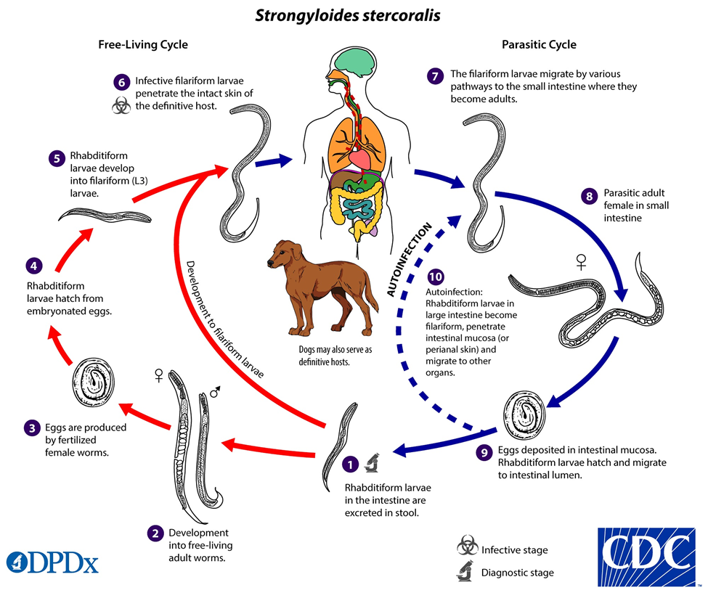
Diagrammatic life cycle

Slide 10
pathogenicity
Caused by SS- strongyloidiasis
Mostly assmptomatic
Symptomatic cases has
Skin lesion
Pulmonary lesion
Intestinal lesion
Hyper infection

Slide 11
Lab Dx
Demonstration of larvae (rhabditiform ) , filariform and adult female by papanicolaou stained smear
Bearmann technique
Agar plate culture
Serological test
Eosinophilia

Slide 12
Rx
Thiabendazole
Prevention and control
Proper human waste disposal
Avoidance of contact with faecally contaminated soil
Treatment of all diagnosed cases

