Slide 1
TEACHING AND LEARNING METHODOLOGY
By. Loice Matelong

Slide 2
OBJECTIVES
By the end of this module, the learner should be able to:
  Explain the basic concept and theories of learning.
  Development of instructional media for learning and teaching.
  Plan, implement and evaluate learning/teaching situation.
  Describe the process of curriculum development.

Slide 3
Concepts of learning
Learning is about change: the change brought about by developing a new skill, understanding a scientific law, changing attitude.

Slide 4
Concepts of teaching
Teaching is a set of events outside the learners which are designed to support internal process of learning

Slide 5
Role of the teacher
General the role of teacher can be categorized into
  Traditional role- teacher centered
  Modern role- facilitator ( student centered)

Slide 6
Theories of Learning
Behaviourist Theories:
B.F. Skinner instrumental/operant conditioning
According to Skinner's theory, it is possible to increase the probability that learning will occur and behavior will be shaped in the direction the teacher wants, if the behavior is rewarded.

Slide 7
  b) Ivan Pavlov – Classical conditioning
Considers the learning of association between stimuli
Was a Russian scientist interested in studying how digestion works in mammals, he began to study what triggers the dogs to salivate.
He summed it up there is a neutral stimulus ( the bell, lab coats)

Slide 8
  c) Edward Thorndike - Trial and error
Experiment with a cat and fish.
Law of effect – any response followed by a reward will be strengthened. Unsuccessful response will be weakened.
Law of exercise/law of use and disuse – repetition strengthens stimulus – response bond.
Law of readiness – learning takes place best in a motivated person.

Slide 9
d) Robert. M. Gagne- nine levels of learning
Gagne categorized learning into different domains so that the different conditions for learning and assessment could be planned accordingly.
1. Gaining attention (raising your voice, gesturing
2.Informing learners of the objective
3. Stimulating recall of prior learning (retrieval)
4.Presenting the stimulus ( presenting new information

Slide 10
  5.Providing learning guidance (provide alternative approaches that illustrate the information that you are trying to convey)
  6.Eliciting performance (demonstrate their knowledge of what you’ve taught them )
  7. Providing feedback (reinforce any points as necessary)
  8. Assessing performance (test)
  9. Enhancing retention and transfer

Slide 11
Cognitive Theories
Cognition is our thinking process describes the very act of acquiring knowledge through perception, thinking, imagination, remembering, judging, problem- solving and selective attention.
The study of cognitive theory is the study of the information processing of the mind. When the mind receives new information, it does two things ; codes it as “new” information or retrieves it from memory as “not new” information

Slide 12
There are 4 basic steps to the cognition or thinking process
  Perception
  Selective
  Attention
  Memory

Slide 13
Three aspects of Cognition
Perception: is the process of selecting, organizing and interpreting stimuli. Stimuli is a thing or event that evokes a response.
Attention: refers to how we actively process specific information present in our environment
Memory: involves the process of acquiring, storing and recalling information

Slide 14
  Benjamin Bloom
  He proposed three domains of learning. These were:
    Affective domain – attitudes, emotions.
    Cognitive domain – knowledge, thinking.
    Psychomotor domain – skills.

Slide 15
2. Humanistic and Social Psychologists
  Carl Rogers
Rogers provided a learner-centred view of learning. His main propositions were that:
All humans have a natural potential and desire to learn.
Learning occurs when the student perceives relevance related to their own purposes.
Significant learning is acquired through doing.

Slide 16
Learning is more effective when the learner is responsible for choosing their direction, discovering resources and formulating problems.
Most learning is self-initiated and involves the whole person, including their feelings as well as intellect.
Self-evaluation is a basic skill that is necessary for effective mature learning.
Learners should retain a continuing openness to change
Rogers’ approach significantly contributed to adult learning principles.

Slide 17
Abraham Maslow
Traditional teaching and learning has concentrated on force-feeding prescribed knowledge and has neglected to encourage the development of the student as a person with a role in society. According to Maslow, education should help students to look within themselves, and from this self-knowledge, develop a set of values which will guide them in their working life.
Maslow emphasises the importance of learning for self enhancement rather than simply for utility. This view is relevant to adult learners who decide to continue with their education out of interest, rather than in order to gain extra degrees or qualifications.

Slide 18
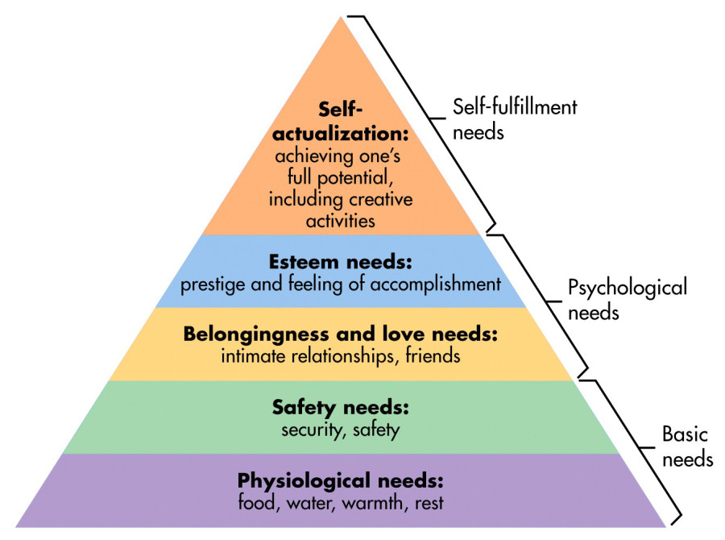
Hierarchy of needs

Slide 19
CHARACTERISTICS OF A GOOD TEACHER

Slide 20
Definition of teaching
Definition:- Teaching refers to helping, guiding and enabling a person to learn.
Facilitating learning is a social activity between two or more human beings. It involves conscious activity in planned teaching or unconscious activity in role modeling.

Slide 21
Characteristics of a good teacher
  Good communication skills
  Good planning skills in content delivery
  Organize learning materials well
  Provide advice and information
  Enthusiastic
  Use assessment to give feedback that modifies learning
  Should be confident in delivery of the subject matter
  Use of variety of teaching methods
  Should be able to relate teaching with students’ experiences

Slide 22
Tasks of a teacher
There are six major tasks or roles of a teacher
They include the following:
PLANNING
The teacher should ensure the following:
Decide what the learner should learn(prepare objectives /tasks)
Put content in suitable sequence
Allocate adequate time to each learning activity
Select appropriate learning activities and teaching methods

Slide 23
Choose appropriate assessment procedures( including methods and timing)
Identify resources needed
Inform students about the intended learning process.

Slide 24
COMMUNICATION
Teacher’s roles in communication includes:
Tell, explain ,advice
Helping students to exchange ideas
Stimulate/provoke students’ thinking
Use of varying teaching techniques
Assessing whether students are understanding the concept being taught

Slide 25
Giving specific and timely feedback to students.
Providing the learner with the expected learning outcome(objectives)
displaying enthusiasm about the topic and its important

Slide 26
PROVIDING RESOURCES
In providing resources needed in the learning process the teacher needs to:
Prepare ,select or adapt relevant educational materials(handouts ,exercises ,books etc)
Arrange learning experiences ,especially opportunities to practice skills(field excursions ,attachments ,and projects)
Involve health personnel in teaching
Arrange access to learning materials such as library ,audio-visual programmes and microscopes

Slide 27
COUNSELLING
The teacher should ensure:
  Show students that you care
  Help students identify their options and make their decisions
  Provide advice and information that help students

Slide 28
ASSESSMENT
In assessment ,the teacher should:
  Design an assessment that measures how much the students have learnt
  Use the assessment to guide students learning
  Use the assessment to give feedback that modifies teaching
  Use the assessment to decide whether students are competent to provide health care.
  Encourage students to use self-assessment and peer assessment

Slide 29
CONTINUING SELF-EDUCATION
For effective learning ,the teacher should:
  Know the subject matter that is taught and where to find relevant information
  Know the way in which the healthcare is provided locally
  Set an example as a continuous learner

Slide 30
Teaching and learning methods

Slide 31
GENERAL PRINCIPLES IN TEACHING
Teaching has to be organized and the following principles in teaching should be considered:
Active listening: give students some activity to do e.g. asking questions.
Clarity: make your teaching clear, speak loudly ,write neatly ,make your teaching meaningful
Ensure mastery: check that all students know/and can do it.
Individualize: allow for individual differences and abilities.
Motivation: make your teaching interesting, relevant and rewarding.

Slide 32
LECTURE
A lecture is a lesson given orally by a teacher, with virtually no student’s participation.
It can be given in printed form.
Lack of student participation is the main characteristics of the lecture in its traditional form.
Advantages:
Provides economical way of using staff time.
It provides a wide field of knowledge in a limited time

Slide 33
Qualities of a good lecture
Relevant to learner
Deal with single topic
Clear
Not too long / short and precise
Audible
Systematic / well organized

Slide 34
Provides up to date view of the subject and the latest results.
It is an alternative method of teaching when books are in short supply.
It can include materials that are not readily accessible in text books.
It can save students time by summarizing a field of study.
It is a good means of introducing a subject.
The lecturer can inspire with his/her enthusiasm.

Slide 35
It is as effective as other methods for imparting information but not more.
Where the lecturer has not provided a syllabus, lecturers will indicate to students the subject matter that is likely to be examined.

Slide 36
Disadvantages
It is one way learning process. Students are just listeners.
It is ineffective for changing attitudes.
It pays little regards to individuals
It doesn’t provide immediate feedback to lecturer.
It doesn’t encourage creative activity on part of students.

Slide 37
It is not capable of helping to achieve all educational objectives.
The student tends to regard knowledge as a closed system.
It cannot provide necessary repetition.
It cannot teach the skills to be acquired by the students.
Students rate of learning declines as the lecture proceeds.
Information comes from a single source.
It usually provides little time for question.
It does not provide for team work.

Slide 38
It doesn’t help develop interpersonal relationships between students and teachers.
It is less popular with students than other methods when there are many lecturers.
Students of lower ability are probably helped more in their acquisition of knowledge by discussion.
For the interpretation of knowledge and problem solving, discussion is probably more effective than lectures.
To achieve the required standards of clinical performance other forms of learning and actual practice area should be included.

Slide 39
Practical
Practical is where students learn in their future working areas.
Advantages
Provides a better understanding of lecture and demonstration presentation.
It provides activities and leads to creativity on the part of the students.
It is effective for stimulating independent thought and changing attitudes.
It is good way of achieving a desired competence for the student.

Slide 40
It provides immediate feedback on performance of the teacher
Provides an opportunity for developing interpersonal relationships between teachers and students.
Provides an opportunity for detailed opportunity discussion of the students work.
It is a two way learning process.

Slide 41
Disadvantages
It is not economical way of using manpower and resources.
It takes time to carry out practical work.
It needs administrative staff for preparation and maintenance of material.
It needs special accommodation

Slide 42
FIELD EXCURSIONS
In this students go away from the training school to do the work they are being trained.
Advantages.
Provides actual situation in the field.
Students are able to observe or participate in the use of theory through experience in the actual situation.
Provides situation for creative and independent thoughts by the student.
Provides opportunity for developing interpersonal relationships between

Slide 43
students, teachers and field staffs
Help promote the desired competence and attitudes.
Provides time for questions and discussion.
Information comes from multiple sources.
Disadvantages
Not economical in terms of resources.
Creates administrative problems in arranging programmes
May confuse students as there is usually a wide gap between field practice and academic theory.
If not well supervised it might become just like an outing.

Slide 44
Steps in field trips
Selection of site
Logistic planning – permission, arrangement for meals and schedule of events.
Field trip preparation-
Field trip
Post field trip
Evaluation

Slide 45
Demonstration
It is the act of showing that something exists or is true by giving proof or evidence
Advantages
Provides economical way of using manpower and resources.
Provides audio-visual observation of the subject.
Students will understand better when they see a demonstration of a lecture.
It may be a good means of teaching where the resources are in a supply
It provides a way of pacing a student rate of working.

Slide 46
Provides opportunities for learning how to do something well as what was done.
It can provide a wide field of knowledge in a limited time.
Utilizes several senses
Disadvantages.
It is one way learning process from instructor to the learner.
Students are just passive. May not provide for the activity on the part of students.

Slide 47
It has little regard for students’ individual differences.
No immediate feedback to instructor on what has been learnt.
It is ineffective for achieving competence unless students are given opportunities for practice

Slide 48
It has little regard for students’ individual differences.
No immediate feedback to instructor on what has been learnt.
It is ineffective for achieving competence unless students are given opportunities for practice

Slide 49
Individual learning
Advantages.
Students can work at their own individual pace.
Students can learn at their own time and place of their choice.
Students can request for teaching whenever necessary.
Teachers can prepare a standardized body of information before hand.
Students can omit parts they already know.
Students can be exposed to a standardized body of information.
Provides creativity and independent thought on the part of the students.

Slide 50
It allows regard for students’ individual differences.
Can help achieve the desired competence.
Provides immediate feedback to the teacher.
Disadvantages
It is uneconomical way of using resources.
The programmed materials have been maintained.
It needs administrative staff.
Information usually come from a single source and may be one way learning process.

Slide 51
No team work and no interpersonal relationships between students.
It takes time to prepare materials for individual learning.

Slide 52
Seminar
A conference or meeting for discussion or training.
Advantages.
Promote interpersonal relationships.
Students can learn a lot from each other.
It allows for team work and personal flexibility.
It provides a method of learning in the future.
Teacher can encourage full participation by all students.
It provides immediate feedback of knowledge gained.

Slide 53
Provides creativity and independent thought on the part of the students.
Facilitate exchange of ideas.
It trains students to work independently in preparing paper for presentation.
Provides greater control of communication between students and teachers.
Students’ performance doesn’t decline with time.
Students learn how to express themselves clearly.

Slide 54
Disadvantages.
Not economical way of using manpower.
It is too slow to be able to cover more than a limited amount of subject matter.
It may suffer from interruptions.
Cannot provide the repetition necessary for individual needs
Some active student might become dominant.

Slide 55
Tutorial
It is a more interactive and specific than a book or lecture, it teach by example and supply information.
Advantages
Communication is two way
Provides contact between student and teacher.
Students are involved.
Teachers give full attention to individual differences between students.
Provides opportunity for detailed discussion of students prepared materials.
Provides immediate feedback for both teacher and student.
Less able students can be helped by the teacher.

Slide 56
Students’ performance doesn’t decline as time progress.
Encourages creativity.
Students tend to regard knowledge as an open system.
Effective in changing attitudes.
Provides more time for questions.
Provides more understanding of the lectures.
Disadvantages.
It is not economical in terms of manpower.

Slide 57
It is too slow to be able to cover more than a limited amount of subject matter.
It may suffer from interruptions.
Cannot provide the repetition necessary for individual needs
It may be dominated by the instructor or active students.

Slide 58
Tutorial
Based on principle of individual difference
Steps
1, diagnosis – after a lecture, the teacher identifies those with similar problem
2. Prescription
3. Follow up

Slide 59
Types of tutorials
Supervision tutorial – for above average
Group tutorial
Practice tutorial – for skills

Slide 60
Project
A project is a series of tasks that need to be completed in order to reach a specific outcome.
Advantages.
Provides activities and calls for creativity by the students.
Encourages initiative by the students.
Encourages students’ independent.
The results of the project provide feedback of students’ progress to the teacher.
Promote interpersonal relationships between students.
Students can work at their own speed.
May provide opportunities for interpersonal relationships between students and people of other departments.
Information comes from multiple sources.

Slide 61
Disadvantages.
It takes time to carry out a project.
Learners may find that the project adds too much to
their workload.
It creates administrative problems in
arranging programmes.
Unless sufficient time is allowed, the learners may produce a superficial report.

Slide 62
Small group discussion.
Advantages.
Allows sharing of resources within the group,Learners help each other with difficult points.
Provides learners with opportunities to interact with the instructor and other students.
students learn to evaluate the logic of and the evidence for their own and other’s positions, that is, learning is through self expression and intercommunication.
Allows learners to become active participants in the learning process.This motivates students to learn more.

Slide 63
Provides an opportunity for the synthesis of varied experiences and data derived from lectures, laboratories, clinics and readings. The student grasps the idea of self learning without fear of failure.
Disadvantages.
Dominance among vocal members over others in a group may hinder equal growth of all members in the learning process.
A group discussion does not guarantee that an objective will be accomplished within a fixed time.
The members of the group must bring to the discussion a body of information that is sufficiently broad and deep.

Slide 64
Lack of planning by the group leader or the group itself concerning the agenda and specific
learning objectives.
As the size of the group increases, the efficiency and effectiveness of the method
will decrease.

Slide 65
Xtics of sgd
Active participation
Reflection based on experience

Slide 66
Simulation.
Simulation is divided into two:-
Games
Simulators
Simulation Game:these are educational games designed to provide students with the opportunity to practice and develop skills in problem solving ,decision making and communicating.
Simulators:Simulators are operational models such as the obstetrical phantom or model for first aid teaching. They present real life situations and allow the learner to interact by practising skills relevant to the situation.

Slide 67
Advantages.
Simulation can create the link between the training situation and the real life situation.
There is always some immediate feedback.
Simulation is a relatively cheap method and often provides experience in a low cost model for a high cost environment.
Simulation can minimise time. Problems of real life can be programmed in advance and dealt with over a variable length of time.

Slide 68
The opportunity to confront real problems in hypothetical settings means subsequent problems cause less alarm, greater confidence, and less harm to all involved.
Simulation allows learners to make their first serious mistakes in a simulated situation rather than in a real one.
Disadvantages.
Simulation techniques cannot simulate all dimensions of a real life situation.
The planning and development time required for a simulation technique may prove to be costly.

Slide 69
Role play
Advantages.
Learners gets an opportunity to practice what was learnt.
Learner is able to express his/her feelings.
Provides the learner with the opportyunity actively participate in the learning process.
Disadvantages.
Not all students may be able to dramatize .
Teachers may not be able to construct a real problem situation or different roles to deal with.

Slide 70
Xtics of role play
Well structured problem situation
Not be explicit
Should not deal with actual/real problem of the role players
Detailed and clear
Learners should volunteer

Slide 71
Steps in role play
Offer relevant scenario to learners
Give students time to complete task
Think, pair and share format
Find a way to process students deliberations.

Slide 72
FACTORS TO CONSIDER WHEN CHOOSING A TEACHING METHOD
What to be covered.e.g. cognitive Practicality of the method
Available resources.

