Slide 1
TERATOLOGY
PREPARED BY: MADAM RUTH

Slide 2
Teratology
Teratology is the science that studies the causes, mechanisms, and patterns of abnormal development.
Developmental disorders present at birth are called congenital anomalies, birth defect or congenital malformation.
Congenital anomalies are of four clinically significant types: malformation, disruption, deformation and dysplasia.

Slide 3
Malformation - definition
Congenital malformation are structural defects present at birth. They may be gross or microscopic, on the surface of the body or within it, familiar or sporadic, hereditary or nonhereditary, single or multiple.
A major congenital anomaly is one that is incompatible with survival, is life-threatening, or seriously compromises an individual´s capacity to function normally in society.

Slide 4
Birth defects
3% of all live-born infants have an major anomaly
Additional anomalies are detected during postnatal live – about 6% at 2 year-olds, 8% in 5year-olds, other 2% later
Single minor anomalies are present in about 14% of newborns

Slide 5
Birth defects
Major anomalies are more common in early embryos (up to 15%) than they are in newborns (3%).
Most severely malformed embryos are spontaneously aborted during first 6 to 8 weeks.

Slide 6
Types of abnormalities
1-Malformations: this occurs during the formation of the structures of the organ (during organogenesis) results in partial or complete non formation or alterations in the normal structure. This occurs in the 3rd to the 8th week of gestation. Ex. Cleft lip and or cleft palate.
2-Disruptions: results in morphological change of the already formed structure due to exposure to destructive process. e.g.: vascular accidents leading to intestinal atresia, amniotic band disruption.
3-Deformations: due to mechanical forces that affect a part of the fetus over a long period. Ex: talipes equinovarus deformity.
4-Syndrome: is a group of anomalies occurring together due to a common cause .

Slide 7
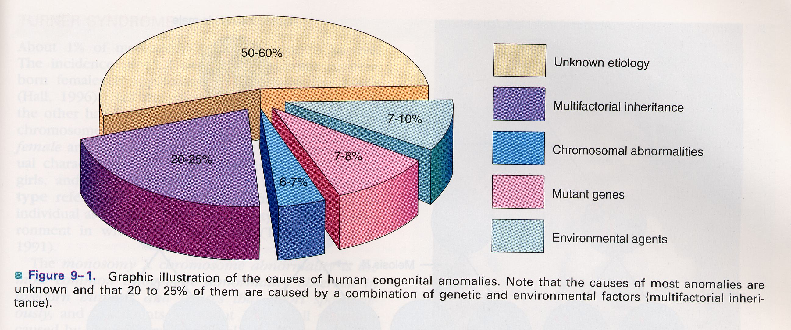
Causes of congenital anomalies

Slide 8
Birth Defects occur during Critical Periods in Development
1. Defects during Zygote are aborted;
2. Defects in the remaining prenatal period are irreversible;
3. Critical Periods: a time of rapid change in the development of the organism (i.e., system or structure) and if interrupted will result in permanent congenital abnormalities.

Slide 9
Sensitive periods in development
1. Occur prenatally and less irreversible
2. Interference will disrupt growth; may result in subtle dysfunctions
3. Continues into post-natal period
Teratogens
- Agents that cause congenital malformations in critical periods, and subtle alterations in the brain during sensitive periods

Slide 10
Anomalies caused by genetic factors
Chromosomal aberrations are common and are present in 6 to 7% of zygotes – (result =abort)
Numerical chromosomal abnormalities – usually non-disjunction- error in cell division
Down syndrom (21) Edwards (18) Patau (13) Turner (X0), Klinenfelter (XXY)
Structural chromosomal abnormalities – chromosome breaks = translocation, deletion (cri du chat syndrome), duplication, inversion.
Mutant genes – achondroplasia, fragile-X syndrome

Slide 11
Anomalies caused by environmental factors
Teratogens are exogeneous agents that may cause developmental defects:
Drugs ( warfarin, valproic acid, phenytoin, vitamin A, thalidomide, cytostatic drugs – cyclophosphamide, lithium carbonate)
Chemicals (PCBs, methylmercury, alcohols)
Infections (rubella, cytomegalovirus, herpes, toxoplasma, syphilis)
Ionizing radiation (RTG)
Maternal factors (diabetes mellitus, hyperthermia, phenylketonuria, hyper-/hypo-thyreosis)

Slide 12
The Thalidomide curse
Thalidomide at one time caused an epidemic of phocomelia

Slide 13
Basic principles in teratogenesis
Critical periods of development
Dosage of the drug or chemical
Genotype (genetic constitution) of the embryo and mother

Slide 15
Critical Period Defect: Cleft Palate
Irreversible congenital abnormality affecting a critical period (palate development) during the embryonic and early fetal stages
May affect pituitary growth as the palate and anterior pituitary are derived from the same embryonic tissue.

Slide 16
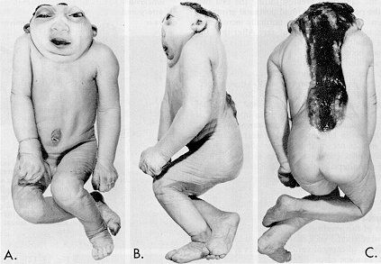
Critical Period Defect: Anencephaly (absence of brain)
Failure for the brain to grow beyond the rhombencephalon. Neonate failed to survive.

Slide 17
Critical Period Defect: Schizencephaly
Developmental of the brain affected during the fetal period (i.e., growth of the forebrain). Cells either failed to migrate or ventricular region failed to close.

Slide 18
Teratogens
Agents that cause congenital malformations

Slide 19
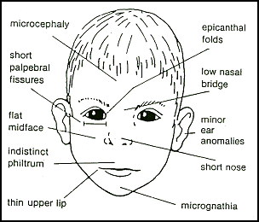
Fetal Alcohol Syndrome
Features: Growth retardation, neurodevelopmental abnormalities (fine motor skills, LD, behavior disorders, and mental retardation in 50%). Facial dysmorphia during embryonic period (week 4-8), CNS problems during the fetal period (migration problems, smaller dendrites, few neurons in brain regions)

Slide 20
Genetic Conditions: Chromosomal Abnormalities
Trisomy 21 (Down’s Syndrome)
Trisomy of other chromosomes
Edward’s Syndrome (Trisomy 18)
Patau’s Syndrome (Trisomy 13)

Slide 21
Trisomy 21: Down’s Syndrome
Non-disjunction of the 21st Chromosome

Slide 22
Anatomical Dysmorphia & Risk (Increase with Maternal Age)
Just 1%-20% graphed here

Slide 23
How does Trisomy 21 happen?
First, normal development…
In normal development mitosis proceeds normally from the first cell division

Slide 24
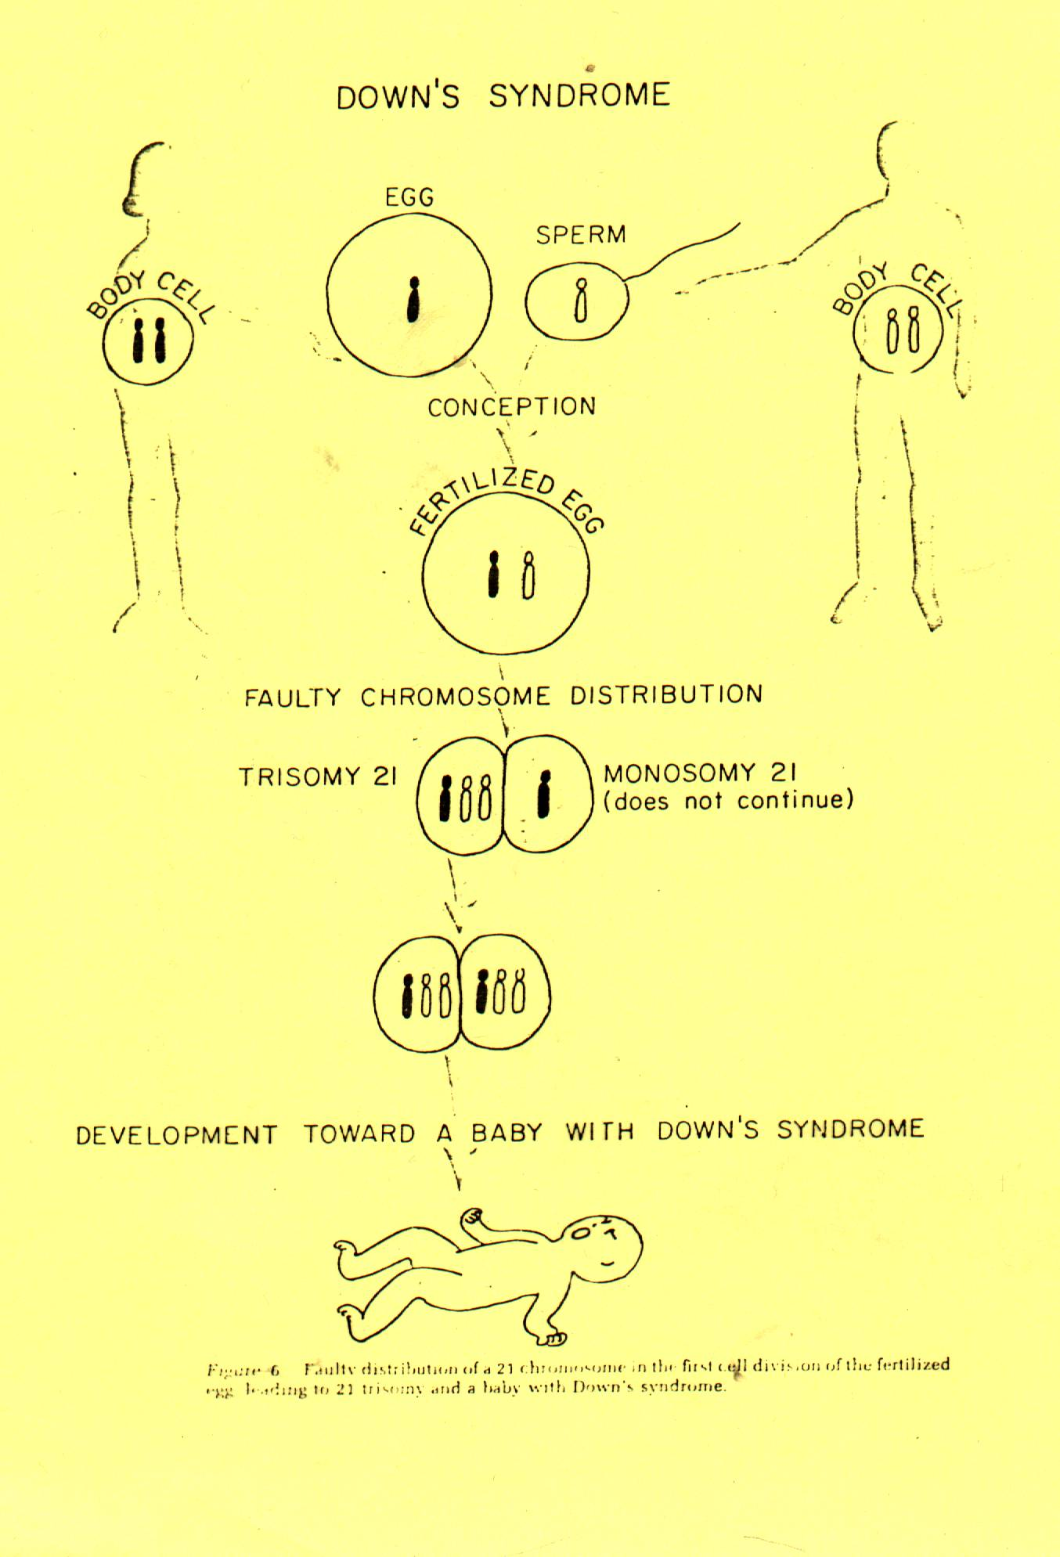
In Down’s Syndrome, non-disjunction of the 21st chromosome can happen at the first cell division

Slide 25
Non-disjunction of the 21st chromosome cab occur after the first cell division resulting in a mosaic form of Down’s Syndrome

Slide 26
Faulty distribution can occur in the egg or sperm when the mother or father is a carrier.

Slide 27
Trisomy 18 – Edward’s Syndrome

Slide 28
Some Features of Edward’s Syndrome
Facial: microcephaly, low set malformed ears
Skeletal: webbed neck, overlapping of fingers and fixed flexion of fingers
CNS: severe mental retardation, neural tube defect, ocular abnormalities
Respiratory: apnea
Cardiovascular problems
Gastrointestinal and genitourinary problems
Life Span: death by 12-24 months (very few reach adulthood)
Incidence: 0.2/1000 births

Slide 29
Trisomy 13: Patau’s Syndrome
Features:
0.1/1000 births
Spina bifida & cleft palate
CNS: underdevelopment of frontal lobe (fails to divide) and corpus callosum
Profound Mental Retardation
Extra fingers and toes, deaf
Life Span: 82% die in the first month, 5-10% die in first year.

Slide 30
Williams Syndrome – Partial Deletion of the 7th Chromosome
Features:
1 in 20,000 births
Neurodevelopmental delays, cognitive deficits, ADHD
Overly friendly, social
Extremely empathic
Low muscle tone
Extremely sensitive hearing

Slide 31
Brain Areas Affected:
Amygdala activates more for threatening scenes and very little for threatening faces. This accounts for absence of anxiety in interpersonal interactions (no fear, hence over friendliness).
Also, abnormal activity in frontal lobe and a disconnect with the amygdala (except for medial-prefrontal which is linked to empathy and the only structure still connected to the amygdala)
Normal Control Williams Syndrome
Amygdala

Slide 32
Autism
A neurodegenerative disorder characterized by impairment in social interaction and communication.
Age of onset: typically between ages 2 and 4 (sometimes earlier)

Slide 33
Symptoms

Slide 34
Teratogen
Teratogenesis is process with threshold-level effect.
Every chemical substance may be teratogenic. This effect depends on quantity. In small amount is without any effect.
Teratogen is factor that is present in environment in so high amount that it can increase occurrence of embryotoxicity manifestation up to basic frequency in non-exposed population
Teratogenicity is a manifestation of developmental toxicity representing a particular case of embryo/fetotoxicity, by the induction or the increase of frequency of structural disorders in the progeny.

Slide 35
Consequences of exposure to teratogens
Death – abortion or miscarriage
Malformation
IUGR – intrauterine growth retardation
Functional defects in the newborn
Normal newborn

Slide 36
About 80% pregnant women use prescribed or over-the-counter drugs
The drugs should only be taken when essential thereby avoiding unnecessary and unknown risks
The same is obviously applied to social drugs like tobacco, alcohol and additive drugs

Slide 37
PRENATAL DIAGNOSIS
Methods of prenatal diagnosis are divided into invasive and non-invasive techniques.
Technique Time Disorders diagnosed
(in weeks)
A. Non-invasive:
Maternal serum screen:
Alpha feto protein (AFP) 16 Neural tube defects (NTD)
Triple test 16 Down syndrome
Ultrasound 18 Structural defects in many
organs as CNS, heart,
kidney, and limbs.
B. Invasive:
- Amniocentesis 14-16 Chromosomal and metabolic
abnormalities, and DNA
analysis.
- Chorionic villus sampling 10-12 As amniocentesis.
- Fetal blood sample near term As amniocentesis + blood
disorders.

Slide 38
Technique of amniocentesis

Slide 39
Technique of CVS

Slide 40
END OF EMBRYOLOGY

