Slide 1
THE CARDIOVASCULAR SYSTEM

Slide 2
CVS
Can be divided into :
The heart
The blood vessels
The heart pumps blood into two systems:
The pulmonary circulation
The systemic circulation

Slide 3
The blood vessels
Delivery system of dynamic structures that begins and ends at the heart
Arteries: carry blood away from the heart; oxygenated except for pulmonary circulation and umbilical vessels of a fetus
Capillaries: contact tissue cells and directly serve cellular needs
Veins: carry blood toward the heart

Slide 4
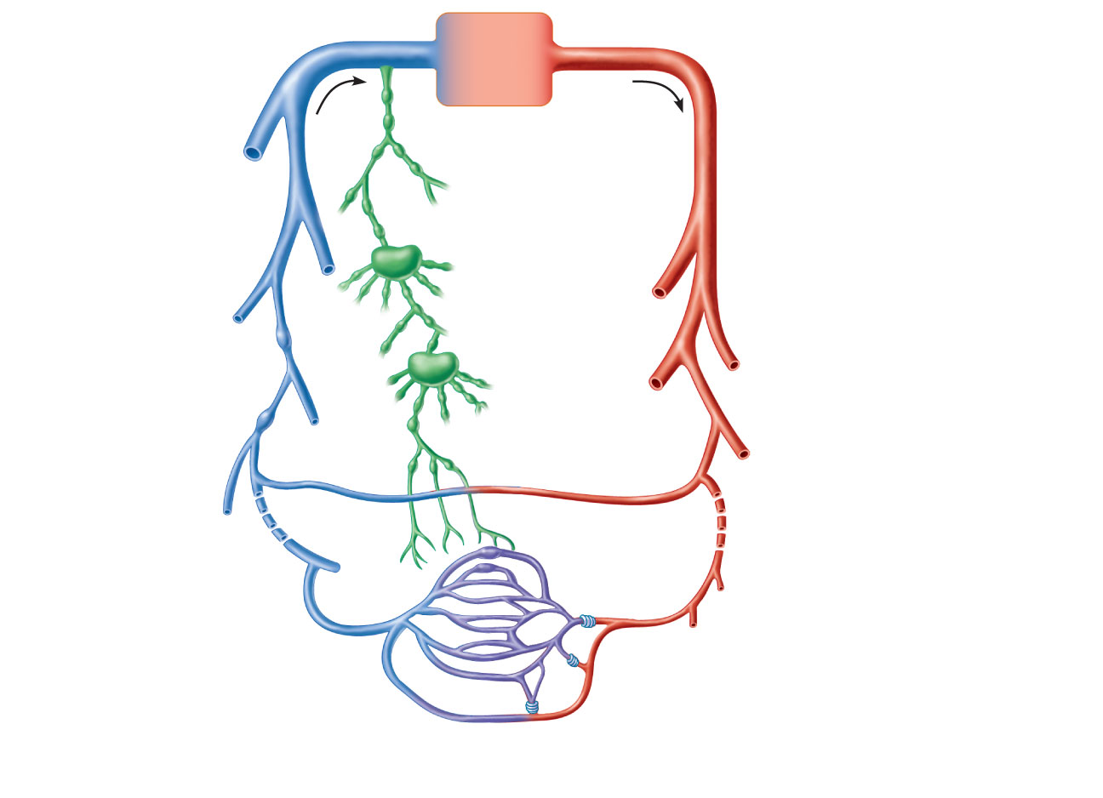
Venous system
Arterial system
Large veins
(capacitance
vessels)
Heart
Elastic arteries
(conducting
vessels)
Large
lymphatic
vessels
Lymph
node
Muscular arteries
(distributing
vessels)
Lymphatic
system
Small veins
(capacitance
vessels)
Arteriovenous
anastomosis
Lymphatic
capillary
Sinusoid
Arterioles
(resistance vessels)
Postcapillary
venule
Terminal arteriole
Metarteriole
Thoroughfare
channel
Capillaries
(exchange vessels)
Precapillary sphincter

Slide 5
Arteries and arterioles
The walls consists of three layer tissue
tunica adventitia or outer layer of fibrous tissue
tunica media or middle layer of smooth muscle and elastic tissue
tunica intima or inner lining of squamous epithelium called endothelium.

Slide 6
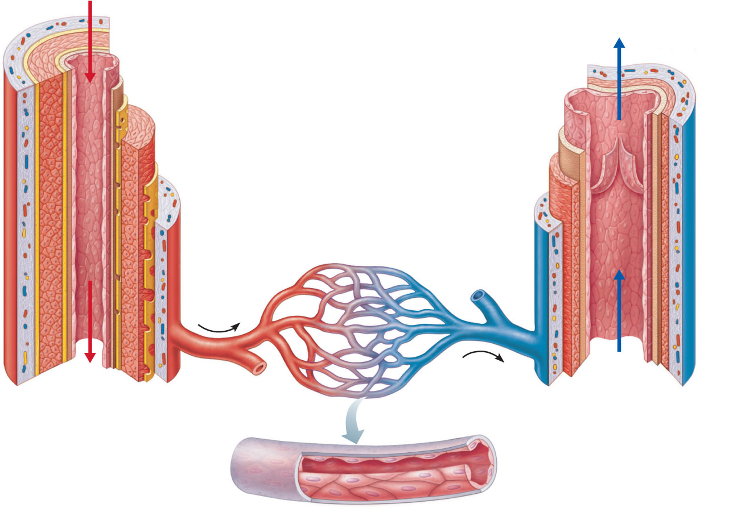
Tunica intima
• Endothelium
Valve
• Subendothelial layer
Internal elastic lamina
Tunica media
(smooth muscle and
elastic fibers)
External elastic lamina
Tunica externa
(collagen fibers)
Lumen
Artery
Lumen
Vein
Capillary
network
Basement membrane
Endothelial cells
(b)
Capillary

Slide 7
Ctied
In the large arteries, sometimes called elastic arteries, the tunica media consists of more elastic tissue and less smooth muscle.
These proportions gradually change as the arteries branch many times and become smaller until in the arterioles(resistance vessels) the tunica media consists almost entirely of smooth muscle hence the diameter is well regulated and determines the blood pressure.
Arteries have thicker walls than veins and this enables them to withstand the high pressure of arterial blood.

Slide 8
Anastomoses and end-arteries
Anastomoses are arteries that form a link between main arteries supplying an area
If one artery supplying the area is occluded anastomotic arteries provide a collateral circulation
End-arteries are the arteries with no anastomoses or those beyond the most distal anastomosis
When an end-artery is occluded the tissues it supplies die

Slide 9
Capillaries
They are minute vessels called capillaries.
Their walls consist of a single layer of endothelial cells through which water and other small-molecule substances can pass.
Blood cells and large-molecule substances such as plasma proteins do not normally pass through capillary walls.
The capillaries form a vast network of tiny vessels which link the smallest arterioles to the smallest venules.
Their diameter is approximately that of an erythrocyte (7 um).

Slide 10
The capillary bed is the site of exchange of substances between the blood and the tissue fluid, which bathes the body cells

Slide 11
Sinusoids
They are wider and leakier capillaries found in some places like the liver
Blood flow through them is slower and can come into contact with the cells outside, this allows faster exchange of substances

Slide 12
Veins and venules
They return blood at low pressure to the heart.
Walls are thinner arteries but have the same three layers of tissue
They are thinner because there is less muscle and elastic tissue in the tunica media
Some veins possess valves which are formed by a fold of tunica intima strengthened by connective tissue, which prevent backflow of blood, ensuring that it flows towards the heart
The cusps are semilunar in shape with the concavity towards the heart.
The smallest veins are called venules

Slide 13
Blood supply
The outer layers of thick vessels receive their blood through a network of blood vesssels called vasa vasorum

Slide 14
Control of blood vessel diameter
Sympathetic nerves supply the smooth muscle of the tunica media of blood vessels.
There is no parasympathetic nerve supply to most blood vessels and therefore the diameter of the vessel lumen and the tone of the smooth muscle is determined by the degree of sympathetic nerve stimulation.

Slide 15
Blood vessel diameter and flow
The blood vessels primarily responsible for providing resistance to blood flow are the small arterioles, the walls of which consist mainly of smooth muscle.
A small change in their lumen results in considerable alteration in blood flow to the part of the body they supply.
Arterioles provide the peripheral resistance to the flow of blood and are therefore called resistance vessels. This is important in maintaining homeostasis of blood pressure

Slide 16
Resistance to flow of fluids along a tube is determined by three factors: the diameter of the tube; the length of the tube; and the viscosity of the fluid involved.
The most important factor in relation to flow of blood along vessels is peripheral resistance.

Slide 17
Local regulation of blood flow
Tissues have the ability to regulate blood flow in them depending on their individual needs, this is called autoregulation
The main mechanisms associated to this local control of blood flow include:
release of metabolic waste products
Tissue temperature
Hypoxia
Release of vasodilator chemicals
Activity of vasoconstrictor substances

Slide 18
Capillary exchange
Assignment

Slide 19
THE HEART
The heart is a roughly cone-shaped hollow muscular organ
Its about 10cm long and about the size of owner’s fist
It weighs about 225g in women and heavier in men, about 310g

Slide 20
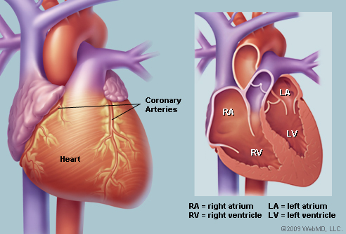
Diagrams of the heart

Slide 21
Position
Heart lies in the thoracic cavity in the media-sternum
It lies obliquely, a little more to the left than the right and presents a base above, and a apex below
The apex is at the level of the 5th intercostal space i.e. a little below the nipple and slightly nearer the midline
The base extends to the level of the 2nd rib

Slide 22
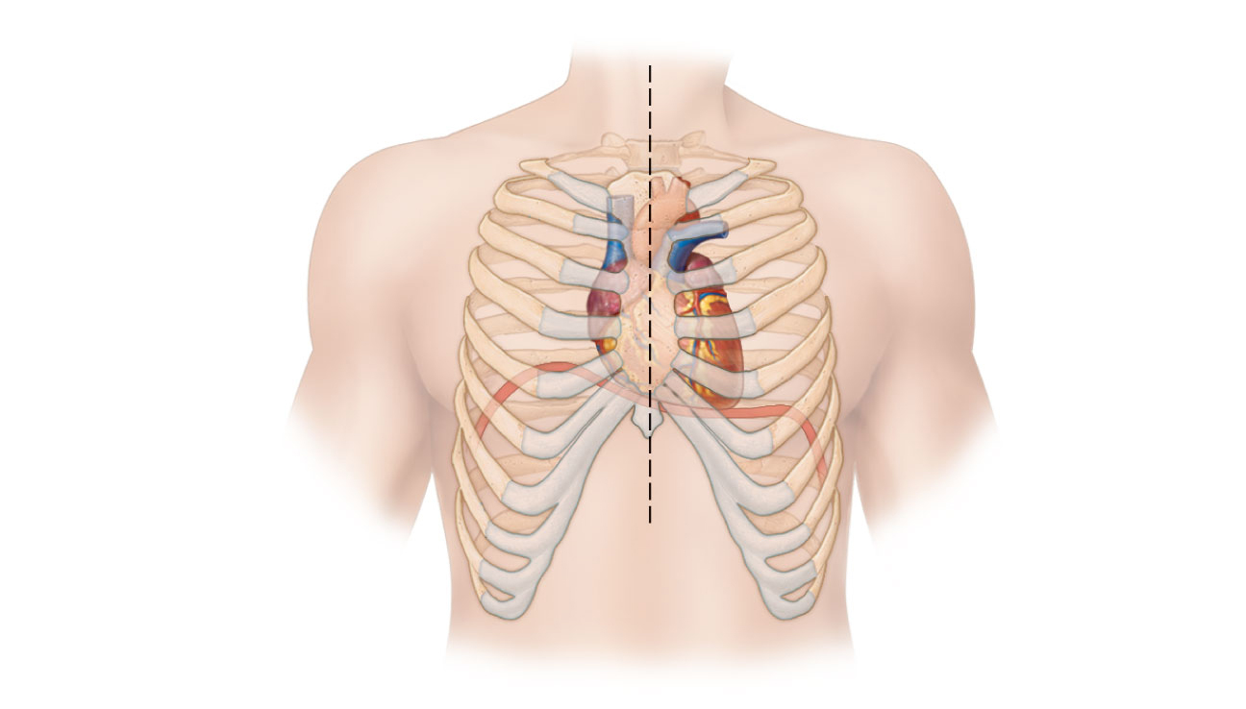
Midsternal line
2nd rib
Sternum
Diaphragm
Point of
maximal
intensity
(PMI)
(a)

Slide 23
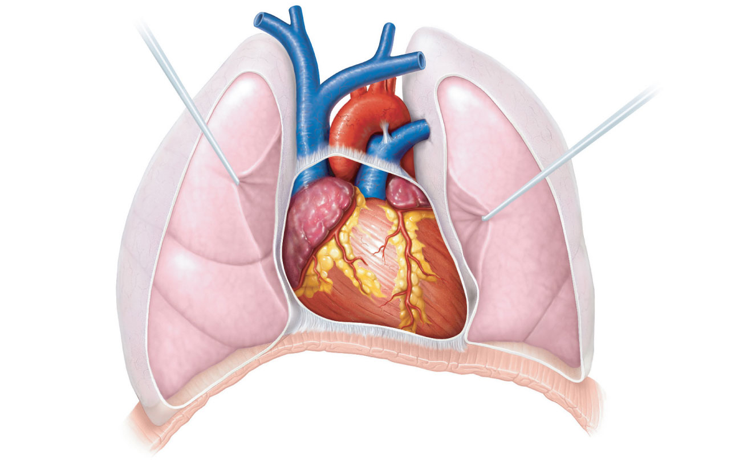
Superior
vena cava
Aorta
Parietal
pleura (cut)
Pulmonary
trunk
Left lung
Pericardium
(cut)
Apex of
heart
Diaphragm
(c)

Slide 24
Organs associated with the heart
AP PG 78

Slide 25
Structure
The heart wall comprises of three layers of tissue(cardiac) namely:
Pericardium
Myocardium
Endocardium

Slide 26
Pericardium
Its the outer most layer and made up of two sacs. The outer fibrous sac continuous with the tunica adventitia of the great vessels
Its inelastic, fibrous nature prevents the heart from over distension
The parietal pericardium (out layer of serous membrane) lines the fibrous sac, the visceral pericardium (the inner layer)
The serous membrane consist of flattened epithelial cells, it secretes the serous fluid into the space between parietal and visceral layers
This allows smooth movement between them when the heart beats

Slide 27
Myocardium
It composed of cardiac muscle found only in heart
Its under involuntary control but is striated like skeletal muscle, each fibre(cell) has a nucleus and one or more branches
Each cell and their branches are very close contact with ends and branches of adjacent cells
Microscopically these ‘’joints” or intercalated discs, are thinker, darker lines than the straitens

Slide 28
Myocardium cont’d
The end-to-end continuity of fibre, each one does not need to have separate nerve supply
When an impulse is initiated it spreads from cell to cell via the branches and the intercalated discs over the whole ‘‘sheet” of muscle causing contraction in coordinated and efficient manner
The myocardium is thickest at the apex and thins out towards the base

Slide 29
Endocardium
This line the chambers and the heart valves, its thin, smooth, glistening membrane that permits smooth blood flow inside the heart
It consist of flattened epithelial cells

Slide 31
Interior of the heart
Divided into right and left by the septum
After birth, blood cannot cross the septum from one side to the other
Each side is divided by an atrioventricular valve into upper atrium and ventricle(double folds of endocardium strengthened by fibrous tissue) below
The right ventricular valve (tricuspid valve) has three flaps or cusps and the left atrioventricular valve(mitral valve) has two flaps
The flow of blood is one way; enters through atria and passes into ventricles below

Slide 32
Interior of the heart cont’d
The valves opens closes passively according to the changes in pressure in the chambers
The valves opens when the pressure in atria is greater than ventricles
During ventricular systole (contraction) the pressure in the ventricle is greater than in the atria

Slide 33
Ctied
The valves snap shut, preventing backward flow of blood to atria
The valves are prevented from opening upwards into atria by tendinous cords called chordae tendineae
Chordae tendineae extends from inferior surface of the cusps to little projections of myocardium into the ventricle, covered with endothelium called papillary muscle

Slide 34
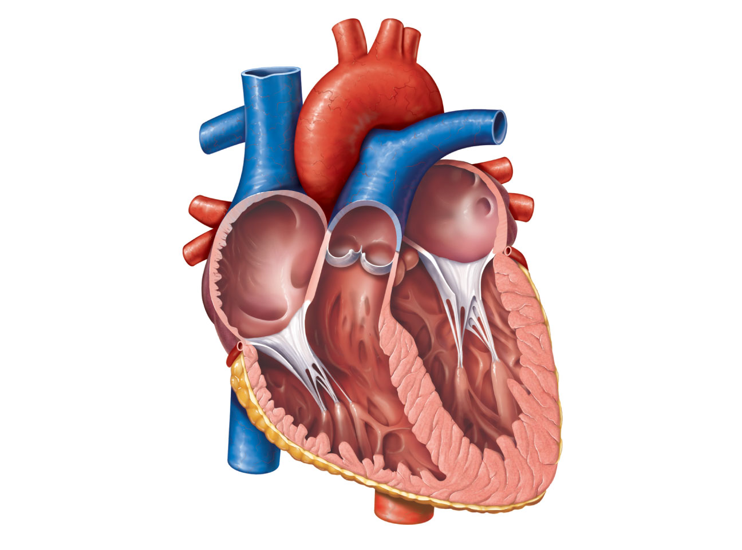
Aorta
Superior vena cava
Left pulmonary
artery
Right pulmonary
artery
Left atrium
Left pulmonary
veins
Pulmonary trunk
Right atrium
Mitral (bicuspid)
valve
Right pulmonary
veins
Fossa ovalis
Aortic valve
Pectinate muscles
Pulmonary valve
Tricuspid valve
Left ventricle
Right ventricle
Papillary muscle
Chordae tendineae
Interventricular
septum
Trabeculae carneae
Epicardium
Inferior vena cava
Myocardium
Endocardium
(e) Frontal section

Slide 35
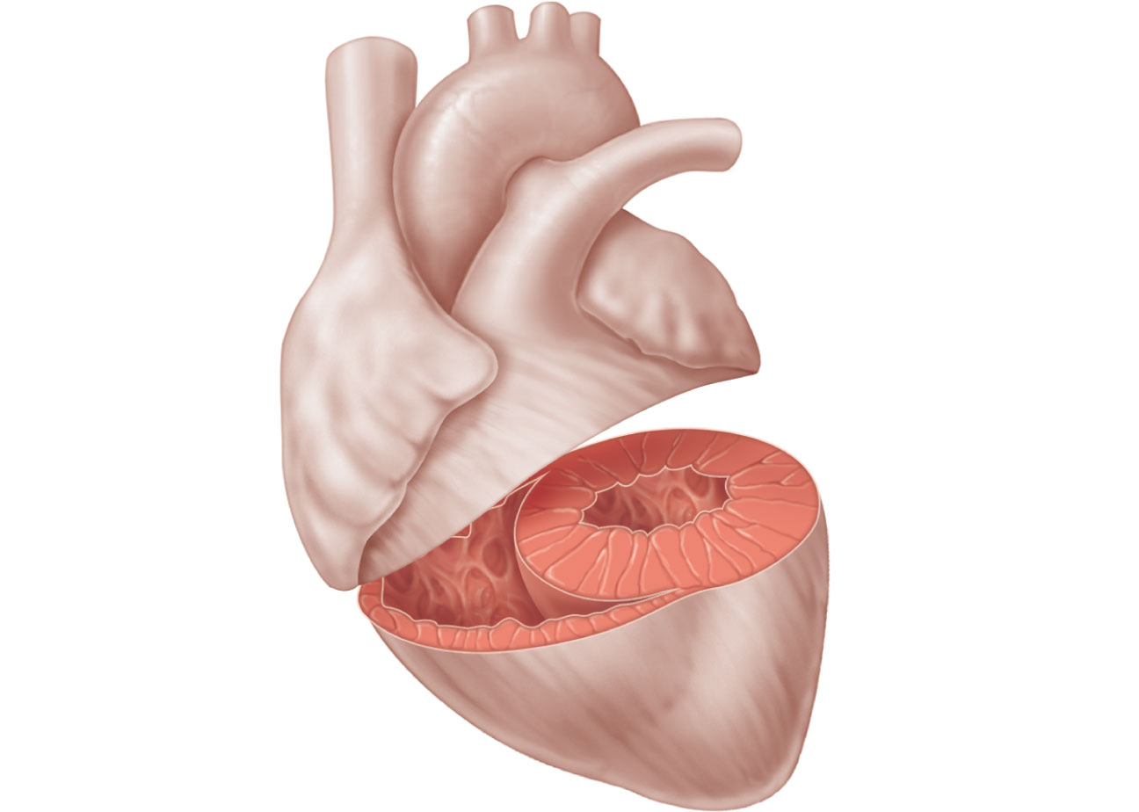
Left
ventricle
Right
ventricle
Interventricular
septum

Slide 36
Flow of blood through the heart
The two largest veins in the body, the superior and inferior venae cavae, empty their blood into right atrium
This blood passes via the right atrioventricular valve into right ventricle
Then pumped into the pulmonary artery or trunk (the only artery in the body which carries deoxygenated blood)
The pulmonary valve, formed by three semilunar cusp prevents backflow of blood into right ventricle when the ventricular muscle relaxes

Slide 37
Flow of blood through the heart cont’d
The right pulmonary artery divides onto right and left pulmonary arteries carrying blood to both lungs for gaseous exchange
There two pulmonary veins from each lungs carry oxygenated blood back to left atrium
Blood then passes through the left atrioventricular valve into left ventricle
The blood is pumped into the aorta, the first artery of the general circulation
The aorta opening is guarded by the aortic valve , formed by three semilunar cusps

Slide 39
Blood supply to the heart (coronary circulation)
Arterial supply –the heart get it blood from right and left coronary arteries, which branch from the aorta immediately distal to aortic valve
Although heart comprises a small proportion of the body, it receives 5% of the blood it pumps

Slide 41
Venous drainage
Most of the venous blood is collected into a number of cardiac veins that joins to form the coronary sinus
Which opens into the right atrium, the remainder passes directly into the heart chambers through little venous channels

Slide 42
Conducting system of the heart
The heart has property of autorhythmicity, means it generates its own electrical impulses and beats independently of nervous or hormonal control
Its not reliant on external mechanism to initiate each heartbeat. However, it has both sympathetic and parasympathetic autonomic nervous nerve fibre

Slide 43
Ctied
The fibres increase or decrease respectively the intrinsic heart beat, also the heart responds to a number of circulating hormones like adrenaline and thyroxine
The specialized neuromuscular cells in the myocardium initiates and conducts impulses, leading to heart muscle coordinated and synchronized contraction

Slide 44
Sinoatrial node(SA node)
Its small mass of specialized cells on right atrium near the opening of the superior vena cava
The Sinoatrial cells are electrically unstable and generates regular impulses, this instability leads them to discharge (depolarise) regularly 60 and 80 times a minute

Slide 45
ctied
Depolarization is followed by recovery (repolarisation), but almost immediately their instability leads them to discharge again, setting the rate
SA node discharges faster than other part of the heart, it normally sets the heart rate (pacemaker of the heart)
Firing of SA node triggers atrial contraction

Slide 46
Atrioventricular node (AV node)
A small mass of neuromuscular tissue is situated in the wall of the atrial septum near the atrioventricular valves
AV node transmits the electrical signals from atria into ventricles, there is a delay here, electrical signals take 0.1 of second to pass through into the ventricles

Slide 47
Ctied
The delay allows the atria to finish contraction before the ventricles start
AV node also acts as pacemaker function and takes over when SA node has a problem, but the AV node intrinsic firing rate is slower than SA node (40-60bpm)

Slide 48
Atrioventricular bundle (AV bundle or bundle of His)
This mass of specialized fibres that originates from AV node
The AV bundle crosses the fibrous ring that separate atria and ventricles then, at the upper end of the ventricular septum
Divides into right and left bundle branches, in ventricular myocardium the branches break into fine bundles up into fine fibres called purkinje fibres

Slide 49
Ctied
The AV bundle, bundle branches and purkinje fibre transmit electrical impulses from the AV node to apex of the myocardium
The wave of ventricular contraction begins, then sweep upwards and outwards, pumping blood into the pulmonary artery and the aorta

Slide 50
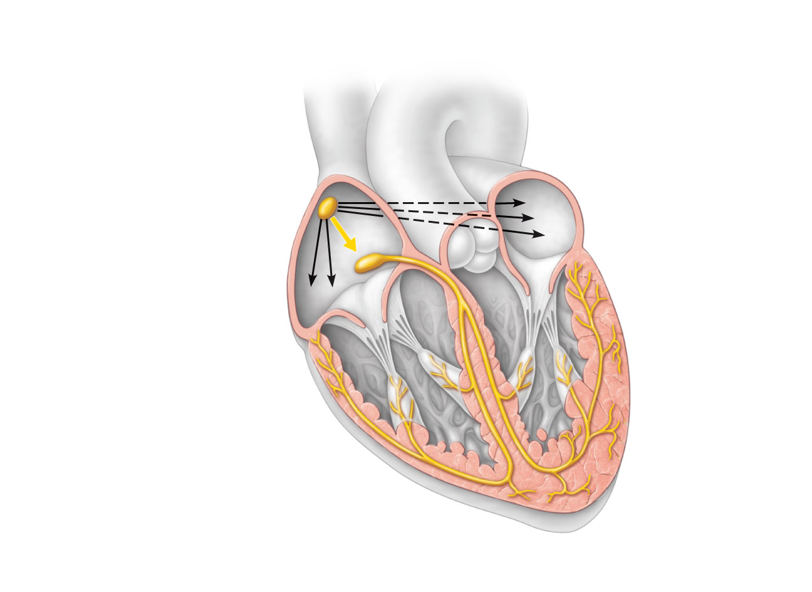
Superior vena cava
Right atrium
The sinoatrial (SA)
node (pacemaker)
generates impulses.
1
Internodal pathway
2
Left atrium
The impulses
pause (0.1 s) at the
atrioventricular
(AV) node.
The atrioventricular
(AV) bundle
connects the atria
to the ventricles.
Purkinje
fibers
3
The bundle branches
conduct the impulses
through the
interventricular septum.
4
Inter-
ventricular
septum
The Purkinje fibers
depolarize the contractile
cells of both ventricles.
5
(a) Anatomy of the intrinsic conduction system showing the
sequence of electrical excitation

Slide 51
Nerve supply to the heart
The heart is influenced by autonomic(sympathetic and parasympathetic) nerve originating in the cardiovascular centre in the medulla oblongata
The vagus nerve(parasympathetic) supply the SA and AV nodes and atrial muscle

Slide 52
Factors affecting heart rate
Autonomic nerve activity
Circulating hormones
Gender
Age
Emotional stress
The baroreceptor reflex
Activity and exercise
Temperature

Slide 53
The cardiac cycle
At rest, the healthy adult heart is likely to beat at a rate of 60-80 bpm
During each heartbeat, or cardiac cycle the heart contracts and the relaxes
The period of contraction is called systole and relaxation diastole

Slide 54
Stages of the cardiac cycle
Example, taking 74 bpm each cycle last about 0.8 of a second and consist of:
atrial systole - contraction of the atria
ventricular systole - contraction of the ventricles
complete cardiac diastole - relaxation of the atria and ventricles
The superior and inferior vena cavae transport deoxygenated blood into the right atrium
At the same time as the pulmonary veins brings oxygenated blood into the left atrium

Slide 55
Ctied
The SA node triggers a wave of contraction over myocardium of both atria
Emptying the atria and completing ventricular filling (atrial systole 0.1 s)
Electrical impulses reaches AV node, slowed down delaying the atrioventricular transmission
This allows atria to finish emptying into the ventricles before they begin to contract
The AV bundle, bundle branches and purkinje fibre transmit electrical impulses from the AV node to apex of the myocardium

Slide 56
Ctied
The wave of ventricular contraction begins, then sweep upwards and outwards, pumping blood into the pulmonary artery and the aorta(ventricular 0.3 s)
After contraction of the ventricles there is complete cardiac diastole, a period of 0.4 seconds, when atria and ventricles are relaxed
At this time myocardium recovers in preparation for the next heartbeat, and the atria refill in preparation for the next cycle

Slide 57
Cardiac cycle summary
Atrial Systole (0.1 s)
This is a relatively short phase
During this phase the blood from the left and right atria is pumped into the ventricles
Ventricular systole(0.3 s)
During this phase the ventricles contract
As they begin to contract the mitral and tricuspid valves close to prevent any backflow into the atria
At the end of this phase the pulmonary and aortic valves close and diastole begins again.

Slide 58
Ctied
Diastole (0.4 s)
During this phase blood flows into the heart. Blood comes into the atria through the pulmonary veins (left atrium) and the superior and inferior vena cava (right atrium)
From the left and right atria the blood flows directly into both ventricles because both the mitral and tricuspid valves are open
The ventricles accept this blood and passively dilate (expand). All cardiac muscle is relaxed throughout this phase
The aortic and pulmonary valves are closed during this phase to prevent the reverse flow of blood from the aorta and pulmonary artery

Slide 59
Heart sounds
The stethoscope diaphragm placed on the chest wall a little below the left nipple a slightly nearer the midline the heartbeats are heard
There are four heart sounds, each correspondent to a particular event in the cardiac cycle
First two sounds most distinguished through the stethoscope like ’’lub dup”

Slide 60
The first sound, ‘lub’ is fairly loud and due to closure of the atrioventricular valves, this corresponds with the start of the ventricular systole
The second sound, ‘dup’ a softer and is due to the closure of the aorta and pulmonary valves, this correspond with ventricular diastole

Slide 61
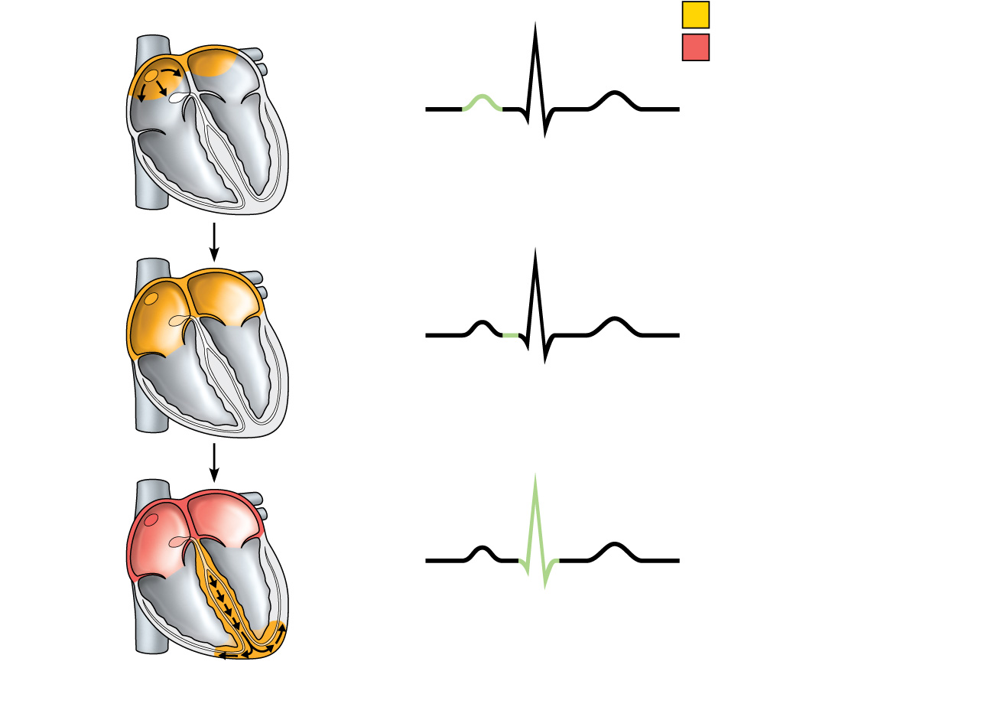
Electrical changes in the heart
SA node
R
Depolarization
Repolarization
P
T
Q
S
1
Atrial depolarization, initiated by the SA node, causes the P wave.
R
AV node
P
T
Q
S
2
With atrial depolarization complete, the impulse is delayed at the AV node.
R
P
T
Q
S
3
Ventricular depolarization begins at apex, causing the QRS complex. Atrial repolarization occurs.

Slide 62
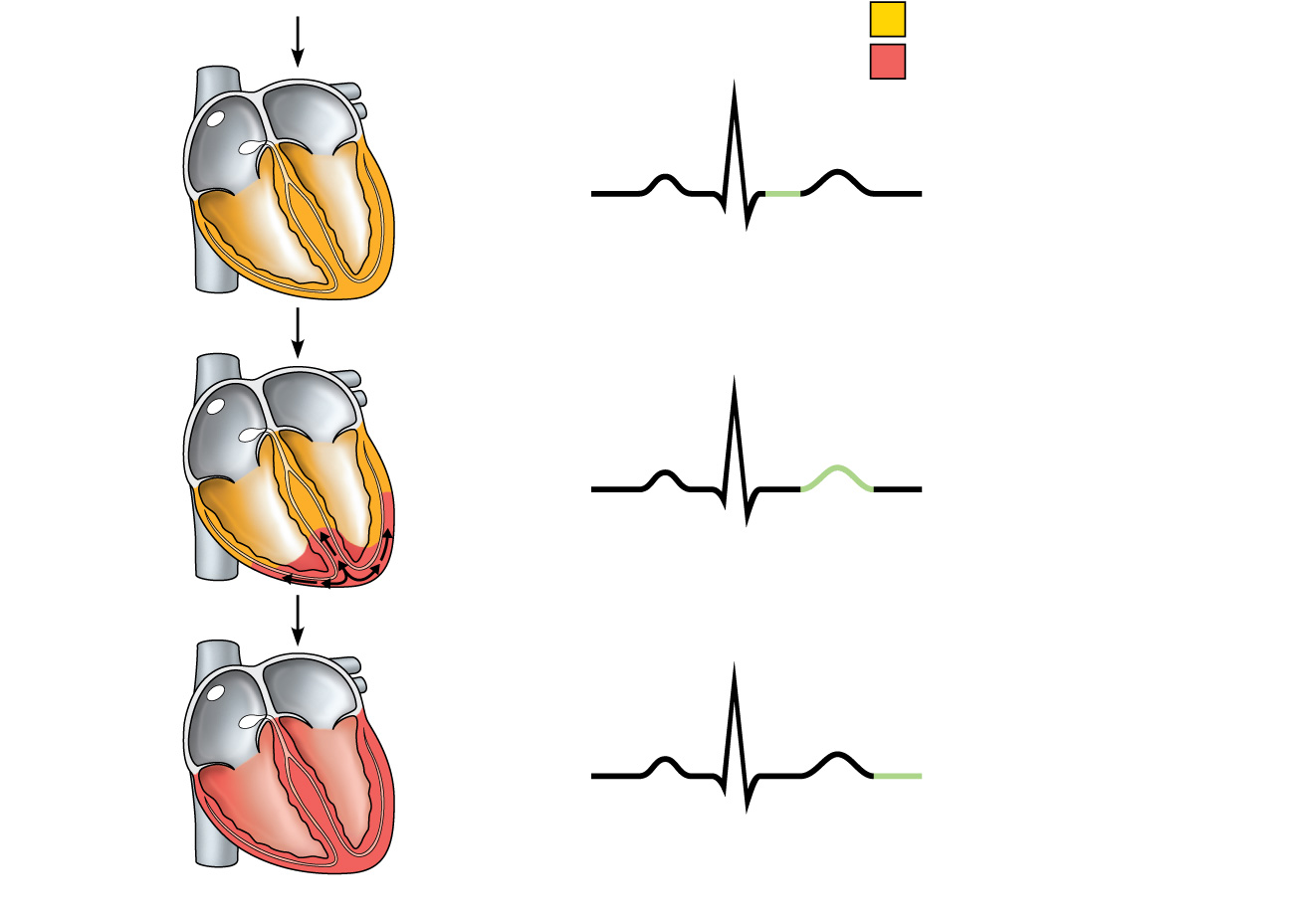
Depolarization
R
Repolarization
P
T
Q
S
4
Ventricular depolarization is complete.
R
P
T
Q
S
5
Ventricular repolarization begins at apex, causing the T wave.
R
P
T
Q
S
6
Ventricular repolarization is complete.

Slide 63
Cardiac output
The cardiac output is the amount of blood ejected from each ventricle every minute
Stroke volume is the amount of blood expelled by each contraction of each ventricle
Cardiac output is expressed in litres per minute(l/m), calculated by multiplying the stroke volume by heart rate
Cardiac output = Stroke volume x Heart rate

Slide 64
Determinants of stroke volume
ventricular end- diastolic volume – VEDV or Preload is the amount of blood in ventricles before contraction
Preload depend on the venous return
The stroke volume increases with increase in preload and when the limit is reached i.e. venous return exceeds the cardiac output
Cardiac output decreases and the heart begins to fail

Slide 65
Ctied
2. Arterial pressure
Affects stroke by creating pressure to blood being pumped ventricle into great vessels
The resistance is sometimes called afterload determined by distensibility or elasticity of large vessels and the peripheral resistance of arterioles
Increased afterload increases the workload of ventricles. This reduces stroke volumes if systemic blood pressure becomes significantly higher than normal

Slide 66
Ctied
3. Blood volume
Its normally kept constant by the kidneys, incase of sudden haemorrhage leads to low stroke volume, cardiac output and venous return falls
However, body compensatory mechanisms tends to return these values toward normal, unless the blood loss is too sudden or severe for compensation leading to hypovolaemic shock

Slide 67
VENOUS RETURN
Its the major determinant of cardiac output, normally the heart pumps out blood returned to it
There are factors that aid in venous return:
The position of the body- gravity assist in venous return from the head and neck when standing or sitting and less resistance from lower parts of the body when one is lying flat

Slide 68
Ctied
muscular contraction-Backflow of blood in veins of the limbs, especially when standing, is prevented by valves. The contraction of the skeletal muscles surrounding deep veins compresses them, pushing blood towards the heart
The respiratory pump-During respiration the chest expansion creates a negative pressure within the thorax, assisting blood flow towards the heart. When the diaphragm descends during inspiration, the increased intra-abdominal pressure blood toward the heart

Slide 69
BLOOD PRESSURE
the force or pressure that the blood exerts on the walls of the blood vessels
Systemic arterial blood pressure maintains the essential flow of blood into and out of body organs
Blood pressure varies according to the time of day, the posture, gender and age of the individual
Blood pressure falls at rest and during sleep, it increases with age and is usually higher in women than men

Slide 70
Systolic and diastolic pressure
When the left ventricle contract and pushes blood into the aorta, the pressure produced within the arterial system is called the systolic blood pressure, its about 120mmHg or 16kPa in adults
When the complete cardiac diastole occurs and the heart is resting, the arterial pressure is lower and is called diastolic blood pressure, in adults its about 80mmHg or 11kPa

Slide 71
Factors determining blood pressure
Bp = cardiac output x peripheral resistance
Cardiac output- An increase in stroke volume increases systolic pressure the than it does to diastolic pressure
Peripheral or arteriolar resistance- Constriction or dilation of the arterioles mainly determines peripheral resistance, constriction rise BP and vasodilation lowers . When elastic tissue in the tunica media is replaced by inelastic fibrous tissues as part of the aging process BP rises

Slide 72
CTIED
Autoregulation- This is the ability of body organs to adjust blood flow and blood pressure in there own local vessels independently of systemic blood pressure. It protects the tissues against swing in systemic pressure e.g. kidney, which can be damaged by pressure increase in glomerular capillary beds and brain, which is sensitive to slight levels of cellular waste

Slide 73
Blood pressure control
1. Short-term control- on a moment to moment basis
2. Long-term control- involves regulation of blood volume by kidneys and the renin-angiotensin-aldosterone system

Slide 74
Short-term blood pressure regulation
nerve endings sensitive to pressure changes(stretch) within the vessel, situated in the arch of the aorta and carotid sinus
Stimulated by rise in arterial blood pressure, responds by increasing their input to the cardiovascular centre(CVC)
The CVC respond by increasing parasympathetic nerve activity to slow the heart down, or sympathetic stimulation in blood vessels is inhibited causing vasodilatation- fall of systemic blood pressure

Slide 75
Ctied
Chemoreceptors – nerve endings situated in the carotid and aortic bodies and are primarily involved in respiration, sensitive to levels of carbon dioxide, oxygen and the blood PH
Rising blood carbon dioxide, falling blood oxygen levels or falling blood PH all indicate failing tissue perfusion and signals to the cardiovascular centre

Slide 76
Sympathetic drive to the heart and blood vessels, pushing blood pressure up to improve tissue blood supply, respiratory effort is also stimulated hence blood oxygen level rises
Similar chemoreceptors are on brain surface in medulla oblongata, they measure oxygen/carbon dioxide level and PH of cerebrospinal fluid

Slide 77
Ctied
Higher centres in the brain- the hypothalamus in the brain controls body temperature and influences cardiovascular centre, which respond by adjusting diameter of skin blood vessels- a mechanism in heat loss and retention

Slide 78
Long-term blood pressure regulation
The longterm is determined by:
renin-angiotensin –aldosterone system
the action of antidiuretic homone
atrial natri-uretic peptide

Slide 79
Pressure in the pulmonary circulation
Pulmonary pressure is much lower than systemic pressure, if lung capillary pressure exceeds 25mmHg, fluid is forces out of the bloodstream and into airsacs (pulmonary oedema)
Autoregulation in the pulmonary circulation ensures blood flow through the vast net-work of capillaries is directed through well-oxygen airsacs

Slide 80
CIRCULATION OF BLOOD
It is convenient to describe it in two parts;
Pulmonary circulation
Systemic or general circulation

Slide 81
Pulmonary circulation
This is the circulation of blood from the right ventricle of the heart to the lungs and back to the left atrium
The pulmonary artery, carrying deoxygenated blood, leaves the upper part of the right ventricle, passes upward and divides into left and right pulmonary artery
The left pulmonary artery runs to the root of the left lung where it divides into two branches, one passing on each lobe
The right pulmonary artery passes to the root of the right lung and divides into two branches.
The larger branch carries blood to the middle and lower lobes, and the smaller branch to the upper lobe

Slide 82
CTIED
These arteries divide and subdivide into smaller arteries, arterioles and capillaries.
Exchange of gases takes place between capillary blood and air in the alveoli of the lungs
Capillaries containing oxygenated blood join up and eventually form two pulmonary veins
The two pulmonary veins leave each lung,carrying oxygenated blood to the left atrium of the heart
During atrial systole, blood is pumped into the left ventricle
During ventricular systole, it is forced into the aorta, the first artery of the general circulation

Slide 83
Systemic or General circulation
The systemic circulation includes the arteries and arterioles that carry oxygenated blood from the left ventricle to the capillaries, plus the veins and venules that return deoxygenated blood to the right atrium.

Slide 84
ASSIGNMENT
G1 – circulatiion in the head and the neck- arterial supply
G2- venous return from the head and the neck
G3-Circulation to the upper limb and descending aorta in the thorax
G4- abdominal aorta and the portal circulation
G5 – Circulation in the pelvis and the lower limbs

Slide 85
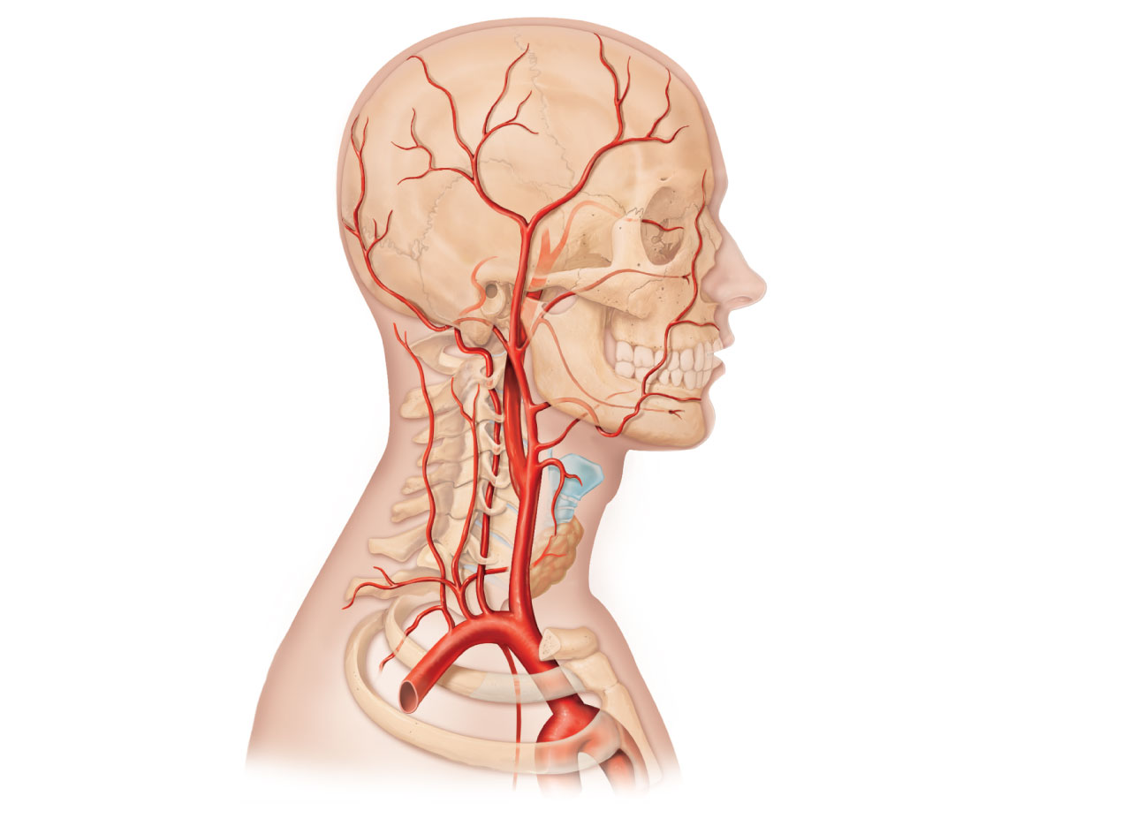
Ophthalmic artery
Basilar artery
Branches of
the external
carotid artery
Vertebral artery
Internal
carotid artery
• Superficial
temporal artery
• Maxillary artery
• Occipital artery
• Facial artery
• Lingual artery
• Superior thyroid
artery
External
carotid artery
Common
carotid artery
Thyrocervical
trunk
Larynx
Costocervical
trunk
Thyroid gland
(overlying trachea)
Subclavian
artery
Clavicle (cut)
Brachiocephalic
trunk
Axillary
artery
Internal thoracic
artery
(b) Arteries of the head and neck, right aspect

Slide 86
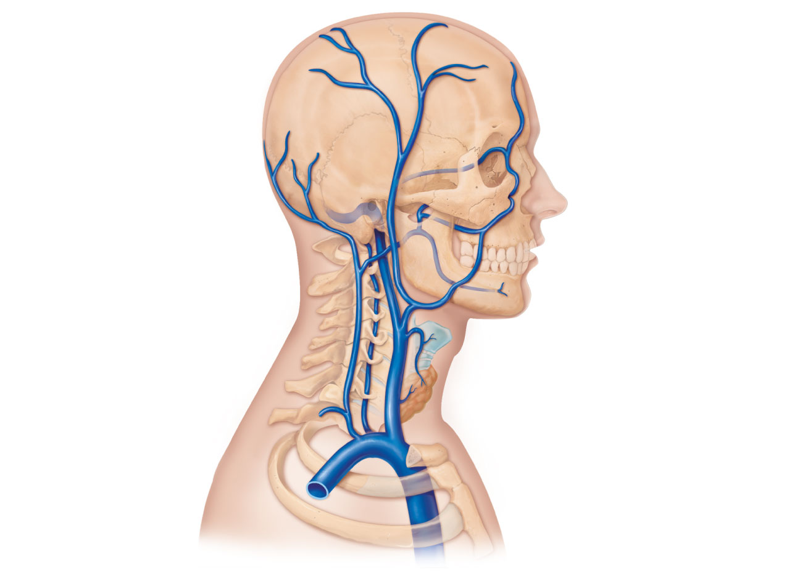
Superficial temporal
vein
Ophthalmic vein
Occipital vein
Posterior
auricular vein
Facial vein
External
jugular vein
Vertebral vein
Internal jugular
vein
Superior and middle
thyroid veins
Brachiocephalic
vein
Subclavian vein
Superior
vena cava
(b) Veins of the head and neck, right superficial aspect

Slide 87
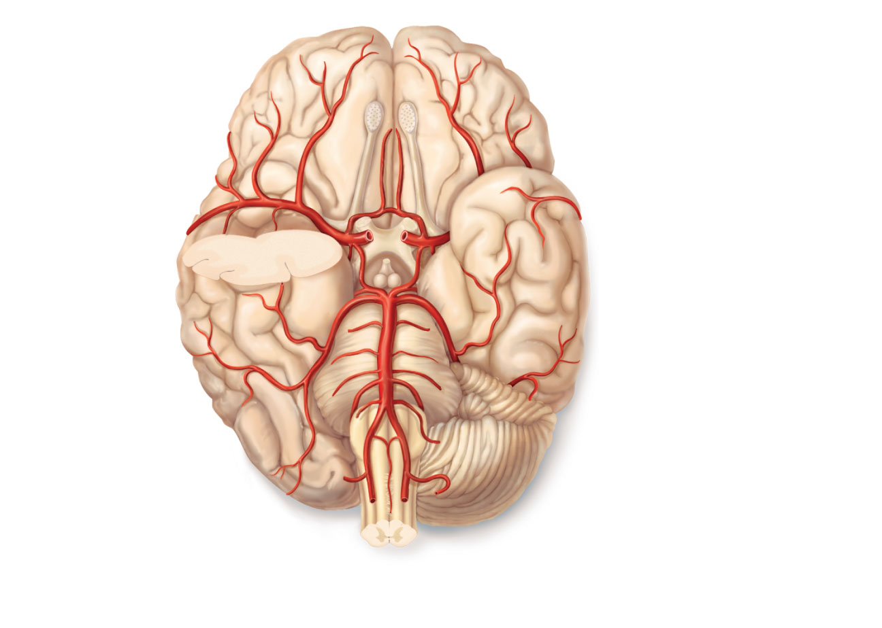
Anterior
Cerebral arterial
circle
(circle of Willis)
Frontal lobe
Optic chiasma
Middle
cerebral
artery
• Anterior
communicating
artery
• Anterior
cerebral artery
Internal
carotid
artery
• Posterior
communicating
artery
Mammillary
body
• Posterior
cerebral artery
Temporal
lobe
Basilar artery
Vertebral artery
Pons
Occipital lobe
Cerebellum
Posterior
(d) Major arteries serving the brain (inferior view, right side
of cerebellum and part of right temporal lobe removed)

Slide 88
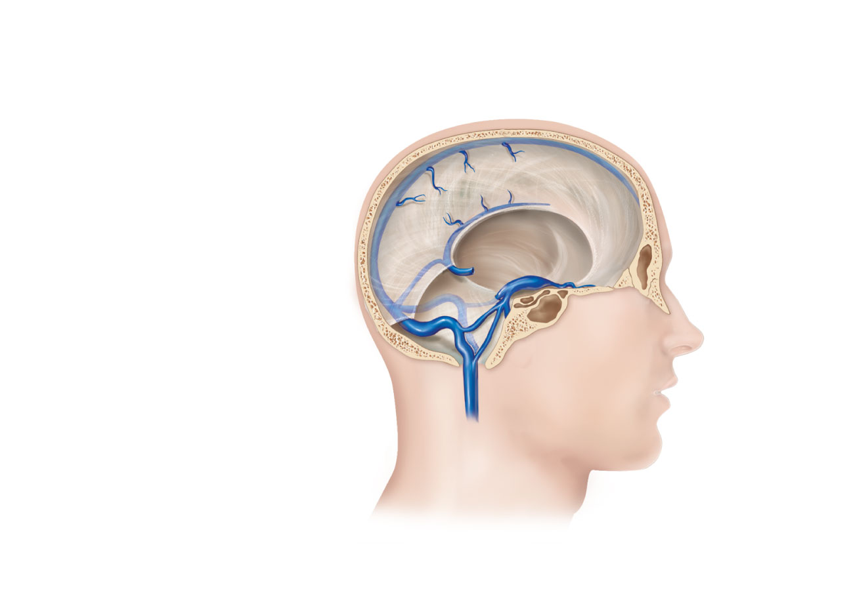
Superior sagittal
sinus
Falx cerebri
Inferior sagittal
sinus
Cavernous
sinus
Straight sinus
Confluence
of sinuses
Transverse
sinuses
Sigmoid sinus
Jugular foramen
Right internal
jugular vein
(c) Dural venous sinuses of the brain

Slide 89
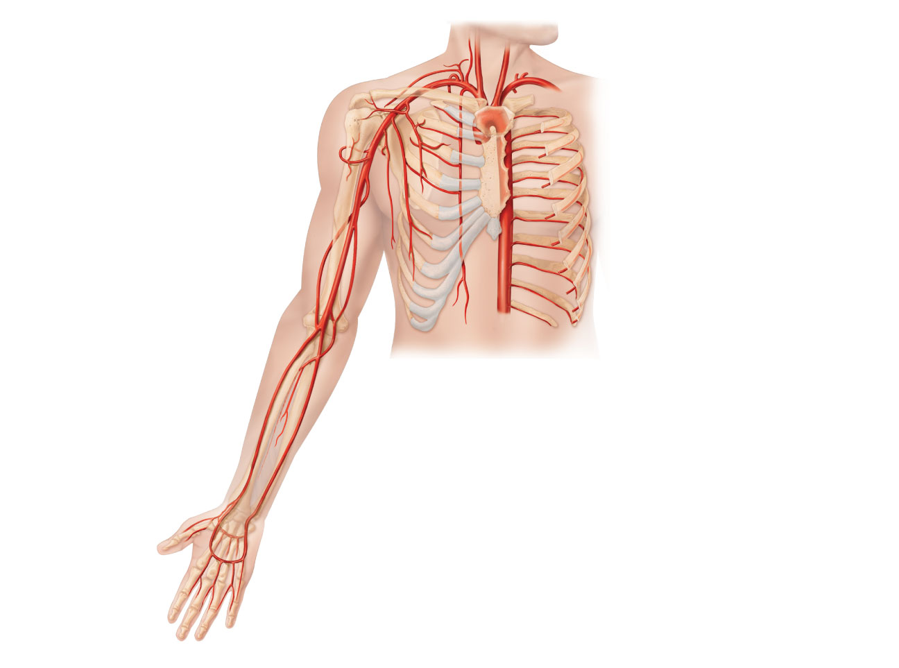
Vertebral artery
Common carotid
arteries
Thyrocervical trunk
Suprascapular artery
Left subclavian artery
Costocervical trunk
Right subclavian artery
Thoracoacromial artery
Brachiocephalic trunk
Axillary artery
Posterior intercostal
arteries
Posterior circumflex
humeral artery
Anterior intercostal
artery
Anterior circumflex
humeral artery
Internal thoracic artery
Subscapular artery
Descending aorta
Brachial artery
Lateral thoracic artery
Deep artery of arm
Radial artery
Common
interosseous
artery
Ulnar artery
Deep palmar arch
Superficial palmar arch
Digital arteries

Slide 90
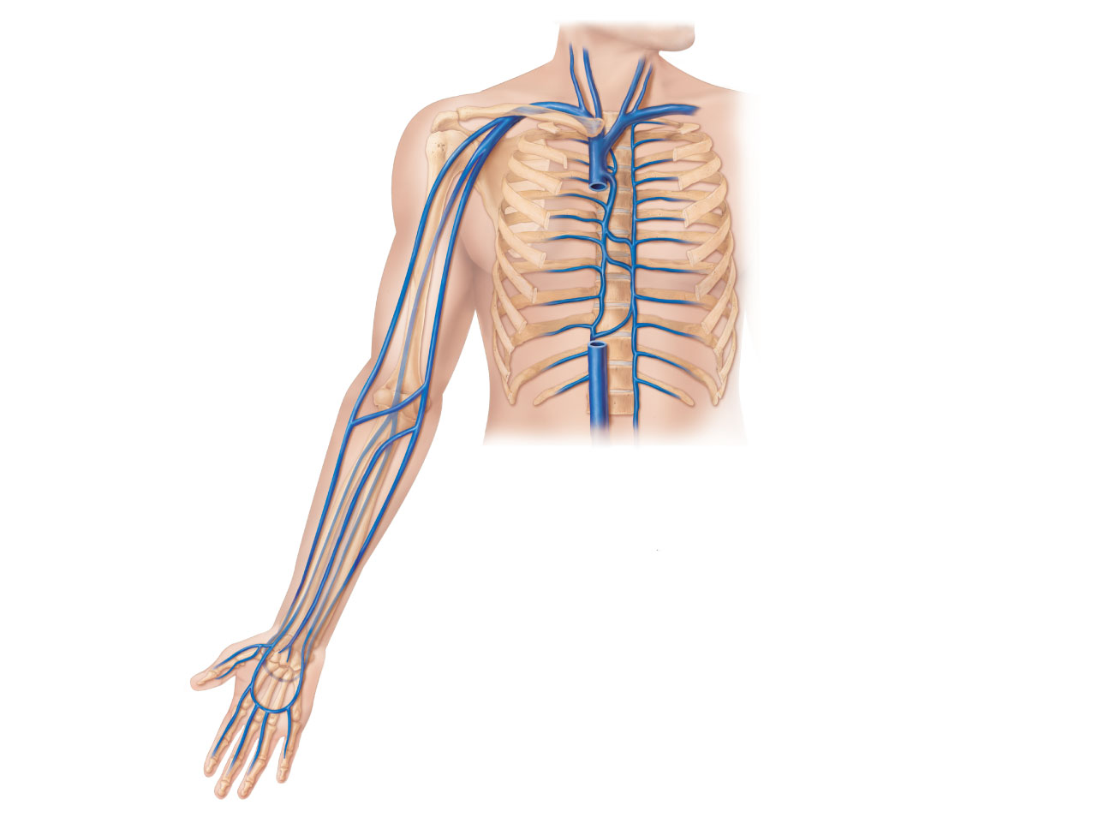
Brachiocephalic veins
Internal jugular vein
Right subclavian vein
External jugular vein
Axillary vein
Left subclavian vein
Brachial vein
Superior vena cava
Cephalic vein
Azygos vein
Basilic vein
Accessory hemiazygos
vein
Hemiazygos vein
Posterior intercostals
Median cubital vein
Inferior vena cava
Ascending lumbar vein
Median antebrachial
vein
Cephalic vein
Basilic vein
Radial vein
Ulnar vein
Deep palmar venous arch
Superficial palmar venous arch
Digital veins
(b) Anterior view

Slide 91
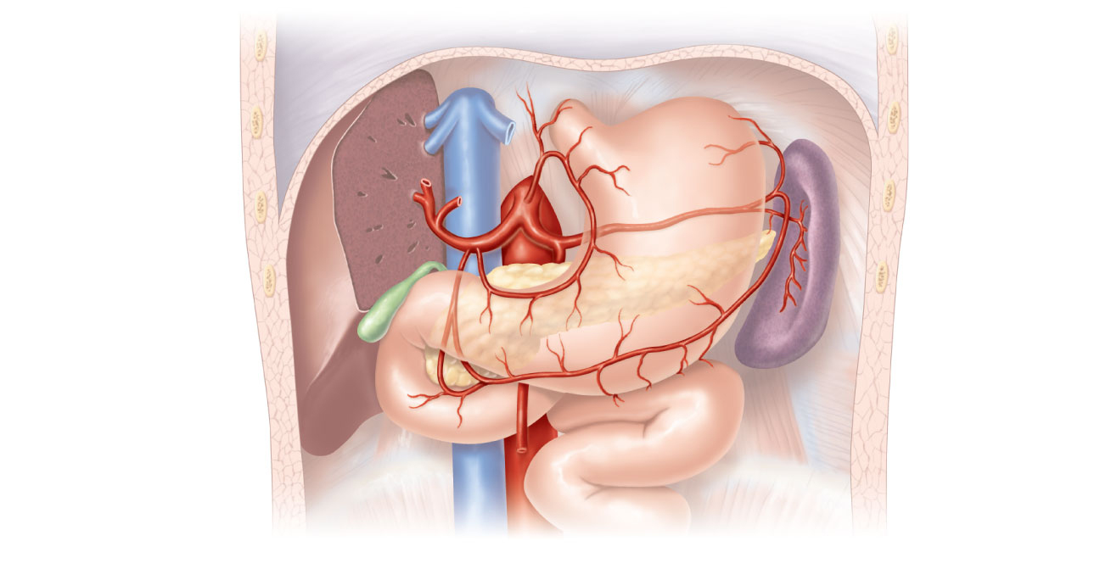
Liver (cut)
Diaphragm
Inferior vena cava
Esophagus
Celiac trunk
Common hepatic
artery
Left gastric
artery
Hepatic artery
proper
Stomach
Splenic artery
Gastroduodenal
artery
Left
gastroepiploic
artery
Right gastric artery
Gallbladder
Spleen
Pancreas
(major portion lies
posterior to stomach)
Right
gastroepiploic
artery
Duodenum
Superior
mesenteric
mesenteric
Abdominal aorta
(b) The celiac trunk and its major branches. The left half of the liver has been removed.

Slide 92
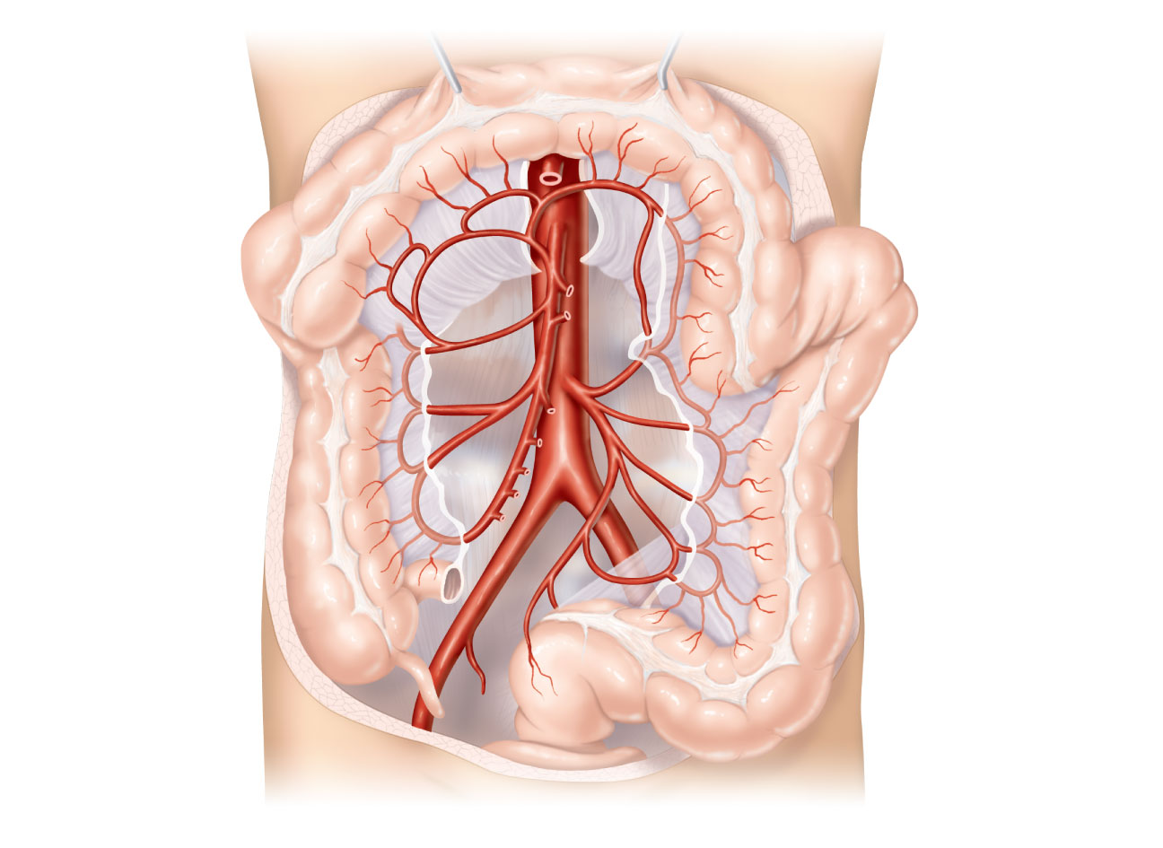
Celiac trunk
Transverse colon
Superior
mesenteric artery
Aorta
Inferior mesenteric
artery
Branches of
the superior
mesenteric artery
Branches of
the inferior
mesenteric
artery
• Middle colic artery
• Intestinal arteries
• Right colic artery
• Left colic artery
• Ileocolic artery
• Sigmoidal arteries
Ascending colon
• Superior rectal
artery
Right common iliac
artery
Descending colon
Ileum
Cecum
Sigmoid colon
Appendix
Rectum
(d) Distribution of the superior and inferior mesenteric arteries.
The transverse colon has been pulled superiorly.

Slide 93
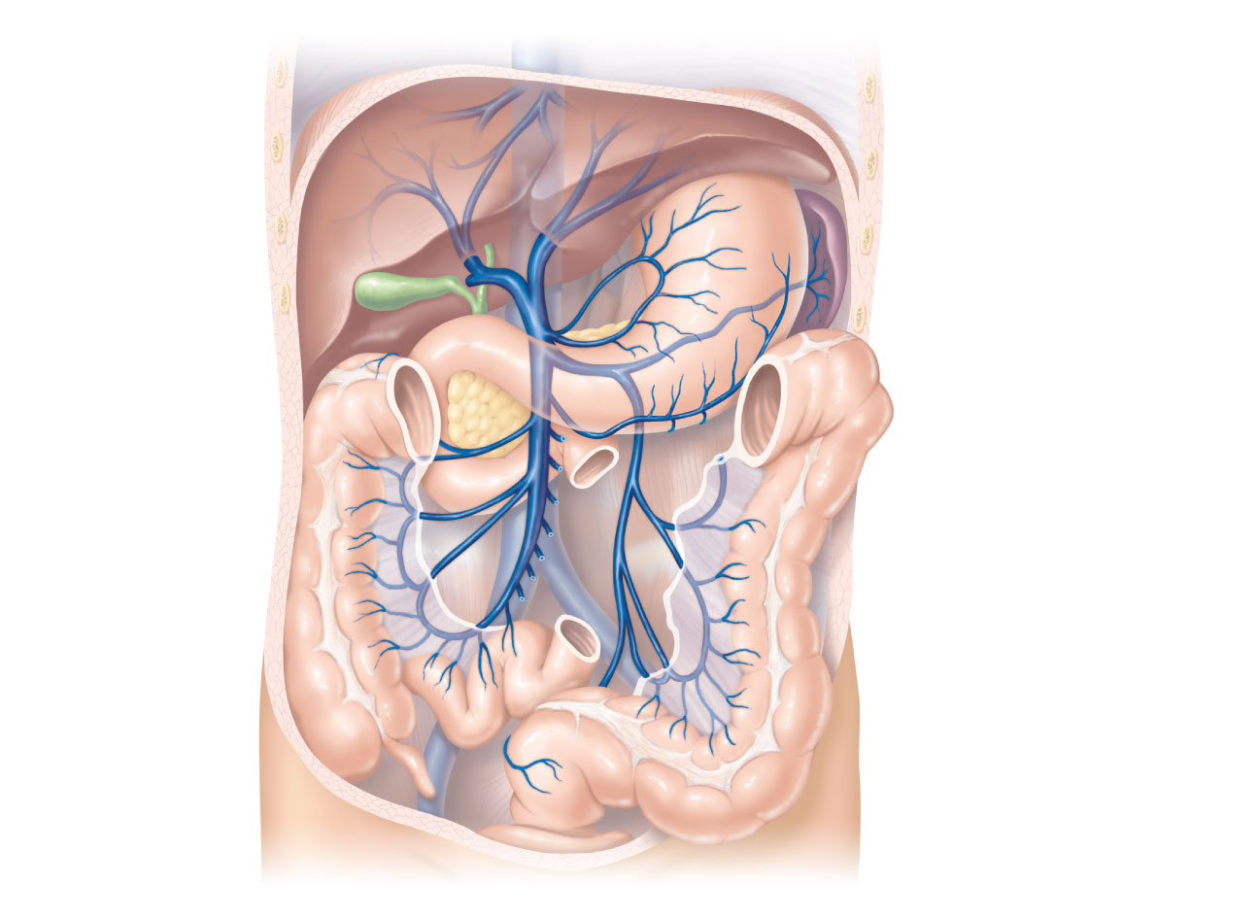
Inferior vena cava
(not part of hepatic
portal system)
Gastric veins
Hepatic veins
Spleen
Inferior vena cava
Liver
Splenic vein
Right gastroepiploic
vein
Hepatic portal
vein
Inferior
mesenteric vein
Superior
mesenteric vein
Small intestine
Large intestine
Rectum

Slide 94
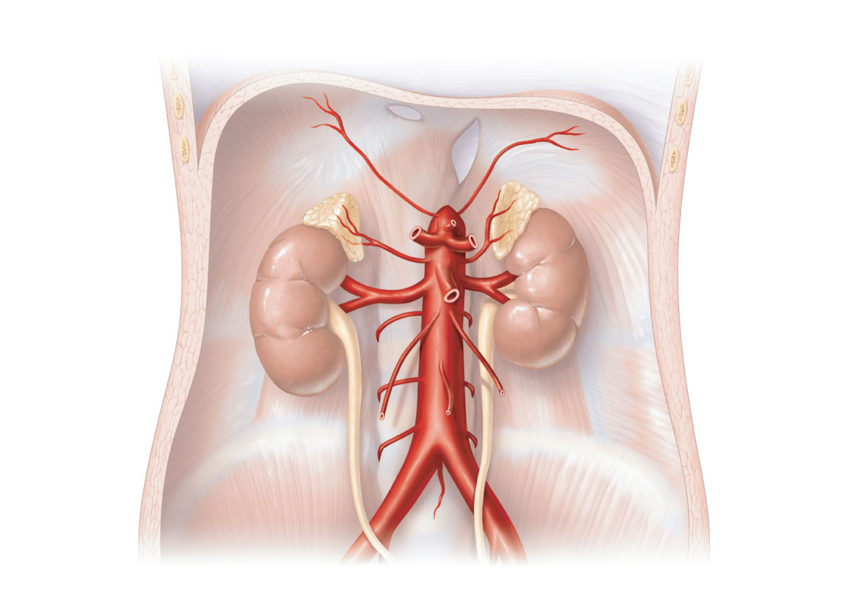
Hiatus (opening)
for inferior
vena cava
Diaphragm
Inferior
phrenic artery
Hiatus (opening)
for esophagus
Middle
suprarenal
artery
Adrenal
(suprarenal)
gland
Renal artery
Kidney
Superior
mesenteric
artery
Celiac trunk
Gonadal
(testicular or
ovarian) artery
Abdominal aorta
Lumbar arteries
Inferior
mesenteric
artery
Ureter
Median sacral
artery
Common
iliac artery
(c) Major branches of the abdominal aorta.

Slide 95
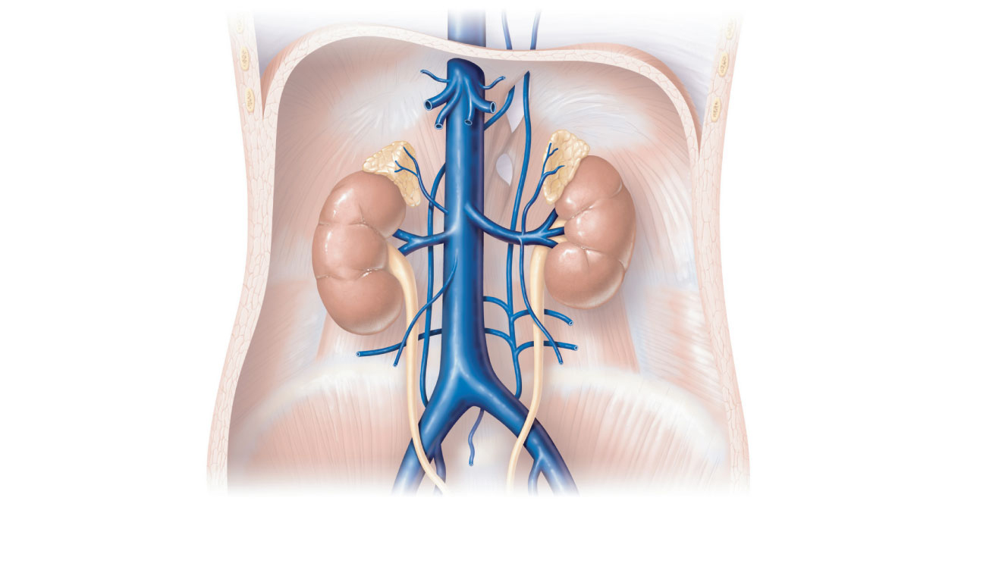
Inferior phrenic
vein
Hepatic veins
Inferior vena cava
Left suprarenal
vein
Right suprarenal
vein
Renal veins
Left ascending
lumbar vein
Right gonadal
vein
Lumbar veins
Left gonadal vein
Common iliac
vein
External iliac
vein
Internal iliac vein
(b) Tributaries of the inferior vena cava. Venous drainage
of abdominal organs not drained by the hepatic portal vein.

Slide 96
Celiac trunk
Transverse colon
Superior
mesenteric artery
Aorta
Inferior mesenteric
artery
Branches of
the superior
mesenteric artery
Branches of
the inferior
mesenteric
artery
• Middle colic artery
• Intestinal arteries
• Right colic artery
• Left colic artery
• Ileocolic artery
• Sigmoidal arteries
Ascending colon
• Superior rectal
artery
Right common iliac
artery
Descending colon
Ileum
Cecum
Sigmoid colon
Appendix
Rectum
(d) Distribution of the superior and inferior mesenteric arteries.
The transverse colon has been pulled superiorly.

Slide 97
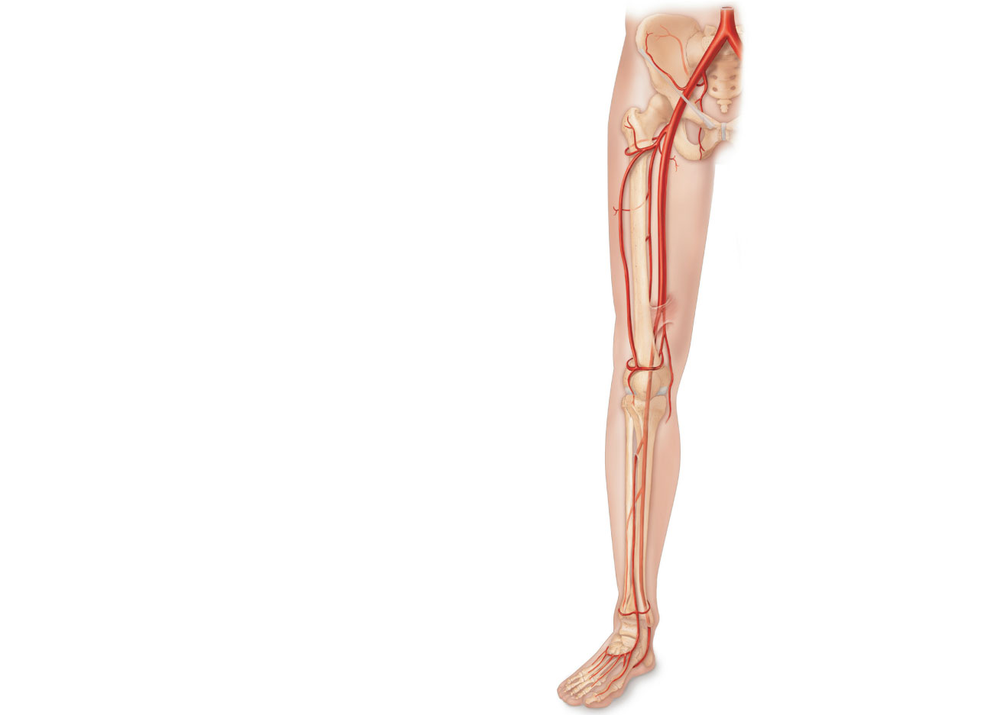
Common iliac artery
Internal iliac artery
Superior gluteal artery
External iliac artery
Deep artery of thigh
Lateral circumflex
femoral artery
Medial circumflex
femoral artery
Obturator artery
Femoral artery
Adductor hiatus
Popliteal artery
Anterior tibial artery
Posterior tibial artery
Fibular artery
Dorsalis pedis artery
Arcuate artery
Dorsal metatarsal
arteries
(b) Anterior view

Slide 98
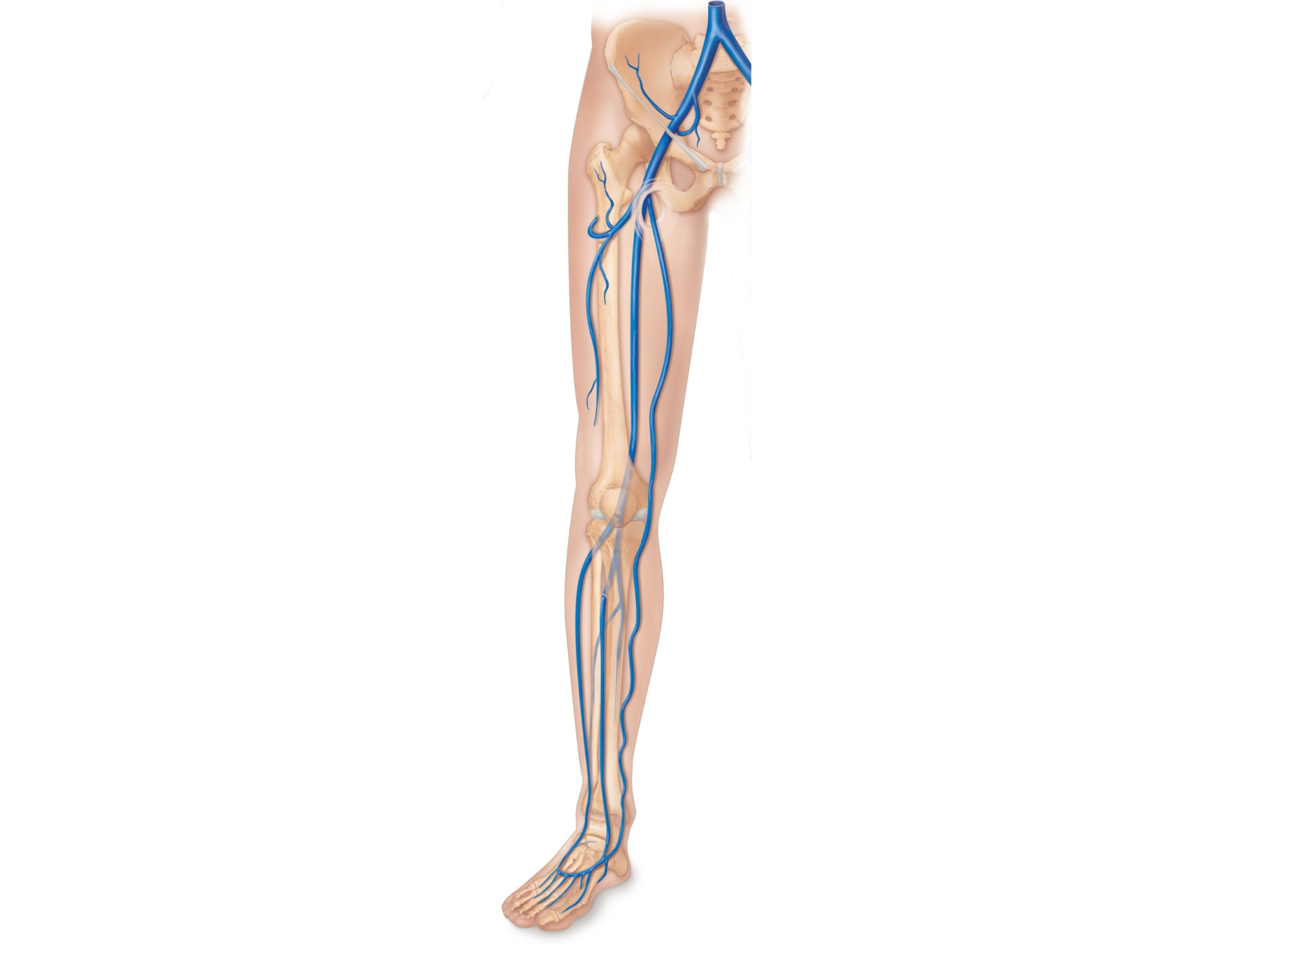
Common iliac vein
Internal iliac vein
External iliac vein
Inguinal ligament
Femoral vein
Great saphenous
vein (superficial)
Popliteal vein
Small saphenous
vein
Fibular vein
Anterior tibial vein
Dorsalis pedis vein
Dorsal venous arch
Dorsal metatarsal
veins
(b) Anterior view

Slide 99
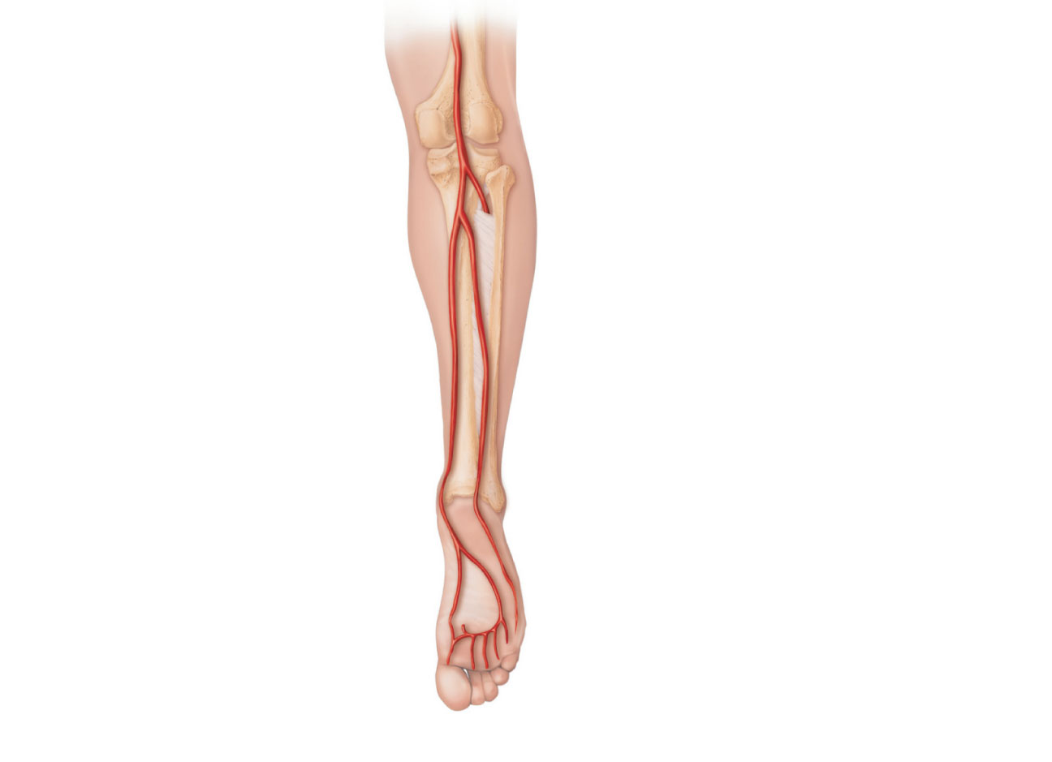
Popliteal artery
Anterior tibial artery
Posterior tibial
artery
Fibular artery
Lateral plantar
artery
Dorsalis pedis artery
(from top of foot)
Medial plantar
artery
Plantar arch
(c) Posterior view
Figure 19.25c

Slide 100
Great saphenous
vein
Popliteal vein
Anterior tibial vein
Fibular vein
Small saphenous
vein (superficial)
Posterior tibial vein
Plantar veins
Deep plantar arch
Digital veins
(c) Posterior view

