Slide 1
The menstrual cycle
Ali Mumbo
Reproductive Health

Slide 2
Objectives
Definition of menstruation
Pre requisites for menstruation
Regulation of menstruation
Ovarian cycle
Phases- Follicular, Luteal
Endometrial cycle- Menses, proliferative, secretory

Slide 3
Menstruation
Menstruation is the cyclic physiologic uterine bleeding due to shedding of the endometrium arising from the interplay of hormones of the HPO axis, adrenals and thyroid gland.
The period extending from the beginning of one period(mens) to the beginning of the next one is called the menstrual cycle

Slide 4
Regulation of menstruation
The normal menstrual cycle is a tightly coordinated cycle of stimulatory and inhibitory effects that results in the release of a single mature oocyte from a pool of primordial oocytes.
It is regulated by the hypothalamus which produces gonadotrophin releasing hormone(GnRH) in pulses and varying amplitudes. The hypothalamus also receives inputs from higher brain centres
GnRH in turn stimulates the pituitary gland to produce follicle stimulating hormone(FSH) and luteinising hormone(LH)

Slide 5
LH and FSH then exert their effects on the ovary to regulate ovarian steroidogenesis mainly of estrogen, progesterone. Inhibin A and inhibin B are also produced in the ovary
These ovarian hormones exert negative and positive feedback on the pituitary and the hypothalamus and produce the characteristic cyclic female genital tract changes

Slide 6
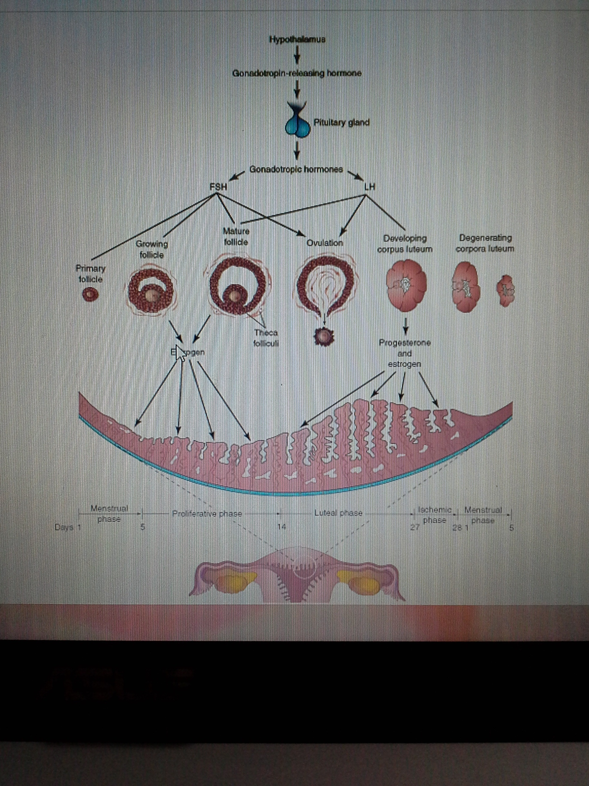

Slide 7
The hormones produced by the ovarian follicles and the corpus luteum produce cyclic changes in the endometrium
Therefore, the endometrium is a mirror of the ovarian cycle because it responds in a consistent manner to the fluctuating concentrations of gonadotropic and ovarian hormones

Slide 8
Prerequisites for menstruation
For menstruation to occur, the following must be present
1. An intact HPO axis
2. Functioning ovaries
3. A responsive endometrium
4. A patent uterovaginal canal
5. A normally functioning thyroid gland

Slide 9
Features of the normal menstrual cycle
The first mens(menarche), occurs at age 8-14 with other pubertal changes.
The normal menses:-
-last 28+/-7 days (14 to 21 days in the follicular phase and 14 days in the luteal phase )
-Duration 2-8 days
- flow of 30-40mls per cycle maximum 80mls
Menstrual discharge consists of: altered blood, mucus, endometrial debri, prostaglandins, enzymes , bacteria

Slide 10
To understand the normal menstrual cycle, it is helpful to divide the cycle into two parts:
The ovarian cycle
The endometrial cycle
NB: Both cycles occurs concurrently as the endometrium mirrors the effects of gonadotropic hormones on the ovaries.

Slide 11
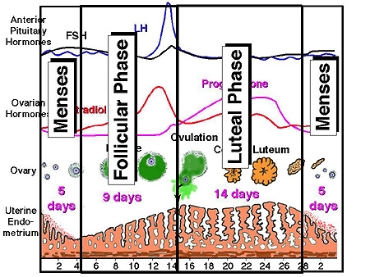

Slide 12
The ovarian cycle
LH and FSH induce cyclic changes in the ovaries
During each cycle, FSH promotes growth of several primordial follicles into 5 to 12 primary follicles.
However, only one primary follicle usually develops into a mature follicle and ruptures through the surface of the ovary, expelling its oocyte

Slide 13
Development of an ovarian follicle
Is characterised by:-
Growth and differentiation of primary follicle
Proliferation of follicular cells
Formation of zona pellucida
Development of theca folliculi

Slide 14
Ovarian cycle: Early Follicular Phase
In early follicular phase, the ovary is the least hormonally active, resulting in low serum estradiol and progesterone concentrations .
Release from the negative feedback effects of estradiol and progesterone results in a late luteal/early follicular phase increase in GnRH pulse frequency and a subsequent increase in serum FSH concentration

Slide 15
Early follicular phase 2
This small increase in FSH secretion results in recruitment of the next cohort of developing follicles, one of which will become the dominant and ultimately ovulatory follicle during that cycle
Serum inhibin B concentrations, secreted by the recruitable pool of small follicles, are maximal at this time and may play a role in suppressing the FSH rise at this time in the cycle

Slide 16
As the primary follicle increases in size, the adjacent connective tissue organizes into a capsule, the theca folliculi.
The theca soon differentiates into two layers
an internal vascular and glandular layer, the theca interna
and a capsule-like layer, the theca externa.
Thecal cells are thought to produce an angiogenesis factor that promotes growth of blood vessels in the theca interna which provide nutritive support for follicular development.

Slide 17
LATE FOLLICULAR PHASE
The serum concentrations of estradiol and inhibin A increase daily during the week before ovulation due to release from the growing follicle
Serum FSH and LH concentrations are falling at this time due to negative feedback effects of estradiol

Slide 18
Late follicular phase 2
As the dominant follicle is selected, FSH induces LH receptors in the ovary and increases ovarian secretion of intrauterine growth factors such as insulin-like growth factor-I (IGF-I)

Slide 19
Ovarian, endometrial, and cervical mucus changes-in late follicular phase
Ovaries: By the late follicular phase, a single dominant follicle has been selected, while the rest of the growing cohort of follicles gradually stop developing and undergo atresia. The dominant follicle increases in size by about 2 mm per day until a mature size of 18 to 20 mm is reached

Slide 20
Rising serum estradiol concentrations result in gradual thickening of the uterine endometrium and an increase in the amount and "stringiness" (Spinnbarkeit) of the cervical mucus.

Slide 21
LUTEAL PHASE: MID-CYCLE SURGE AND OVULATION
Serum estradiol concentrations continue to rise until they reach a peak approximately one day before ovulation then the mid-cycle surge occurs 24-48 hours prior to ovulation.
The surge represents a switch from negative feedback control of LH secretion by ovarian hormones (estradiol and progesterone) to a sudden positive feedback effect, resulting in a 10-fold increase in serum LH concentrations and a smaller rise in serum FSH concentration

Slide 22
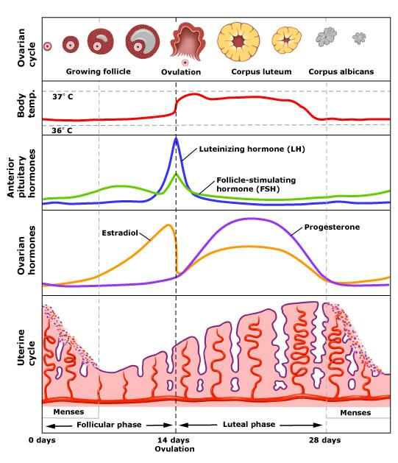
Menstrual cycle-Note the midcycle estradiol and LH, FSH surge

Slide 23
LUTEAL PHASE: MID-CYCLE SURGE AND OVULATION-3
At this time the frequency of LH pulses continues to be approximately one per hour, but the amplitude of the LH pulses increases dramatically.
The LH surge stimulates completion of reduction division of the oocyte and initiates luteinisation of the granulasa cells, synthesis of progesterone and prostaglandins
Progesterone acts rapidly to slow the pulse generator so that LH pulses become less frequent by the termination of the surge.

Slide 24
Ovarian changes-Luteal phase -mid cycle
The oocyte in the dominant follicle completes its first meiotic division
The local secretion of plasminogen activator and other cytokines required for the process of ovulation is increased
The oocyte is released from the follicle at the surface of the ovary approximately 36 hours after the LH surge.

Slide 25
Around mid cycle, the ovarian follicle, under the influence of FSH and LH, undergoes a sudden growth spurt, producing a cystic swelling or bulge on the surface of the ovary.
A small avascular spot, the stigma, soon appears on this swelling. Before ovulation, the secondary oocyte and some cells of the cumulus oophorus detach from the interior of the distended follicle

Slide 26
Ovulation is triggered by a surge of LH production
Ovulation usually follows the LH peak by 12 to 24 hours.
The LH surge, elicited by the high estrogen level in the blood, appears to cause the stigma to balloon out, forming a vesicle .
The stigma soon ruptures, expelling the secondary oocyte with the follicular fluid.
Expulsion of the oocyte is the result of
intrafollicular pressure
contraction of smooth muscle in the theca externa owing to stimulation by prostaglandins.
Enzymatic digestion of the follicular wall seems to be one of the principal mechanisms leading to ovulation.

Slide 27
Growing follicles produce estrogen, a hormone that regulates development and function of the reproductive organs.
The vascular theca interna produces follicular fluid and some estrogen. Its cells also secrete androgens that pass to the follicular cells which, in turn, convert them into estrogen.
Some estrogen is also produced by widely scattered groups of stromal secretory cells, known collectively as the interstitial gland of the ovary

Slide 28
The expelled secondary oocyte is surrounded by the zona pellucida and one or more layers of follicular cells, which are radially arranged as the corona radiata , forming the oocyte-cumulus complex.
The LH surge also seems to induce resumption of the first meiotic division of the primary oocyte. Hence, mature ovarian follicles contain secondary oocytes

Slide 29
Ovarian changes-Luteal phase -mid cycle 2
It then travels down the fallopian tube to the uterine cavity

Slide 30
Shortly after ovulation, the walls of the ovarian follicle and theca folliculi collapse and are thrown into folds.
Under LH influence, they develop into a glandular structure, the corpus luteum, which secretes progesterone and some estrogen, causing the endometrial glands to secrete and prepare the endometrium for implantation of the blastocyst.

Slide 31
If the oocyte is not fertilized, the corpus luteum involutes and degenerates 10 to 12 days after ovulation.
It is then called a corpus luteum of menstruation. The corpus luteum is subsequently transformed into white scar tissue in the ovary, a corpus albicans. Except during pregnancy, ovarian cycles normally persist throughout the reproductive life of women and terminate at menopause

Slide 32
If the oocyte is fertilized, the corpus luteum enlarges to form a corpus luteum of pregnancy and increases its hormone production.
Degeneration of the corpus luteum is prevented by human chorionic gonadotropin, a hormone secreted by the syncytiotrophoblast of the blastocyst

Slide 33
Endometrium-changes-Luteal phase -mid cycle
increasing serum progesterone concentrations -cessation of mitoses and "organization" of the glands

Slide 34
MIDDLE TO LATE LUTEAL PHASE
Progesterone secretion from the corpus luteum results in gradually rising progesterone concentrations in the middle to late luteal phase.
This leads to progressive slowing of LH pulses down to one pulse every four hours
A gradual decrease in LH secretion results in a gradual fall in progesterone and estradiol production by the corpus luteum in the absence of a fertilized oocyte.

Slide 35
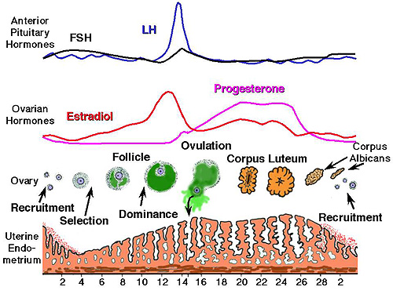

Slide 36
Endometrial changes in late luteal phase
The decline in estradiol and progesterone release from the resolving corpus luteum results sequentially in the loss of endometrial blood supply, endometrial sloughing, and the onset of menses approximately 14 days after the LH surge

Slide 37
In response to falling corpus luteum steroid production, the hypothalamic-pituitary axis is released from negative feedback and FSH levels rise, thereby beginning the next cycle

Slide 38
Phases of the menstrual cycle
The changes in estrogen and progesterone levels cause cyclic changes in the structure of the female reproductive tract, notably the endometrium. These changes are divided into 3 phases:-
The menstrual phase
The proliferative(follicular, estrogenic ) phase
Luteal(Secretory, Progesterone phase)

Slide 39
Menstrual Phase
The functional layer of the uterine wall is shed off and discarded with mentrual flow
Usually lasts 4-5 days
After menstruation, the eroded endometrium is thin

Slide 40
Proliferative(follicular Phase)
Lasts about 9 days
Coincides with growth of ovarian follicles and is controlled by the estrogen produced by these follicles
There is a 2 to 3 fold ^ in the thickness of the endometium and in its water content
The surface epithelium reforms and covers the endometrium
The glands increase in number and the spiral arterioles elongate

Slide 41
Luteal phase(secretory)
Coincides with the formation, functioning and growth of the corpus lueum
The progesterone produced by the corpus luteum stimulates the endometrium to secrete glycogen rich material
The glands become wide, tortuous, saccular and the endometrium thickens because of the influence of progesterone and estrogen from the corpus luteum

Slide 42
As the spiral arteries grow into the upper compact superficial layer, they become increasingly coiled
The venous network becomes complex and large lacunae(venous spaces) develop

Slide 43
If fertilization does not occur
The corpus luteum degenerates
Estrogen and progesterone levels fall and the secretory endometrium enters an ischaemic phase( a phase of reduced blood flow)
Menstruation occurs

Slide 44
The ischaemic phase occurs as the spiral arteries constrict due to progesterone withdrawal
In addition to vascular changes the hormone withdrawal also results in:-
Stopage of glandular secretion
Loss of interstitial fluid
Shrinkage of the endometrium
This results in venous stasis and patchy ischaemic necrosis in the suprficial tissues

Slide 45
Eventually, rupture of damaged blood vessel walls follows and blood seeps into the surrounding connective tissues
Small pools of blood form and break through the endometrial surface, and flow out with small pieces of detached endometrium.

Slide 46
If fertilization occurs
Cleavage of the zygote and formation of the blastocyct occur
The blastocyst begins to implant in the endometrium on approximately the sixth day of the luteal phase(day 20 of a 28-day cycle)
Human chorionic gonadotrophin, a hormone produced by syncytiotrophoblast, keeps the corpus luteum secreting estrogens andprogesterone
The luteal phase continues and menstruation does not occur

Slide 47
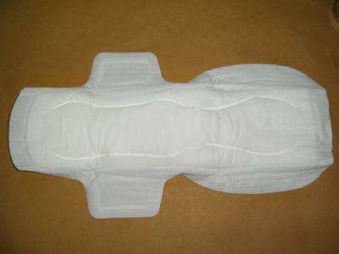
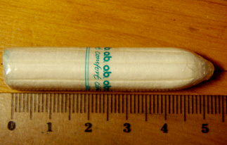

Slide 48
Menstrual disorders

Slide 49
Absence of menses (by age 13 for girls, in reproductive age women who are not pregnant or are not breastfeeding)
Too heavy, prolonged menses
Painful menses (Dysmenorhoea)
Too frequent menses
Anovulatory menstrual cycles

Slide 50
The end!
Questions?
Thank you

