Slide 1
THE NERVOUS SYSTEM
Samuel Ngigi K.

Slide 2
MODULE OUTLINE
UNIT 1 - Introduction, Brain and Spinal Cord
Organization and structure of the nervous systems
The Neurones and Nerve Impulse transmission; Neurotransmitters
Cerebral blood flow; Blood Brain barrier, the meninges and CSF
The Brain – structure and function, metabolism
The Spinal cord, spinal nerves and reflexes
Peripheral nerves

Slide 3
Cont.
UNIT 2 – Sensory Neurophysiology
Sensory receptors – types and functions
Somatic sensation – pain, thermal, tactile and position
Hearing and balance
Vision and taste
Smell and skin

Slide 4
Cont.
UNIT 3 – Motor and Integrative Physiology
States of brain activity
Motor and Integrative functions of the brain
Cortical control of motor functions
Intellectual functions – learning and memory
Behavioural and motivational mechanisms
Locomotion

Slide 5
Intro.
The nervous system and the endocrine system provide the body with the capacity to maintain a homeostatic environment through mechanisms of monitoring changes within the body and responding appropriately.
These processes involve communication, control and integration achieved via anatomic structures and functional mechanisms.
The nervous system is the most complex body system whose working determines our personality, intelligence and skills.

Slide 6
Cont.
It has specialized properties of irritability, conduction and integration.
Irritability is the ability to receive and respond to stimuli from internal and external environments.
Conductivity is the ability to transmit signals to and from the central integrating centres.
Integration is the ability to analyse information from the environment so as to generate behaviour that is appropriate to that information.

Slide 7
Cont.
The nervous system develops from a few primitive cells called neuroectoderm that divides to form a hollow fluid-filled tube called the neural tube and the neural crest.
This takes place during the 1st three weeks of embryology.
Within the 1st two months part of the neural tube develops into the primitive brain

Slide 8
Cont.
NERVES AND TRACKS (FIBRES)
A nerve is a bundle of peripheral nerve fibres outside the CNS held together by several layers of connective tissue and glial cells.
A delicate layer of fibrous tissue endoneurium surrounds an individual nerve fibre.
The bundles of fibres (called fasciculus) are held together by a connective tissue called perineurium.
The entire nerve is surrounded and supported by connective tissue called epineurium.

Slide 9
Cont.
Most nerves are composed of both motor and sensory fibres (mixed nerves) however, others e.g. some cranial nerves that contain only sensory processes for example those serving special senses of sight, hearing and smell.
Classification of Nerve Fibres
The nerve fibres are classified depending on structure, distribution, source of origin, function, chemical transmitter and diameter and conduction.

Slide 10
Cont.
1. Structural classification
Myelinated nerve fibres
Non-myelinated nerve fibres
2. Distribution
Somatic nerve fibres – supply skeletal muscles of the body
Visceral or autonomic – supply various organs of the body
3. Source of Origin
Cranial nerves – arise from the brain
Spinal nerves - arise from the spinal cord

Slide 11
Cont.
4. Function
Motor nerve fibres
Sensory nerve fibres
5. Chemical Neurotransmitter
Adrenergic nerve fibres
Cholinergic nerve fibres
6. Diameter and Conduction
The nerves are classified into 3 major types based on the thickness of the fibres and the rate of impulse conduction.
The velocity of impulse transmission through a nerve fibre is directly proportional to the thickness of the fibres.

Slide 12
Cont.
DIVISION OF NERVOUS SYSTEM
Central Nervous system (CNS)
The Brain
Spinal cord
Peripheral Nervous system (PNS)
Sensory (Afferent) nervous system
Motor (Efferent) nervous system
Somatic nervous system
Autonomic nervous system (ANS)
Sympathetic nervous system
Parasympathetic nervous system

Slide 13
Nervous System
Central Nervous System (CNS) Peripheral Nervous System (PNS)
Brain Spinal Cord Motor System Sensory system
Autonomic System Somatic System
Sympathetic System Parasympathetic System

Slide 14
Cont.
The nervous system is made up of two types of cells namely the neurones and neuroglia (glial cells).
There are 100 billion neurones and 10 – 50 times the number of glial cells in the CNS.

Slide 15
Cells of the nervous system?
NEURONES
GLIAL CELLS
ASTROCYTES
PROTOPLASMIC
FIBROUS
EPENDYMAL
MICROGLIAL
OLIGODENDROCYTES
SCHWANN
NEUROSATELITE CELLS

Slide 16
Cont.
1. NEURONES
The neurone is the basic functional unit of the central nervous system.
Neurones are excitable cells that conduct impulses making the nervous system functions possible as they make up the wiring of the body’s information circuit.
There are approximately 100 billion neurones in the body accounting for 10 - 20% of the nervous system cells.

Slide 17
Cont.
Neurones are specialized cells that respond to chemical and physical stimuli, conduct electrochemical impulses and release chemical regulators that are specific in function.
These characteristics enable the neurones perform functions such as perception of stimuli, learning, memory and control of muscle in glands.

Slide 18
Cont.
Structure of a Neurone
The neurone has three principal parts namely the cell body , dendrites and axon.
1. The Cell Body/soma
Cell body is the enlarged portion of the neurone containing a nucleus, cytoplasm and organelles (mitochondria and golgi apparatus) and serves as a nutritional centre.

Slide 19
Cont.
2. Dendrites
Dendrites are twig-like extensions or processes projecting from the cell body.
Dendrites receive inputs from other neurones and conduct impulses to the cell body.
They have many branches or projections increasing their receptor surface.

Slide 20
Cont.
The distal ends of dendrites of sensory cells are called receptor cells.
Each neurone has 5 –7 processes arising from the cell body and branching out extensively especially in the cerebral and cerebella cortex.

Slide 21
Cont.
3. The Axon (Nerve Fibres)
This is a single long process of varying diameter (1 um – 20 um) and length (few mm – 1 metre) originating from a thickened portion of the cell body called the axon hillock extending the target cells.
Axons conduct nerve impulses away from the cell body.
The axon has two segments namely the initial segment (trigger zone) and the main axon that has collateral and terminal axons.

Slide 22
Cont.
Axons may be covered by a fatty membranous sheath called the myelin sheath (myelinated) or may not (unmyelinated).
The myelin sheath speeds up conduction of electric signals along the axon conserving energy.
The axons have nodes of Ranvier which are spaces between adjacent myelin forming cells.

Slide 23
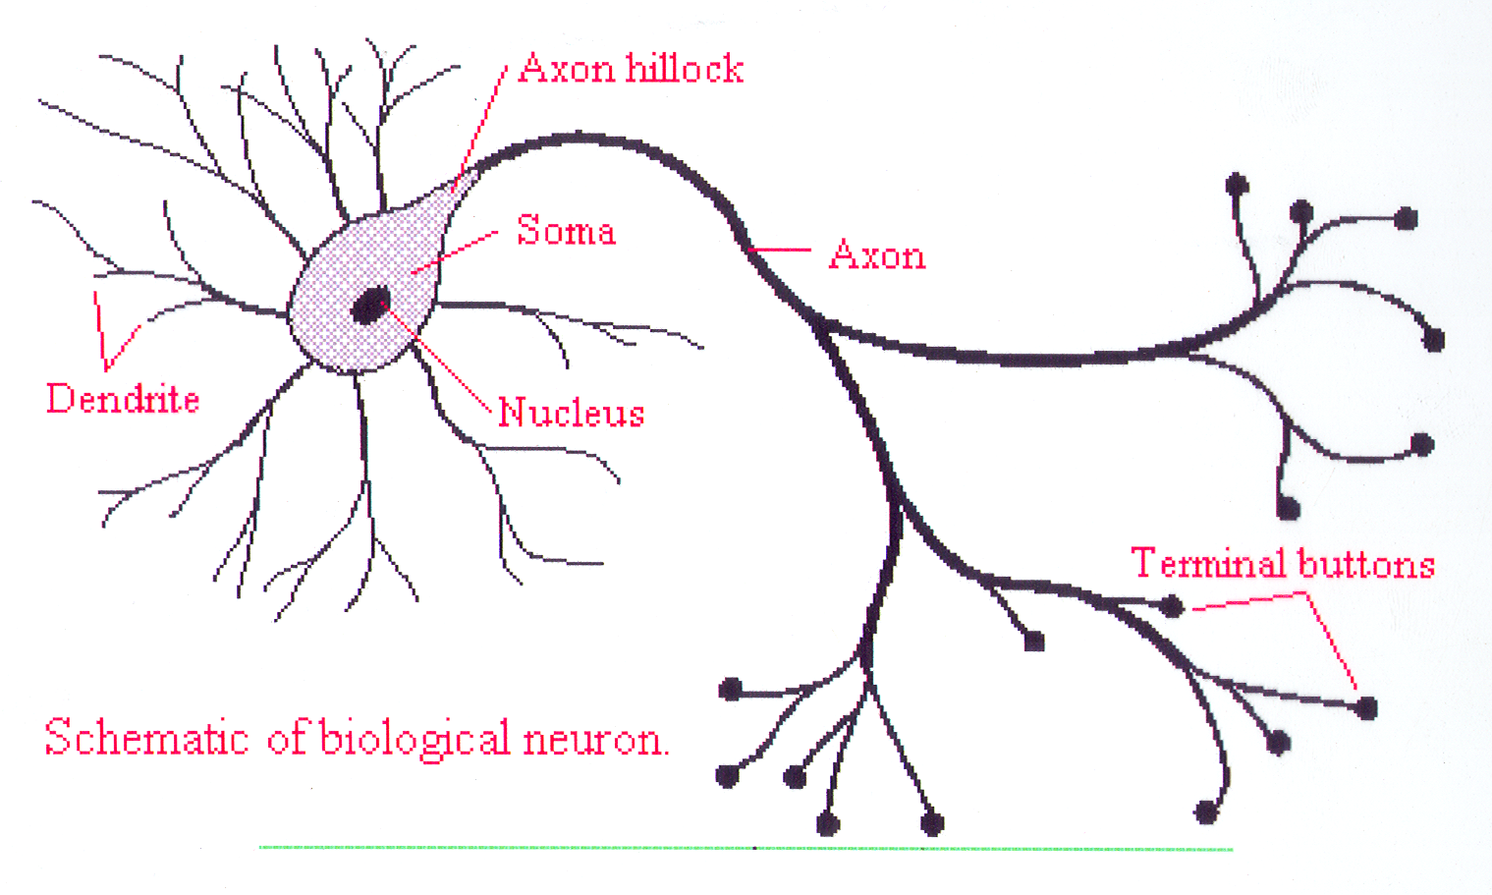

Slide 24
NEURON
Schematic diagram of an idealized neuron and its major components. Most afferent input from axons of other cells terminates in synapses on the dendrites (d), although some may terminate on the soma (S). Excitatory terminals tend to terminate more distally on dendrites than do inhibitory ones, which often terminate on the soma

Slide 25
Cont.
CLASSIFICATION OF NEURONES
Can be functional or structural
Functional classification – Based on the function of the neurone
Sensory (Afferent) neurones
Motor (Efferent) neurones
Interneurones (Association neurones)

Slide 26
Cont.
Functionally
A. Sensory (Afferent) Neurones
Sensory neurones are mainly outside the central nervous system and transit nerve impulses from receptors at the peripheral endings to the brain or spinal cord.
They have only short central processes of their axons entering the CNS.
They have no dendrites.

Slide 27
Cont.
B. Motor (Efferent) Neurones
Motor neurones are mainly found in the central nervous system where their cell body, dendrites and small segments of their axons are found but most of the axons remain outside the CNS.
They transmit information or nerve impulses out of the CNS to efferent cells in the muscles, glands and other neurones.
There are two types of motor neurons: - the somatic motor neurons and autonomic motor neurons.

Slide 28
Cont.
The somatic motor neurons provide reflex and voluntary control of skeletal muscles while the autonomic motor neurons innervate involuntary effectors such as the smooth muscles, cardiac muscle and glands.
Autonomic motor neurones together with their central control centres form the autonomic nervous system

Slide 29
Cont.
C. Interneurones
Interneurones, which are exclusively located in the brain and spinal cord (CNS) account for 99% of all neurones function as integrators and signal changers because they integrate groups of afferent and efferent neurones into complex circuits.

Slide 30
Cont.
Structural – based on the number of processes extending from the cell body
Multipolar
Bipolar
Pseudounipolar

Slide 31
Cont.
Structurally
A. Bipolar Neurones
Bipolar neurons have two processes at either ends of the cell body - one axon & one dendrite.
These neurons are also sensory.
For example, biopolar neurons can be found in the retina of the eye.

Slide 32
Cont.
B. Multipolar Neurones
Multipolar neurons are so-named because they have many processes that extend from the cell body: lots of dendrites plus a single axon.
Functionally, these neurons are either motor (conducting impulses that will cause activity such as the contraction of muscles) or association (conducting impulses and permitting 'communication' between neurons within the central nervous system).

Slide 33
Cont.
C. Unipolar Neurones
Unipolar neurons have one process from the cell body.
However, that single, very short, process splits into longer processes (a dendrite plus an axon).
Unipolar neurons are sensory neurons - conducting impulses into the central nervous system.
Most sensory neurones are unipolar.

Slide 34
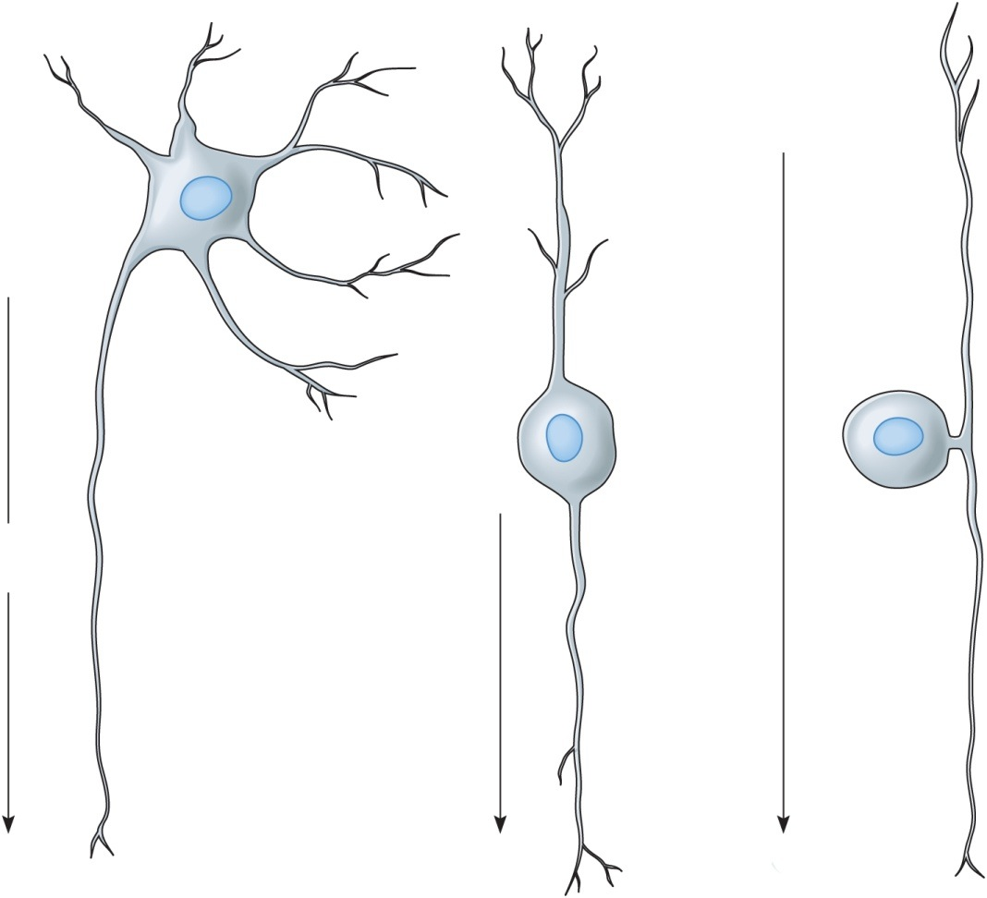
Classification of Neurons: Structural Differences
Bipolar neurons
Two processes
Eyes, ears, nose
Copyright © The McGraw-Hill Companies, Inc. Permission required for reproduction or display.
Dendrites
Unipolar neurons
One process
Ganglia of PNS
Sensory
Peripheral
process
Multipolar neurons
99% of neurons
Many processes
Most neurons of CNS
Axon
Direction
of impulse
Central
process
Axon
Axon
(a) Multipolar
(b) Bipolar
27
(c) Unipolar

Slide 35
Cont.
NEUROGLIA OR GLIAL CELLS
Glial cells are the cells that support the neurones physically and metabolically and form the bulk of the cells in the CNS accounting for 80 – 90%.
Neurones branch more extensively than the glial cells and occupy 50% of the volume of the brain and spinal cord.
Neuroglia or glial cells are cells that offer support functions and they do not conduct impulses.

Slide 36
Cont.
Neuroglia
Astroglia (astrocytes)
Oligodendroglia (oligodendrocytes)
Microglia
Schwann cells
Ependyma
Satellite cells

Slide 37
Cont.
1. Astrocytes
Astrocytes are star-shaped cells, which are the largest, and most numerous cells found throughout the CNS.
They regulate the composition of the ECF in the CNS by removing potassium ions and neurotransmitters around synapses as well as providing glucose to the cells and removing ammonia.

Slide 38
Cont.
2. Oligodendrocytes
These are fewer and smaller in size.
They hold nerve fibres together and form myelin.
3. Microglia
These are small stationary cells that enlarge in inflamed or degenerating brain tissue.
They are phagocytic cells that destroy microbes and cellular debris and facilitate immune functions in the CNS.

Slide 39
Cont.
4. Schwann Cells
Schwann cells are found only in the peripheral nervous system where they hold nerve fibres together and form myelin.
5. Ependyma Cells
Ependyma cells resemble epithelial cells and line fluid filled cavities in the brain ventricles and spinal cord where they take part in fluid production.
Some have cilia that keep the fluid moving.

Slide 40
Cont.
LEVELS OF NERVOUS SYSTEM FUNCTION
There are three major levels of nervous system function namely the spinal cord level, lower brain (sub cortical) and higher brain (cortical) levels.
A. Higher Brain (Cortical)
The higher brain is a large memory storehouse that functions in association with all other levels and parts of the nervous system.
It is the powerhouse where though processes (thinking machinery) are carried out.

Slide 41
Cont.
B. Lower Brain (Sub cortical) Level
The lower brain (sub cortical) controls the subconscious activities.
It is made up of the medulla, pons, mesencephalon, hypothalamus, thalamus, cerebellum and basal ganglia.
It controls arterial pressure and respiration, equilibrium, feeding reflexes and emotional patterns.

Slide 42
Cont.
C. Spinal Cord Level
The spinal cord is for transmission of signals from the periphery to the central parts of the nervous system and also perfomes spinal cord functions such as controlling walking movements and reflex actions for withdrawal of body parts from obnoxious stimuli, body support against gravity, control of local blood vessels and G.I.T movements and urinary secretion.

Slide 43
PRINCIPLES OF NERVOUS FUNCTION
At the end of the lesson the learner should be competent to: -
Describe the process of nerve impulse generation and conduction
Describe the process of generation of the resting membrane and action potential
Describe the structure of synapses
Classify synapses
Explain how synapses transmit impulses
Classify neurotransmitters
Explain how neurotransmitters work

Slide 44
Cont.
NERVE IMPULSE GENERATION
The extracellular fluid (ECF) and intracellular fluid (ICF) contain both positively and negatively charged compounds whose distribution around the cell’s plasma membrane creates an electrical phenomenon that plays a significant role in cell function and nerve transmission of impulses or signals.
Nerve impulses form the basis by which communication of information is transmitted in the nervous system.
Separated electric charges of opposite electrical sign i.e. the negative and positive, have the potential of doing work when allowed to come together.

Slide 45
Cont.
This potential is called electric potential or potential difference that is simply referred to as potential.
The units of measuring the electric potential are volts (V) and since the potential difference in many biological systems is very small it is usually measured in millivolts (mV) where 1 mV is equivalent to 0.001V.
Movement of the electric charge is called a current (I) and is determined by the electric force between the charges.

Slide 46
Cont.
The current depends on the electric potential (E) which is measured in voltage and the nature of the material through which the current passes through.
Hindrance to movement of electric charge is called resistance (R).
The relationship between current (I), electric potential (E) and resistance (R) is summed up in the Ohm’s Law.
Ohm’s Law
Current, I (amperes) = Potential difference, E (volts)
Resistance, R (ohms)

Slide 47
Cont.
Materials with a high resistance to movement of an electrical charge are called insulators e.g. lipids in the body and those with low resistance are called conductors e.g. water, ECF and ICF.
Neurones exhibit excitability and conductivity because they have a low threshold for excitation by stimuli such as electrical, chemical or mechanical and hence initiate and conduct signals called nerve impulses.

Slide 48
Cont.
MEMBRANES POTENTIALS
All living cells including neurones maintain a difference in concentration of ions across their membranes with a small excess of positive ions on the outside of the membrane and a small excess of negative ions on the inside.
This creates a difference in electrical charge across the plasma membrane called the membrane potential.
The opposite electrical charges (ions) are separated by a membrane and have the potential to move towards one another when allowed to cross the membrane.

Slide 49
Cont.
A membrane that exhibits a membrane potential is described as being polarised because it has a negative and positive poles.
For example a voltage of –70 mV means that the potential difference is 70 mV and that the inside of the cell is negative with respect to the outside and a value of +30 mV indicates a potential difference of 30 mV with the inside of the membrane being positive with respect to the outside (which is negative)

Slide 50
Cont.
Resting Membrane Potential (RMP)
Membranes are polarized that they exhibit a resting membrane potential (RMP).
RPM is the potential difference exhibited by all cells under resting conditions resulting from the difference in electrical charge across the membrane with the inside of the cell being negatively charged and the outside is positively charged.
This imbalance is achieved by ion transport mechanisms in the plasma membrane of the neurones.

Slide 51
Cont.
It is called resting membrane potential because it occurs when the membrane is not being stimulated or conducting impulses (its resting).
RMP varies from –5 mV to –100 mV depending on the type of cell but in the neurones it is –40 mV to –75 mV and can change rapidly in response to stimulation.
The magnitude of RMP is determined by the difference in concentration of the specific ions in ECF and ICF and membrane permeability to different ions.

Slide 52
Cont.
Local Potentials
In the neurones, membrane potentials can fluctuate above and below RMP in response to certain stimuli.
A slight shift away from RMP in a specific region of the plasma membrane is called a local potential because they are isolated to a particular region of the plasma membrane.
Excitation of the neurone occurs when a stimulus triggers the opening of more sodium channels allowing more Na⁺ to enter the cell reducing the number of positive ions on the outside.

Slide 53
Cont.
Equilibrium potential
Is when membrane potential at which two fluxes become equal in magnitude but opposite in direction hence there is no net movement of the ions involved.
It varies in magnitude and direction for different ions.

Slide 54
Cont.
Action Potential
Action potential is the membrane potential of an active neurone that has been stimulated and is conducting an impulse.
It is a very rapid change in membrane potential that occurs when the nerve cell membrane is stimulated.
The membrane potential goes from the RMP of -70 mV to some positive value usually +30 mV in a very short period of time.

Slide 55
Cont.
Generation of Action Potential
A. Depolarization
A stimulus causes the sodium channels (gates) to open.
This allows rapid diffusion of the many sodium ions into the nerve cell because of the concentration gradient.
All these positively charged sodium ions rushing in causes the membrane potential to be positive (inside is more positive than the outside).
Sodium channels just open briefly and close.

Slide 56
Cont.
B. Repolarization
The potassium channels then open and because there is more potassium inside the membrane than outside, positively charged potassium ions diffuse out.
As these positive ions move out, the inside of the membrane becomes negative with respect to the outside. This is described as repolarization.

Slide 57
Cont.
C. Hyperpolarization
This is a brief period of temporary increased K movement causing a brief state of hyperpolarization the resting membrane potential is restored by the Na/K pump and return of the channels to their resting states.
D. Depolarisation
Stimulus triggers Na+ channels to open and allow diffusion of Na+ into the cell

Slide 58
Cont.
Threshold potential
This is the firing level which is achieved by further depolarisation with increased diffusion of Na+ into the cell as more channels are opened
Ionic exchange
A sequence of ionic exchange occurs along the axon.
Ions move relatively free within the cell and within the interstitial fluid attracted by positive charges and repelled by those that are the same.

Slide 59
Cont.
Inside the cell K⁺ ions tend to move away from depolarised sites whereas Cl⁻ ions (negatively charged) tend to be drawn towards it.
This reduces the voltage of neighbouring sites from the resting level of –70 mV opening up voltage-gated Na channels.
When the drop is enough to reach threshold membrane permeability the sodium increases and an action potential is generated.
This is transmitted to other sites, which become activated.

Slide 60
Cont.
All or Nothing Law
All-or-nothing law - action potential occur maximally or not at all.
There is no such a thing as a partial or weak action potential.
Either the threshold is reached and action potential occurs or it is not reached and no action potential occurs.
Once a region of the axon membrane has been depolarised to a threshold value the positive feedback effect causes membrane potential to shoot to about +40 mV irrespective of the length of time the Na and K gates remain open, as this is independent of the strength of the depolarising stimuli.

Slide 61
Cont.
Refractory Period
This is a brief period during which a local area of a neurone’s membrane resists re-stimulation.
It lasts 0.5 milliseconds after membrane potential surpasses the threshold potential.
Refractory period has 2 phases of absolute refractory period and relative refractory period (10 – 15 ms).

Slide 62
Cont.
A. Absolute Refractory Period
During an action potential a second stimulus will not produce a second action potential no matter how strong the stimulus is.
It corresponds to the period when the sodium channels are open (typically just a millisecond or less).

Slide 63
Cont.
B. Relative Refractory Period
Another action potential can be produced but only if the stimulus is greater than the threshold stimulus.
It corresponds to the period when the potassium channels are open (several milliseconds).
The nerve membrane becomes progressively more “sensitive” (easier to stimulate) as the relative refractory period proceeds.
So it takes a very strong stimulus to cause an action potential at the beginning of the refractory period but only a slightly above threshold stimulus to cause an action potential near the end of the relative refractory period.

Slide 64
Cont.
IMPULSE CONDUCTION
Neurones have properties of irritability and conductivity, which facilitate transmission of nerve impulses.
Irritability is the ability of dendrites and cell bodies to respond to a stimulus and convert it into an impulse.
Conductivity is the capacity to transmit an impulse along an axon.
Conduction of impulses through the nerve can be point-to-point or salutatory.

Slide 65
Cont.
A. Point-to-point Conduction
At the peak of action potential the inside of the neurone’s plasma membrane is positive relative to the outside resulting in an electrical current to flow between the site of action potential and adjacent regions of the membrane.
This local current triggers the opening of voltage-sensitive Na+ channels in the next segment.
This cycle is repeated several times along the axon.

Slide 66
Cont.
Since each action potential is an all-or-none phenomenon, the fluctuation in membrane potential moves along the membrane without decreasing or increasing in magnitude.
Backward movement of action potential is prevented by the previous segment of the membrane remaining in a refractory period for longer to such as not to allow re-stimulation.

Slide 67
Cont.
B. Salutatory conduction
The myelin sheaths resist ion movement and the resulting flow of current hence electrical charge can only occur at the gaps (Nodes of Ranvier) where the action potential “leaps” from one node to the next.
This type of impulse conduction is called salutatory conduction.

Slide 68
Cont.
CONDUCTION VELOCITY(SPEED OF CONDUCTION ) IN METRES/SEC
The speed of nerve impulse conduction is determined by: -
Diameter of the axon
Myelination
Temperature
The speed is usually 0.5 m/sec to 100 m/sec. An increase in any of these factors increases the speed of conduction.

Slide 69
Cont.
Salutatory conduction in myelinated axons is faster than the point-to-point one in unmyelinated axons.
Diseases that cause demyelination of axons such as multiple sclerosis, Gullein Barre syndrome (GBS) and diabetes mellitus reduced nerve conductivity.
The fastest fibres e.g. those innervating the skeletal muscles have a speed of up to 130 m/sec (300 miles per hour) and the slowest e.g. some sensory from the skin do 0.5 m/sec (3 miles per hour).

Slide 70
Cont.
SYNAPSES
A synapse is a specialised junction between two neurones where impulses or signals are transmitted from one neurone called the presynaptic neurone to another one called postsynaptic neurone.
There are 10¹⁴ (100 quadrillion) synapses in the central nervous system

Slide 71
Cont.
Synapse Connections
Thousands of synapses from different presynaptic neurone can affect single postsynaptic neurones (convergence) or a single presynaptic neurone can affect many postsynaptic neurones (divergence).
TYPES OF SYNAPSES
There are two types: -
Electrical synapses
Chemical synapses

Slide 72
Cont.
1. Electrical Synapses
The electrical synapses are made up of tubular protein structures that are joined by gap junctions that allow local current from action potential to move from one neurone to the next directly through the open fluid channels.
They are very few in the central nervous system but they are found in the smooth muscles, cardiac muscle and visceral smooth muscle.

Slide 73
Cont.
2. Chemical Synapses
Chemical synapses are abundant in the central nervous system of human beings.
They use chemical substances called neurotransmitters (transmitter substance).
The presynaptic neurone secretes a neurotransmitter, which in turn acts on the receptor proteins in the next membrane exciting it.

Slide 74
Cont.
A chemical synapse is made up of three structures namely a synaptic knob, a synaptic cleft and the plasma membrane of a postsynaptic neurone.
A synaptic knob is a tiny bulge at the end of the terminal branch of a presynaptic neurone and contains numerous vesicles, which have chemical substances of messengers called neurotransmitters.

Slide 75
Cont.
The synaptic cleft is the tiny space (20 – 30 nm) between the synaptic knob and the plasma membrane of postsynaptic neurone.
Plasma membrane of the postsynaptic neurone has protein molecules embedded in, opposite each synaptic knob and serve as receptor sites for neurotransmitter molecules.

Slide 76
Cont.
SYNAPTIC TRANSMISSION
MECHANISM OF SYNAPTIC TRANSMISSION
When an impulse (an action potential) reaches a synaptic knob (end bulb) the end bulb becomes more permeable to calcium.
The voltage-sensitive Ca⁺⁺ channels open allowing Ca to diffuse rapidly into the knob.
Increased ICF concentration of Ca⁺⁺ triggers movement of neurotransmitter vesicles to the plasma membrane of the synaptic knob
Ca++ ions fuse with the membrane and release neurotransmitters, which are spurt into the synaptic cleft.

Slide 77
Cont.
Neurotransmitters diffuse across the synaptic cleft and bind to the receptor proteins on the postsynaptic membrane resulting in opening of K⁺ and Na⁺ and K⁺ and Cl⁻ channels on the plasma membrane producing a postsynaptic potential which can be excitatory or inhibitory.
Excitatory postsynaptic potential (EPSP) is generated when K⁺ and Na⁺ channels open allowing Na⁺ to move into the cell faster than K⁺ moves out of the cell resulting in depolarisation.

Slide 78
Cont.
If a threshold is attained then action potential is generated in the membrane and the signal is transmitted
Inhibitory postsynaptic potential (IPSP) arises from the opening of K⁺ and Cl⁻ channels that allow K⁺ to move out as Cl⁻ enters the cell making the inside of the cell more negative hence hyperpolarized.
This situation does not generate action potential hence the signal is inhibited.
Once neurotransmitter binds to the postsynaptic receptor its action is quickly terminated.

Slide 79
Cont.
Summation
The amount of neurotransmitters produced by one knob is not sufficient to trigger an action potential but may facilitate initiation of action potential by producing a local depolarisation of synaptic membrane (excitatory).
When several knobs are activated simultaneously the effect of the stimuli adds up or summates to produce an action potential. This is called spatial summation.
But when one knob stimulates a postsynaptic neurone in rapid succession the effects can add up over a brief period of time to produce an action potential. This is called temporal summation.

Slide 80
Cont.
NEUROTRANSMITTERS
Neurotransmitters are the means by which neurones communicate with one another.
Neurotransmitters are chemical substances responsible for impulse transmission through a synapse.
Classification
Classification is based on function or chemical structure.

Slide 81
Cont.
Functional Classification
A. Excitatory neurotransmitters
Excitatory neurotransmitters make the membrane potential less negative via increased permeability of the membrane to sodium and therefore tend to “excite” or stimulate the postsynaptic membrane.

Slide 82
Cont.
B. Inhibitory neurotransmitters
Inhibitory neurotransmitters make the membrane more negative via increased permeability of the membranes to potassium and therefore tend to “inhibit” or make less likely the transmission of an impulse.
Some neurotransmitters have excitatory effects on some synapses and inhibitory effects on others.
For example acetylcholine excites skeletal muscles but inhibits cardiac muscles.

Slide 83
Cont.
EXCITATORY
Acetylcholine
Aspartate
Dopamine
Histamine
Norepinephrine
Epinephrine
Glutamate
Serotonin
INHIBITORY
GABA
Glycine

Slide 84
Cont.
Chemical Classification
Class I
Acetylcholine (Ach)
Class II
Biogenic amines
Catecholamines
Dopamine
Noradrenaline (norepinephrine)
Adrenaline(epinephrine)
Serotonin (5-Hydroxytryptamine, 5HT)
Histamine

Slide 85
Cont.
Class III
Amino acids
Excitatory amino acids
Glutamate
Aspartate
Inhibitory amino acids
Gamma-amino butyric acid (GABA)
Glycine

Slide 86
Cont.
Class IV
Neuropeptides
Endogenous opoids (beta-endorphin, enkephalins, dynorphins)
Substance P
Vasoactive intestinal peptide (VIP)
Cholecystokinin (CCK)
Miscell
1. Gases (Nitrous oxide, Carbon monoxide)
2. Purines (Adenosine and Adeno triphosphate, ATP)
3. Endocannabinoids

Slide 87
Cont.
1. ACETYLCHOLINE (ACH)
Acetylcholine is the commonest chemical neurotransmitter present at most neurone-to-neurone connections in the peripheral nervous system (outside the brain) and in a few neurones in end organ synapses of neuromuscular origin in the heart and sweat glands.
ACh is primarily found in the autonomic nervous system.

Slide 88
Cont.
Acetylcholine is a cholinergic neurotransmitter which is excitatory in action.
It has very rapid action which involves opening of the ligand gated sodium channels and it is destroyed immediately by enzyme acetylcholinesterase found on the basement of the synaptic cleft.

Slide 89
Cont.
Acetylcholine is found in : -
Neuromuscular junction
Preganglionic parasympathetic nerve
Postganglionic parasympathetic nerves
Preganglionic sympathetic nerves
Postganglionic sympathetic nerves for sweat glands and blood vessels in the skeletal muscle
Nerves in amacrine cells of the retina
Many areas of the brain

Slide 90
Cont.
2. BIOGENIC AMINES
These are synthesized from amino acids e.g. tyrosine, trytophan, histadine and contain an amine group (R-HN₂).
They are found in various regions of the brain where they affect learning, emotions and motor control.
The most common amines in the nervous system are dopamine, epinephrine, norepinephrine, serotonin and histadine.

Slide 91
Cont.
Dopamine, Norepinephrine and epinephrine contain a catechol (a six carbon ring with 2 adjacent hydroxyl ions) and an amine group (R-NH₂) hence the name catecholamines.
Catecholamines are formed from the amino acid tyrosine. Enzymes determine the release of amines.
A. Noradrenaline/norepinephrine
Norepinephrine is primarily found at postganglionic synapses e.g. in the heart and adrenal glands. It is an important transmitter in the CNS and PNS.

Slide 92
Cont.
Neurone fibres that release norepinephrine and epinephrine (adrenaline – British) are called adrenergic fibres.
There are two classes of receptors for adrenaline and noradrenaline: - alpha-adrenergic receptors (a1 and a 2) and beta-adrenergic receptors (b1 and b2).
Noradrenaline is an adrenergic neurotransmitter with mainly excitatory activity but has inhibitory activity in very few instances.

Slide 93
Cont.
Noradrenaline is found in: -
Cerebral cortex
Postganglionic sympathetic nerve endings
Hypothalamus
Brain stem
Pons
Spinal cord

Slide 94
Cont.
b. Dopamine
Dopamine is secreted by neurones that originate from the substancia nigra and terminate in the basal ganglia and its effects are mainly excitatory.
It is an excitatory neurotransmitter found in the hypothalamus, corpus striatum, limbic system and retina.
Prolactin is a form of dopamine.
c. Histamine
Histamine is an excitatory neurotransmitter found in the hypothalamus, limbic system and cortex.

Slide 95
Cont.
d. Serotonin (5HT)
Serotonin (5-hydroxy tryptane, 5HT) is an inhibitory neurotransmitter working in the hypothalamus, limbic system, cerebellum, midbrain, spinal cord and gastrointestinal tract.
Serotonin is produced from amino acid tryptophan and its effects are of slow onset hence it works as a neuromodulator mainly in the brain stem neurones.
It has excitatory effects on pathways controlling muscles and inhibitory on pathways mediating sensations. The brain has 1-2% of the body’s serotonergic fibres.

Slide 96
Cont.
3. AMINO ACIDS
Amino acids, which are most prevalent in the CNS affecting virtually all neurones, are synthesized from amino acids.
Amino acids are found in all cells of the body where they are used to synthesize various structural and functional proteins and in the nervous system they are stored in synaptic vesicles and used as neurotransmitters.

Slide 97
Cont.
A. Excitatory Amino acids
Glutamate
Aspartate
They are found at many excitatory synapses in the CNS where they function in learning, memory and neural development.
They are implicated in epilepsy, Alzheimer’s disease, Parkinsonism and neural damage that follows strokes, brain trauma and ischaemic brain conditions.

Slide 98
Cont.
B. Inhibitory Amino acids
Gamma-aminobutyric acid (GABA)
Glycine
1. GABA
GABA is an inhibitory neurotransmitter which facilitates opening of the potassium channels in the cerebellum, cerebral cortex, retina and spinal cord.

Slide 99
Cont.
4. NEUROPEPTIDES
Neuropeptides are composed of 2 or more amino acids linked together by peptide bonds.
They are processed in ribosome from prohormones or prehormones, packed in synaptic vesicles and transported by axon into terminals or varicosities where the vesicle contents are cleaved by peptidases.
Neurones with neuropeptides are called peptidergic e.g. vasoactive intestinal peptide (VIP) and cholecystokinin (CCK).

Slide 100
Cont.
Substance P
Substance P is a neurotransmitter for afferent neurones that relay sensory information into CNS.
It terminates in the dorsal horn of the spinal cord with mainly excitatory functions. It is neurotransmitter found in the afferent neurones and mediates nociception in many parts of the brain and retina.
Endocannabinoids
The primary psychoactive ingredient in cannabis affects the brain by activating a specific cannabinoid receptor.
It affects memory, cognition and pain reception.

Slide 101
Cont.
5. Nitric Oxide (NO)
Nitrous oxide is neurotransmitter in the central nervous system.
It is an important neurotransmitter at the neuromuscular junctions between inhibitory motor fibres of intrinsic nerve plexus and smooth muscle fibres of the gastrointestinal tract.
Nitric oxide is produced by non-neural cells mainly the endothelial cells of the blood vessels from where it dissolves into the cells and exerts its action.

Slide 102
THE CENTRAL NERVOUS SYSTEM
At the end of the lesson the learner should be competent to: -
Outline the major divisions of the central nervous system
Describe the structure and function of the meninges
Describe the functions of the CSF
Describe the structure and function blood brain barrier (BBB)
Outline the major divisions of the brain and spinal cord

Slide 103
Cont.
Outline the structure of the brain and spinal cord
Describe the function of the various parts of the brain and spinal cord
Describe the function of the cerebellum
Describe the function of the structures of the brain stem

Slide 104
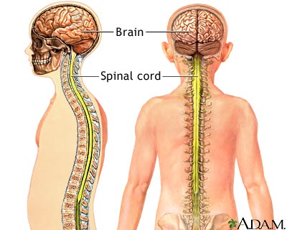
CENTRAL NERVOUS SYSTEM

Slide 105
Cont.
1. THE MENINGES
An outer covering consisting of the cranial bones that encase the brain and the vertebrae bones, also encase the spinal cord and inner coverings consisting of connective tissue called meninges that cover both the brain and spinal cord, protecting these delicate organs of the CNS.
The meninges are composed of three distinct layers namely: -
The Dura matter
The Arachnoid matter
The Pia matter

Slide 107
Cont.
A. THE DURA MATTER
This is a double-layered outer structure of the meninges made up of a strong white fibrous tissue.
The thicker outer periosteal layer adheres lightly to the cranium forming the periosteum and the thinner inner meningeal layer follows the general contour of the brain.
The spinal dura is not double layered but resembles the meningeal layer of the cranial dura.

Slide 108
Cont.
2. THE ARACHNOID MATTER
This is the middle layer of the meninges.
It is a delicate netlike layer that lies between the dura and pia matter.
It spreads over the CNS but does not extend into the sulci or fissures of the brain.

Slide 109
Cont.
3. THE PIA MATTER
The pia matter is the transparent thin innermost layer of the meninges that is attached to the surface of the CNS and follows the irregular outline of the brain and spinal cord.
It is a highly vascularized layer composed of modified loose fibrous connective tissue.
It functions to support vessels that nourish the underlying cells of the brain and spinal cord and together with the dura matter contributes to formation of the choroids plexuses in the ventricles of the brain.

Slide 110
Cont.
SPACES
A. Epidural Space
The epidural space is the space between the dura matter and the bony covering of the brain and spinal cord.
It contains a supporting cushion of fat and connective tissue.
B. Subdural Space
This is the space between the dura matter and arachnoid matter.

Slide 111
Cont.
It contains a small amount of lubricating serous fluid
C. Subarachnoid Space
This is the space under the subarachnoid and outside the pia matter.
The subarachnoid space contains the cerebral spinal fluid (CSF).

Slide 112
Cont.
CEREBRAL SPINAL FLUID (CSF)
The ventricles, central canal and the subarachnoid space contain the clear lymph-like fluid called the cerebral spinal fluid (CSF), which forms a protective cushion around and within the CNS.
The CNS lacks lymphatic circulation so the CSF moves the cellular wastes into the venous circulation.

Slide 113
Cont.
FUNCTIONS OF CSF
Protective cushion that spreads the force of impact over a large area to reduce the damage effects
Reservoir for circulating fluid
Removal of waste products
Monitor changes in internal environment e.g. concentration of CO₂

Slide 114
Cont.
CSF CHARACTERISTICS
Normal CSF
Appearance Crystal clear, colourless
Pressure 100 – 180 mm of water with patient in recumbent position
Cell content 5 cell/mm³, mononuclear cells only, no polymorphonuclear cells
Protein 0.1 – 0.5 gm/L
Glucose 2/3 – ½ of blood glucose
IgG < 15% of total CSF protein
Notes:
The recumbent position is used to describe the position of the body when it is laying down. For example, anytime someone lays down to sleep at night.

Slide 115
Cont.
LUMBAR PUNCTURE
Lumbar puncture is a procedure used for obtaining samples of cerebro-spinal fluid (CSF) by penetrating the lumbar meninges below L3/L4 or L4/L5 interspaces.
The CSF is secreted by cells of the choroids plexus and absorbed via the arachnoid villi into the dural sinuses and spinal sinuses.
The CSF gives information in terms of CSF pressure, colour, cell content (cytology), & chemical content.

Slide 117
Cont.
Lumbar puncture technique
Requirements – a long hollow needle , a sterile LP tray and 3 sterile bottles
Examine the fundi to exclude increased intracranial pressure.
Ask the patient to lie on the left side aspect with the spine fully flexed with the back on the edge of the couch. The trunk should be flexed with the knees and chin as appropriate as possible.
Locate 3rd and 4th lumbar spines (the 4th lumbar spine lies in the transverse plane of the iliac crests)

Slide 118
Cont.
Clean and drape the patient
Apply local anaesthesia
Use a disposable needle (8 cm length)
Put the needle firmly through the skin and press it steadily forwards and slightly towards the patient’s head
When the needle is felt to enter the spinal cavity the CSF will drip slightly from the needle.
Collect the CSF in three bottles
Allow patient to rest for the first 8 – 24 hours

Slide 119
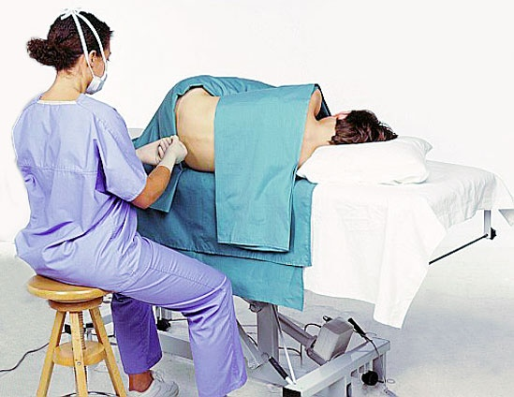
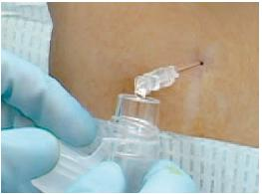
CLINICAL APPLICATION

Slide 120
Cont.
THE BLOOD BRAIN BARRIER (BBB)
The blood brain barrier (BBB) is a structural arrangement of capillaries, surrounding connective tissue and astrocytes that selectively determines movement of solutes from plasma of blood to ECF of the brain.
It regulates the exchange of substances between blood and ECF in the central nervous system by controlling both the kinds of substances that enter the ECF of the brain and the rate at which they do so.
It minimises the ability of many harmful substances to reach the neurones.
Notes:
Astrocytes: a star-shaped glial cell of the central nervous system.

Slide 121
Cont.
2. THE BRAIN
The brain is one of the largest organs in the adults weighing 1.5 Kg (1/50th of the body weight) and receives 20% of the total blood flow to the body per minute because of its high metabolic demands.

Slide 122
Cont.
DIVISIONS OF THE HUMAN BRAIN
The brain is divided into three main parts namely: -
The Fore brain
Cerebrum (telencephalon)
Thalamus and hypothalamus (diencephalon)
Brain stem
Midbrain (mesencephalon)
Pons (metencephalon)
Medulla oblongata (myelencephalon)
The hind brain – cerebellum (metancephalon)

Slide 124
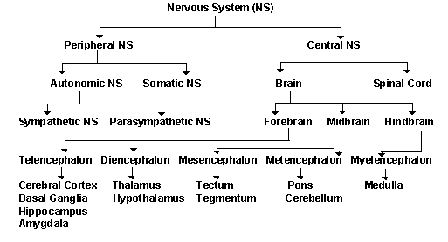

Slide 125
Cont.
The human brain has three major structural components: the large dome-shaped cerebrum (top), the smaller somewhat spherical cerebellum (lower right), and the brainstem (centre).
Prominent in the brainstem are the medulla oblongata (the egg-shaped enlargement at centre) and the thalamus (between the medulla and the cerebrum).

Slide 126
Cont.
The cerebrum is responsible for intelligence and reasoning.
The cerebellum helps to maintain balance and posture.
The medulla is involved in maintaining involuntary functions such as respiration, and the thalamus acts as a relay centre for electrical impulses travelling to and from the cerebral cortex

Slide 127
Cont.
A. Cerebrum –
This is the most developed area of brain in the human species and is considered to be the center of the highest functions.
The major functions include: awareness of sensory perception; voluntary control of movement (regulation of skeletal muscle movement); language; personality traits; sophisticated mental activities such as thinking, memory, decision making, predictive ability, creativity and self-consciousness.

Slide 128
Cont.
Divisions of the Cerebral Cortex (Functional Areas)
Each cerebral hemisphere is divided by fissures into four primary lobes namely
Frontal lobe
Parietal lobe
Temporal lobe
Occipital lobe

Slide 129
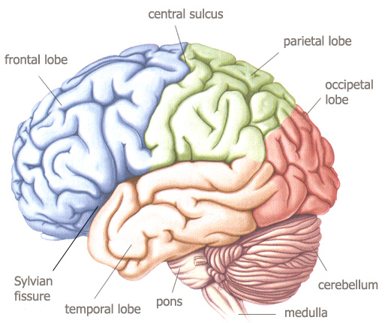
CEREBRAL LOBES

Slide 130
Cont.
1. The Frontal Lobe
The frontal lobe forms the anterior portion of each cerebral hemisphere.
It is separated from the parietal lobe by the central sulcus and contains the precentral gyrus, which is located just in front of the central sulcus and is involved in motor control functions.

Slide 131
Cont.
Functions
Voluntary motor control of skeletal muscles
Personality development
Higher intellectual processes – concentration, planning, decision-making
Verbal communication

Slide 132
Cont.
2. Parietal Lobes (2)
The parietal lobes contain the post central gyrus.
It is the primary area of the cortex responsible for sensation arising from cutaneous, muscle, tendon and joint receptors.

Slide 133
Cont.
3. Temporal Lobes (2)
The temporal lobes contain auditory centres that receive sensory fibres from the cochlea of each ear.
It is involved in interpretation and association of auditory and visual information.
4. Occipital Lobe
This is the primary area responsible for vision and coordination of eye movements.

Slide 134
Cont.
Functional Areas of the Cerebral Cortex
The cerebral cortex has various functional areas whose function depends on structures with which it communicates.
The functions are sensory or motor or integrative functions.

Slide 135
Cont.
1. Motor area
The motor area lies in the precentral gyrus and anterior wall of the central sulcus
Initiates movement of various areas of the body
Blood supply is via the middle cerebral artery that supplies the area controlling structures of the face, arm and trunk and the anterior cerebral artery covering the areas of the legs and perineum.

Slide 136
Cont.
2. Sensory area
Lies in the postcentral gyrus and the posterior wall of the central sulcus
It corresponds to the motor area
Plays a role in appreciation of kinaesthetic sensibility, touch, and temperature
Notes:
Kinaesthetic: relating to a person's awareness of the position and movement of the parts of the body by means of sensory organs (proprioceptors) in the muscles and joints.

Slide 137
Cont.
3. Auditory area
Lies within the upper part of the temporal lobe immediately below the anterior transverse temporal gyrus (below the lateral sulcus).
It lies near the posterior branch of the middle meningeal artery
The middle cerebral artery supplies it.

Slide 138
Cont.
4. Visual area
The visual area lies on the medial surface of the occipital lobe behind the parieto-occipital sulcus and includes the greater part of the occipital lobe.
Each occipital cortex receives impulses from its own half of each retina i.e. it registers the opposite visual filed.
5. Olfactory area (rhinencephalon) - Lies deep within the temporal lobe

Slide 139
Cont.
6. Taste area - the taste area lies near the lower end of the postcentral gyrus
7. Speech area
The speech area is situated in the lower part of the parietal lobe and extends into the temporal lobe.
Perceives the spoken word
There is a dominant area in the left hemisphere in right-handed people and vice versa.

Slide 140
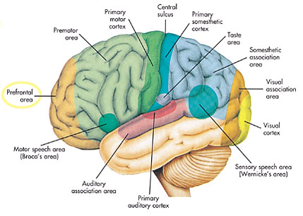
FUNCTIONAL LOCALIZATION

Slide 141
Cont.
3. THE SPINAL CORD
The spinal cord surrounded by its coverings lies loosely in the vertebral canal.
The spinal cord is the slender cylindrical portion of the CNS that extends through the vertebral column from the level of the foramen magnum of the skull where it is continuous with the medulla oblongata to the lower boarder of the 1st lumbar vertebra.

Slide 142
Cont.
It has an average length of 45 cm in males and 43 cm in females.
The spinal cord has 31 segments namely - cervical (8), thoracic (12), lumbar (5), sacral (5) and coccygeal (1).

Slide 143
Cont.
It consists of centrally located grey matter and peripherally located white matter.
The grey matter is involved in reflexes consisting of interneurones, cell bodies and dendrites of efferent neurones, entering fibres of afferent neurones and glial cells.
It appears grey since the nerve fibres present lack myelin. The white matter contains ascending and descending tracts, which conduct impulses to and from the brain.

Slide 144
Cont.
FUNCTIONS OF THE SPINAL CORD
A. Impulse conduction
Provides a means of neural communication to and from the brain
Ascending tracts conduct impulses up the cord to the brain (sensory fibres)
Descending tracts conduct impulses down the cord from the brain (motor fibres)
B. Reflex centre or integration
Centre for spinal reflexes

Slide 145
Cont.
Spinal nerve pathways are involved in the skeletal muscles, cardiac and smooth muscles controlling heart rate, breathing rate, blood pressure and digestive activities
Spinal nerve pathways are involved in swallowing, coughing, sneezing and vomiting

Slide 146
Cont.
COVERINGS OF THE SPINAL CORD
The coverings of the spinal cord are membranous in nature and are called meninges namely the dura matter, pia matter and arachnoid matter.
The meninges are responsible for protection and nourishment of the nervous tissue

Slide 147
THE PERIPHERAL NERVOUS SYSTEM
At the end of the lesson the learner should be able to: -
Identify the divisions of the peripheral nervous system
Outline the structure of the components of the peripheral nervous system
Describe the functions of the peripheral nervous system
Identify the cranial nerves by name and function
Describe the general function of each cranial nerve

Slide 148
Cont.
Describe the process of examination of the cranial nerves
Identify pathologies associated with each cranial nerve
Discuss the structure of a typical spinal nerve
Identify all structures innervated by the spinal nerves
Identify the location of the four major plexuses
Discuss somatic reflexes of clinical importance
Outline the clinical implications of spinal nerve injury

Slide 149
PERIPHERAL NERVOUS SYSTEM
ANATOMICAL COMPONENTS
CRANIAL (12 PAIRS) & SPINAL NERVES (31 PAIRS)
SENSORY AND AUTONOMIC GANGLIA
NERVE PLEXUSES
FUNCTIONAL COMPONENTS
SOMATIC & AUTONOMIC NERVOUS SYSTEMS
AFFERENT (SENSORY) AND EFFERENT (MOTOR)
Notes:
Ganglion: a structure containing a number of nerve cell bodies, typically linked by synapses, and often forming a swelling on a nerve fibre.
A nerve plexus is a plexus (branching network) of intersecting nerves. A nerve plexus is composed of afferent and efferent fibers that arise from the merging of the anterior rami of spinal nerves and blood vessels.

Slide 150
Cont.
Nerves in the peripheral nervous system transmit signals between the central nervous system and receptors (sensory nervous system) and effectors (motor) nervous system in all parts of the body.
The nerve fibres are grouped into bundles called nerves.
A Schwann cell surrounds each nerve fibre.

Slide 151
Cont.
Some fibres are wrapped in layers of tightly held up Schwann cells forming the myelin sheath and others are unmeylinated.
A nerve contains nerve fibres whose axons are of efferent neurones or afferent neurones or both.
The nerves are classified as belonging to the efferent or afferent division of the PNS.

Slide 152
Cont.
All spinal nerves contain both afferent and efferent fibres whereas some cranial nerves contain afferent fibres only (e.g. optic nerve) or efferent only (e.g. trochlear nerve).
We shall discuss the peripheral nervous system in five main blocks of: -
Peripheral nerves – ascending (afferent/sensory) and descending (efferent/motor)
Cranial Nerves
Spinal Nerves
Spinal Reflexes
Autonomic nervous system

Slide 153
Cont.
1. THE PERIPHERAL NERVES
The peripheral nervous system has 43 pairs of nerves - 12 pairs of cranial nerves and 31 pairs of spinal nerves.
The divisions of the peripheral nervous system based on function are the somatic and autonomic nervous system.
The somatic supplies and receives fibres (neurones) to and from the skin, skeletal muscles, joints and tendons.

Slide 154
Cont.
The autonomic (visceral) supplies and receives fibres to and from smooth muscle, cardiac muscle and glands.
The autonomic fibres are motor (efferent fibres) in action.
The autonomic nervous system has two divisions – parasympathetic division (controls normal body functions) and sympathetic division (helps body cope with stress)

Slide 155
Cont.
DIVISIONS OF THE PNS
Afferent (sensory) division
Efferent (motor) division
Somatic nervous system
Autonomic nervous system
Sympathetic division
Parasympathetic division
Enteric division

Slide 156
Cont.
2. THE CRANIAL NERVES
There are 12 pairs of cranial nerves that facilitate communication within the body.
Cranial nerves arise from the under surface of the brain mainly from the brain stem.
They leave the cranial cavity by way of small foramina in the skull and extend to their various destinations.

Slide 157
Cont.
Both name and number can identify the cranial nerves.
Their names suggest either their distribution or their function whereas their numbers indicate the order in which they emerge from the brain from anterior to posterior.
The numbers are usually designated by Roman numerals.
All the cranial nerves are made up of bundles of axons.

Slide 158
Cont.
Mixed nerves contain axons of sensory and motor neurones, sensory cranial nerves consist of sensory axons only and motor cranial nerves consist mainly of motor axons.
Cranial nerves classified as motor nerves do contain a small number of sensory fibres, the proprioceptive fibres that carry information regarding tension in the muscles controlled by the motor fibres of the same motor nerve.

Slide 159
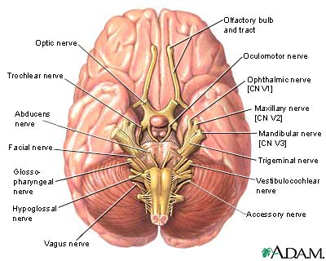
CRANIAL NERVES

Slide 160
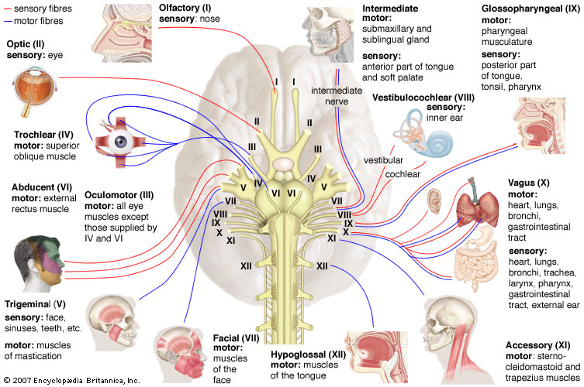
CRANIAL NERVE DISTRIBUTION

Slide 161
Cont.
3. SPINAL NERVES
There are 31 pairs of spinal nerves (8 cervical pairs, 12 thoracic, 5 lumbar, 5 sacral and 1 coccygeal pair) connected to the spinal cord.
The nerves have no special names but are numbered according to the level of the vertebra at which they emerge from the spinal cavity.
The 8 cervical nerves pairs are called C1 – C8, the 12 thoracic as T1 – T12, the 5 lumbar as L1 – L5 and the 5 sacral pairs as S1 –S5.

Slide 162
Cont.
C1 nerves emerge from the cord in the space above the first cervical vertebra and C8 nerves emerge between the last cervical vertebra (C7) and the first thoracic vertebra (T1).
Other cervical nerves and all the thoracic nerve pairs pass out of the spinal cavity horizontally through the intervertebral foramina for their respective vertebrae.

Slide 163
Cont.
Lumbar, sacral and coccygeal nerve roots descend from their point of origin at the lower end of the spinal cord at L1 before reaching their intervertebral foramina of their respective vertebrae through which the nerves emerge.
This gives the lower end of the spinal cord with its attached spinal nerve roots a horse’s tail appearance hence the name cauda equina (Latin for horse tail).

Slide 164
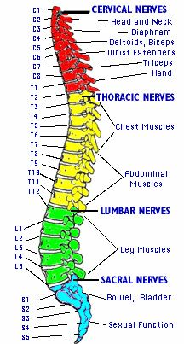

Slide 165
Cont.
NEURONES IN SPINAL NERVES
Each spinal nerve includes numerous sensory (afferent) and motor (efferent) neurones which are classified as somatic and visceral.
Somatic neurones conduct impulses to and from somatic structures (skin, skeletal muscles, tendons and joints) whereas the visceral neurones conduct impulses to and from visceral structures (smooth muscle, cardiac muscle and glands).
Hence all spinal nerves can be classified into four categories namely: - somatic afferent, somatic efferent, visceral afferent and visceral efferent neurones.

Slide 166
Cont.
A. Somatic Afferent Neurones
These are sensory neurones that conduct impulses initiated in receptors in the skin, skeletal muscles, tendons and joints.
Somatic afferent neurones are unipolar neurones that enter the spinal cord through the dorsal root and their cell bodies are located in the dorsal root ganglia.

Slide 167
Cont.
B. Somatic Efferent Neurones
These are motor neurones that conduct impulses from the spinal cord to skeletal muscles.
These neurones are multipolar neurones with cell bodies located in the grey matter of the spinal cord.
Somatic efferent neurones leave the spinal cord through the ventral root of the spinal cord.

Slide 168
Cont.
C. Visceral Afferent Neurones
These are sensory neurones that conduct impulses initiated in receptors in smooth muscle and cardiac muscle.
These neurones are unipolar and enter the spinal cord through the dorsal root and their cell bodies are located in the dorsal root ganglia.
Visceral afferent neurones are collectively called enteroceptors or visceroceptors.

Slide 169
Cont.
D. Visceral Efferent Neurones
These are neurones that conduct impulses to smooth muscle, cardiac muscle and glands.
They make up the autonomic nervous system (ANS).
Some visceral efferent neurones begin in the brain white matter while others begin in the spinal cord.

Slide 170
Cont.
Two visceral efferent neurones are involved in conduction of an impulse from the spinal cord or brain to a smooth muscle or gland.
The two neurones are preganglionic neurone and postganglionic neurone.

Slide 171
Cont.
4. SPINAL REFLEXES
A reflex is a predictable motor response to a sensory stimulus.
The term reflex however is usually used to mean only involuntary responses rather than the voluntary ones involving the cerebral cortex.
The neural pathway involved in execution of a reflex is called the reflex arc.

Slide 172
Cont.
If the centre of a reflex arc is in the brain the response it mediates is called a cranial reflex and spinal reflex if in the spinal cord.
Reflexes deviate from the normal in certain diseases hence testing of reflexes is a valuable diagnostic tool.
In testing a patient’ s reflexes a clinician interprets the results on the basis of what is known about the reflex arc that must function to produce normal reflexes.
A reflex consists of either muscle contraction or glandular secretion hence the names somatic reflexes and autonomic (visceral) reflexes respectively.

Slide 173
Cont.
A. SOMATIC REFLEXES
Somatic reflexes involve contraction of skeletal muscles and have their motor neurones in the anterior horn cell or lower motor neurone.
Important somatic reflexes include: -
Knee reflex (Patella reflex)
Ankle reflex (Achilles reflex)
Babinski reflex
Corneal reflex
Abdominal reflex

Slide 174
5. AUTONOMIC NERVOUS SYSTEM (ANS)
At the end of the lesson the learner should be competent to: -
Identify the two major subdivisions of the autonomic nervous system (ANS)
Describe the structures of the autonomic nervous system
Identify the autonomic nervous system neurotransmitters and the fibres where they are found.
Describe the function of the autonomic nervous system
Describe the autonomic pathways
Describe effects of malfunction or non-function of the autonomic nervous system

Slide 175
AUTONOMIC NERVOUS SYSTEM
PARTS
SYMPATHETIC
PARASYMPATHETIC
ENTERIC NERVOUS SYSTEM
TARGETS
VISCERA
GLANDS
BLOOD VESSELS
NONSTRIATED MUSCLE

Slide 176
Cont.
The autonomic nervous system is a subdivision of the efferent portion of the peripheral nervous system.
ANS innervates organs whose functions are not usually under voluntary control e.g. the cardiac muscle (the heart), smooth muscle (the visceral) and glands.
The ANS does not function autonomously because it is continually influenced by impulses from autonomic centres located at various levels in the brain.

Slide 177
Cont.
These clusters of neurones have axons conducting impulses directly or indirectly to autonomic preganglionic neurones.
The autonomic centres operate in a hierarchy with the highest centres in the cerebral cortex, which send impulse to other autonomic centres in the brain mainly the thalamus.
Neurones in the thalamus then stimulate or inhibit impulses to parasympathetic and sympathetic preganglionic neurones

Slide 178
Cont.
DIVISIONS
The ANS has two divisions: - the sympathetic division and the parasympathetic division.
Both divisions consist of separate neural pathways supplying the same autonomic effectors (where there in dual innervation) but their actions are antagonist where one inhibits the effectors and the other stimulates the effectors.

Slide 179
Cont.
This is a form of dual innervation that is well controlled and allows the innervated receptors to participate in times events such as the sexual response in which effectors must be stimulated then rapidly inhibited (or vice versa) in a specific timed sequence.
However, some autonomic effectors are singly innervated receiving input from only the sympathetic division.

Slide 180
Cont.
PARA:
In general the Parasympathetic division can initially be described by the phrases “Rest and Digest” or “Feed and Breed”.
This simply means that this portion of the ANS is for housekeeping activities, putting things back in place, storing needed things and eliminating waste.
For example, after lunch, when you sit down to read, the Parasympathetic division is at work.

Slide 181
Cont.
Your heart rate is lowered, your gastrointestinal tract activity is increased, increasing its mobility and secretions.
The diameter of your bronchioles (airways) is small, as you don‟t need more air when your are sitting reading.
The diameter of your pupils is also small, this enables the fine focus of your eyes for reading the pages in front of you.

Slide 182
Cont.
Enhance “rest-and-digest” activities
Mechanisms that help conserve and restore body energy during times of rest
Normally dominate over sympathetic impulses
SLUDD type responses = salivation, lacrimation, urination, digestion & defecation
3 “decreases”--- decreased HR, diameter of airways and diameter of pupil
Paradoxical fear when there is no escape route or no way to win
causes massive activation of parasympathetic division
loss of control over urination and defecation

Slide 183
Cont.
SYM:
In general the Sympathetic division can initially be described by the phrases “Fight or Flight”.
This implies that this portion of the ANS is for emergency situations, for putting up your dukes and fighting, or running away – either way it requires a lot of energy.

Slide 184
Sympathetic Responses
Dominance by the sympathetic system is caused by physical or emotional stress -- “E situations”
emergency, embarrassment, excitement, exercise
Alarm reaction = flight or fight response
dilation of pupils
increase of heart rate, force of contraction & BP
decrease in blood flow to nonessential organs
increase in blood flow to skeletal & cardiac muscle
airways dilate & respiratory rate increases
blood glucose level increase

Slide 185
Cont.
STRUCTURE OF THE ANS
Each autonomic pathway is made up of autonomic nerves, ganglia and plexuses, which are made up of autonomic neurones.
All autonomic neurones are efferent neurones that conduct impulses away from the brain and spinal cord to the autonomic effectors.

Slide 186
Cont.
It operates as a relay of two neurones – the preganglionic and postganglionic neurones that conduct information from the CNS to the autonomic effectors.
The preganglionic neurones with cell bodies in the CNS are myelinated (white) and conduct impulses from the brain stem or spinal cord to an autonomic ganglion where the synapse with a second autonomic neurone called postganglionic neurone, which are unmyelinated (grey) conducting impulses away from the ganglion to the effectors

Slide 187
Cont.
STRUCTURE OF SYMPATHETIC PATHWAYS
The sympathetic autonomic nervous system has relatively short preganglionic and relatively long postganglionic neurones.
The axon of one sympathetic preganglionic neurone synapses with many postganglionic neurones and that is why sympathetic responses are widespread involving many organs or parts of the body.

Slide 188
Cont.
They are also called the thoracolumbar division because its preganglionic fibres exit the spinal cord between T1 and L2 levels.
Most sympathetic nerve fibres separate from somatic motor fibres and synapse with postganglionic neurones.

Slide 189
Cont.
Short fibres from both grey and white rami form a trunk connecting ganglia that lie on the same side of the vertebral column to form a sympathetic chain ganglion that resembles a chain of beads.
Each chain extends from C2 to the level of the coccyx.
There are 22 sympathetic chain ganglia on each side of the vertebral column (3 – cervical, 11 thoracic, 4 lumbar and 4 sacral).

Slide 190
Cont.
STRUCTURE OF PARASYMPATHETIC PATHWAYS
The parasympathetic autonomic nervous system has relatively long preganglionic and relatively short postganglionic neurones.
Axons of many parasympathetic preganglionic neurones synapse with one postganglionic neurone and that is why parasympathetic responses are usually involves only one organ.

Slide 191
Cont.
Parasympathetic preganglionic neurones have their dendrites and cell bodies in nuclei in the brain stem or lateral grey column of sacral cord hence the parasympathetic division is also called craniosacral division.

Slide 192
ANS Neurotransmitters
Classified as either cholinergic or adrenergic neurons
Adrenergic
Cholinergic

Slide 193
Parasympathetic
Cholinergic neurons release acetylcholine from preganglionic neurons & from parasympathetic postganglionic neurons
Action: Excites or inhibits depending upon receptor type and organ involved
Receptor:
Nicotinic receptors are found on dendrites & cell bodies of autonomic NS cells and at NMJ
Muscarinic receptors are found on plasma membranes of all parasympathetic effectors

Slide 194
Sympathetic
Adrenergic neurons release norepinephrine (NE) from postganglionic sympathetic neurons only
Action: Excites or inhibits organs depending on receptors
Receptor:
Alpha1 and Beta1 receptors produce excitation
Alpha2 and Beta2 receptors cause inhibition
Beta3 receptors (brown fat) increase thermogenesis
NE lingers at the synapse until enzymatically inactivated by monoamine oxidase (MAO) or catechol-O-methyltransferase (COMT)

Slide 195
Cont.
FUNCTIONS OF AUTONOMIC NERVOUS SYSTEM
The ANS regulates autonomic effects in order to maintain or quickly restore homeostasis.
Both sympathetic and parasympathetic divisions are tonically active and continually conduct impulses to autonomic effectors.

Slide 196
Cont.
They exert opposite or antagonistic influences on effectors.
Sympathetic impulses tend to stimulate an effector while parasympathetic impulses tend to slow it.
The actual heart rate is determined by whichever division dominates.

Slide 197
Cont.
Functions of Sympathetic Division
The sympathetic system maintains normal functioning of dually innervated autonomic effectors when in resting state e.g. maintain heart rate and strength and muscle tone.
It functions as a major emergency system when homeostasis of the body is physically or psychologically threatened in preparation for “fight-or-flight”.
Chronic exposure to stress can lead to dysfunction of the sympathetic effectors and the ANS.

Slide 198
Cont.
Functions of Parasympathetic Division
The parasympathetic system is the dominant controller of most autonomic effectors most of the time.
Under quiet non-stressful conditions, more impulses reach the autonomic effectors by cholinergic parasympathetic fibres than by adrenergic sympathetic fibres.
It dominates during the times of rest and repair.
Acetylcholine the neurotransmitter of the parasympathetic system slows the heartbeat but acts to promote digestion and elimination.

Slide 199
Cont.
Organs with Dual Innervation
Most visceral organs have dual innervation by both sympathetic and parasympathetic divisions.
The effects of the two divisions may be antagonist, complementary or cooperative effects.
Antagonist effects are for example innervation of the pacemaker of the heart where adrenergic stimulation from sympathetic nerve fibres stimulates the pacemaker cells increasing the heart rate while cholinergic stimulation from the parasympathetic fibres inhibit pacemaker cells reducing the heart rate.

Slide 200
Cont.
The reverse of the above will occur in intestinal movements and secretions.
Complementary effects can be seen in the salivary glands.
Parasympathetic stimulation causes secretion of watery saliva and other exocrine glands in digestive tract and sympathetic stimulation constricts blood vessels in digestive tract reducing blood flow to the salivary glands causing production of thicker and more viscous saliva.

Slide 201
Cont.
Cooperative effects can be seen in the urinary and reproductive systems
Erection of the penis is due to vasodilatation due to parasympathetic stimulation and ejaculation results from sympathetic stimulation.
Contraction of the bladder is myogenic but it is promoted by parasympathetic stimulation.

Slide 202
Cont.
Micturation is enhanced by sympathetic stimulation, which increases tone of the bladder muscles.
Emotional states accompanied by sympathetic nerve activity e.g. extreme fear may result in reflex urination at bladder volumes that are normally too low to trigger the micturation reflex.

Slide 203
Cont.
Organs without Dual Innervation
These include the adrenal medulla, Errector pili muscles, sweat glands and most blood vessels, which receive only sympathetic innervation.
Regulation is achieved by increases or decreases in the tone (firing rate) of the sympathetic fibres.
Constriction of blood vessels is produced by increased sympathetic activity via stimulation of alpha-adrenergic receptors and vasodilatation results from decreased sympathetic nerve stimulation.

Slide 204
Cont.
Sympathetic system brings about proper thermoregulatory responses to heat.
In a hot room reduced sympathetic stimulation produces dilatation of blood vessels in the surface of the skin increasing cutaneous blood flow and better heat radiation.
Exercise increases sympathetic activity leading to constriction of blood vessels in the skin of limbs and sweat glands in the trunk.

Slide 205
COMPARISON – SYMPATHETIC & PARASYMPATHETIC
CHARACTERISTIC | SYMPATHETIC | PARASYMPATHETIC
ORIGIN | THORACOLUMBAR | CRANIOSACRAL
LOCATION OF GANGLIA | PARAVERTEBRAL | PERIPHERAL
NEUROTRANSMITTER | ADRENERGIC | CHOLINERGIC
DISTRIBUTION | WIDESPREAD | LOCALISED
EFFECTS | EMERGENCY | ELECTIVE

Slide 206
SENSORY NEUROPHYSIOLOGY
By the end of the lesson the learner should be competent to: -
Classify sensory receptors
Describe sensory receptors
Explain the differences between tonic and phasic receptors
Explain the law of specific nerve energies
Identify the stimuli detected by the somatic senses
Describe the different types of cutaneous receptors
Describe the neural pathways in sensory organs
Describe characteristics of the generator potential
Describe general and special sensation

Slide 207
Cont.
The sensory system is the part of the nervous system consisting of sensory receptors, neural pathways and the brain parts that process the information.
Sensory receptors receive stimuli from the internal and external environment; neural pathways conduct information from the receptors to the parts of the brain that primarily process the information.
This is called sensory information.

Slide 208
Cont.
Information processed by the sensory system may or may not lead to conscious awareness of the stimulus.
If sensory information does reach the consciousness it is called a sensation and the understanding of a sensation’s meaning is called perception.
Perception occurs by means of neural processing of sensory information e.g. pain is a sensation but the idea that the pain is from a hurting tooth is perception.

Slide 209
Cont.
SENSORY RECEPTORS
Sensory receptors and sense organs enable the body to respond to stimuli resulting from changes in our internal and external environment, a function that is crucial for survival.
For instance the ability to see and hear assists us avoid injury from dangers in our external environment while internal sensations such as pain and pressure to hunger and thirst assist us maintain a homeostatic internal environment.

Slide 210
Cont.
Sensory receptors may be part of a neurone or a specialized cell that can generate action potentials in neurones.
Receptors are associated with surrounding non-neural cell to form sense organs such as the ear, eye or tongue.
Receptors in each sense organ are adapted to respond to one particular form of energy at much lower threshold than other receptors e.g. light reaches the skin but eyes respond to light.

Slide 211
Cont.
STIMULUS
A stimulus is the energy form that impinges upon a sensory receptor that it is acting on.
The particular form of energy to which a receptor is most sensitive to is called its adequate stimulus.
RECEPTOR RESPONSE
The general function of receptors is to respond to stimuli by converting them into nerve impulses.
Different receptors respond to different stimuli.

Slide 212
Cont.
When an adequate stimulus acts on a receptor a membrane potential called receptor potential develops in the receptor membrane.
This potential is also called generator potential, a graded potential depending on the strength of the stimulus.
The transduction process involves opening and closing of ion channels in specialized receptors that receive information from the outside world.

Slide 213
Cont.
CLASSIFICATION OF RECEPTORS
Sensory receptors can be classified based on structure and functional.
Structural classification
Dendrites endings of sensory neurones e.g. those in the skin responsible for pain and temperature
Encapsulated in non-neural structures e.g. pressure receptors in the skin.

Slide 214
Cont.
Functional classification
1. Based on stimuli that activate them
Mechanoreceptors - are activated by mechanical stimuli which changes the position of the receptor resulting in generation of receptor potential.
Examples – touch, pressure receptors in the skin, hair cells in the inner ear, pressure to blood vessels, stretch or pressure in muscles, tendons or lung tissue.

Slide 215
Cont.
Chemoreceptors - are activated either by amount of changing concentration of certain chemicals.
Examples – taste buds for taste and olfactory epithelia for smell; Regulation of blood pH and sugar (aortic and carotid bodies).
Thermoreceptors – respond to heat or cold

Slide 216
Cont.
Photoreceptors – rods and cones in the eye that respond to light stimuli
Nociceptors - nociceptors are activated by intense stimuli of any type that results in tissue damage.
May be caused by toxic chemical, intense light, sound, pressure or heat. Sensation produced is one of pain.

Slide 217
Cont.
2. Based on the Type of information the receptors deliver to the brain
Proprioceptors - Proprioceptors provide sense of body position and allow fine control of skeletal movements.
Include muscles spindles, golgi tendon organs and joint receptors

Slide 218
Cont.
Cutaneous receptors these are the receptors for touch and pressure, warmth and cold and pain receptors.
Special senses – sight, hearing, equilibrium, taste and smell

Slide 219
Cont.
3. Receptor response (sensory adaptation)
Phasic receptors - phasic receptors respond with a burst of activity when a stimulus is first applied but then quickly decrease their firing rate (quick adaptation). They alert us to changes in sensory stimuli. Examples – odour, touch and temperature.
Tonic receptors - tonic receptors produce a relatively constant rate of firing as long as the stimulus is maintained because they are slow adapting.

Slide 220
Cont.
4. Local site
Teleceptors – detects from a distance
Exteroceptors – external environment near at hand
Interoceptors (visceroceptors) – internal environment
Proprioceptors

Slide 221
Cont.
DISTRIBUTION OF RECEPTORS
Receptors for special senses of smell, taste, vision, hearing and equilibrium are grouped into localized areas e.g. nasal mucosa for smell and tongue for taste or into a complex organ such as the eye and ear.
The general sense organs consist of microscopic receptors widely distributed throughout the body in the skin, mucosa, connective tissues, muscles, tendons, joints and viscera.

Slide 222
Cont.
Sensations produced by these receptors are called somatic senses.
The distribution of somatic senses is not uniform as in some areas the distribution is dense while in other sites is spare.
For example the skin covering the fingertips contains more receptors to touch than does the skin on the back.

Slide 223
Cont.
SOMATIC SENSATIONS (GENERAL)
Somatic sensation is sensation from the skin, body walls, muscles, bones, tendons and joints and is initiated by somatic receptors.
The receptors in the skin are called cutaneous receptors and are responsible for cutaneous sensation e.g pain, warmth, cold, touch/pressure.

Slide 224
Cont.
1. PAIN
Pain receptors are called nociceptors and are widely distributed on the surface of the body (exteroceptors) and in deep visceral organs (visceroceptors) however, the brain lacks sensory receptors.
The visceral organs have abundant nociceptors.
Pain receptors are free nerve endings that respond to different stimuli e.g. tissue damage due to mechanical stretching, chemicals, ischaemia and extreme temperature.

Slide 225
Cont.
Nociceptors
These are nerve endings with small unmyelinated and lightly myelinated afferent neurones that respond to intense mechanical or thermal stimulation and chemicals (bradykinin, histamine, prostaglandins, growth factors and neuropeptide neurotransmitters).
These substances combine with chemical binding sites on the nociceptors.

Slide 226
Cont.
2. TEMPERATURE
There are two types of thermoreceptors in the skin each of which responds to a limited range of temperature.
Extremes of temperature results in stimulation of free nerve endings generating receptor potential then action potential providing sensation of temperature

Slide 227
Cont.
3. TOUCH AND PRESSURE
Touch and pressure receptors are exteroceptors that respond to stimuli that changes their shape or placement that is they are also mechanoreceptors.
Touch-pressure experiences include hair bending, deep pressure, vibrations and superficial touch.

Slide 228
Cont.
4. PROPRIOCEPTORS (STRETCH)
These are receptors associated with muscles and tendons where they give information on muscle length and strength of muscle contraction.
There are two types of stretch receptors – muscle spindle receptors and Golgi tendon receptors
Muscle spindle receptors are stimulated if the length of a relaxed muscle exceeds a certain limit.

Slide 229
Cont.
SPECIAL SENSES
The special senses are characterized by receptors grouped closely together or located in specialized organs.
These senses are: -
Olfaction (smell)
Gustation (taste)
Auditory (hearing)
Equilibrium (balance)
Vision (sight)

Slide 230
Cont.
GUSTATION (TASTE)
A variety of receptors are present in the mouth.
This includes mechanoreceptors, thermoreceptors, nociceptors and chemoreceptors.
Mechanoreceptors mediate sensations of touch and pressure, thermoreceptors for cold and heat and the nociceptors for pain.
These receptors are found in the mucosa lining the oral cavity and the tongue.

Slide 231
Cont.
OLFACTION (SMELL)
The olfactory receptor cells are chemoreceptors located in a specialized portion of the nasal mucosa.
These cells have unique olfactory cilia, which touch the surface of the olfactory epithelium lining the upper surface of the nasal cavity.

Slide 232
Cont.
HEARING AND EQUILIBRIUM
The ear has dual sensory functions of hearing and balance (equilibrium).
Stimulation or trigger responsible for hearing and balance involves activation of specialized mechanoreceptors called hair cells.
Physical forces such as sound waves and movement act on hair cells to generate receptor potentials that are converted into nerve impulses, which are eventuality perceived in the brain as sound or balance.

Slide 233
Cont.
EYE AND VISION
The eye is the body’s sense organ for vision.
The eye is housed within the orbit of the skull with approximately 5/6th of the eyeball lying in the bony socket and only a small portion of the anterior surface being exposed.
It is protected by the eyelids and kept most by the fluid secreted by the lacrimal glands.
The eye converts the energy of light into neural impulses that are interpreted by the brain as light.

Slide 234
Cont.
CUTANEOUS SENSATION (SKIN)
The skin has an outer layer – the epidermis and the inner layer - the dermis, which both contain sensory receptors.
The sensory receptors range from simple, bare nerve endings to complex combinations of nerves, muscles, connective tissue and supporting cells.
These receptors are mechanoreceptors, thermoreceptors and chemoreceptors.

Slide 235
MOTOR AND INTEGRATIVE PHYSIOLOGY
At the end of the lesson the learners should be able to:
Define key terms
Outline the general structure of the motor system
Explain the basic principles of operation of the motor system
Describe the functions of all the brain structures concerned with motor control
Outline disorders affecting the brain structures of motor control.

Slide 236
Cont.
Motor functions of the nervous system generally refer to control of skeletal muscle activity by the nervous system.
Skeletal muscles are supplied by nerve fibres originating in the anterior column of the spinal cord.
The anterior column motor cells are the final common pathway for mediating neural influences to the skeletal muscle.

Slide 237
Cont.
Normal skeletal muscle activity always has a purpose to serve.
The purpose may be: -
Locomotion
Communication (speech and gestures)
Reading (eye movements)
Temperature regulation(shivering)
Maintenance of balance or posture

Slide 238
Cont.
MOTOR PATHWAYS
Information from the motor areas of the brain to the effector organs is carried by the descending nerve fibres called motor pathways.
The signals are transmitted to the spinal cord via the corticospinal tracts and accessory pathways involving the basal ganglia, cerebellum and the brain stem.

Slide 239
Cont.
Various brain regions exert their influence on posture and movement via descending pathways to the motor neurones and interneurones.
There are two types of pathways namely the corticospinal pathways and brain stem pathways.
The pathways are divided into two portions – the upper and lower motor neurones.

Slide 240
Cont.
The Upper Motor Neurones
These form the descending tracts that control activity of the lower motor neurones.
There are a number of such tracts but the most important ones are the corticospinal and corticobulbar tracts.
The main function of the corticobulbar and corticospinal pathways is the control of voluntary skilled movements.

Slide 241
Cont.
The Lower Motor Neurones
These are the neurones that directly innervate skeletal muscles and have their cell bodies lying in the grey matter of the spinal cord and brain stem.
They constitute the final common pathway by which the nervous system controls movement.

Slide 242
Cont.
Lesions of the Motor Pathways
Lower Motor Neurone syndrome/lesion (LMNL)
Damage to the lower motor neurone produces a number of signs and symptoms. Lower motor neurone syndrome/lesion (LMNL) presents with: -
Weakness (paresis) or paralysis (plegia) of individual muscles

Slide 243
Cont.
Muscle wasting
Fasciculation (visible spontaneous contractions of motor units)
Hypotonia (reduced resistance to passive stretching)
Areflexia or hyporeflexia (loss or diminution of deep tendon reflexes)

Slide 244
Cont.
Upper Motor Neurone syndrome/lesion (UMNL)
Clinical signs of UMNL are also referred to as pyramidal signs.
Weakness or paralysis of specific movements (extension of the upper limbs and flexion of the lower limbs, termed “pyramidal weakness”)
No muscle wasting

Slide 245
Cont.
Hypertonia: Increased resistance to passive stretching of muscles (spasticity); initial resistance to muscular stretching followed by relaxation (clasp-knife response)
Hyperreflexa (hyperactivity of deep tendon reflexes)
Emergence of the extensor plantar response (positive Babinski reflex) leading to dorsiflexion of the great toe on stimulation of the sole of the foot.

Slide 246
Cont.
INTEGRATIVE FUNCTIONS
The integrative functions of the nervous system consist of all events that take place in the cerebrum between reception of sensory impulses and its sending of motor impulses to receptive targets.
This includes consciousness and mental functions of all kinds.

Slide 247
Cont.
The mental functions include: -
Consciousness
Behaviour
Emotions
Learning
Memory
Motivation
Speech and language

Slide 248
Cont.
CONSCIOUSNESS
Consciousness is the state of awareness of one’s self, one’s environment and other beings.
It depends on excitation of cortical impulses conducted to them by the reticular activating system (RAS).
The RAS consists of centres in the brain’s reticular formation that receives impulses from the spinal cord send them to the thalamus and then to all parts of the cerebral cortex.

Slide 249
Cont.
Without continued excitation of cortical neurones by the reticular activating impulses one becomes unconscious and cannot be aroused.
The RAS is an arousal or alerting system of cerebral cortex and maintains unconscious.
Drugs that depress RAS decrease alertness and induce sleep e.g. barbiturates whereas others stimulate them e.g. amphetamine

Slide 250
Cont.
THE ELECTROENCEPHALOGRAM (EEG)
The EEG is the record of electrical activity of cortical neural units.
It is recorded through the skull and scalp hence it is of a much lower voltage than if recorded directly from the cortex.
Synaptic potentials produced at cell bodies and dendrites of cerebral cortex create electrical currents that can be recorded.

Slide 251
Cont.
These records are called electroencephalograms (EEG).
Deviations from normal EEG patterns are helpful in clinical diagnosis of epilepsy and abnormal states and absence of EEG reflects brain death.
In EEG the electrodes are placed in different regions of the scalp and they consist of waves called brain waves.

Slide 252
Cont.
There are four types of brain waves namely beta (b) , alpha (a), theta (q) and delta (d) based on the frequency (Hz) and amplitude (V) ranging from the fastest to the slowest.
The brain waves vary in different regions of the brain, in different states of awareness and in abnormal conditions of the cerebrum.
It is important in diagnosis of epilepsy, Alzheimer’s disease and psychoses.

Slide 253
Cont.
MEMORY (RETENTION)
Memory is a process that involves retention and storage of information.
It is a course by which people encode, store and retrieve information.
Memory is built on these three basic processes, which are very distinct.
It is a central process in children’s cognitive development.
Conscious memory comes into play as early as 7 months of age and both children and adults have little or no memory of events experienced before the age of 3.

Slide 254
Cont.
Most of the information is stored in the cerebral cortex but basal regions of the brain and the spinal cord can store negligible amounts.
Physiologically memory is caused by changes in capability of synaptic transmission from one neuron to the next as a result of previous neural activity.
These changes cause new pathways or facilitated pathways to develop for transmission of signals through the neural circuits of the brain.

Slide 255
Cont.
LEARNING
Human beings have the ability to alter behaviour on the basis of experience.
Learning is acquisition of information that should lead to change in behaviour.
Learning is a relatively permanent change in behaviour as a result of experience or training.

Slide 256
Cont.
MOTIVATION
Motivation is the force or energy in us that makes us act in a particular way and direction.
The factors direct and energize behaviour of humans and other organisms.
Different motives have different strengths at different times.

Slide 257
Cont.
EMOTIONS
Emotions are feeling that generally have both physiological and cognitive elements and influence behaviour.
Emotions have both mental and physical components.
They involve cognition (awareness of the sensation and usually its cause), affect (the feeling itself), conation (the urge to take action) and physical changes such as hypertension, tachycardia and sweating.

Slide 258
Cont.
LANGUAGE
Language which is a key part of human culture is one of the fundamental bases of human intelligence.
Language consists of the ability to speak and write words plus the ability to understand spoken and written word.
Disorders of speech and language are referred to as aphasias.
Language areas are mainly located in the left hemisphere of the cerebral cortex at the Broca’s and Wernicke’s areas.

Slide 259
End of Presentation
Thank You for Listening

