Slide 1
THE SKIN

Slide 2
OBJECTIVES
By the end of the study the learner will be able to:
Describe the structure of the skin
Explain the principal functions of the skin
Compare and contrast the processes of primary and secondary wound healing

Slide 3
Skin (Integument)
Consists of three major regions
Epidermis—superficial region
Dermis—middle region
Hypodermis (superficial fascia)—deepest region
Subcutaneous layer deep to skin (not technically part of skin)
Mostly adipose tissue

Slide 4
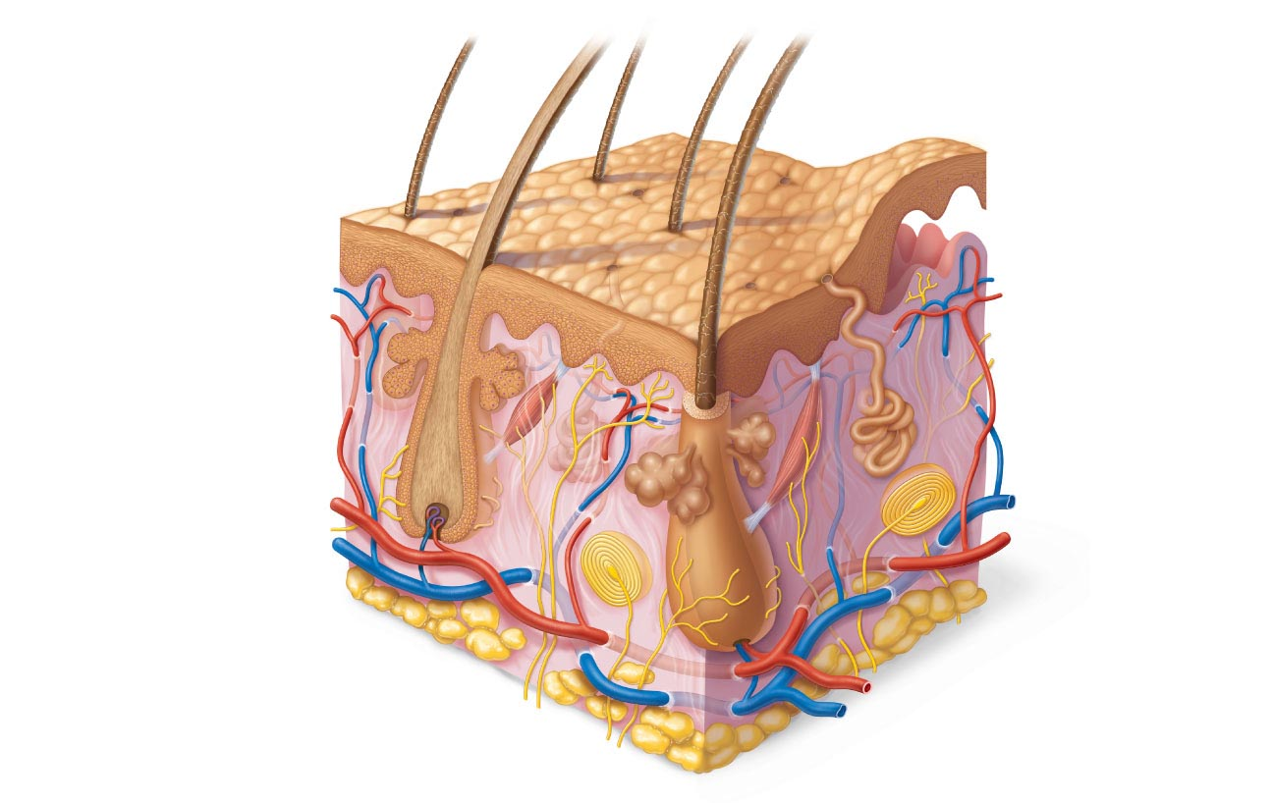
Hair shaft
Dermal papillae
Epidermis
Subpapillary
vascular plexus
Papillary
layer
Pore
Appendages
of skin
Dermis
Reticular
layer
• Eccrine sweat
gland
• Arrector pili
muscle
Hypodermis
(superficial fascia)
• Sebaceous
(oil) gland
• Hair follicle
Nervous structures
• Hair root
• Sensory nerve fiber
Cutaneous vascular
plexus
• Pacinian corpuscle
• Hair follicle receptor
(root hair plexus)
Adipose tissue
Figure 5.1

Slide 5
Epidermis
Is the most superficial layer of the skin
It is composed of keratinized stratified squamous epithelium which vary in thickness in different parts
It does not contain any blood vessels or nerve endings but the deepest layer is bathed by interstitial fluid form the dermis
There several layers of cells in the epidermis which extend from the deepest i.e. germinative layer to the most superficial i.e. stratum corneum

Slide 6
Epidermis ctied
The cells on the surface are flat, thin, non nucleated, dead cells or squames in which the cytoplasm has been replaced by a protein called keratin
The cells are constantly being rubbed off and replaced by cells from the germinative layer
Complete replacement takes a month
Maintenance of a healthy epidermis depends on: desquamation, effective keratinisation and continual cell division
Hair, secretions from sebaceous glands and ducts of sweat glands pass through epidermis to reach the surface

Slide 7
Ctied
The surface of epidermis is ridged by projections of cells in the dermis called papilla
The downward projections of germinative layer between papilla aid in nutrition of the epidermal cells and stabilise the two layers preventing damage due to shearing
Blisters develop when the epidermis and the dermis separate and serous fluid collects between them

Slide 8
Skin Color
Three pigments contribute to skin color:
Melanin
Yellow to reddish-brown to black, responsible for dark skin colors
It is derived from amino acids tyrosine and is secreted by melanocytes and absorbed by the epithelial cells
It varies from race to ethnic and genetic makeup
The difference in colour depends on amount secreted and presence of sun promotes synthesis of melanin
melanin protects the skin from harmful effects of sunlight

Slide 9
Skin colour ctied
Carotene
Yellow to orange, most obvious in the palms and soles
And excessive levels of bile pigments in blood

Slide 10
Skin col
Hemoglobin
Responsible for the pinkish hue of skin

Slide 11
Dermis
It is tough and elastic, formed from connective tissue and matrix containing collagen fibres interlaced with elastic fibres
When it raptures in cases of stretching forms a striae or stretch marks
Collagen fibres give the skin its tensile strength but as it declines wrinkles are formed
Macrophages and mast cells are the main cells found here
The following are found at the dermis:

Slide 12
Blood and lymph vessels
They form a fine network at the dermis

Slide 13
Sensory nerve endings
There are sensory receptors sensitive to touch, temperature, pressure and pain
These sensory receptors are: meisner’s corpuscle (for light pressure), pacinian corpuscle (deep pressure) and free nerve ending(pain)

Slide 14
Sweat glands
Two main types of sweat (sudoriferous) glands
Eccrine (merocrine) sweat glands—abundant on palms, soles, and forehead
Sweat: 99% water, NaCl, vitamin C, antibodies, dermcidin, metabolic wastes
Ducts connect to pores
Function in thermoregulation

Slide 15
Sweat Glands
Apocrine sweat glands—confined to axillary and anogenital areas
Sebum: sweat + fatty substances and proteins
Ducts connect to hair follicles
Functional from puberty onward (as sexual scent glands?)
Specialized apocrine glands
Ceruminous glands—in external ear canal; secrete cerumen
Mammary glands

Slide 16
Hair
Formed by Extensions from the epidermal surface into dermis called follicles
At the bottom there is a cluster of cells called papilla or bulb
Its formed at the bulb and the cells are pushed up however has they go away from the source of nutrition they die and become keratinized
The colour is genetically determined and depends on the amount of melanin secreted

Slide 17
Arrector pili
Smooth muscle attached to follicle
Responsible for “goose bumps”
The muscles are stimulated by sympathetic nervous system in response to fear or cold
The erect hair traps air which acts as an insulator

Slide 18
Sebaceous glands
Widely distributed
Most develop from hair follicles
Become active at puberty
They secrete sebum into the hair follicle
They are widely distributed in the body with the exception of the sores and the palms
They have a bactericidal effect on the skin hence protecting it from bacteria, they softens hair and skin

Slide 19
Nails
Scale like modification of the epidermis on the distal, dorsal surface of fingers and toes.
They are derived from the same cells as epidermis and hair
They protect the tips of the fingers and the toe
The root of the nail is embedded in the skin covered by the cuticle which forms the hemispherical pale area called lunula
The nail plate is the exposed part that has grown out of the epidermis called the nail bed

Slide 20
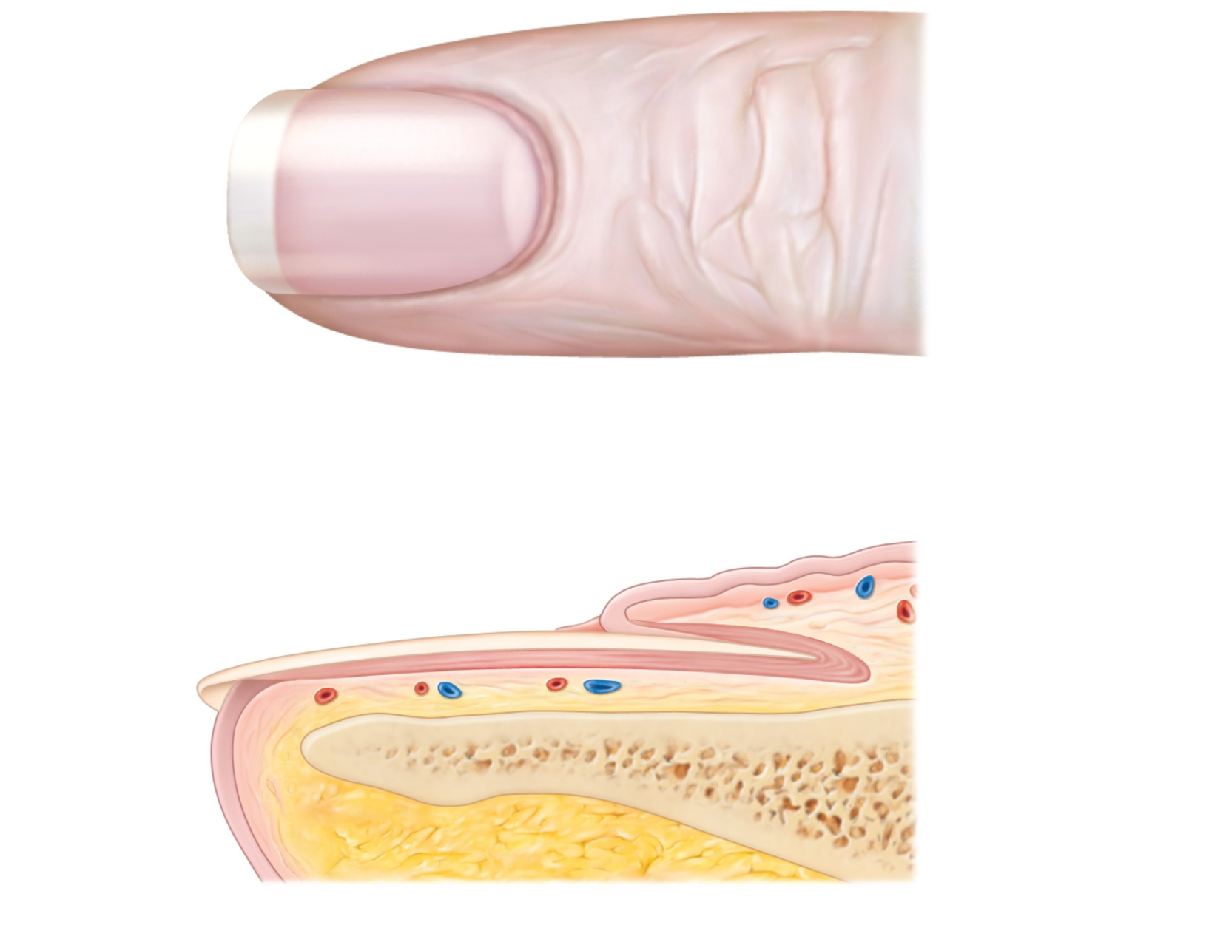
Lateral
nail fold
Lunule
(a)
Free edge
of nail
Body
of nail
Eponychium
(cuticle)
Proximal
nail fold
Nail bed
Root of nail
Nail
matrix
(b)
Hyponychium
Phalanx (bone of fingertip)

Slide 21
Functions of the skin
Protection—three types of barriers
Chemical
Low pH secretions (acid mantle) and defensins retard bacterial activity

Slide 22
Functions ctied
Physical/mechanical barriers
Keratin and glycolipids block most water and water- soluble substances
Limited penetration of skin by lipid-soluble substances, plant oleoresins (e.g., poison ivy), organic solvents, salts of heavy metals, some drugs
Biological barriers
Dendritic cells, macrophages, and DNA

Slide 23
Function ctied
Body temperature regulation- it ensure that there is constant temperature by either conserving or emitting heat.
When the temperature of the circulating blood is cold, the temperature regulation center at the hypothalamus sends impulses that constrict the flow of blood to the dermis and also stimulate the skeletal muscles to shiver
When the body temperature rises between 0.25°c and 0.5°c the sweat glands secret sweat into the skin, evaporation of the sweat cools the temperature
The amount of blood supply to the skin greatly affects the amount of heat lost

Slide 24
Functions ctied
Fever is as a result of pyogens released by cells in the inflammatory region in case of an infection which cause the hypothalamus to release prostaglandins that resets the hypothalamic thermostat to a higher temperature
Hypothermia is a core temperature below 35°c. at 32°c , compensatory mechanism that restore temperature fails and fatality can occur at 25°c

Slide 25
Functions ctied
3. Metabolic functions
Synthesis of vitamin D by converting 7-dehydrocholesterol in the presence of ultraviolet rays into vit D which is used with calcium and phosphate in formation and maintained of bone

Slide 26
Functions ctied
4. Cutaneous sensations- there sensory receptors which are sensitive to:
Temperature, touch, and pain
5. Blood reservoir—up to 5% of body’s blood volume
6. Excretion—nitrogenous wastes and salt are excreted in sweat

Slide 27
Functions ctied
7. absorption- some drugs, hormone and toxic chemicals can be absorbed through the skin

Slide 28
WOUND HEALING
The following conditions affect the healing process of a wound:
Systemic factors like infection, nutrition and general health, immunity, blood supply and systemic conditions
Local factors like blood supply, contamination

Slide 29
Primary healing(healing by first intention
This follows minimal destruction of tissue and the damaged edges are in close apposition. The following are the stages:
Inflammation- the surface become inflamed and the blood clot and cell debris fill the gap between them. Phagocytes begin to remove the debris stimulating fibroblast activity which secrete collagen that binds the surfaces together

Slide 30
Healing by ctied
Proliferation-epithelial cells proliferate across the wound , epidermis meet and grow upwards. Granulation tissue develop invading the clot and restoring blood supply. Fibroblasts continue secreting collagen fibbers as the debris and any bacteria are removed by phagocytosis
Maturation- granulation tissues replaced by fibrous scar tissue rearrangement of collagen fibres occur and the strength of wound healing increases

Slide 31
Secondary healing ( healing by secondary intention)
This follows destruction of large amount of tissue or where the damaged edges cannot be brought into apposition
The stages are the same as in primary healing and the time depends on the effective removal of the cause and the size of the wound

Slide 32
Fibrosis/ scar formation
Fibrous fibre is formed during secondary healing. The process begins with formation of granulation tissue then over time new capillaries and inflammatory material are removed leaving collagen fibres.
adhesions- they cause adjacent structures to stick together and may limit movement
Fibrosis of infarcts- is caused by blockage of a vessel by thrombus or an embolus. Fibrosis of one large infarct or several small one may cause dysfunction of organ

Slide 33
Tissue shrinkage-it occurs as the fibrous tissue ages. The effect depend son the site and extent of the fibrosis e.g. small tubes may narrow or get obstructed and loss their elasticity, contractures may extend across the joints

Slide 34
Complications of wound healing
Infection this is usually by bacteria which causes pus formation.
Healing following pus formation is by secondary intention
Superficial abscesses tend to rupture and discharge pus through the skin. Healing is usually complete
Deep abscess may have various outcomes like the following:

Slide 35
Complications ctied
Early rapture and complete discharge of pus followed by complete healing
Rupture and limited discharge of pus followed by development of a chronic abscess with sinus
Rupture and discharge of pus into the adjacent organs or cavity forming a fistula
Eventual removal of pus by phagocytes followed by healing

Slide 36
Enclosure of pus by fibrous tissue that may become source of infection
Formation of adhesions between adjacent membranes
Shrinkage of fibrous tissue as it ages which may reduce the lumen or obstruct a tube

