Slide 1
THE SPECIAL SENSES
SAMUEL NGIGI K.
KMTC

Slide 2
SPECIAL SENSE OF VISION
Topic Objectives
Describe the various parts of the eye and list the functions of each.
Explain how light rays in the environment are brought to a focus on the retina and the role of accommodation in this process.
Describe the electrical responses produced by rods and cones and explain how these responses are produced.
Trace the neural pathways that transmit visual information from the rods and cones to the visual cortex.
Define the following terms: hyperopia, myopia, astigmatism, presbyopia, and strabismus.

Slide 3
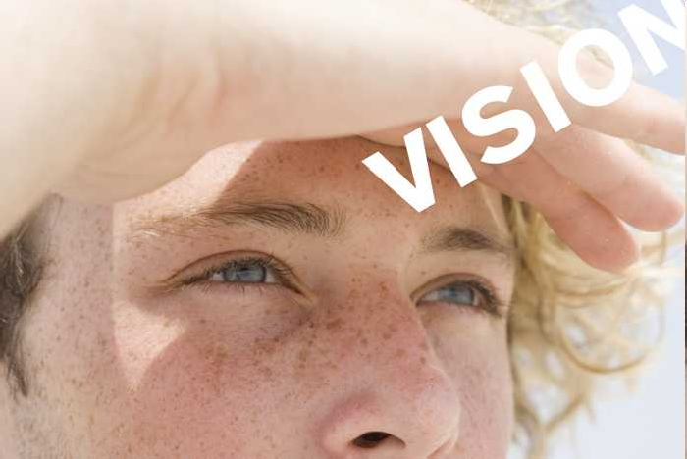
One of the senses that make or destroy a Man

Slide 4
The eyes are complex sense organs.
Within its protective casing, each eye has:
a layer of receptors;
a lens system that focuses light on these receptors; and
a system of nerves that conducts impulses from the receptors to the brain.
The way these components operate to set up conscious visual images is the subject of this lesson.

Slide 5
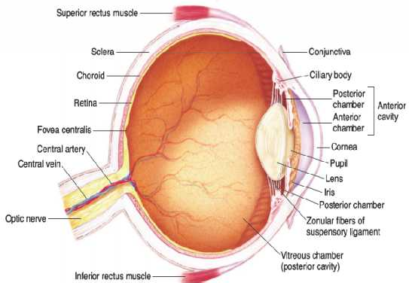
Anatomy of the Eye
Lining the posterior two thirds of the choroid is the retina, the neural tissue containing the receptor cells.
The outer protective layer of the eyeball, the sclera, is modified anteriorly to form the transparent cornea, through which light rays enter the eye.
Inside the sclera is the choroid, a layer that contains many of the blood vessels that nourish the structures in the eyeball.
The internal anatomy of the eye (Adapted from Medical Physiology: a Systems Approach by Hershel and Michael. McGraw-Hill Company, 2011).

Slide 6

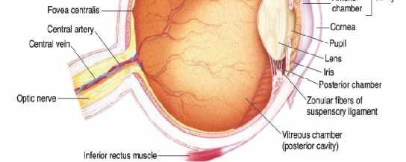
Variations in the diameter of the pupil can produce up to a 5-fold change in the amount of light reaching the retina.
The crystalline lens is a transparent structure held in place by a circular lens suspensary ligament (zonule) that is attached to the thickened anterior part of the choroid, the ciliary body.
The ciliary body contains circular and longitudinal muscle fibers that attach near the corneoscleral junction.
In front of the lens is the pigmented and opaque iris, the colored portion of the eye, which contains circular muscle fibers that constrict and radial fibers that dilate the pupil.
The internal anatomy of the eye (Adapted from Medical Physiology: a Systems Approach by Hershel and Michael. McGraw-Hill Company, 2011).

Slide 7
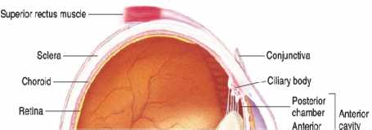

The space between the lens and the retina is filled primarily with a clear gelatinous material called the vitreous humor.
The space between the lens and the retina is filled primarily with a clear gelatinous material called the vitreous humor.
Aqueous humor, a clear liquid that nourishes the cornea and lens, is produced in the ciliary body by diffusion and active transport from plasma.
It flows through the pupil and fills the anterior chamber of the eye.
It is normally reabsorbed
through the canal of Schlemm, a venous channel at the junction between the iris and the cornea (anterior chamber angle).
The internal anatomy of the eye (Adapted from Medical Physiology: a Systems Approach by Hershel and Michael. McGraw-Hill Company, 2011).

Slide 8
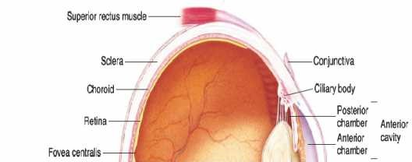

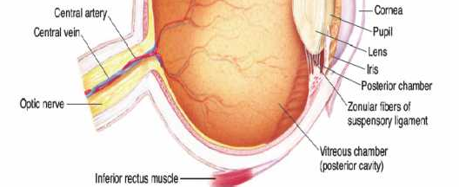
Obstruction of this outlet leads to increased intraocular pressure.
One cause of increased pressure is decreased permeability through:
the trabecular meshwork,
the tissue around the base of the cornea that drains the aqueous humor from the eye (open-angle glaucoma); and
forward movement of the iris, obliterating the angle (angle- closure glaucoma).
The internal anatomy of the eye (Adapted from Medical Physiology: a Systems Approach by Hershel and Michael. McGraw-Hill Company, 2011).

Slide 9
Glaucoma can be treated with β-adrenergic blocking drugs or carbonic anhydrase inhibitors, both of which decrease the production of aqueous humor, or with cholinergic agonists, which increase aqueous outflow.
The eye is well protected from injury by the bony walls of the orbit.
The cornea is moistened and kept clear by tears that course from the lacrimal gland in the upper portion of each orbit across the surface of the eye to empty via the lacrimal duct into the nose.
Blinking helps keep the cornea moist.

Slide 10
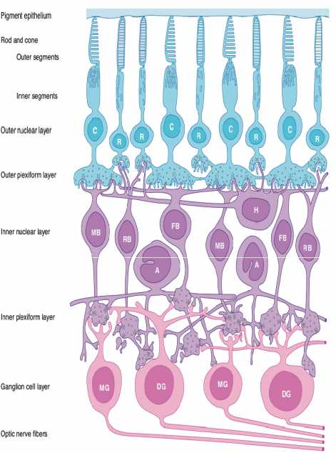
Retina
The retina extends anteriorly almost to the ciliary body. It is organized into:
10 layers within which;
Are found rods and cones, which are the visual receptors and some non-visual Photoreceptors (e.g. melanopsin); and
four types of neurons: bipolar cells, ganglion cells, horizontal cells, and amacrine cells.
Neural components of the extrafoveal portion of the retina (Adapted from Medical Physiology: a Systems Approach by Hershel and Michael. McGraw-Hill Company, 2011).

Slide 11
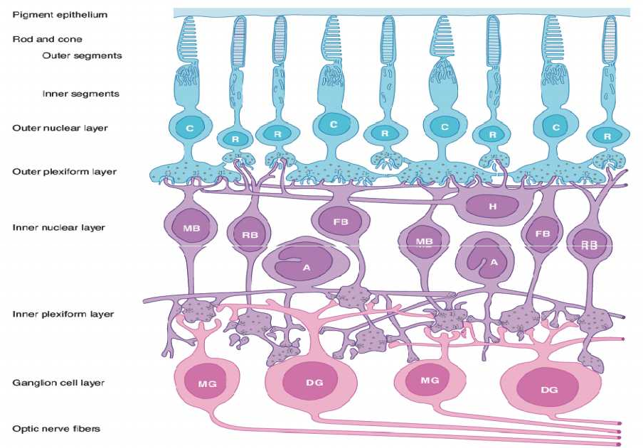
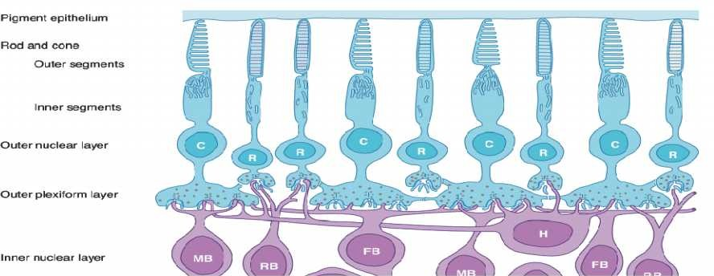
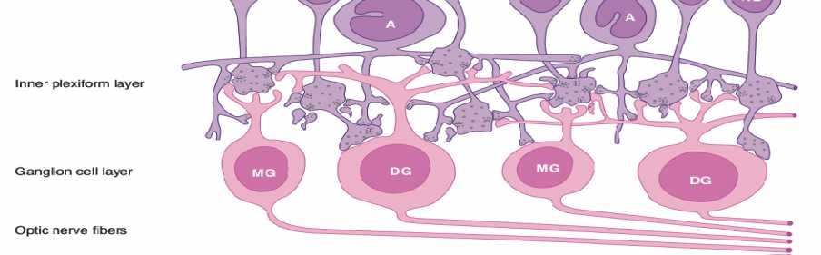
Neural components of the extrafoveal portion of the retina (Adapted from Medical Physiology: a Systems Approach by Hershel and Michael. McGraw-Hill Company, 2011). Key: C, cone; R, rod; MB, RB, and FB, midget, rod, and flat bipolar cells; DG and MG, diffuse and midget ganglion cells; H, horizontal cells; A, amacrine cells.

Slide 12
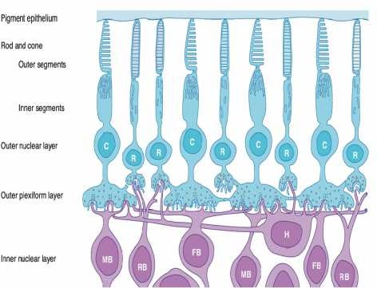
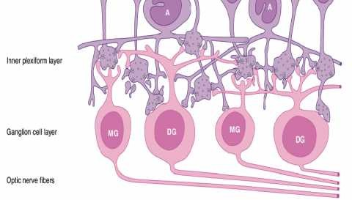
Rods and cones, which are next to the choroid, synapse with bipolar cells, and bipolar cells synapse with ganglion cells.
The axons of ganglion cells converge and leave the eye as the optic nerve.
Horizontal cells connect receptor cells to the other receptor cells in the outer plexiform layer.
Amacrine cells connect ganglion cells to one another in the inner plexiform layer via processes of varying length and patterns.
Neural components of the extrafoveal portion of the retina (Adapted from Medical Physiology: a Systems Approach by Hershel and Michael. McGraw-Hill Company, 2011).

Slide 13
Gap junctions also connect retinal neurons to one another.
The receptor layer of the retina rests on the pigment epithelium next to the choroid, so light rays must pass through the ganglion cell and bipolar cell layers to reach the rods and cones.
The pigment epithelium absorbs light rays, preventing the reflection of rays back through the retina.
Such reflection would produce blurring of the visual images.
Neural components of the extrafoveal portion of the retina (Adapted from Medical Physiology: a Systems Approach by Hershel and Michael. McGraw-Hill Company, 2011).

Slide 14
The optic nerve leaves the eye and the retinal blood vessels enter it at a point 3 mm medial to and slightly above the posterior pole of the globe.
This region is visible through the ophthalmoscope as the optic disk.
There are no visual receptors over the disk, and consequently it is a blind spot.
Near the posterior pole of the eye is a yellowish pigmented spot, the macula lutea.
Neural components of the extrafoveal portion of the retina (Adapted from Medical Physiology: a Systems Approach by Hershel and Michael. McGraw-Hill Company, 2011).

Slide 15

When attention is attracted to or fixed on an object, the eyes are normally moved so that light rays coming from the object fall on the fovea.
This marks the location of the fovea centralis, a thinned-out, rod-free portion of the retina.
In it, the cones are densely packed, and each synapses to a single bipolar cell, which, in turn, synapses on a single ganglion cell, providing a direct pathway to the brain.
There are very few overlying cells and no blood vessels; thus, the fovea is the point where visual acuity is greatest.
Neural components of the extrafoveal portion of the retina (Adapted from Medical Physiology: a Systems Approach by Hershel and Michael. McGraw-Hill Company, 2011).

Slide 16
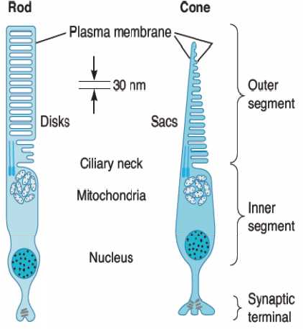
Visual Receptors in the Retina
Rods are responsible for vision in low light (night vision) and provide only black and white vision.
Cones are responsible for
color vision.
Each rod and cone is divided into an outer segment, an inner segment that includes a nuclear region, and a synaptic zone.
Schematic diagram of a rod and a cone

Slide 17

The outer segments are modified cilia and are made up of regular stacks of flattened saccules or disks composed of membrane.
These saccules and disks contain the photosensitive compounds that react to light, initiating action potentials in the visual pathways.
The inner segments are rich in mitochondria.
Schematic diagram of a rod and a cone

Slide 18
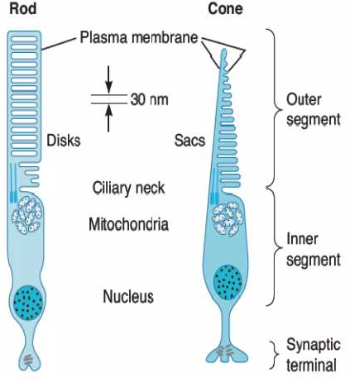
The rods are named for the thin, rod like appearance of their outer segments.
In the extrafoveal portions of the retina, rods predominate, and there is a good deal of convergence.
Cones generally have thick inner segments and conical outer segments, although their morphology varies from place to place in the retina.
In cones, the saccules are formed in the outer segments by infoldings of the cell membrane, but in rods the disks are separated from the cell membrane.
Schematic diagram of a rod and a cone

Slide 19
Flat bipolar cells make synaptic contact with several cones, and rod bipolar cells make synaptic contact with several rods.
Because there are approximately 6 million cones and 120 million rods in each human eye but only 1.2 million nerve fibers in each optic nerve, the overall convergence of receptors through bipolar cells on ganglion cells is about 105:1. However, there is divergence from this point on.
There are twice as many fibers in the geniculocalcarine tracts as in the optic nerves, and in the visual cortex, the number of neurons concerned with vision is 1,000 times the number of fibers in the optic nerves.

Slide 20
The Image-forming Mechanism
The eyes convert energy in the visible spectrum into action potentials in the optic nerve.
The images of objects in the environment are focused on the retina.
The light rays striking the retina generate potentials in the rods and cones.
Impulses initiated in the retina are conducted to the cerebral cortex, where they produce the sensation of vision.

Slide 21
Light rays are bent when they pass from a medium of one density into a medium of a different density, except when they strike perpendicular to the interface.
The bending of light rays is called refraction and is the mechanism that allows one to focus an accurate image onto the retina.
Parallel light rays striking a biconvex lens are refracted to a point behind the lens.
In the eye, light is actually refracted at the anterior surface of the cornea and at the anterior and posterior surfaces of the lens.
The process of refraction can be represented diagrammatically by drawing the rays of light as if all refraction occurs at the anterior surface of the cornea.

Slide 22
The retinal image is inverted.
The connections of the retinal receptors are such that from birth any inverted image on the retina is viewed right side up and projected to the visual field on the side opposite to the retinal area stimulated.
This perception is present in infants and is innate.
Common Defects of the Image-forming Mechanism
In some individuals, the eyeball is shorter than normal and the parallel rays of light are brought to a focus behind the retina.
This abnormality is called hyperopia or farsightedness.

Slide 23
Sustained accommodation (focusing due to contraction of the ciliary muscle), even when viewing distant objects, can partially compensate for the defect, but the prolonged muscular effort is tiring and may cause headaches and blurring of vision.
The defect can be corrected by using glasses with convex lenses, which aid the refractive power of the eye in shortening the focal distance.
In myopia (nearsightedness), the anteroposterior diameter of the eyeball is too long.
The shape of the eye appears to be determined in part by the refraction presented to it.

Slide 24
In young adult humans, the extensive close work involved in activities such as studying accelerates the development of myopia.
This defect can be corrected by glasses with biconcave lenses, which make parallel light rays diverge slightly before they strike the eye.
Astigmatism is a common condition in which the curvature of the cornea is not uniform.
When the curvature in one meridian is different from that in others, light rays in that meridian are refracted to a different focus, so that part of the retinal image is blurred.
Astigmatism can usually be corrected with cylindrical lenses placed in such a way that they equalize the refraction in all meridians.

Slide 25
Strabismus is a misalignment of the eyes usually due to problems with eye muscles and one of the most common eye problems in children, affecting about 4% of children under 6 years of age.
It is characterized by one or both eyes turning inward (crossed-eyes), outward (wall eyes), upward, or downward.
Strabismus is also commonly called “wandering eye” or “crossed-eyes”. It occurs when visual images do not fall on corresponding retinal points.
When visual images chronically fall on non corresponding points in the two retinas in young children, one is eventually suppressed (suppression scotoma).

Slide 26
Accommodation
When the ciliary muscle is relaxed, parallel light rays striking the optically normal (emmetropic) eye are brought to a focus on the retina.
As long as this relaxation is maintained, rays from objects closer than 6 m from the observer are brought to a focus behind the retina, and consequently the objects appear blurred.
The problem of bringing diverging rays from close objects to a focus on the retina can be solved by increasing the curvature of the lens, a process called accommodation.
At rest, the lens is held under tension by the lens ligaments and is pulled into a flattened shape.

Slide 27
The ciliary muscle contracts when the gaze is directed at a near object.
This decreases the distance between the edges of the ciliary body and relaxes the lens ligaments, so that the lens springs into a more convex shape.
The degree to which the lens curvature can be increased is limited, and light rays from an object very near the individual cannot be brought to a focus on the retina, even with the greatest of effort.
The nearest point to the eye at which an object can be brought into clear focus by accommodation is called the near point of vision.
Due to increasing hardness of the lens, the near point recedes throughout life, slowly at first and then rapidly with advancing age, from 9 cm at age 10 to 83 cm at age 60.

Slide 28
By the time a healthy individual reaches age 40–45, the loss of accommodation is usually sufficient to make reading and close work difficult.
This condition, which is known as presbyopia, can be corrected by wearing glasses with convex lenses.
The Photoreceptor Mechanism- Ionic Basis of Photoreceptor Potentials
Na+ channels in the outer segments of the rods and cones are open in the dark, so current flows from the inner to the outer segment.
Current also flows to the synaptic ending of the photoreceptor.

Slide 29
The Na+, K+-ATPase in the inner segment maintains ionic equilibrium.
Release of synaptic transmitter is steady in the dark.
When light strikes the outer segment, the reactions that are initiated close some of the Na+ channels, and the result is a hyperpolarizing receptor potential.
The hyperpolarization reduces the release of synaptic transmitter, and this generates a signal in the bipolar cells that ultimately leads to action potentials in ganglion cells.
The photosensitive compounds in the rods and cones of the eyes are made up of a protein called an opsin and retinal, the aldehyde of vitamin A.

Slide 30
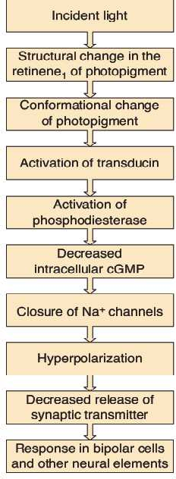
The photosensitive pigment in the rods is called rhodopsin, one of the many receptors coupled to G proteins with Its opsin called scotopsin.
Rhodopsin has a peak sensitivity to light at a wavelength of 505 nm.
Sequence of Events in Photoreceptors
Light activates rhodopsin that then activates the associated heterotrimeric G protein, transducin.
The G protein exchanges GDP for GTP, and the α-subunit separates.

Slide 31
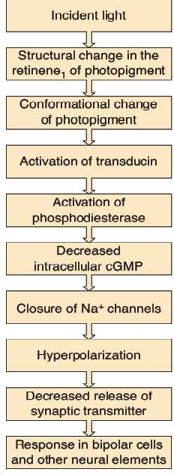
This subunit remains active until its intrinsic GTPase activity hydrolyzes the GTP.
The α-subunit activates cGMP phosphodiesterase, which converts cGMP to 5′-GMP.
cGMP normally acts directly on Na+ channels to maintain them in the open position, so the decline in the cytoplasmic cGMP concentration causes some Na⁺ channels to close.
This produces the hyperpolarizing potential.

Slide 32
This cascade of reactions occurs very rapidly and amplifies the light signal.
The amplification helps explain the remarkable sensitivity of rod photoreceptors; these receptors are capable of producing a detectable response to as little as one photon of light.
Cone receptors subserve color vision and respond maximally to light at wavelengths of 440, 535, and 565 nm.
The cone opsin resembles rhodopsin.
The cell membrane of cones is invaginated to form the saccules, but the cones have no separate intracellular disks like those in rods.
The details of theresponses of cones to light are similar to those in rods.

Slide 33
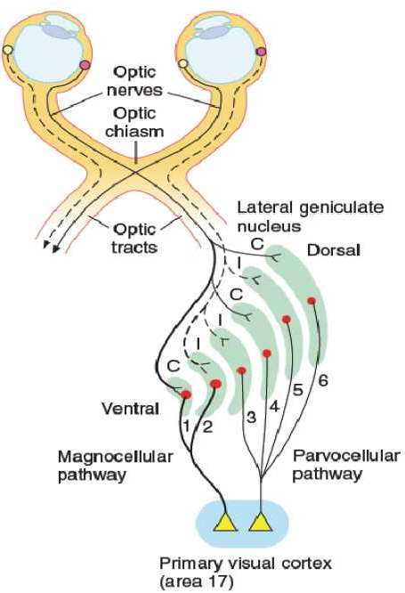
Visual Pathways
The axons of the retinal ganglion cells pass caudally in the optic nerve and optic tract to end in the lateral geniculate body in the thalamus.
The fibers from each nasal hemiretina decussate in the optic chiasm.
In the geniculate body, the fibers from the nasal half of one retina and the temporal half of the other synapse on the cells whose axons form the geniculocalcarine tract.

Slide 34
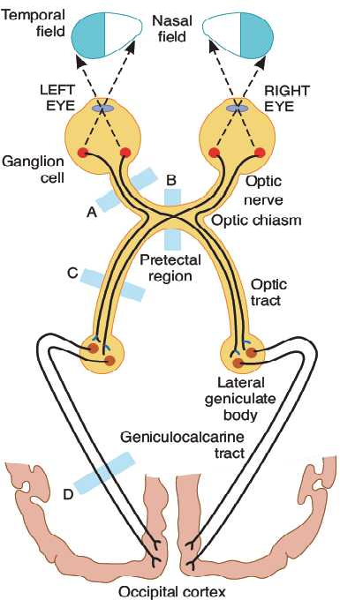
This tract passes to the occipital lobe of the cerebral cortex.
The primary visual receiving area (primary visual cortex, Brodmann’s area 17; also known as V1) is located principally on the sides of the calcarine fissure.

Slide 35
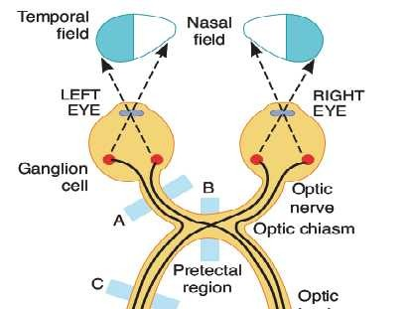
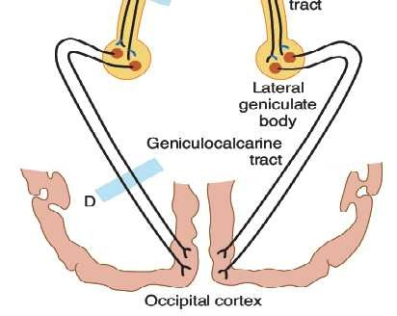
Effect of Lesions in the Optic Pathways
Lesions along the neural pathways from the eyes to the brain can be localized with a high degree of accuracy by the effects they produce in the visual fields.
The fibers from the nasal half of each retina decussate in the optic chiasm, so that the fibers in the optic tracts are those from the temporal half of one retina and the nasal half of the other.

Slide 36
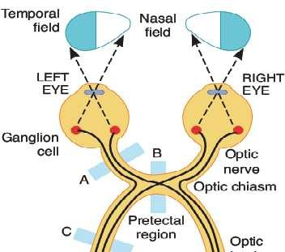
Since each optic tract subserves half of the field of vision, a lesion of one optic nerve causes blindness in that eye, but a lesion in one optic tract causes blindness in half of the visual field.
This defect is classified as a homonymous (same side of both visual fields) hemianopia (half-blindness).

Slide 37
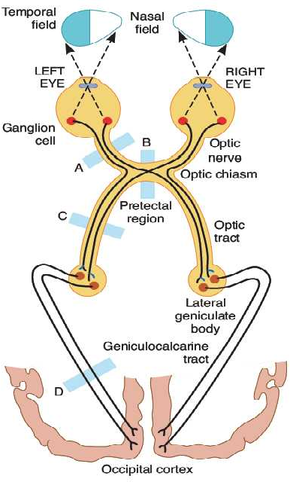
Lesions affecting the optic chiasm (e.g., pituitary tumors) cause disruption of the fibers from both nasal hemiretinas and produce a heteronymous (opposite sides of the visual fields) hemianopia.
Because the fibers from the maculas are located posteriorly in the optic chiasm, hemianopic scotomas develop before vision in the two hemiretinas is completely lost.

Slide 38
Selective visual field defects are further classified as bitemporal, binasal, and right or left.
The optic nerve fibers from the upper retinal quadrants subserving vision in the lower half of the visual field terminate in the medial half of the lateral geniculate body, whereas the fibers from the lower retinal quadrants terminate in the lateral half.

Slide 39
Color Vision
Colors have three attributes: hue, intensity, and saturation
(degree of freedom from dilution with white).
For any color there is a complementary color that, when properly mixed with it, produces a sensation of white.
Black is the sensation produced by the absence of light, but it is probably a positive sensation because the blind eye does not “see black;” rather, it “sees nothing.”
The sensation of white, any spectral color, and even the extraspectral color, purple, can be produced by mixing various proportions of red light (wavelength 723 - 647 nm), green light (575 - 492 nm), and blue light (492 - 450 nm).
Red, green, and blue are therefore called the primary colors.

Slide 40
Also, the color perceived depends in part on the color of other objects in the visual field.
Thus, for example, a red object is seen as red if the field
is illuminated with green or blue light, but as pale pink or white if the field is illuminated with red light.
Color is mediated by ganglion cells that subtract or add input from one type of cone to input from another type.
Processing inthe ganglion cells and the lateral geniculate nucleus produces impulses that pass along three types of neural pathways that project to V1:
a red-green pathway that signals differences between L- and M-cone responses;

Slide 41
a blue-yellow pathway that signals differences between S-cone and the sum of L- and M-cone responses; and
a luminance pathway that signals the sum of L- and M-cone responses.
Blue-yellow color vision deficits are less common and show no gender selectivity.
Color blindness is usually due to an inherited absence of cones for specific colors.
It can also occur in individuals with lesions of area V8 of the visual cortex.

Slide 42
These pathways project to the blobs and the deep portion of layer 4 of V1.
From the blobs and layer 4, color information is projected to V8.
However, it is not known how V8 converts color input into the sensation of color.
Color blindness is most often an inherited condition in which individuals are unable to distinguish certain colors.
The most common type is a red-green color vision deficit, a genetically sex-linked condition that occurs in about 8% of males and 0.4% of females.

Slide 43
Pupillary Light Reflex
When light is directed into one eye, the pupil constricts
(pupillary light reflex).
The optic nerve fibers that carry the impulses initiating these pupillary responses leave the optic nerves near the lateral geniculate bodies.
On each side, they enter the midbrain via the brachium of the superior colliculus and terminate in the pretectal nucleus.
From this nucleus, the second-order neurons project to the ipsilateral and contralateral Edinger–Westphal nucleus.
The third-order neurons pass from this nucleus to the ciliary ganglion in the oculomotor nerve, and the fourth-order neurons pass from this ganglion to the ciliary body.

Slide 44
Eye Movements
The eye is moved within the orbit by six ocular muscles.
These are innervated by the oculomotor, trochlear, and
abducens (cranial) nerves.
Because the oblique muscles pull medially, their actions vary with the position of the eye.
When the eye is turned nasally, the inferior oblique elevates it and the superior oblique depresses it.
When it is turned laterally, the superior rectus elevates it and the inferior rectus depresses it.
Because much of the visual field is binocular, a very high order of coordination of the movements of the two eyes is necessary if visual images are to fall at all times on corresponding points in the two retinas and to avoid diplopia (double vision).

Slide 45
There are four types of eye movements, each controlled by a different neural system but sharing the same final common path, the motor neurons that supply the external ocular muscles.
Saccades, sudden jerky movements, occur as the gaze shifts from one object to another.
They bring new objects of interest onto the fovea and reduce adaptation in the visual pathway that would occur if gaze were fixed on a single object for long periods.
Smooth pursuit movements are tracking movements of the eyes as they follow moving objects.
Vestibular movements, adjustments that occur in response to stimuli initiated in the semicircular canals, maintain visual fixation as the head moves.

Slide 46
Convergence movements bring the visual axes toward each other as attention is focused on objects near the observer.
Saccadic movements seek out visual targets, pursuit movements follow them as they move about, and vestibular movements stabilize the tracking device as the platform on which the device is mounted (i.e., the head) moves about.
Saccades are programmed in the frontal cortex and the superior colliculi and pursuit movements in the cerebellum.

Slide 47
HEARING AND EQUILIBRIUM
Topic Objectives
Describe the components and functions of the external, middle, and inner ear.
Describe the way that movements of molecules in the air are converted into impulses generated in hair cells in the cochlea.
Trace the path of auditory impulses in the neural pathways from the cochlear hair
cells to the auditory cortex, and discuss the function of the auditory cortex.
Explain how pitch and loudness are coded in the auditory pathways.
Describe the various forms of deafness and tests for their diagnosis.
Explain how the receptors in the semicircular canals detect acceleration
rotational
and how the receptors in the saccule and utricle detect linear acceleration.
List the major sensory inputs that provide the information synthesized in the brain into the sense of position in space.

Slide 48
Receptors for hearing and equilibrium are housed in the ear.
The external ear, middle ear, and cochlea of the inner ear are concerned with hearing.
The semicircular canals, utricle, and saccule of the inner ear are concerned with equilibrium.
Receptors in:
the semicircular canals (hair cells) detect rotational acceleration;
receptors in the utricle detect linear acceleration in the horizontal direction; and
receptors in the saccule detect linear acceleration in the vertical direction.

Slide 49
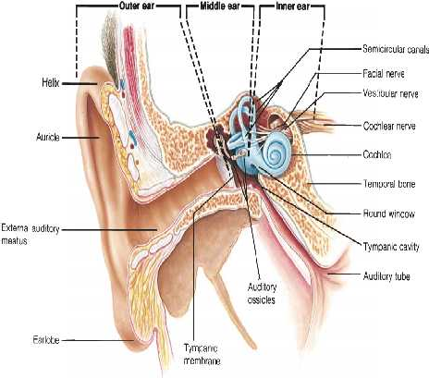
Anatomy of the External and Middle Ear
The external ear funnels sound waves to the external auditory meatus.
Sound waves pass inward to the tympanic membrane (eardrum).
The middle ear is an air-filled cavity in the temporal bone that opens via the auditory (Eustachian) tube into the nasopharynx and through the nasopharynx to the exterior.
The tube is usually closed, but during swallowing, chewing, and yawning it opens, equalizing air pressure on the two sides of the eardrum.

Slide 50
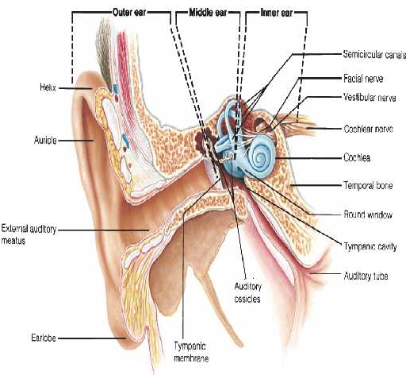
The three auditory ossicles (malleus, incus, and stapes) are in the middle ear.
The manubrium (handle of the malleus) is attached to the back of the tympanic membrane.
Its head is attached to the wall of the middle ear, and its short process is attached to th incus, which articulates with th head of the stapes.
The foot plate of the stapes is attached by an annular ligament to the walls of the oval window.
e
e

Slide 51
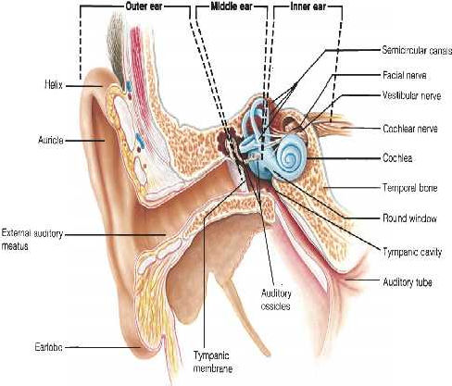
Two small skeletal muscles (tensor tympani and stapedius) are located in the middle ear.
Contraction of the tensor tympani pulls the manubrium of the malleus medially and decreases the vibrations of the tympanic membrane;
Contraction of the stapedius pulls the foot plate of the stapes out of the oval window.

Slide 52
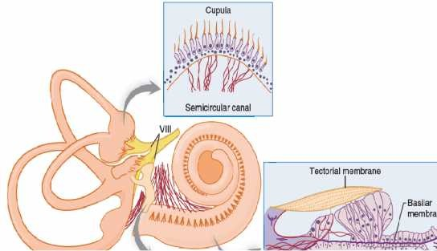
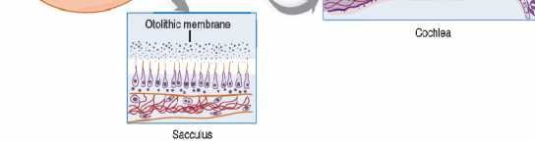
Anatomy of the Inner Ear and Cochlea
The inner ear (labyrinth) made up of two parts, one within the other.
The bony labyrinth is a series of channels in the temporal bone.
is
Inside these channels, surrounded by a fluid (perilymph) is the membranous labyrinth that is filled with a K⁺-rich fluid (endolymph).
There is no communication between the spaces filled with endolymph and those filled with perilymph.

Slide 53
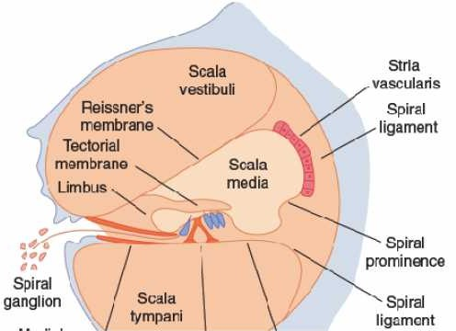
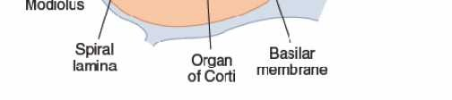
The cochlear portion of the labyrinth is a coiled tube that, in humans, is 35-mm long and makes approximately 2.75 turns.
The basilar membrane and Reissner’s membrane divide it into three chambers or scalae.
The upper scala vestibuli and the lower scala tympani contain perilymph and communicate with each other at the apex of the cochlea via a small opening (helicotrema).
At the base of the cochlea, the scala vestibuli ends at the oval window, which is closed by the footplate of the stapes.

Slide 54
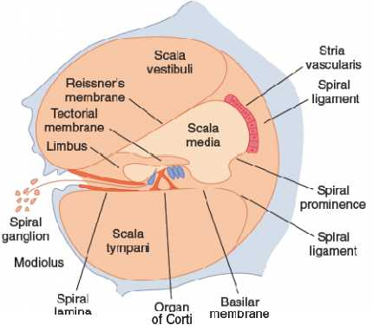
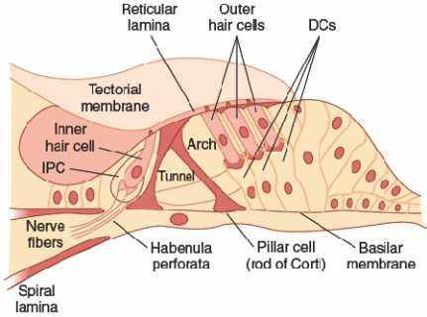
The scala tympani end at the round window, a foramen on the medial wall of the middle ear that is closed by the flexible secondary tympanic membrane.
The scala media is continuous with the membranous labyrinth and does not communicate with the other two scalae.
The organ of Corti contains the auditory receptors (hair cells) whose processes pierce the reticular lamina that is supported by the pillar cells or rods of Corti

Slide 55
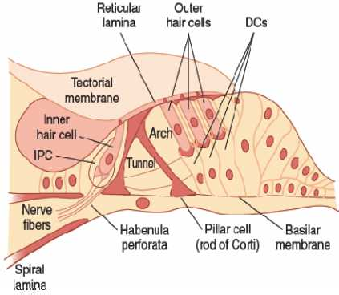
The hair cells are arranged in four rows:
three rows of outer hair cells lateral to the tunnel formed by the rods of Corti; and
one row of inner hair cells medial to the tunnel.
Covering the rows of hair cells is the tectorial membrane in which the tips of the hairs of the outer cells are embedded.
~95% of these sensory neurons innervate inner hair cells; and
~5% innervate outer hair cells, and each sensory neuron innervates several outer hair cells.
The cell bodies of the sensory neurons are located in the spiral ganglion within the modiolus:

Slide 56
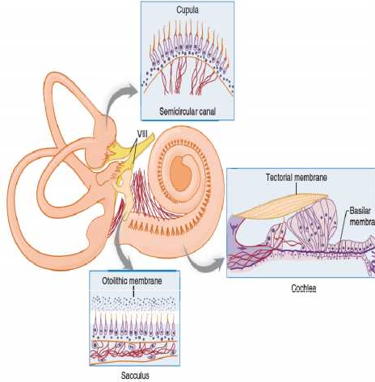
By contrast, most efferent fibers in the auditory nerve terminate on the outer hair cells.
The axons of afferent neurons that innervate hair cells form the auditory (cochlear) division of the eighth cranial nerve.
The semicircular canals are oriented in the three planes.
Inside the bony canals, the membranous canals are suspended in perilymph.
A receptor structure (crista ampullaris) is located in the expanded end (ampulla) of each of the membranous canals.

Slide 57

Each crista consists of hair cells and supporting (sustentacular) cells surmounted by a gelatinous partition (cupula) that closes off the ampulla.
The processes of the hair cells are embedded in the cupula, and the bases of the hair cells contact the afferent fibers of the vestibular division of the eighth cranial nerve.
A receptor structure (crista ampullaris) is located in the expanded end (ampulla) of each of the membranous canals.
Within each membranous labyrinth is an otolithic organ (macula).

Slide 58
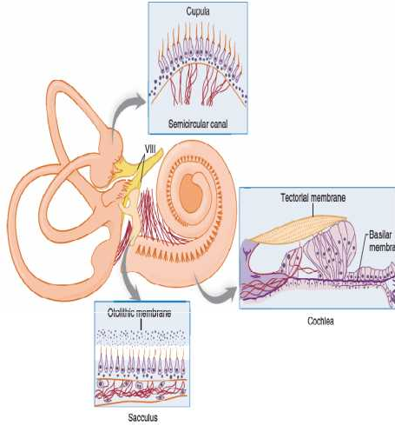
Another macula is located on the wall of the saccule in a semivertical position.
The maculae contain supporting cells and hair cells, surmounted by an otolithic membrane in which are embedded crystals of calcium carbonate, the otoliths, which are also called otoconia or ear dust.
The processes of the hair cells are embedded in the membrane.
The nerve fibers from the hair cells join those from the
cristae in the vestibular
division of the eighth cranial nerve.

Slide 59
Auditory Receptors: Hair Cells
The hair cells:
in the organ of Corti signal hearing;
in the utricle signal horizontal acceleration;
in the saccule signal vertical acceleration; and
a patch in each of the three semicircular canals signals rotational acceleration.
These hair cells have a common structure.
Each is embedded in an epithelium made up of supporting cells, with the basal end in close contact with afferent neurons.
Projecting from the apical end are 30–150 rod-shaped processes or hairs.

Slide 60
Except in the cochlea, one of these, the kinocilium, is a true but nonmotile cilium with nine pairs of microtubules around its circumference and a central pair of microtubules.
It is one of the largest processes and has a clubbed end.
The kinocilium is lost from the hair cells of the cochlea in adults; however, the other processes (stereocilia) are found in all hair cells.
They have cores composed of parallel filaments of actin that is coated with isoforms of myosin.
Within the clump of processes on each cell there is an orderly structure.
Along an axis toward the kinocilium, the stereocilia increase progressively in height; along the perpendicular axis, all stereocilia are the same height.

Slide 61
Electrical Responses
The resting membrane potential of the hair cells is about –60 mV.
When the stereocilia are pushed toward the kinocilium, the membrane potential is decreased to about –50 mV.
The hair processes provide a mechanism to generate changes in membrane potential proportional to the direction and distance the hair moves.
When the bundle of processes is pushed in the opposite direction, the cell is hyperpolarized.
Displacing the processes in a direction perpendicular to this axis provides no change in membrane potential.
On the other hand, displacing the processes in directions that are intermediate between these two directions produces depolarization or hyperpolarization that is proportionate to the degree to which the direction is toward or away from the kinocilium.

Slide 62
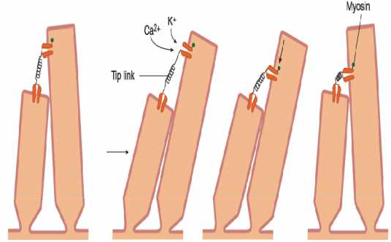
Genesis of Action Potentials in Afferent Nerve Fibers
Very fine processes called tip links tie the tip of each stereocilium to the side of its higher neighbor, and at the junction are mechanosensitive cation channels.
If shorter stereocilia are pushed toward higher ones, the open time of the channels increases.
A molecular motor in the higher neighbor then may move the channel toward the base, releasing tension in the tip link.
K⁺ and Ca²⁺ enter via the channel and produce depolarization.
This causes the channel to close and permits restoration of the resting state.

Slide 63
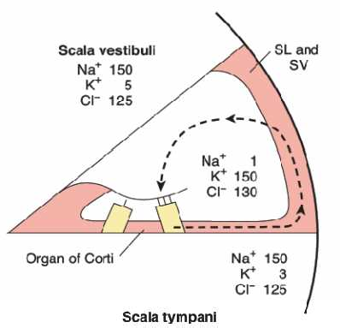
Depolarization of hair cells causes them to release a neurotransmitter that initiates depolarization of neighboring afferent neurons.
The K+ that enters hair cells via the mechanosensitive cation channels is recycled.
It enters supporting cells and then passes on to other supporting cells via tight junctions.
The processes of the hair cells project into the endolymph and the bases are bathed in perilymph.
In the cochlea, it eventually reaches the stria vascularis and is secreted back into the endolymph, completing the cycle.

Slide 64
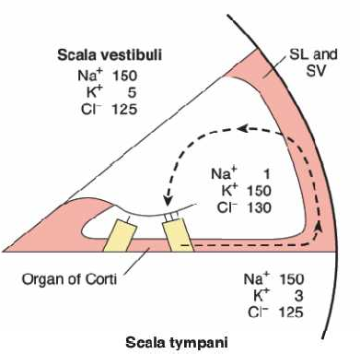
The perilymph is formed mainly from plasma; endolymph is formed in the scala media by the stria vascularis and has a high concentration of K+ and a low concentration of Na+.
Cells in the stria vascularis have a high concentration of Na⁺,K⁺- ATPase.

Slide 65
Hearing
Sound Waves
Sound is the sensation produced when vibrations of molecules in the external environment strike the tympanic membrane.
The loudness of a sound is typically correlated with the amplitude of a sound wave and its pitch with its frequency (number of waves per unit of time).
The amplitude of a sound wave is expressed on a relative scale, called a decibel scale.
The intensity of a sound in bels is the logarithm of the ratio of the intensity of that sound to a standard sound.
A value of 0 dB does not mean the absence of sound; rather, it is a sound level whose intensity is equal to that of a standard.

Slide 66
The 0–160-dB range from threshold pressure to a pressure that is potentially damaging to the organ of Corti actually represents a 107-fold variation in sound pressure.
A range of 120–160 dB (e.g., firearms, jackhammer, jet plane on takeoff) is painful;
90–110 dB (e.g., subway, bass drum, chain saw, lawn mower) is extremely high;
60–80 dB (e.g., alarm clock, busy traffic, dishwasher, conversation) is very loud;
40–50 dB (e.g., moderate rainfall, normal room noise) is moderate; and
30 dB (e.g., whisper, library) is faint.

Slide 67
The sound frequencies audible to humans range from about 20 to 20,000 cycles per second (cps, Hz).
The range decreases with age, especially difficulty detecting higher frequency sounds.
The threshold of the human ear varies with the pitch of the sound; the greatest sensitivity is in the 1,000–4,000-Hz range.
The pitch of the average male and female voice in conversation is 120 and 250 Hz, respectively.
The number of pitches that can be distinguished by an average individual is about 2,000, but trained musicians can improve on this figure considerably.

Slide 68
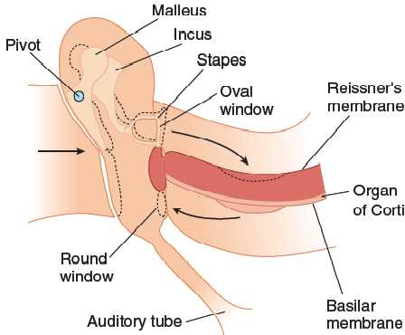
Sound transmission
The ear converts sound waves in the environment into action potentials in the auditory nerves.
The waves are transformed by the eardrum and auditory ossicles into movements of the foot plate of the stapes.
These movements set up waves in the fluid of the inner ear.
The action of the waves on the organ of Corti generates action potentials in the nerve.

Slide 69
The tympanic membrane moves in and out in response to the pressure changes produced by sound waves on its external surface.
Thus, the membrane functions as a resonator that reproduces the vibrations of the sound source.
It stops vibrating almost immediately when the sound wave stops.
The malleus rocks on an axis through the junction of its long and short processes, so that the short process transmits the vibrations of the manubrium to the incus.
The motions of the tympanic membrane are imparted to the manubrium.

Slide 70
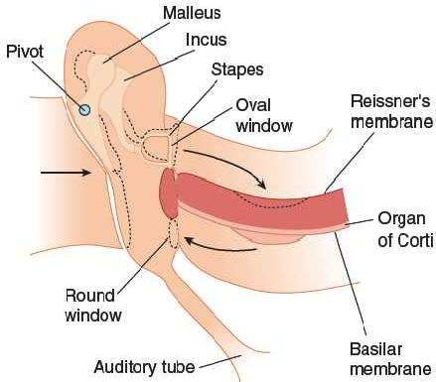
The incus moves in such a way that the vibrations are transmitted to the head of the stapes.
Movements of the head of the stapes swing its foot plate to and fro like a door hinged at the posterior edge of the oval window.
The auditory ossicles function as a lever system that converts the resonant vibrations of the tympanic membrane into movements of the stapes against the perilymph filled scala vestibuli of the cochlea.
This system increases the sound pressure that arrives at the oval window, because:

Slide 71
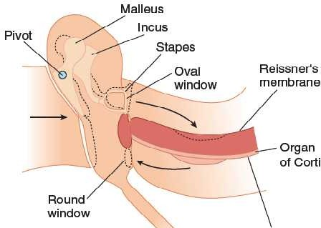
the lever action of the malleus and incus multiplies the force 1.3 times; and
the area of the tympanic membrane is much greater than the area of the foot plate of the stapes.
When the middle ear muscles
(tensor tympani and stapedius) contract, the manubrium of the malleus pulls inward and the foot plate of the stapes pushes outward, decreasing sound transmission.
Loud sounds initiate the tympanic reflex, which contracts the middle ear muscles to prevent strong sound waves from causing excessive stimulation of the auditory receptors.

Slide 72
Bone and Air Conduction
Ossicular conduction is the normal conduction of sound waves to the fluid of the inner ear via the tympanic membrane and the auditory ossicles
Sound waves also initiate vibrations of the secondary tympanic membrane that closes the round window; this process, unimportant in normal hearing, is called air conduction.
Bone conduction is the transmission of vibrations of the bones of the skull to the fluid of the inner ear; this plays a role in transmission of extremely loud sounds.
Considerable bone conduction also occurs when a vibrating tuning fork is applied directly to the skull.

Slide 73
Traveling Waves
The movements of the foot plate of the stapes set up a series of traveling waves in the perilymph of the scala vestibuli.
The bony walls of the scala vestibuli are rigid, but Reissner’s membrane is flexible.
The basilar membrane is not under tension, and it also is readily depressed into the scala tympani by the peaks of waves in the scala vestibuli.
Displacements of the fluid in the scala tympani are dissipated into air at the round window.
Sound distorts the basilar membrane, and the site at which this distortion is maximal is determined by the frequency of the sound wave.

Slide 74
The tops of the hair cells in the organ of Corti are held rigid by the reticular lamina, and the processes of the outer hair cells are embedded in the tectorial membrane.
When the stapes moves, both membranes move in the same direction, but they are hinged on different axes, so a shearing motion bends the hairs.
The processes of the inner hair cells are not attached to the tectorial membrane, but they are bent by fluid moving between the membrane and the underlying hair cells.

Slide 75
Action Potentials in Auditory Nerve Fibers
Inner hair cells are the primary sensory cells that generate action potentials in auditory nerves and are stimulated by the fluid movements noted above
Outer hair cells respond to sound, but depolarization makes them short and hyperpolarization makes them lengthy.
They do this over a very flexible part of the basal membrane, and this action increases the amplitude and clarity of sounds.
The frequency of the action potentials in auditory nerve fibers is proportional to the loudness of the sound stimuli.
The major determinant of the pitch perceived when a sound wave strikes the ear is the place in the organ of Corti that is maximally stimulated.

Slide 76
The traveling wave set up by a tone produces peak depression of the basilar membrane, and consequently maximal receptor stimulation, at one point.
The distance between this point and the stapes is inversely related to the pitch of the sound, with low tones producing maximal stimulation at the apex of the cochlea and high tones producing maximal stimulation at the base.

Slide 77
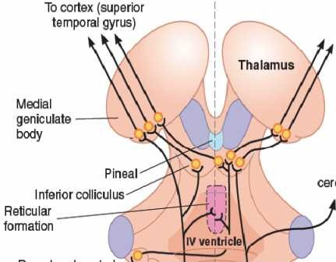
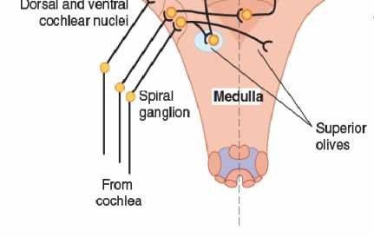
Central Pathway
The afferent fibers in the auditory division of the eighth cranial nerve end in dorsal and ventral cochlear nuclei.
To cerebellum
From there, auditory impulses pass by various routes to the auditory cortex via:
the inferior colliculi;
the centers for auditory reflexes; and
the medial geniculate body in the thalamus.
Auditory Pathway

Slide 78
Central Pathway
Other impulses enter the reticular formation.
Information from both ears converges on each superior olive, and beyond this, most of the neurons respond to inputs from both sides.
To cerebellum
The primary auditory cortex is Brodmann’s area 41.
Low tones are represented anterolaterally and high tones posteromedially in the auditory cortex.
Auditory Pathway

Slide 79
In the primary auditory cortex, most neurons respond to inputs from both ears, but strips of cells are stimulated by input from the contralateral ear and inhibited by input from the ipsilateral ear.
There are several additional auditory receiving areas, just as there are several receiving areas for cutaneous sensation.
The auditory association areas adjacent to the primary auditory receiving areas are widespread.
The olivocochlear bundle is a prominent bundle of efferent fibers in each auditory nerve that arises from both ipsilateral and contralateral superior olivary complexes and ends primarily around the bases of the outer hair cells of the organ of Corti.

Slide 80
Deafness
Hearing loss is the most common sensory defect in humans.
Presbycusis, the gradual hearing loss associated with aging, affects more than one third of those over 75 and is probably due to gradual cumulative loss of hair cells and neurons.
In most cases, hearing loss is a multifactorial disorder caused by both genetic and environmental factors.
Conductive deafness refers to impaired sound transmission in the external or middle ear and impacts all sound frequencies.
Causes of conduction deafness include:
plugging of the external auditory canals with wax or foreign bodies;

Slide 81
fluid accumulation due to otitis externa (inflammation of the outer ear, “swimmer’s ear”);
otitis media (inflammation of the middle ear);
perforation of the eardrum; and
Osteosclerosis in which bone is resorbed and replaced with sclerotic bone that grows over the oval window.
Sensorineural deafness is usually due to the loss of cochlear hair cells but can also be due to problems with the eighth cranial nerve or within central auditory pathways.
It can impair the ability to hear certain pitches while others are unaffected.

Slide 82
Aminoglycoside antibiotics such as streptomycin and gentamicin obstruct the mechanosensitive channels in the stereocilia of hair cells and can cause the cells to degenerate, producing sensorineural hearing loss and abnormal vestibular function.
Damage to the outer hair cells by prolonged exposure to noise is associated with hearing loss.
Other causes include tumors of the eighth cranial nerve and cerebellopontine angle and vascular damage in the medulla.
Conduction and sensorineural deafness can be differentiated by simple tests with a tuning fork.

Slide 83
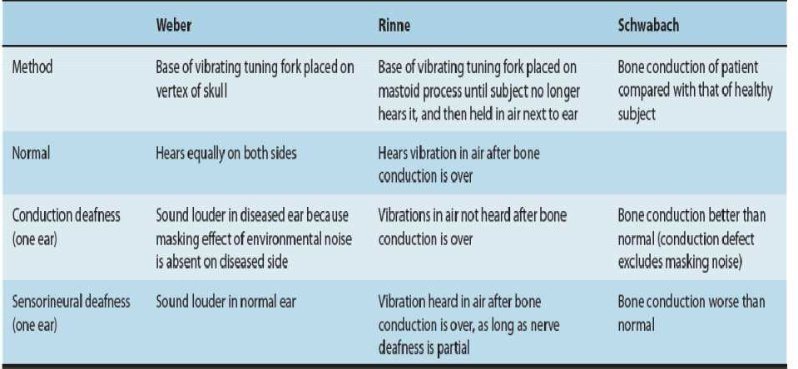
Three of these tests, named for the individuals who developed them, are outlined below.
The Weber and Schwabach tests demonstrate the important masking effect of environmental noise on the auditory threshold.
Common tests with a tuning fork to distinguish between sensorineural and conduction deafness.

Slide 84
VESTIBULAR SYSTEM
The vestibular system is divided into the vestibular apparatus and central vestibular nuclei
The vestibular apparatus within the inner ear detects head motion and position and transduces this information into a neural signal.
The vestibular nuclei are concerned with maintaining the position of the head in space; the tracts that descend from these nuclei mediate head-on-neck and head-on-body adjustments.
The vestibular ganglia contain the cell bodies of the neurons supplying the cristae and maculae.

Slide 85
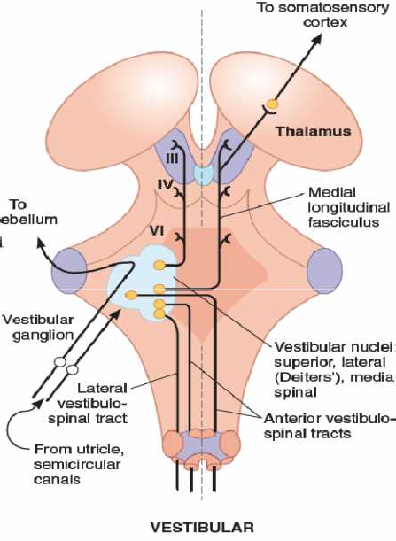
Each vestibular nerve terminates in the ipsilateral vestibular nucleus and in the flocculonodular lobe of the cerebellum.
Fibers from the semicircular canals end in the superior and medial divisions of the vestibular nucleus and project mainly to nuclei controlling eye movement.
Fibers from the utricle and saccule end in Deiters’ nucleus, which projects to the spinal cord.

Slide 86
The vestibular nuclei also project to the thalamus and from there to the primary somatosensory cortex.
The ascending connections to cranial nerve nuclei are concerned with eye movements.

Slide 87
Smell and Taste
Topic Objectives:
Describe the basic features of the olfactory epithelium and olfactory bulb.
Explain signal transduction in odorant receptors.
Outline the pathway by which impulses generated in the olfactory epithelium reach the olfactory cortex.
Describe the location and cellular composition of taste buds.
Name the five major taste receptors and their signal transduction mechanisms.
Outline the pathways by which impulses generated in taste receptors reach the insular cortex.

Slide 88
Introduction
Smell and taste are classified as visceral senses because of their close association with gastrointestinal function.
Physiologically, they are related to each other; the flavors of various foods are in large part a combination of their taste and smell.
This explains why food may taste “different” if one has a cold that depresses the sense of smell.
Both smell and taste receptors are chemoreceptors that are stimulated by molecules in solution in mucus in the nose and saliva in the mouth respectively.

Slide 89
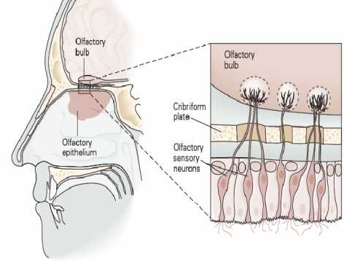
Physiology of Smell
Olfactory Epithelium and Olfactory Bulbs
A specialized portion of the nasal mucosa which is yellowish and pigmented is known as olfactory epithelium.
It contains 10–20 million bipolar olfactory sensory neurons interspersed with glia- like supporting (sustentacular) cells and basal stem cells.
Each neuron has a short, thick dendrite that projects into the nasal cavity where it terminates in a knob containing 10–20 cilia.
The olfactory epithelium is the place in the body where the nervous system is closest to the external world.

Slide 90
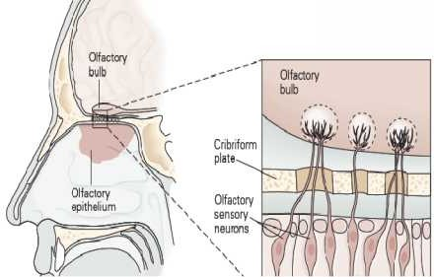

The cilia are unmyelinated processes that contain odorant receptors.
The axons of the olfactory sensory neurons pass through the cribriform plate of the ethmoid bone and enter the olfactory bulbs.
New olfactory sensory neurons are generated by basal stem cells as needed to replace those damaged by exposure to the environment.
In the olfactory bulbs, the axons of the olfactory sensory neurons (first cranial nerve) contact the primary dendrites of the mitral cells and tufted cells
This combination forms an anatomically discrete synaptic units called the olfactory glomeruli.

Slide 91
Both types of neurons send axons into the olfactory cortex.
The olfactory bulbs also contain periglomerular cells, which are inhibitory neurons connecting one glomerulus to another, and granule cells, which have no axons and make reciprocal synapses with the lateral dendrites of the mitral and tufted cells.
At these synapses, the mitral or tufted cell excites the granule cell by releasing glutamate, and the granule cell in turn inhibits the mitral or tufted cell by releasing γ-Aminobutyric acid (GABA).

Slide 92
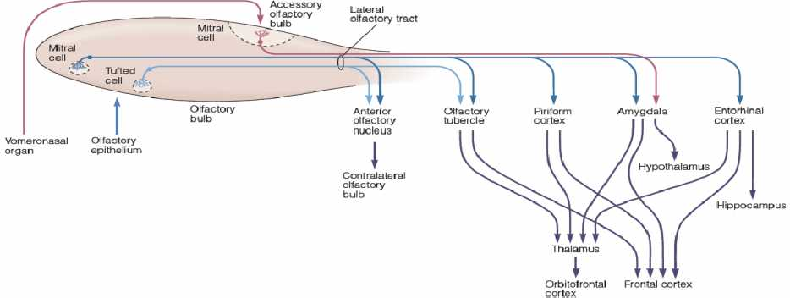
Olfactory Cortex
The axons of the mitral and tufted cells pass posteriorly through the lateral olfactory stria to terminate on apical dendrites of pyramidal cells in five regions of the olfactory cortex:
anterior olfactory nucleus,
olfactory tubercle,
Piriform cortex,
Amygdala; and
entorhinal cortex

Slide 93
From these regions, information travels directly to the frontal cortex or via the thalamus to the orbitofrontal cortex.
Conscious discrimination of odors relies on the pathway to the orbitofrontal cortex.
The orbitofrontal activation is generally greater on the right side than the left; thus, cortical representation of olfaction is asymmetric.
The pathway to the amygdala is involved with the emotional responses to olfactory stimuli, and the pathway to the entorhinal cortex is concerned with olfactory memories.

Slide 94
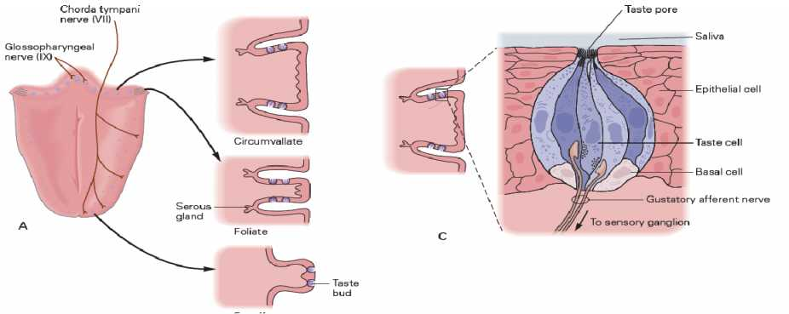
Physiology of Taste
Taste Buds
The specialized sense organ for taste (gustation) consists of approximately 10,000 taste buds.
There are four morphologically distinct types of cells within each taste bud: basal cells, dark cells, light cells, and intermediate cells.

Slide 95
The latter three cell types are referred to as Type I, II, and III taste cells.
They are the sensory neurons that respond to taste stimuli.
The apical ends of taste cells have microvilli that project into the taste pore, a small opening on the dorsal surface of the tongue where taste cells are exposed to the oral contents.
Each taste bud is innervated by about 50 nerve fibers, and conversely, each nerve fiber receives input from an average of five taste buds.
The basal cells arise from the epithelial cells surrounding the taste bud.

Slide 96
They differentiate into new taste cells, and the old cells are replaced with a half-time of about 10 days.
If the sensory nerve is cut, the taste buds it innervates degenerate and eventually disappear.
The taste buds are located in the mucosa of the epiglottis, palate, and pharynx and in the walls of papillae of the tongue:
the fungiform papillae are rounded structures most numerous near the tip of the tongue and consists of up to 5 taste buds, mostly located at the top of the papilla;
the circumvallate papillae are prominent structures arranged in a V on the back of the tongue with up to 100 taste buds, mostly located along the sides of the papillae; and
the foliate papillae are on the posterior edge of the tongue.

Slide 97
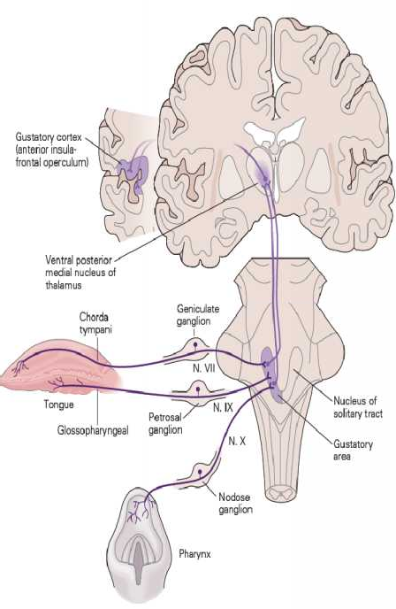
Taste Pathways
The sensory nerve fibers from the taste buds on the anterior two thirds of the tongue.
They travel in the chorda tympani branch of the facial nerve, and those from the posterior third of the tongue reach the brain stem via the glossopharyngeal nerve.
The fibers from areas other than the tongue (e.g., pharynx) reach the brain stem via the vagus nerve.

Slide 98
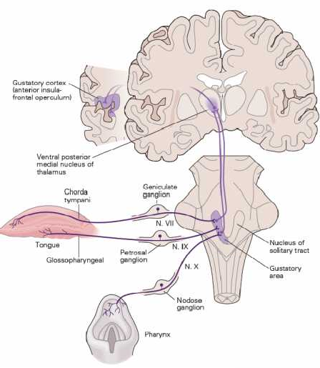
On each side, the myelinated but relatively slowly conducting taste fibers in these three nerves unite in the gustatory portion of the nucleus of the tractus solitarius (NTS) in the medulla oblongata.
From there, axons of second- order neurons ascend in the ipsilateral medial lemniscus to pass directly to the ventral posteromedial nucleus of the thalamus
Then fibers project to the anterior insula and frontal operculum in the ipsilateral cerebral cortex.
This region is rostral to the face area of the postcentral gyrus, which may be the area that mediates conscious perception of taste and taste discrimination.

