Slide 1
THIS WEEK CNS BY DAKTARI OUMA
CNS-Organisation -blood supply ,CSF meninges and blood brain barrier,the brain, the spinal cord, neuron, functions of the neuron, action potential in neurons, synapse, Week 2: functions of the central nervous system, sensory receptors, peripheral nervous system, autonomic nervous system Week 3 motor and integrative functions ;cortical control of motor functions cerebral blood flow ,intellectual functions, behavioural and motivational mechanism; states of brain activity, locomotion Embryology; developmental urogenital system

Slide 2
Nervous Tissue
Overview of the Nervous System
Nerve Cells (Neurons)
• Universal Properties
• Functional Classes
• Structure of a Neuron
• Axonal Transport

Slide 3
Overview of the Nervous System
Receptors
neural integration
Effectors
central nervous system (CNS)
peripheral nervous system (PNS)
A nerve
ganglion
e sensory (afferent2 ) division
somatic3 sensory division
motor (efferent4 ) division
visceral motor division (autonomic5 nervous system)~ sympathetic division~parasympathetic division
somatic motor division

Slide 4
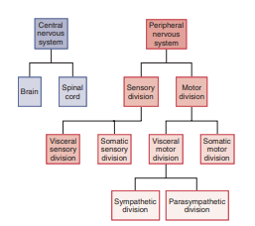
,

Slide 5
Nerve Cells (Neurons)
Universal Properties
Excitability (irritability)..
Conductivity.
Secretion.

Slide 6
Functional Classes
Sensory (afferent) neurons
Interneurons6 (association neurons)
Motor (efferent) neurons

Slide 8
Structure of a Neuron
Soma or cell body or perikaryon (PERR-ih-CARE-ee-on)
Neurofibrils
Dendrites
axon hillock
axon (nerve fiber)
Axoplasm
axolemma.
terminal arborization
synaptic knob (terminal button)
(synapse)
synaptic vesicles

Slide 10
Structure of a Neuron
Neurons are classified structurally according to the number of processes extending from the soma
1. Multipolar neurons
2. Bipolar neurons
3. Unipolar neurons
4. Anaxonic neurons

Slide 12
Axonal Transport
axonal transport
anterograde transport
retrograde transport

