Slide 2
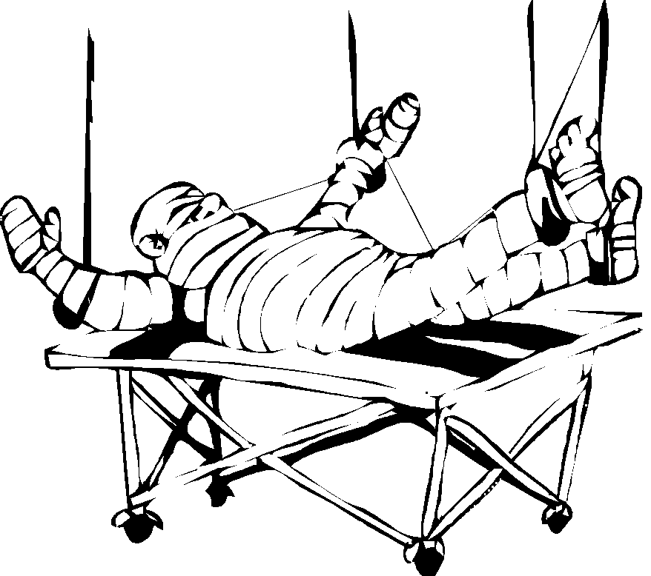
TRACTION IN ORTHOPAEDICS
PRESENTER – N CHESIRE

Slide 3
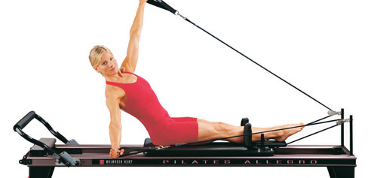
Principle of Traction

Slide 4
WHAT IS TRACTION ?
Orthopedist’s great "master tool“.
Traction - the application of a force to stretch certain parts of the body in a specific direction
Notes:
No matter how complicated a fracture might appear to be, traction will often times pull the fragments into alignment very nicely.

Slide 5
WHY DO WE NEED TRACTION ?
Inflammation of a joint
Pain and muscle spasm
Defomity

Slide 6
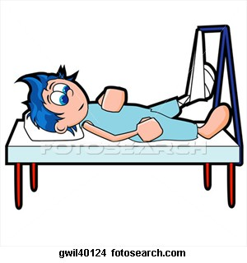
fracture of bone
Abnormal Mobility
Pain
Notes:
agonist and antagonist muscle.

Slide 7
TRACTION
The purpose of traction is to:
To regain normal length and alignment of involved bone.
To reduce and immobilize a fractured bone.
To relieve or eliminate muscle spasms.
To relieve pressure on nerves, especially spinal.
To prevent or reduce skeletal deformities or muscle contractures.

Slide 8
TRACTION
Controls pain.
Reduces fracture.
Maintain reduction.
Prevents & corrects deformity.

Slide 9
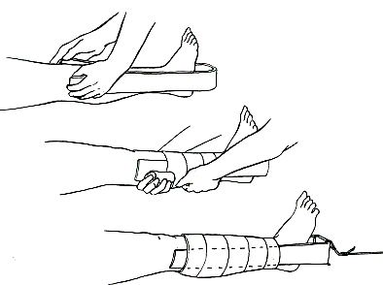
Buck’s Traction
Often used preoperatively for femoral fractures
Can use tape
No more than 5 kgs
Not used to obtain or hold reduction

