Slide 1
TRAUMA AND EMERGENCY

Slide 2
Objectives
By the end of this lesson, learner will be able to,
define what is first aid.
State principles of trauma and emergency
State principles of first aid
List components of first aid kit.
State guidelines of lifting a patient
Discuss management of casualties with, head injury, spinal cord injury, CVA, poisoning, snake bites etc

Slide 3
First aid
What is first aid?
First aid is emergency help given to an injured or suddenly ill person using readily available materials.
First aider, A person who takes charge of an emergency scene and gives first aid.
Casualty, the injured or ill person.

Slide 4
Principles of Trauma and Emergency
TRAUMA
Def; it is an injury to the body tissues.
TYPES OF TRAUMA
Physical
psychological

Slide 5
CAUSES OF TRAUMA
Accidents
Stings
Bites, e.g. snake or dog bites
Burns
Foreign body- can be in the ear, nose or eyes.

Slide 6
EMERGENCIES
Def; it is a situation that requires urgent interventions or immediate actions.
An emergency is a situation that poses an immediate risk to health, life, property, or environment.
Most emergencies require urgent intervention to prevent a worsening of the situation, although in some situations, mitigation may not be possible and agencies may only be able to offer palliative care for the aftermath.

Slide 7
Cont.
CAUSES
- Acute diseases
- Accidents

Slide 8
TYPES OF EMERGENCIES
Medical emergencies- which includes poisoning, asthmatic attacks, unconsciousness, epileptic fits, diabetic cases
Surgical emergencies- this includes bleedings, cuts, stab wounds, vaginal bleedings, intestinal obstruction.
Paediatric emergencies- includes conditions that affect children, examples, foreign bodies, poisoning.
Psychiatric emergencies – include suicidal patients, aggressive.
Obstetric emergencies- include precipitate labour, obstructed labour.

Slide 9
EFFECTS OF EMERGENCIES
Haemorrhage
Fractures
Shock
Unconsciousness

Slide 10
ACCIDENTS
Def: It is unfortunate incident that happens unexpectedly and unintentionally, typically resulting in damage and injury of tissues and cells.

Slide 11
Common causes of accidents in our Kenyan homes.
Open fires.
Accidental ingestion of drugs and chemicals.
Charcoal burners in poorly ventilated rooms.
Open pools
Open pits.
Wet slippery floors.
Burns from hot fluids, e.g. hot water, soups, tea.

Slide 12
FACTORS THAT MAKE PEOPLE PRONE TO ACCIDENTS
Young age and old age.
Sickness e.g. epilepsy
Carelessness
Ignorance
Poverty

Slide 13
PRINCIPLES OF TRAUMA AND EMERGENCY
If the casualties have multiple problems , injuries:
Treat the first one which is greater in threatening ; example:
  If you find a casualty / patient bleeding and have a fracture that is bleeding.
  (resuscitation) must be done simultaneously with the primary survey
  Treatment takes precedence over diagnosis

Slide 14
Cont.
If a patient has multiple problems or injuries, treat first the one that is the greatest threat to life
Indicated treatments should not be delayed simply because the diagnosis is not yet certain.
A detailed history is not essential to start evaluation & treatment of an injured patient Identifying the greatest Threats to Life in the Trauma Patient.

Slide 15
Triage
Def. the process of making decisions at an emergency scene where multiple people are injured.
In triage, first aiders quickly examine all casualties and place them in order of greatest need for first aid and for transportation.
The idea is to do the most good for the greatest number of casualties.

Slide 16
Cont.
Casualties are categorized into three levels of priority:
Highest priority—casualties who need immediate first aid and transportation to medical help.
Medium priority—casualties who probably can wait one hour for medical help without risk to their lives.
Lowest priority—casualties who can wait and receive first aid and transportation last, or casualties who are obviously dead.

Slide 17
ASSESS THE SITUATION
Upon approaching the scene, quickly take in as much information as possible, and take into the consideration the principle of DRSABCD.
D -Danger – Always presume that there is some danger so check for and deal with any danger to yourself, the victim and bystanders e.g. traffic, electricity, infection from body fluid etc.
R -Response – Check for response by talking and asking the questions and shaking victim’s shoulders gently.
S -Shout – The first aider must shout for help when there is no response and he is alone with a the victim.

Slide 18
Cont.
A - Airway – Casualty must have a clear and unobstructed airway to be able to survive. Maintain an open airway by tilting the head back while placing two fingers to life the chin. This head filth-chin position must be maintained to ensure the casualty airway remain open.
B - Breathing – check for up to 10 seconds for breathing, if breathing but unconscious place in the recovery position, this will help to maintain an open airway but if not breathing, start compression at once.

Slide 19
Cont.
C - Compression – Commence chest compression immediately when casualty is not breathing at ratio of three degrees compression to two breaths (CPR).
D - Defibrillator – A medium used to bring back the heart to its normal rhythm.

Slide 20
Principles of first aid
Survey the scene (as expected under observation).
Do a primary survey of the victim.
Phone the emergency medical service (EMS) or look for help.
Do a secondary survey of the victim when appropriate.

Slide 21
The first aid kit
Essential items in a first aid kit
Antiseptics & Cleansers. ...
Antibiotics. ...
Adhesive Bandages. ...
Gauze Rolls / Gauze Pads / Trauma Dressings. ...
Wraps & Bandages. ...
First Aid Instruments - Scissors / Tweezers / Tongue Depressors. ...

Slide 22
Lifting and moving casualties
Always try to give necessary first aid where the casualty is found, then wait for the paramedics to move the person.
However, there are times when this is not possible, You may have to move a casualty when:
There are life-threatening hazards to yourself or the casualty e.g. danger from fire, explosion, gas or water

Slide 23
Cont.
The casualty must be transported to a medical facility

Slide 24
Lifting techniques and proper body mechanics
Using incorrect body mechanics in lifting or moving a casualty may leave the rescuer suffering muscle strains. Use the following lifting guidelines:
Stand close to the object to be lifted.
Bend your knees, not your waist.
Tilt the object so that you can put one hand under the
edge or corner closest to you.
Place your other hand under the opposite side or corner,
getting a good grip on the object.
Use your leg muscles to lift, and keep your back straight.
When turning, turn your feet first; don’t twist your body.

Slide 25
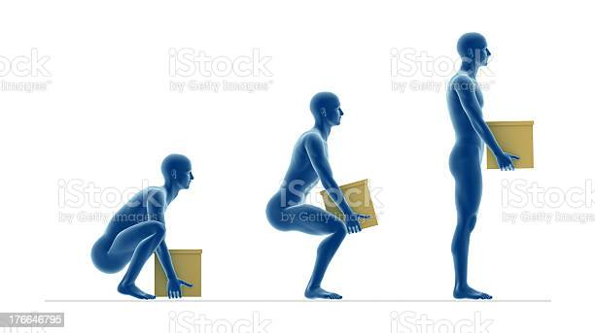
Cont.

Slide 26
Management of casualties with,
Head injury
Things to check for:
  Scalp wound
  Clear fluid/watery blood from nose or ear
  Consciousness
  Assume the pt has neck injury too
  Check for ABCs
  Apply direct pressure on wound using a sterile dressing
  Secure the dressing intact with a bandage
  Help the patient lie down in a comfortable position
  Call for help…..911

Slide 27
Cont.
2. Spinal cord injury
Aim to prevent further injury
Do not change the pts position unless they are in immediate danger
Reassure pt
Steady and support the pts head on the surface they are on using both hands in a position where the head, neck and spine are aligned

Slide 28
Cont.
Roll up blankets or towels on either side of the casualty's head and neck to keep the head in place
Check vitals
Wait for an ambulance
If the casualty is unconscious, open airway using the jaw thrust method
Check for breathe sounds

Slide 29
Cont..
Begin cpr if pt is not breathing
If you need to move the patient, use the log roll method
Monitor vitals while waiting for help

Slide 30
Cont.
Log roll method
Used to turn casualty when they’ve got a spinal injury
While supporting the head and neck, the limbs are straightened gently to be in line with the head and neck
The casualty is gently rolled over while the casualty head, trunk and legs are kept in a straight line.

Slide 31
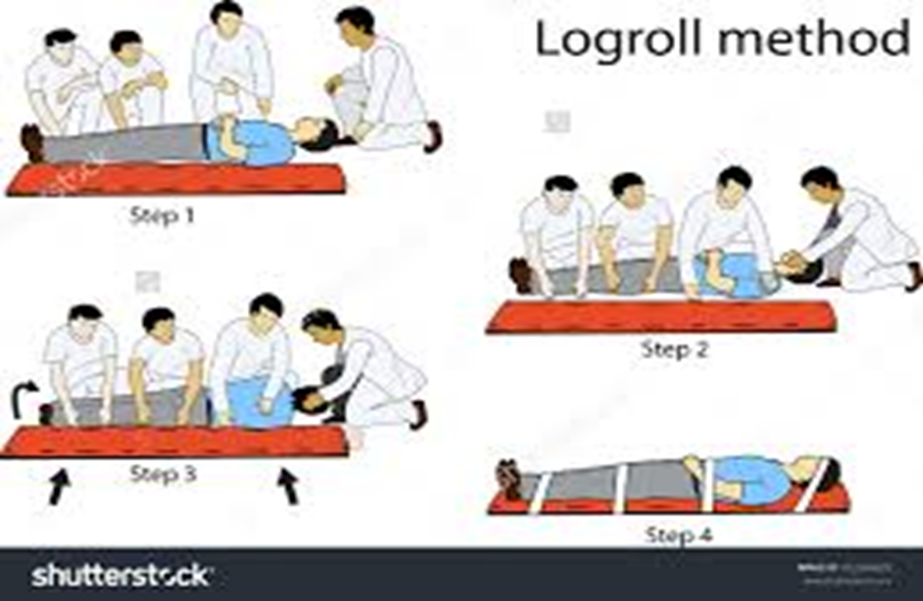
Cont.

Slide 32
Cerebral Vascular injury
Otherwise known as stroke
Things to check for
Facial weakness – casualty unable to smile evenly, mouth and eye may be droopy
Arm weakness – can only raise one arm
Speech problems
Sudden weakness or numbness of the face, one or both arms/legs or either side of the body

Slide 33
Cont.
FAST – medical pseudonyms used to diagnose cvs accidents
Blurred vision or sudden vision loss
Sudden confusion
Sever headache
Dizziness, unsteadiness or sudden falls

Slide 34
Poisoning
Poison
A substance that is taken or absorbed into the body through ingestion, absorption via skin, inhalation, injection or splashing into the eyes.
in sufficient quantities can cause either temporary or permanent damage
Once the poison gets into the bloodstream its rapidly carried into organs and tissues which may lead to loss of function of the affected organs and body systems

Slide 35
S&S
May vary according to the type of poison that is present in the system
The most common are
Nausea and vomiting
Abdominal pain
Consciousness
Difficulties in breathing
Blurred vision
Seizures
Irregular heartbeat

Slide 36
Assignment
Study the different types of poisons, there modes of entry into the body, there characteristic effects and the first aid to be administered to the casualty

Slide 37
Snake bites
What to check for
Puncture or bite marks
Severe pain, redness and swelling around the bite mark
Nausea & vomiting
Blurred vision
Increased salivation and sweating
Breathing difficulties

Slide 38
Cont.
Aim to
Stop venom from spreading – pt should lie down, head and shoulders raised, minimize movement
Apply pressure bandage on bite, apply another that will act as a torniquet as far up the limb as possible
Monitor vitals, as you wait for ambulance
Most importantly try and get the type of snake that bit the casualty

Slide 39
Scorpion stings
What to check for
Pain, redness and swelling at the sting site
Headache
What to do
Reassure pt and help them sit or lie down and be still
Raise affected part and place a cold compress on the affected part to minimise swelling
Monitor vitals as you wait for the ambulance

Slide 40
Drowning
Ask someone to call 911 or help
Lie the casualty down, if unresponsive give them 5 initial rescue breathes before starting cpr
Keep checking breathing and pulse and response level until help arrives

Slide 41
First aid for choking
A person chokes when the airway is partly or completely blocked and airflow to the lungs is reduced or cut off.
First aid for a choking adult
1. Perform a scene survey.
2. If the casualty can cough forcefully, speak or breathe, tell them to try to cough up the object.

Slide 42
Cont.
If you think there might be a severe obstruction, check by asking, “Are you choking?” If the casualty cannot cough forcefully, speak or breathe, use back blows followed by abdominal thrusts to remove the blockage.
Give back blows and abdominal thrusts.
Support the casualty and give up to five blows between the shoulder blades using the heel of your hand.

Slide 43
Cont.
3. If the obstruction is not cleared, step behind the casualty ready to support them if they become unconscious.
4. Make a fist, place it on the casualty’s abdomen at the belly button, in line with the hip bones. Grasp the fist with the other hand and give five forceful inward and upward abdominal thrusts.

Slide 44
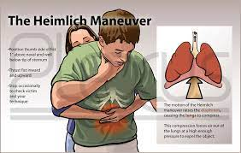
Conti.

Slide 45
Reading assignment
Read and make notes on, first aid for choking in a child.

Slide 46
Basic Life Support
Objectives
By the end of the lesson, learner will be able to,
Define terms in BLS
List chain of survival
Explain resuscitation in
Adult
Child
infant

Slide 47
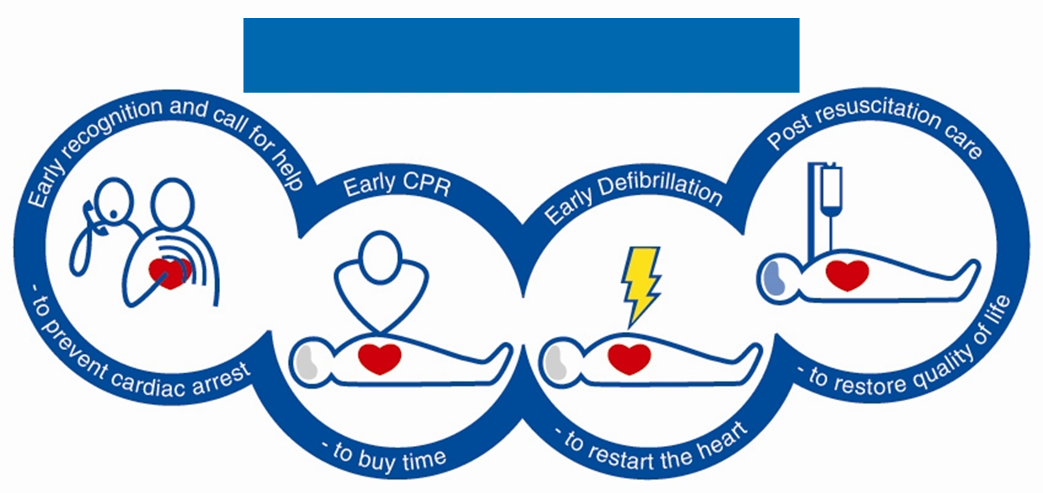
Chain of survival

Slide 48
Primary survey
D Don’t / Danger / Dodge / Drive
R Rescue / Run / Response / Repair
s Silence / Summon / Slap / Shout
A Automatic / Arm / Awful / Airway
B Breathing / Back / Bruise / Belly
C Catch / Cough / Circulation / Casualty
Choose the correct word for each part of the primary survey.

Slide 49
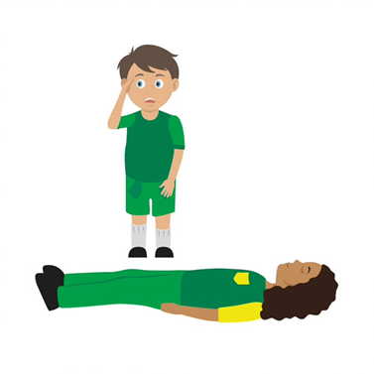
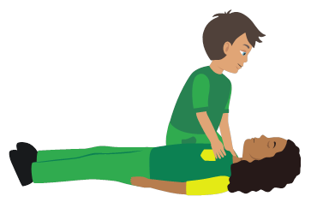

Primary survey
2. Response
Check the casualty’s response. Ask questions and gently tap shoulders. Say “open your eyes!”
1. Check for danger
Always make sure the area is safe
4. Airway
If not clear, then open by tilting the head back, use one hand on forehead and two fingers under the chin.

Slide 50
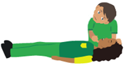
Cont…
5. Breathing
Check for normal breathing. Do not put your face next to theirs,
instead look at chest rising and falling only. (Remember 10 seconds!)
6. Circulation (only if breathing normally)
Check the casualty for bleeding

Slide 51


What’s next?
If YES, then place the casualty into the recovery position
Is the casualty unresponsive but breathing normally?

Slide 52
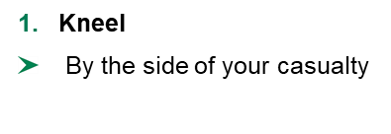
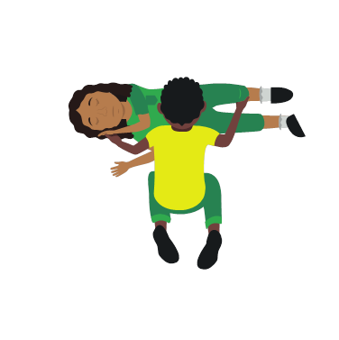
Recovery position
2. Angle arm
Put the arm nearest to you to make a right angle. Palm facing upwards
3. Hand to cheek
Bring the arm furthest away across the chest and place the back of their hand against the cheek nearest to you
Hold it there
4. Knee bend
With other hand, bend their far knee up so that the foot is flat on the floor.

Slide 53
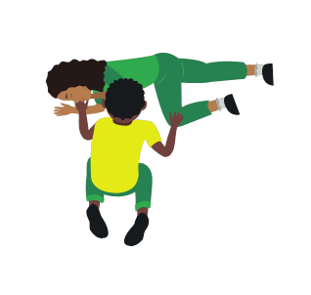
Cont..
5. Knee pull
Pull on the knee to roll the casualty towards you onto their side
Adjust them as necessary
6. Ensure airway is open
Recheck breathing
Call 999/112
Stay and monitor casualty until help arrives

Slide 54

Cont.
Is the casualty unresponsive and not breathing normally?
Call 911 for emergency help and start CPR. You can instruct an adult how to do this if you cannot do it yourself.

Slide 55
Cardiopulmonary Resuscitation
Cardiopulmonary resuscitation (CPR) consists of the use of chest compressions and artificial ventilation to maintain circulatory flow and oxygenation during cardiac arrest.
CPR is artificial respiration and artificial circulation.
Artificial respiration provides oxygen to the lungs
Artificial circulation causes blood to flow through the body.

Slide 56
CPR remember
You may not be strong/confident enough to do CPR on a casualty. That’s OK, you can tell someone else what they need to do
It is important to understand that sometimes even CPR cannot save somebody
Anything you can do to help, even just calling someone else to help, could be lifesaving
Never do CPR on someone if they are responsive and breathing normally

Slide 57
CPR – Adult casualty
Perform a scene survey.
Assess responsiveness.
If there is no response, call for medical help on a mobile device, and place the phone on speaker-phone, and send someone for an AED.
Perform a primary survey:
Open the airway.
Check for breathing for at least 5 and no more than 10 seconds

Slide 58
Cont.
5. If the casualty is not breathing, or not breathing effectively (agonal breaths) position your hands in the centre of the upper chest and your shoulders directly over your hands. Keep your elbows locked.

Slide 59
Cont.
6. Give 30 compressions—Push hard—Push Fast!
Press the heels of the hands straight down on the breastbone. The depth of each compression should be at 5-6 cm (2-2.4 inches).
Release pressure and completely remove your weight at the top of each compression to allow chest to return to the resting position.
Give compressions at a rate of 100 to 120 per minute. Count compressions out loud to keep track of how many you have given, and to help keep a steady rhythm.

Slide 60
Cont.
7. Open the airway by tilting the head and lifting the chin.
8. Position a barrier device and breathe into the casualty twice.
For an adult casualty, each breath should take about for 1 second, with just enough air to make the chest rise.
This is one cycle of 30:2 (30 compressions to 2 ventilations)

Slide 61
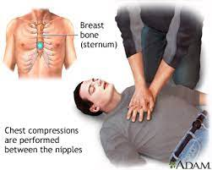
Cont.

Slide 62
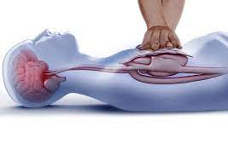
Cont..

Slide 63
Agonal breathing
Agonal breathing is an abnormal pattern of breathing driven by a brain-stem reflex, characterized by irregular gasping respirations at times accompanied by strange vocalizations.
They can occur with cardiac arrest and lead bystanders to believe the casualty is breathing.
A casualty with agonal breathing should be treated as though they are not breathing.

Slide 64
CPR – Child casualty
1. Perform a scene survey.
2. Assess responsiveness.
3. If there is no response, send or call for medical help and an AED if available.
4. Perform a primary survey:
Open the airway.
Check for breathing for at least 5 and no more than 10 seconds.

Slide 65
Cont.
5. If the casualty is not breathing, or not breathing effectively (agonal breaths) position your h
ands in the centre of the upper chest and your shoulders directly over your hands. Keep your elbows locked. You may use one or two hands depending on the size of the child.

Slide 66
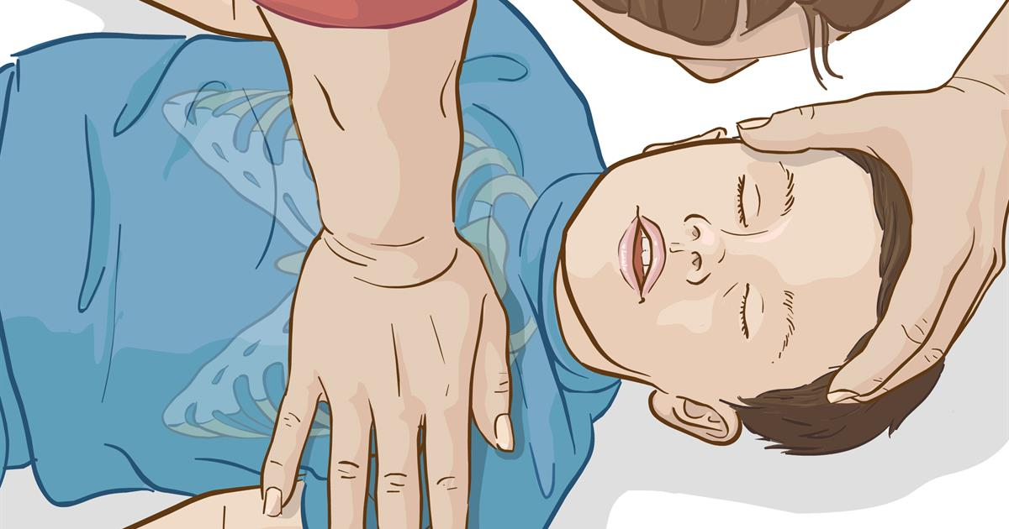
Cont.

Slide 67
Cont.
6. Give 30 compressions—Push hard—Push Fast!
Press the heels of the hands straight down on the breastbone. The depth of each compression should be 1/3 of the chest depth, or 5 cm (2 inches).
Release pressure and completely remove your weight at the top of each compression to allow chest to return to the resting position.
Give compressions at a rate of 100 to 120 per minute. Count compressions out loud to keep track of how many you have given, and to help keep a steady rhythm.

Slide 68
Cont.
7. Open the airway by tilting the head and lifting the chin.
8. Position a barrier device and breathe into the casualty twice, with just enough air to make the chest rise.

Slide 69
Cont.
9. Continue CPR until either an AED is applied, the casualty begins to respond, another first aider or medical help takes over or you are too exhausted to continue. The AED should be applied as soon as it arrives to the scene

Slide 70
CPR – Infant casualty
Perform a scene survey.
Assess responsiveness. Gently tap the baby’s feet.
If there is no response, send or call for medical help and an AED if available.
Perform a Primary Survey
Open the airway.
Check for breathing for at least 5 and no more 10 seconds

Slide 71
Conti…
5. If the baby is not breathing, or not breathing effectively (agonal breaths) begin CPR.
Place two fingers on the breastbone just below the nipple line. Push down on the breastbone 1/3 the depth of the chest or about 4 cm (1 1/2 inches).
Release the pressure completely but keep your fingers in light contact with the chest. Repeat the pressure and release phases rhythmically so that each phase takes the same amount of time.

Slide 72
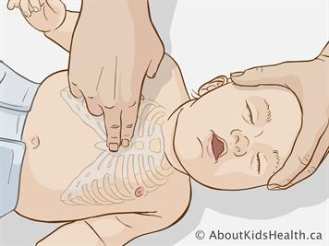
Cont..

Slide 73
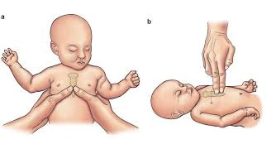
Cont.

Slide 74
Cont.
Give compressions at a rate of 100 to 120 per minute. Count compressions out loud to keep track of how many you have given, and to help keep a steady rhythm.
6. Open the airway by tilting the head and lifting the chin.
7. Position a barrier device and breathe into the casualty twice, with just enough air to make the chest rise.

Slide 75
Cont..
8 . Continue CPR until either an AED is applied, the casualty begins to respond, another first aider or medical help takes over or you are too exhausted to continue. The AED should be applied as soon as it arrives to the scene.

Slide 76
Automated External Defibrillation—AED
Automated external defibrillation, the application of an electric shock to a heart that has stopped pumping effectively, has been proven to be one of the most important tools in saving the lives of sudden cardiac arrest casualties.
An automated external defibrillator (AED) is an electronic device that is programmed to recognize and shock two types of heart rhythms, Ventricular Fibrillation (VF) and pulseless Ventricular Tachycardia (VT).

Slide 77
Using an AED (always follow the AED’s voice prompts)
Power on the AED.
Follow the voice prompts. The audio instructions will direct you to:
Bare the chest and attach electrode pads. The pads need to stick directly to the skin, so excessive sweat, water, and chest hair needs to be removed before application

Slide 78
Cont..
Stand back (or clear)
Press the shock button and/or continue CPR as prompted by the machine.
Continue with CPR and listen for the AED to give additional instructions

Slide 79
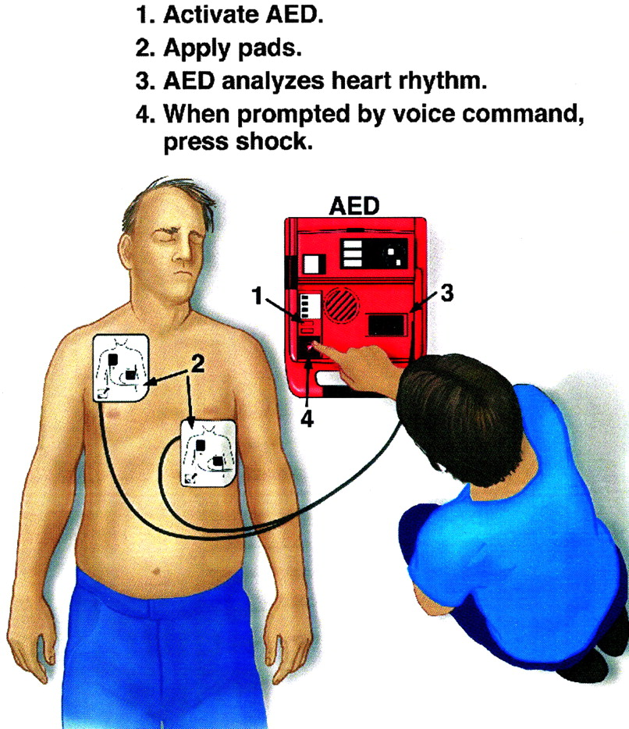
AED

Slide 80
THE END
THANK YOU

