Slide 1
OBJECTIVES
Historical Background Of Trauma And Emergency
Definition Of Terms;
trauma
Basic Life Support
Resuscitation
Triaging
Emergency
Emergency care environment
Roles and functions of emergency nurse

Slide 2
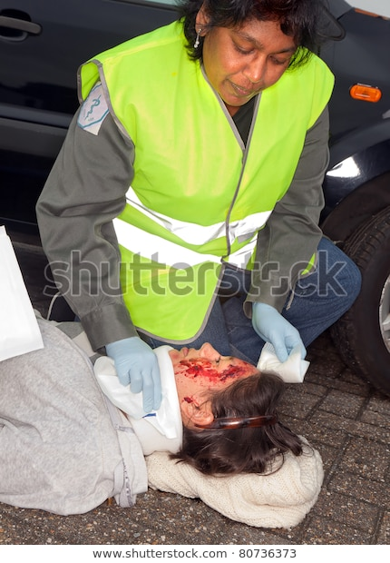

Slide 3
What do you see in the above photograph?

Slide 4
HISTORICAL BACKGROUND OF TRAUMA EMERGENCY
Was founded by Florence Nightngale during 2nd World war(1939-1945) where she used to care for wounded/traumatized soldiers by nursing them.
Currently Trauma and Emergency is a specialty in Nursing.

Slide 5
CONCEPTS IN BASIC LIFE SUPPORT
TRAUMA
Is injury to any body cell, tissue,Organ, system or the entire organism.
Is the experience of severe psychological distress following any terrible or life threatening events.

Slide 6
Trauma can be accidental, intentional or pathological.
Accidental;
Through Road traffic accidents, burns, falls, cuts.
Intentional Trauma
Through fighting, assault, suicidal attempts.
c) Pathological Trauma
Caused as of disease process especially chronic disease e.g. cancer, HTN, kidney disorders, diabetes.
result

Slide 7
Trauma can affect different aspects of a person to include;
Physical
A person can lose a body part, become paralyzed or alter self image.
b) Social
One loses their social status e.g. by playing or interacting well with peers.
c) Emotional/Psychological
Is as a result of extraordinarily stressful events. This can lower self esteem and lead to depression.

Slide 8
d) Economical
Trauma can lead to loss of jobs due to suffering life long disabilities.
Financial recourses can be depleted due to caring of a traumatized patient.
e) Spiritual
Some people lose faith in God and feel homeless especially those suffering from life long disabilities.

Slide 9
CAUSES OF TRAUMA
Blunt objects e.g. metal rods.
Sharp objects e.g. panga, needles, axe, knife, spear, arrow, broken glasses, bullets
Violent actions e.g. strikes, rape.
Spoken word which lead to emotional or Psychological trauma.

Slide 10
Basic Life Support
Is a level of medical care which is used for victims of life threatening illness or injuries until they can be given full medical care at a hospital.

Slide 11
Resuscitation is the process of correcting physiological disorders (such as lack of breathing or heartbeat) in an acutely ill patient.
It is an important part of intensive care medicine, trauma surgery and emergency medicine.
Well known examples are cardiopulmonary resuscitation.

Slide 12
Triaging
It is a process of sorting out patients according to the severity of the injuries/conditions and treating /giving priority to the ones who are severely injured.
The sorting of patients (as in an emergency room) according to the urgency of their need for care.

Slide 13
Emergency
An emergency is a sudden or unexpected situation that poses an immediate risk to health, life, property, or environment. Most emergencies require urgent intervention to prevent worsening of the situation.

Slide 14
Emergency Care Environment
The following items should be available;
Communication should be done using various ways include phone calls, bells rings, sirens.
Human resource which include Nurses, Doctors, Lab tech, Radiologist, supporting staff, drivers.
Equipment e.g. Oxygen cylinder, stretchers, wheel chairs, trolleys, sphygmomanometers.
Supplies e.g. syringes, needles, branulars, bandages, catheters, gloves( clean and sterile), Intravenous fluids.
Emergency rooms for treating the sick and ensuring privacy and confidentiality.
Emergency drugs arranged well in emergency tray.

Slide 15
TASK
Name some of the emergency drugs that should be available in an emergency room?

Slide 16
ROLES OF AN EMERGENCY NURSE
Care provider – provides comprehensive care to the injured patients and their families.
Educator – they educate both the patients and the family on how to take care of the patient both in the hospital and at home.
Advocate – he/she ensures the protection of the rights of the patient.
Manager/supervisor – she coordinates activities of other staffs during emergency management.

Slide 17
FUNCTIONS OF AN EMERGENCY NURSE
1) ASSESSMENT
Assess the patient.
Assess the environment/Emergency care area.
2) DIAGNOSIS
Make patient diagnosis.
A nurse should be able to triage the patients.

Slide 18
3) PLANNING
Plans for the nursing intervention.
Plans for the treatment to be given to the patient.
Plans for the resources in the emergency area.
4) IMPLEMENTATION
Implements patient treatment.
Implement what was prescribed to the patient

Slide 19
5) EVALUATION
Evaluate patients care.
Evaluate the resource in the emergency area.
Recommendation for replacement of equipment(faulty).
6) DOCUMENTATION
Puts in written all the activities carried out on a patient(what is not written is not done)
NOTE:
The nurse may provide direct resuscitative measure to a patient and hence should have resuscitation skills.
The nurse also provides preliminary emergency care before transferring in order to stabilize the patient.

