Slide 1
TRAUMA, EMERGENCY & BASIC LIFE SUPPORT

Slide 2
BASIC LIFE SUPPORT
Is a specific level of pre – hospital medical care provided by trained responders, including emergency medical technicians in the absence of advance medical care
Generally does not include use of drugs or invasive skills

Slide 3
Concepts of BLS
Quickly start the Chain of Survival.
Deliver high-quality chest compressions to circulate oxygen to the brain and vital organs.
Know when and how to use an Automatic External Defibrillator (AED).
Provide rescue breathing.
Understand how to work with other rescuers as part of a team.

Slide 4
Sequence checks to be made in the assessment of a casualty
DRSABC
Danger to the casualty and first aider.
Response- Shake the victim, shout for help, command the victim.
Send/Shout for help.
Airway- Open the airway and clear the mouth and position the head tilt chin lift.
Breathing- Look , listen and feel. Look for chest movement, listen to airflow at the mouth and nose(+- additional noise) and feel for air flow at the mouth and nose.
6. Circulation – Take pulse rate.

Slide 5
Problems
Incident Problems
Casualty problems
Crowd
Hazardous material
Fire
Visibility
Falling objects
Smoke and fumes
Power lines
Bleeding
Unconsciousness
Fainting
Burns
Fractures
Asthma attack
Seizures

Slide 6
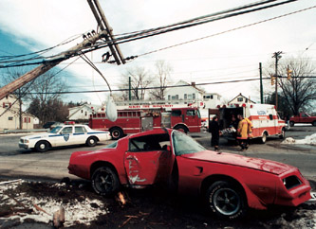
Incident management

Slide 7
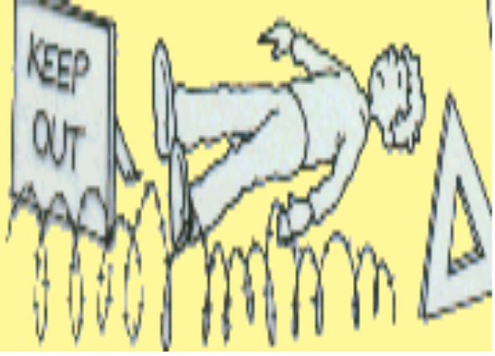
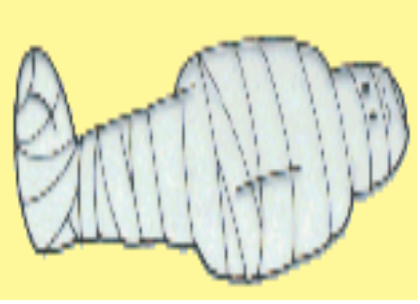
Incident Management
Assess the situation
Make the Area Safe
Emergency aid
Get Help
Aftermath

Slide 8
PRINCIPLES AND PRACTICES OF FIRST AID
Survey the scene (as expected under observation).
Do a primary survey of the victim.
Phone the emergency medical service (EMS) or look for help.
Do a secondary survey of the victim when appropriate.

Slide 9
SURVEY THE SCENE
In responding to an emergency situation, make a quick survey of the entire scene, look at the area around the victim, this should take only few seconds, then decide what to do next.
Consider the following as you do your survey and don’t forget the principle of DRABCD.

Slide 10
Is the scene safe?
You must not first decide if the situation is safe for you, also, you cannot help a victim by becoming a victim yourself.
You should know your abilities.
However, if you cannot get a victim because of extreme hazards, such as fire, toxic fumes, heavy traffic, electrical wires or deep swift moving water call emergency services or other services needed to handle the specific life-threatening hazard.

Slide 11
However, if you safely get to victim, decide if it is save to remain at the scene while you continue the steps of emergency action principle and care for the victim.
If it is not safe, you may need to make an immediate emergency rescue.

Slide 12
What happened?
If the victim is conscious, ask questions to what happened extent of victim’s illness or injury.
If victim is unconscious, ask bystanders or look for clues, the scene itself often gives the answer.

Slide 13
How many people are injured?
You should look beyond the victim you see at first glance. There may be other victims.

Slide 14
TRIAGE
In an accident or emergency you may have multiple patienrs
Decide which patients to treat first
Priority is to those with life threatening injuries/illness
Triage principles include:
Life comes before a limb – patient not breathing normally is a priority to one whose bleeding
Acute needs comes before long-term outcmes. Patient with internl bleeding has higher priority for evacuation than a patientwith a fractured spine

Slide 15
Are there bystanders who can help?
However, if there are bystanders, use them to help you find out what happened.
Although bystanders may not be trained in first aid, but they can help you in other important ways such as calling medical attention, by offering emotional support to the victim(s), their friends and their families and by keeping onlookers from crowding around the victim.

Slide 16
ASSESS THE SITUATION
Upon approaching the scene, quickly take in as much information as possible, and take into the consideration the principle of DRSABCD.
D -Danger – Always presume that there is some danger so check for and deal with any danger to yourself, the victim and bystanders e.g. traffic, electricity, infection from body fluid etc.
R -Response – Check for response by talking and asking the questions and shaking victim’s shoulders gently.
S -Shout – The first aider must shout for help when there is no response and he is alone with a the victim.

Slide 17
A - Airway – Casualty must have a clear and unobstructed airway to be able to survive. Maintain an open airway by tilting the head back while placing two fingers to life the chin. This head filth-chin position must be maintained to ensure the casualty airway remain open.
B - Breathing – check for up to 10 seconds for breathing, if breathing but unconscious place in the recovery position, this will help to maintain an open airway but if not breathing, start compression at once.

Slide 18
C - Compression – Commence chest compression immediately when casualty is not breathing at ratio of three degrees compression to two breaths (CPR).
D - Defibrillator – A medium used to bring back the heart to its normal rhythm.

Slide 19
DO A PRIMARY SURVEY OF THE VICTIM
The purpose of the primary survey is to check for the life threatening conditions and to give urgent first aid care

Slide 20
The primary survey (assessment for priorities)
Danger
Remove any dangers to you bystanders or casualty
Response
Question, command
& Shake.

Slide 21
Levels of response
Alert
Voice
Pain
Unresponsive
Question
Command
Shake or Pinch

Slide 22
If there is a response:
Summon help if needed.
Assess and Treat any condition or Injury found.
Monitor and record.
If there is no response:
Shout for help (if alone)
open the airway.

Slide 23
Primary survey ...
Airway
Open the airway by head tilt, chin lift maneuver.

Slide 24
Primary Survey…
Breathing
Look, Listen and Feel for 10secs

Slide 25
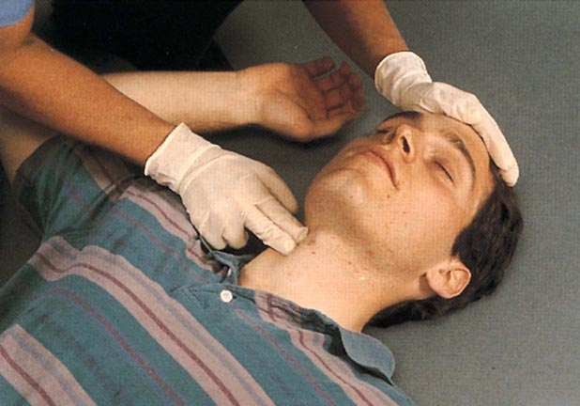
Primary Survey cont.…
Circulation:
Check for signs of life: normal skin color,
Temperature, movements or a pulse if you can(10 seconds)
Check for signs of severe
bleeding and stop it if you can

Slide 26
The Primary Survey summary
Danger
Response
Airway:
Breathing
Circulation

Slide 27
MAKING THE CALL
Make the call to medical yourself or give the responsibility to bystanders.
Make sure that adequate and precise information is passed on to the medicals.
This includes:
The location of the emergency (exact address, city or town, location, landmark name of he building, floor apartment or room number).

Slide 28
The telephone number of the phone being used.
The caller’s name.
What happened.
Number of victims.
The victim’s condition.
The help being given

Slide 29
What to do
If the patient is unconscious and not breathing normally 1 Follow DRSABCD. The patient is breathing normally Follow DRSABCD. Place the unconscious breathing patient in the recovery position, carefully supporting the head and neck. Ask the conscious patient what happened. Manage life-threatening injuries, such as severe external bleeding, and send for medical aid. If possible, do not leave an unconscious patient alone. Manage other injuries such as minor wounds. Conduct a secondary observation, carrying out a head-to-toe examination. Check the patient for identification, medication or a medical alert device (eg bracelet or necklace). Ask bystanders what happened and record all observations. Continue to check the patient’s response and breathing. Provide information to medical personnel when they arrive.

Slide 30
DO A SECONDARY SURVEY OF THE VICTIM
The purpose of a secondary survey is to check the victim carefully and in an orderly way for injuries or other problems that are not an immediate threat to life but which could cause problems if not corrected. For example a broken bone.

Slide 31
Secondary survey (assessment for other injuries/medical conditions)
This includes the following:
Top-to-toe assessment
History
External clues
Signs & Symptoms

Slide 32
What to do
Examine the head. Check for blood, bruising and swelling. Check the face. Check the eyes: compare the size of the pupils; look for bruising, cuts and swelling. Compare one side of the face to the other to check for swelling or other abnormalities. Check the neck. Check for injuries: bruising, cuts. Check the collarbones: breakages, bruising. Check the shoulders, arms and hands for wounds, bleeding and fractures. Check shoulder joints and shoulder blades. Check the full length of each arm. Check both hands and each finger for bruising, swelling, cuts, breaks and feeling. | ©5 Check the chest for injuries,bruising, cuts. Does the chest expand easily and evenly? Does breathing cause pain? Check the abdomen for injuries, bruising, cuts. Is it tender? Does a gentle press on the abdomen cause pain? Check the pelvis and buttocks for injuries, bruising, cuts. Push the tops of the hips towards each other. Does this cause pain? Check for evidence of wet pants or blood from the genital area. Check the legs, ankles and feet. Check the full length of each leg for bruising, swelling, cuts, breaks or abnormal alignment. Check both feet and each toe for bruising, swelling, cuts, breaks and feeling.

Slide 33
DECIDING TO TRANSPORT THE VICTIM
After completing the emergency action principle (EAPS) consider transporting the victim to the hospital yourself if the victim’s condition is not severe. This is an important decision.
Do not transport a victim with life threatening condition may develop. Moreover, there maybe some situations, when an ambulance is not readily available and you may have to weigh the risks and consider taking the victim to the hospital.
However, you must pay close attention to the victim and watch for any changes in his or her condition.

Slide 34
TRAUMA
Def; it is an injury to the body tissues.
TYPES OF TRAUMA
Physical
psychological

Slide 35
CAUSES OF TRAUMA
Accidents
Stings
Bites, e.g. snake or dog bites
Burns
Foreign body- can be in the ear, nose or eyes.

Slide 36
EMERGENCIES
Def; it is a situation that requires urgent interventions or immediate actions.
An emergency is a situation that poses an immediate risk to health, life, property, or environment.

Slide 37
Most emergencies require urgent intervention to prevent a worsening of the situation, although in some situations, mitigation may not be possible and agencies may only be able to offer palliative care for the aftermath.
CAUSES
- Acute diseases
- Accidents

Slide 38
TYPES OF EMERGENCIES
1. Medical emergencies- which includes poisoning, asthmatic attacks, unconsciousness, epileptic fits, diabetic cases
2. Surgical emergencies- this includes bleedings, cuts, stab wounds, vaginal bleedings, intestinal obstruction.
3. Paediatric emergencies- includes conditions that affect children, examples, foreign bodies, poisoning.
4. Psychiatric emergencies – include suicidal patients, aggressive.
5. Obstetric emergencies- include precipitate labour, obstructed labour.

Slide 39
EFFECTS OF EMERGENCIES
Haemorrhage
Fractures
Shock
Unconsciousness

Slide 40
CAUSES OF EMERGENCIES
1. Natural emergencies
Floods, land slides, thunders, tornadoes, fires e.g. wild fires, winter, Health hazard, disease.
A pandemic is a global disease outbreak. It is determined by how the disease spreads, not how many deaths it causes. When a new influenza A virus emerges, a flu pandemic can occur. Because the virus is new, the human population has little to no immunity against it. The virus spreads quickly from person-to-person worldwide.

Slide 41
2. Terrorism
is the use of force or violence against persons or property for purposes of intimidation, coercion, or ransom. Acts of terrorism include threats of terrorism, assassinations, kidnappings, hijackings, cyber attacks, bomb threats, and explosions.
To carry out these activities, terrorists use chemical, biological, radiological, and nuclear weapons as well as explosive devices. These weapons and devices are often referred to as CBRNE.

Slide 42
3. Hazardous materials
Chemicals purify drinking water, increase crop production, and simplify household chores.
Hazardous materials are those that can cause death, serious injury, long-lasting health effects, and damage to buildings, residences, and other property.

Slide 43
ACCIDENTS
Def: It is unfortunate incident that happens unexpectedly and unintentionally, typically resulting in damage and injury of tissues and cells.

Slide 44
Common causes of accidents in our Kenyan homes.
Open fires.
Accidental ingestion of drugs and chemicals.
Charcoal burners in poorly ventilated rooms.
Open pools
Open pits.
Wet slippery floors.
Burns from hot fluids, e.g. hot water, soups, tea.

Slide 45
FACTORS THAT MAKE PEOPLE PRONE TO ACCIDENTS
Young age and old age.
Sickness e.g. epilepsy
Carelessness
Ignorance
Poverty

Slide 46
PRINCIPLES OF TRAUMA AND EMERGENCY
If the casualties have multiple problems , injuries:
Treat the first one which is greater in threatening ; example:
If you find a casualty / patient bleeding and have a fracture that is bleeding.
(resuscitation) must be done simultaneously with the primary survey
Treatment takes precedence over diagnosis

Slide 47
Principles of Emergency Trauma Care
If a patient has multiple problems or injuries, treat first the one that is the greatest threat to life
Indicated treatments should not be delayed simply because the diagnosis is not yet certain.
A detailed history is not essential to start evaluation & treatment of an injured patient Identifying the greatest Threats to Life in the Trauma Patient.

Slide 48
Life threats from trauma are (listed in order of decreasing severity):
Loss of airway – kills most quickly – Head position, blood, vomitus, foreign body, external compression
Loss of breathing – it kills

