Slide 1
TRAUMA, EMERGENCY AND BASIC LIFE SUPPORT
CODE: TEB 1201
MODULE 21

Slide 2
OBJECTIVES
By the end of this module, the learner should:
Perform Basic Life Support.
Manage patients following trauma.
Apply principles of trauma in providing emergency care to casualties of mass accidents.

Slide 3
BASIC LIFE SUPPORT
Is a specific level of pre – hospital medical care provided by trained responders, including emergency medical technicians in the absence of advance medical care
Generally does not include use of drugs or invasive skills

Slide 4
Concepts of BLS
Quickly start the chain of survival.
Deliver high-quality chest compressions to circulate oxygen to the brain and vital organs.
Know when and how to use an Automated External Defibrillator.
Provide rescue breathing.
Understand how to work with other rescuers as part of a team

Slide 5
Sequence check to be made in the assessment of a casualty
DRSABC
Danger to the casualty and first aider.
Response – shake the victim, shout for help, command the victim.
Send /shout for help.
Airway- open the airway and clear the mouth and position the head tilt chin lift.
Breathing- look, listen and feel. Look for chest movement, listen to airflow at the mouth and nose and feel for air flow at the mouth and nose.
Circulation- take pulse.

Slide 6
Problems
Incident problems
Crowd
Hazardous material
Fire
Visibility
Falling objects
Smoke and fumes
Power lines

Slide 7
Casualty problems
Bleeding
Unconsciousness
Fainting
Burns
Fractures
Asthma attack
seizures

Slide 8
Specific objectives
By the end of the lesson the learner should be able to
Define cardiopulmonary resuscitation
State importance of cardiopulmonary resuscitation
list the indications cardiopulmonary resuscitation
State the contraindications cardiopulmonary resuscitation
Understand the basic steps in pulmonary resuscitation and demonstrate the skills.
Differentiate resuscitation of the adult , child and infant .
List complications of cardiopulmonary resuscitation.

Slide 9
define
Cardiopulmonary Resuscitation – is an emergency lifesaving procedure performed when the heart stops beating. Immediate CPR can double or triple chances of survival after cardiac arrest.
Cardiopulmonary resuscitation (CPR) consists of the use of chest compressions and artificial ventilation to maintain circulatory flow and oxygenation during cardiac arrest . Although survival rates and neurologic outcomes are poor for patients with cardiac arrest, early appropriate resuscitation—including early defibrillation when needed—and appropriate implementation of post–cardiac arrest care lead to improved survival and neurologic outcomes.

Slide 10
Why is cardiopulmonary rescuscitation important?
Keeping the blood flow active – even partially – extends the opportunity for a successful resuscitation once trained medical staff arrive on site.

Slide 11
indications
It should only be performed when a person shows no signs of life or when they are: unconscious. unresponsive. not breathing or not breathing normally (in cardiac arrest, some people will take occasional gasping breaths – they still need CPR at this point.

Slide 12
contraindication
The only absolute contraindication to CPR is a do-not-resuscitate (DNR) order or other advanced directive indicating a person's desire to not be resuscitated in the event of cardiac arrest. A relative contraindication to performing CPR is if a clinician justifiably feels that the intervention would be medically futile

Slide 13
The basic steps of cardiopulmonary resuscitation
  CPR is most successful when administered as quickly as possible. It should only be performed when a person shows no signs of life or when they are:
unconscious
Unresponsive
not breathing or not breathing normally (in cardiac arrest, some people will take occasional gasping breaths – they still need CPR at this point. Don’t wait until they are not breathing at all).
It is not essential to search for a pulse when a person is found with no signs of life. It can be difficult to find a person’s pulse sometimes and time can be wasted searching. If CPR is necessary, it must be started without delay.
The basic steps for performing CPR can be used for adults, children and infants. They are based on guidelines updated in 2010 that are easy to follow and remember.

Slide 14
The basic steps are:
D – Dangers?
R – Response?
S – Send for help
A – Open airway
B – Normal breathing
C – Start CPR
D – Attach defibrillator (AED).

Slide 15
Cont….
1. Dangers- Check for any dangers to protect both your and the persons safety.
2. Response. Look for a response. Is the victim conscious? Gently shake them and shout at them, as if you are trying to wake them up. If there is no response, get help.
3. Send for help. ask for an ambulance.

Slide 16
Cont…..
4. Open airway. Check the airway. It is reasonable to gently roll the person on their back if you need to. Gently tilt their head back, open their mouth and look inside. If fluid and foreign matter is present, gently roll them onto their side. Tilt their head back, open their mouth and very quickly remove any foreign matter (for example, chewing gum, false teeth, vomit). It is important not to spend much time doing this, as performing CPR is the priority. Chest compressions can help to push foreign material back out of the upper airway.

Slide 17
Cont…..
5. Normal breathing. Check for breathing – look, listen and feel for signs of breathing. If the person is breathing normally, roll them onto their side. If they are not breathing, or not breathing normally, go to step 6. The person in cardiac arrest may make occasional grunting or snoring attempts to breathe and this is not normal breathing. If unsure of whether a person is breathing normally, start CPR as per step six.

Slide 18
Cont…….
6. start CPR
Cardiac compressions: place the heel of one hand on the lower half of the person’s breastbone.
Place the other hand on top of your first hand and either grasp your own wrist or interlock your fingers, depending on what is comfortable for you.
The depth of compression should be one third of the chest depth of the person atleast 2 inches
30 compressions to two breaths (mouth-to-mouth as per step 7) aiming for 100 compressions and no more than eight breaths per minute, OR
If unwilling to do mouth-to-mouth, perform continuous compressions at a rate of approximately 100 per minute.
Sometimes, people will have their ribs broken by chest compressions. This is still better than the alternative of not receiving CPR. If it occurs, pause and reposition your hands before continuing. Chest compressions are tiring and fatigue will affect the quality. If any other rescuers are available and willing to assist, rotate the person performing compressions every two minutes, even if you don’t feel tired yet.

Slide 19
Cont…..
. Mouth-to-mouth. If the person is not breathing normally, make sure they are lying on their back on a firm surface and: Open the airway by tilting the head back and lifting their chin.
Close their nostrils with your finger and thumb.
Put your mouth over the person’s mouth and blow into their mouth.
Give 2 full breaths to the person (this is called ‘rescue breathing’). Make sure there is no air leak and the chest is rising and falling. If their chest does not rise and fall, check that you’re tilting their head back, pinching their nostrils tightly and sealing your mouth to theirs. If still no luck, check their airway again for any obstruction.
If you cannot get air into their lungs, go back to chest compressions.If there is an airway obstruction, compressions may help shift the object.
Continue CPR, repeating the cycle of 30 compressions then 2 breaths until professional help arrives. Chest compressions are tiring and fatigue will affect the quality.If any other rescuers are available and willing to assist, rotate the person performing compressions every 2 minutes, even if you don’t feel tired yet.

Slide 20
Cont…..
8.Attach automated external defibrillator (AED) as soon as one becomes available. Only use an adult AED on any person over the age of eight years, who is unresponsive and not breathing normally. For children under the age of eight, ideally, a paediatric AED and pads should be used. Devices differ and instructions should be followed in each instance.
CPR must be continued until the AED is turned on and the pads are attached.
Place pads following the diagram instructions on the pads. Pad-to-skin contact is important for successful defibrillation. Remove any medication pads, excess moisture or excessive chest hair (if this can be done with minimum delay).
It is important to follow the prompts on the AED. Do not touch the victim during analysis or shock delivery.

Slide 21
complications
1. Aspiration & Vomiting
2. Broken Ribs Bone
3. Internal Brain Injuries
4. Abdominal Distension
5. Aspiration Pneumonia

Slide 22
Differences between infant, Child and adult resuscITation
number of compressions
Depths of compressions
Placement of upper limb

Slide 23
System Approach to Trauma
objectives:
By the end the lesson the learners should be able to:
Assessment of signs of life (ABCDE) and their management
Organization(assessment of situation, prioritization, staff deployment and control of situation)

Slide 24
Why the ABCDE approach
The goal is to :
identify life threatening conditions rapidly.
Ensure the airway stays open.
Ensure breathing and circulation are adequate to deliver oxygen to the body.

Slide 25
The ABCDE should be followed by a rapid history using the SAMPLE approach(signs and symptoms, allergies, medications, past medical history, last oral intake and events )
SAMPLE history rapidly gathers history critical to the management of the acutely ill patient.

Slide 26
ABCDE: Initial Approach
The most important step is to stay safe.
Scene safety from: fire, motor vehicle crash, building collapse, chemical spill, violence and infectious disease.
Personal protective equipment : gloves, gown, mask, goggles and hand washing.

Slide 27
Safety consideration
Scene safety (Scene hazards, Violence and
Infectious disease risk)
Use personal protective equipment (consider appropriate PPE for situation, gloves, eye protection, gown and mask)
Cleaning and decontamination(use PPE and wash your hands before and after every patient contact or sanitise, clean/ disinfect surfaces, refer to local decontamination protocals for chemical exposures)
Ask for help early(multiple patients, make arrangements if transfer is needed and know who to call for infectious outbreaks or hazards exposures)

Slide 28
AIRWAY ASSESSMENT
Always assess the airway
Ask if the patient if he/she can talk normally?- if YES, the airway is open
If the patient cannot talk at all –
Look to see if the chest wall is moving and
Listen to see if there is air movement from mouth or nose
If the patient cannot talk normally –
Listen for abnormal sounds suggesting obstruction (stridor/grunting/snoring)
Look and Listen for fluid (such as blood, vomit) in the airway
Look for foreign body, abnormal swelling around the airway and altered mental status
Look to see if patient is unable to swallow saliva or drooling

Slide 29
Airway Management
If the patient is unconscious and not breathing normally:
  If no concern for trauma: Position patient on firm surface • Tilt the head • Lift the chin to open the airway(HEAD-TILT/CHIN-LIFT manoeuvre) • Remove foreign body if visible • Give oxygen 5 L/min
  If trauma suspected: Stabilize cervical spine(maintain c-spine immobilization and use JAW-THRUST manoeuvre, do not lift head! , open airway using jaw thrust, remove foreign body if visible, clear secretions, give oxygen 5 L/min
Consider placing an AIRWAY DEVICE to keep the airway open
  Oropharyngeal airway(Use if patient unconscious • Use correct size - measure from front of ear to corner of mouth • Slide airway over tongue • If patient resists, gags or vomits, remove immediately!
  Nasopharyngeal airway(Better tolerated if patient is semi-conscious • Pass well lubricated into one nostril • Direct posteriorly, towards the throat )

Slide 30
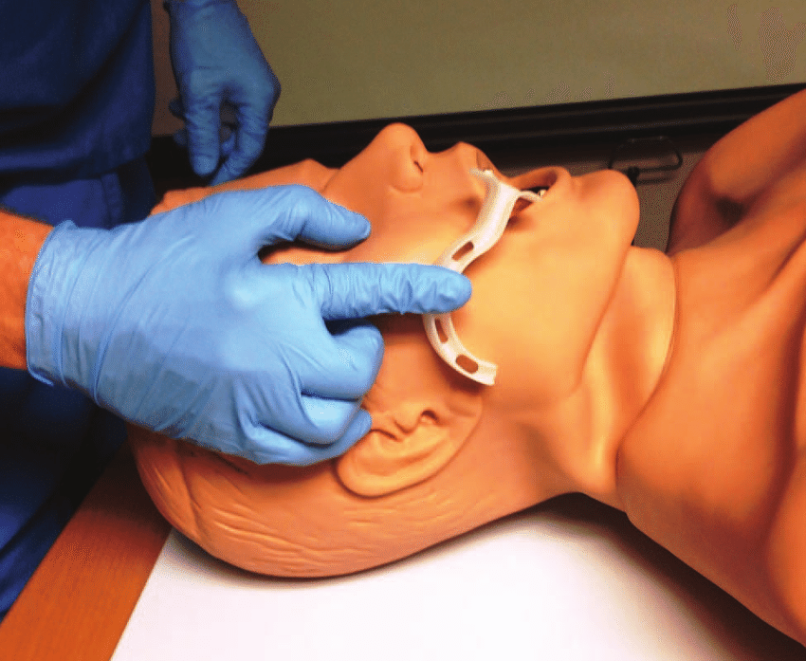
Oropharyngeal airway

Slide 31
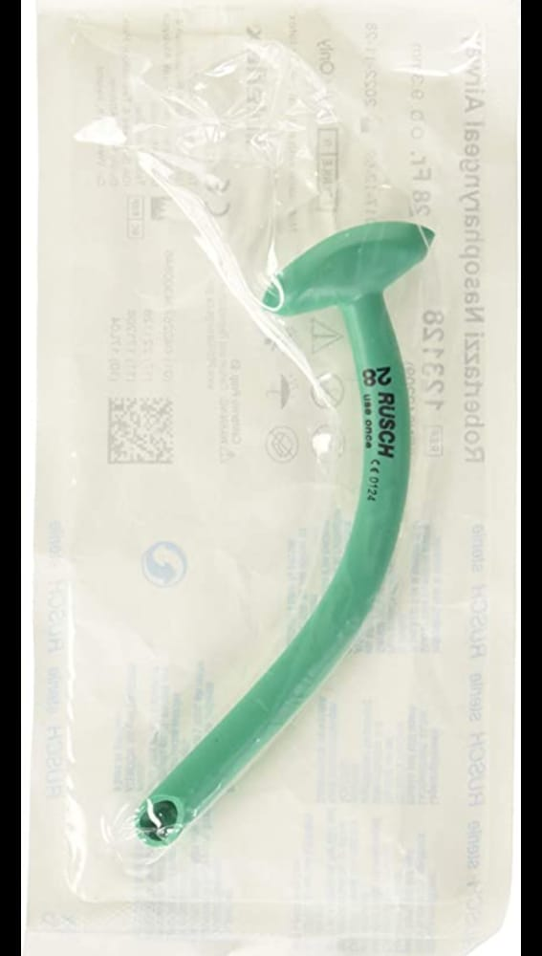
Nasopharyngeal airway

Slide 32
Airway Management: Choking
If foreign body is suspected:
  Visible foreign body: carefully REMOVE IT
  If the patient is able to cough or make noise, keep the patient calm
    ENCOURAGE to cough
  If the patient is choking (unable to cough/make sounds) use age-appropriate CHEST THRUSTS/ABDOMINAL THRUSTS/ BACK BLOWS
  If the patient becomes unconscious while choking: follow CPR PROTOCOLS

Slide 33
Airway obstruction
Signs and symptoms
Secretions and vomiting
Foreign object

Slide 34
Airway obstruction: management
The airway can become obstructed by secretions, vomit or foreign bodies.
Remove the foreign body if possible and suction fluid. Be careful not to push a foreign body further into the airway.
Do not try to remove a foreign body unless clearly visible.
• Use age-appropriate chest thrusts/abdominal thrusts/back blows if the airway is completely obstructed.
• The tongue may obstruct the airway in patients with a decreased level of consciousness. – Open the airway using a head-tilt and chin lift manoeuvre, or use jaw thrust (if there is concern for trauma); and place an oral or nasopharyngeal airway as needed.
– These patients may also not be able to protect their airway and need to be watched for vomiting and aspiration.
Plan for rapid handover/transfer to advanced provider capable of advanced airway management if the obstruction cannot be removed

Slide 35
Airway obstruction: Burns
Signs/ Symptoms
• Burns to head and neck
• Burned nasal hairs or soot around the nose or mouth
• Abnormal sounds from the airway (such as stridor)
• Change in voice
• Poor chest rise

Slide 36
Airway obstruction: burns (management)
Give oxygen to ALL patients with suspected airway burn even if they do not show signs of hypoxia.
• Open the airway using appropriate manoeuvre and place an oral or nasopharyngeal airway as needed.
• Maintain cervical spine immobilization if there is evidence of trauma.
• The airway can swell and close of very quickly in burn patients.
Plan for rapid handover/transfer to a provider capable of advanced airway management.

Slide 37
Airway obstruction: trauma
Signs and symptoms
Neck hematoma or injuries to head and neck
Abnormal sounds from the airway (such as stridor, snoring, gurgling)
Change in voice
Poor chest rise

Slide 38
management
Suction to remove any blood that might block the airway.
Open the airway using jaw thrust only (do not use head-tilt/chin-lift); and place an oral airway as needed (do not use nasopharyngeal airways if there is facial trauma).
Maintain cervical spine immobilization if there is evidence of trauma.
Plan for rapid handover/transfer to advanced provider capable of advanced airway management or surgical intervention.

Slide 39
NOTE
For any abnormal airway sounds, REASSESS the airway frequently as partial obstruction might worsen to completely block the airway

Slide 40
Airway obstruction: Severe Allergic Reaction
Signs and symptoms
• Mouth, lip, and tongue swelling
• Difficulty breathing with stridor and/or wheezing
• Rash or hives (patches of pale or red, itchy, warm, swollen skin)
• Tachycardia and hypotension
• Abnormal sounds from the airway (such as stridor, snoring, gurgling)
• Poor chest rise

Slide 41
Management
Monitor for airway obstruction.
•Give intramuscular adrenaline for airway obstruction, severe wheezing or shock.
– Adrenaline can wear of in minutes so be prepared to give additional doses.
• Place an IV and give IV fluids.]
• Reposition airway as needed (sit patient upright if no trauma) and give oxygen.
• If severe or not improving, prepare for rapid handover/transfer for advanced airway management.

Slide 42
Breathing: Assessment
Look, listen and feel to see if the patient is breathing
Assess if the breathing is very fast, very slow or very shallow
Look for increased work of breathing
  Accessory muscle work
  Chest indrawing
  Nasal flaring
  Abnormal chest wall movement
Listen for abnormal breath sounds
REMEMBER with severe wheezes there may be no audible breath sounds because of severe airway narrowing

Slide 43
Breathing: Assessment
Listen to see if breath sounds are equal
Check for the absence of breath sounds on one side
  If dull sound with percussion to the same side
    THINK large pleural effusion or haemothroax
  If also hypotension, distended neck veins or tracheal shift
    THINK tension pneumothorax
Check oxygen saturation

Slide 44
Breathing: Management
If unconscious with abnormal breathing, perform BAG-VALVE-MASK-VENTILATION with OXYGEN and follow CPR PROTOCOLS
If not breathing adequately (too slow or too shallow) begin BAG-VALVE-MASK-VENTILATION with OXYGEN
  If oxygen is not immediately available, do not delay ventilation
  Plan for immediate TRANSFER for airway management
If breathing fast or hypoxia, give OXYGEN
If wheezing, give SALBUTAMOL
If concern for anaphylaxis, give intramuscular ADRENALINE
If concern for tension pneumothorax, perform NEEDLE DECOMPRESSION, give OXYGEN, give IV FLUIDS
  Plan for immediate transfer for chest tube
If concern for pleural effusion, haemothorax, give OXYGEN
  Plan for immediate transfer for chest tube
If cause unknown, consider trauma

Slide 45
Breathing conditions : tension pneumothorax
Hypotension WITH difculty in breathing AND any of the following:
• distended neck veins
• absent breath sounds on affected side
• hyperresonance with percussion on affected side
• tracheal shift away from affected side

Slide 46
Management
NOTE: Any pneumothorax can become a tension pneumothorax. Air in the cavity between the lungs and the chest wall can collapse the lung (simple pneumothorax). Building pressure (tension) from a large pneumothorax can displace and block flow from the main vessels back to the heart, causing shock (tension pneumothorax).
• If tension pneumothorax is suspected, perform emergency needle decompression.
• Give oxygen
• Give IV fluids.
• Arrange for rapid handover/transfer to an advanced provider capable of placing a chest tube.

Slide 47
Breathing conditions: suspected opiate overdose
Signs and sypmtoms
• Slow respiratory rate
• Hypoxia
• Very small pupils
Opioid medications (such as morphine, pethidine, and heroin) can decrease the body’s drive to breathe

Slide 48
management
Give naloxone to reverse the effects of opioids. [–
Monitor closely as naloxone will wear of and additional doses may be needed.
Give oxygen.

Slide 49
Breathing conditions: Asthma/ COPD
Signs and sypmtoms
Wheezing
Cough
Accessory muscle use
May have history of asthma/COPD chronic obstructive pulmonary disease diagnosis, allergies or smoking
Asthma and COPD are conditions causing spasm in the lower airways, resulting in narrowing that causes difficulty in breathing and wheezing

Slide 50
management
Administer salbutamol as soon as possible. (Salbutamol helps to relieve the spasm in the air passages)
• Give oxygen if indicated.

Slide 51
Breathing conditions: large pleural effusion/ hemothorax
Signs and symptoms
Difficulty in breathing
Decreased breath sounds on affected side
Dull sounds with percussion on affected side
If there is a large amount of fluid, may have tracheal shift
Pleural effusion occurs when fluid builds up in the space between the lung and the chest wall or diaphragm. As the fluid builds up, it limits expansion of the lungs.

Slide 52
management
Give OXYGEN
Arrange for HANDOVER/TRANSFER
  Many of these patients will need a chest tube or drainage

Slide 53
Circulation: Assessment
Look, listen and feel for signs of poor perfusion
  Cool, moist extremities
  Delayed capillary refill
  Diaphoresis
  Low blood pressure
  Tachypnoea
  Tachycardia
  Absent pulses

Slide 54
Circulation: Assessment
Look for internal and external signs of bleeding
  Chest
  Abdomen
  From stomach or intestines
  Pelvic fracture
  Femur Fracture
  From wounds
Check for pericardial tamponade
    Hypotension
    Distended neck veins might indicate pericardial tamponade
    Muffled heart sounds
Check blood pressure

Slide 55
Circulation: Management
For cardiopulmonary arrest follow relevant CPR PROTOCOLS
If poor perfusion: GIVE IV FLUIDS
  If external bleeding: APPLY DIRECT PRESSURE
  If internal bleeding or pericardial tamponade, REFER to centre with surgical capabilities
If unknown cause, remember trauma
  Apply BINDER for pelvic fracture or SPLINT for femur fracture with compromised blood flow

Slide 56
Circulation conditions: Pulselessness
Signs/symptoms
No pulse
Unconscious
Not breathing

Slide 57
Management
Follow relevant CPR PROTOCOLS

Slide 58
Circulation conditions: shock
Signs and Symptoms
• Rapid heart rate (tachycardia)
• Rapid breathing (tachypnoea)
• Pale and cool skin
• Capillary refll>3 seconds
• Sweating (diaphoresis)
• May have dizziness, confusion, altered mental status
• May have hypotension
Poor perfusion is the failure to deliver enough oxygen-carrying blood to the vital organs. When poor perfusion continues until organ function is affected, this is called shock and can lead rapidly to death.

Slide 59
management
• Initial treatment for shock includes laying the patient fat (if tolerated).
• Give oxygen.
• Control bleeding.
• Start an IV and give IV fluids.
• If there are signs of infection, give antibiotics if available.
• Prepare for rapid handover/transfer

Slide 60
Circulation conditions: severe bleeding
If severe bleeding is not controlled, the patient can lose a significant amount of blood, which can lead to shock.
Large quantity of blood can also be lost into the chest, pelvis, thigh, and into the abdomen before the bleeding is recognized.
Signs/symptoms
Bleeding wounds
Bruising around the umbilicus (belly button) or over the flanks can be a sign of internal bleeding
Bleeding from the rectum or vagina or in vomit
Pelvic fracture
Femur fracture
Decreased breath sounds on one side of the chest (haemothorax)
Signs of poor perfusion (such as hypotension, tachycardia, pale skin, diaphoresis)
External bleeding that is not controlled can lead quickly to shock. A large quantity of blood can also be lost into the chest, pelvis, thigh and abdomen before the bleeding is recognized.

Slide 61
management
• Stop the bleeding. Depending on the source, use: – direct pressure– use deep wound packing if large and gaping – a tourniquet only for uncontrolled bleeding with pressure, bind pelvis (pelvic binder) or splint femur femur fracture
• Give IV fluids.
• Refer for blood transfusion and ongoing surgical management if needed.
NOTE: A tourniquet should be used only for life-threatening bleeding.

Slide 62
Circulation conditions: pericardial tamponade
Signs and Symptoms
Signs of poor perfusion (tachycardia, tachypnoea, hypotension, pale and cool skin, cold extremities, capillary refill >3 seconds)
Distended neck veins
Muffled heart sounds
May have dizziness, confusion, altered mental status
Pericardial tamponade occurs when fluid builds up in the sac around the heart. The pressure from this fluid can collapse the chambers of the heart and keep them from filling properly, limiting blood flow to the tissues and causing shock.

Slide 63
management
Treatment is drainage by pericardiocentesis
IV FLUIDS to counter the pressure from fluid in heart sac
Plan for HANDOVER/TRANSFER
  Needs facility capable of draining fluid

Slide 64
Disability: Assessment
Assess level of consciousness
  AVPU or GCS in trauma
Check for low blood glucose (hypoglycaemia)
Check pupils (size, reactivity to light and if equal)
Check movement and sensation in all four limbs
Look for abnormal repetitive movements or shaking
  Seizures/convulsions

Slide 65
GCS(GLASGOW COMA SCORE)
GLASGOW COMA SCORE (GCS
Eyes Score
Open spontaneously 4
Open to command 3
Open to pain 2
None 1

Slide 66
GCS
Verbal Score
Oriented 5
Confused talk 4
Inappropriate words 3
Incomprehensible sounds 2
None 1

Slide 67
GCS
Motor score
Obeys commands 6
Localizes pain 5
Withdraws to pain 4
Flexor(decorticate) 3
Extensor (decerebrate) 2
None 1

Slide 68
Eyes +Verbal + Motor Scores = GCS
– Severe head injury: GCS 8 or less
– Moderate head injury: GCS 9-12
– Mild head injury: GCS 13-15
GCS is to be repeated and recorded frequently. It is the best way to determine deterioration

Slide 69
Head injury
Deterioration
– Unequal or dilated pupils may indicate increased intracranial pressure
– Avoid sedation or analgesics as it interferes with neurologic examinations, reduces breathing (increased CO2 causes increased intracranial pressure)
– Bradycardia, hypertension may indicate worsening condition

Slide 70
Disability: management
If altered mental status, no trauma, ABCDEs otherwise normal
  place in RECOVERY POSITION
If altered mental status, low glucose (<3.5mmol/L) or if unable to check glucose
  Give GLUCOSE
If actively seizing
  Give BENZODIAZEPINE
If pregnant and seizing
  Give MAGNESIUM SULPHATE

Slide 71
Disability: Management
If small pupils and slow breathing, consider opioid overdose
  Give NALOXONE
If unequal pupils, consider increased pressure in the brain
  RAISE HEAD OF BED 30 DEGREES if no concern for spinal injury
  Plan for early TRANSFER/REFERRAL
If unknown cause of altered mental status, consider trauma
  IMMOBILIZE the cervical spine

Slide 72
EXPOSURE
Remove all patient's clothing
• Examine whole patient
• Front and back; log roll carefully
• Do not allow patient to get cold (especially children)

Slide 73
Exposure: Assessment
Examine the entire body for hidden injuries, rashes, bites or other lesions
  Rashes, such as hives, can indicate an allergic reaction
  Other rashes can indicate infection

Slide 74
Exposure: Management
If snake bite is suspected
  IMMOBILIZE the extremity
  Take a picture of the snake (if possible) to send to referral hospital
General exposure considerations
  REMOVE constricting clothing and jewelry
  COVER the patient to prevent hypothermia
    Acutely ill patients may be unable to regulate body temperature
  PREVENT hypothermia
    Remove wet clothing and dry patient thoroughly
  Respect the patient’s modesty
If cause unknown, remember trauma
  LOG ROLL for suspected spinal cord injury

Slide 75
organization
ASSESSMENT OF SITUATION
It is a process that includes a clinical interview, standardized measures and/ or behavioral observations designed to gather an in depth understanding of the nature, timing and severity of traumatic events, the effects of those events, current trauma related symptoms and functional impairment

Slide 76
ORGANIZATION
PRIORITIZATION
Red code:
1st priority and have most urgent life threatening conditions.
Yellow code:
2nd priority and have urgent conditions with significant injuries but are not life threatening.
Care can be delayed for 45 to 60 minutes
Green code/ walking wounded
3rd priority and have non urgent conditions that are minor.
Injuries are localized
Black code
They are expected to die, they are unresponsive and have no spontaneous breathing and circulation

Slide 77
ORGANIZATION
STAFF DEPLOYMENT
Deployment is the process of using personnel in an effective and efficient way

Slide 78
ORGANIZATION
CONTROL OF SITUATION
A person may try to control a situation by placing themselves in charge and doing everything themselves.

Slide 79
END

Slide 80
CASUALTY MASS ACCIDENTS
OBJECTIVES:
Types of emergencies
Principles of trauma and emergency care(trauma triaging- primary and secondary survey), transport, hospital care

Slide 81
TRAUMA
Def; it is an injury to the body tissues.
TYPES OF TRAUMA
Physical
psychological

Slide 82
CAUSES OF TRAUMA
Accidents
Stings
Bites, e.g. snake or dog bites
Burns
Foreign body- can be in the ear, nose or eyes.

Slide 83
EMERGENCIES
Def; it is a situation that requires urgent interventions or immediate actions.
An emergency is a situation that poses an immediate risk to health ,life, property, or environment.

Slide 84
Most emergencies require urgent intervention to prevent a worsening of the situation, although in some situations, mitigation may not be possible and agencies may only be able to offer palliative care for the aftermath.
CAUSES
- Acute diseases
- Accidents

Slide 85
TYPES OF EMERGENCIES
1. Medical emergencies- which includes poisoning, asthmatic attacks, unconsciousness, epileptic fits, diabetic cases
2. Surgical emergencies- this includes bleedings, cuts, stab wounds, vaginal bleedings, intestinal obstruction.
3. Paediatric emergencies- includes conditions that affect children, examples, foreign bodies, poisoning.
4. Psychiatric emergencies – include suicidal patients, aggressive.
5. Obstetric emergencies- include precipitate labour, obstructed labour.

Slide 86
EFFECTS OF EMERGENCIES
Haemorrhage
Fractures
Shock
Unconsciousness

Slide 87
CAUSES OF EMERGENCIES
1. Natural emergencies
Floods, land slides, thunders, tornadoes, fires e.g. wild fires, winter, Health hazard, disease.
A pandemic is a global disease outbreak. It is determined by how the disease spreads, not how many deaths it causes. When a new influenza A virus emerges, a flu pandemic can occur. Because the virus is new, the human population has little to no immunity against it. The virus spreads quickly from person-to-person worldwide.

Slide 88
2. terrorism
is the use of force or violence against persons or property for purposes of intimidation, coercion, or ransom. Acts of terrorism include threats of terrorism, assassinations, kidnappings, hijackings, cyber attacks, bomb threats, and explosions.
To carry out these activities, terrorists use chemical, biological, radiological, and nuclear weapons as well as explosive devices. These weapons and devices are often referred to as CBRNE.

Slide 89
3. Hazardous materials
Chemicals purify drinking water, increase crop production, and simplify household chores.
Hazardous materials are those that can cause death, serious injury, long-lasting health effects, and damage to buildings, residences, and other property.

Slide 90
Accidents
Def: It is unfortunate incident that happens unexpectedly and unintentionally, typically resulting in damage and injury of tissues and cells.

Slide 91
Common causes of accidents in our Kenyan homes
Open fires.
Accidental ingestion of drugs and chemicals.
Charcoal burners in poorly ventilated rooms.
Open pools
Open pits.
Wet slippery floors.
Burns from hot fluids, e.g. hot water, soups, tea.

Slide 92
Factors that make people prone to accidents
Young age and old age.
Sickness e.g. epilepsy
Carelessness
Ignorance
Poverty

Slide 93
Principles of trauma and emergency
If the casualties have multiple problems , injuries:
Treat the first one which is greater in threatening ; example:
  If you find a casualty / patient bleeding and have a fracture that is bleeding.
  (resuscitation) must be done simultaneously with the primary survey
  Treatment takes precedence over diagnosis

Slide 94
Priciples of emergency trauma care
If a patient has multiple problems or injuries, treat first the one that is the greatest threat to life
Indicated treatments should not be delayed simply because the diagnosis is not yet certain.
A detailed history is not essential to start evaluation & treatment of an injured patient Identifying the greatest Threats to Life in the Trauma Patient.

Slide 95
Life threats from trauma are (listed in order of decreasing severity):
Loss of airway – kills most quickly – Head position, blood, vomitus, foreign body, external compression
Loss of breathing – it kills

Slide 96
TRIAGE
In an accident or emergency you may have multiple patients
Decide which patients to treat first
Priority is to those with life threatening injuries/illness
Triage principles include:
  Life comes before a limb – patient not breathing normally is a priority to one whose bleeding
  Acute needs comes before long-term outcomes. Patient with internal bleeding has higher priority for evacuation than a patient with a fractured spine

Slide 97
Primary survey
It is a quick way to find out how to treating conditions a casualty may have in order of priority. We can use DRABC to do this: danger response, airway breathing and circulation.
MAKING THE CALL
Make the call to medical yourself or give the responsibility to bystanders.
Make sure that adequate and precise information is passed on the medicals.
This includes: the location of emergency (exact address, city or town, location, landmarks name of the building, floor apartment or room number)

Slide 98
Secondary survey
The purpose of a secondary survey is to check the victim carefully and in an orderly way for injuries or other problems that are not an immediate threat to life but which could cause problems if not corrected. For example a broken bone.
The secondary is a rapid but thorough head to toe examination assessment to identify all potentially injuries.
It is helpful to set the priorities for continued evaluation and management.
It should be performed after the the primary survey and initial stabilization is complete.
This includes the following: top-to-toe assessment, history, external clues, signs and symptoms

Slide 99
transport
After completing the emergency action principle (EAPS) consider transporting the victim to the hospital yourself if the victim’s condition is not severe. This is an important decision.
Do not transport a victim with life threatening condition may develop. Moreover, there maybe some situations, when an ambulance is not readily available and you may have to weigh the risks and consider taking the victim to the hospital.
However, you must pay close attention to the victim and watch for any changes in his or her condition.

Slide 100
transport
The transport of the seriously injured patient is associated with risk and requires particular expertise and attention.
The transfer of patient requiring medical attention has developed over the years and now includes complex undertakings that undoubtedly confer a degree of risk on the patient.
When deciding to transport an injured patient there are risks and appropriate mitigation must be in place, particularly if primary transfer to a major trauma centre involves bypassing a nearer facility.
It is clear that those clinicians who undertake medical transfers must be appropriately trained and must have access to local or national guidelines.

Slide 101
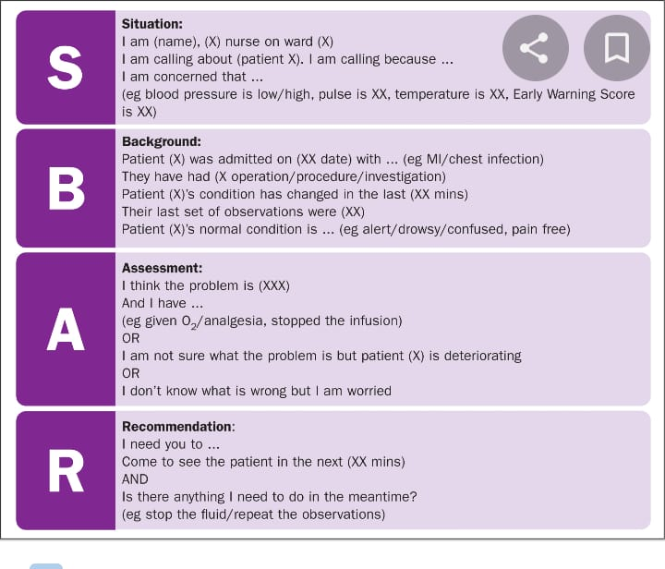
pictures

