Slide 1
THE CELL
Moses ndanyi
Msc. Medical physiology
Kmtc kakamega

Slide 2
Objectives
Structure of the cell
Organization and functions of cell organelles
Cell membrane:
Structure
Transport across the cell membrane

Slide 3
The Cell
Basic living unit of the body.
Body contains on average 100 trillion of which 25% are RBCs.
All have basic characteristics that are alike but differ in adaptation to their specific functions.
Major parts: Nucleus and cytoplasm.

Slide 4
Cell’s chemical composition
Substances making up the cell(protoplasm) are composed of five basic substances:
Water
Proteins
Carbohydrates
Lipids
Ions

Slide 6
PHYSICAL STRUCTURE OF THE CELL
The Cell is Made up of organelles
THE NUCLEUS
Control Centre of the cell containing DNA.
DNA - (1)Determines characteristics of cells
(2)controls and promotes reproduction-DNA-
Genetic system control
(3)controls day to day function of all body cells
e.g reactions taking place in the
cytoplasm(DNA-RNA mechanisms)

Slide 8
The DNA Structure

Slide 9
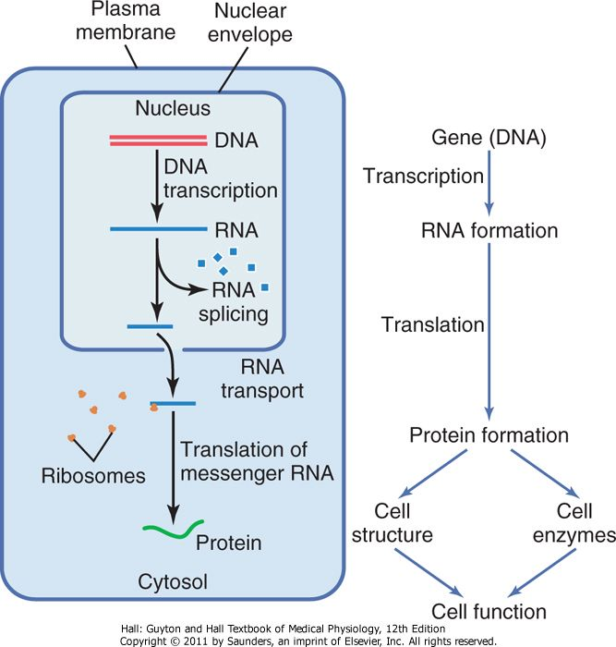

Slide 10
MITOCHONDRIA
“Power houses”
Number and distribution-depends on energy requirement of that cell.
Contain DNA similar to that found in the cell nucleus
Many infoldings onto which oxidative enzymes are attached
Inner cavity filled with matrix has large quantities of dissolved enzymes necessary for extraction of energy from nutrients

Slide 12
oxidation of nutrients leads to release of energy and formation of carbon dioxide and water.
Energy used to synthesize high energy substance “ATP”. High energy phosphate bonds contain 12,000 calories per mole of ATP
Transported out of the mitochondria diffusing through out cell to release energy where its required.

Slide 14
LYSOSOMES
“Intracellular digestive system”
vesicular organelles form by breaking off from the golgi apparatus and then dispersing through out the cytoplasm.
Digest
-damaged cellular structures
-ingested food particles
-unwanted matter e.g bacteria
-involved in regression of cells e.g muscles after
inactivity, uterus after delivery, mammary glands
after lactation.

Slide 15
contain protein agrregates(granules) with different Hydrolase(digestive) enzymes.
combine hydrogen ion with one part of the cpd and hydroxyl portion with the other part of cpd.
contain bactericidal agents
-Lysozyme-dissolve bacterial cell membrane
-Lysoferrin-binds to iron & other substances before they can contribute to bacterial growth.
PH 5 activates hydrolases and inactivates bacterial metabolic systems.

Slide 16
PEROXIXOMES
Similar physically to lysosomes but differ in that:
- formed by self replication or maybe budding from the SER rather than from golgi apparatus.
-contain OXIDASES rather than hydrolases.
oxidases combine oxygen with hydrogen ions derived from different intracellular chemicals to form hydrogen peroxide a highly oxidizing substance that detoxifies substances e.g alcohol by liver cells.
-

Slide 18
SYNTHESIS & FORMATION OF CELLULAR STRUCTURES
These are functions of Endoplasmic reticulum and the Golgi apparatus
These organelles are extensive in secretory cells
Two distinct Endoplasmic Reticular- Granular (rough) and agranular (smooth)

Slide 19
ENDOPLASMIC RETICULUM
ER is an anastomosing network of intercommunicating channels and sacs formed by a membrane which is continuous with the nucleus envelope
Most synthesis begin in the ER
Smooth endoplasmic reticulum lacks ribosomes. Its cisternae are tubular
Rough endoplasmic reticulum is dotted with ribosomes-major site for protein synthesis. Its cistenae are flat sacs.

Slide 21
Rough Endoplasmic Reticulum
Prominent in cells specialized for protein secretion, such as pancreatic acinar cells
RER walls –laden with protein enzymes
Protein synthesized in the attached ribosomes enter ER’s matrix for post translational modification (glycosylation, crosslinking and folding)
Proteins by free ribosomes remain free

Slide 22
Most of the proteins and glycoproteins are packaged into small membranous sacs (transport vesicles) that pinch off the and delivered to the Golgi apparatus

Slide 23
Smooth Endoplasmic Reticulum
SER is in communication with the RER
Its enzymes (all integral proteins forming part of its membranes) play no role in protein synthesis. But catalyze:
1. Lipid metabolism, cholesterol synthesis, and synthesis of the lipid components of lipoproteins (in liver cells)

Slide 24
2. Synthesis of steroid-based hormones (testes,ovaries and adrenal cortex)
3. Absorption, synthesis, and transport of fats (in intestinal cells)
4. Detoxification of drugs, certain pesticides, and carcinogens (in liver and kidneys)- Peroxisome
5. Breakdown of stored glycogen to form free glucose (in esp liver cells )
6. In skeletal and cardiac muscle the elaborate SER (sarcoplasmic reticulum)- stores Ca²⁺ and release it during muscle contraction.
Other than examples aforementioned, most body cells contain little or no true SER.

Slide 25
GOLGI APPARATUS
Consists of six stacked and flattened membranous sacs, shaped like hollow dinner plates, associated with many tiny membranous vesicles
There are 1 or so per cell, usually near the nucleus
The Golgi apparatus is the principal “traffic director” for cellular proteins.
Its major function is to modify, concentrate, and package the proteins and lipids made at the ER.

Slide 26
The transport vesicles that bud off from the rough ER move and fuse with the membranes at its convex (cis) face, the “receiving” side.

Slide 27
Inside the apparatus, the proteins are modified: trimmed/elongated/ phosphate and carbohydrate groups added.
The various proteins are “tagged” for delivery to specific places, sorted, and packaged in at least three types of vesicles that bud from the concave (trans/maturing) side
-As lysosomes,
-Vesicles destined to replenish membranes,
- vesicles headed for exocytosis

Slide 29
CYTOSKELETON
Is an elaborate series of rods running through the cytosol.
This network acts as a cell’s “bones,” “muscles,” and “ligaments” by supporting cellular structures and providing machinery for cell and organelle movements.
Has 3 componets 1. Microtubules (25nm)
2. Microfilaments (7nm)
3. Intermediate filament(10nm)

Slide 30
Microtubules are hollow tubes made of spherical protein subunits called tubulins (α,β,γ). Most microtubules radiate from a small region of cytoplasm near the nucleus called the centrosome
They determine the overall shape of the cell, as well as the distribution of cellular organelles - Mitochondria, lysosomes, and secretory granules attach to the microtubules and are continually pulled along the microtubules and repositioned by tiny protein machines called motor proteins (kinesins, dyneins, and others)

Slide 31
They are remarkably dynamic organelles, constantly growing out from the centrosome, disassembling, and then reassembling.
Microfilaments, are strands of the protein actin. A network of microfilaments is attached to the cytoplasmic side of the plasma membrane that strengthens the cell surface.
Most microfilaments are involved in cell motility or changes in cell shape.
Actin can interact with myosin to generate contractile forces in a cell and to form cleavage during cell division.

Slide 32
Microfilaments attached to CAMs aid amoeboid motion, and for the membrane changes that accompany endocytosis and exocytosis.
Intermediate filaments are tough, insoluble protein fibers
They are the most stable and permanent of the cytoskeletal elements; have high tensile strength.
They attach to desmosomes, and their main job is to resist pulling forces exerted on the cell.
examples- neurofilaments in nerve cells and keratin filaments in epithelial cells.

Slide 33
THE CELL MEMBRANE
Fluid like elastic lipid bilayer enveloping each cell= plasma membrane
It’s 7.5- 10nm thick, semi-permeable
Its mass is 55 % protein, 25% phospholipids, 13%cholesterol, 4% other lipids, 3% carbohydrates

Slide 34
Cellular transport

Slide 35
Outline
Review lipid bilayer and protein channels
Passive transport
Simple diffusion vs facilitated diffusion
3 forces that determine net diffusion rate
Concentration
Electrical charge
Osmotic pressure
Active transport
Primary active transport vs secondary active transport

Slide 36
Phospholipid Bilayer and Protein Channels

Slide 37
Diffusion
Diffusion is the passive flow of materials due to the random motion of molecules or particles to fill a given space evenly
Diffusion across a cell membrane can be:
SIMPLE—occurring via free flow through protein channels or directly across the cell membrane
FACILITATED—requiring to be carried across the cell membrane by a carrier protein

Slide 38
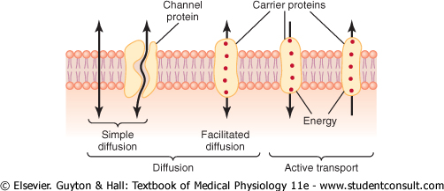
Simple Diffusion—lipid solubility
Lipid soluble materials diffuse directly through the lipid membrane
Rate determined by lipid solubility and concentration gradient
O2, CO2, alcohol
Of these, O2 flows most freely—almost as if membrane didn’t exist

Slide 39
Simple Diffusion—water solubility
Water and water soluble materials (ions, glucose, etc.) must diffuse through protein channels
Protein channels have 2 important properties
They are SELECTIVELY PERMEABLE
They can be GATED

Slide 40
Selective Permeability
Protein channels control the materials that flow through them via structure (size) and charge
Example: Sodium channel is the right size for sodium and negatively charged to draw Na+ away from attached water and through channel
Example: Potassium channel is smaller but not charged, so doesn’t pull off water, leaving K+ smaller than sodium and allowing only K+ to enter

Slide 41
Gating
Some protein channels have gates
Gates open in 2 ways:
Voltage gating—change in membrane potential opens gate
Example: action potentials (cardiac, nerve, muscle)
Ligand (chemical) gating—a chemical or ligand binds to the protein → conformational change in the protein → opens gate
Example: nerve signal transmission with ACh

Slide 42
Selective Permeability and Gating

Slide 43
Facilitated Diffusion
Materials must be carried across the cell membrane by a CARRIER PROTEIN
Glucose or amino acids bind to receptor → conformational change in the protein → delivers material to opposite side of the membrane

Slide 44
Facilitated Diffusion
Glucose and Amino Acids enter cells primarily via facilitated diffusion

Slide 45
Clinical Correlation—Facilitated Diffusion
Insulin (secreted after meals) increases glucose uptake into cells 10-20 fold primarily by increasing rate of facilitated diffusion

Slide 46
Facilitated Diffusion VS Simple Diffusion
Difference between simple and facilitated diffusion is that the rate of facilitated diffusion reaches a maximum

Slide 47
3 Forces Determine Net Diffusion Rate
Net diffusion rate is the rate at which any material will diffuse across a membrane
3 forces work together to determine net diffusion rate
Concentration
Electrical charge
Osmotic pressure

Slide 48
Concentration
Materials will flow from high concentration to low concentration
The greater the difference in concentration, the greater the rate of diffusion

Slide 49
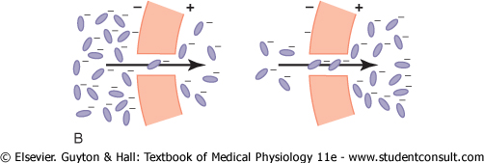
Electrical Charge
Charged particles are attracted to opposite charge and repelled by similar charge
If there is a difference of charge across a membrane, there will be a net diffusion of ions towards the opposite charge

Slide 50
Electrical Charge—Nernst Potential
As ions flow down their electric gradient (towards like charges), a CONCENTRATION GRADIENT is created
The concentration gradient will eventually balance the electrical gradient, and there will be NO net flow
The voltage (electrical gradient) that balances a given concentration gradient is called the NERNST POTENTIAL

Slide 51
Pressure
If there is higher pressure on one side of a membrane than another, there will be a net diffusion of substances from higher to lower pressure

Slide 52
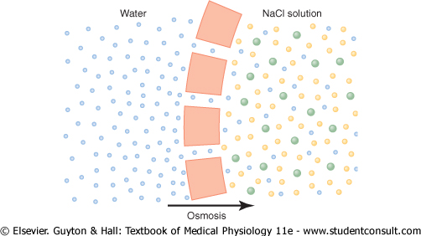
Osmosis
Osmosis is the movement of water across a semipermeable membrane from an area of low solute concentration to an area of high solute concentration

Slide 53
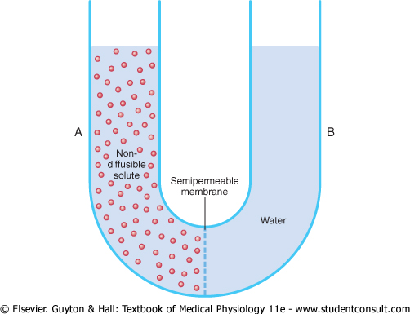
Osmotic Pressure
Osmotic pressure is the amount of pressure that balances the tendency of water to move across the membrane to an area of high solute concentration

Slide 54
Osmolarity and Osmolality
The number of particles in solution determines the osmotic pressure of that solution
This is called osmolarity or osmolality
Osmolarity is the number of osmoles / liter of solution
Osmolality is the number of osmoles / kg of water
In humans, 300 mosm/kg = 5790 mmHg

Slide 55
Active Transport
DEFINITION: Moving ions or molecules across a cell membrane against their electrochemical gradient
Divided into Primary Active Transport
Uses ATP as energy source
And Secondary Active Transport
Uses energy stored in another ion’s/molecules electrochemical gradient

Slide 56
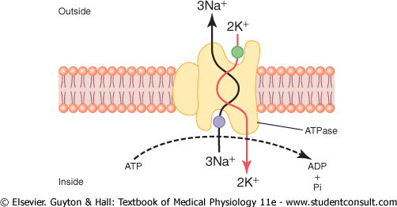
Primary Active Transport
Na+, K+, Ca2+, H+, Cl-
Sodium-Potassium ATP-ase pump

Slide 57
Clinical Correlation—Primay Active Transport
Na+/K+ pump regulates volume of every cell
Na+/K+ pump creates the basis for nerve conduction, muscle contraction, and heart beats by creating a membrane potential
Ca2+ is pumped into sarcoplasmic reticulum of muscle cells to facilitate muscle contraction
Parietal cells pump H+ ions against 1 million fold concentration gradient in gastric glands

Slide 58
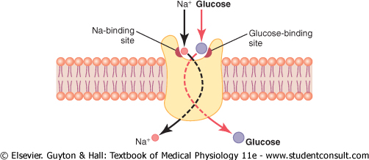
Secondary Active Transport
CO-TRANSPORT
Use energy from Na+ concentration gradient to move glucose or amino acids into cell
Glucose & Amino Acids
both molecules move in the same direction

Slide 59
Secondary Active Transport
COUNTER-TRANSPORT
Use energy from the Na+ concentration gradient to move Ca2+ and H+ out of cells
Na+/Ca2+ and Na+/H+
ions move in opposite directions—i.e. Na+ into the cell and H+ or Ca2+ out of the cell

Slide 60
Clinical Correlation—Secondary Active Transport
Na+/glucose and Na+/Amino acid co-transport are the main mechanism by which we absorb glucose and amino acids into intestinal epithelial cells
In renal tubular cells, Na+/H+ counter-transport is responsible for eliminating H+ ions and regulating pH of the blood

Slide 61
Summary—Transport Mechanisms
Cellular Transport
Diffusion
Active Transport
Simple
Facilitated
Primary
Secondary
Lipid soluble
Water soluble
Co-transport
Counter-transport
direct through membrane
through protein channels
uses carrier proteins
uses ATP
Uses Na+ gradient
Uses Na+ gradient
O2
CO2
H2O
ions
Glucose
amino acids
Na+/K+ ATP-ase
Glucose
amino acids
Ca2+
H+

Slide 62
It’s electrogenic:
Pumps 3Na+ out , 2K+ in
Notes:
Regulation of Na+-K+ ATPase Activity
The amount of Na+ normally found in cells is not saturating, so if it increases, the pump activity and hence the amount of Na+ extruded from the cell increase. Pump activity is affected by second messengers produced in cells, including cAMP and diacylglycerol (DAG). Thyroid hormones increase pump activity by a genomic action to increase the formation of Na+-K+ ATPase molecules. Aldosterone also increases the number of pumps, although this effect is probably secondary. Dopamine in the kidney inhibits the pump by phosphorylating it, causing a natriuresis. Insulin increases pump activity, probably by a variety of different mechanisms. Finally, Na+-K+ ATPase is anchored in the membrane by the cytoskeleton, and it is interesting that G-actin increases pump activity.

Slide 63
Secondary Active transport
Energy is derived indirectly from ATPase activity in form of ion gradient created by the pump activity
- Cotransport (uniport
or symport) e.g
Na⁺ -Gl; Na⁺ -AA
Na⁺ -K⁺ -2Cl⁻
- Countertransport
(antiport) e.g Na⁺-H⁺
Na⁺ -Ca²⁺

Slide 64
CELL DIVISION AND DEATH
cell cycle
DIVISION –cell cycle
There are three classes
of cells ;
Labile cells – frequent
divisions throughout life
Stable Cells – Cells lost by
wear and tear are replaced
by the mitotic activity of
Others- liver, kidneys
Permanent cells – non-replicating cells lose ability to divide either at birth or shortly thereafter- nerves ,muscle and cardiac
Notes:
During G₁, cells grow rapidly and carry out their routine functions. The S phase is the period of DNA synthesis. In G₂, materials needed for cell division are synthesized and growth continues. During the M phase (cell division), mitosis and cytokinesis occur, producing two daughter cells. Important checkpoints at which mitosis may be prevented from occurring are found throughout interphase; two are shown on the diagram

Slide 65
CELL DEATH
-Autolysis of cells & tissue regression e.g uterus- work of lysosomes
-Apoptosis – ‘cell suicide’ under genetic control e.g immune syst rids of inappropriate clone etc
The final common pathway for apoptosis is i)Activation of caspase ( cysteine proteases )
ii)DNA fragmentation
iii) cytoplasmic&chromatin condensation
iv) membrane bleb formation
v) cell break up and debris removed by phagocytosis

Slide 66
Review
What is the difference between passive and active transport?
What is one example of primary active transport?
What would be the clinical consequence of losing the Na+/K+ ATP-ase?
How does insulin work to increase glucose absorption into muscles following a meal?

Slide 67
T H A N K
Y O U

