Slide 1
The Gastrointestinal System
SAMUEL NGIGI K.
KMTC

Slide 2
Alimentary tract provides the body with a continual supply of water, electrolytes, and nutrients
To achieve this requires
Movement of food through the alimentary tract
Secretion of digestive juices and digestion of the food

Slide 3
Absorption of water, various electrolytes, and digestive products
Circulation of blood through the gastrointestinal organs to carry away the absorbed substances
Control of all these functions by local, nervous, and hormonal systems

Slide 4
There are accessory organs involved in GIT processes. This includes the liver, the pancreas and gall bladder among others
Apart from this, the GIT is exposed to various agents which come in with the substances being taken up in the GIT.
This includes microbes as well as other toxic products
As such, it has to have immune functions to defend against this microbes

Slide 5
The GIT itself has resident microbes hence the term gut microbiota.
This gut microbiota may play an important role in health and disease

Slide 6
Once food has been digested into the end products- glucose, amino acids, fatty acids, it has to be converted to appropriate forms for storage.
Again, the final products have to be converted to appropriate form for utilization in body processes as energy. This is metabolism where the is production of ATP which is the form by which the body gets its energy. This is metabolism

Slide 7
Processes of digestion
General anatomy of the GIT system
Motility of the GIT system
Mastication
Swallowing
Stomach
Small intestine motility
Large intestines motility

Slide 8
Digestion
Mouth – secretions, digestion and regulation
Stomach- general anatomy, secretions and its regulation, digestion
Pancreas: Anatomy, secretions (exocrine and endocrine) and regulation
Liver and gall bladder: Anatomy, hormonal control, bile secretions. hepatic circulation
Small intestines: Anatomy, secretions and its regulation, digestion and absorption
Large intestine: Anatomy, secretions and absorption
Notes:
Exocrine glands are glands that secrete substances onto an epithelial surface by way of a duct. Examples of exocrine glands include sweat, salivary, mammary, ceruminous, lacrimal, sebaceous, and mucous.
Endocrine glands are ductless glands of the endocrine system that secrete their products, hormones, directly into the blood. The major glands of the endocrine system include the pineal gland, pituitary gland, pancreas, ovaries, testes, thyroid gland, parathyroid gland, hypothalamus and adrenal glands.

Slide 9
Regulation
Nervous control of GIT:
General anatomy of the GIT wall
Anatomy of the neuromuscular structure – Enteric nervous system, Intestitial cells of Cajal
Myogenic Basis of GI phasic contraction: Slow Waves/Basal Electrical Rhythm
ANS
GIT Reflexes
Notes:
The enteric nervous system (ENS) is the intrinsic nervous system of the gastrointestinal tract.

Slide 10
Processes (cont’d)
Hormonal control of GIT
Regulation of eating
Immune functions of the GIT
Gut microbiota
Metabolism
Blood sugar regulation
GIT disorders

Slide 11
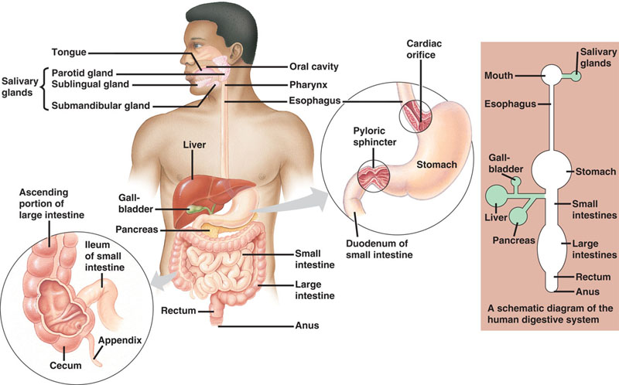
Overview of the Digestive System

Slide 12
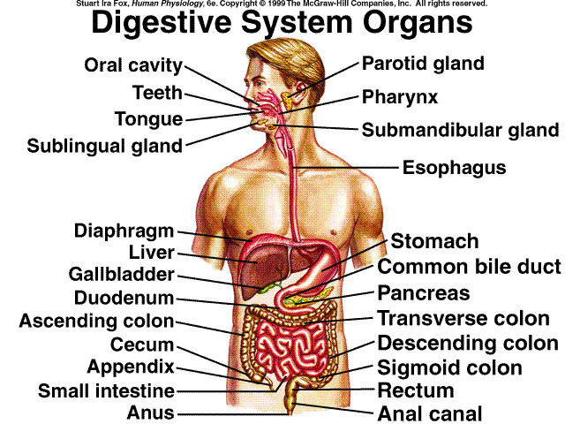
See Table 16-2

Slide 13
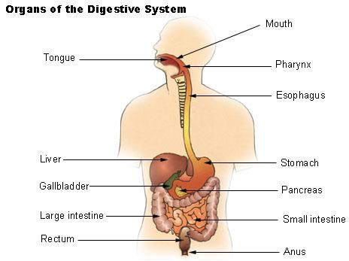
GIT consists of;
Oral cavity or mouth
Pharynx
Esophagus
Stomach
Small intestine
Large intestine
Rectum
Anus

Slide 14
Functions of the GI Tract
Ingestion: Taking in food
Digestion: Chemical and Mechanical
Absorption: moving nutrients from the lumen of the GI tract into the cells of the body
Excretion: getting rid of undigested and unabsorbed material
Movement: movement of ingested food throughout the GI tract

Slide 15
Organs of the Digestive System
Accessory Digestive Organs:
Salivary glands
Liver, gall bladder
Pancreas
Digestive Tract:
Oral Cavity
Pharynx
Esophagus
Stomach
Small Intestine
Large Intestine

Slide 16
The Oral Cavity
Boundaries are:
- lips (anteriorly)
- cheeks (laterally)
- palate (superiorly)
The oral cavity is important in:
- mastication (chewing): mechanical digestion
- secretion of saliva for digestion (amylase;digests starch), coating food (mucus)
- no significant absorption of nutrients occurs in the oral cavity

Slide 17
The Pharynx
The pharynx is the passageway from the nose and mouth to the esophagus and respiratory tract
Boundaries: uvula to epiglottis
During swallowing, food is directed from pharynx to esophagus (away from respiratory tract).

Slide 18
Esophagus
The esophagus is a passageway from the pharynx to stomach
Contains two sphincters: upper and lower esophageal sphincters (controls flow)
Upper sphincter is skeletal (voluntary), lower sphincter is smooth muscle (involuntary)
Peristaltic waves move food from pharynx to stomach.

Slide 19
The Stomach
The stomach stores food, and mixes and mechanically and chemically digests it
The stomach also secretes digestive juices
pepsin: digests protein
hydrochloric acid (acidic pH, required for pepsin activity, and to kill ingested bacteria)
Mucus: protects the stomach wall
Partially digested food: chyme
Little absorption occurs in the stomach (exceptions: alcohol, aspirin…)

Slide 20
Histology of the Stomach
Cell types:
Chief cells: produce pepsinogen (inactive precursor to pepsin)
Parietal cells: produce HCl and intrinsic factor (absorption of vitamin B12; important in RBC maturation)
“Endocrine” cells:
G cells: gastrin
D cells: somatostatin (paracrine)
Enterochromaffin-like cells: histamine (paracrine)
Notes:
Paracrine: relating to or denoting a hormone which has effect only in the vicinity of the gland secreting it.

Slide 21
Small Intestine
Connects the stomach with the large intestine
It is the major site of digestion
It is also the major site of absorption
Specialized structures (villi, microvilli) increase the surface area of the small intestine, aiding absorption.
The small intestine has three parts (duodenum, jejunum, and ileum)
The bile duct (from liver) and pancreatic duct (digestive juices) empty into the duodenum.

Slide 22
Histology of the Small Intestine
Absorptive cells
Goblet cells (mucus)
Enteroendocrine cells:
secretin
cholecystokinin

Slide 23
Motor Functions (Motility) of GIT

Slide 24
Motility of the GIT
1. Motility in the mouth
2 types;
Chewing or Mastication:
It is reflex in nature
Significance:
Breaks the food into small pieces to be easily swallowed
Expose food to salivary amylase enzyme, which begins digestion of starch
Help digestion of all types of food especially cellulose containing food e.g. vegetables

Slide 25
Salivary Glands
Are compound tubular glands that produce a liquid containing
water,
mucus,
proteins,
a buffer, and
enzymes.

Slide 26
The purpose of saliva is to
Moisten food
begin the digestion of starch,
neutralize acids,
stimulate growth of beneficial bacteria in the mouth and
dissolve food chemicals so for taste (stimulate the chemoreceptors of the mouth).
Salivary glands include the parotid, submandibular, and sublingual glands
Notes:
While some of the bacteria in our mouths are harmful and can cause serious illness, much of our oral bacteria are actually beneficial in preventing disease. Streptococci make up a large part of oral bacteria. There are four main species within streptococci: the mutans, salivarius, anginosus, and mitis groups.

Slide 27
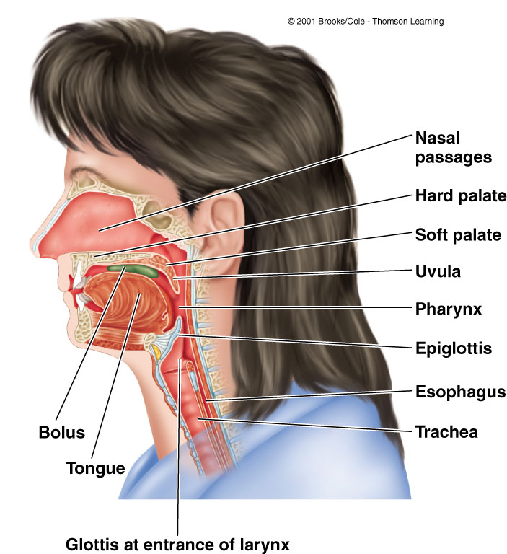
Pharynx and Esophagus

Slide 28
Motility of the GIT
b) Swallowing:
Def.
Swallowing is the transport of food from mouth to stomach
Steps:
It consists of 3 phases or steps;
1) Buccal Phase: food is pushed back into pharynx from mouth

Slide 29
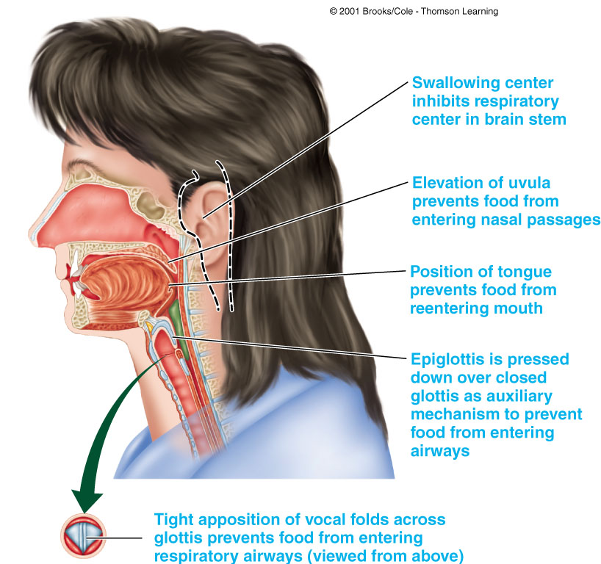

Slide 30
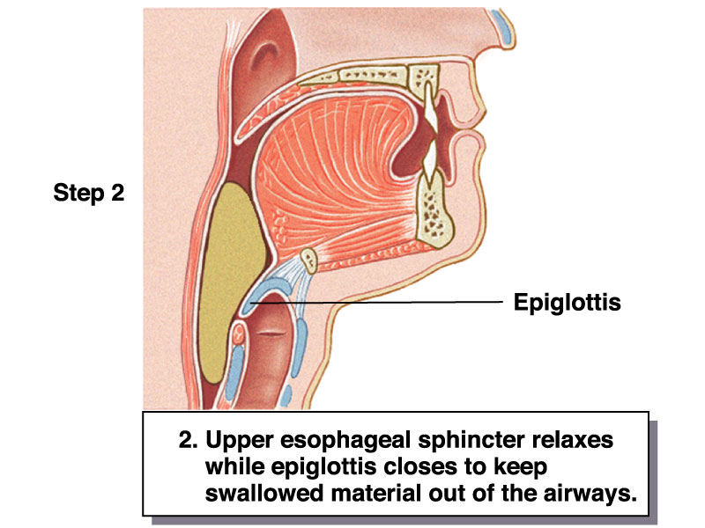
Motility of the GIT
b) Swallowing:
2) Pharyngeal Phase: food pass through pharynx to esophagus

Slide 31
Motility of the GIT
b) Swallowing:
3) Oesophageal Phase: food pass through esophagus to stomach by peristaltic movements

Slide 32
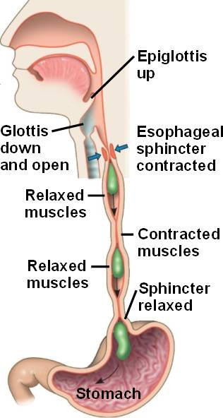
2. Motility of Esophagus
Motility of GIT
The esophagus is 25 cm ms tube
It is guarded by 2 sphincters;
Upper esophageal sphincter prevents air from entering the GIT
Lower esophageal sphincter prevents gastric contents from re-entering the esophagus from the stomach
Esophageal peristalsis sweeps down the esophagus

Slide 33
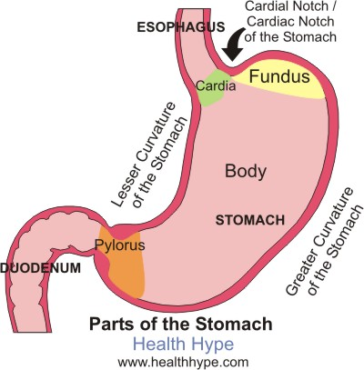
3. Motility of Stomach
Motility of GIT
The stomach consists of fundus, body and pylorus
Proximal area (fundus and body) has a thin wall and contracts weakly and infrequently → holds large volumes of food (to store food) because of receptive relaxation
Distal area (pylorus) has thick wall with strong and frequent peristaltic contractions that mix and propel food into the duodenum.
Also, distal area is responsible for gastric emptying into duodenum

Slide 34
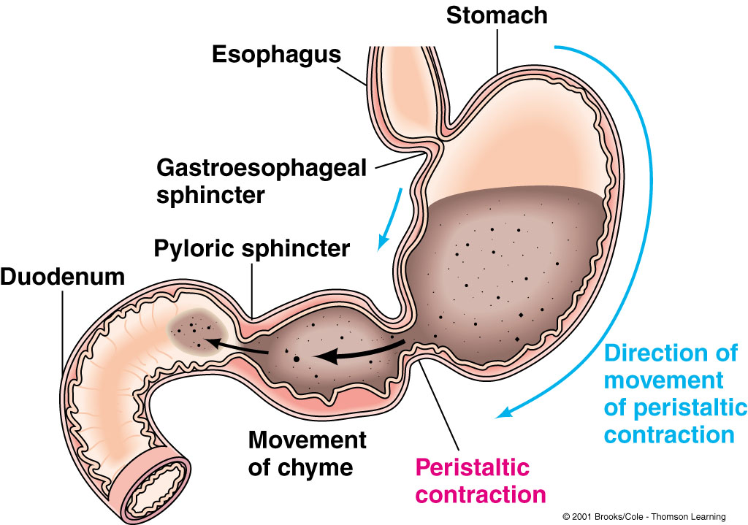
Pendular Movement

Slide 35
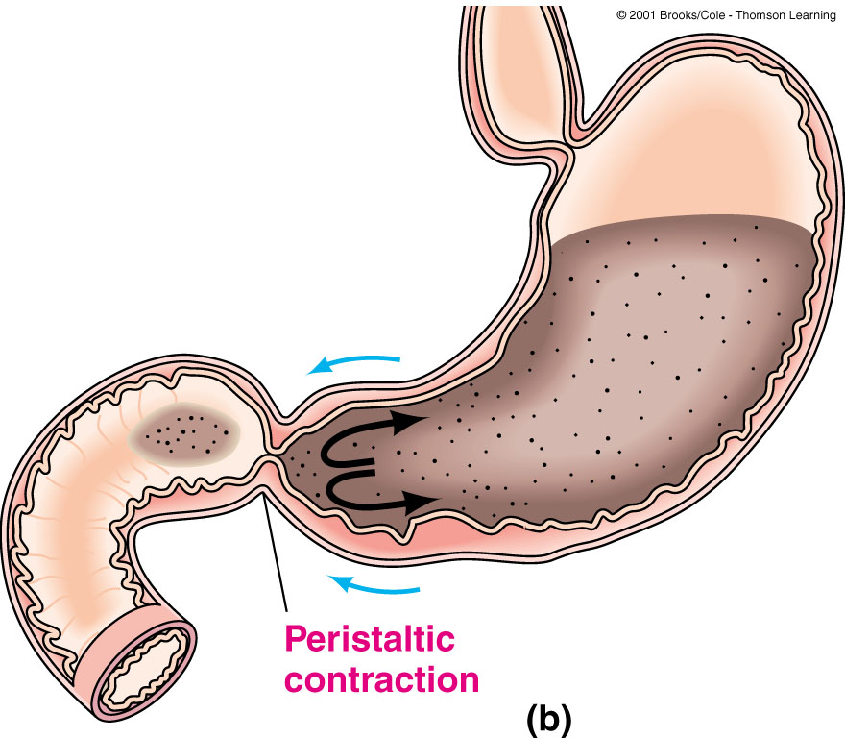

Slide 36
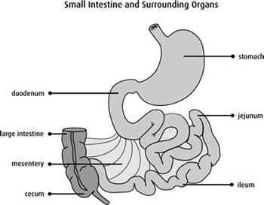
4. Motility of Small intestine
Motility of GIT
Types:
Two basic motility patterns exist segmentation and peristalsis.
Significance:
Motility of the small intestine serves 3 functions:
Mixing contents with enzymes and other secretions → help digestion
Maximizing exposure of the contents to membranes of intestinal cells → help absorption and digestion.
3. Propulsion of contents into the large intestine.

Slide 37
2. Microscopic anatomy- the small intestine is designed for absorption of nutrients, thus its modifications increase its surface area by 200 square feet.
Circular folds- transverse ridges (1 cm tall) that force the chyme to spiral as it slows it down to increase absorption.
b. Villi- these are finger-like projections (1mm tall) made up of simple columnar epithelial cells specialized for absorption (enterocytes). They are in close contact with capillaries and lacteal (lymph vessels that absorb fat)

Slide 38
C. Microvilli- microscopic folds on the apical side of the simple columnar epithelial cell in the mucosa. The folds increase the surface area of the cell's membrane allowing for greater interaction. This is also the area where chemical digestion is completed.
Intestinal crypts contain cells that produce digestive juice in the small intestine and stem cell replace the epithelium every 3-6 days. Duodenal glands also secrete a solution that neutralizes stomach acid.

Slide 39
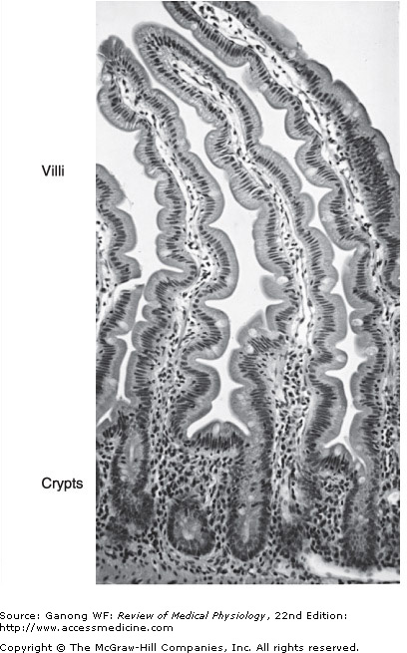
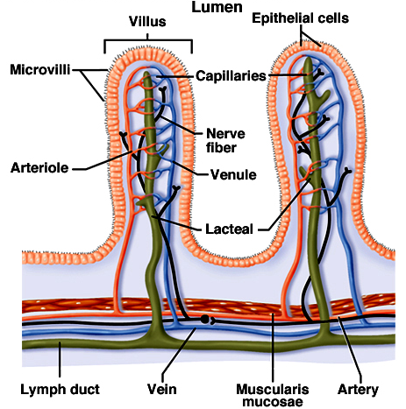
Villi & Crypts
Vander, Fig. 15-7
Ganong, Fig. 26-27

Slide 40
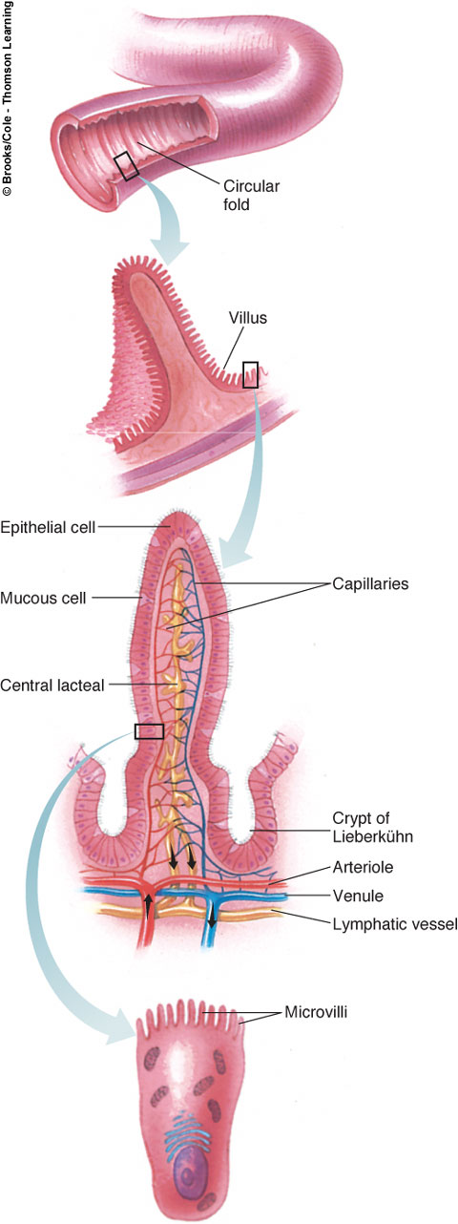

Slide 41
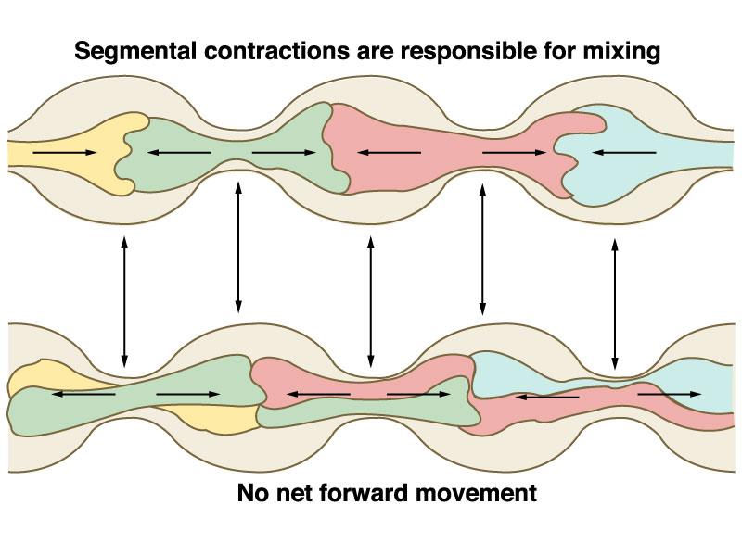
Motility of GIT
Segmentation movements
and cutting
1 ~ 5 cm

Slide 42
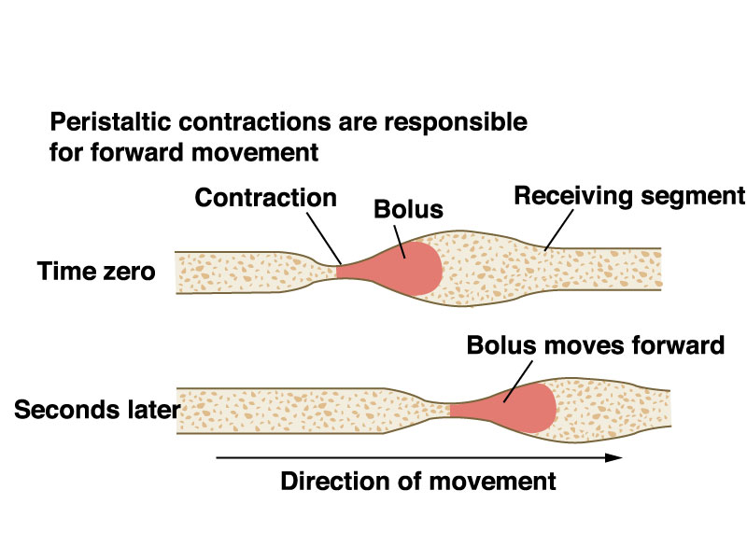
Peristalsis
Motility of GIT
Orad
caudad

Slide 43
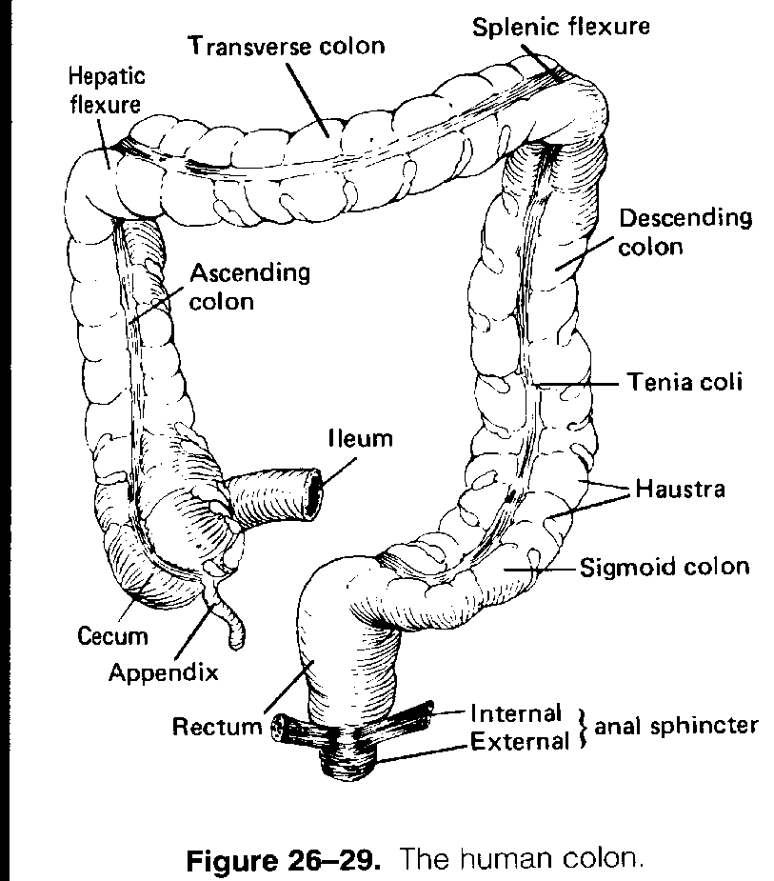
5. Motility of Large intestine or colon
Motility of GIT
Types:
Include :
a) Segmentation in the large intestine causes the contents to be continuously mixed
b) Mass movement propels the contents of one segment of the large intestine into the next downstream segment.
c) Defecation involves involuntary reflexes and voluntary reflexes → evacuation of colonic content through anal canal

Slide 44
Large intestine- Area where food remains for 12-24 hours. Some absorption and digestion occurs (by bacteria) it is primarily designed to reabsorb water and electrolytes.
1. Gross anatomy- It is wider than the small intestine but shorter. It is divided into the cecum (opening of ileum to large intestine, has iliocecal valve), the vermiform appendix (opens to the cecum, contains lymphoid tissue), the colon (has at least four sections), the rectum (has rectal valves that prevent feces from being passed along with gas) and the anal canal (external to abdominal pelvic cavity, has external anal canal).

Slide 45
The sections of the colon and bends are: ascending colon, right colic (hepatic) flexure, transverse colon, left colic (splenic) flexure, descending colon, and sigmoid colon and rectum. Some of the feature are: the teniae coli (longitudincal strips that run along the colon), the haustra (pockets or sacs) and the epiploic appendages (hanging fat filled pouches)

Slide 46
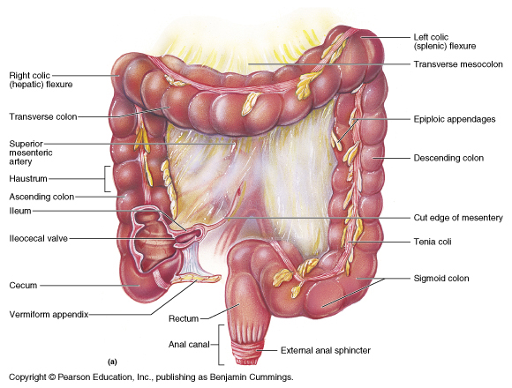

Slide 47
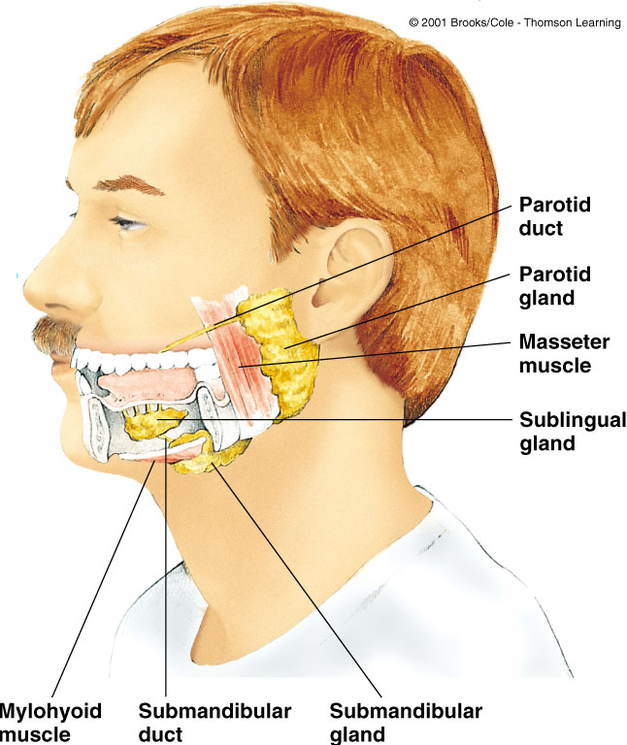
Ingestion/Mastication

Slide 49
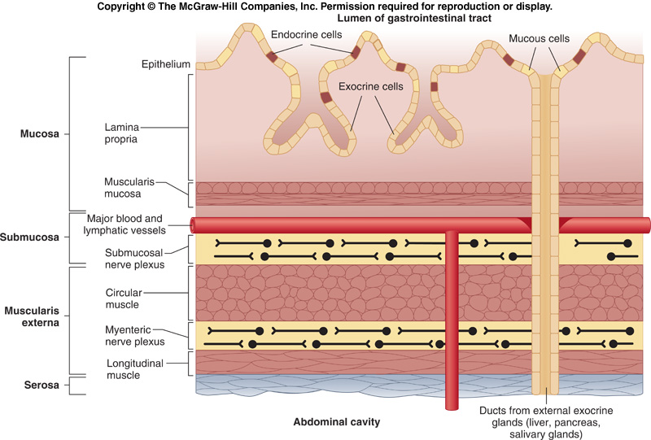
Figure 15-6
General Anatomy of Gut Wall
(Contains connective tissue, immune cells, capillaries, nerve endings)
(Might have role in villus movement)
The gut wall has a layered organization, with the absorptive cells lining the lumen and neural and muscular components below. Blood and lymph vasculature is abundant to transport absorbed nutrients.

Slide 50
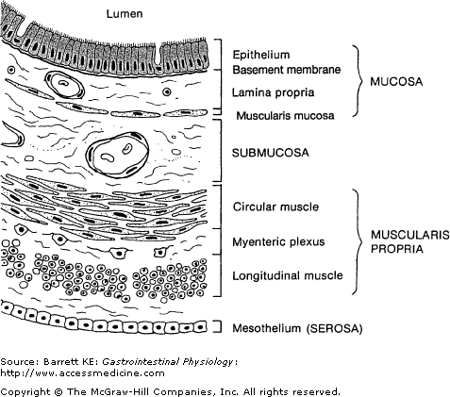
General Structure of Gut Wall: Cross Section
50

Slide 51
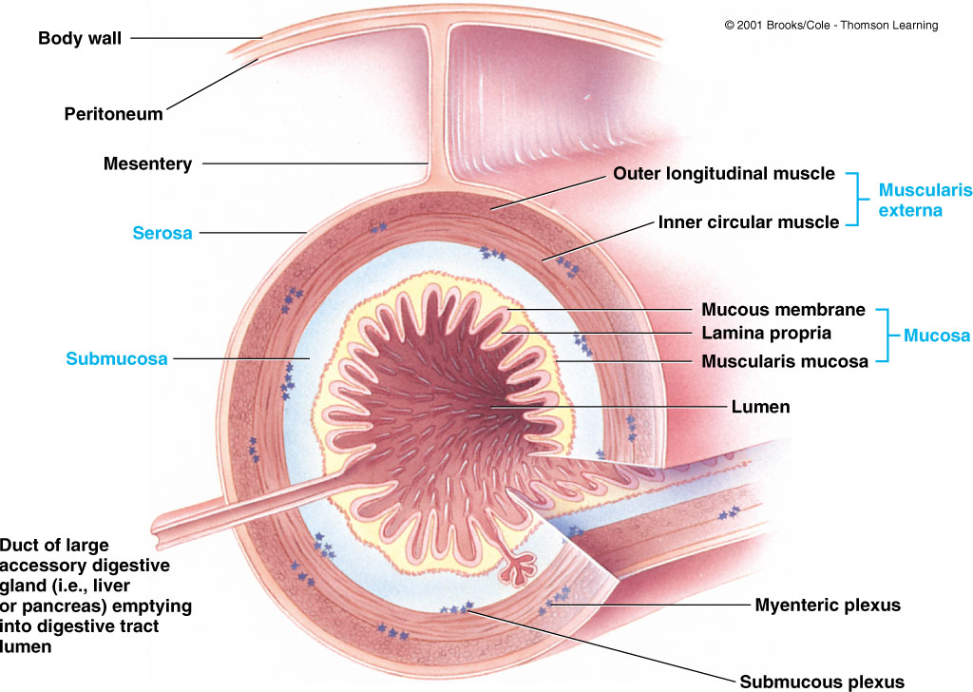

Slide 53
INTERSTITIAL CELLS OF CAJAL (ICC)
Cells mediate between efferent neurons and smooth muscle cells:
Responsible for slow waves and pacemaker activity of smooth muscle.
Also amplify neuronal input.
Central to GI motility regulation.
Loss of ICC implicated in many human motility disorders (Hirshsprung’s disease, severe constipation, IBD(Inflammatory bowel disease)etc).
Notes:
Hirschsprung's disease is a condition that affects the large intestine (colon) and causes problems with passing stool. The condition is present at birth (congenital) as a result of missing nerve cells in the muscles of the baby's colon.

Slide 54
Movements
1. Peristalsis
2. Rhythmic segmentation
3. Pendular movement
4. Tonus changes
5. Villar Movement

Slide 55
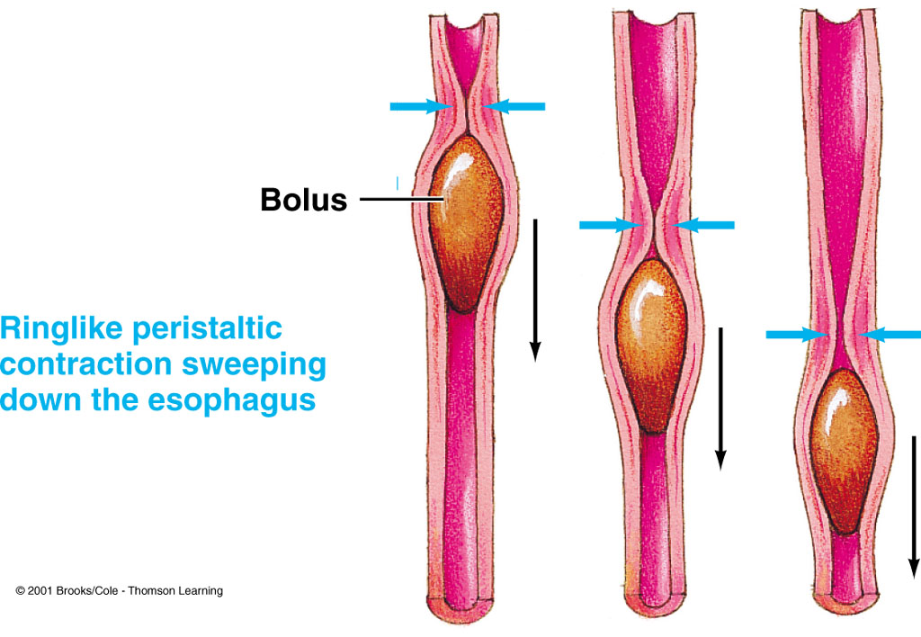
Peristalsis

Slide 56
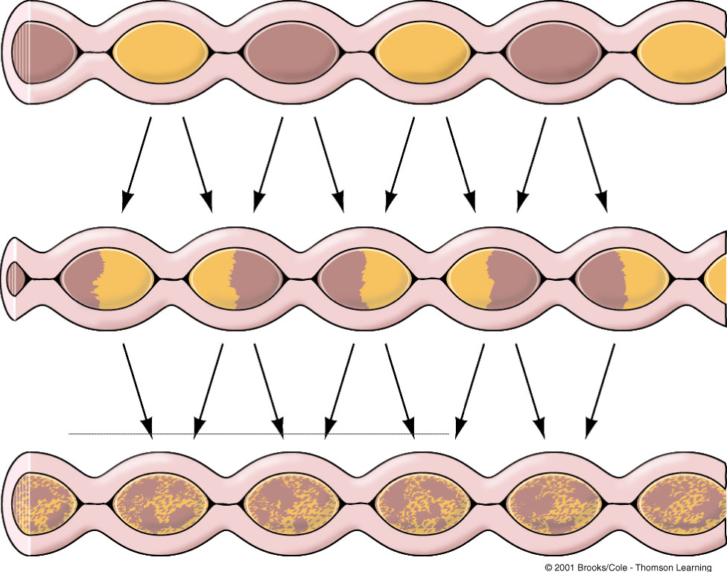
Rhythmic Segmentation

Slide 57
Digestive Processes
Mouth
Pharynx and Esophagus
Stomach
Pancreas and Gall Bladder
Small Intestine
Large Intestine

Slide 58
Secretions of GIT
The total volume of GIT secretions is about 6-8 L/day
Secretions arise from specialized cells lining the GI tract, the pancreas, liver and gallbladder.
GI secretions function to lubricate (water and mucus), protect (mucus), sterilize (HCl), neutralize (HCO₃⁻), and digest (enzymes).

Slide 59
Secretions of GIT in Mouth
Salivary Glands
Three pairs of glands
Parotid
Sublingual
Submandibular
Functions of saliva
Lubricates, cleanes oral cavity
Dissolves chemicals
Suppresses bacterial growth
Digest starch by amylase

Slide 60
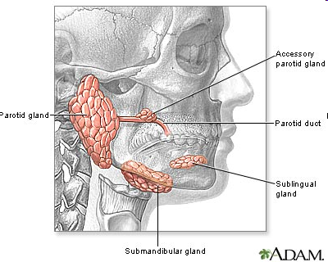
Salivary Secretions
Salivary glands contain serous cells that produce a watery fluid with amylase, and mucous cells that produce lubricating and binding mucus.
Salivary glands receive parasympathetic stimulation that triggers production of a large volume of saliva at sight or smell of food.

Slide 61
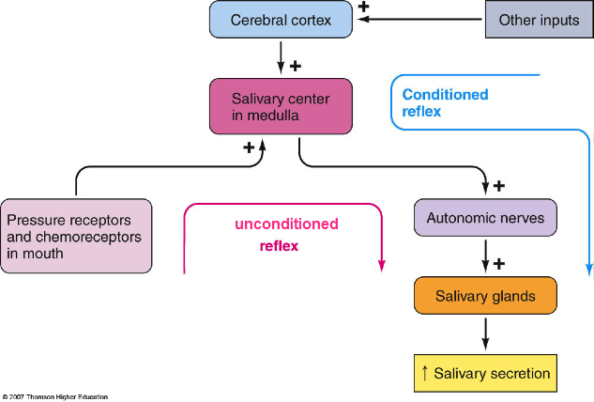
Regulation of salivary secretion

Slide 62
Stomach
Anatomy
Hormonal Control
Secretions

Slide 63
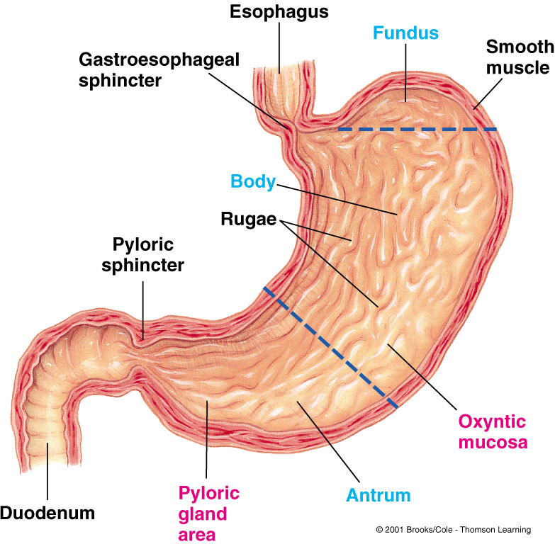
Stomach
Stomach Anatomy

Slide 64
Hormonal Control of Digestion
TRIGGER: Amino acids from partially digested proteins; vagus stimulation due to distension
HORMONE: Gastrin
FROM: Antral mucosa
ACTS ON: Fundic parietal cells; chief cells
TO: Secrete HCl; pepsinogen

Slide 65
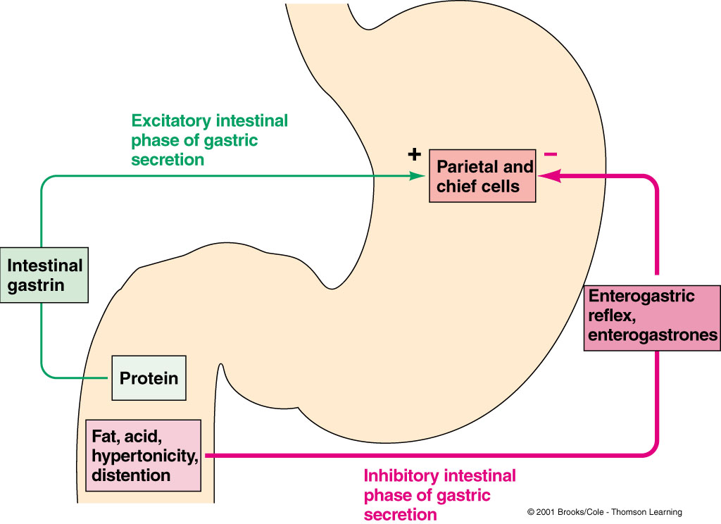

Slide 66
Secretions
Gastric Juice
HCl (Activates Pepsinogen, antibacterial, softens cellulose)
Pepsinogen (activated to Pepsin): proteins --> peptides, amino acids
Mucus

Slide 67
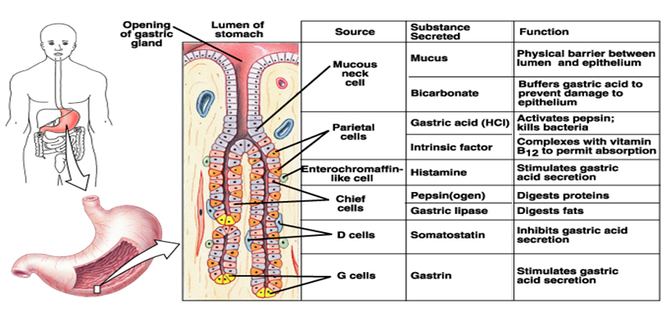
GIT secretions in Stomach

Slide 68
Function of Gastric HCL
Activates pepsinogen into pepsins
Provides optimum for pH for action of pepsins
Denatures protein → help its digestion
Kills bacteria in food
Help Fe²⁺、Ca²⁺ absorption.
Promotes pancreatic, small intestinal and bile secretion

Slide 69
Mucus secretion
Function of mucous and intrinsic factor
Soluble and insoluble mucus are secreted by cells of the stomach.
Soluble mucus mixes with the contents of the stomach and helps to lubricate chyme.
Insoluble mucus forms a protective barrier against the high acidity of the stomach content.
Intrinsic Factor
Help absorption of vitamin B12

Slide 70
Mucus
Mixture of water, electrolytes and glycoproteins
Adherent qualities making it adhere to food particles and to spread as a thin film over surfaces
Has sufficient body that it coats the gut wall and prevents actual contact of most food particles with the mucosa
Has low resistance to slippage so that particles can slide along epithelium with great ease
Causes fecal particles to adhere with one another to form faeces
Is strongly resistant to digestion by gastrointestinal enzymes
Glycoproteins have amphoteric properties hence capable of buffering small quantities of acid or alkali. Mostly has some bicarbonate ions which neutralize acid
Notes:
an amphoteric compound is a molecule or ion that can react both as an acid and as a base

Slide 71
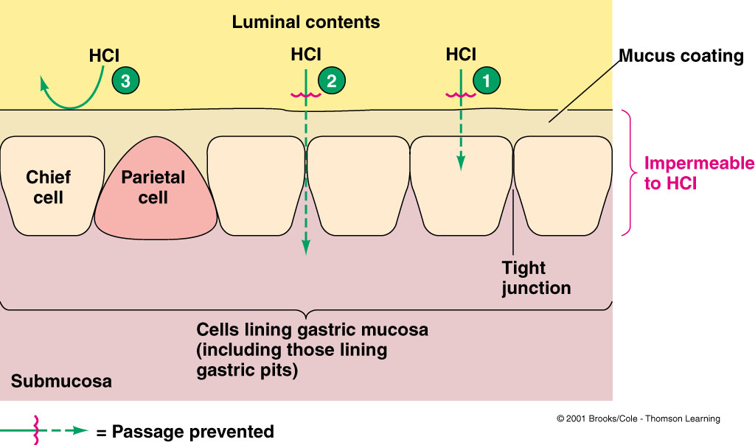
Stomach Protection/Ulcers

Slide 72
1) Luminal membrane of gastric mucosal cells is impermeable for H⁺ ions
2) Tight junctions between gastric mucosal cells prevent penetration of H⁺ between cells
3) Unstirred, bicarbonate rich mucus layer maintains pH 7 at cell surface and protects gastric mucosa from gastric juice (pH 2)

Slide 73
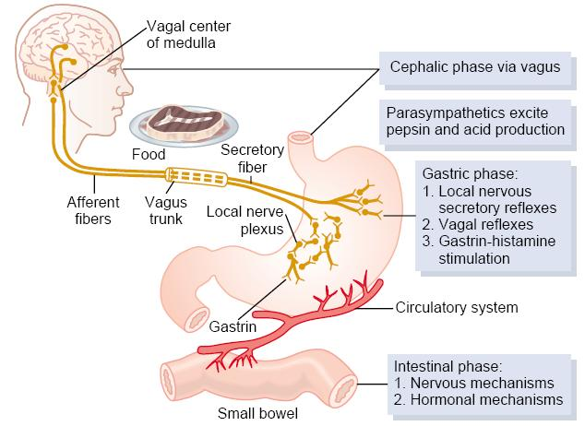
Regulation of Gastric Secretion

Slide 74
Three Phases
Cephalic Phase
Gastric Phase
Intestinal Phase

Slide 75
Cephalic Phase
Anticipatory/Sensory
Mediated via vagus
Chief cells secrete acid
Parietal cells secrete pepsinogen
G cells secrete gastrin

Slide 76
Gastric Phase
Begins with arrival of food in stomach
Two stimuli:
stretch receptors in stomach
digested protein
G cells in antrum stimulated by vagus and by protein

Slide 77
intestinal phase
The intestinal phase is not fully understood, because of a complex stimulatory and inhibitor process.
Amino acids and small peptides that promote gastric acid secretion are infused into the circulation, however, at the same time chyme inhibits acid secretion.
The secretion of gastric acid is an important inhibitor of gastrin release.
If the pH of the antral contents falls below 2.5, gastrin is not released.
Some of the hormones that are released from the small intestine by products of digestion (especially fat), in particular glucagon and secretin, also suppress acid secretion.

Slide 78
Pancreas
Anatomy
Hormonal Control
Secretions

Slide 79
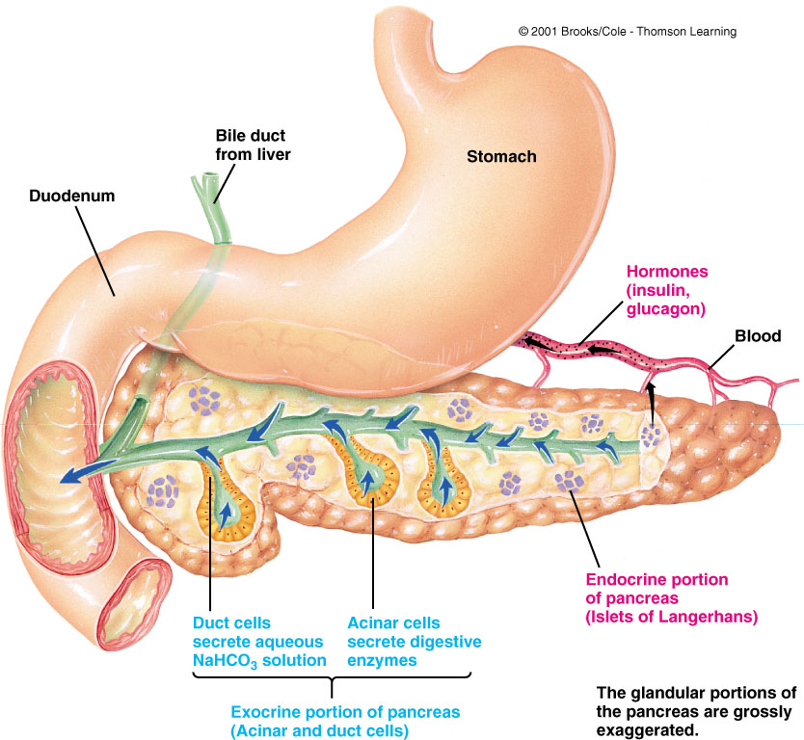
Anatomy

Slide 80
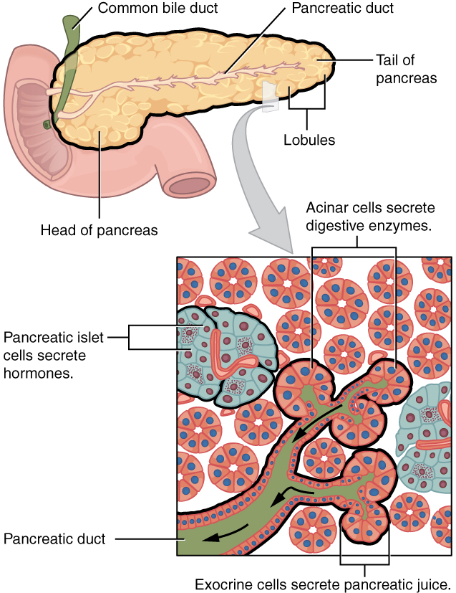
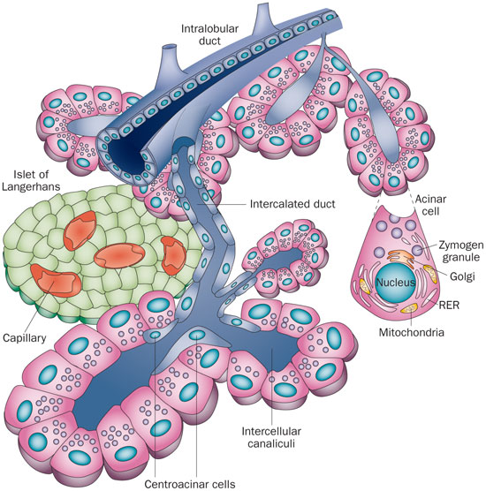
Pancrease

Slide 81
Pancreatic Secretion
Pancreas has 2 functions:
a) Endocrine functions: secretes insulin and glucagon from islets of Langerhans
b) Exocrine function: secretion of pancreatic juice
It has 2 components: aqueous and enzymatic components.
Aqueous component (contains HCO3) is important for neutralizing stomach acid in the duodenum so pancreatic enzymes can function properly
Enzymatic component is essential for the proper digestion and absorption of carbohydrates, fats, and proteins
Pancreatic enzymes include trypsin, chemotrypsin, lipase, and amylase

Slide 82
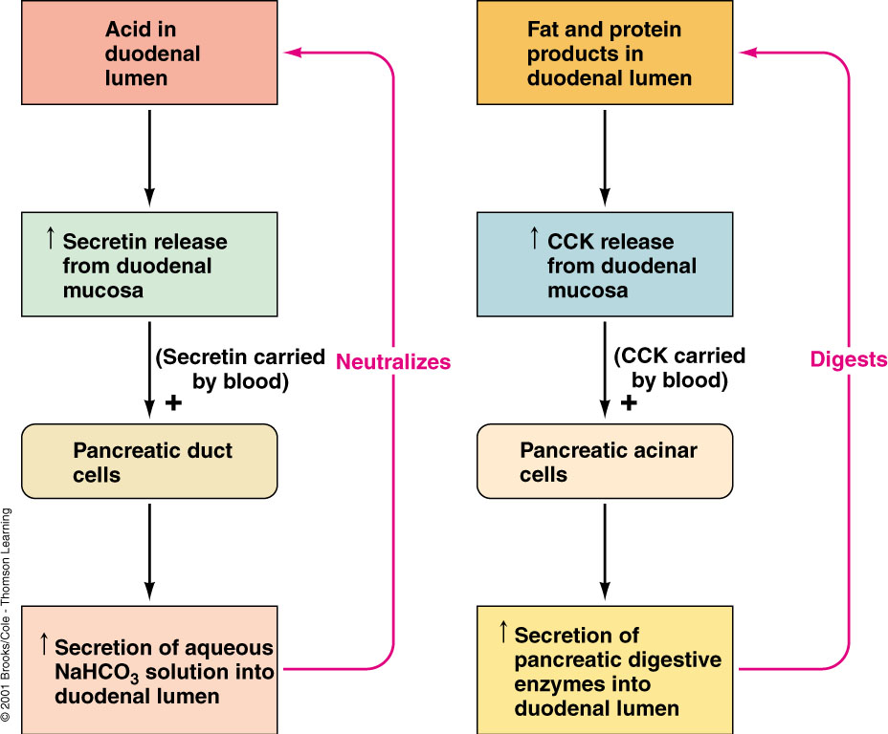
Hormonal Control
Notes:
Cholecystokinin (CCK)

Slide 83
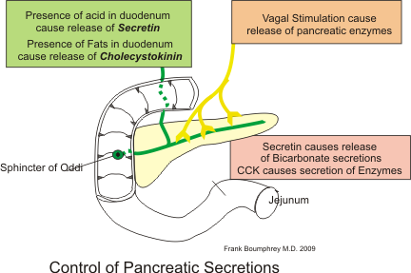
Regulation of pancreatic secretion
Notes:
Cholecystokinin: This hormone is synthesized and secreted by enteric endocrine cells located in the duodenum. Its secretion is strongly stimulated by the presence of partially digested proteins and fats in the small intestine. As chyme floods into the small intestine, cholecystokinin is released into blood and binds to receptors on pancreatic acinar cells, ordering them to secrete large quantities of digestive enzymes.
Secretin: This hormone is also a product of endocrinocytes located in the epithelium of the proximal small intestine. Secretin is secreted (!) in response to acid in the duodenum, which of course occurs when acid-laden chyme from the stomach flows through the pylorus. The predominant effect of secretin on the pancreas is to stimulate duct cells to secrete water and bicarbonate. As soon as this occurs, the enyzmes secreted by the acinar cells are flushed out of the pancreas, through the pancreatic duct into the duodenum.
Gastrin: This hormone, which is very similar to cholecystokinin, is secreted in large amounts by the stomach in response to gastric distention and irritation. In addition to stimulating acid secretion by the parietal cell, gastrin stimulates pancreatic acinar cells to secrete digestive enzymes.

Slide 84
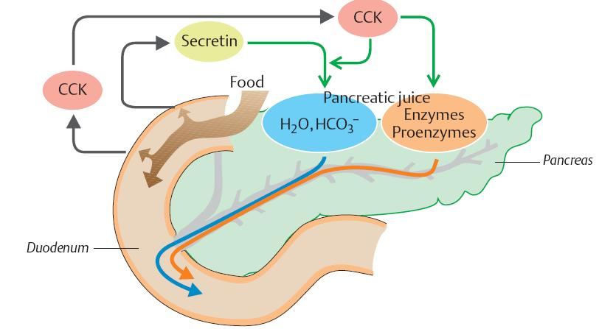
Regulation of pancreatic secretion

Slide 85
Secretions
Pancreatic Digestive Enzymes
Trypsinogen (Activated by enterogastrone to trypsin): Proteins --> peptides
Chymotrypsinogen (activated by Trypsin): Proteins --> peptides
Procarboxypeptidase (activated by trypsin): Peptides --> amino acids
Amylase: Starch --> Maltose
Lipase: Fats --> fatty acids + glycerol and monoglycerides
Pancreatic aqueous NaHCO₃

Slide 86
Functions of pancreatic juice enzymes
pancreatic amylase
Starch Maltose + Maltotriose
pH 7.0
Lipase + colipase
Fat（Triglyceride） Monoglyceride + Fatty acids
pH 8.0
protein
Enterokinase
Trypsinogen Trypsin
Chymotrypsinogen
Chymotrypsin
polypeptide
Carboxypeptidase
amino acid

Slide 87
Liver and Gall Bladder
Anatomy
Hormonal Control
Secretions

Slide 88
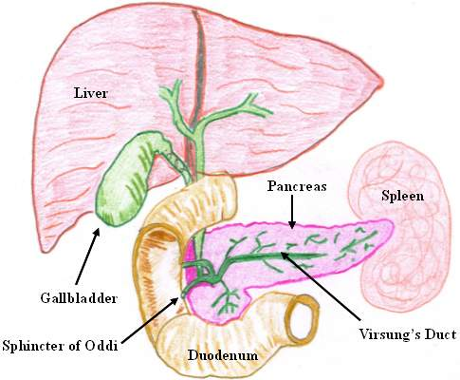
Liver and Gallbladder

Slide 89
liver
Considered the largest gland,
Performs over 500 functions that influence several systems beside the digestive system.
Produces bile which emulsifies fat and making it accessible to fat digesting enzymes.
Also involved in balancing blood glucose levels
Also clears toxins or drugs from the blood
Makes blood proteins

Slide 90
GIT circulation and liver
Blood flow to GIT extensive known as splanchnic circulation.
Includes blood flow through gut itself, plus through spleen, pancreas and the liver
Flows through gut, spleen, pancreas then to liver through portal vein
In liver passes through millions of minute sinusoids then leaves via portal veins to vena cava
In liver, reticuloendothelial cells that line the sinusoids remove bacteria and particulate matter before emptying into vena cava.
Prevents harmful materials from entering into circulation
Notes:
Sinusoids are low pressure vascular channels that receive blood from terminal branches of the hepatic artery and portal vein at the periphery of lobules and deliver it into central veins. Sinusoids are lined with endothelial cells and flanked by plates of hepatocytes.

Slide 91
Non fat water soluble nutrients transported in the portal system to the sinusoids
Hepatic cells absorb and temporarily store ½ to ¾ of this nutrients
Chemical intermediary processing of these nutrients occur in liver cells
Fats absorbed in GIT not carried through portal system but absorbed into intestinal lymphatics and conducted into circulation via thoracic duct bypassing liver

Slide 92
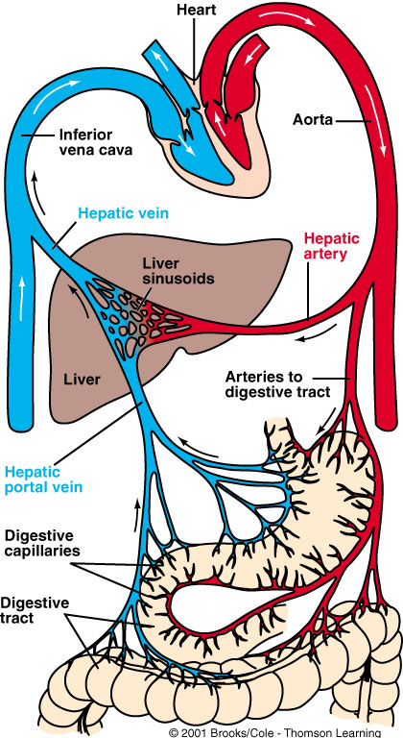
Hepatic Circulation

Slide 93
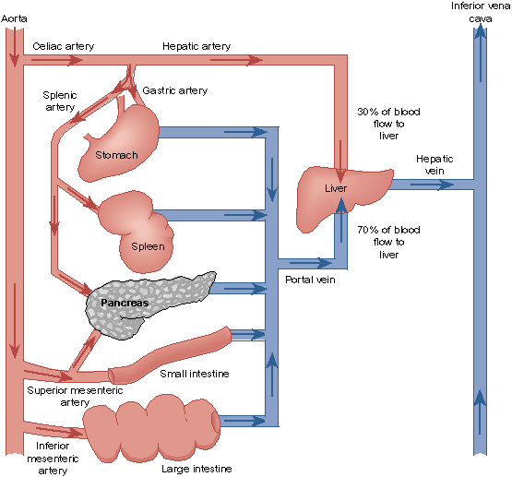
Splanchnic Circulation

Slide 94
Liver
Functions of the Liver:
1) Metabolic regulation
Store absorbed nutrients, vitamins
Release nutrients as needed
2) Hematological regulation
Plasma protein production
Remove old RBCs
3) Production of bile
Required for fat digestion and absorption

Slide 95
Bile secretion = digestive/absorptive function of the liver
Components of bile
• bile salts (conjugates of bile acids)
• bile pigments (e.g. bilirubin)
• cholesterol
• phospholipids
• proteins
• electrolytes (similar to plasma, isotonic with plasma)
600-1200 ml/day

Slide 96
Function of bile
• bile salts (conjugates of bile acids with taurine or glycine) important for absorption of lipids in small intestine. Bile acids emulsify lipids and form mixed micelles necessary for lipid absorption.
• bile acids are derived from cholesterol and therefore are responsible for excretion of cholesterol.

Slide 97
Function of bile
excretion of bilirubin (product of hemoglobin degradation).
• Bile acids are actively absorbed and recirculated through enterohepatic circulation.

Slide 98
Enterohepatic circulation of bile
73

Slide 99
Hormonal Control
Cholecystokinin --> gall bladder emptying

Slide 100
Secretions
Bile
Bile Salts: Emulsifies fats
Alkaline secretions
Bilirubin

Slide 101
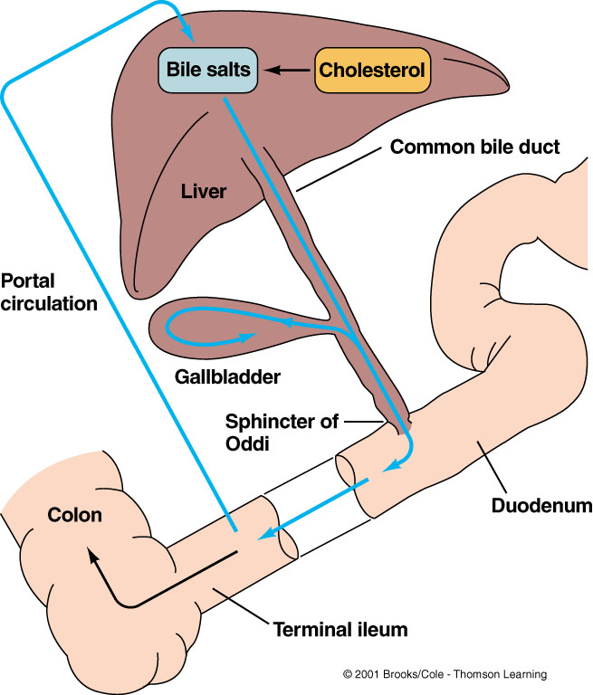
Circulation of Bile Salts

