Slide 1
The oral cavity and Oesophagus
KENNEDY KINYUA

Slide 2
The Oral Cavity
The oral cavity, better known as the mouth, is the start of the alimentary canal. It has three major functions:
Digestion – receives food, preparing it for digestion in the stomach and small intestine.
Communication – modifies the sound produced in the larynx to create a range of sounds.
Breathing – acts as an air inlet in addition to the nasal cavity.

Slide 3
Oral Cavity
The oral cavity spans between the oral fissure (anteriorly – the opening between the lips), and the oropharyngeal isthmus (posteriorly – the opening of the oropharynx).
It is divided into two parts by the upper and lower dental arches (formed by the teeth and their bony scaffolding).
The two divisions of the oral cavity are:
the vestibule, and
the mouth cavity proper.

Slide 4
Vestibule
The horseshoe-shaped vestibule is situated anteriorly. It is the space between the lips/cheeks, and the gums/teeth.
The vestibule communicates with the mouth proper via the space behind the third molar tooth, and with the exterior through the oral fissure.
The diameter of the oral fissure is controlled by the muscles of facial expression – principally the orbicularis oris.
Opposite the upper second molar tooth, the duct of the parotid gland opens out into the vestibule, secreting salivatory juices.

Slide 5
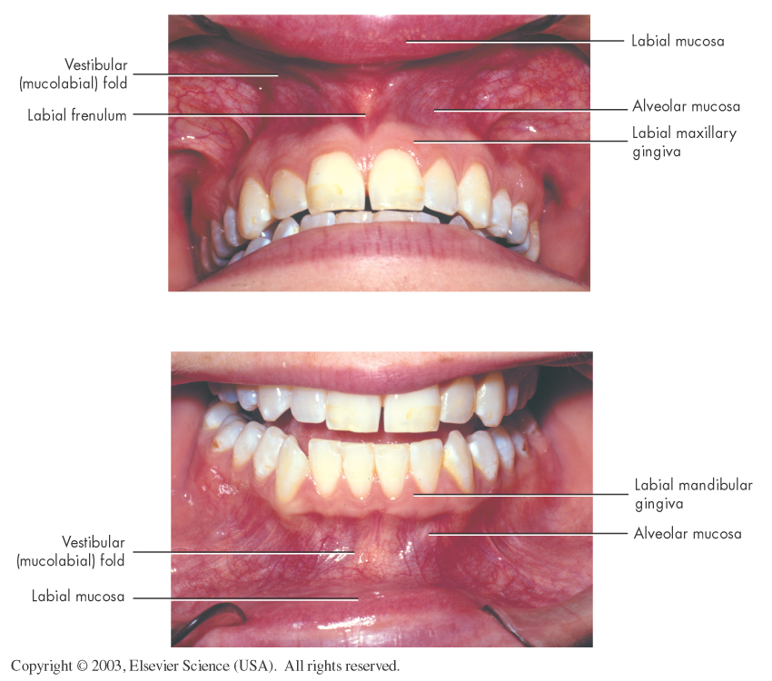
Vestible and vestibular tissue of the oral cavity.

Slide 6
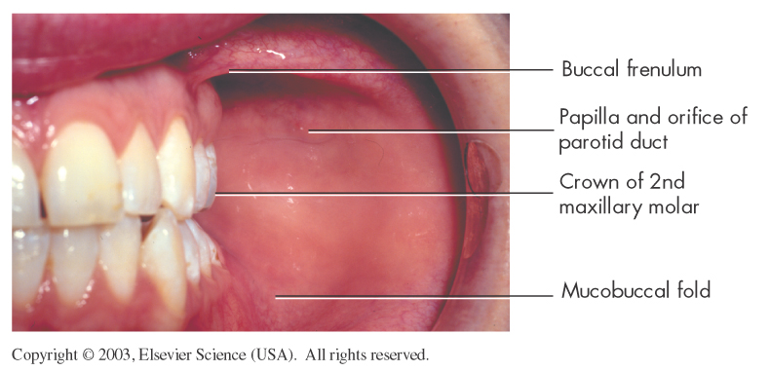
Buccal vestibule and buccal mucosa of the cheek.

Slide 7
Lips
The lips are also known as labia, are outlined by the
vermilion border.
The lips form the entryway of the mouth.
The labial commissure is the angle at the corner of the
mouth where the upper and lower lips join.
The nasolabial sulcus (Philtrum) is the groove
extending upward between each labial commissure and the
ala of the nose.
Notes:
Notes:
There are 2 different surfaces of the lip: Skin and the mucous membrane (vermilion border and internal surface).

Slide 8
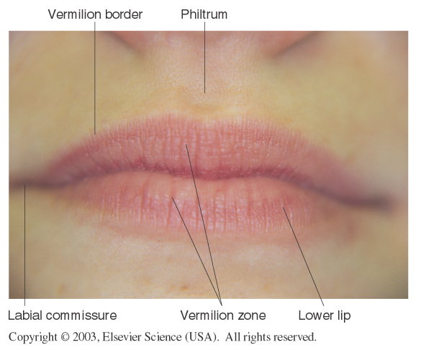
Landmarks of the lips and associated anatomical structures.

Slide 9
Lips, continued
The following structures underlie the epithelium of the skin of the lips:
Vasculature
Sweat glands
Hair follicles
Muscles that function to move the lips
Notes:
Notes:
The lips are also known as labia.
There are 2 different surfaces of the lip: Skin and the mucous membrane (vermilion border and internal surface).

Slide 10
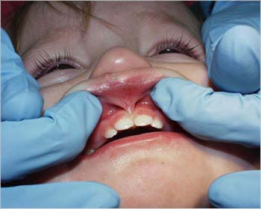
Lips, continued
The mucous membrane of the lips is non-keratinized with
many capillary
vessels close to the surface, giving it the pinkish/red color.
Examination of the lips is valuable in recognizing signs of illness, such as cyanosis, herpetic lesions, or trauma.
Notes:
Glossary: Cyanosis: A bluish or purplish discoloration due to deficient oxygenation of the blood.

Slide 11
Cheeks
The cheeks form the sides of the mouth.
Like the lips, the cheeks are muscles covered with skin on
the outside and mucous membranes on the inside.
Examination of the oral mucosa is especially important in
people who chew tobacco/miraa to screen for oral cancer.

Slide 12
The Cheeks
The cheeks are formed by the buccinator muscle, which is lined internally by the oral mucous membrane.
The buccinator muscle contracts to keep food between the teeth when chewing, and is innervated by the buccal branch of the facial nerve (CN VII).

Slide 13
The Gingivae
The gingivae (gums), is the part of oral mucosa that cover the alveolar processes of the jaws and surround the necks of the teeth.
Types of gingivae:
Marginal Gingiva - is a 1.5 mm strip of gingival tissue which surrounds the neck of the tooth and is known as such due to the fact that the inner wall forms the gingival wall of the sulcus.
Attached gum - continuous with the marginal gum. It is firm, resilient, and tightly bound to the underlying periosteum of alveolar bone
Interdental gum - lies between the teeth. They occupy the gingival embrasure, which is the interproximal space beneath the area of tooth contact

Slide 14
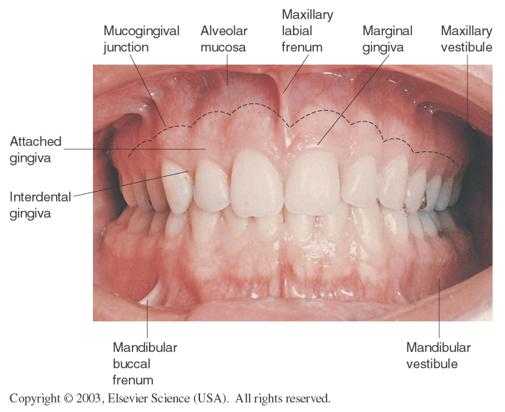
View of the gingivae and associated anatomic structures

Slide 15
Characteristics of Normal Gingivae
Normal gingivae surround the tooth in collarlike fashion and are self-cleansing.
It is firm and resistant and tightly adapted to the tooth and bone.
The surfaces of the attached gingivae and interdental papillae are stippled and similar in appearance to the rind of an orange.
The color of the surface varies according to the individual's pigmentation.

Slide 16
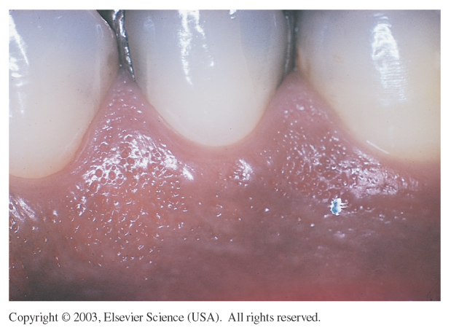
It is normal for the color of gingivae to vary according to the pigmentation of the individual

Slide 17
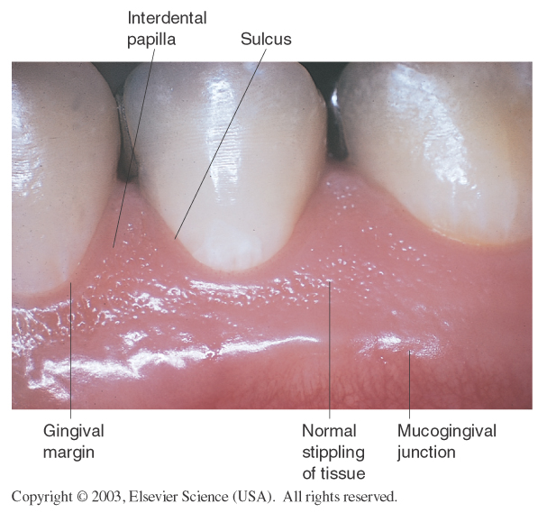
Close-up view of the gingivae and associated anatomic landmarks.

Slide 18
Mouth Proper
The mouth proper lies posteriorly to the vestibule.
It is bordered by a roof, a floor, and the cheeks.
The tongue fills a large proportion of the cavity of the mouth prope

Slide 19
The Roof of mouth
The roof of the mouth proper consists of:
the hard palate and
soft palates.
The hard palate
is found anteriorly.
It is a bony plate that separates the nasal cavity from the oral cavity.
It is covered superiorly by respiratory mucosa (ciliated pseudostratified columnar epithelium) and inferiorly by oral mucosa (stratified squamous epithelium).

Slide 20
Landmarks on the Hard Palate
Incisive papilla is a pear-shaped pad of tissue
that covers the incisive foramen.
Palatal rugae are irregular ridges of masticatory
mucosa extending laterally from the incisive papilla.
Palatine raphe runs posteriorly from the incisive
papilla at the midline.
Palatal glands are numerous small glands that
open onto the palatal mucosa as small pits.

Slide 22
The Soft Palate
The soft palate is the movable posterior third of the palate.
It has no bony skeleton and hangs like a limp curtain into the pharynx behind it.
It ends posteriorly as a free edge with a hanging projection called the uvula.
It acts as a valve that can lower to close the oropharyngeal isthmus, and elevate to separate the nasopharynx from the oropharynx.

Slide 23
Soft Palate− cont’d
The soft palate is supported posteriorly by two arches (the fauces).
The anterior arch runs from the soft palate down to the lateral aspects of the tongue as the palatoglossal arch.
The posterior arch is the free posterior border of the soft palate and is called the palatopharyngeal arch.
The opening between the two arches is called the isthmus of fauces and contains the palatine tonsil.

Slide 24
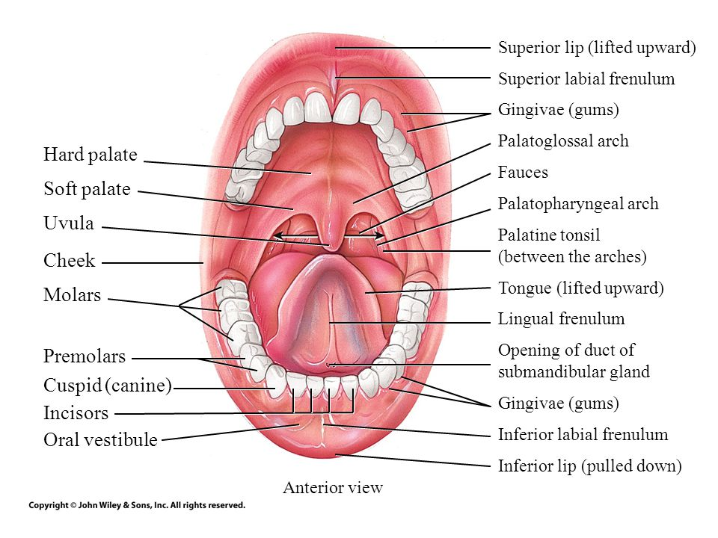
Features of the soft palate.

Slide 25
The Floor of the mouth
The floor of the oral cavity consists of several structures:
Muscular diaphragm – comprised of the bilateral mylohyoid muscles. It provides structural support to the floor of the mouth, and pulls the larynx forward during swallowing.
Geniohyoid muscles – pull the larynx forward during swallowing.
Tongue – connected to the floor by the frenulum of the tongue, a fold of oral mucosa.
Salivary glands and ducts.

Slide 26
The Tongue
The tongue is an important organ and is
responsible for a number of functions:
Speech
Manipulation and positioning of food
Sense of taste
Swallowing
Cleansing of the oral cavity

Slide 27
Parts and Surfaces of the Tongue
Body: Anterior two thirds of the tongue
Root: Posterior portion that turns downward
toward the pharynx
Dorsum: Upper and posterior roughened surface
Sublingual surface/Floor of the mouth:
Covered with smooth, transparent mucosa
Lingual frenulum/Frenum: A thin fold of mucous
membrane that extends from the floor of the mouth
to the underside of the tongue

Slide 28
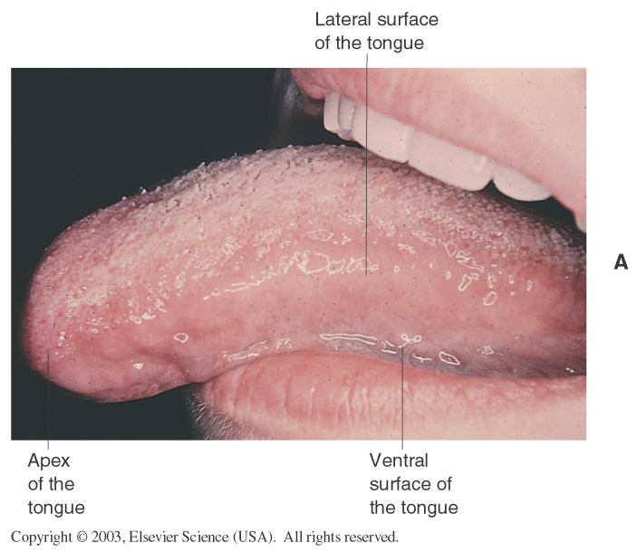
Body and root of the tongue.

Slide 29
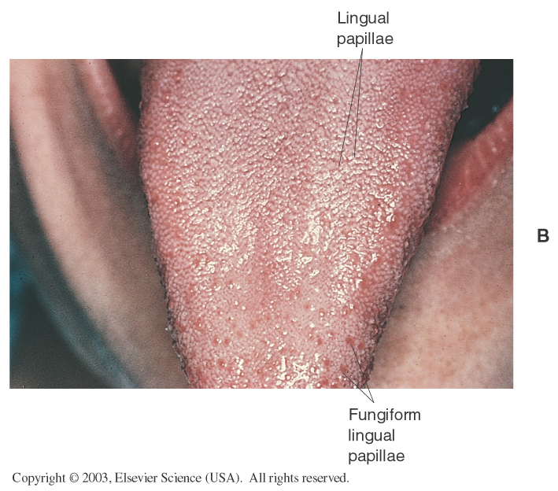
Dorsum of tongue.

Slide 30
Dorsum of tongue

Slide 31
Dorsum of the Tongue
Presence of different papillae on the tongue surface
Filiform papillae
are the smallest and most numerous.
They are aligned in parallel rows.
These papillae aid in licking and provide friction for moving food by the tongue.
Fungiform papillae
Are scattered over the tongue surface.
They have a vascular core that gives them a reddish hue.
Also, they house taste buds.
Vallate papillae
are in V shaped row at the back of the tongue.
They have bitter receptors.

Slide 32
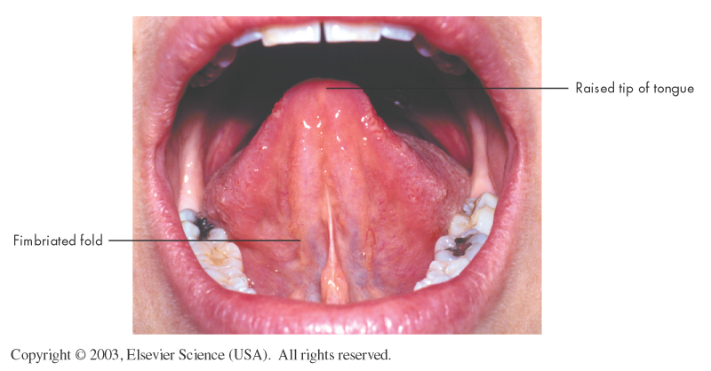
Floor of the mouth and associated landmarks.

Slide 33
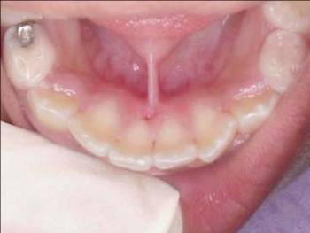
Floor of the mouth continued
The frenulum connects the floor of the mouth to the tongue.
In some infants, the frenulum is thick and severely limits the movement of the tongue. This disorder is called ankyloglossia.
In cases where breastfeeding is inhibited, a frenectomy may be done to release the tongue.
Notes:
Notes:
The lingual frenulum, or frenum, is normally made up of a thin strip of tissues.
In infants, ankyloglossia can lead to difficulty with feeding.
Glossary: Ankyloglossia: A congenital defect characterized by limited mobility of the tongue due to shortness of its frenulum. Frenectomy: Excision of a frenulum.

Slide 34
Taste Buds
The taste buds, are the receptor cells for
the sense of taste & are located on the dorsum of
the tongue.
A substance must be mixed with liquid before it can
stimulate the taste buds on the tongue.

Slide 35
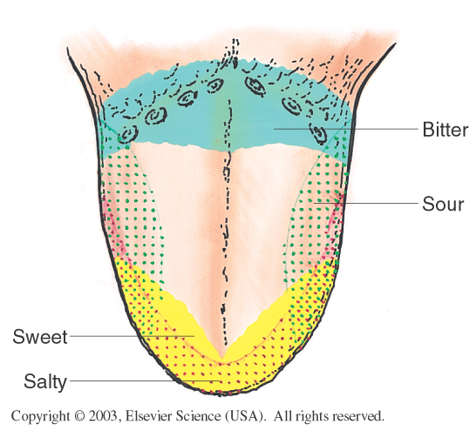
Regions of the tongue sensitive to various tastes.

Slide 36
Innervation
Sensory innervation of the oral cavity is supplied by the branches of the trigeminal nerve (CN V).
The hard palate is innervated by the greater palatine and nasopalatine nerves, both of which are branches of the maxillary nerve (CN V2).
The soft palate is innervated by lesser palatine nerve, another branch of the maxillary nerve.
The floor of the oral cavity receives sensory innervation from the lingual nerve – a branch of the mandibular (V3) division of the trigeminal nerve.
The tongue is also innervated by special sensory fibres for taste from the chorda tympani, a branch of the facial nerve (CN VII).
The cheeks are innervated by the buccal nerve. It is also a branch of the mandibular division of the trigeminal nerve

Slide 37
Clinical relevance: The Gag Reflex
The gag reflex is protective against foreign bodies touching the posterior aspects of the oral cavity, which are most innervated by the glossopharyngeal nerve (CN IX).
When stimulated, a reflex arc leads to contraction of the pharyngeal musculature and the elevation of the soft palate. The efferent nerve in this case is the vagus nerve (CN X).

Slide 38
Salivary Gland is any cell or organ discharging a secretion into the oral cavity.
Major and minor Salivary Glands
Major (Paired)
Parotid
Submandibular
Sublingual
Minor
Those in the Tongue, Palatine Tonsil, Palate, Lips and Cheeks

Slide 39
EXTRINSIC SALIVARY GLANDS

Slide 40
Salivary Glands Continued
Submandibular salivary glands open intra-orally through tiny openings near the frenulum called Wharton’s ducts.
Parotid glands glands empty through tiny openings called Stenson’s ducts.
Stenson's ducts appear as small bumps on the inside of the cheeks near the maxillary second molars
The ducts of the sublingual salivary glands are present on either side of the Wharton’s ducts
Failure of the Parotid glands to produce saliva leads to xerostomia, an abnormal dryness of the mouth.
Notes:
Notes:
The ducts of the sublingual salivary glands are present on either side of the Wharton’s ducts.
The Parotid glands are located along the sides of the jaw, just below and in front of the ears, between the masseter muscle and the skin.
Stenson's ducts appear as small bumps on the inside of the cheeks near the maxillary second molars.
Examination of the Parotid glands might lead to the discovery of inflammation, known as parotitis.

Slide 42
Child and Adult Dentition
The human dentition is composed of two sets of teeth – primary and permanent.
Teeth are organised into two opposing arches – maxillary (upper) and mandibular (lower).
These can be divided down the midline (mid-sagittal plane) into left and right halves.
Teeth are positioned in alveolar sockets, and connected to the bone by a suspensory periodontal ligament.

Slide 43
The primary dentition
The primary dentition is composed of 20 teeth, with 10 in each arch.
There are five teeth in each quadrant, composed of two incisors (central and lateral), a canine, and two molars.
These teeth are referred to as letters A, B, C, D and E.
The primary teeth begin to erupt at 6 months of age.
Most children have a complete primary dentition by 3 years of age

Slide 44
.

Slide 45
The permanent dentition
The permanent dentition is composed of 32 teeth with 16 in each arch.
There are eight teeth in each quadrant, composed of two incisors (central and lateral), a canine, two premolars, and three molars.
These teeth are referred to as numbers, 1 (central incisor) to 8 (3rd molar or ‘wisdom’ tooth).

Slide 46
Teeth eruption
The permanent teeth begin to erupt, and replace the primary teeth, at 6 years of age.
The permanent teeth complete eruption by approximately age 13 years – with the exception of the 3rd molar ‘wisdom’ teeth, which usually erupt by the age of 21 years.

Slide 47
.

Slide 48
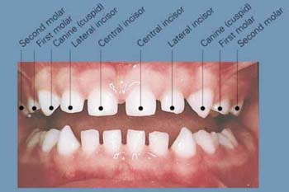
Types of Teeth
There are 4
kinds of teeth:
1. Incisors
2. Canines
3. Premolars
4. Molars

Slide 49
Teeth, continued
The 4 front teeth are the central and lateral incisors. Next to the incisors are the cuspids.
Next to the cuspids are the 8 premolars, or bicuspids.
The final 12 teeth are the molars.
The molars have pits and fissures that can harbor cariogenic bacteria and are commonly the site of dental caries.
Notes:
Notes:
There are 2 central and lateral incisors on the top and 2 on the bottom.
Cuspids is another name for the canine teeth.
The molars are numbered first (6 year), second (12 year), or third (wisdom teeth) molars, depending on their location.
Along with naming the primary teeth, dentists give them letters for identification. Permanent teeth are assigned numbers.
In children, the tooth farthest back on the upper (maxillary) right is "A" and the last tooth on the lower (mandibular) right is "T".
In the permanent teeth, tooth number 1 is the tooth farthest back on the right side of the mouth in the upper (maxillary) jaw and tooth number 32 is farthest back on the bottom (mandibular) right side of the mouth.

Slide 50
Permanent Dentition
Central Incisors
Lateral Incisors
Canines
First Premolars
Second Premolars
First Molars
Second Molars
Third Molars

Slide 51
Teeth eruption

Slide 52
Tooth Structure
A tooth can be divided into two main parts –
the crown and
the root.
The part of a tooth which is visible in the mouth is referred to as the clinical crown, while the part which is not visible is, by definition, the clinical root.
The anatomic crown is covered by enamel, whilst the anatomic root is covered by cementum:

Slide 53
.

Slide 54
Parts of a tooth
Enamel
is a robust, avascular hard tissue with a high mineral content.
It is, in effect, designed to provide thermal insulation for a tooth, and to protect the internal vital tissues from destruction.
Enamel is susceptible to dental caries, tooth wear and acid dissolution.
The enamel is mostly composed of hydroxyapatite crystals.
Binding of fluoride to the hydroxyapatite leads to the formation of fluoroapatite crystals, which makes the enamel harder and more resistant to decay

Slide 55
Parts
Cementum
is a softer, more sensitive tissue.
It becomes visible if a tooth is extruded from the alveolar socket during a traumatic dental injury, and when periodontal disease (disease of the tooth supporting tissues) causes root exposure; a person becomes “long in the tooth”.

Slide 56
Parts of a tooth: dentine
A layer of dentine lies beneath the enamel and cementum, throughout the crown and root.
Dentine is a vital, innervated tissue that accounts for the majority of the hard tooth structure.
The enamel protects the dentin, a hard, thick substance containing thousands of tubules that surround the nerve.
These tubules contain tiny projections of the nerve and are sensitive to exposure to air, acid, and touch.
The part of the tooth where the dentine and enamel meet is called the dentineo-enamel junction (DEJ).
The boundary where the anatomic crown meets the anatomic root (where the enamel meets the cementum) is called the cemento-enamel junction (CEJ)

Slide 57
Parts of a tooth
The pulp cavity is the space within a tooth root that is filled with the vital dental pulp, a pink mass of innervated, vascular tissue.
The end of the root is called the apex.
The apical foramen is the space at the apex through which blood vessels and nerves enter the dental pulp, and through which pulp infection may enter the alveolus and surrounding soft tissues.

Slide 58
.

Slide 59
Incisors
There are 8 incisors in both the primary and permanent dentition; 4 maxillary and 4 mandibular.
Central and lateral incisors have straight edges that are designed to incise in to food.
They are located at the front of mouth with central incisors nearest the midline, and lateral incisors between the central incisors and the canines.

Slide 60
incisors

Slide 61
Canines
There are 4 canines in both the primary and permanent dentition; 2 maxillary and 2 mandibular.
They are located at corners of the mouth and have an incisal edge that has a sharp, triangular shaped projection.
The function of the cusp is to pierce and hold food.
They are sometimes referred to as cuspid teeth.

Slide 62
canines
Canines have long stable roots that withstand greater forces than incisors.
Teenagers who experience dental crowding (the total width of the teeth exceeds the available width of the arch for the teeth to erupt in to) may present with unerupted canines.
These are frequently located radiographically in the palate, or high the buccal sulcus.
Oral surgery may be required to aid the eruption of these teeth.

Slide 63
Premolars
The permanent dentition has 8 premolars that generally have 2 cusps, but this is not always the case.
They are sometimes referred to as bicuspid teeth.
They are located between the canines and the molars, and they share some of the characteristics of these teeth.
There are no premolars in the primary dentition.
Premolar teeth are frequently extracted by dentists to relieve dental crowding, particularly prior to orthodontic treatment

Slide 64
Molars
There are 8 molars in the primary permanent dentition; 4 maxillary and 4 mandibular.
There are 12 molars in the permanent dentition; 6 maxillary and 6 mandibular.
The number of cusps varies between 3 and 5.
They are located at the back of the mouth, and are designed to crush and chew food, prior to swallowing.

Slide 65
Molar
Molar teeth are particularly at risk of dental caries (decay) due to the presence of deep grooves that run across the occlusal (top) surface of the teeth, and due to the presence of a relatively wide point of contact between adjacent molars.
These sites are more difficult to clean than the smooth walls of the labial (lip), buccal (cheek), lingual (tongue), and palatal (palate) surfaces of teeth.

Slide 66
molars

Slide 67
Tooth notation systems
Learning nomenclature is the first step in understanding dental anatomy.
Tooth numbering or “shorthand” system of tooth notation is necessary in clinical practice for recording data and communication.
The various tooth notation systems are as follows:
Palmer notation system
Universal notation system
FDI system

Slide 68
FDI system (Federation Dentaire Internationale)
The FDI system is a two digit system that has been adopted by WHO and also IADR(International Association for Dental Research) .
In this system the first digit indicates the quadrant and the second digit indicates the tooth within the quadrant. 1 to 4 and 5 to 8 as the first digit indicates permanent and primary dentition respectively. 1 to 8 and 1 to 5 as the second digit indicates permanent and primary teeth respectively.
Primary teeth- 55 54 53 52 51 61 62 63 64 65
85 84 83 82 81 71 72 73 74 75

Slide 69
Primary Teeth
55 54 53 52 51 61 62 63 64 65
85 84 83 82 81 71 72 73 74 75
First Digit = quadrant
Second Digit = Tooth number in
the quadrant

Slide 70
Sides of the Tooth
These terms describe the sides of the tooth:
Buccal/labial/facial – Side that faces outward, toward the cheeks or lips
Lingual/palatal – Inside surface facing the tongue or the palate
Mesial - Sides of the teeth that face the front of the mouth
Distal - Surfaces of the teeth that face the back of the mouth
Occlusal - Surface of the back teeth where biting and chewing takes place
Incisal - Biting surface of the front teeth

Slide 71
The oesophagus
The oesophagus is a fibromuscular tube, approximately 25cm in length, that transports food from the pharynx to the stomach.
It originates at the inferior border of the cricoid cartilage, C6, extending to the cardiac orifice of the stomach, T11.

Slide 72
Anatomical Position
The oesophagus originates in the neck, at the level of the sixth cervical vertebrae (C6).
It is continuous with the laryngeal part of the pharynx.
It descends downward into the superior mediastinum of the thorax.
Here, it is situated between the trachea and the vertebral bodies T1 to T4.
It then enters the abdomen by piercing the muscular right crus of the diaphragm, through the oesophageal hiatus (simply, a hole in the diaphragm) at the T10 level.

Slide 73
Anatomical Structure
The phrenoesophageal ligament connects the oesophagus to the border of the oesophageal hiatus.
This permits independent movement of the oesophagus and diaphragm during respiration and swallowing.
The abdominal part of oesophagus is approximately 2cm long – it terminates by joining the cardiac orifice of the stomach at level of T11.

Slide 74
Parts
The oesophagus consists of an internal circular and external longitudinal layer of muscle.
Furthermore, the external longitudinal layer is composed of different muscle types in each third of the oesophagus:
Superior third – voluntary striated muscle
Middle third – voluntary striated and smooth muscle
Inferior third – smooth muscle

Slide 75
General organization of hollow GI
Generally 4 layers but may vary from one region to next
Mucosa
Epithelium – usually simple columnar with goblets; may be stratified squamous if protection needed
Lamina propria - connective tissue deep to epithelium
Muscularis mucosae -produces folds - plicae (small intestine) or rugae (stomach)
Submucosa – made up of loose connective tissue contains submucosal plexus and blood vessels
Muscularis externa – smooth muscle, usually two layers (controlled by the myenteric plexus ) -
outer layer: longitudinal
inner layer: circular
Serosa visceral layer of mesentery or adventitia depending on location

Slide 76
General organization of hollow GI

Slide 77
ESOPHAGUS ANATOMY

Slide 78
Layers of the oesophagus
The esophageal mucosa contains non-keratinized stratified squamous epithelium.
At the esophageal stomach junction the epithelium changes to simple columnar epithelium.
The submucosa contains mucus secreting glands.
As a bolus moves through the esophagus, it compresses these glands, causing them to secrete mucus which aids in the movement of food.

Slide 79
Layers of oesophagus
The muscularis externa is skeletal muscle in its superior third, a mixture of skeletal and smooth muscle in its middle third, and entirely smooth muscle in its inferior third.
There is no serosa on the esophagus.
Its entire surface is covered by connective tissue called adventitia which blends with surrounding structures.

Slide 80
.
Food is transported through the oesophagus by peristalsis – a rhythmic contractions of the muscles, which propagates down the oesophagus.
Hardening of these muscular layers can interfere with peristalsis and cause dysphagia – difficulty in swallowing.

Slide 81
peristalsis

Slide 82
Oesophageal Sphincters
Upper Oesophageal Sphincter
The upper sphincter is an anatomical, striated muscle sphincter at the junction between the pharynx and oesophagus.
It is produced by the cricopharyngeus muscle.
Normally, it is constricted to prevent the entrance of air into the oesophagus.
Lower Oesophageal Sphincter
The lower oesophageal sphincter is a physiological sphincter located in the gastro-oesophageal junction (junction between the stomach and oesophagus).
The gastro-oesophageal junction is situated to the left of the T11 vertebra, and is marked by the change from oesophageal to gastric mucosa.

Slide 83
Lower Oesophageal Sphincter
The sphincter is classified as a physiological (or functional) sphincter, as it does not have any specific sphincteric muscle.
Instead, the sphincter is formed from four phenomena:
The oesophagus enters the stomach at an acute angle.
The walls of the intra-abdominal section of the oesophagus are compressed when there is a positive intra-abdominal pressure.
The folds of mucosa present aid in occluding the lumen at the gastro-oesophageal junction.
The right crus of the diaphragm has a “pinch-cock” effect.

Slide 84
.
Upper esophageal sphincter

Slide 85
Lower Oesophageal Sphincter

Slide 86
Vasculature
Thoracic part
The thoracic part of the oesophagus receives its arterial supply from the branches of the thoracic aorta and the inferior thyroid artery (a branch of the thyrocervical trunk).
Venous drainage into the systemic circulation occurs via branches of the azygous veins and the inferior thyroid vein.

Slide 87
Vasculature
Abdominal part
The abdominal oesophagus is supplied by the left gastric artery (a branch of the coeliac trunk) and left inferior phrenic artery.
This part of the oesophagus has a mixed venous drainage via two routes:
To the portal circulation via left gastric vein
To the systemic circulation via the azygous vein.
These two routes form a porto-systemic anastomosis, a connection between the portal and systemic venous systems.

Slide 88
Lymphatics
The lymphatic drainage of the oesophagus is divided into thirds:
Superior third – deep cervical lymph nodes.
Middle third – superior and posterior mediastinal nodes.
Lower third – left gastric and celiac nodes.

Slide 89
Clinical Relevance: Disorders of the Oesophagus
Barrett’s Oesophagus
refers to the metaplasia (reversible change from one differentiated cell type to another) of lower oesophageal squamous epithelium to gastric columnar epithelium.
It is usually caused by chronic acid exposure as a result of a malfunctioning lower oesophageal sphincter.
The acid irritates the oesophageal epithelium, leading to a metaplastic change.
The most common symptom is a long-term burning sensation of indigestion.
It can be detected via endoscopy of the oesophagus. Patients who are found to have it will be monitored for any cancerous changes.

Slide 90
Clinical Relevance: Disorders of the Oesophagus
Oesophageal Carcinoma
Around 2% of malignancies are oesophageal carcinomas.
The clinical features of this carcinoma are:
Dysphagia – difficulty swallowing. It becomes progressively worse over time as the tumour increases in size, restricting the passage of food.
Weight loss
There are two major types of oesophageal carcinomas: squamous cell carcinoma and adenocarcinoma.
Squamous Cell Carcinoma – the most common subtype of oesophagus cancer. It can occur at any level of the oesophagus.
Adenocarcinoma – only occurs in the inferior third of the oesophagus and is associated with Barrett’s oesophagus. It usually originates in the metaplastic epithelium of Barrett’s oesophagus.

Slide 91
Clinical Relevance: Disorders of the Oesophagus
Oesophageal Varices
The abdominal oesophagus drains into both the systemic and portal circulation, forming an anastomosis between the two.
Oesophageal varices are abnormally dilated sub-mucosal veins (in the wall of the oesophagus) that lie within this anastomosis.
They are usually produced when the pressure in the portal system increases beyond normal, a state known as portal hypertension.
Portal hypertension most commonly occurs secondary to chronic liver disease, such as cirrhosis or an obstruction in the portal vein.
The varices are predisposed to bleeding, with most patients presenting with haematemesis (vomiting of blood).
Alcoholics are at a high risk of developing oesophageal varices.

Slide 92
THANK YOU

