Slide 1
Trauma
Abdullah Alsakka
EM Consultant

Slide 2
Objectives
Epidemiology of Trauma Care
History of Development of Trauma Care
Mechanisms of Injury
Basics of Trauma Management
Primary Survey
Resuscitation
Secondary Survey
ABCDE Format
Cervical Spinal Immobilization
Specific Case Examples

Slide 3
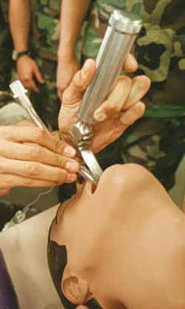
Initial Assessment and Management of the Trauma Patient

Slide 4
Epidemiology
Motor Vehicle collision are major cause of long term morbidity and mortality in developing nations
WHO predicts that by 2020, Road Traffic Accidents will be second leading cause of loss of life for world’s population
High Morbidity = Loss of income to society
Challenges in Developing Countries
Technological Advances in Trauma Care
Lack of Infrastructure for Trauma Management
EMS
Pre-hospital notification
MD/RN Training in trauma care
Notes:
Epidemiology of Trauma
Challenges in Developing Nations regarding management of trauma care
Technological advances – cars, computers, etc
Lack of infrastructure for Trauma Management
No EMS
No Pre-hospital notification
MD/RN’s trained in specialty trauma care

Slide 5
Injury: Scale of the Global Problem
5.8 million deaths/year
10% of worlds deaths
32% more deaths than HIV, TB and
Malaria combined
Source: Global Burden of Disease, WHO, 2004
Notes:
WHO

Slide 6
Epidemiology
Trimodal Distribution of Trauma Deaths
Golden Hour = 80% of trauma deaths in first hour after injury
Rapid trauma care has greatest level of impact in these patients
50%
30%
20%
Immediately
Hours
Days/Weeks

Slide 7
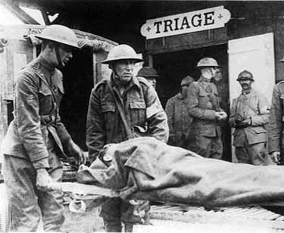
History of Trauma System Development
Standardized Trauma Assessment
Nebraska Cornfield, 1976
Orthopedic Surgeon
Lead to development of ATLS
Trauma Systems Development
First developed my military
Expanded in US to Level 1, 2, 3 Trauma Centers
Urban Systems
Statewide networks of systems
Level 1 – Highest level of care, Leaders in research, clinical care and education
Level 2 – Provides definitive care in wide range of complex traumatic patients
Level 3 – Provides initial stabilization and treatment. May care for uncomplicated trauma patients
Level 4 – Provides initial stabilization and transfers all trauma patients for definitive care
Otisarchives1 (flickr)
Notes:
Nebraska, 1976
- Orthopedic surgeon piloting a plane
- Crashed into a rural Nebraska Cornfield
- Surgeon sustained serious injuries, 3 children sustained critical injuries, wife killed instantly
- Care delivered on scene and at initial facility was inadequate
- Lead to development of ATLS Course in 1978

Slide 8
Mechanisms of Injury
Blunt Trauma
Compression Forces
Cells in tissues are compressed and crushed
E.g. Spleen
Shear Forces
Acceleration/Deceleration Injury
E.g. Aorta
Shearing force = Spectrum from Full thickness tear (Exsanguination) to Partial tear (Pseudoaneurysm)
Overpressure
Body cavity compressed at a rate faster than the tissue around it, resulting in rupture of the closed space
E.g. in trauma = diaphragmatic rupture, bladder injury
Notes:
Mechanisms of Traumatic Injury
Blunt Trauma
Three separate types of forces involved in blunt traumatic injury that produce injury to the body and internal organs
Compression
Compression forces occur when cells in tissues are compressed and crushed similar to placing an organ (spleen) on a table and hitting it repeatedly with a hammer
Shear
Shear forces occur when an organ and the organ’s attachment do not accelerate or decelerate at the same time or same rate of speed.
Prime example is the aorta, the large blood artery that leaves the heart and carries blood to the body. The aorta is attached by branching vessels to the spine along the majority of the descending portion but is not attached by the same mechanism at the arch of the aorta.
So if a rapid decelerating mechanism is encountered the arch may move more freely than the descending aorta and the result is a shearing force or tearing that results in a full thickness tear in the aorta or disruption leading to immediate exsanguination or less extensive tear resulting in a pseudoaneurysm.
Similar shear forces work on other organs such as the spleen, kidney, etc.
Overpressure
Overpressure occurs when a body cavity is compressed at a rate faster than the tissue around it, resulting in overpressure and rupture of the closed space.
Example is a plastic bag filled with air that is then punched rapidly and results in high enough pressure to rupture the bag.
Similar mechanisms involved in abdominal cavity when compressed against the steering column of a car resulting in diaphragmatic rupture into the thoracic cavity. Also mechanisms involved in other organs with similar contained pressures, eg bladder, bowels, lungs.
Vehicular Collisions
Frontal Impact Collisions – A vehicle traveling at a higher rate of speed hits another vehicle that is moving at a slower rate of speed or is not moving at all and the vehicles are oriented with the passengers towards each other
The occupants of the vehicle traveling faster will continue to move forward even after the car has been stopped by the collision until they have impacted against another structure (steering wheel, windshield)
Lateral Impact Collisions
Rear Impact Collisions
Off-Center or Rotational Collisions
Rollover
Occupant Protection
Open Vehicles

Slide 9
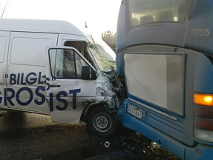
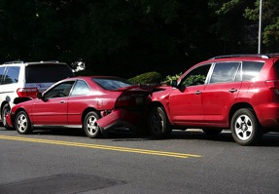
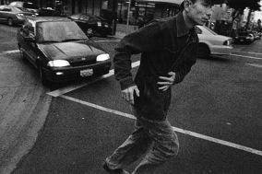
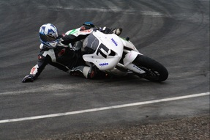
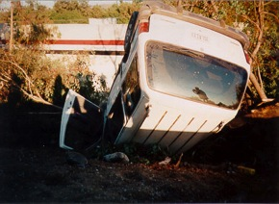
Mechanisms of Injury
Frontal Impact Collisions
Lateral Impact Collisions (T bone)
Rear Impact Collisions
Rollover Mechanism
Open Vehicle or Motorcycle/Moped
Pedestrian Vs. Car
Penetrating Injury (Guns vs. Knives)
Notes:
Frontal Impact Collisions – A vehicle traveling at a higher rate of speed hits another vehicle that is moving at a slower rate of speed or is not moving at all and the vehicles are oriented with the passengers towards each other
The occupants of the vehicle traveling faster will continue to move forward even after the car has been stopped by the collision until they have impacted against another structure (steering wheel, windshield)
Lateral Impact Collisions
Rear Impact Collisions
Off-Center or Rotational Collisions
Rollover
Occupant Protection
Open Vehicles

Slide 10
Basics of Trauma Assessment
Preparation
Team Assembly
Equipment Check
Triage
Sort patients by level of acuity
Primary Survey
Designed to identify injuries that are immediately life threatening and to treat them as they are identified
Resuscitation
Rapid procedures and treatment to treat injuries found in primary survey before completing the secondary survey
Secondary Survey
Full History and Physical Exam to evaluate for other traumatic injuries
Monitoring and Evaluation, Secondary adjuncts
Transfer to Definitive Care
ICU, Ward, Operating Theatre, Another facility
Notes:
Basics of Trauma Assessment
The trauma assessment is comprised of several steps designed to construct a standardized method for trauma assessment to ultimately decrease trauma morbidity and mortality. It is comprised of several steps:
Preparation
Triage
Primary Survey
Resuscitation
Secondary Survey
Monitoring and Evaluation
Transfer to definitive care
saf

Slide 11
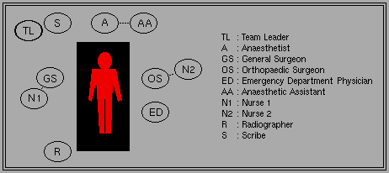
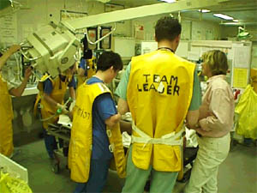
Preparation for Patient Arrival
Organize Trauma Response Team
:

Slide 12
Primary Survey
Airway and Protection of Spinal Cord
Breathing and Ventilation
Circulation
Disability
Exposure and Control of the Environment
Notes:
Primary Survey
Designed to identify injuries that may be immediately life threatening and to treat them as they are identified. The order of evaluation corresponds to the severity of the injury to cause bad outcomes.
Airway and Protection of spinal cord
Breathing and Ventilation
Circulation
Disability
Exposure and control of the environment

Slide 13
Primary Survey
Key Principles
When you find a problem during the primary survey, FIX IT.
If the patient gets worse, restart from the beginning of the primary survey
Some critical patients in the Emergency Department may not progress beyond the primary survey

Slide 14
Airway and Protection of Spinal Cord
Why first in the algorithm?
Loss of airway can result in death in < 3 minutes
Prolonged hypoxia = Inadequate perfusion, End-organ damage
Airway Assessment
Vital Signs = RR, O2 sat
Mental Status = Agitation, Somnolent, Coma
Airway Patency = Secretions, Stridor, Obstruction
Traumatic Injury above the clavicles
Ventilation Status = Accessory muscle use, Retractions, Wheezing
Clinical Pearls
Patients who are speaking normally generally do not have a need for immediate airway management
Hoarse or weak voice may indicate a subtle tracheal or laryngeal injury
Noisy respirations frequently indicates an obstructed respiratory pattern
Notes:
Airway and Protection of Spinal Cord
First Question: Does the patient have a secure airway?
Loss of airway can kill the patient in 3 minutes
asfa

Slide 15
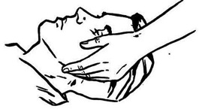
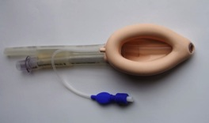
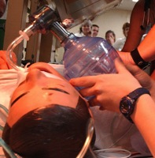
Airway Interventions
Maintenance of Airway Patency
Suction of Secretions
Chin Lift/Jaw thrust
Nasopharyngeal Airway
Definitive Airway
Airway Support
Oxygen
NRBM (100%)
Bag Valve Mask
Definitive Airway
Definitive Airway
Endotracheal Intubation
In-line cervical stabilization
Surgical Crichothyroidotomy

Slide 16
Protection of Spinal Cord
General Principle: Protect the entire spinal cord until injury has been excluded by radiography or clinical physical exam in patients with potential spinal cord injury.
Spinal Protection
Rigid Cervical Spinal Collar = Cervical Spine
Long rigid spinal board or immobilization on flat surface such as stretcher = T/L Spine
Etiology of Spinal Cord Injury (U.S.)
Road Traffic Accidents (47%)
High energy falls (23%)
Clinical Pearls
Treatment (Immobilization) before diagnosis
Return head to neutral position
Do not apply traction
Diagnosis of spinal cord injury should not precede resuscitation
Motor vehicle crashes and falls are most commonly associated with spinal cord injuries
Main focus = Prevention of further injury

Slide 17
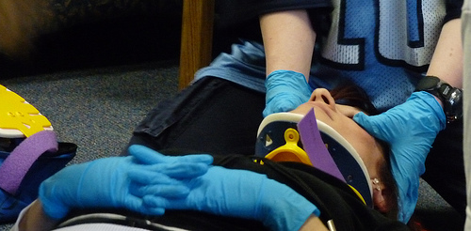
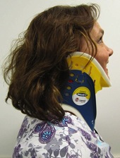
C-spine Immobilization
Return head to neutral position
Maintain in-line stabilization
Correct size collar application
Blocks/tape
Sandbags

Slide 18
Breathing and Ventilation
General Principle: Adequate gas exchange is required to maximize patient oxygenation and carbon dioxide elimination
Breathing/Ventilation Assessment:
Exposure of chest
General Inspection
Tracheal Deviation
Accessory Muscle Use
Retractions
Absence of spontaneous breathing
Paradoxical chest wall movement
Auscultation to assess for gas exchange
Equal Bilaterally
Diminished or Absent breath sounds
Palpation
Deviated Trachea
Broken ribs
Injuries to chest wall

Slide 19
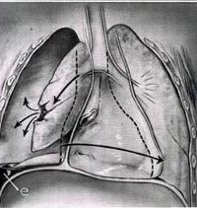
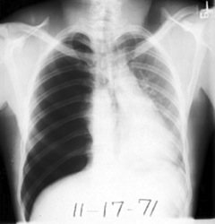
Breathing and Ventilation
Identify Life Threatening Injuries
Tension Pneumothorax
Air trapping in the pleural space between the lung and chest wall
Sufficient pressure builds up and pressure to compress the lungs and shift the mediastinum
Physical exam
Absent breath sounds
Air hunger
Distended neck veins
Tracheal shift
Treatment
Needle Decompression
2nd Intercostal space, Midclavicular line
Tube Thoracostomy
5th Intercostal space, Anterior axillary line

Slide 20
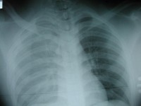
Breathing and Ventilation
Hemothorax
Blood collecting in the pleural space and is common after penetrating and blunt chest trauma
Source of bleeding = Lung, Chest wall (intercostal arteries), heart, great vessels (Aorta), Diaphragm
Physical Exam
Absent or diminished breath sounds
Dullness to percussion over chest
Hemodynamic instability
Treatment = Large Caliber Tube Thoracostomy
10-20% of cases will require Thoracostomy for control of bleeding

Slide 21
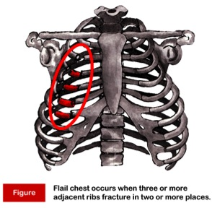
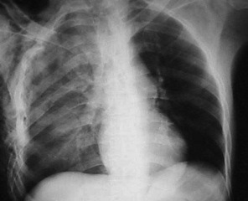
Breathing and Ventilation
Flail Chest
Direct injury to the chest resulting in an unstable segment of the chest wall that moves separately from remainder of thoracic cage
Typically results from two or more fractures on 2 or more ribs
Typically accompanied by a pulmonary contusion
Physical exam = paradoxical movement of chest segment
Treatment = improve abnormalities in gas exchange
Early intubation for patients with respiratory distress
Avoidance of overaggressive fluid resuscitation

Slide 22
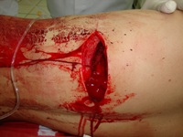
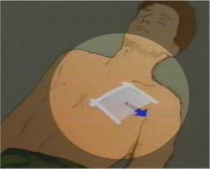
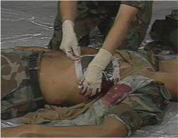
Breathing and Ventilation
Open Pneumothorax
Sucking Chest Wound
Large defect of chest wall
Leads to rapid equilibration of atmospheric and intrathoracic pressure
Impairs oxygenation and ventilation
Initial Treatment
Three sided occlusive dressing
Provides a flutter valve effect
Chest tube placement remote to site of wound
Avoid complete dressing, will create a tension pneumothorax
Author unknown, http://www.trauma.org/index.php/main/image/902/

Slide 23
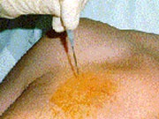
Needle Thoracostomy
Needle Thoracostomy
Midclavicular line
14 gauge angiocath
Over the 2nd rib
Rush of air is heard

Slide 24
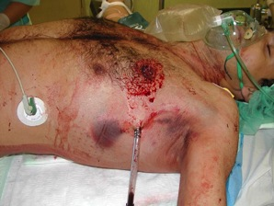
Tube Thoracostomy
Insertion site
5th intercostal space,
Anterior axillary line
Sterile prep, anesthesia with lidocaine
2-3 cm incision along rib margin with #10 blade
Dissect through subcutaneous tissues to rib margin
Puncture the pleura over the rib
Advance chest tube with clamp and direct posteriorly and apically
Observe for fogging of chest tube, blood output
Suture the tube in place
Complications of Chest Tube Placement
Injury to intercostal nerve, artery, vein
Injury to lung
Injury to mediastinum
Infection
Allergic reaction to lidocaine
Inappropriate placement of chest tube

Slide 25
Circulation
Shock
Impaired tissue perfusion
Tissue oxygenation is inadequate to meet metabolic demand
Prolonged shock state leads to multi-organ system failure and cell death
Clinical Signs of Shock
Altered mental status
Tachycardia (HR > 100) = Most common sign
Arterial Hypotension (SBP < 120)
Femoral Pulse – SBP > 80
Radial Pulse – SBP > 90
Carotid Pulse – SBP > 60
Inadequate Tissue Perfusion
Pale skin color
Cool clammy skin
Delayed cap refill (> 3 seconds)
Altered LOC
Decreased Urine Output (UOP < 0.5 mL/kg/hr)

Slide 26
Circulation
Types of Shock in Trauma
Hemorrhagic
Assume hemorrhagic shock in all trauma patients until proven otherwise
Results from Internal or External Bleeding
Obstructive
Cardiac Tamponade
Tension Pneumothorax
Neurogenic
Spinal Cord injury
Sources of Bleeding
Chest
Abdomen
Pelvis
Bilateral Femur Fractures

Slide 27
Circulation
Emergency Nursing Treatment
Two Large IV Lines
Cardiac Monitor
Blood Pressure Monitoring
General Treatment Principles
Stop the bleeding
Apply direct pressure
Temporarily close scalp lacerations
Close open-book pelvic fractures
Abdominal pelvic binder/bed sheet
Restore circulating volume
Crystalloid Resuscitation (2L)
Administer Blood Products
Immobilize fractures
Responders vs. Nonresponders
Transient response to volume resuscitation = sign of ongoing blood loss
Non-responders = consider other source for shock state or operating room for control of massive hemorrhage

Slide 28
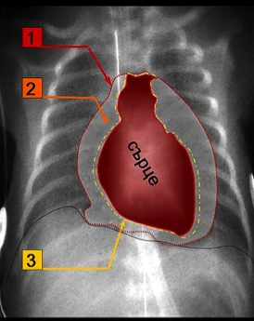
Circulation
Pericardial Tamponade
Pericardium or sac around heart fills with blood due to penetrating or blunt injury to chest
Beck’s Triad
Distended jugular veins
Hypotension
Muffled heart sounds
Treatment
Rapid evacuation of pericardial space
Performed through a pericardiocentesis (temporizing measure)
Open thoracotomy
Pericardium
Blood
Heart
Epicardium

Slide 29
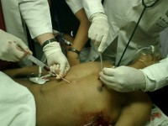
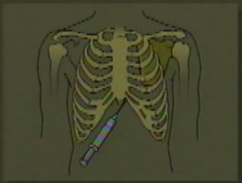
Pericardiocentesis
Puncture the skin 1-2 cm inferior to xiphoid process
45/45/45 degree angle
Advance needle to tip of left scapula
Withdraw on needle during advance of needle
Preferable under ultrasound guidance or EKG lead V attachment
Complications
Aspiration of ventricular blood
Laceration of coronary arteries, veins, epicardium/myocardium
Cardiac arrhythmia
Pneumothorax
Puncture of esophagus
Puncture of peritoneum

Slide 30
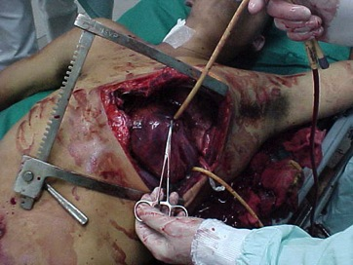
Circulation
A word about cardiac arrest . . .
Care of the trauma patient in cardiac arrest
CPR
Bilateral Tube Thoracostomy
Pericardiocentesis
Volume Resuscitation
Traumatic cardiac arrest due to blunt injury has very low survival rate (< 1%)
No point for emergency thoracotomy
Selected cases of cardiac arrest due to penetrating traumatic injury may benefit from emergent thoracotomy
Pericardial tamponade
Cross clamp aorta

Slide 31
Disability
Baseline Neurologic Exam
Pupillary Exam
Dilated pupil – suggests transtentorial herniation on ipsilateral side
AVPU Scale
Alert
Responds to verbal stimulation
Responds to pain
Unresponsive
Gross Neurological Exam – Extremity Movement
Equal and symmetric
Normal gross sensation
Glasgow Coma Scale: 3-15
Rectal Exam
Normal Rectal Tone
Note: If intubation prior to neuro assessment, consider quick neuro assessment to determine degree of injury

Slide 32
Disability
GCS ≤ 8
Intubate
Glasgow Coma Scale
Eye
Spontaneously opens 4
To verbal command 3
To pain 2
No response 1
Best Motor Response
Obeys verbal commands 6
Localizes to pain 5
Withdraws from pain 4
Flexion to pain (Decorticate Posturing) 3
Extension to pain (Decerebrate Posturing) 2
No response 1
Verbal Response
Oriented/Conversant 5
Disoriented/Confused 4
Inappropriate words 3
Incomprehensible words 2
No response 1

Slide 33
Disability
Key Principles
Precise diagnosis is not necessary at this point in evaluation
Prevention of further injury and identification of neurologic injury is the goal
Decreased level of consciousness = Head injury until proven otherwise
Maintenance of adequate cerebral perfusion is key to prevention of further brain injury
Adequate oxygenation
Avoid hypotension
Involve neurosurgeon early for clear intracranial lesions

Slide 34
Disability
Cervical Spinal Clearance
Patients must be alert and oriented to person, place and time
No neurological deficits
Not clinically intoxicated with alcohol or drugs
Non-tender at all spinous processes
No distracting injuries
Painless range of motion of neck

Slide 35
Exposure
Remove all clothing
Examine for other signs of injury
Injuries cannot be diagnosed until seen by provider
Logroll the patient to examine patient’s back
Maintain cervical spinal immobilization
Palpate along thoracic and lumbar spine
Minimum of 3 people, often more providers required
Avoid hypothermia
Apply warm blankets after removing clothes
Hypothermia = Coagulopathy
Increases risk of hemorrhage

Slide 36
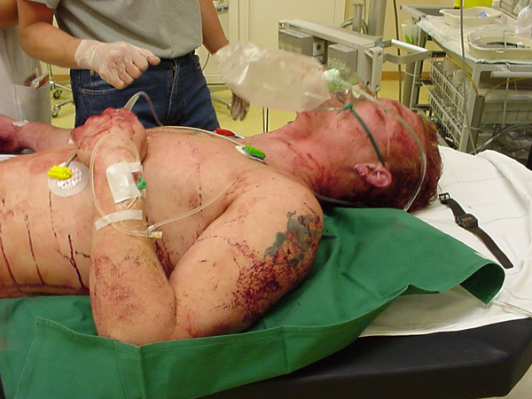
Exposure

Slide 37
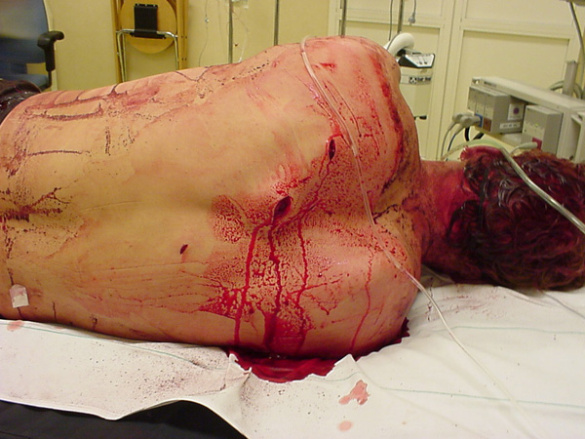
Exposure

Slide 38
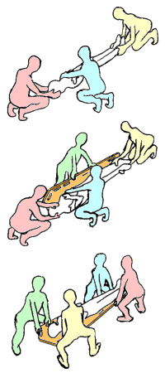
Trauma Logroll
One person = Cervical spine
Two people = Roll main body
One person = Inspect back and palpate spine

Slide 39
Secondary Survey
Secondary Survey is completed after primary survey is completed and patient has been adequately resuscitated.
No patient with abnormal vital signs should proceed through a secondary survey
Secondary Survey includes a brief history and complete physical exam

Slide 40
History
AMPLE History
Allergies
Medications
Past Medical History, Pregnancy
Last Meal
Events surrounding injury, Environment
History may need to be gathered from family members or ambulance service

Slide 41
Physical Exam
Head/HEENT
Neck
Chest
Abdomen
Pelvis
Genitourinary
Extremities
Neurologic

Slide 42
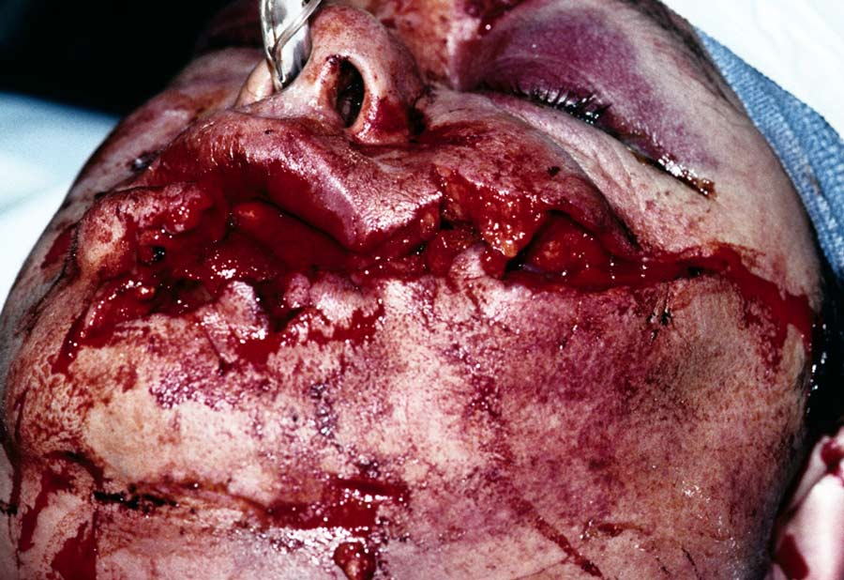
Physical Exam
Source unknown

Slide 43
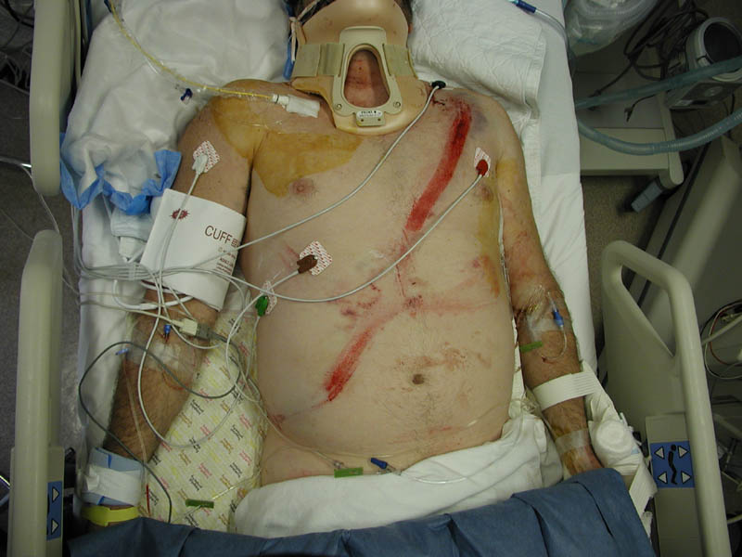
Physical Exam
Seatbelt sign

Slide 44
Physical Exam
Battle Sign
Raccoon's Eyes
Cullen’s Sign
Grey-Turner’s Sign

Slide 45
Adjuncts to Secondary Survey
Radiology
Standard emergent films
C-spine, CXR, Pelvis
Focused Abdominal Sonography in Trauma (FAST)
Additional films
Cat scan imaging
Angiography
Foley Catheter
Blood at urethral meatus = No Foley catheter
Pain Control
Tetanus Status
Antibiotics for open fractures

Slide 46
FAST Exam
Focused Abdominal Sonography in Trauma
4 views of the abdomen to look for fluid.
RUQ/Morrison’s pouch
Sub-xiphoid – view of heart
LUQ – view of spleno-renal junction
Bladder – view of pelvis

Slide 47
FAST
Has largely replaced deep peritoneal lavage (DPL)
Bedside ultrasound looking for blood collection in an unstable patient.
If the patient is unstable and a blood collection is found, proceed emergently to the operating theater.

Slide 48
FAST
Sensitivity of 94.6%
Specificity of 95.1%
Overall accuracy of 94.9% in identifying the presence of intra-abdominal injuries.
Yoshil: J Trauma 1998; 45

Slide 49
FAST Right Upper Quadrant - Morrison’s Pouch
Between the liver and kidney in RUQ.
First place that fluid collects in supine patient.

Slide 50
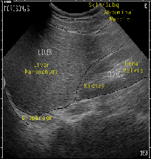
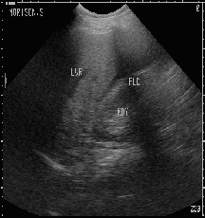
FAST Exam - RUQ

Slide 51
FAST – Sub-xiphoid
Evaluate for pericardial fluid
View through liver
Transhepatic or Parasternal
Searches for fluid between heart and pericardium

Slide 52
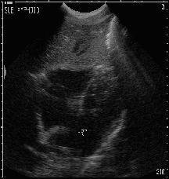
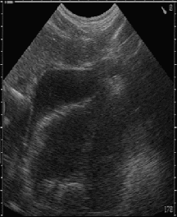
FAST – Sub-xiphoid

Slide 53
FAST – Left Upper Quadrant
View between the spleen and kidney
Another dependent place that fluid collects
Also see diaphragm in this view

Slide 54
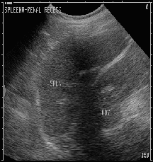
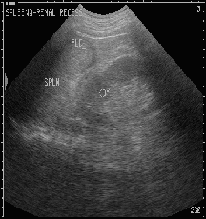
FAST - LUQ

Slide 55
FAST – Bladder View
Evaluates for fluid in the pouch of Douglas
Posterior to bladder
Dependent potential space

Slide 56
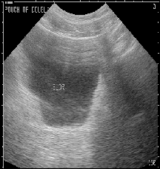
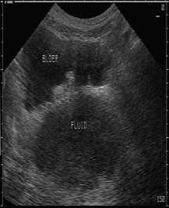
FAST – Bladder View

Slide 57
Interpret this FAST Image:

Slide 58
Trauma in Special Populations
Pregnancy
Supine Hypotensive Syndrome
After 20 weeks, enlarged uterus with fetus and amniotic fluid compresses inferior vena cava
Decreases venous return and decrease cardiac output
Keep pregnant patients in left lateral decubitus position to avoid excessive hypotension
Optimal maternal and fetal outcome is determined by adequate resuscitation of mother
Fetal Monitoring

Slide 59
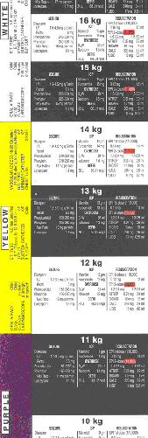
Trauma in Special Populations
Pediatric Trauma Resuscitation
Differences in head to body ratio and relative size and location of anatomic features make children more susceptible to head injury, abdominal injury
Underdeveloped anatomy leads to chest pliability and less protection of thoracic cage
Cardiac Arrest
Typically result from respiratory arrest degrading into cardiac arrest
Resuscitation
Broselow Tape
ABCDE

Slide 60
Classic Radiographical Findings
Pelvic Fracture

Slide 61
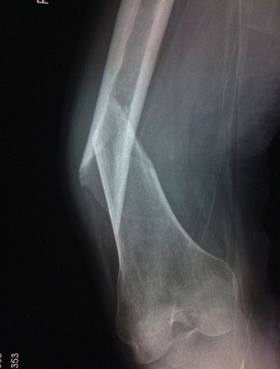
Classic Radiographic Findings
Femur Fracture

Slide 62
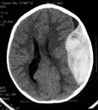
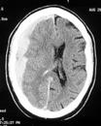
Classic Radiographic Findings
Epidural Hematoma
Middle Meningeal Artery
Subdural Hematoma
Bridging Veins

Slide 63
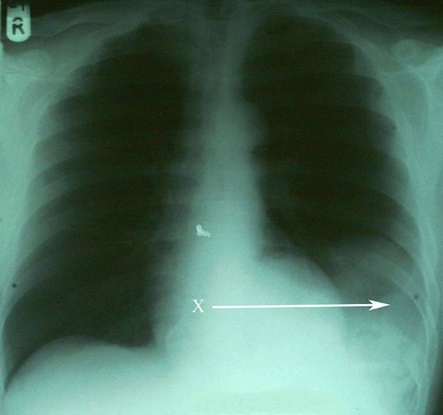
Classic Radiographic Findings
Diaphragmatic rupture w/ spleen herniation

Slide 64
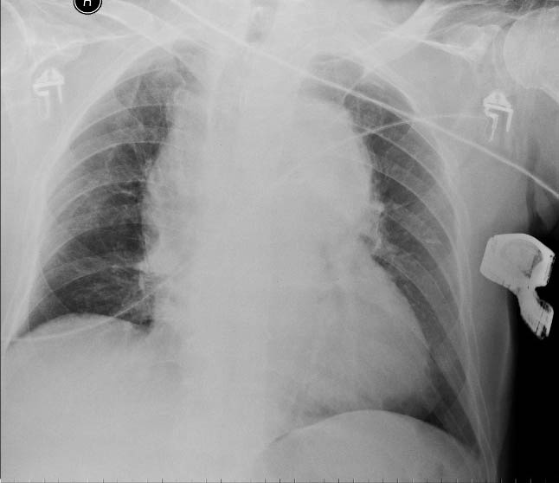
Classic Radiographic Findings
Widened Mediastinum – Aortic Injury

Slide 65
Definitive Care
Secondary Survey followed by radiographic evaluation
CatScan
Consultation
Neurosurgery
Orthopedic Surgery
Vascular Surgery
Transfer to Definitive Care
Operating Room
ICU
Higher level facility

Slide 66
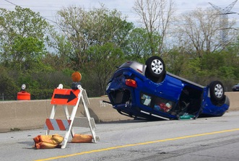
Case Example
Mr. Jones – 45 y/o male involved in a rollover road motor vehicle collision and was ejected from the vehicle.
Patient was unrestrained. Patient was not ambulatory on scene of accident and is brought into trauma bay for evaluation.
What concerns you about story?
First steps of evaluation and management

Slide 67
Case Example
Exam
Awake, diaphoretic
Pulse = 120
BP = 90/60
RR = 18
O2 sat = 94%
What do you want to do next?

Slide 68
Case Example
Preparation
Primary Survey
Awake, alert, talking to provider
Breathing
Absent breath sounds on left
What do you want to do next?
Circulation
Vital Signs?
Access?
Resuscitation?
IV/O2/Monitor
Disability
GCS = 14
Exposure

Slide 69
Case Example
Chest tube placed
Rush of air heard consistent with pneumothorax
Repeat Vital Signs
Pulse 120
BP 80/40
RR = 15
O2 sat = 99% NRBM
What do you want to do next?
Patient complaining of abdominal pain
Ecchymosis noted over left flank
Resuscitation?

Slide 70
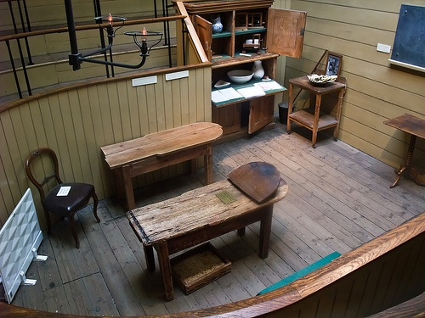
Case Example
Blood Product Administration
Transfer to definitive care = Operating Theatre
)

Slide 71
Conclusion
Assessment of the trauma patient is a standard algorithm designed to ensure life threatening injuries do not get missed
Primary Survey + Resuscitation
Airway
Breathing
Circulation
Disability
Exposure
Secondary Survey
Definitive Care

Slide 72
Questions?
)

