Slide 1
Kenya Medical Training College- Thika Campus Department of Orthopaedic & Trauma Medicine September 2021- certificate class Topic: Traumatology II Facilitator: Miss Regina Wambui

Slide 2
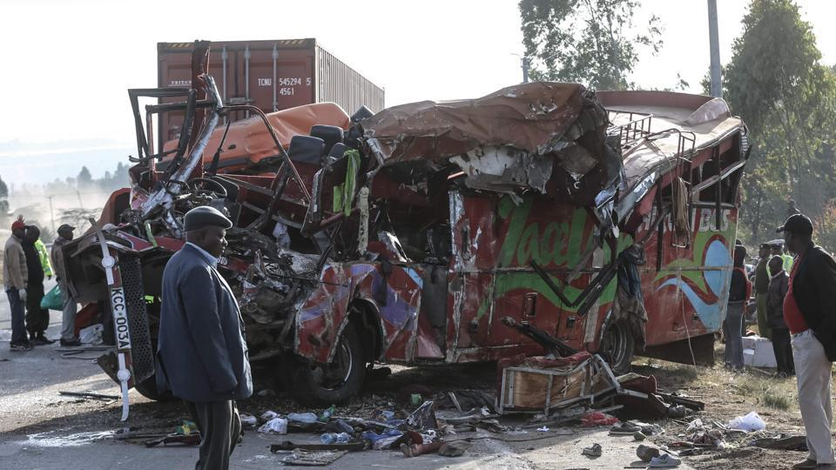
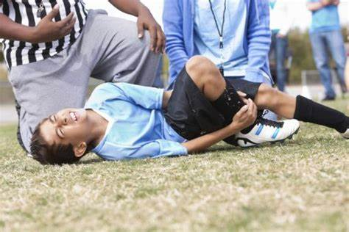

Slide 3
Learning Outcome
By the end of this lesson
you should be able to
Manage trauma conditions

Slide 4
Objectives
Describe injuries of the upper extremities

Slide 5
Introduction
Fractures of upper extremities:
shoulder girdle
Clavicle
Humerus
Radius
Ulna
Carpals, metacarpals and phalanges.

Slide 6
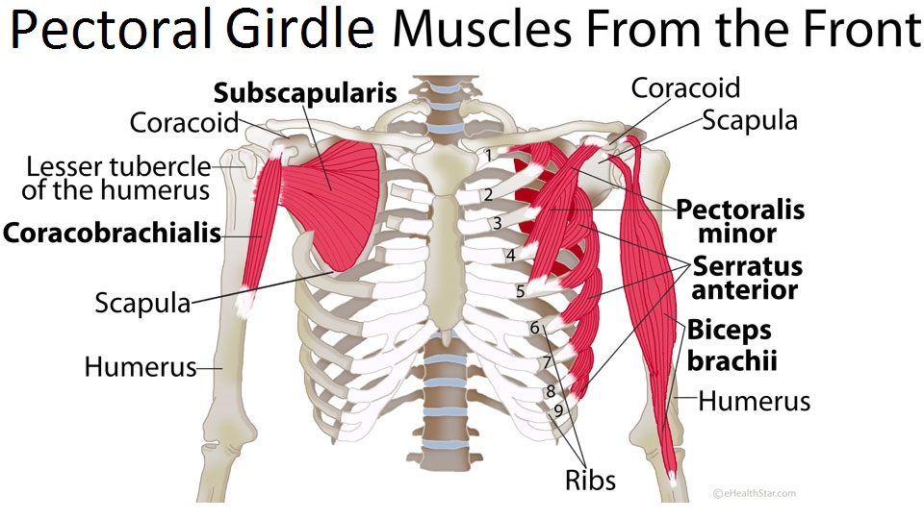
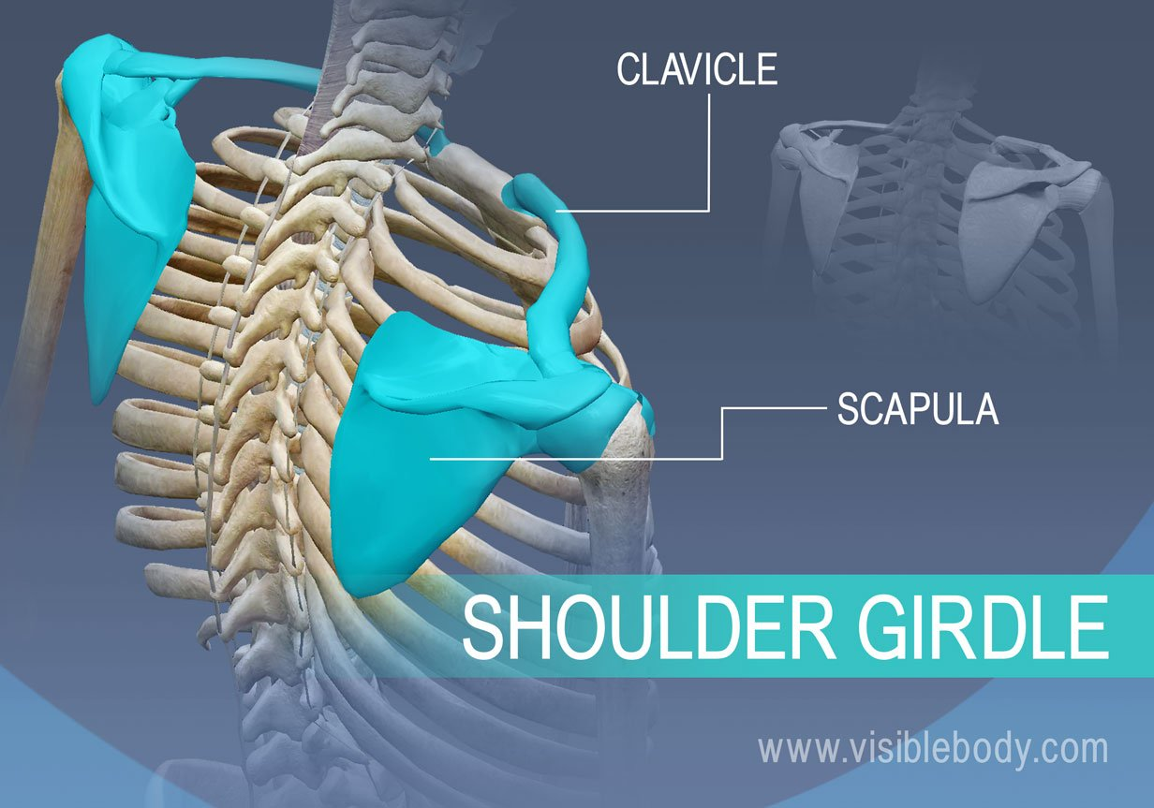
Shoulder Girdle

Slide 7
Cnt’ Shoulder Girdle
Is also called the Pectoral girdle
It is a bone ring, incomplete posteriorly
Formed by two sets of bone: the scapulae,
Posteriorly, the clavicles anteriorly
and completed anteriorly by the manubrium
Of the sternum (part of axial skeleton)

Slide 8
Bones the shoulder girdle is formed by two pairs of bones, the scapulae and the clavicles. The pectoral girdle forms the following joints: Sternoclavicular joints anteriorly acromioclavicular and glenohumeral joints Muscles that attach to and move this bones they are: Rhomboids, trapezius, subclavius, pectoralis minor and levator scapulae muscles.

Slide 9
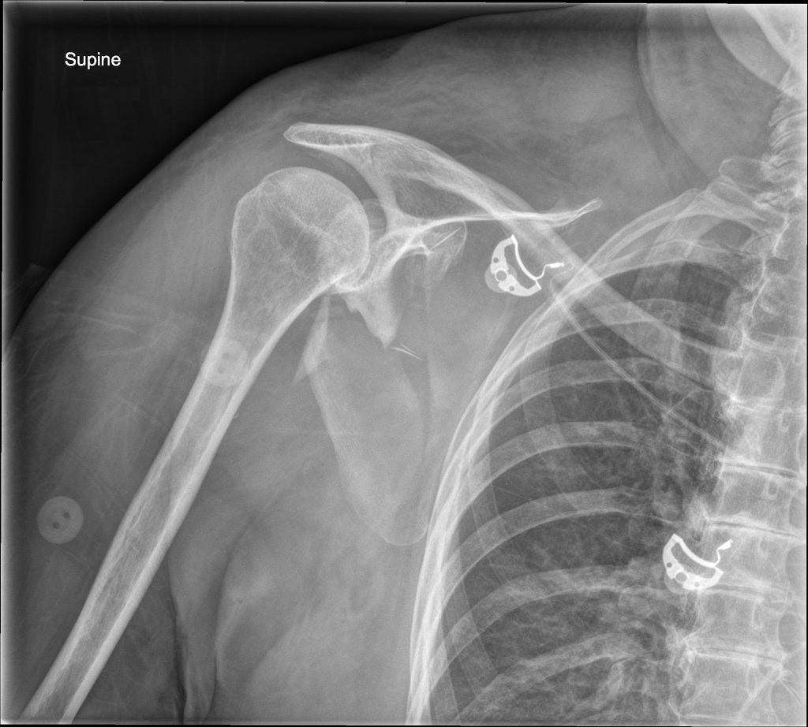
Scapula Fractures

Slide 10
Scapular fractures are typically high energy injuries
50% scapular fractures involve the bone and the scapula spine
10% of the scapula involve the glenoid fossa
Fractures usually occurs due to a high energy trauma
with about 80-90% associated injuries
Associated injuries : rib fractures, pulmonary contusions, head injury
Most scapula fractures are treated conservatively even the fracture is moderately displaced. Use an armsling and pain killers

