Slide 1
URINARY SYSTEM

Slide 2
INTRODUCTION
The urinary system’s ability to filter the blood resides in about 2-3 million tufts of specialized capillaries-the glomeruli-distributed more or less equally between the two kidneys
The glomeruli filter blood based on the particle size whereby large elements such as blood cells, platelets, antibodies and albumen are left
The glomerulus is the first part of the nephron, which then continues as a highly specialized tubular structure responsible for creating the final urine composition
All other solutes such as ions, amino acids, vitamins and wastes are filtered to create a filtrate composition very similar to plasma
The glomeruli creates 200 liters of this filtrate daily yet you excrete less than 2 litres of waste you call urine

Slide 3
NORMAL URINE CHARACTERISTICS
CHARACTERISTIC | NORMAL VALUES
COLOUR | Pale yellow to deep amber
ODOUR | ODOURLESS
VOLUME | 750-2000 ML/24 Hour
PH | 4.5-8.0
SPECIFIC GRAVITY | 1.003-1.032
OSMOLARITY | 40-1350 mOsmol/kg
UROBILINOGEN | 0.2-1.0 mg/100ml
White blood cells | 0-2 HPF(per high-power field microscope)
Leukocyte esterase | None
Protein | None or trace
Bilirubin | less than 0.3mg/100 ml
Ketones | None
Nitrites | None
Blood | None
Glucose | None

Slide 4
URINALYSIS(urine analysis) often provides clues to renal disease, if proteins are found there is damage to the glomeruli and unusually large amounts of urine may point to diseases like Diabetes mellitus or hypothalamic tumours that cause diabetes insipidus
The colour of urine is determined mostly by the breakdown products of red blood cell destruction. The heme of haemoglobin is converted by the liver into water soluble forms that can be excreted into the bile and indirectly into urine. This yellow pigment is urochrome.
Urine colour may be affected by certain foods. Diseases of the liver or obstructions of bile drainage from liver impart a dark tea or cola hue to the urine. Dehydration produces darker, concentrated urine that may possess the slight oduor of ammonia

Slide 5
Minimum urine output is 500 mL/ day to rid the body of wastes. Output below this level due to severe dehydration or renal disease is termed as OLIGURIA. The virtual absence of urine production is termed ANURIA and excessive urine production is termed as POLYURIA
The urethra transports urine from the bladder to the outside of the body for disposal. The urethra is the only urologic organ that shows any significant anatomic difference between males and females; all other urine transport structures are identical
All structures involved in the transport and storage of the urine are large enough to be visible to the naked eye. This transport and storage system not only stores the waste, but it protects the tissues from damage due to the wide range of pH and osmolarity of the urine, prevents infection by foreign organisms, and for the male, provides reproductive functions.

Slide 6
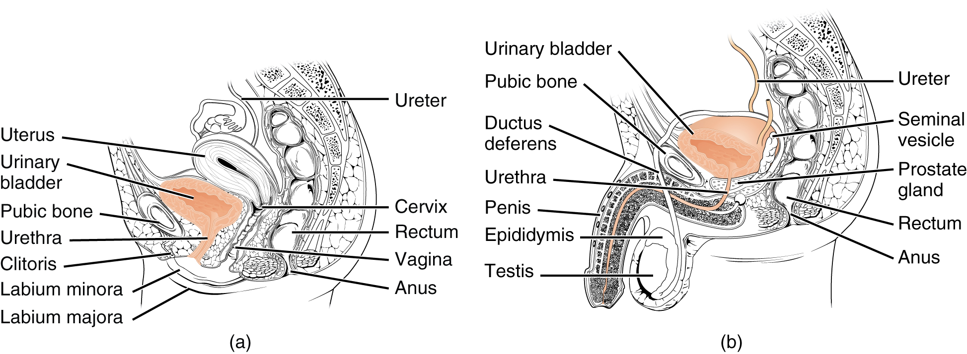
FEMALE AND MALE URETHRA

Slide 7
Female Urethra
The external urethral orifice is embedded in the anterior vaginal wall inferior to the clitoris, superior to the vaginal opening (introitus), and medial to the labia minora. Its short length, about 4 cm, is less of a barrier to fecal bacteria than the longer male urethra and the best explanation for the greater incidence of UTI in women. Voluntary control of the external urethral sphincter is a function of the pudendal nerve. It arises in the sacral region of the spinal cord, traveling via the S2–S4 nerves of the sacral plexus.
The male urethra passes through the prostate gland immediately inferior to the bladder before passing below the pubic symphysis. The length of the male urethra varies between men but averages 20 cm in length. It is divided into four regions: the preprostatic urethra, the prostatic urethra, the membranous urethra, and the spongy or penile urethra

Slide 8
BLADDER
The urinary bladder collects urine from both ureters. The bladder lies anterior to the uterus in females, posterior to the pubic bone and anterior to the rectum. During late pregnancy, its capacity is reduced due to compression by the enlarging uterus, resulting in increased frequency of urination. In males, the anatomy is similar, minus the uterus, and with the addition of the prostate inferior to the bladder. The bladder is a retroperitoneal organ whose "dome" distends superiorly when the bladder is filling with urine

Slide 9
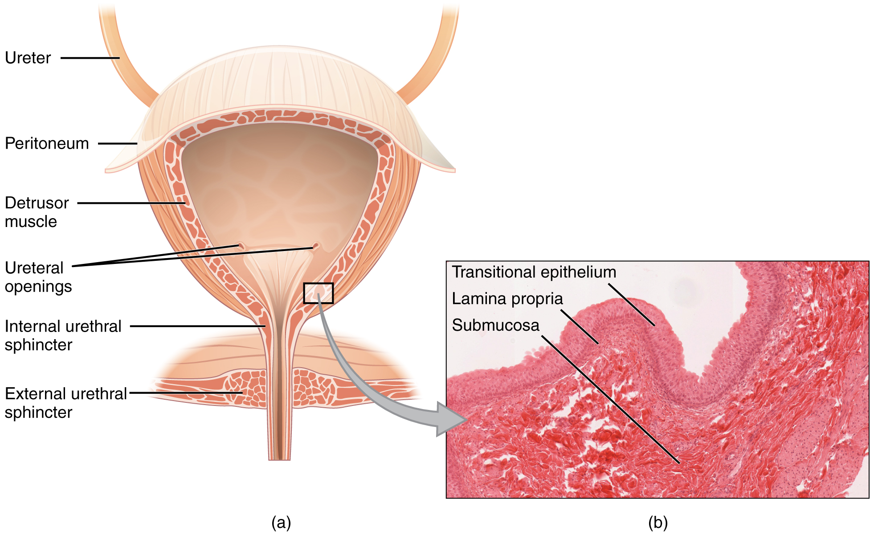
BLADDER

Slide 10
URETERS
The kidneys and ureters are completely retroperitoneal, and the bladder has a peritoneal covering only over the dome. As urine is formed, it drains into the calyces of the kidney, which merge to form the funnel-shaped renal pelvis in the hilum of each kidney. The renal pelvis narrows to become the ureter of each kidney. As urine passes through the ureter, it does not passively drain into the bladder but rather is propelled by waves of peristalsis. As the ureters enter the pelvis, they sweep laterally, hugging the pelvic walls. As they approach the bladder, they turn medially and pierce the bladder wall obliquely. This is important because it creates an one-way valve (a physiological sphincter rather than an anatomical sphincter) that allows urine into the bladder but prevents reflux of urine from the bladder back into the ureter. Children born lacking this oblique course of the ureter through the bladder wall are susceptible to “vesicoureteral reflux,” which dramatically increases their risk of serious UTI. Pregnancy also increases the likelihood of reflux and UTI

Slide 11
KIDNEYS
The kidneys lie on either side of the spine in the retroperitoneal space between the parietal peritoneum and the posterior abdominal wall, well protected by muscle, fat, and ribs. They are roughly the size of your fist, and the male kidney is typically a bit larger than the female kidney. The kidneys are well vascularized, receiving about 25 percent of the cardiac output at rest. The left kidney is located at about the T12 to L3 vertebrae, whereas the right is lower due to slight displacement by the liver. Upper portions of the kidneys are somewhat protected by the eleventh and twelfth ribs. Each kidney weighs about 125–175 g in males and 115–155 g in females. They are about 11–14 cm in length, 6 cm wide, and 4 cm thick, and are directly covered by a fibrous capsule composed of dense, irregular connective tissue that helps to hold their shape and protect them. This capsule is covered by a shock-absorbing layer of adipose tissue called the renal fat pad, which in turn is encompassed by a tough renal fascia. The fascia and, to a lesser extent, the overlying peritoneum serve to firmly anchor the kidneys to the posterior abdominal wall in a retroperitoneal position

Slide 12
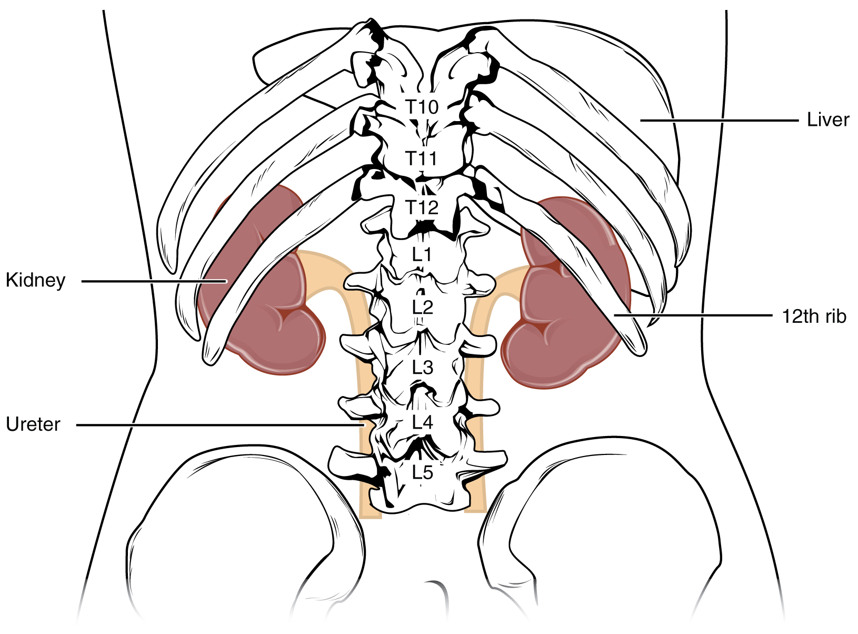

Slide 13
On the superior aspect of each kidney is the adrenal gland. The adrenal cortex directly influences renal function through the production of the hormone aldosterone to stimulate sodium reabsorption. A frontal section through the kidney reveals an outer region called the renal cortex and an inner region called the medulla. The renal columns are connective tissue extensions that radiate downward from the cortex through the medulla to separate the most characteristic features of the medulla, the renal pyramids and renal papillae. The papillae are bundles of collecting ducts that transport urine made by nephrons to the calyces of the kidney for excretion. The renal columns also serve to divide the kidney into 6–8 lobes and provide a supportive framework for vessels that enter and exit the cortex. The pyramids and renal columns taken together constitute the kidney lobes.

Slide 14
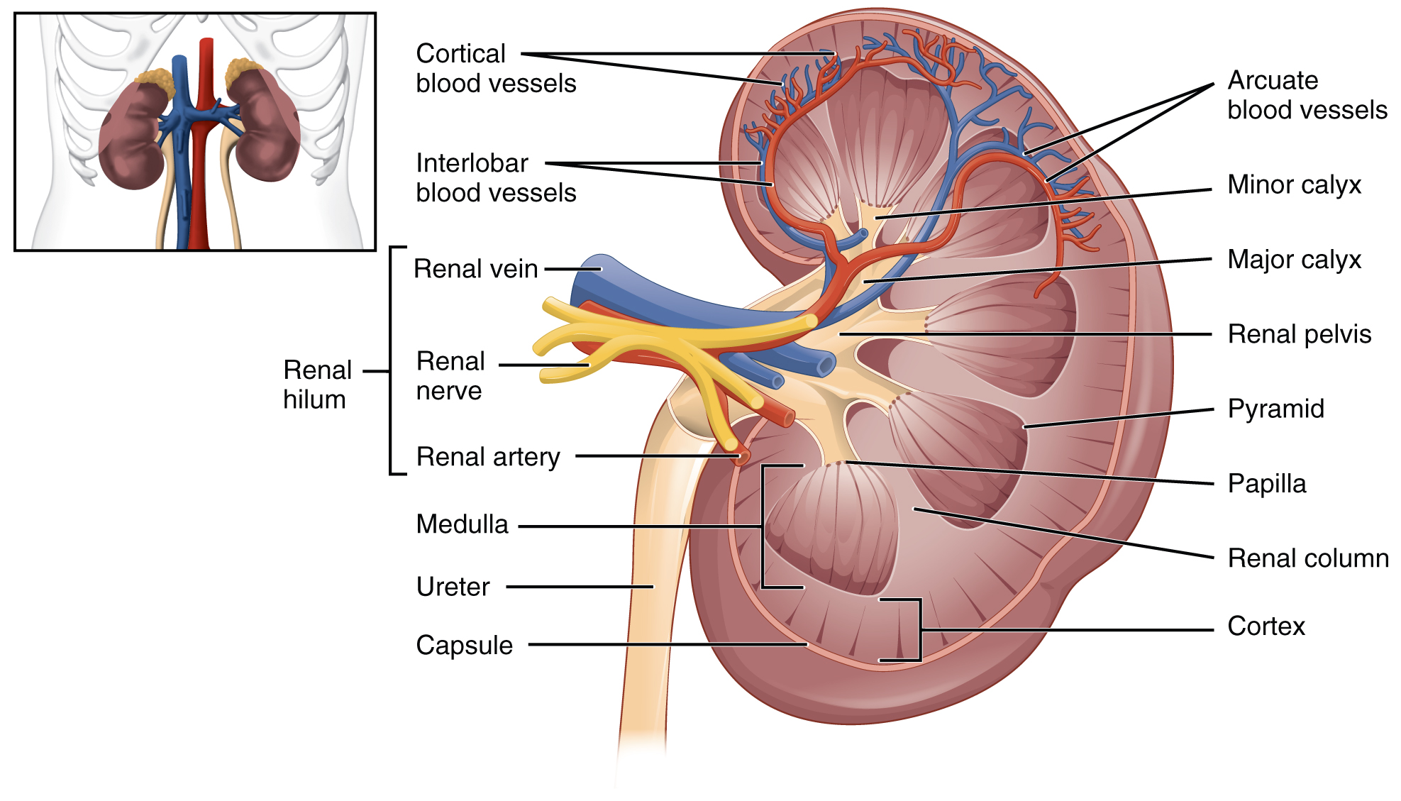

Slide 15
RENAL HILUM
The renal hilum is the entry and exit site for structures servicing the kidneys: vessels, nerves, lymphatics, and ureters. The medial-facing hila are tucked into the sweeping convex outline of the cortex. Emerging from the hilum is the renal pelvis, which is formed from the major and minor calyxes in the kidney. The smooth muscle in the renal pelvis funnels urine via peristalsis into the ureter. The renal arteries form directly from the descending aorta, whereas the renal veins return cleansed blood directly to the inferior vena cava. The artery, vein, and renal pelvis are arranged in an anterior-to-posterior order.

Slide 16
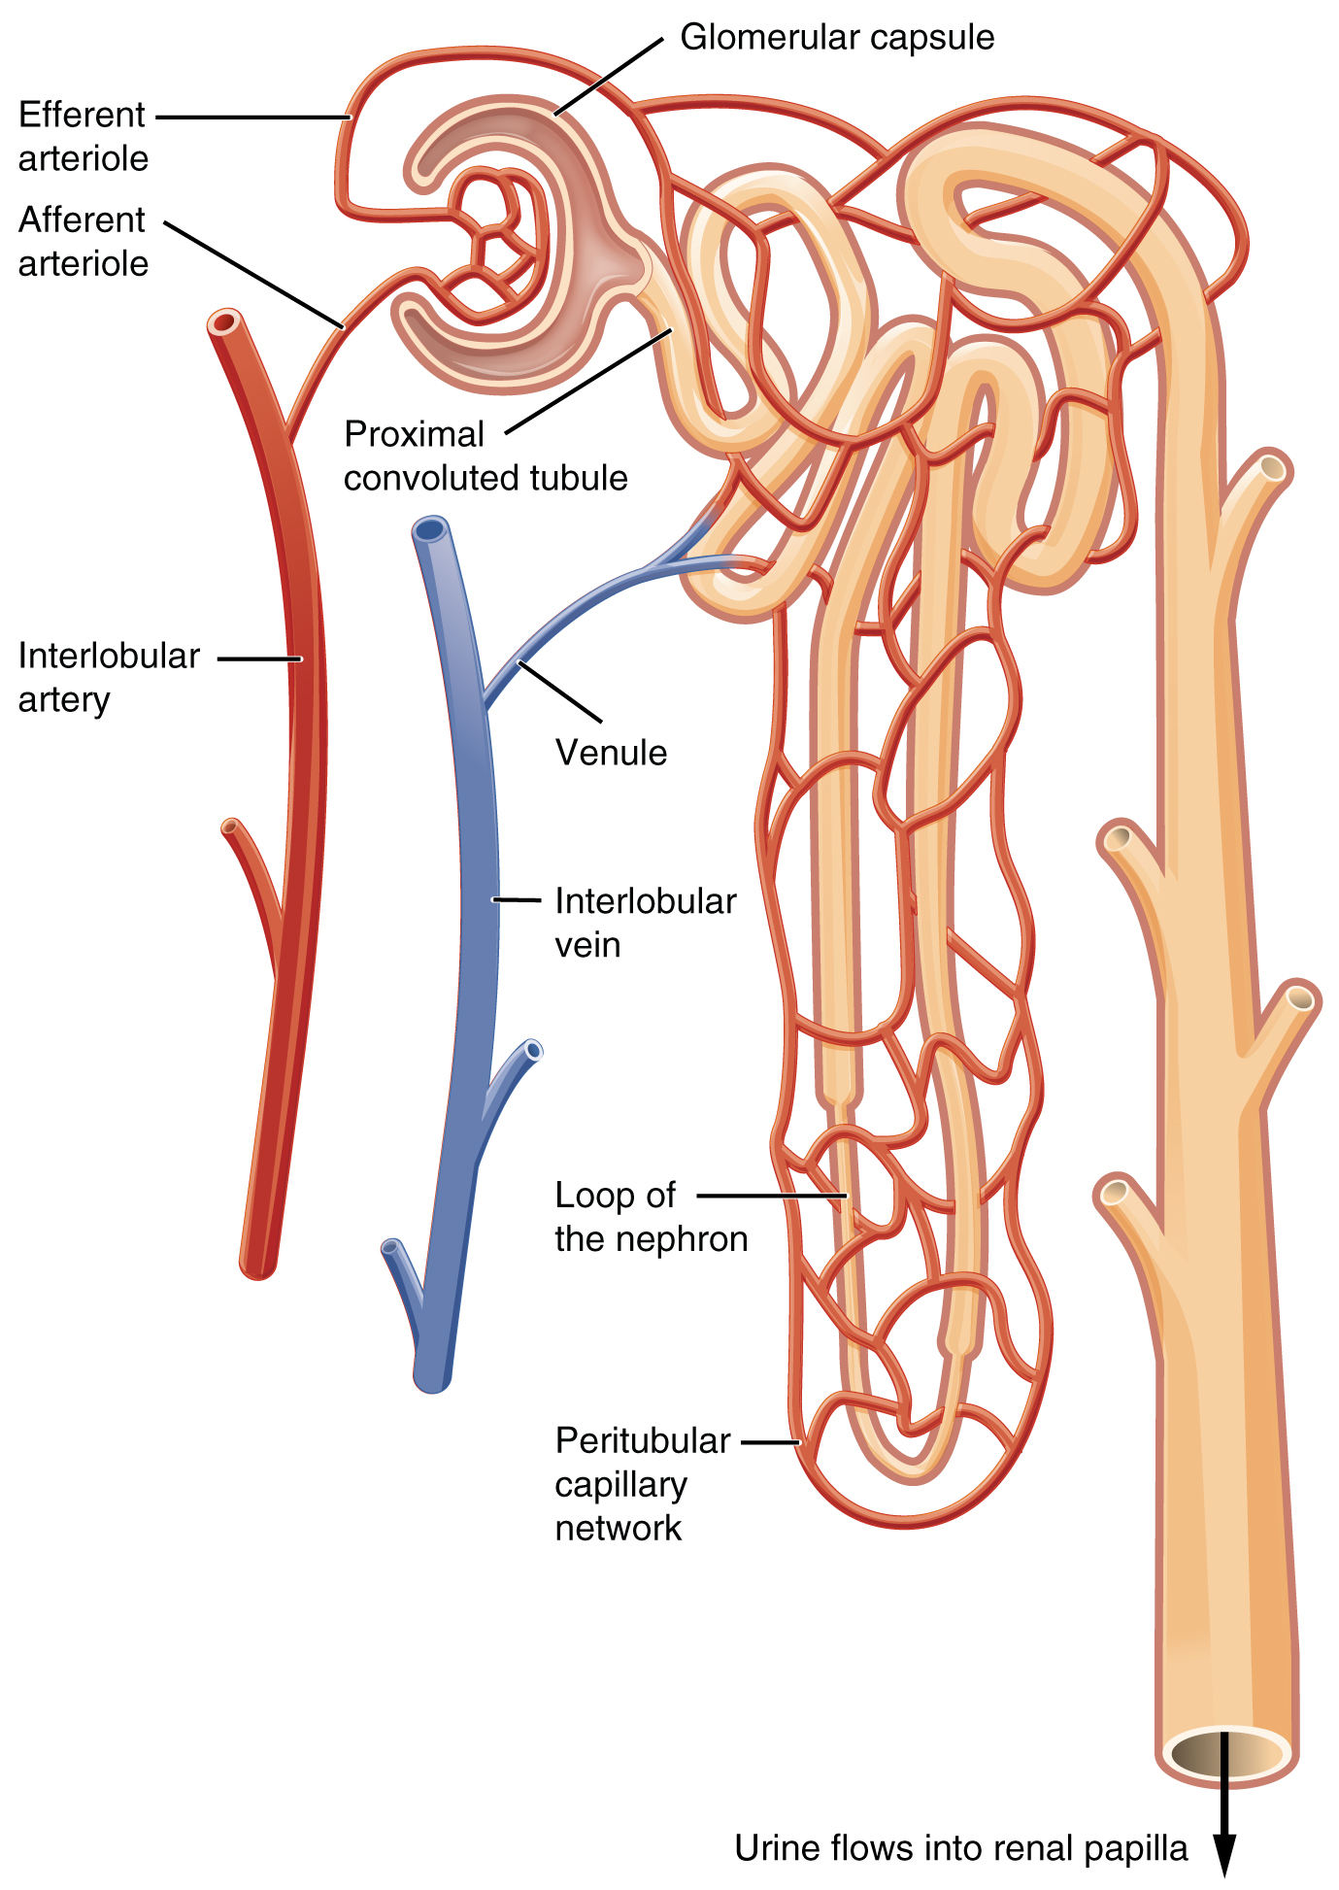
NEPHRON

Slide 17
The renal artery first divides into segmental arteries, followed by further branching to form interlobar arteries that pass through the renal columns to reach the cortex. The interlobar arteries, in turn, branch into arcuate arteries, cortical radiate arteries, and then into afferent arterioles. The afferent arterioles service about 1.3 million nephrons in each kidney. Nephrons are the “functional units” of the kidney; they cleanse the blood and balance the constituents of the circulation. The afferent arterioles form a tuft of high-pressure capillaries about 200 µm in diameter, the glomerulus. The rest of the nephron consists of a continuous sophisticated tubule whose proximal end surrounds the glomerulus in an intimate embrace—this is Bowman’s capsule. The glomerulus and Bowman’s capsule together form the renal corpuscle. As mentioned earlier, these glomerular capillaries filter the blood based on particle size. After passing through the renal corpuscle, the capillaries form a second arteriole, the efferent arteriole

Slide 18
These will next form a capillary network around the more distal portions of the nephron tubule, the peritubular capillaries and vasa recta, before returning to the venous system. As the glomerular filtrate progresses through the nephron, these capillary networks recover most of the solutes and water, and return them to the circulation. Since a capillary bed (the glomerulus) drains into a vessel that in turn forms a second capillary bed, the definition of a portal system is met. This is the only portal system in which an arteriole is found between the first and second capillary beds. (Portal systems also link the hypothalamus to the anterior pituitary, and the blood vessels of the digestive viscera to the liver

Slide 19
CORTEX
In a dissected kidney, it is easy to identify the cortex; it appears lighter in color compared to the rest of the kidney. All of the renal corpuscles as well as both the proximal convoluted tubules (PCTs) and distal convoluted tubules are found here. Some nephrons have a short loop of Henle that does not dip beyond the cortex. These nephrons are called cortical nephrons. About 15 percent of nephrons have long loops of Henle that extend deep into the medulla and are called juxtamedullary nephrons

Slide 20
Glomerular Filtration Rate (GFR)
The volume of filtrate formed by both kidneys per minute is termed the glomerular filtration rate (GFR). The heart pumps about 5 L blood per min under resting conditions. Approximately 20 percent or one liter enters the kidneys to be filtered. On average, this liter results in the production of about 125 mL/min filtrate produced in men (range of 90 to 140 mL/min) and 105 mL/min filtrate produced in women (range of 80 to 125 mL/min). This amount equates to a volume of about 180 L/day in men and 150 L/day in women. Ninety-nine percent of this filtrate is returned to the circulation by reabsorption so that only about 1–2 liters of urine are produced per day

Slide 21
FUNCTIONS OF THE KIDNEY
Vitamin D Synthesis
In order for vitamin D to become active, it must undergo a hydroxylation reaction in the kidney, that is, an –OH group must be added to calcidiol to make calcitriol (1,25-dihydroxycholecalciferol). Activated vitamin D is important for absorption of Ca⁺⁺ in the digestive tract, its reabsorption in the kidney, and the maintenance of normal serum concentrations of Ca⁺⁺ and phosphate. Calcium is vitally important in bone health, muscle contraction, hormone secretion, and neurotransmitter release. Inadequate Ca⁺⁺ leads to disorders like osteoporosis and osteomalacia in adults and rickets in children. Deficits may also result in problems with cell proliferation, neuromuscular function, blood clotting, and the inflammatory response.

Slide 22
Erythropoiesis
EPO is a 193-amino acid protein that stimulates the formation of red blood cells in the bone marrow. The kidney produces 85 percent of circulating EPO; the liver, the remainder. If you move to a higher altitude, the partial pressure of oxygen is lower, meaning there is less pressure to push oxygen across the alveolar membrane and into the red blood cell. One way the body compensates is to manufacture more red blood cells by increasing EPO production. If you start an aerobic exercise program, your tissues will need more oxygen to cope, and the kidney will respond with more EPO. If erythrocytes are lost due to severe or prolonged bleeding, or under produced due to disease or severe malnutrition, the kidneys come to the rescue by producing more EPO. Renal failure (loss of EPO production) is associated with anemia, which makes it difficult for the body to cope with increased oxygen demands or to supply oxygen adequately even under normal conditions. Anemia diminishes performance and can be life threatening.

Slide 23
Blood Pressure Regulation
Due to osmosis, water follows where Na⁺ leads. Much of the water the kidneys recover from the forming urine follows the reabsorption of Na⁺. ADH stimulation of aquaporin channels allows for regulation of water recovery in the collecting ducts. Normally, all of the glucose is recovered, but loss of glucose control (diabetes mellitus) may result in an osmotic dieresis severe enough to produce severe dehydration and death. A loss of renal function means a loss of effective vascular volume control, leading to hypotension (low blood pressure) or hypertension (high blood pressure), which can lead to stroke, heart attack, and aneurysm formation

Slide 24
Regulation of Osmolarity
Blood pressure and osmolarity are regulated in a similar fashion. Severe hypo-osmolarity can cause problems like lysis (rupture) of blood cells or widespread edema, which is due to a solute imbalance. Inadequate solute concentration (such as protein) in the plasma results in water moving toward an area of greater solute concentration, in this case, the interstitial space and cell cytoplasm. If the kidney glomeruli are damaged by an autoimmune illness, large quantities of protein may be lost in the urine. The resultant drop in serum osmolarity leads to widespread edema that, if severe, may lead to damaging or fatal brain swelling. Severe hypertonic conditions may arise with severe dehydration from lack of water intake, severe vomiting, or uncontrolled diarrhea. When the kidney is unable to recover sufficient water from the forming urine, the consequences may be severe (lethargy, confusion, muscle cramps, and finally, death)

Slide 25
Recovery of Electrolytes
Sodium, calcium, and potassium must be closely regulated. The role of Na⁺ and Ca⁺⁺ homeostasis has been discussed at length. Failure of K⁺ regulation can have serious consequences on nerve conduction, skeletal muscle function, and most significantly, on cardiac muscle contraction and rhythm
pH Regulation
Recall that enzymes lose their three-dimensional conformation and, therefore, their function if the pH is too acidic or basic. This loss of conformation may be a consequence of the breaking of hydrogen bonds. Move the pH away from the optimum for a specific enzyme and you may severely hamper its function throughout the body, including hormone binding, central nervous system signaling, or myocardial contraction. Proper kidney function is essential for pH

Slide 26
Elimination of Drugs and Hormones
Water-soluble drugs may be excreted in the urine and are influenced by one or all of the following processes: glomerular filtration, tubular secretion, or tubular reabsorption. Drugs that are structurally small can be filtered by the glomerulus with the filtrate. Large drug molecules such as heparin or those that are bound to plasma proteins cannot be filtered and are not readily eliminated. Some drugs can be eliminated by carrier proteins that enable secretion of the drug into the tubule lumen. There are specific carriers that eliminate basic (such as dopamine or histamine) or acidic drugs (such as penicillin or indomethacin). As is the case with other substances, drugs may be both filtered and reabsorbed passively along a concentration gradient

