Slide 1
Upper Respiratory Tract Infections
Samuel Ngigi K.
KMTC

Slide 2
What is a URI?
A URI is an infection that affects the upper air passages, including:
the larynx, which is the muscular organ containing the vocal cords
the nasal cavity, which is the space above and behind the nose
the nasal passages, or the nostrils
the pharynx, which is the cavity behind the nose and mouth

Slide 3
Introduction
Upper respiratory tract infection (URI) represents the most common acute illness evaluated in the outpatient setting.
URIs range from the common cold--typically a mild, self- limited, catarrhal syndrome of the nasopharynx--to life-threatening illnesses such as epiglottitis.
Viruses account for most URIs.
Bacterial primary infection or superinfection may require targeted therapy.
Notes:
Catarrhal: Copious discharge of mucus associated with inflammation of mucous membranes, especially of the nose and throat.

Slide 4
Symptoms
The most common symptoms of a URI include:
coughing
discomfort in the nasal passages
Mild fever, which is more common in children
excess mucus
nasal congestion
pain or pressure behind the face
a runny nose
a scratchy or sore throat
sneezing
Less common symptoms can include:
bad breath
body aches
headache
hyposmia, or the loss of sense of smell
itchy eyes
Notes:
Hyposmia, or microsmia, is a reduced ability to smell and to detect odors. A related condition is anosmia, in which no odors can be detected. Some of the causes of olfaction problems are allergies, nasal polyps, viral infections and head trauma.

Slide 5
Causes
The causes of URIs are almost always viral. Droplets of infected saliva and mucus spray out into the air when a person sneezes or coughs. Other people may breathe them in, or they can land on surfaces that others touch.
If another person then puts their hand near their mouth, they may get an infection.
There are more than 200 common cold viruses that cause URIs.
Other risk factors include:
damage to the airways or nasal cavity
not washing the hands frequently
contact with groups of children
crowded places, such as airplanes and buses
having an autoimmune disorder
removal of adenoids or tonsils, which are part of the immune system
smoking and secondhand smoke
spending time in the hospital or in a care center

Slide 6
Treatment
Antihistamines
brompheniramine (Bromfed)
chlorpheniramine (Chlor-Trimeton)
diphenhydramine (Benadryl)
Pain-relievers
acetaminophen (Tylenol)
ibuprofen (Advil)
Decongestants
oxymetazoline (Afrin)
phenylephrine (Sudafed PE)
pseudoephedrine (Sudafed)

Slide 7
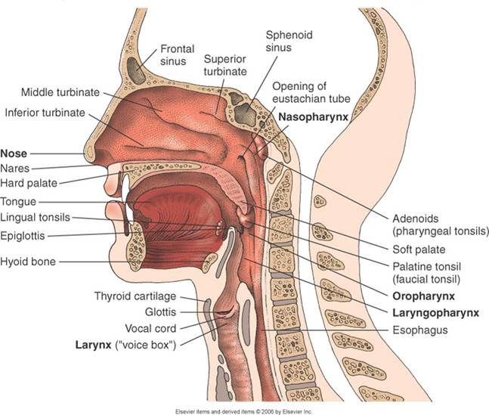
Upper Respiratory Tract

Slide 8
SINUSITIS
DEFINITION:
"Sinusitis" simply means your sinuses are inflamed―red and swollen―because of an infection or another problem

Slide 9
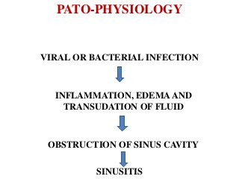

Slide 10
TYPES OF SINUSITIS
ACUTE SINUSITIS
CHRONIC SINUSITIS

Slide 11
ACUTE SINUSITIS
Acute sinusitis (acute rhinosinusitis) causes the cavities around your nasal passages (sinuses) to become inflamed and swollen.
CAUSES:
Viral infection (Rhinovirus, influenza, and parainfluenza)
Bacterial infection (Streptococcus pneumoniae, Haemophilus influenzae, Moraxella catarrhalis, Group A beta-hemolytic streptococci, andStaphylococcus aureus)
Fungal infection (Saprophytic fungi of the order Mucorales, including Rhizopus,Rhizomucor,Absidia,Mucor,Cunninghamella,Mortierella,Saksenaea, and Apophysomyces species)
Allergies such as hay fever/allergic rhinitis
Nasal polyps or tumours
Deviated nasal septum
Tooth infection
Enlarged or infected adenoids in children

Slide 12
RISK FACTORS
Hay fever/allergic rhinitis or another allergic condition
A nasal passage abnormality
A medical condition such as cystic fibrosis, gastroesophageal reflux disease (GERD), or an immune system disorder
Regular exposure to pollutants
Notes:
Allergic rhinitis, also known as hay fever, is a type of inflammation in the nose which occurs when the immune system overreacts to allergens in the air. Signs and symptoms include a runny or stuffy nose, sneezing, red, itchy, and watery eyes, and swelling around the eyes.

Slide 13
SIGN AND SYMPTOMS
Drainage of a thick, yellow or greenish discharge from the nose or down the back of the throat
Nasal obstruction or congestion, causing difficulty breathing through your nose
Pain, tenderness, swelling and pressure around your eyes, cheeks, nose or forehead
Aching in your upper jaw and teeth
Reduced sense of smell and taste
Cough, which may be worse at night
Other signs and symptoms can include:
Ear pain
Headache
Sore throat

Slide 14


Slide 15
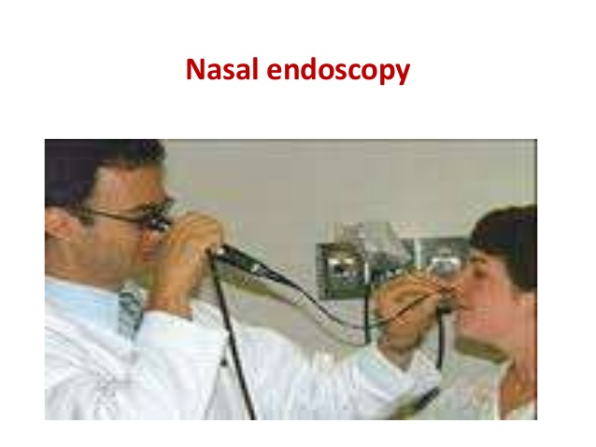

Slide 16
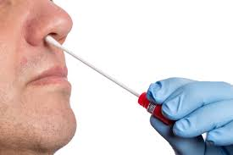
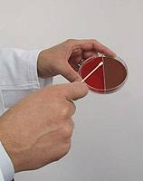
Nasal and sinus cultures

Slide 17
COMPLICATIONS
Asthma
Chronic sinusitis
Meningitis
Vision problems
Ear infection

Slide 18
MEDICAL MANAGEMENT

Slide 19

Saline nasal spray

Slide 20
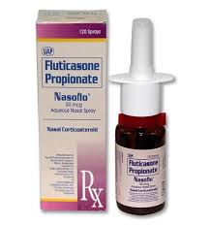
Nasal corticosteroids

Slide 21
Over-the-counter pain relievers
aspirin, acetaminophen or ibuprofen.
Aspirin has been linked with Reye's syndrome, so use caution when giving aspirin to children or teenagers.
Though aspirin is approved for use in children older than age 2, children and teenagers recovering from chickenpox or flu- like symptoms should never take aspirin.
Reye's syndrome usually occurs in children who have had a recent viral infection, such as chickenpox or the flu. Taking aspirin to treat such an infection greatly increases the risk of Reye's. Both chickenpox and the flu can cause headaches. That is why it is important to not use aspirin to treat a child's headache.
Notes:
Reye's syndrome is a rare disorder that causes brain and liver damage. Although it can happen at any age, it is most often seen in children. Reye's syndrome usually occurs in children who have had a recent viral infection, such as chickenpox or the flu.

Slide 22
Decongestants
oral decongestants include Sudafed, Actifed and Drixoral.
Nasal sprays include phenylephrine and oxymetazoline.
These medications are generally taken for only a few days at most.

Slide 23
Antibiotics
Antibiotics used to treat acute sinusitis caused by a bacterial infection include amoxicillin, doxycycline or the combination drug trimethoprim- sulfamethoxazole.

Slide 24
Antifungal medications
acute sinusitis is caused by a fungal infection, which can be treated with antifungal medication (ketoconazole or itraconazole).

Slide 25
Immunotherapy
If allergies are contributing to your sinusitis, allergy shots (immunotherapy) that help reduce the body's reaction to specific allergens may help treat your symptoms.

Slide 26
LIFE STYLE AND HOME REMEDIES
Get plenty of rest
Drink plenty of fluids
Steam your sinus cavities
Apply warm compresses to your face
Rinse out your nasal passages
Sleep with your head elevated

Slide 27

Steam your sinus cavities

Slide 28
CHRONIC SINUSITIS
Chronic sinusitis is a common condition in which the cavities around nasal passages (sinuses) become inflamed and swollen.
Chronic sinusitis lasts 12 weeks or longer despite treatment attempts.

Slide 29
CAUSES
Nasal polyps or tumours
Allergic reactions
Deviated nasal septum
Trauma to the face
Respiratory tract infections
Allergies such as hay fever

Slide 30
RISK FACTORS
A nasal passage abnormality, such as a deviated nasal septum or nasal polyps
Aspirin sensitivity that causes respiratory symptoms
A medical condition, such as cystic fibrosis or chronic obstructive pulmonary disease (COPD)
An immune system disorder, such as HIV/AIDS or cystic fibrosis
Hay fever or another allergic condition that affects your sinuses
Asthma — about 1 in 5 people with chronic sinusitis have asthma
Regular exposure to pollutants such as cigarette smoke

Slide 31
SIGN AND SYMPTOMS
Drainage of a thick, yellow or greenish discharge from the nose or down the back of the throat
Nasal obstruction or congestion, causing difficulty breathing through your nose
Pain, tenderness and swelling around your eyes, cheeks, nose or forehead
Reduced sense of smell and taste
Ear pain
Aching in your upper jaw and teeth
Cough, which may be worse at night
Sore throat
Bad breath (halitosis)
Fatigue or irritability
Nausea

Slide 32
ASSESSMENT AND DIAGNOSIS
Nasal endoscopy
Imaging studies
Nasal and sinus cultures
An allergy test

Slide 33
COMPLICATIONS
Asthma flare-ups
Meningitis
Vision problems
Aneurysms or blood clots
Notes:
An aneurysm refers to a weakening of an artery wall that creates a bulge, or distention, of the artery. Most aneurysms do not show symptoms and are not dangerous. However, at their most severe stage, some can rupture, leading to life-threatening internal bleeding.

Slide 34
MEDICAL MANAGEMENT
The goal of treating chronic sinusitis is to:
Reduce sinus inflammation
Keep your nasal passages draining
Eliminate the underlying cause
Reduce the number of sinusitis

Slide 35
Treatments to relieve symptoms
Saline nasal spray, which you spray into your nose several times a day to rinse your nasal passages.
Nasal corticosteroids:
These nasal sprays help prevent and treat inflammation.
Examples include fluticasone, budesonide, triamcinolone, mometasone and beclomethasone.
Oral or injected corticosteroids:
These medications are used to relieve inflammation from severe sinusitis, especially if you also have nasal polyps.
Examples include prednisone and methylprednisolone.

Slide 36
Decongestants
These medications are available in over-the- counter (OTC) and prescription liquids, tablets and nasal sprays An example of an OTC nasal spray is oxymetazoline.

Slide 37
Antibiotics
Antibiotics used to treat chronic sinusitis caused by a bacterial infection include amoxicillin, doxycycline or the combination drug trimethoprim- sulfamethoxazole.

Slide 38
Immunotherapy
If allergies are contributing to your sinusitis, allergy shots (immunotherapy) that help reduce the body's reaction to specific allergens may help treat the condition.

Slide 39
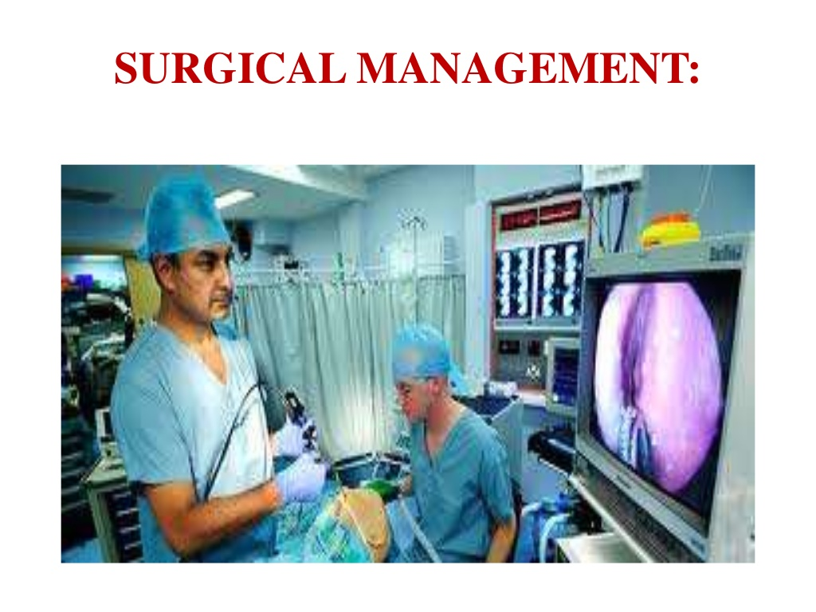
SURGICAL MANAGEMENT

Slide 40
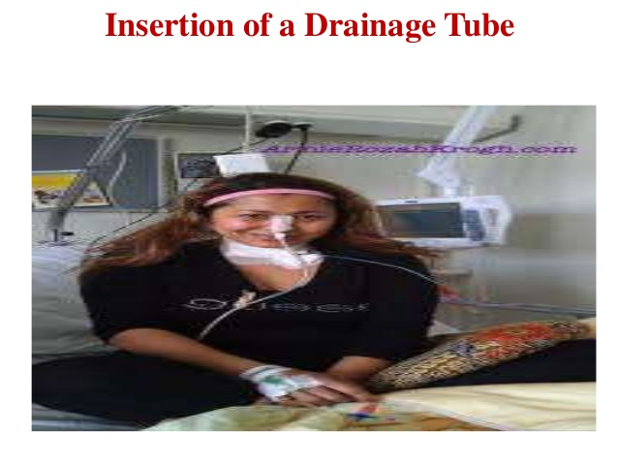

Slide 41
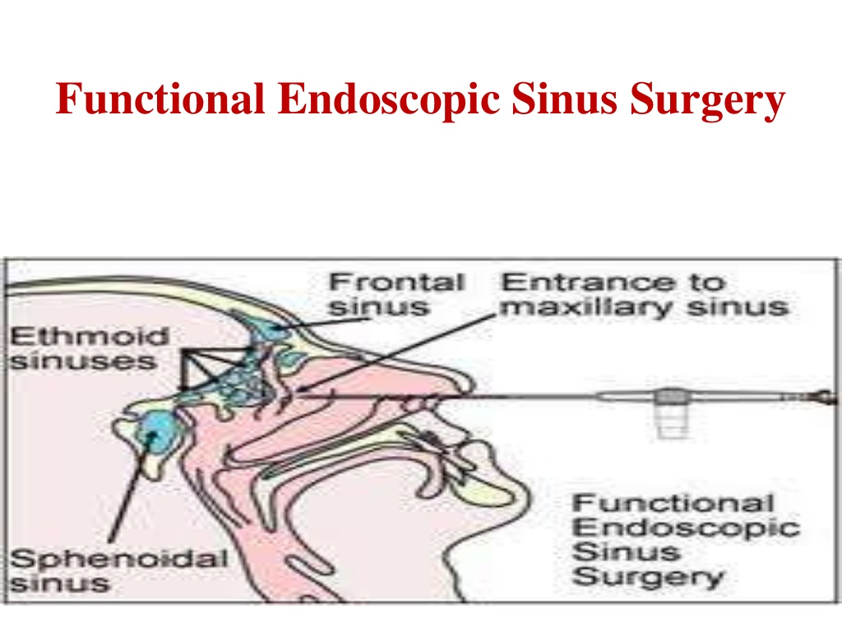

Slide 42
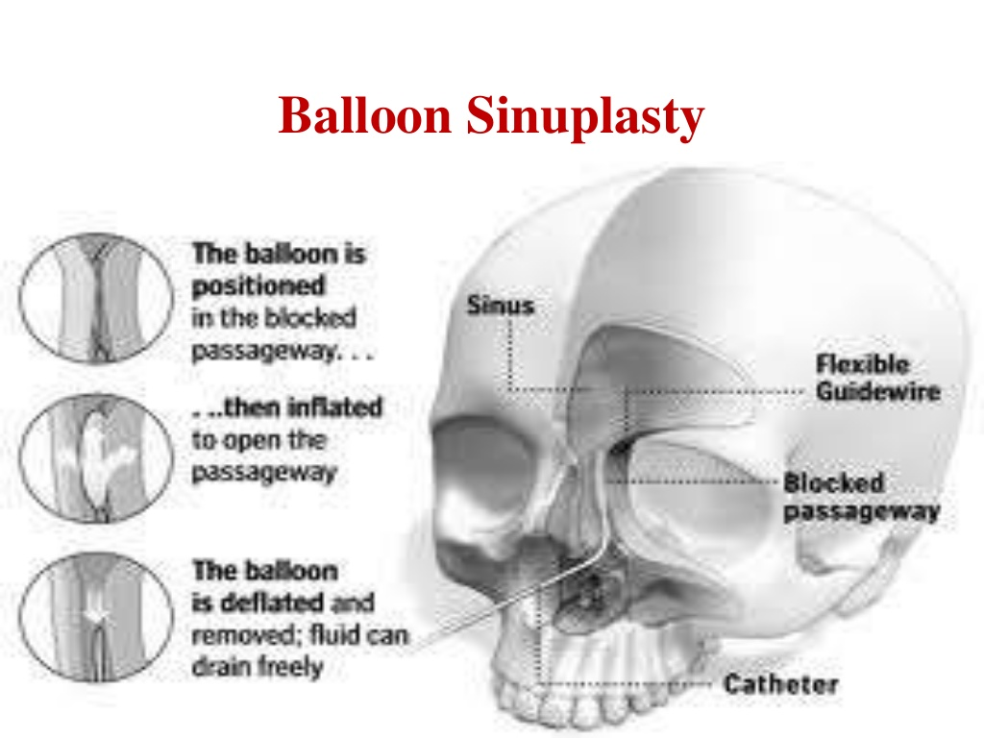

Slide 43
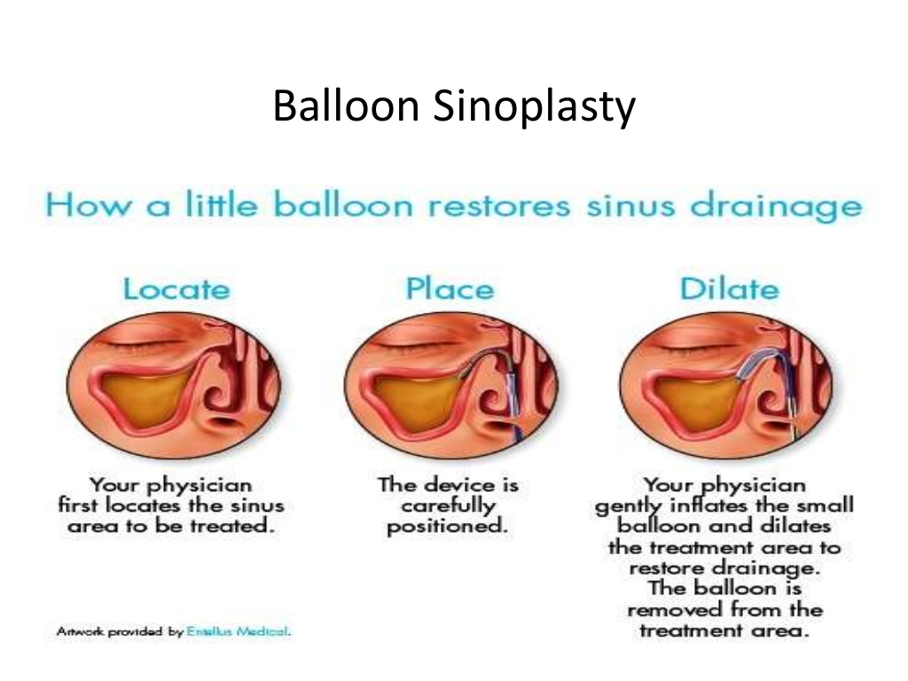

Slide 44
Non-pharmacological treatment
Humidifier to relieve the drying of mucous membranes associated with mouth breathing
Increase oral fluid intake
Saline irrigation of the nostrils
Moist heat over affected sinus

Slide 45
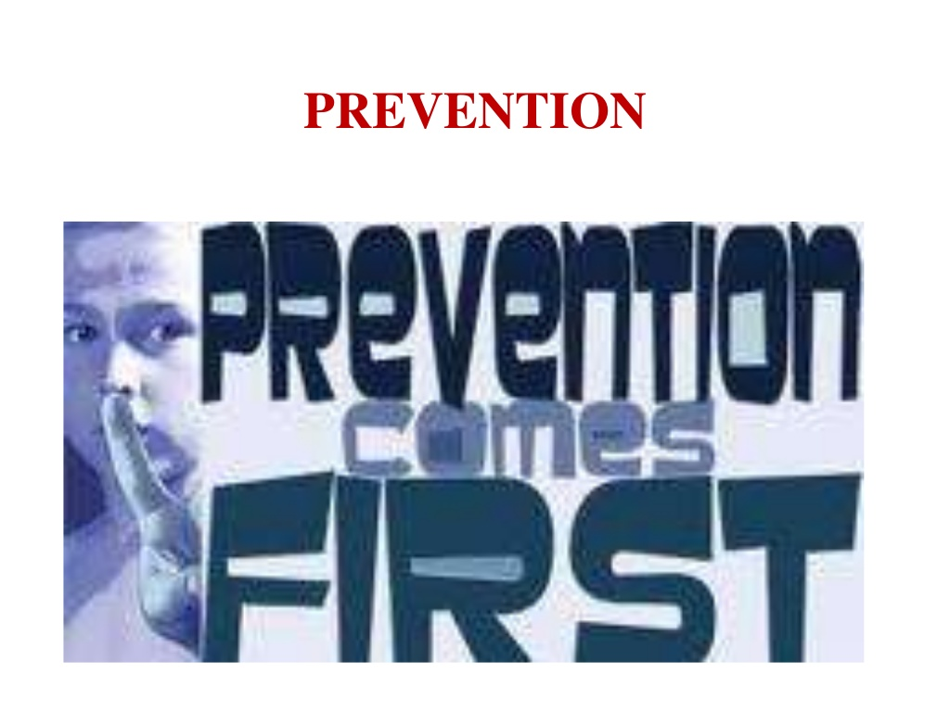

Slide 46
To Be Continued…
Thank You

Slide 47
RHINITIS
DEFINITION:
Rhinitis is a reaction that occurs in the eyes, nose and throat when airborne irritants (allergens) trigger the release of histamine. Histamine causes inflammation and fluid production in the fragile linings of nasal passages, sinuses, and eyelids.

Slide 48
TYPES
ALLERGIC RHINITIS
Seasonal
Perennial
NON ALLERGIC RHINITIS
vasomotor rhinitis (irritant rhinitis)
Eosinophilic
rhinitis medicamentosa
neutrophilic rhinosinusitisnial

Slide 49
CAUSES
Allergic rhinitis is a very common cause of rhinitis
Seasonal allergic rhinitis (hay fever) is usually caused by pollen in the air, and sensitive patients have symptoms during peak times during the year.

Slide 50
CAUSES CN’TD…
Perennial allergic rhinitis, a type of chronic rhinitis is a year-round problem, and is often caused by indoor allergens (particles that cause allergies), such as dust and animal dander in addition to pollens that may exist at the time.
Symptoms tend to occur regardless of the time of the year.

Slide 51
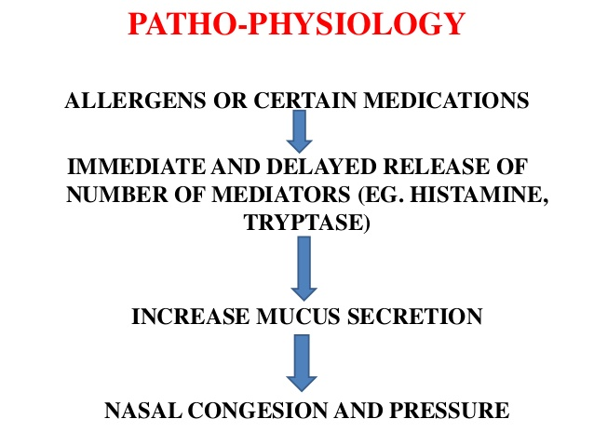

Slide 52
SIGN AND SYMPTOMS
Itchy nose, mouth, eyes, throat, skin, or any area
Problems with smell
Runny nose
Sneezing
Tearing eyes

Slide 53
Symptoms that may develop later include:
Stuffy nose(nasal congestion)
Coughing
Clogged ears and decreased sense of smell
Sore throat
Puffiness under the eyes
Fatigue and irritability

Slide 54
Investigations and Diagnosis
Nasal endoscopy
Imaging studies: Imaging studies such as CT scan are not routinely required for the diagnosis of rhinitis. However, a CT scan may be required when further evaluation is needed, such as in cases of complicated rhinosinusitis or when other pathological conditions are suspected.
Nasal and sinus cultures
X- ray study: A Chest x ray is not indicated for the diagnosis of rhinitis. However, it may be necessary in the evaluation of associated co-morbid conditions

Slide 55
Steroid nasal sprays
Examples of the nasal steroids include:
beclomethasone,
flunisolide,
budesonide,

Slide 56
Antihistamines
Antihistamines are drugs that block the histamine reaction.
These medications work best when given prior to exposure.
Eg.Sedating or first generation [diphenhydramine, chlorpheniramine, clemastine].
Non-sedating or second generation [loratadine, cetirizine].

Slide 57
Decongestant sprays
Examples of decongestant sprays include:
oxymetazoline, and
phenylephrine

Slide 58
Oral decongestants
Oral decongestants temporarily reduce swelling of sinus and nasal tissues leading to an improvement of breathing and a decrease in obstruction.
The most common decongestant is pseudoephedrine.

Slide 59
Cromolyn sodium
Cromolyn sodium (Nasalcrom) is a spray helps to stabilize allergy cells (mast cells) by preventing release of allergy mediators, like histamine.

Slide 60
Montelukast
Montelukast is an agent that acts similar to antihistamine, although it is involved in another pathway in allergic response.

Slide 61
Ipratropium
Ipratropium (Atrovent nasal) is used as a nasal spray and helps to control nasal drainage mediated by neural pathways.
It will not treat an allergy, but it does decrease nasal drainage.

Slide 62
Mucus thinning agents
Mucus thinning agents are utilized to make secretions thinner and less sticky.
They help to prevent pooling of secretions in the back of the nose and throat where they often cause choking.
The thinner secretions pass more easily.
Guaifenesin is a commonly used formulation.

Slide 63
Allergy shots (Immunotherapy)
Allergy shots interfere with the allergic response.
After identification of an allergen, small amounts are given back to the sensitive patient

Slide 64
SURGICAL MANAGEMENT
Septal deviation, septal spurs, septal perforation, enlargement of the turbinates, and nasal/sinus polyps can lead to pooling of or overproduction of secretions, blockage of the normal pathways leading to chronic sinusitis, and chronic irritation.
The surgery is performed by an ear-nose- throat doctor (otolaryngologist).

Slide 65
EPIGLOTTITIS
DEFINITION:
Epiglottitis is inflammation of the tissue that covers the trachea (windpipe).
It is a life-threatening disease.

Slide 66
Causes of Epiglottitis
Various organisms that can cause Epiglottitis include Streptococcus pneumonie, Haemophilus parainfluenzae, varicella-zoster, herpes simplex virus type 1, and Staphylococcus aureus, among others.
Heat damage that results in epiglottitis is also known as thermal epiglottitis.

Slide 67
Signs & Symptoms of Epiglottitis
Severe sore throat
Difficult and painful swallowing
Drooling due to severe pain when swallowing
A muffled or hoarse voice
Harsh, raspy breathing
Difficulty breathing
Blue skin or lips

Slide 68
DIAGNOSTIC FINDINGS
Blood culture or throat culture
Complete blood count (CBC)
Neck x-ray

Slide 69
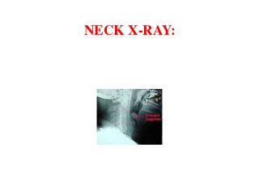
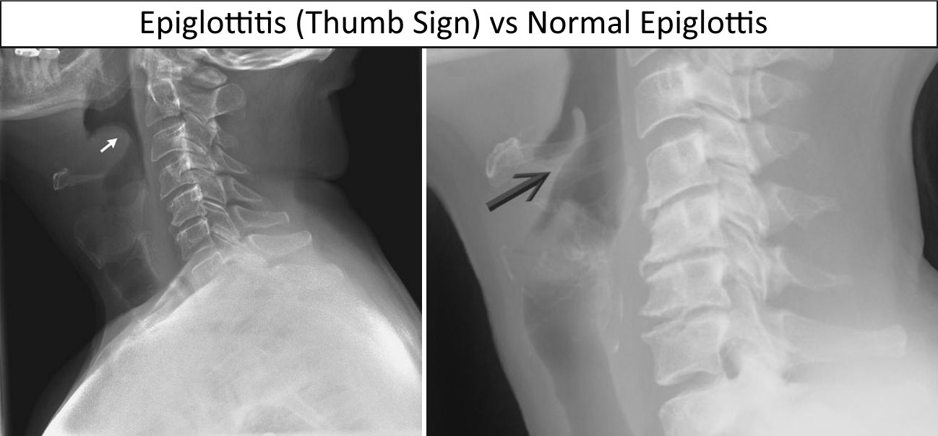

Slide 70
Medical Treatment
Antibiotics: like ampicillin/sulbactam, amoxicillin/clavulanic acid or cephalosporin group of drugs like ceftriaxone (given intravenously), cefuroxime (can be given both intravenously and orally) and cefotaxime (given intravenously).
Corticosteroids and epinephrine

Slide 71
Complications
Meningitis
Epiglottic abscess
Cervical adenitis
Vocal granuloma

Slide 72
LARYNGITIS
DEFINITION:
Laryngitis is swelling and irritation of the voice box that is usually associated with hoarseness or loss of voice.

Slide 73
RISK FACTORS
SMOKING
OVERUSING YOUR VOICE
HAVING UPPER RESPIRATORY INFECTION LIKE A COLD , FLU OR BROCHITIS

Slide 74
CAUSES
Overuse of voice
Allergies
Bacterial infection
Bronchitis
Gastroesophageal reflux disease (GERD)
Injury
Irritants and chemicals

Slide 75
SIGN AND SYMPTOMS
Hoarseness
Loss of voice
Tickling and scratchiness in your throat
A constant urge to clear your throat •
Dry throat or cough •
Fever, general feeling of lethargy and tiredness, and difficulty breathing are indications of more severe cases

Slide 76
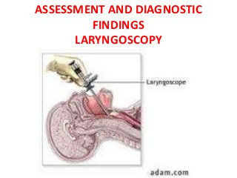

Slide 77
Other Investigations:
Chest and neck x rays
biopsy

Slide 78
MEDICAL MANAGEMENT
STEROIDS
E.g. prednisolon, dexamethasone
It is given either by intramuscular route or orally
Antibiotics:

Slide 79
SURGICAL MANAGEMENT
LASER VAPORIZATION
LAPAROSCOPIC ANTIREFLUX SURGERY

Slide 80
PHARYNGITIS
DEFINITION
Pharyngitis is inflammation of the pharynx, which is in the back of the throat. It's most often referred to simply as “sore throat.”
TYPES:
ACUTE PHARYNGITIS
CHRONIC PHARYNGITIS

Slide 81
CAUSES
Most sore throats are caused by viruses, although a few are due to bacterial infections.
Viruses that can cause sore throat include the common cold, the flu, and mononucleosis (often called "mono").
Bacteria like Group A streptococcus (commonly known as strep throat) can also cause pharyngitis.

Slide 82
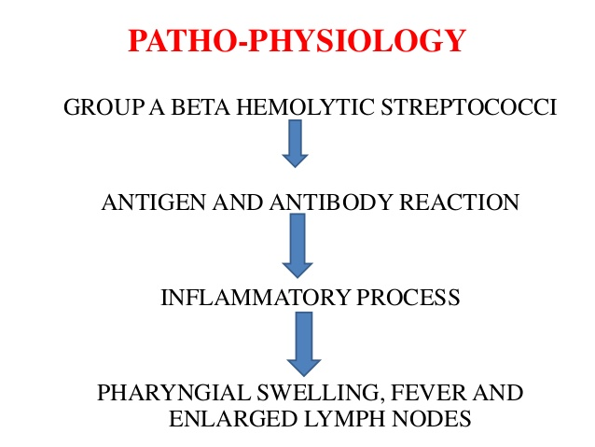

Slide 83
Risk Factors
Cold and flu seasons
Having close contact with someone who has a sore throat or cold
Smoking or exposure to second hand smoke
Frequent sinus infections
Allergies

Slide 84
Signs and Symptoms
Sore throat with cold
Sneezing
Cough
A low fever
Mild headache
Sore throat with flu
Fatigue
Enlarged lymph nodes in neck and armpits
Swollen tonsils
Loss of appetite

Slide 85
DIAGNOSTIC FINDINGS
Tests that may be done include:
Blood culture or throat culture
Complete blood count (CBC)
Neck x-ray

Slide 86
COMPLICATION
Abscess around the tonsils or in the back of the throat
Blockage of the airway
Rheumatic fever (complication of strep throat)
Sepsis (life-threatening bacterial blood infection)
Spread of infection

Slide 87
MEDICAL MANAGEMENT
Antibiotics used to treat pharyngitis:
Amoxicillin
Penicillin

Slide 88
Analgesics used to treat pharyngitis
E.g.
Acetaminophen
Ibuprofen

Slide 89
TONSILLITIS
DEFINITION:
Tonsillitis is an inflammation of the tonsils most commonly caused by viral or bacterial infection.

Slide 90
CAUSES
Inflammation of the tonsils may result from bacterial or viral infections.
Bacterias: Tonsillitis is often caused by Group A streptococcal bacteria, resulting in strep throat.
Virus: Tonsillitis may be caused by viruses such as the Epstein-Barr virus (cause of glandular fever) or the Coxsackie virus

Slide 91
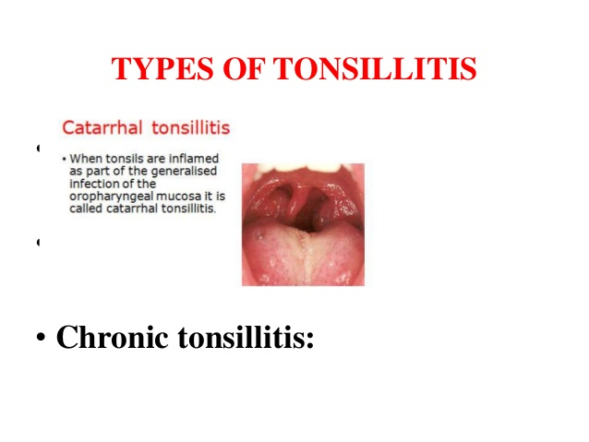

Slide 92
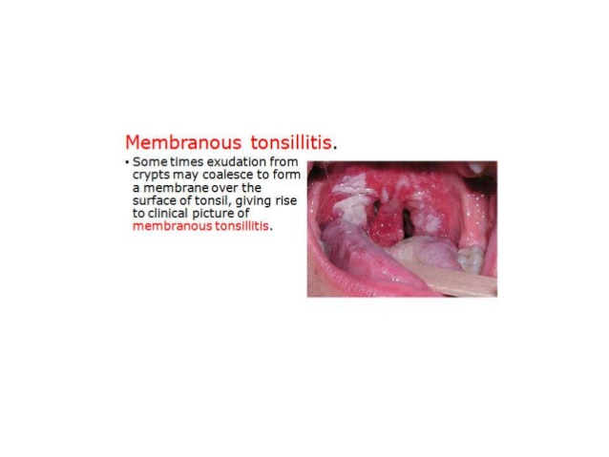

Slide 93
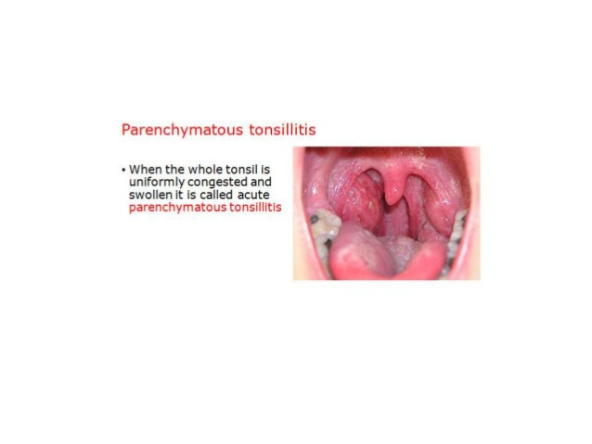

Slide 94
Signs and symptoms
Difficulty in swallowing
Change in voice
Hoarseness
Bad breath
Cough and nasal congestions
Headache
Sore glands in throat
Pain in throat and sore throat
Tonsils coated with white or yellow patches
Difficult breathing because of swollen tonsils
Red and sore tonsils
Sore eyes
Body aches
Chills

Slide 95
ASSESSMENT AND DIAGNOSTIC FINDINGS
Blood count
Mononucleosis test
The mononucleosis spot test looks for two antibodies in the blood that indicate infection with the Epstein- Barr virus (EBV).

Slide 96
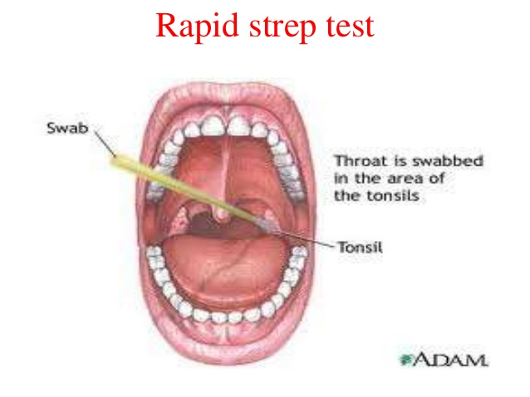

Slide 97
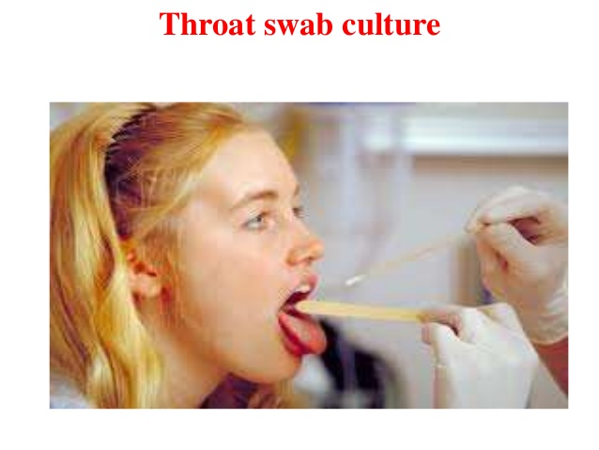

Slide 98
MEDICAL MANAGEMENT
NSAIDs, Paracetamol/Acetaminophen, Ibuprofen
If tonsillitis is caused by Group A Beta-Hemolytic Streptococci, antibiotics like penicillin, amoxicillin, erythromycin, or clindamycin
Rest
Hydration
Anti-inflammatory, pain relief, and fever tackling medicines such as ibuprofen, acetaminophen, and aspirin

Slide 99
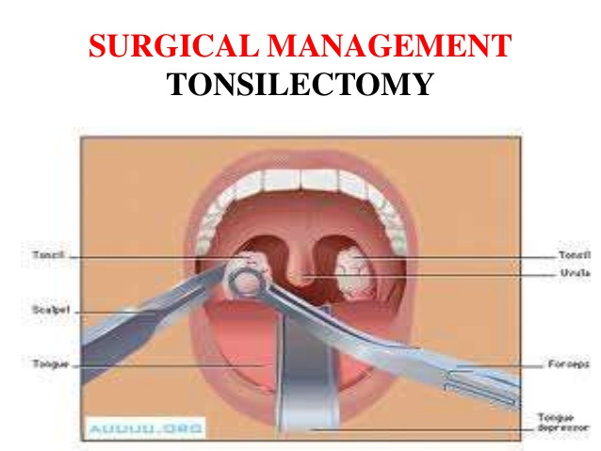

Slide 100
COMPLICATIONS
Peritonsillitis or Peritonsillar abscess
Acute Suppurative cervical lymphadenitis
Acute gangrenous tonsillitis
Edema of the larynx
Septicaemia

Slide 101
READ:
Peritonsillar Abscess or Quinsy
Adenoids

Slide 102
End of Presentation
Thank You

