Slide 1
Current Update on the 6th Edition 2020 Guidelines for
The Diagnosis, Treatment and Prevention of malaria in Kenya
Notes:
Self introduction
Purpose of the presentation.

Slide 2
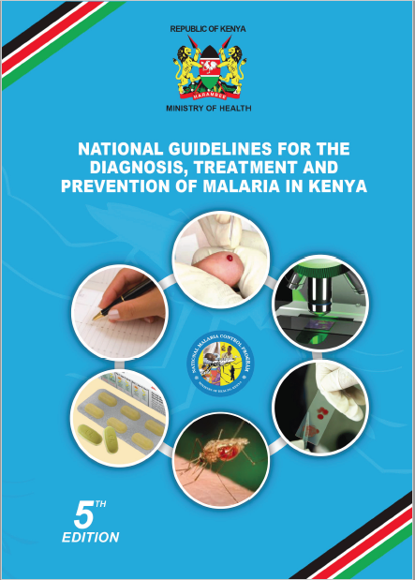
Cover page
The sixth edition of the guidelines contains new information in line with the KMS 2019-2023 and the revised WHO guidelines (3rd edition)
The guideline document is intended to serve as a guide to all health professionals both pre- and in-service, in the private sector, researchers, trainers in medical training institutions and all partners involved in the implementation of malaria control and prevention activities in Kenya.

Slide 3
  Chapter 1 - Introduction
Goal
To reduce malaria incidence and deaths by at least 75 percent of the 2016 levels by 2023 in Kenya.
The purpose of malaria control is to reduce morbidity and prevent mortality due to malaria thereby mitigating the socio-economic burden of the disease on Kenya.
Objective of the guidelines
To provide the target audience with evidence-based recommendations for the treatment and prevention of malaria.
Target Audience
All healthcare professionals, public health and policy specialists working in hospitals, research institutions, medical schools, non- governmental organizations and agencies working as partners in health or malaria programs
Diagnosis Based Treatment
Diagnosis of malaria is based on detection of parasites and parasite products in the blood
The two methods used routinely for parasitological diagnosis of malaria are microscopy and RDTs.
Formulations
Only ACTs that are co-formulated (both medicines combined in the same tablet) should be used for the treatment of uncomplicated malaria in Kenya.
Injectable formulations (artesunate and quinine) are the recommended formulations for treatment of severe malaria

Slide 4
Chapter 1 - Background
Interventions to manage malaria in Kenya have been integrated
5th edition
6th edition
Core interventions
Provision of prompt and effective treatment or malaria case management
Prevention and treatment of malaria in pregnancy
Vector control using long lasting insecticidal nets, indoor residual spraying and other integrated vector management strategies
Epidemic preparedness and response
Cross-cutting interventions
Advocacy, communication and Social mobilization
Monitoring and Evaluation
Core interventions
Provision of prompt diagnosis and effective treatment of malaria
Prevention and treatment of malaria in pregnancy
Vector control using
  Long Lasting insecticidal nets, indoor residuals praying.
  LSM and other integrated vector management strategies
Malaria Elimination
  Active case detection, notification, investigation, and response system(s) for elimination in targeted counties
  Strengthen malaria surveillance and use of the information
Strengthen Social Behavioural Change
Monitoring and Evaluation

Slide 5
Chapter 2 – Malaria in Kenya
Epidemiology of Malaria In Kenya
Kenya has four malaria epidemiological zones,
Endemic: Areas of stable malaria around Lake Victoria in western Kenya and in the coastal regions.
Seasonal transmission: Arid and semi-arid areas of northern and south-eastern parts of the country experience short periods of intense malaria transmission
Epidemic prone areas of western highlands of Kenya: Malaria transmission in the western highlands of Kenya is seasonal, with considerable year-to-year variation. Epidemics are experienced when climatic conditions favour sustainability of minimum temperatures around 18°C.
Low risk malaria areas: This zone covers the central highlands of Kenya including Nairobi. The temperatures are usually too low to allow completion of the sporogonic cycle of the malaria parasite in the vector.
The epidemiological zones are used to select appropriate interventions
Malaria Control Interventions (KMS 2019-2023)

Slide 6
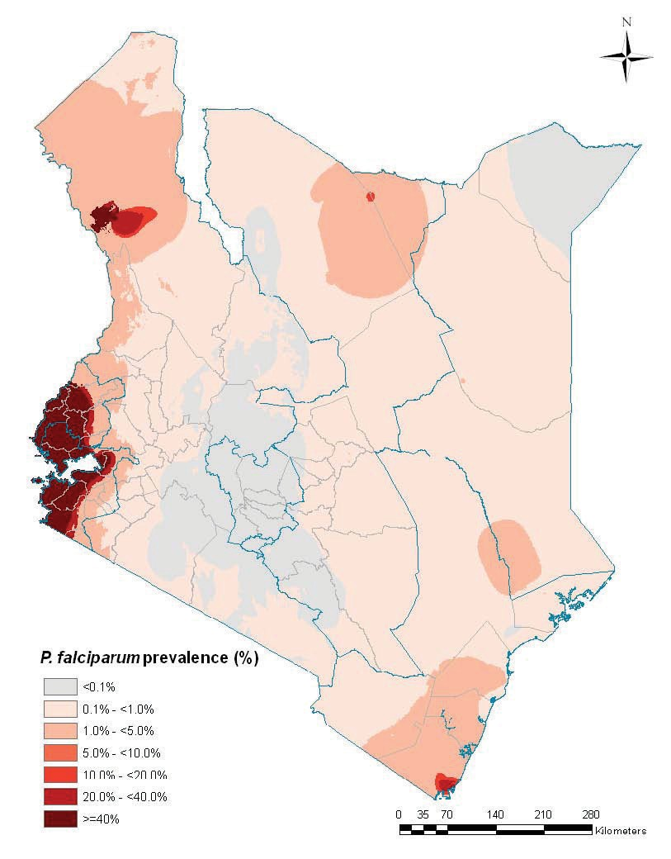
Chapter 2 – Malaria in Kenya
Illustration of Malaria endemicity in Kenya
5th edition
6th edition
In 2009, a model-based map of the intensity of p. falciparum transmission in Kenya
Malaria endemicity by zone

Slide 7
Chapter 3 - Clinical features and classification of malaria
Test all suspected cases.
Treat all malaria test positive cases according to the guidelines.
Track all testing and treatment information through recording in relevant registers.
5th edition
6th edition
Classification of malaria
Uncomplicated
  This is characterized by fever in the presence of peripheral parasitaemia. Other features may include chills, profuse sweating, muscle pains, joint pains, abdominal pain, diarrhoea, nausea, vomiting, irritability and refusal to feed. These features may occur singly or in combination.
Severe
  This is a life-threatening manifestation of malaria, and is defined as the detection of P. falciparum in the peripheral blood in the presence of any one or more of the clinical or laboratory features
Introduction to malaria life cycle
Classification of malaria
  Uncomplicated
  This is characterized by fever in the presence of peripheral parasitaemia. Other features may include chills, profuse sweating, muscle pains, joint pains, abdominal pain, diarrhoea, nausea, vomiting, irritability and refusal to feed. These features may occur singly or in combination.
Severe
  This is a life-threatening manifestation of malaria, and is defined as the detection of P. falciparum in the peripheral blood in the presence of any one or more of the clinical or laboratory features

Slide 8
Chapter 4 - Parasitological diagnosis of malaria
Routine Diagnosis:
Microscopy (higher level facilities)
Rapid Diagnostic Test kits (Community, Dispensary and Health Centre)
NB
There is no need to confirm an initial mRDT Positive with microscopy.
Microscopy should be used for all treatment follow up.
5th edition
6th edition
Microscopy
  To detect parasites, identify species, quantify parasites
RDTs
  To detect cell products (HRP2, pLDH) due to infection
Other diagnostic tests
Microscopy expanded to include
  QA – slide rechecking and proficiency testing
  Microscopy procedures
RDTs expanded to include
  Gene deletion
Other diagnostic tests expanded to include
  Parasite culture
Biosafety during testing introduced

Slide 9
Chapter 5 - Management of uncomplicated malaria
Treat as an outpatient case with oral ACTs or oral quinine in 1st trimester in pregnancy
The recommended first line treatment for uncomplicated malaria in Kenya is Artemether-Lumefantrine (AL).
  It is currently available as a co-formulated tablet containing 20mg of Artemether and 120mg of Lumefantrine.
  Child friendly dispersible tablets are also available.
5th edition
6th edition
Dosing schedule for AL
Dosing schedule for AL
Weight | Age
5 to <15kg | ^{5 months to <3 years}
15 to <25kg | ^{3 to <8 years}
25 to <35kg | ^{8 to <12 years}
≥35kg | ^{≥12 years}
Weight | Age in years
5 - 14 kg | 5 months - <3years
15 - 24 kg | 3 – 7years
25 - 34 kg | 8 – 11years
Above 35 kg | ≥12years

Slide 10
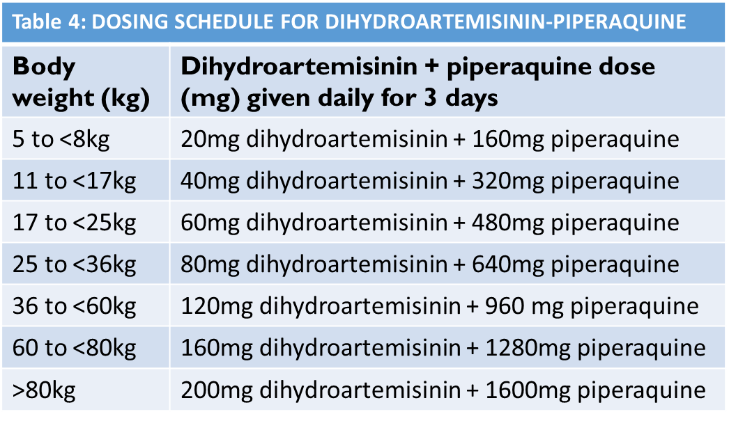
  Chapter 5 - Management of uncomplicated malaria: Treatment failure
Treatment failure defined as a failure to achieve the desired therapeutic response after the initiation of therapy
Suspected if a patient deteriorates clinically at any time or symptoms persists 3-14 days after initiation of drug therapy
The recommended drug is Dihydroartemisinin + piperaquine (DHAP)
5th edition
6th edition
Management of suspected treatment failure
Second line treatment in adults and children of all age groups
Body weight (kg) | Dihydroartemisinin + piperaquine dose (mg) given daily for 3 days
5 to <8 | 20 + 160
8 to <11 | 30 + 240
11 to <17 | 40 + 320
17 to <25 | 60 + 480
25 to <36 | 80 + 640
36 to <60 | 120 + 960
60 <80 | 160 + 1280
>80 | 200 + 1600

Slide 11
Chapter 6 : Severe Malaria I
Overview & Presentation
Signs & Symptoms in Adults /Children
Medical emergency, risk for death from severe malaria is greatest in the first 24 hours,
Managed in a facility with inpatient services.
In the absence of this, pre-referral management should be initiated and patients referred
Common presentations : severe anemia, respiratory distress and cerebral malaria. Severe malaria can occur in the absence of fever.
Treatment :
  Recommended treatment for severe malaria is parenteral Artesunate.
  Quinine can be used when there is no artesunate
Sign or symptom | Adults | Children
Duration of illness | 5-7 days | Shorter (1-2 days)
Respiratory distress/ deep breathing (acidosis) | Common | Common
Convulsions | Common (12%) | Very common (30%)
Posturing (decorticate/decerebrate and opisthotonic rigidity) | Uncommon | Common
Prostration/obtundation | Common | Common
Resolution of coma | 2-4 days | Faster (1-2 days)
Neurological sequelae after cerebral malaria | Uncommon (1%) | Common (5-30%)
Jaundice* | Common | Uncommon
Hypoglycaemia* | Less common | Common
Metabolic acidosis* | Common | Common
Pulmonary oedema | Uncommon | Rare
Renal failure* | Common | Rare
CSF opening pressure* | Usually normal | Usually raised
Bleeding/clotting disturbances* | Up to 10% | Rare
Invasive bacterial infection (co-infection)* | Uncommon (<5%) | Common (10%)

Slide 12
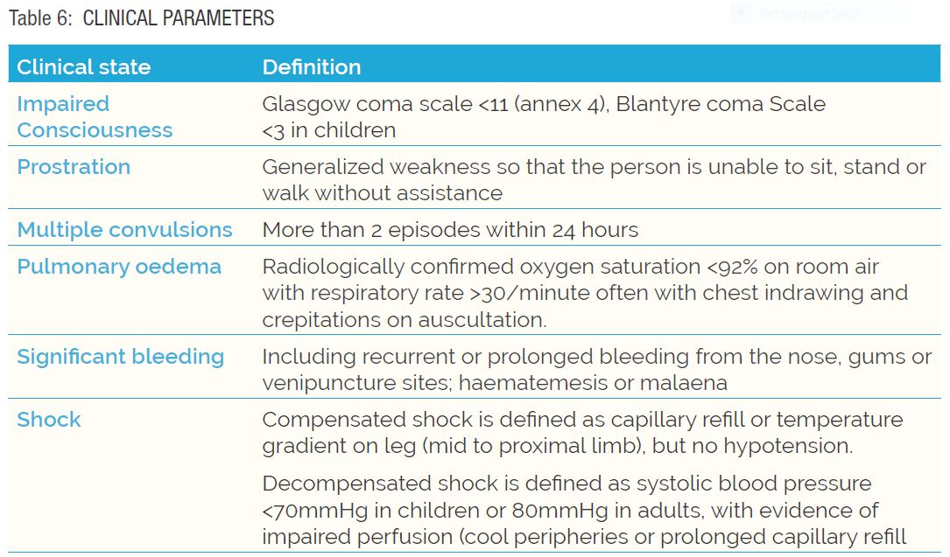
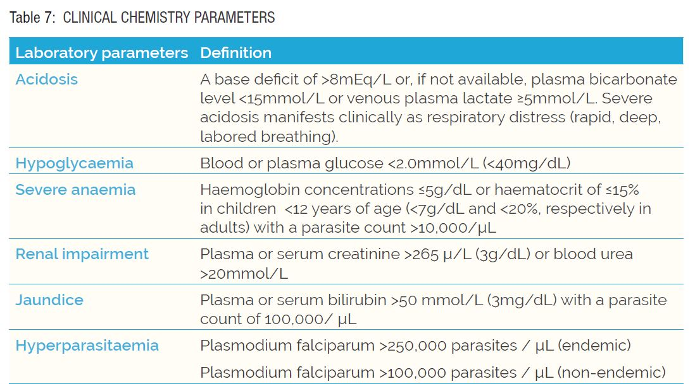
Chapter 6 : Severe Malaria II
Definition of Clinical presentation
Definition of Clinical chemistry presentation

Slide 13
Chapter 6 - Management of severe malaria
This is a life-threatening manifestation of malaria, mostly due to P. falciparum
Severe malaria is a medical emergency and should be managed in a facility with inpatient services.
In the absence of this, pre-referral management should be initiated and patients referred for inpatient management.
The recommended treatment for severe malaria is parenteral artesunate.
  The preferred route of administration is intravenous (IV). However intramuscular (IM) can be used as an alternative where the intravenous route is not feasible.
  In the absence of artesunate, parenteral quinine or IM artemether should be administered.
5th edition
6th edition
Administer artesunate as follows:
Dosage:
  For children: ≤20kg administer 3.0 mg/kg
  For other patients >20kg administer 2.4 mg/kg
  A dosing schedule for parenteral artesunate-based on body weights and dose (ml)
Dosage and administration of artesunate:
Dosage:
  For children: ≤20kg administer 3.0 mg/kg
  For other patients >20kg administer 2.4 mg/kg
  A dosing schedule for parenteral artesunate-based on body weights and dose (ml)

Slide 14
Treatment of Severe Malaria
Pre-Referral Management
Begin in the primary health facility (while waiting for referral)
Broad spectrum parenteral antibiotics (preferably IV Ceftriaxone) in altered consciousness + antimalarials
Pre-Referral Treatment:
IM artesunate continues until the patient PHYSICALLY moves to another facility.
or
Intramuscular Quinine if artesunate is not there
MUST be diluted (maximum concentration is 100mg/ml for adults, and 50mg/ml for children) before intramuscular injection.
Rectal artesunate: <6yrs
Artemether: STAT dose of 3.2mg/kg

Slide 15
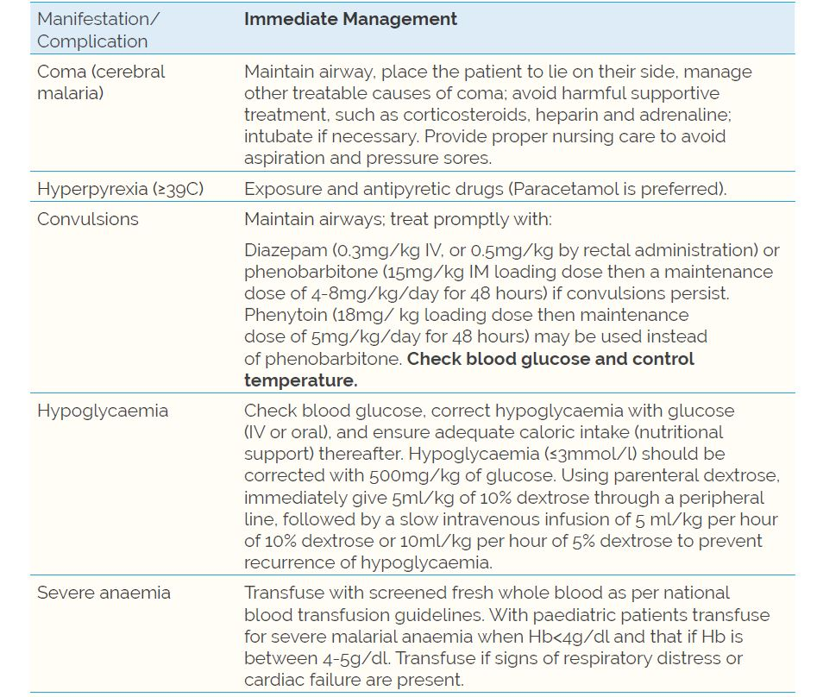
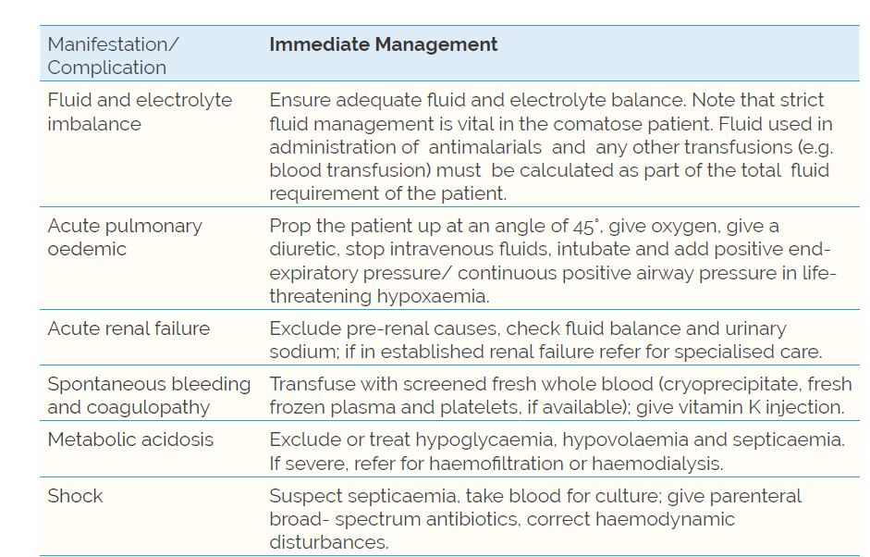
Chapter 6 : Severe Malaria III
SUPPORTIVE TREATMENT FOR MANIFESTATIONS OF SEVERE MALARIA
*crucial in reducing the high mortality associated with severe malaria.

Slide 16
Chapter 7 - Malaria in pregnancy
Management of Uncomplicated Malaria in Pregnancy
TYPE OF MALARIA | SIGNS AND SYMPTOMS USUALLY PRESENT | SIGNS AND SYMPTOMS SOMETIMES PRESENT
Uncomplicated malaria | Fever shivering/ chills/ rigors Headache, muscle/joint pain nausea and vomiting, False labor pain (uterine contractions) | Enlarged spleen
First trimester
The recommended treatment for uncomplicated malaria in the first trimester is a 7-day therapy of oral quinine.
Do not withhold Artemether-lumefantrine or any other treatment in the 1st trimester if quinine is not available.
Second and third trimesters
AL is the recommended treatment in the 2nd and 3rd trimesters.

Slide 17
Chapter 7 - Malaria in Pregnancy
TYPE OF MALARIA | SIGNS AND SYMPTOMS USUALLY PRESENT | SIGNS AND SYMPTOMS SOMETIMES PRESENT
Severe | Convulsions, Severe jaundice, Signs of severe dehydration, especially if woman has been vomiting repeatedly, Sudden weight loss, Sunken eyes, Reduced skin turgor, Dry mouth, Reduced amount of urine or no urine at all, Spontaneous bleeding from the gums, skin and vein puncture sites | Confusion, drowsiness, coma, Fast breathing/ breathlessness/difficulty in breathing ,Vomiting at every feed or unable to feed, Pale conjuctivae, mucous membranes, tongue and palms, Jaundice
Management of severe malaria in pregnancy
This is a life-threatening manifestation of malaria, and is defined as the detection of P. falciparum in the peripheral blood in the presence of any one or more of the clinical or laboratory features
Severe malaria in pregnancy is a medical emergency. Aggressive management is essential.
The recommended drug for severe malaria is parenteral artesunate. Quinine may be uses if artesunate is not available
NB - Pregnant women have an increased risk of quinine induced hypoglycaemia

Slide 18
Chapter 7 – Malaria in pregnancy:
Intermittent Preventive Treatment of malaria in pregnancy (IPTp)
ANC package for prevention of malaria in pregnancy
  Intermittent Preventive Treatment of malaria in pregnancy (IPTp).
  Long lasting Insecticidal Nets.
  Provision of prompt diagnosis and treatment of malaria.
  Health promotion.
5th edition
6th edition
The current recommended medicine for IPTp
of sulphadoxine 500mg and pyrimethamine
25mg (SP).
IPTp is recommended in areas of high malaria transmission.
Administer IPTp with each scheduled visit after quickening to ensure women receive a minimum of 3 doses.
IPTp should be given at an interval of at least 4 weeks (1 month).
The current recommended medicine for IPTp
of sulfadoxine 500mg and pyrimethamine 25mg
(SP).
IPTp is recommended in moderate and high malaria transmission areas.
Administer IPTp with each scheduled visit from 13 weeks of pregnancy to ensure women receive a minimum of 3 doses.
IPTp should be given at an interval of at Least 4 weeks apart according to the IPTp schedule (Annex 10.6).
,

Slide 19
Chapter 8 - Basic techniques in managing malaria medicines
Chapter 8 - Basic principles in managing malaria commodities
5th edition
6th edition
CONCEPT OF ESSENTIAL DRUGS
The WHO defines essential drugs as those that satisfy the health care needs of the majority of the population; they should therefore be available at all times in adequate amounts and in appropriate dosage forms, at a price the community can afford. Antimalarials are “essential medicines”.
Pharmaceutical management
Pharmaceutical management is a set of practices aimed at ensuring the timely availability and appropriate use of safe, effective, quality medicines and related products and services in any health-care setting.
The Pharmaceutical Management Cycle7
The Pharmaceutical Management Cycle is a systematic approach to ensure that medicines at all levels of health care delivery are consistently available and appropriately used. It emphasizes the connections between four drug management activities - selection, procurement, distribution and use. The cycle is depicted below:
8.1 Introduction
Health commodities required for the management of malaria include those for prevention. diagnosis and treatment of malaria. For case management of malaria. the commodities required are as follows:
  Prevention: sulfadoxine + pyrimethamine tabs, proguanil. mefloquine. Long Lasting insecticidal nets CLLINs)
  Diagnosis: malaria rapid diagnostic tests CRDTs), microscopy reagents
  Treatment: artemether + lumefantrine tablets
Commodity management (Managing Access to medicines and health technologies)
Commodity management is a set of practices aimed at ensuring the timely availability and appropriate use of safe, effective, quality products in any health-care setting.
The Commodity Management Cycle is a systematic approach to ensure that medicines at all Levels of health care delivery are consistently available and appropriately used. It emphasizes the connections between four drug management activities - selection, procurement, distribution and use. The cycle is depicted below:

Slide 20
Chapter 8 - Basic techniques in managing malaria medicines
Chapter 8 - Basic principles in managing malaria commodities
5th edition
6th edition

Slide 21
Chapter 8 - Basic techniques in managing malaria medicines
Chapter 8 - Basic principles in managing malaria commodities
5th edition
6th edition
8.2.4.1 Ordering
The facility should order supplies periodically from the central medical store using a standard order form. The formula below is used to derive the amount of medicines to order:
8.2.4.2 Receiving
The facility should counter-check commodities received against the standard order form and delivery note, and record the receipts on a stock/bin card.
8.5.2.1 Ordering
The facility should order commodities quarterly from KEMSA through the LMIS.
The LMIS is Linked to the KHIS.
Consumption data is used to derive reorder quantities using the formula:
Quantity to Order = Average Monthly Consumption x review period in months Less stock on hand
8.5.2.2 Receiving
Commodities should be received by a designated health facility staff
Counter-check commodities received against what was ordered and what is on the delivery note.
Accurately recorded in the stock card.

Slide 22
Chapter 8 - Basic techniques in managing malaria medicines
Chapter 8 - Basic principles in managing malaria commodities
5th edition
6th edition
8.2.4.3 Storage
Malaria medicines and commodities such as RDTs should be stored under optimal conditions to ensure their safety and efficacy in accordance with the principles of good storage practices:
  Good arrangement.
  Quality maintenance (appropriate temperature, light and humidity).
  Assured security.
  Good inventory control and stock rotation (First in First Out/First Expiry First Out).
  Good record keeping.
8.5.2.3 Storage (WHO Good storage practices)
Commodities should be stored under optimal conditions :
  Proper arrangement, Quality maintenance, Assured security
Good inventory control and stock rotation (First in First Out/ First Expiry First Out)
Good record keeping
Regular stock counts
Disposal of unusable stock should be carried out according to the guidelines for disposal of pharmaceuticals safety guidelines for medical waste.

Slide 23
Chapter 8 - Basic principles in managing malaria commodities:
Flow of logistics management information
5th edition
6th edition
Figure 3: Flow of logistics management information

Slide 24
Chapter 8 - Basic principles in managing malaria commodities: Reverse Logistics
6th edition
Reverse logistics is the process of moving M/Commodities from health facilities back to the supplier or KEMSA in order to recapture value or dispose properly.
Reverse logistics may be applied for suspected poor-quality medicinal products and LLINs at the peripheral facilities. (KEMSA has a well -defined process for this).
Expired commodities should be disposed off by the county authorities in accordance with the relevant Laws and guidelines.
In the event that funds are available at national Level to support reverse logistics, KEMSA will Liaise with the DNMP and the various county pharmacists to implement this.

Slide 25
Chapter 8 - Basic principles in managing malaria commodities: Quality Assurance
6th edition
Quality assurance is a wide-ranging concept covering all matters that influence the quality of a product:
  development, quality control, production, distribution, and inspections.
Several activities are carried out to ensure that the quality of malaria commodities is maintained from
  procurement through storage and distribution to the last point of use.
During procurement, all commodities should have documentation from
  the relevant regulatory authority e.g. Good Manufacturing Practices (GMP)
  from manufacturing sites
  registration and retention certifications from PPB for medicines.
Delivery, inspection and testing is done at KEMSA.
At predetermined intervals, the commodities are sampled randomly during storage
Once in a year,
  post marketing surveillance (PMS) is done jointly across the country in public health facilities.
  Feedback is given by the PPB to health facilities thereafter and any findings used for improvement.

Slide 26
Chapter 8 - Basic principles in managing malaria commodities: Pharmacovigilance
Pharmacovigilance is collecting, monitoring, researching, assessing and evaluating information from healthcare providers and patients on the adverse effects of medicines, biological products, herbals and traditional medicines, with the view to identifying new information about hazards, and preventing harm to patients.
5th edition
6th edition
Counterfeit
WHO defines a counterfeit pharmaceutical product as a product that is deliberately and fraudulently mislabeled with respect to identity and or source.
8.8.3 Poor quality medicinal products (PQMPs)
Substandard/ Spurious/ Falsely labelled/ Falsified and Counterfeits (SSFFCs) medicines are a global health problem.
Any suspected poor-quality medicinal products should be reported to the PPB.
Suspicion of poor quality may arise from physical examination of a product (e.g. discoloration, disintegration of tablets) or observation of lack of efficacy with a given batch of medicines.

Slide 27
Chapter 9 - Other topical issues in malaria prevention and control
Chapter 9 - Malaria prevention
5th edition
6th edition
CHEMOPROPHYLAXIS FOR NON-IMMUNE POPULATIONS
VECTOR CONTROL
EPIDEMIC PREPAREDNESS AND RESPONSE
PREVENTION OF MALARIA INFECTION THROUGH BLOOD TRANSFUSION
ADVOCACY COMMUNICATION AND SOCIAL MOBILIZATION
Annexed
VECTOR CONTROL
EPIDEMIC PREPAREDNESS AND RESPONSE
Annexed
Social Behaviour Change for Malaria

Slide 28
Chapter 9 - Other topical issues in malaria prevention and control
6th edition
9.1 Vector Control
Other methods such as Larval Source Management (LSM) may be useful in reduction of number of adult mosquitos emerging from breeding sites.
9.4. I Malaria Elimination
Malaria elimination is the interruption of Local transmission (reduction to zero incidences of indigenous cases) of a specified malaria parasite species in a defined geographical area as a result of deliberate activities.
In view of shrinking malaria burden, especially in low risk areas, the country, through DNMP will
  Establish requisite structures necessary to guide the implementation of malaria elimination in targeted counties by 2023
  Select counties for elimination will be based on malaria incidence in Low transmission zones.

Slide 29
Chapter 9 - Other topical issues in malaria prevention and control: Malaria Vaccine
6th edition
The malaria vaccine is one of the potential interventions intended to prevent malaria - specifically P. falciparum malaria, which is the most common and dangerous form of malaria in Kenya.
The objective of the vaccination is to provide protection to populations at risk as a complementary and potentially new intervention that will help reduce mortality and serious morbidity due to malaria.

Slide 30
ANNEX:10.6 SCHEDULE FOR IPTp PROVISION
6th edition
MOTHER & CHILD HEALTH HANDBOOK - 2020

Slide 31
Notes:
All we do is to achieve a malaria – free Kenya.
Invite brief Q&A.

