Slide 1
Vitamin A DEFICIENCY
HND OPHT/18001/014

Slide 2
INTRODUCTION
Vitamin A is a broad term for a number of similar compounds
Fast recognized fat soluble vitamin
Has two forms;
Preformed vitamin A : retinoids(from animals)
Provitamin A; carotenoids( predominantly beta-carotene from plants)

Slide 3
Preformed vitamin A- RETINOIDS
Active or usable forms
Four categories of retinoids
Retinoi
Retinal
Retinoic acid
Retinyln esters
All retinoids are absorbed as retinol
Sources;animal products like liver fish fish oils milk eggs etc
Liver is the richest source

Slide 4
PROVITAMIN A - CAROTENOIDS
Precursor of vitamin A
Predominantly beta carotene
Body has to convert it into active vitamin A after consumption
Sources;plant products like carrot green leafy vegetables papaya mango bringal
Notes:
Diatary vitamin a both plants and animal sourcres ,intestines bloodstream through intestinal lymphatics,
Most retinal reaches the liver ,,,hear 90% is stored as well
Its boud to a protein,,retinal protein
Rpe is the second only to liver in its concentration to vitamin A…it aquires from circulation,.via phagocytocis

Slide 5
ROLE OF VITAMIN A
.formation of rhodopsin – used in night vision
Maintance of healthy cornea and conjuctiva
Immune function; ensures working mucosal cells ,membranes and epithelial layers-;bodys first line defence, also aids in development of lymphocytes and white blood cells

Slide 6
Biochemical function of vitamin A
Vision in dim light
necessary for maintance of normal epithelium ;synthesis of goblet cells in epithelial tissue which secrete mucous having antimicrobial component
Embryonic development and reproduction; during fetal development, retinoic acid allows for development of lungs,hearts eyes and ears and regulates expression of growth hormone gene
Acts as an antioxidant; caretinoids oxidize free radicals and prevent free radical cellular damage that can lead to cancer and other diseases

Slide 7
VITAMIN A DEFICIENCY(xerophthalmia)
Xerophthalmia is a general term applied to all the ocular manifestations of impaired vitamin A metabolism, from night blindness through complete corneal destruction
Xeros-Dry
Opthalmia- eye
Literally means ‘dry eye’
It’s the leading preventable cause of blindness in children throughout the world
30% of world’s blindness due to nutritional corneal ulceration

Slide 8
VITAMIN A DEFICIENCY RISKS
PEM
Measles ,chickenpox ,high fevers
Bronchopneumonia ,tuberculosis, Diphtheria
Gastroenteritis, dysentery, worm infestations

Slide 9
VITAMIN A DEFICIENCY SYMPTOMS
The main symptom of vitamin A deficiency is vision loss and blindness.
Vision loss often begins as a problem adjusting to seeing in the dark, or night blindness.
People with night blindness do not see well in the dark, but are able to see normally if enough light is present. As the vitamin A deficiency worsens, the conjunctiva, the covering on the white of the eye that helps lubricate your eye, dries out, and corneal ulcers appear. The progression of the deficiency eventually leads to vision loss and blindness.

Slide 10
WHO CLASSIFICATION
XN Night blindness
X1A Conjunctival xerosis
X1B Bitot’s spots
X2 Corneal xerosis
X3A Corneal ulceration/keratomalacia affecting
less than one-third corneal surface
X3B Corneal ulceration/keratomalacia affecting
more than one-third corneal surface.
XS Corneal scar due to xerophthalmia
XF Xerophthalmic fundus

Slide 11
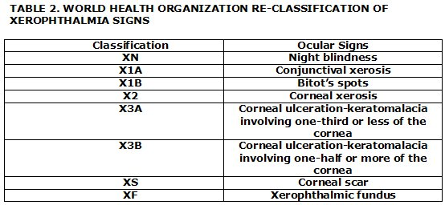

Slide 12
CLINICAL FEATURES OF XEROPHTHALMIA

Slide 13
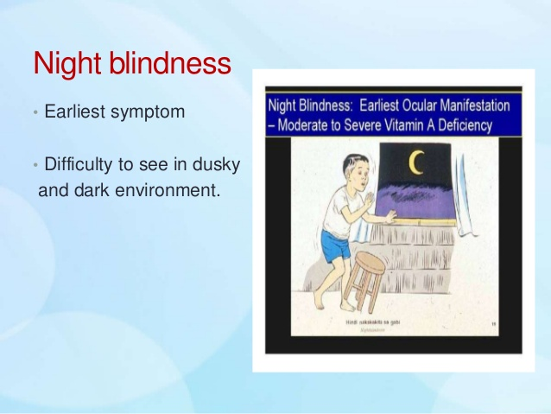
1. X N (night blindness)
It is the earliest symptom of xerophthalmia in children.
It has to be elicited by taking detailed history from the guardian or relative.

Slide 14
Insufficient vitamin a
Insufficuent rhodopsin production
Lack of functioning of rod cells
Brain doesn’t receive enough signals
Night blindness

Slide 15
2.X1A (conjunctival xerosis).
consists of one or more patches of dry, lustreless, nonwettable conjunctiva , well described as ‘emerging like sand banks at receding tide’ when the child ceases to cry.
patches almost always involve the inter-palpebral area of the temporal quadrants and often the nasal quadrants as well.
In more advanced cases, the entire bulbar conjunctiva may be affected. Typical xerosis may be associated with conjunctival thickening, wrinkling and pigmentation.
Due to loss of goblet cells and mucus

Slide 17
3. X1B (Bitot’s spots).
It is an extension of the xerotic process seen in stage X1A.
The Bitot’s spot is a raised, silvery white, foamy, triangular patch of
keratinised epithelium, situated on the bulbar conjunctiva in the inter-palpebral area
It is usually bilateral and temporal, and less frequently nasal.

Slide 18
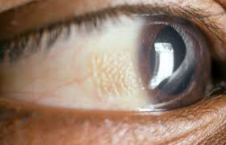

Slide 19
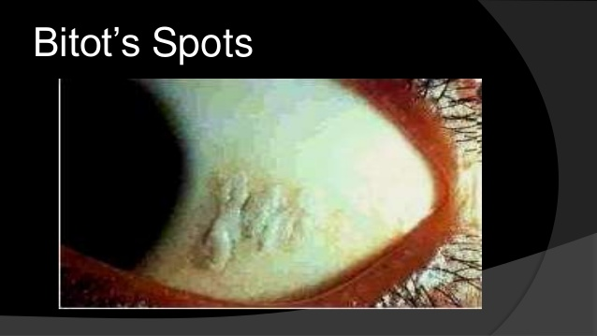
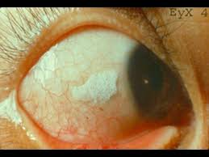

Slide 20
4. X2 (corneal xerosis).
The earliest change in the cornea is punctate keratopathy which begins in the lower nasal quadrant,
followed by haziness and/or granular pebbly dryness .
Involved cornea lacks lustre.

Slide 21
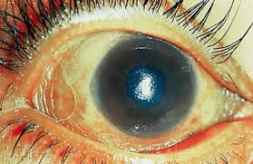

Slide 22
X3A and X3B (corneal ulceration/keratomalacia)
Infiltration of corneal stroma giving bluish hazy appearence
Characteristic liqifactive process called colliquative necrosis
Small ulcers (1-3 mm) occur peripherally;
they are characteristically circular, with steep margins and are sharply demarcated .
Large ulcers and areas of necrosis may extend centrally or involve the entire cornea.
If appropriate therapy is instituted immediately, stromal defects involving less than one-third of corneal surface (X3A) usually heal, leaving some useful vision. However, larger stromal defects (X3B) commonly result in blindness

Slide 23
Cont..
At first there is excavation of ulcer at the central part Then corneal perforation as the disease advances Iris prolapse And even loss of vitreous and extrusion of lens
When this whole process involves the cornea leads to Keratomalacia

Slide 24
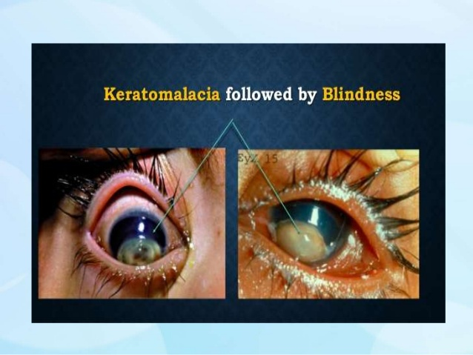

Slide 25
6.XS (corneal scars).
Healing of stromal defects results in corneal scars of different densities and sizes which may or may not cover the pupillary area
A detailed history is required to ascertain the cause of corneal opacity.

Slide 27
7. XFC (Xerophthalmic fundus).
It is characterized by typical seed-like, raised, whitish lesions scattered uniformly over the part of the fundus at the level of optic disc

Slide 29
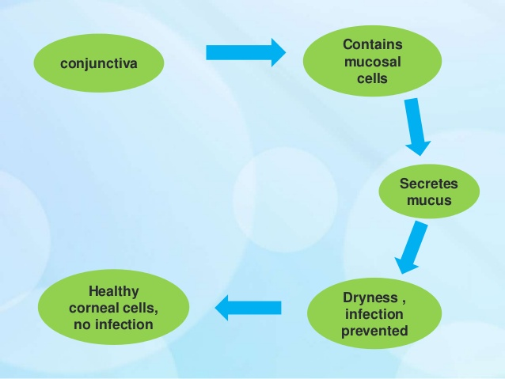

Slide 30
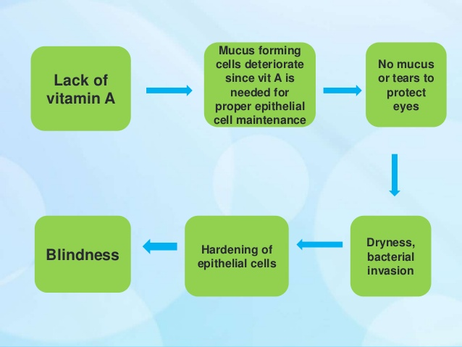

Slide 31
TREATMENT
1. Local ocular therapy. For conjunctival xerosis
artificial tears (0.7 percent hydroxypropyl methyl cellulose or 0.3 percent hypromellose) should be instilled every 3-4 hours.
In the stage of keratomalacia,full-fledged treatment of bacterial corneal ulcer should be instituted

Slide 32
2. Vitamin A therapy
Treatment schedules apply to all stages of active xerophthalmia viz. XN, X1A, X1B,X2, X3A and X3B.
Oral administration is the recommended method of treatment.
However, in the presence of repeated vomiting and severe diarrhea ,intramuscular injections of water-miscible preparation should be preferred

Slide 33
Cont..
All patients above the age of 1 year (except women of reproductive age): 200,000 IU of vitamin
A orally or 100,000 IU by intramuscular injection should be given immediately on diagnosis and repeated the following day and 4 weeks later.
Children under the age of 1 year and children of any age who weigh less than 8 kg should be treated with half the doses for patients of more than 1 year of age.
Women of reproductive age, pregnant or not: (a)Those having night blindness (XN), conjunctivalxerosis (X1A) and Bitot’s spots (X1B) should betreated with a daily dose of 10,000 IU of vitamin A orally (1 sugar coated tablet) for 2 weeks.
(b) For corneal xerophthalmia, administration of full dosage schedule (described for patients above1 year of age) is recommended.

Slide 34
3. Treatment of underlying conditions
such as PEM and other nutritional disorders, diarrhoea, dehydration and electrolyte imbalance, infections and parasitic conditions should be considered simultaneously.

Slide 35
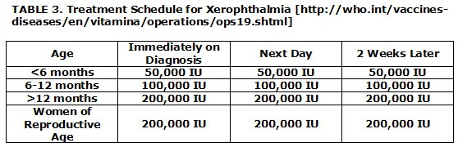
Prophylaxis against xerophthalmia

Slide 36
REFERENCES
American academy of ophthalmology

Slide 37
Thank you

