Slide 1
Voluntary Medical Male Circumcision
(VMMC)
KRCHN(B) class
MBUNGU

Slide 2
Definition
Voluntary Medical Male Circumcision (VMMC) is the surgical removal of all or part of the foreskin of the penis (prepuce) by a trained health-care professional
Voluntary medical male circumcision (VMMC) reduces female-to-male sexual transmission of HIV by 60%.

Slide 3
VMMC
VMMC services incorporate a package of HIV prevention interventions which include;
  Safer sex education
  Education on and provision of condoms,
  HIV testing
  Management of STIs.
The WHO and UNAIDS recommend the implementation of VMMC programs in countries with a high HIV prevalence among the general population.
VMMC is cost-effective and should be included, alongside behavioural and structural strategies, as part of a comprehensive HIV prevention plan

Slide 4
Introduction
It is an ancient practice that has its origin in religious rites.
In many communities, it is usually performed on the first or second day after birth.
In some communities, it is performed at the beginning of adolescence as a rite of passage into adulthood.

Slide 5
Epidemiology of MC
According to WHO (2018);
  Approx. 30% of the world’s males aged 15 years or older are circumcised
  Male circumcision is common in many African countries, and is almost universal in North Africa and most of West Africa.
  It is less common in southern Africa, where prevalence is around 15% in several countries (Botswana, Namibia, Swaziland, Zambia & Zimbabwe), and higher in others (Malawi 21%, South Africa 35%, Lesotho 48%, Mozambique 60%, and Angola and Madagascar > 80%) .
  Prevalence in Central and East Africa varies from approx. 15% in Burundi & Rwanda to 70% in Tanzania, 84% in Kenya and 93% in Ethiopia

Slide 6
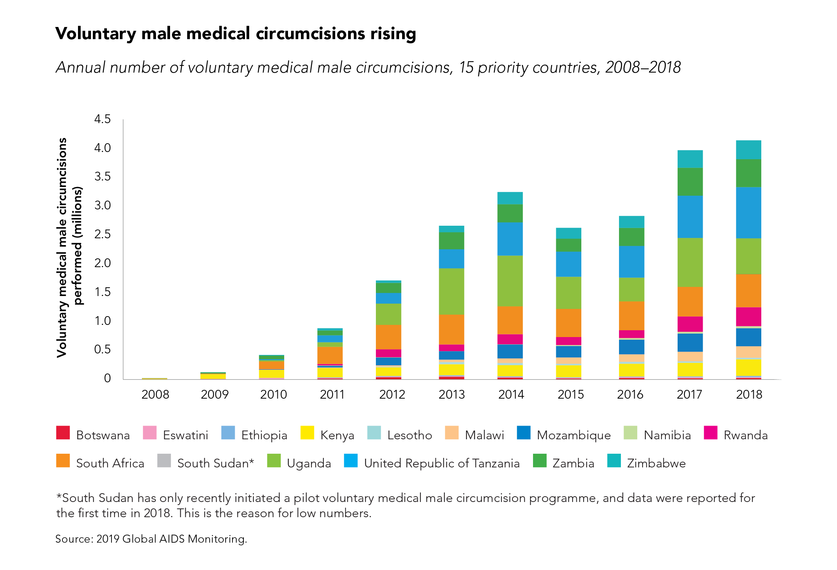

Slide 7
Epidemiology
Although an estimated 84% of all Kenyan men are circumcised, the percentage is much lower among the Luo and Turkana ethnic groups (17% and 40%, respectively). Instead, children traditionally had their six lower front teeth removed at initiation.
Kenya launched its VMMC programme in 2008 with an initial target of circumcising 860,000 men by July 2013 (80% coverage)
Kenya has achieved coverage among communities that did not previously practice male circumcision such as the Nyanza region and is targeting the counties of Turkana, Marsabit, West Pokot and Coast.

Slide 8
Epidemiology of MC CT’D
Kenya
Between 2008 and 2013, the number of annual VMMCs increased dramatically from 8,000 to 190,000. The country fell just short of its target, reaching 800,000 men (71%) but achieved its coverage goal in the Nyanza region where most of the implementation took place.
The next phase of Kenya’s VMMC strategy aims to see 95% of men circumcised by 2019. The second stage of the programme has shifted its focus to infant male circumcision, which targets children between 0 to 60 days old, and adolescents (10 to 14 years). The country also aims to encourage safer surgical practices within traditionally circumcising communities. In 2015, under the new phase of the strategy, Kenya surpassed its annual target of 940,000 circumcisions by around 100,000.
As of 2014, the last data available, Kenya had reached 93% eligible men with VMMC.

Slide 9
The foreskin
The foreskin is a continuation of skin from the shaft of the penis that covers the glans penis and the urethral meatus.
It is attached to the glans by the frenulum, a highly vascularized tissue of the penis.
The frenulum forms the interface between the outer and inner foreskin layers, and when the penis is not erect, it tightens to narrow the foreskin opening.
Circumcision removes some, or all, of the foreskin from the penis.
The word “circumcision” comes from the Latin circumcidere (meaning “to cut around”).

Slide 10
How is MC performed?
– The foreskin is freed from the head of the penis (glans).
– Excess foreskin is clipped off.
If done in the newborn period, the procedure is simpler and quicker than in adolescents and adults.
The period of superficial healing after MC is 5-10 days (although it takes 4–6 weeks for the wound to be fully healed).

Slide 11
Medical indications for male circumcision
Phimosis (inability to retract the foreskin) – The most frequent medical reason for male circumcision
Paraphimosis - the inability to return the foreskin to its original location; it forms a tight band of constricting tissue, causing swelling of the glans and foreskin,
Balanposthitis - an acute or chronic inflammation of the mucosal surface of the foreskin and glans
Balanitis xerotica obliterans - a chronic sclerosis and atrophic process of the glans penis and foreskin – a risk factor for penile cancer and the only absolute indication for circumcision.
Excessive skin and tears in the frenulum - are rare but can occur in adults

Slide 12
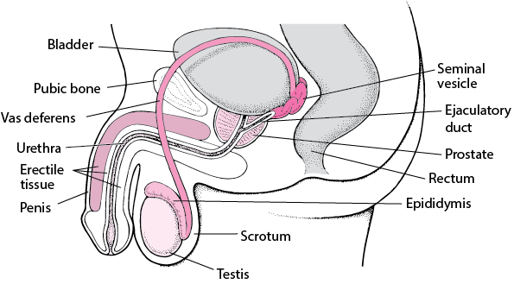
Male Reproductive system organs

Slide 13
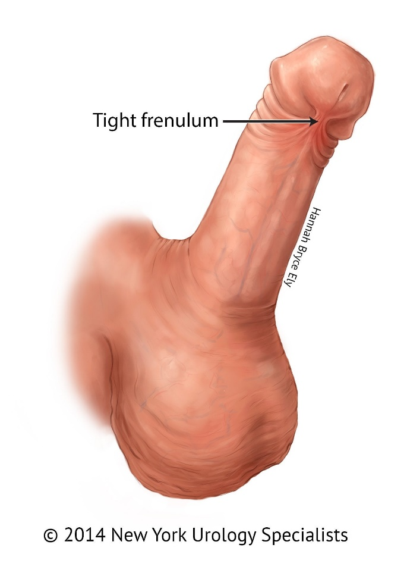
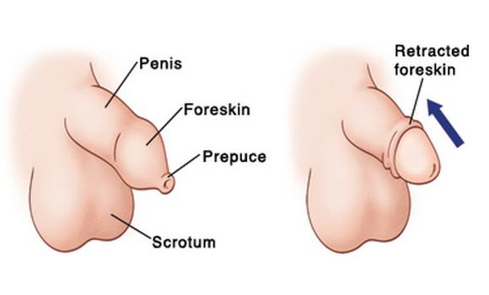
Indications….

Slide 14
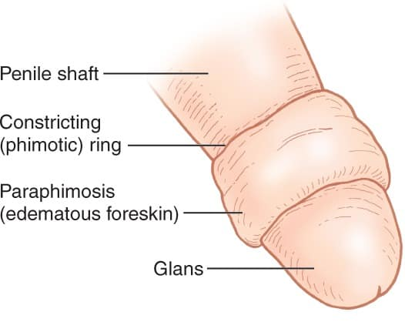
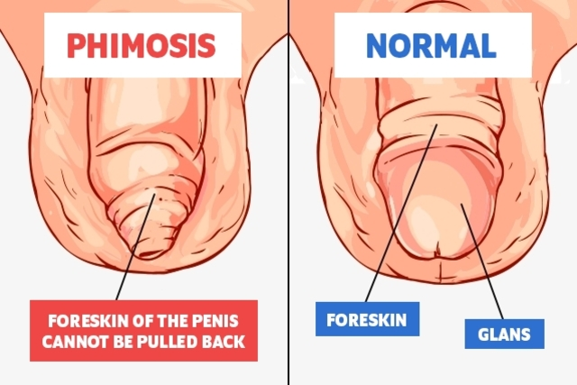
Indications …..
Paraphimosis
phimosis
.

Slide 15
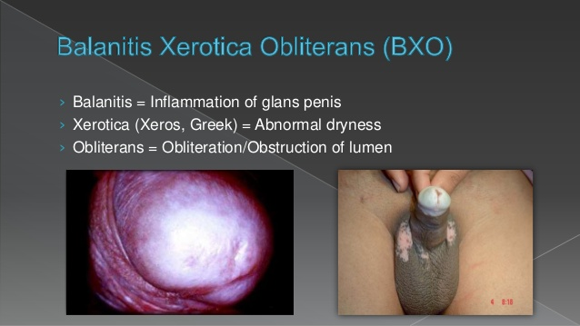

Slide 16
Benefits of Male Circumcision
Easier to maintain penile hygiene
A decreased risk of urinary tract infections
Prevention of inflammation of the glans (balanitis) and the foreskin (posthitis)
Prevention of phimosis (the inability to retract the foreskin) and paraphimosis (the inability to return the foreskin to its original location)
A reduced risk of some sexually transmitted diseases in men, especially ulcerative diseases like chancroid and syphilis
A reduced risk of men becoming infected with HIV (reduced the risk by approx. 60%.)
A reduced risk of penile cancer
Reduced risk of Human papillomavirus (HPV) infection

Slide 17
How MC Protects against HIV
The highly vascularized foreskin mucosa, which is prone to tearing or bleeding during intercourse (especially with the “dry sex” practices common in Southern Africa) facilitates HIV infection in uncircumcised men.
Ulcerative STIs like HSV-2, chancroid and syphilis, which are more prevalent in uncircumcised men, facilitate HIV infection
The inner foreskin has numerous Langerhans cells and other immune cell targets which are unusually susceptible to HIV infection.
    Studies show that the viral uptake in this tissue is 7 times more efficient than in cervical tissue in women.
    HPV infection was lower in circumcised men and, as long suspected, cervical cancer rates were higher in the female partners of uncircumcised men

Slide 18
Methods of Circumcision
Dorsal slit method
Forceps guided method
Sleeve resection method

Slide 19
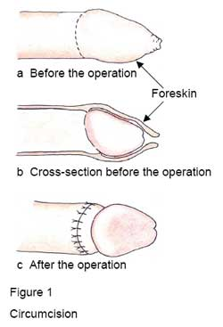
The circumcised penis

Slide 20
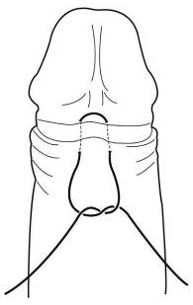
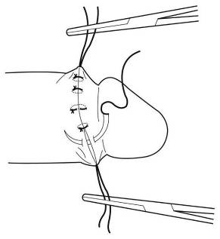
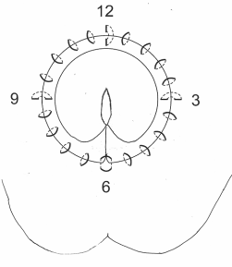
Suturing Plan
a
b
c
Horizontal mattress suture at the frenulum (6 o’clock). Vertical mattress sutures at 9, 12 and 3 o’clock and simple sutures between these.

Slide 21
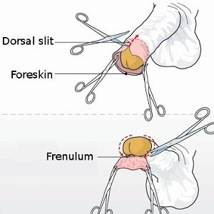
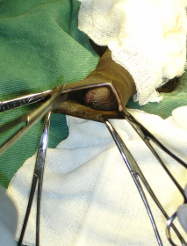
Dorsal slit method

Slide 22
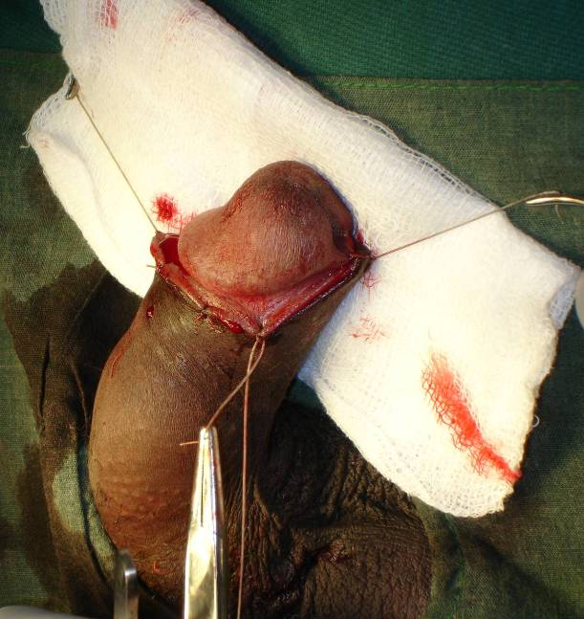
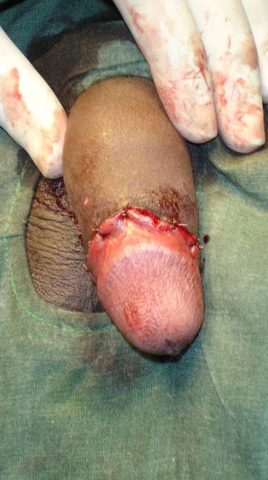
Once the four mattress sutures are in place, further simple sutures are placed to accurately approximate the wound edges.

Slide 23
Forceps Guided Method
Advantages:
  Can be learned by surgeons/ surgical assistants who are relatively new to surgery
  Ideal for use in a clinic with limited resources
  Can be done without a surgical assistant
Disadvantages:
  Leaves 0.5–1.0 cm of mucosal skin proximal to glans
  Cosmetic effect may be less satisfactory

Slide 24
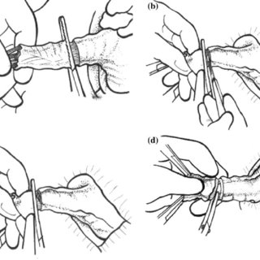
Forceps guided method

Slide 25
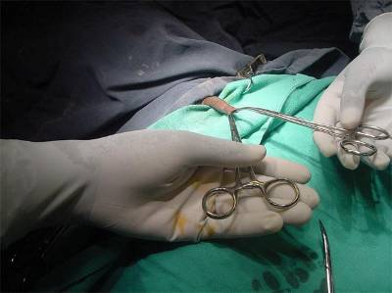
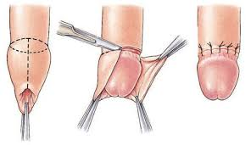
Forceps-guided

Slide 26
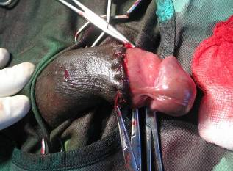
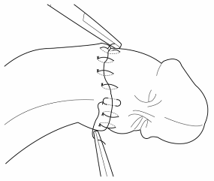
Forceps Guided Method
Final outcome:
Note residual mucosal portion of the foreskin

Slide 27
Bleeding from the frenular artery.
If there is excessive bleeding from the frenular artery, an under-running haemostatic stitch should be used to occlude the artery (Fig. 7.1). Great care is needed not to bite too deeply, because the urethra is near to the surface skin and can easily be damaged.

Slide 28
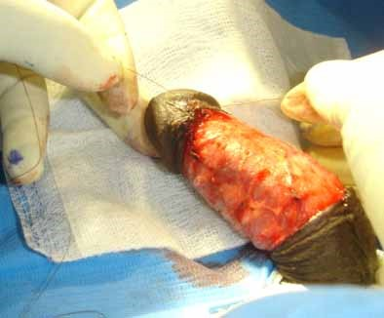
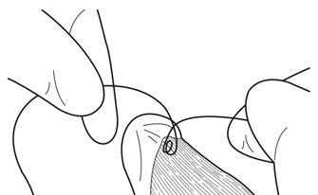
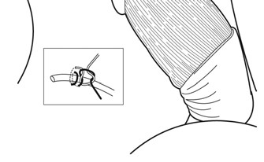

Slide 29
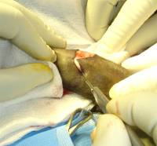
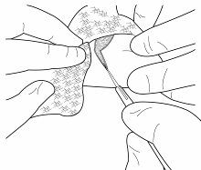
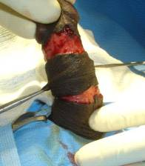
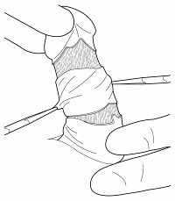
Sleeve Resection Method
Outer and inner incisions are made
Then the two incisions are joined together by cutting the skin between the proximal and distal incisions with scissors

Slide 30
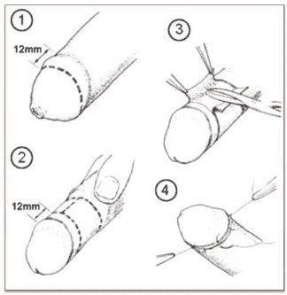
Sleeve Resection Method….

Slide 31
Risks/complications of Male Circumcision
Pain
Risk of bleeding + haematoma formation
Infection at the site of the circumcision
Increased sensitivity of the glans for first few months after the procedure
Irritation of the glans
Meatitis (inflammation of the opening of the penis)
Injury to the penis
Reactions to the anaesthetic used during circumcision
Delayed wound healing

Slide 32
Post-op Management
Irrespective of the method of circumcision, a standard penile dressing technique is used:
  Check that there is no bleeding. Minor bleeding from a skin edge will often stop after five minutes of pressure with a gauze.
  Once satisfied that bleeding has stopped, place a piece of paraffin embedded gauze (or Sofratulle) around the wound.
  Apply a sterile, dry gauze over this, and secure it in position with adhesive tape.

Slide 33
Post-op care….
Incision Care
A wrap-around dressing is usually applied to the penis. If the bandage falls off after the surgery, which often happens, it isn't a major concern.
The bandage/dressing is normally removed on the 2nd day after surgery if it hasn't already fallen off.
Removing the dressing can be easier after a sitz bath or shower for 10 minutes
After the bandage is off, the penis is open to air ; antibiotic ointment (e.g. Bactroban cream) may be applied around the sutures, several times each day. This will prevent the dry edges of the incision from sticking to clothes.
Tight clothing should be avoided to reduce pressure on the penis.
After removal of the dressing, a slight ooze is expected. If oozing persists, patient should return to the hospital

Slide 34
Post-op care….
Encourage patient to;
Avoid rough or active sports for the two weeks following surgery, as they can cause oozing from the incision.
Avoid strenuous activities, such as bicycle riding, jogging, weight lifting, or aerobic exercise, for 4 weeks or until review by surgeon.
Eat a balanced diet & drink plenty of fluids
Avoid full-body bathing until the 2nd day post-op, but sponge baths are fine; After the second day, they can shower or bathe as normal, but should not scrub the incision site

Slide 35
* Post-op care….
Pain Control – can be achieved using NSAIDs or Paracetamol.
Follow-up - a post-operative visit should be done about four weeks after the surgery

Slide 36
Complications that occur within the first 2 weeks
  Infection. After 2–3 days, the most likely problem is wound infection. An infection often causes increasing pain, and there may be visible signs, such as redness or purulent discharge. The patient should be given an appropriate antibiotic
Take frequent showers and to put a clean dressing on the wound between showers. If the infection is severe, the man should be advised to lie on his back, so that his penis is the highest point of his body. This promotes drainage of lymphatic fluid and speeds up the healing process. Sitting in a chair is a bad position.
Alternatively the wound can be left without a dressing, but should be protected from flies.

Slide 37
Complications that occur within the first 2 weeks
Wound disruption and cutting out of stitches. When stitches cut out, this usually indicates that there is an infection, and the patient should be given antibiotics (see above). If more than 48 hours have passed since the operation, do not try to re-suture the wound, as the new stitches are likely to become infected and also cut out, making the situation worse.
The wound should be left to heal by secondary intention. The man should be seen at the clinic as often as necessary until the wound has healed. In general, the healing process after infection leaves an untidy result, at least for the first few months. The man should be reassured that the appearance will usually become normal after about a year.

Slide 38
Complications that occur within the first 2 weeks
Worsening wound infection with signs of gangrene. A rare risk of genital surgery is infection with multiple bacteria, causing progressive skin loss. In this situation, the blood supply is cut off, and the skin becomes necrotic and turns completely black (Fournier’s gangrene- synergistic gangrene or necrotizing fasciitis) common in men who have diabetes. Any man with signs of spreading infection or black gangrenous skin should be urgently transferred to a referral centre. At the referral centre, it is usually necessary to give a general anaesthetic and remove all the dead skin.

Slide 39
Late complications
In the long term, the client may complain of:
decreased sensitivity of the glans;
oversensitivity of the glans;
unsightly circumcision wounds, ragged scars or other cosmetic concerns;
persistent adhesions at the corona and inclusion cysts. These problems can be avoided if the foreskin is fully retracted during the operation and all adhesions carefully divided;

Slide 40
Late complications
Discomfort during erection from the scrotal being skin pulled up the shaft of the penis and a tight scrotal sac. This can result from removal of too much skin during the circumcision. These problems can be avoided by careful preoperative marking of the incision lines.
torsion (misalignment) of the skin of the penile shaft. This can be avoided by taking care during the operation to align the midline raphe with the frenulum.

Slide 41
Post Operative Instructions to clients
After the operation, rest at home for one or two days. This will help the wound to heal.
You may bathe on the day after surgery, but do not let the dressing get wet.
Remove the dressing 24–48 hours after surgery.
Do not pull or scratch the wound while it is healing.
Do not have sexual intercourse or masturbate for 4–6 weeks, and use condoms to protect the wound for every act of sexual intercourse for at least six months until the wound has healed completely.
Return to the clinic for a follow-up visit about one week after the operation. A health care worker will check to see how the wound is healing.

Slide 42
Post Operative Instructions to clients
You may have a little pain or swelling around the wound. This is normal. Check occasionally to make sure that it does not get worse. Take any medicines provided or recommended by the clinic. Be sure to follow the instructions given to you.
Return to the clinic or call:
if you notice increased bleeding from the surgical wound;
if the pain or swelling at the surgical wound gets progressively worse;
if you have difficulty in passing urine;
_____

Slide 43
Post Operative Instructions to clients
if you develop a fever within one week of surgery;
If you have severe pain in the lower abdomen;
If the wound is discharging pus.
If you have any of these problems, go to:

